Slide 1
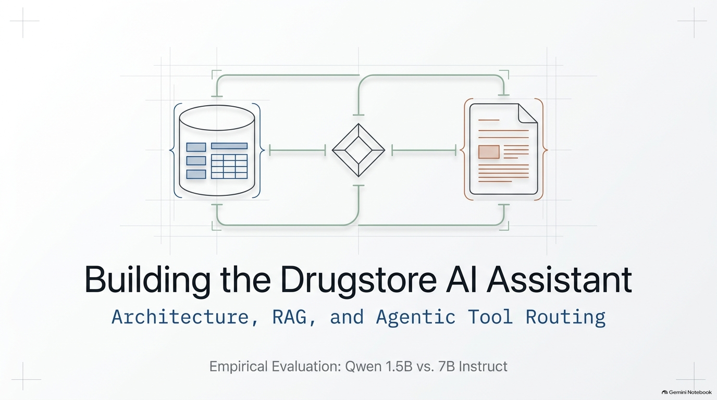
Amit Shraga
Yuval Shaanan
Michal Peri Markovich

Slide 2
Project Goal
Using NLP to Query Store Database
  Retrieving data in excel
Assistant for Drug store
  Able to find the correct medication or product
  Evaluate prices, Inventory

Slide 3
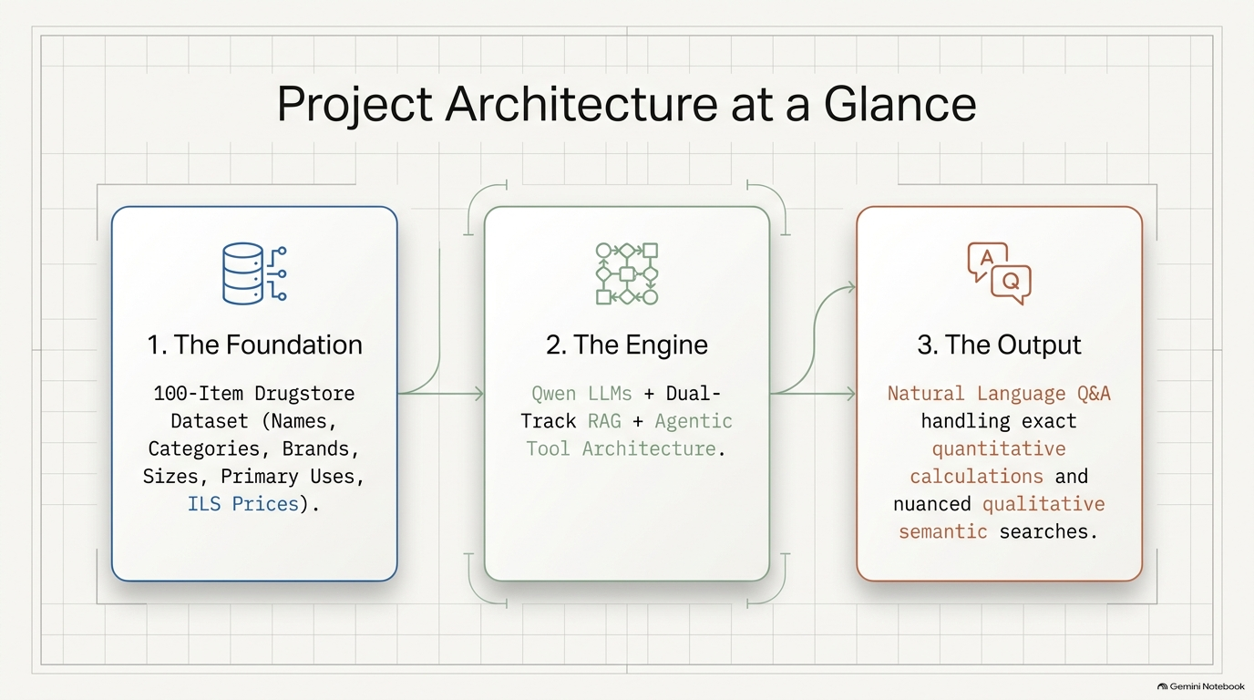

Slide 4
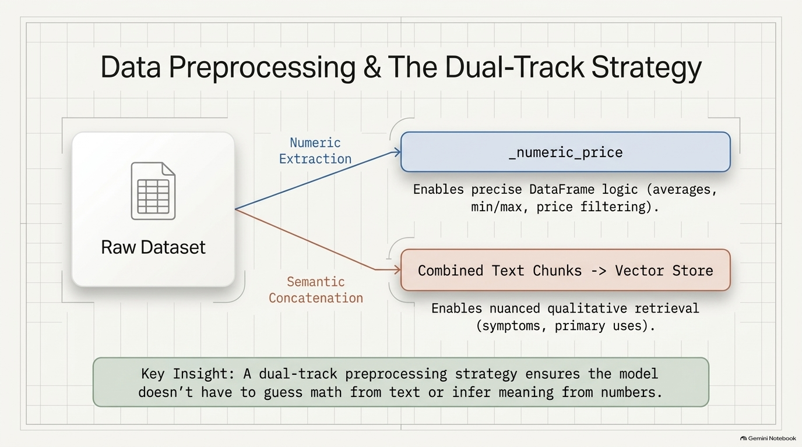

Slide 5
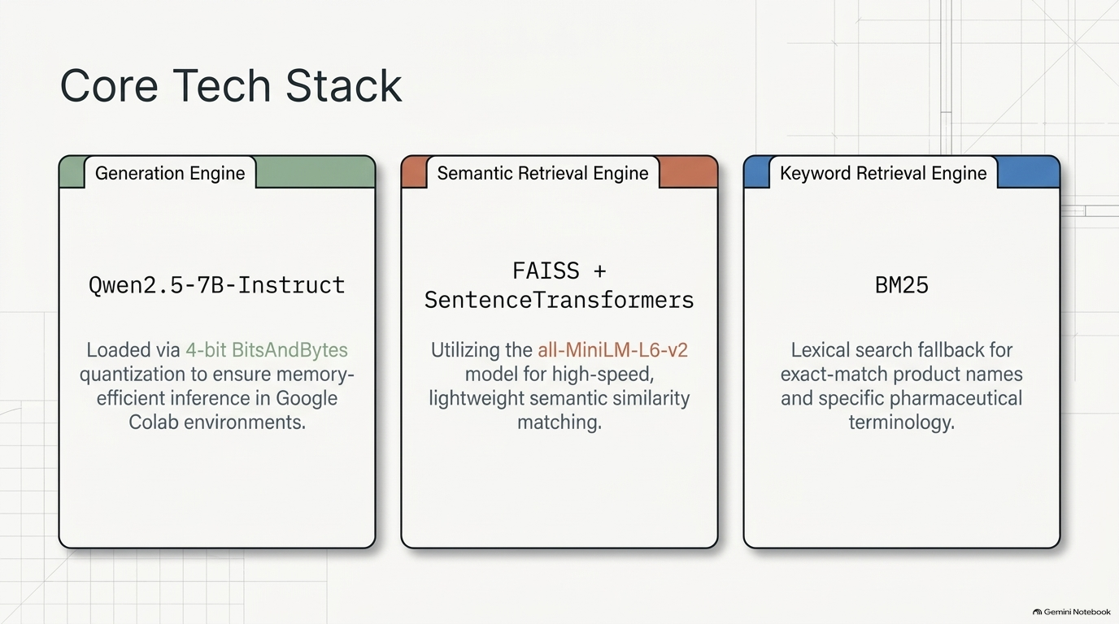

Slide 6
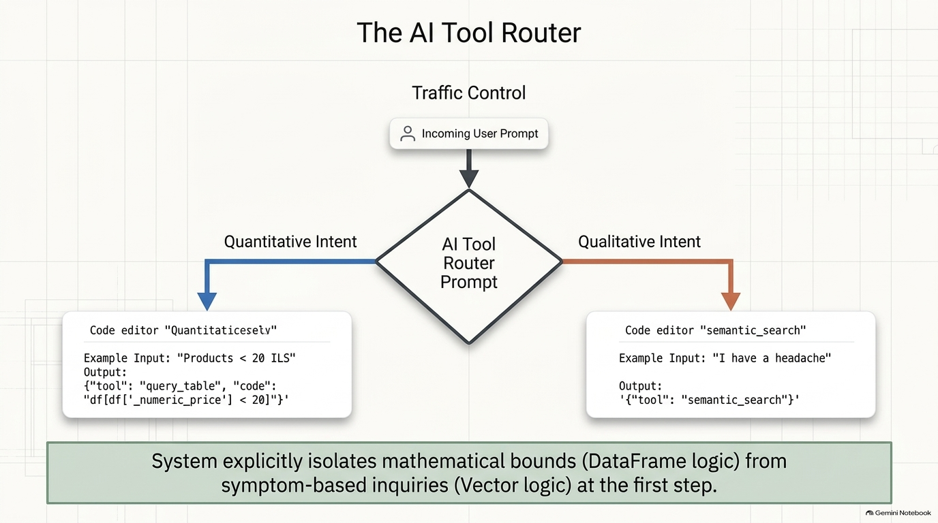

Slide 7
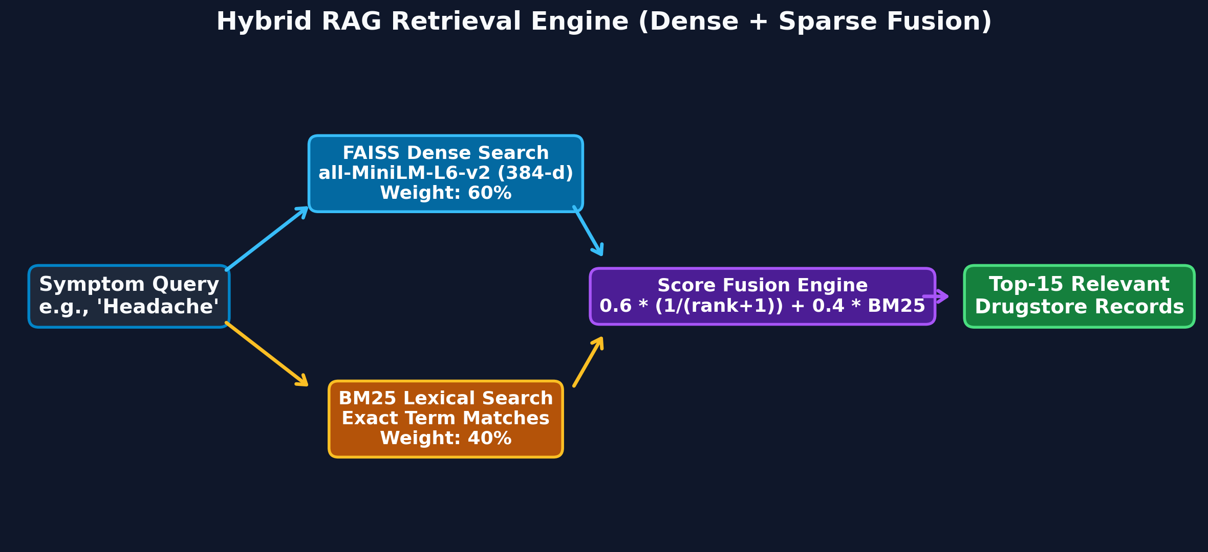
HYBRID RETRIEVAL ENGINE
FAISS Dense Search Combined with BM25 Lexical Search

Slide 8
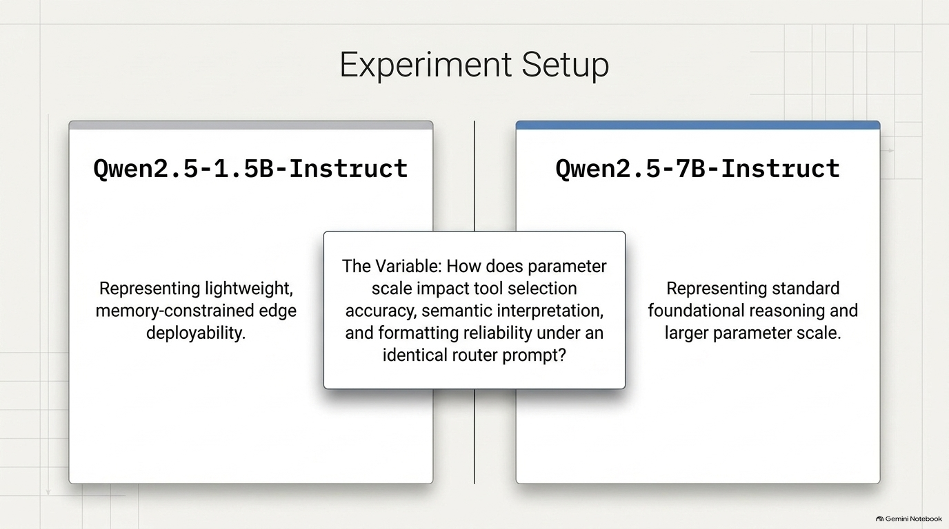

Slide 9
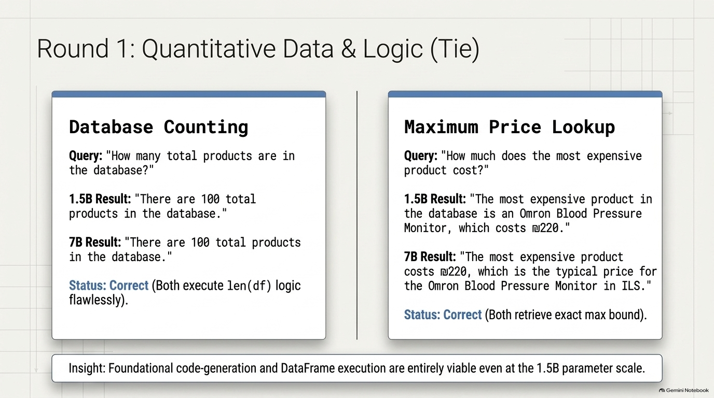

Slide 10
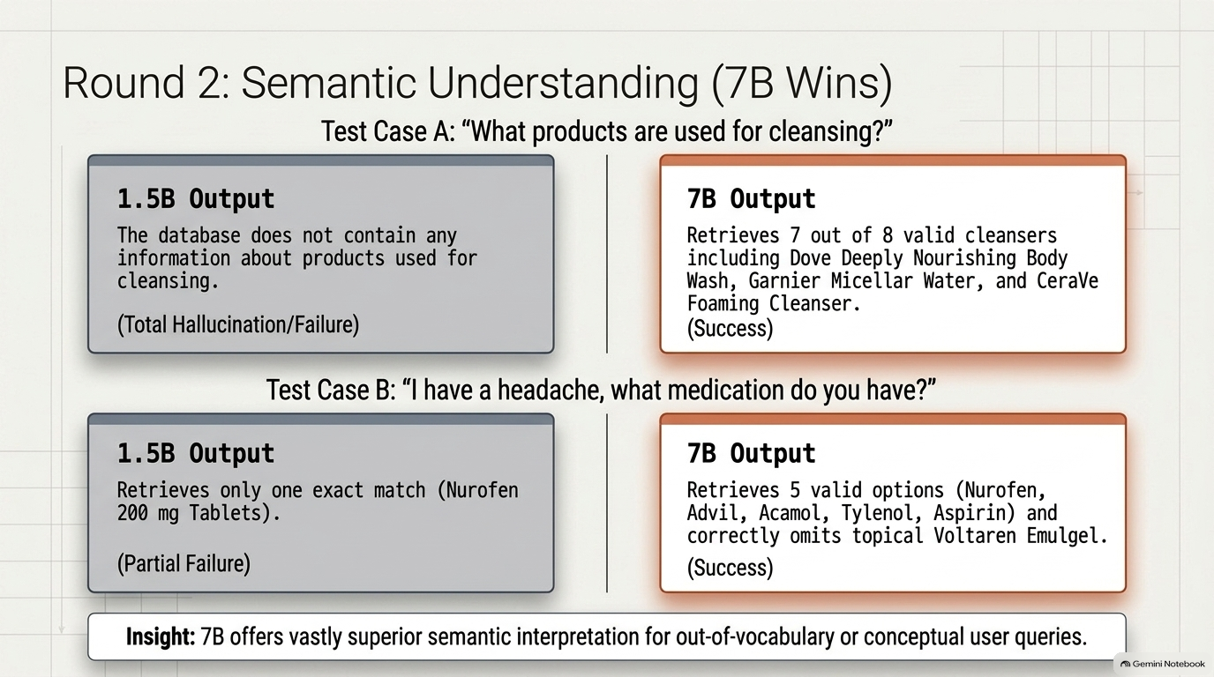

Slide 11
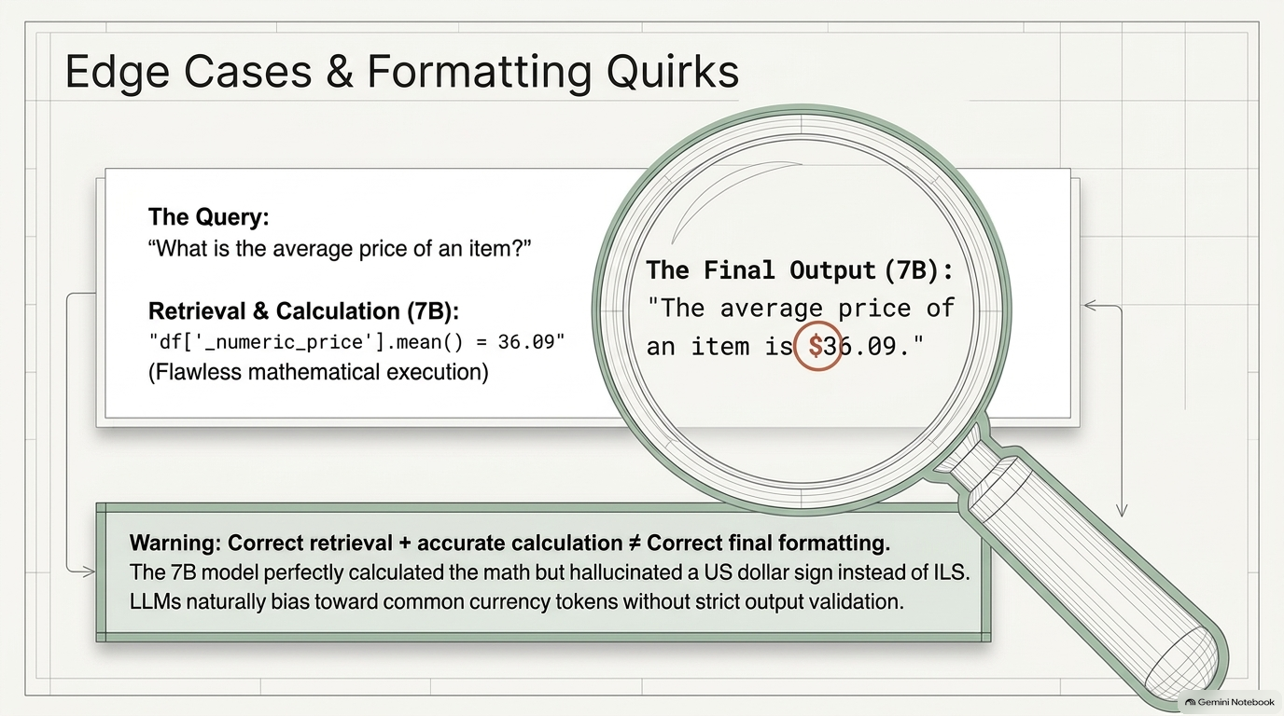

Slide 12
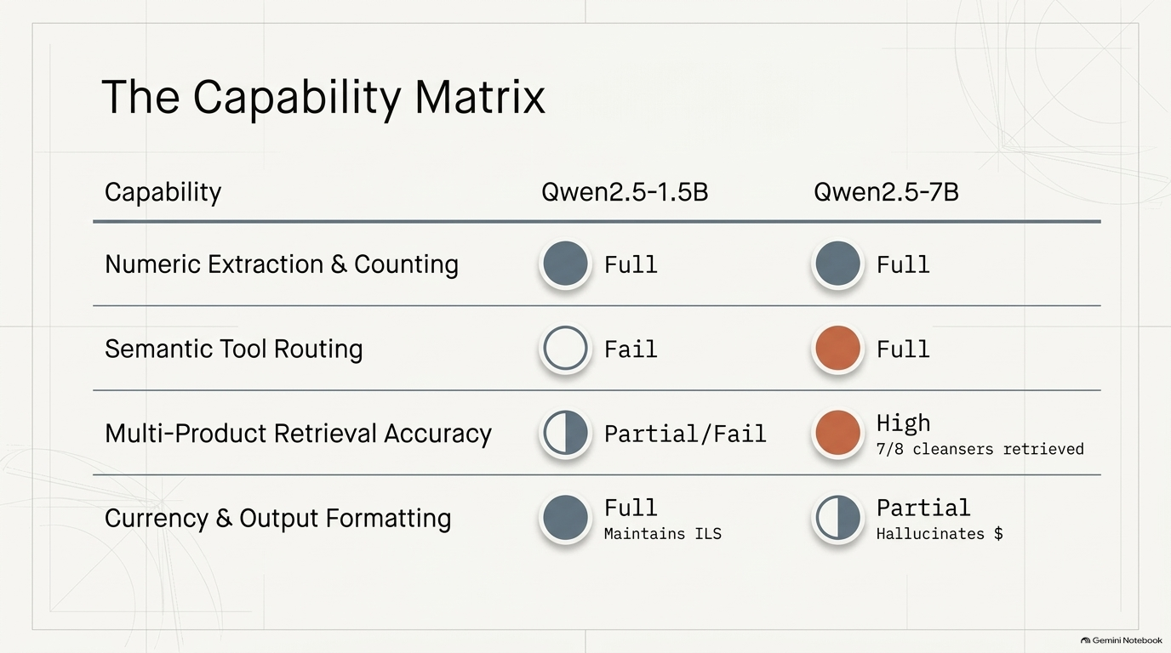

Slide 13
problem
❓ Question: what is the cheapest thing you have for an headache?
💡 Answer: Tylenol Extra Strength - ₪24
Product | Type | Price
Advil | Ibuprofen pain/fever relief | ₪18
Nurofen | Ibuprofen pain/fever relief | ₪22
Acamol | Paracetamol pain/fever relief | ₪14
Tylenol | Paracetamol pain/fever relief | ₪24
Aspirin | Low-dose aspirin product | ₪12
Requires both semantic reasoning (headache) and quantitative reasoning (cheapest)
Solution
Multi-tool agent

Slide 14
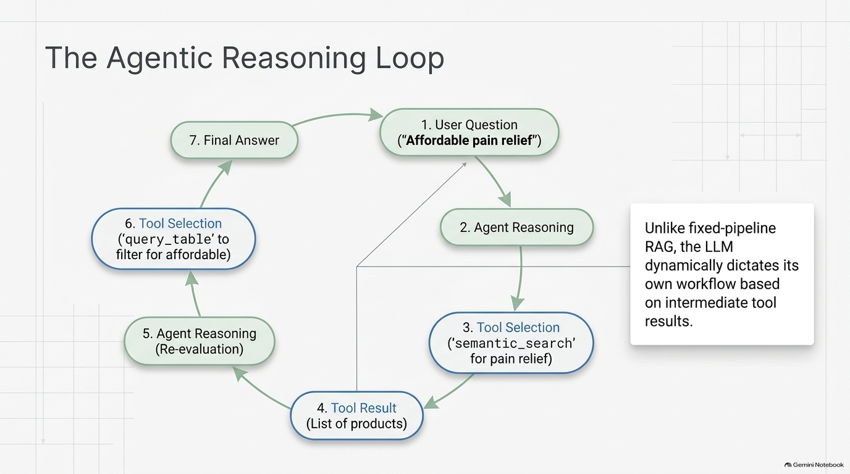

Slide 15
AGENTIC ARCHITECTURE
Iterative Reasoning Loop with Tool Call Observations
1. USER QUERY
Receives complex question e.g. budget + headache.
2. LLM REASONING
Generates single JSON tool call per turn.
3. TOOL EXECUTION
Runs Python tool & captures observation string.
4. FINAL ANSWER
Repeats until calling final_answer (max 6 steps).

Slide 16
TOOL ECOSYSTEM
Five Specialized Tools Grounded in Database Data
search_products
SUBSTRING SEARCH
Exact matches for brand names (e.g. 'Cetaphil', 'Nurofen').
by_category
CATEGORY + BUDGET FILTER
Filters by category with optional max_price guard.
semantic_search
FAISS + BM25 SEARCH
Meaning-based search for unstated symptom needs.
query_table
PANDAS EXPRESSION
Direct code execution for exact counts and math.
calculator
REGEX WHITELISTED MATH
Safe arithmetic evaluation on retrieved numbers.

Slide 17
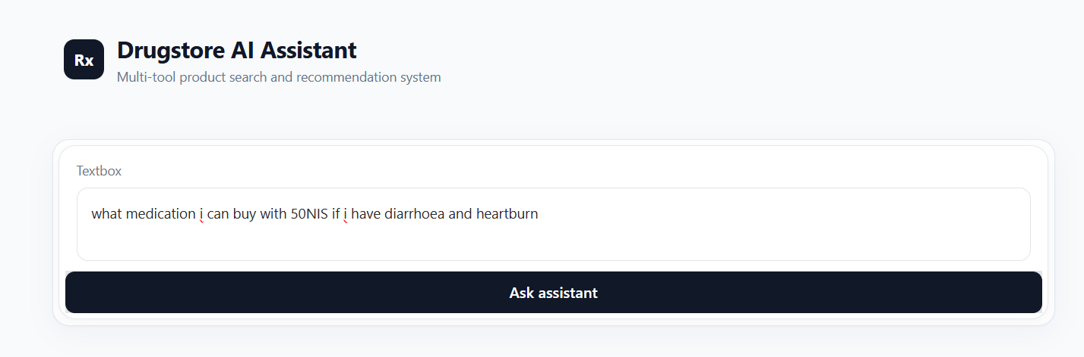
The Agent

Slide 18
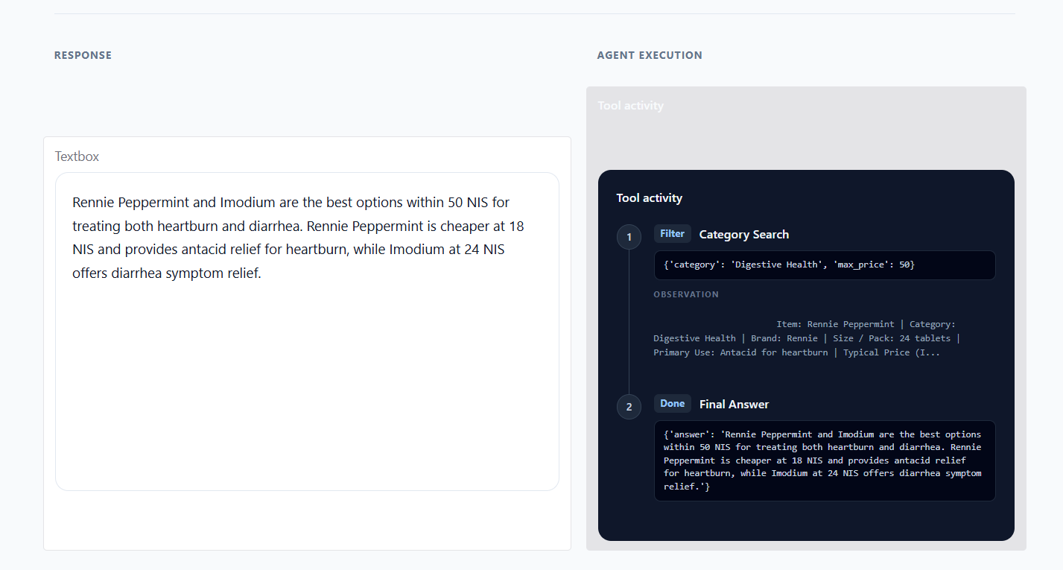
The Agent

Slide 19
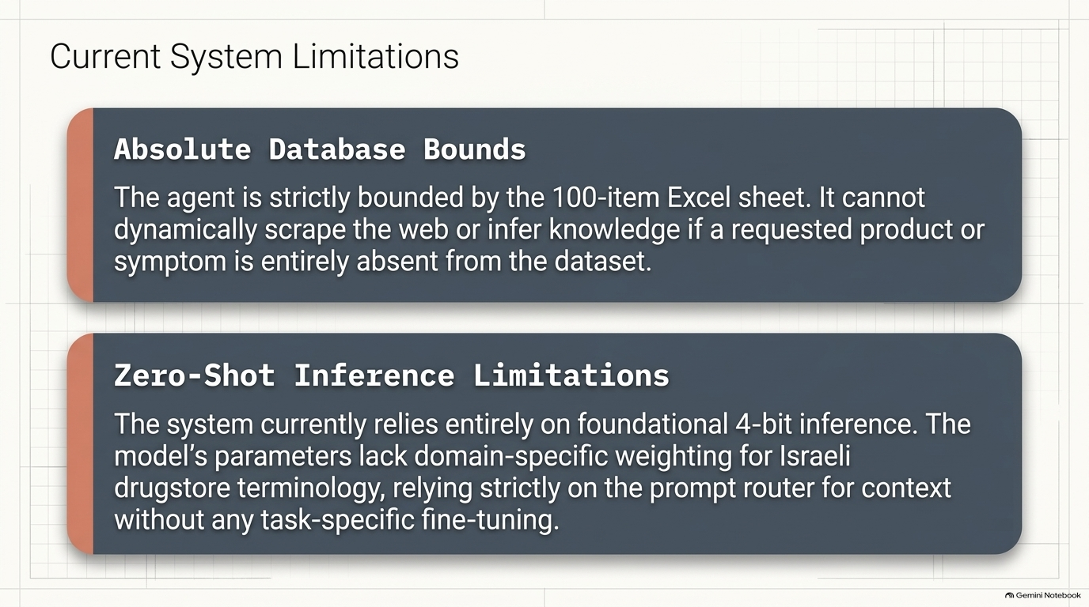

Slide 20
