Slide 1
Business Problem
Allowing end users to search for a restaurant nearby and get comparative rating for venues in the area.
This considers a venues ratings, price indicator and likes for the venue in consideration to create a comparative rating for given venue.
This gives end users a clarity in making choice for venues not just based on rating but how cost effective it is and how much likes have been registered by the restaurants visitors.

Slide 2
Data
Used the Foursquare API to get the list of venues in Soho neighborhood of Manhattan borough.
https://api.foursquare.com/v2/venues/explore?&client_id={}&client_secret={}&v={}&ll={},{}&radius={}&limit={}&query={}
In the nest slide I have showcased the overall data used for mapping of comparative rating of restaurants in Soho. I have only used 20 venues for ease of representation.
In slide 4, I have also attached the mapping of restaurants. Top 10 are color coded in green and bottom 10 are coded in red. It is decided based on comparative rating rather than just the rating of the restaurant.

Slide 3
Data Continued
 | Id | Name | Category | Latitude | Longitude | price | likes | ratings | final_rating
20 | 56ccead2498e8cad8d3cedff | Xi'an Famous Foods | Chinese Restaurant | 40.72105 | -73.99607 | 4 | 100 | 4 | 0.6
19 | 4c7d4f1b8da18cfa1afc9ece | Osteria Morini | Italian Restaurant | 40.72199 | -73.99779 | 4 | 80 | 4.5 | 0.81
18 | 4f0f47650cd695a0e54cb438 | Jack's Wife Freda | Mediterranean Restaurant | 40.72202 | -73.99753 | 4 | 90 | 4.5 | 0.83
17 | 49e4f405f964a52078631fe3 | Emporio | Italian Restaurant | 40.72263 | -73.99513 | 4 | 90 | 4.5 | 0.83
16 | 4f3046da7beb0cfa14dcac59 | Taïm Falafel and Smoothie Bar | Falafel Restaurant | 40.72194 | -73.99628 | 3 | 100 | 4 | 1
15 | 4ade0324f964a520586721e3 | Calexico Cart | Mexican Restaurant | 40.72548 | -73.99995 | 3 | 110 | 4 | 1.02
14 | 40c10d00f964a520dd001fe3 | Ruby's Café | Australian Restaurant | 40.72229 | -73.99625 | 4 | 90 | 5 | 1.08
13 | 5484890c498e985cf4e3c076 | sweetgreen | Restaurant | 40.72118 | -73.99711 | 2 | 68 | 3.5 | 1.086
12 | 3fd66200f964a520e6e51ee3 | Mercer Kitchen | American Restaurant | 40.72474 | -73.99866 | 2 | 110 | 3.5 | 1.17
11 | 3fd66200f964a52070e91ee3 | Balthazar | French Restaurant | 40.72271 | -73.9982 | 2 | 150 | 3.5 | 1.25
10 | 5431872b498eec43384fd39d | Maman | Café | 40.72022 | -73.99833 | 2 | 150 | 3.5 | 1.25
9 | 431e2d80f964a52079271fe3 | La Esquina | Mexican Restaurant | 40.72145 | -73.99761 | 2 | 50 | 4 | 1.3
8 | 46ff98a7f964a520234b1fe3 | Lure Fishbar | Seafood Restaurant | 40.7247 | -73.99833 | 2 | 50 | 4 | 1.3
7 | 59e0ee84f0ca95526b7fce9f | CAVA | Mediterranean Restaurant | 40.72193 | -73.99651 | 3 | 150 | 4.5 | 1.35
6 | 4cc6222106c25481d7a4a047 | Rubirosa Ristorante | Pizza Place | 40.72273 | -73.99599 | 2 | 100 | 4 | 1.4
5 | 3fd66200f964a52020e61ee3 | Housing Works Bookstore Cafe | Café | 40.72464 | -73.99655 | 2 | 150 | 4 | 1.5
4 | 45697387f964a520e53d1fe3 | Despaña | Spanish Restaurant | 40.72114 | -73.99796 | 2 | 200 | 4.3 | 1.75
3 | 4d9f8d97a428a1cdd92acb04 | Parm | Italian Restaurant | 40.72302 | -73.99585 | 2 | 300 | 4 | 1.8
2 | 55ea9f4d498ed46db0383483 | Champion Pizza Soho | Pizza Place | 40.72164 | -73.99747 | 2 | 200 | 4.5 | 1.85
1 | 56bbc58e498eed7b2c402556 | Pasquale Jones | American Restaurant | 40.72104 | -73.99675 | 2 | 250 | 4.5 | 1.95

Slide 4
Methodology
Exploratory analysis used to predict the comparative rating for the restaurant rather than default rating of restaurant to make choice for the venue.
Using Ratings/Price indicator and Likes to create a comparative ranking for the venues.

Slide 5
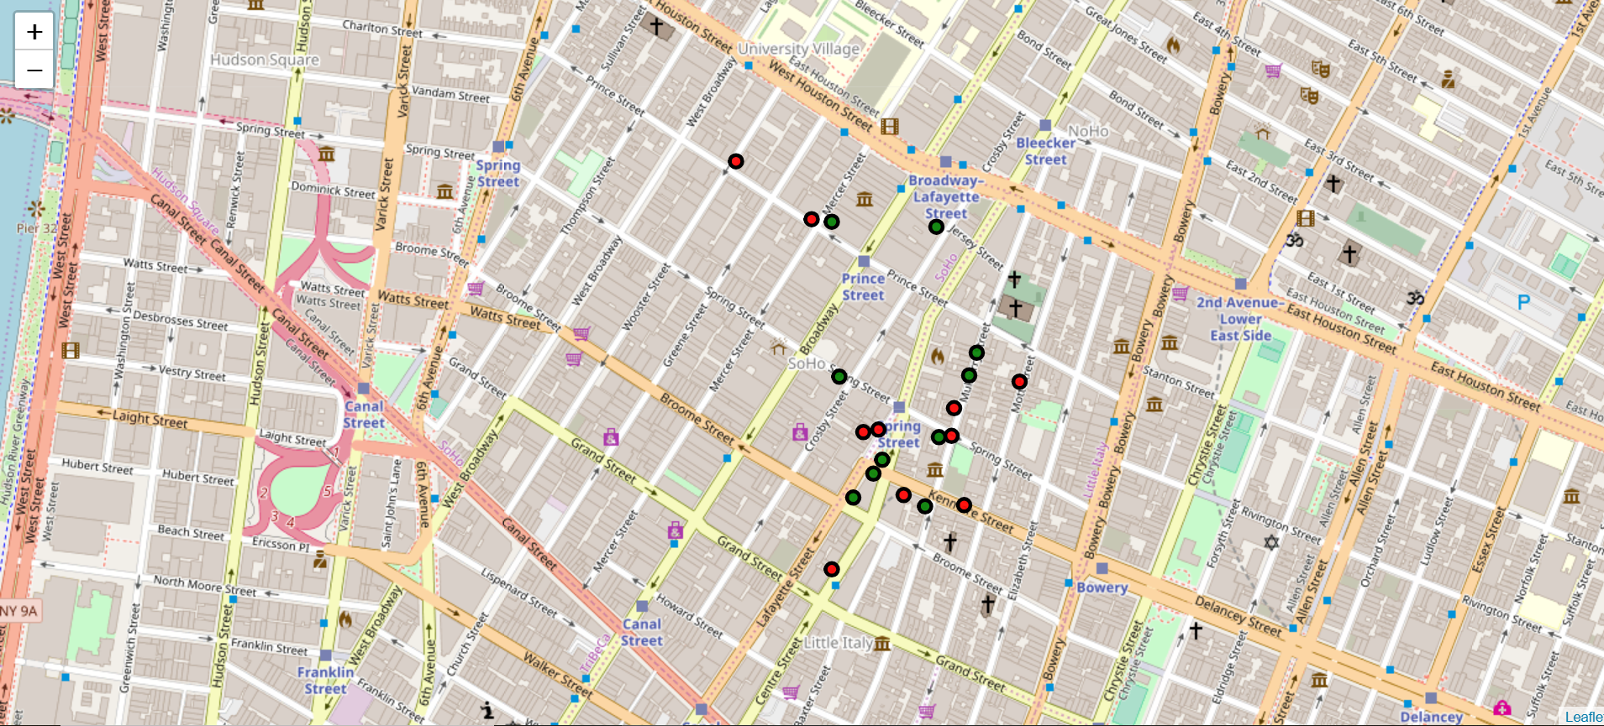
Result

Slide 6
Result continued
As we can see we have created clustering of restaurant based on comparative ranking rather than just ratings of the restaurant.
This gives a user ability to make informed choice while choosing a restaurant not just based on rating but comparing the cost along with rating and likes registered for the venue.

Slide 7
Observation & conclusion
We can observe that the comparative rating is done based on actual rating, average price and likes returned for each venue
We can see restaurants Pasquale Jones and Champion Pizza Soho have same rating and price indicator but different likes count. The comparative rating for Pasquale Jones is higher than Champion Pizza Soho as former had higher number of likes.
Take example of restaurants sweetgreen and Ruby’s Café. Even though Ruby’s Café has 5 rating and sweetgreen is rated 3.5 we see that comparative rating of sweetgreen is almost same as Ruby’s Café. This is because the price indicator for Ruby’s Café is higher than sweetgreen
This exploratory analysis compares the rating of the restaurant, price indicator of the restaurant and number of likes registered for the restaurant and gives a comparative ranking for the restaurants in the area. Here we have given 50% weightage to Rating, 40% weightage to Price indicator and 10% weightage to likes. This goes to show that even a restaurant with slightly higher rating can be less preferred if the price indicator is used in the ranking as cost plays a big part in the decision making on choosing the restaurant.

