Slide 1
Selenium 2.x
Presented by :Amit Srivastava

Slide 2
What is Selenium?
Selenium is a free (open source) automated testing suite for web applications across different browsers and platforms.
It is quite similar to HP Quick Test Pro (QTP) only that Selenium focuses on automating web-based applications.

Slide 3
Selenium | QTP
Open Source | Licensed
Can Execute on Cross Browsers | Can Execute on Some Specific version of I.E, Chrome and FireFox.
Can Run on various Operating System | Only For Windows
Only Test Web Based Applications | Can Test Desktop and Web Based Application
No default Test Generation Report | Default test result generation with in the tool.

Slide 4
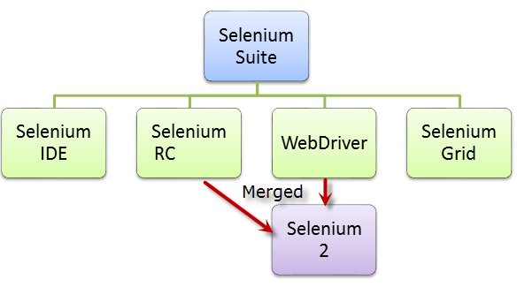
Selenium is not just a single tool but a suite of softwares, each catering to different testing needs of an organization. It has four components.

Slide 5

Who Develop Selenium?
Selenium was created by Jason Huggins in 2004. An engineer at ThoughtWorks, he was working on a web application that required frequent testing. Having realized that the repetitious manual testing of their application was becoming more and more inefficient, he created a JavaScript program that would automatically control the browser's actions. He named this program as the "JavaScriptTestRunner."
Seeing potential in this idea to help automate other web applications , he made JavaScriptRunner open-source which was later re-named as Selenium Core

Slide 6
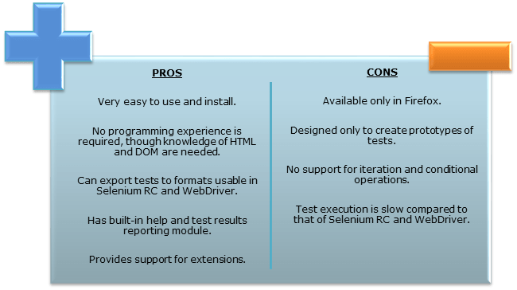
Selenium IDE
Selenium Integrated Development Environment (IDE) is the simplest framework in the Selenium suite and is the easiest one to learn. It is a Firefox plugin that you can install as easily as you can with other plugins.

Slide 7
Installing Selenium IDE , FireBug and FirePath

Slide 8
Selenium IDE Setup
Creating Test Case and TestSuite
Debugging Selenium IDE (BreakPoint and Power Debugger)
Verify vs Assert
Handling Alerts, FileUpload
Pattern Matching
a) globbing
eg.
command Target Value
verifyTextPresent id=txt glob: taxyear*
globbing can be * ? []
[] - used to match any single character
e.g [0-9]
e.g [a-c]
b) Exact
e.g.
command Target Value
verifyTextPresent id=txt exact: amit[0-9]
c) RegEx
command Target Value
verifyTextPresent id=txt regexp: [Aa]mit[0-9]+
command Target Value
verifyTextPresent id=txt regexpi: amit[0-9]+

Slide 9
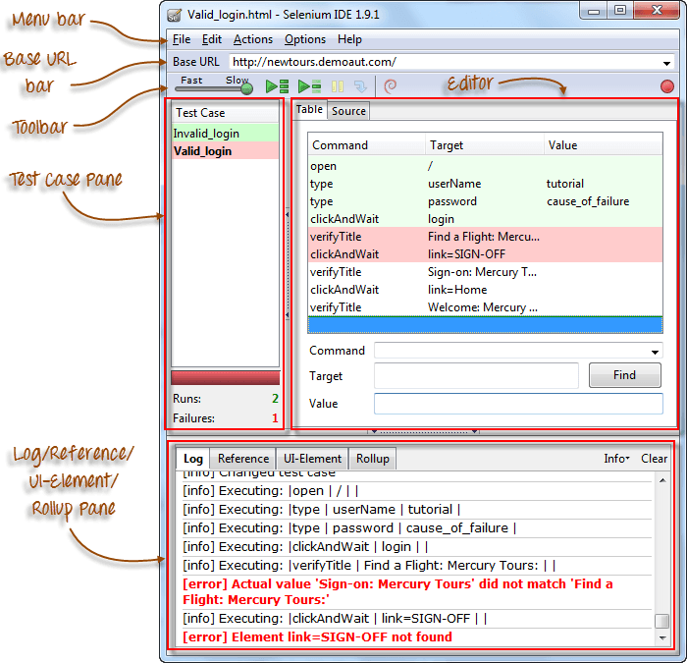
Notes:
amitsrivastava
amit123456
http://newtours.demoaut.com/

Slide 10
Selenium Test Reports
TestResult
https://addons.mozilla.org/EN-us/firefox/addon/test-results-selenium-ide/
Pretty report
https://addons.mozilla.org/en-us/firefox/addon/selenium-ide-pretty-report/

Slide 11
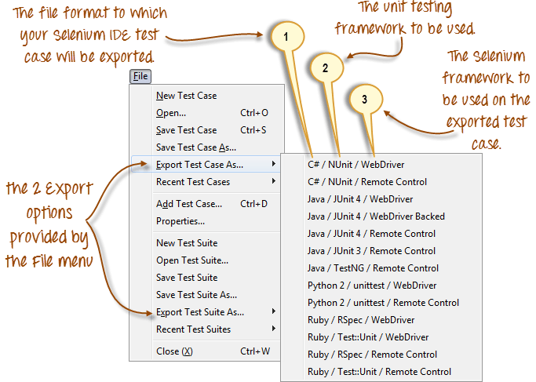

Slide 12
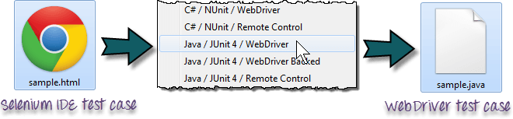

Slide 13
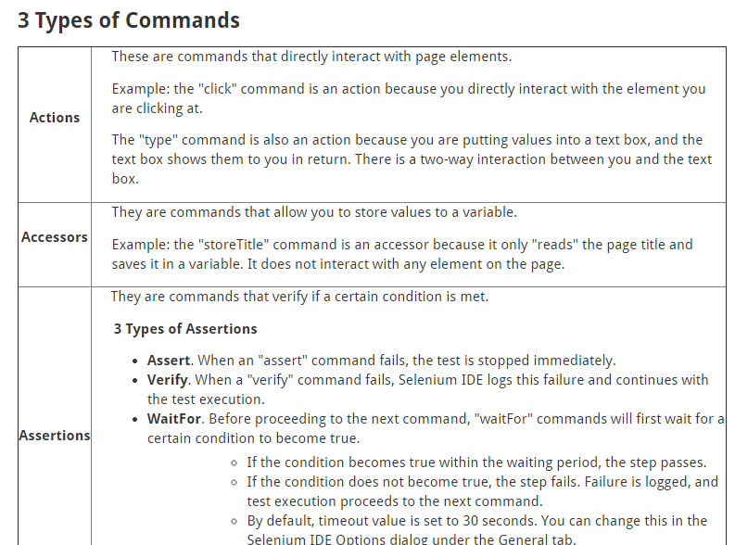

Slide 14
Create a Script Manually with Firebug
Now, we shall recreate the same test case manually, by typing in the commands. This time, we will need to use Firebug.
Step 1 Open Firefox and Selenium IDE.
Type the base URL
The record button should be OFF.
Step 2 Click on the topmost blank line in the Editor.

Slide 15
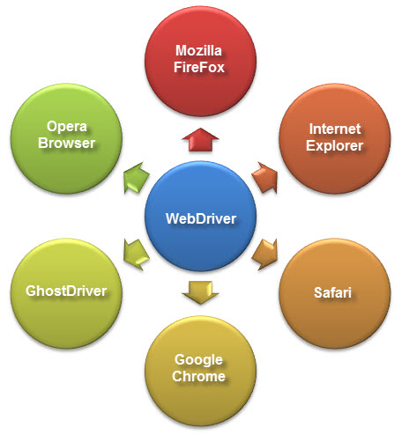
WebDriver is a web automation framework that allows you to execute your tests against different browsers

Slide 16
WebDriver also enables you to use a programming language in creating your test scripts(not possible in Selenium IDE).
You can now use conditional operations like if-then-else or switch-case
You can also perform looping like do-while.
Following programming languages are supported by WebDriver
Java
.Net
PHP
Python
Perl
Ruby
You do not have to know all of them. You just need to be knowledgeable in one

Slide 17
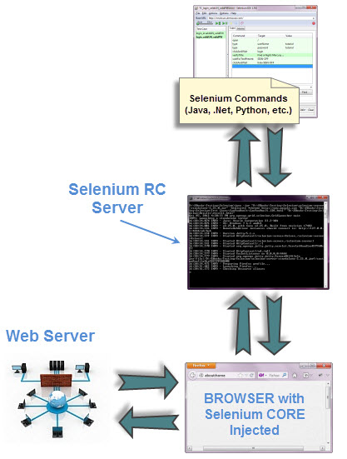
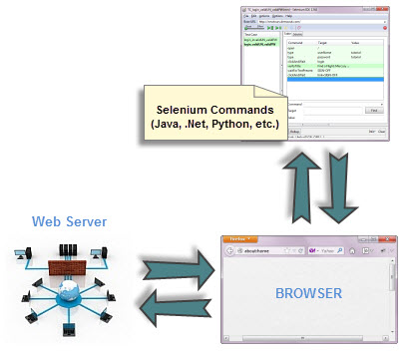
WebDriver Vs Selenium RC

Slide 18
Setup WebDriver
Step 1 - Install Java on your computer
Step 2 - Install Eclipse IDE
Step-3 Download WebDriver
http://docs.seleniumhq.org/download/
Step -4
Download Chrome Driver
http://chromedriver.storage.googleapis.com/index.html?path=2.14/

Slide 19
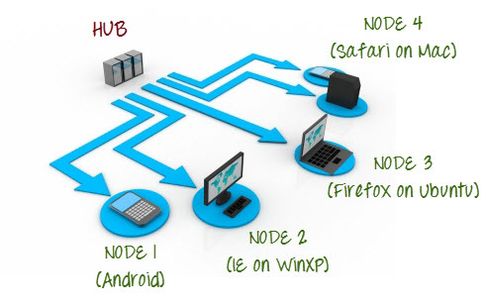
Selenium Grid uses a hub-node concept where you only run the test on a single machine called a hub, but the execution will be done by different machines called nodes.

Slide 20
When to Use Selenium Grid?
You should use Selenium Grid when you want to do either one or both of following :
Run your tests against different browsers, operating systems, and machines all at the same time.This will ensure that the application you are testing is fully compatible with a wide range of browser-OS combinations.
Save time in execution of your test suites. If you set up Selenium Grid to run, say, 4 tests at a time, then you would be able to finish the whole suite around 4 times faster.

Slide 21
Download Selenium Server from
http://docs.seleniumhq.org/download/

Slide 22
Run the Hub
Hub - The hub is the central point where you load your tests into.
There should only be one hub in a grid.
http://www.seleniumhq.org/download/
java -jar selenium-server-standalone-2.30.0.jar -role hub
http://localhost:4444/grid/console
Run the Node
Nodes-Nodes are the Selenium instances that will execute the tests that you loaded on the hub.
There can be one or more nodes in a grid.
Nodes can be launched on multiple machines with different platforms and browsers.
The machines running the nodes need not be the same platform as that of the hub.
java –jar selenium-server-standalone-2.44.0.jar –role node –hub http://192.168.1.6:4444/grid/register -browser browserName=firefox -port 5555
Notes:
java –jar selenium-server-standalone-2.44.0.jar –role node –hub (HubAddress)http://192.168.1.6:4444/grid/register -browser browserName=firefox -port 5555

Slide 23
Add Code on Hub Machine
DesiredCapabilities capability = DesiredCapabilities.firefox();
capability.setBrowserName("firefox");
capability.setPlatform(Platform.LINUX);
WebDriver driver = new RemoteWebDriver(new URL("http://192.168.1.6:4444/wd/hub"),capability);

