Slide 1
Data Structure Lab no.-1
Aim:-Perform Linear Search and Binary Search on an array.

Slide 2
Linear search
It’s a sequential search which is done over all items one by one.
Every item is checked and if a match is found then that particular item is returned, otherwise the search continues till the end of the data collection.

Slide 3
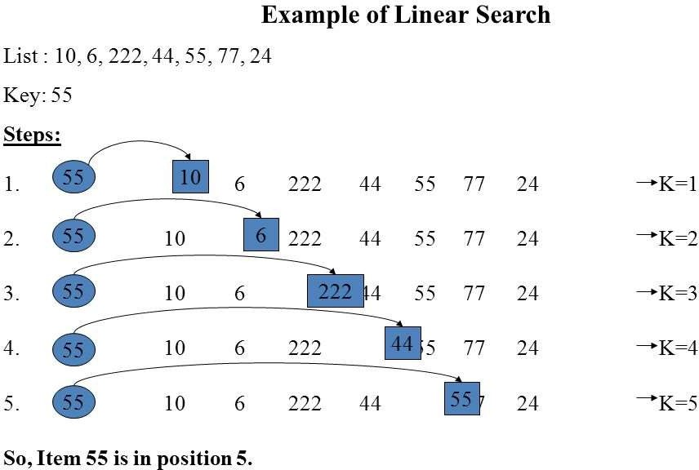

Slide 4
Pseudo code for Linear search
procedure linear_search (list, value) for each item in the list
if match item == value return the item's location end if
end for
end procedure

Slide 5
Binary search
This search works on the principle of divide and conquer.
For this, the data collection should be in the sorted form.
Binary search looks for a particular item by comparing the middle most item of the collection.

Slide 6
If a match occurs, then the index of item is returned. If the middle item is greater than the item, then the item is searched in the sub-array to the left of the middle item.
Otherwise, the item is searched for in the sub-array to the right of the middle item.
This process continues on the sub-array as well until the size of the sub array reduces to zero.

Slide 7
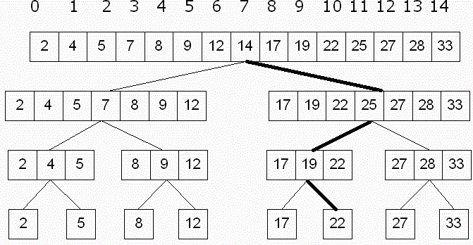
Example of Binary search

Slide 8
pseudo code for Binary search
BinarySearch(A[0..N-1], value)
{
low = 0 high = N - 1
while (low <= high) {
// invariants: value > A[i] for all i < low value < A[i] for all i > high
mid = (low + high) / 2 if (A[mid] > value)

Slide 9
high = mid - 1
else if (A[mid] < value) low = mid + 1
else return mid
}
return not_found // value would be inserted at
index "low"
}

Slide 10
Output
Enter the array:………………………. Array enterd is: 2,5,10,67,89
Enter the choice of search technique:
Press 1. For linear search and 2 for binary search 1
Enter the number you want to search: 5
Output: the required element is at position 2

Slide 11
Viva Questions:
Q1. The sequential search, also known as.
Q2. What is the primary requirement for implementation of binary search in an array?
Q3. Is binary search applicable on array and linked list both?
Q4. What is the principle of working of Binary search?
Q5. Which searching algorithm is efficient one?

