Slide 1
Data Structure Lab no.-3
Aim:- Implementation of Stack and Queue using array.

Slide 2
Definition and Overview of Stacks
What is a stack?
Stores a set of elements in a particular order
Stack principle: LAST IN FIRST OUT = LIFO
It means: the last element inserted is the first one to be removed

Slide 3
Last In First Out
A
B A
C B A
D C B A
E D C B A
D C B A
top
top
top
top
top

Slide 4
Stack Operations
Push
causes a value to be stored in (pushed onto) the stack
Pop
retrieves and removes a value from the stack

Slide 5
Stacks-Implementation using Arrays
Allocate an array of some size (pre-defined) Maximum N elements in stack
Bottom stack element stored at element 0
last index in the array is the top
Increment top when one element is pushed, decrement after pop

Slide 6
The Push Operation
Suppose we have an empty integer stack that is capable of holding a maximum of three values. With that stack we execute the following push operations.
push(5);
push(10);
push(15);

Slide 7
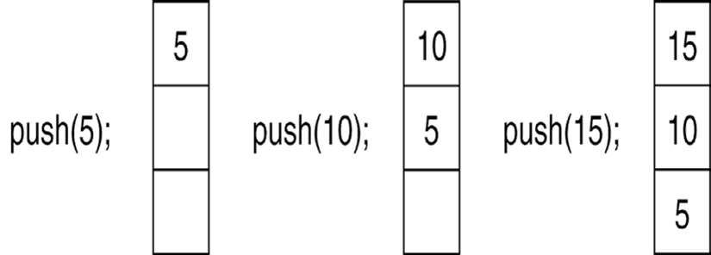
The Push Operation
The state of the stack after each of the push operations:

Slide 8
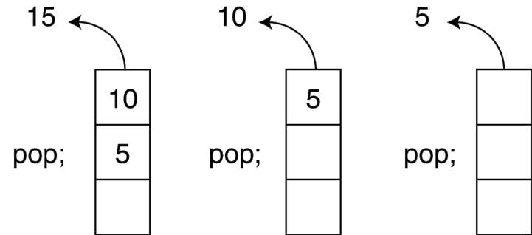
The Pop Operation
Now, suppose we execute three consecutive pop operations on the same stack:

Slide 9
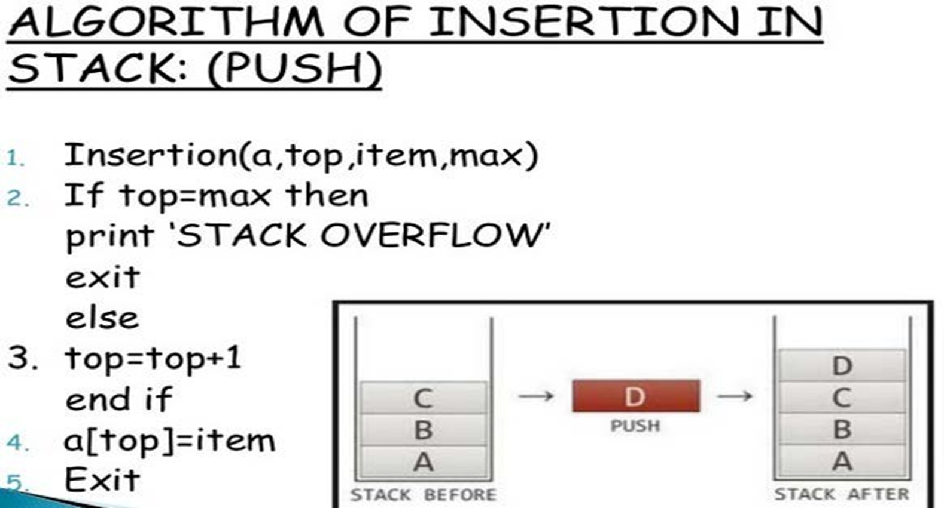

Slide 10
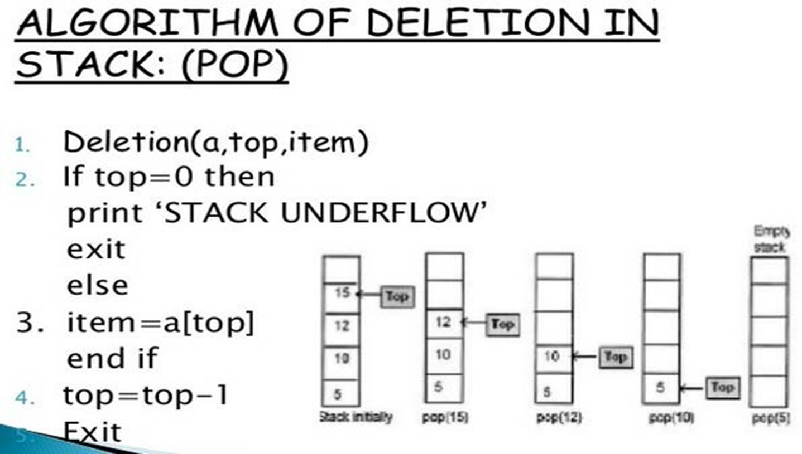

Slide 11
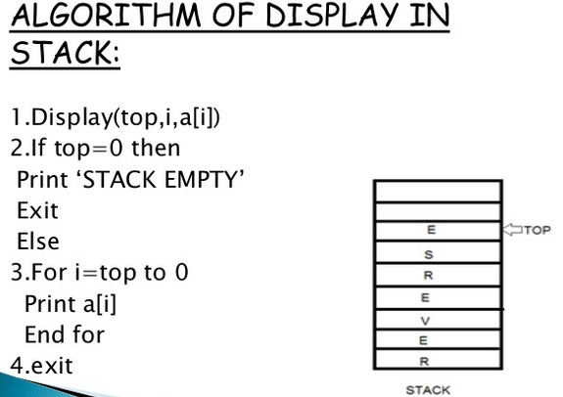

Slide 12
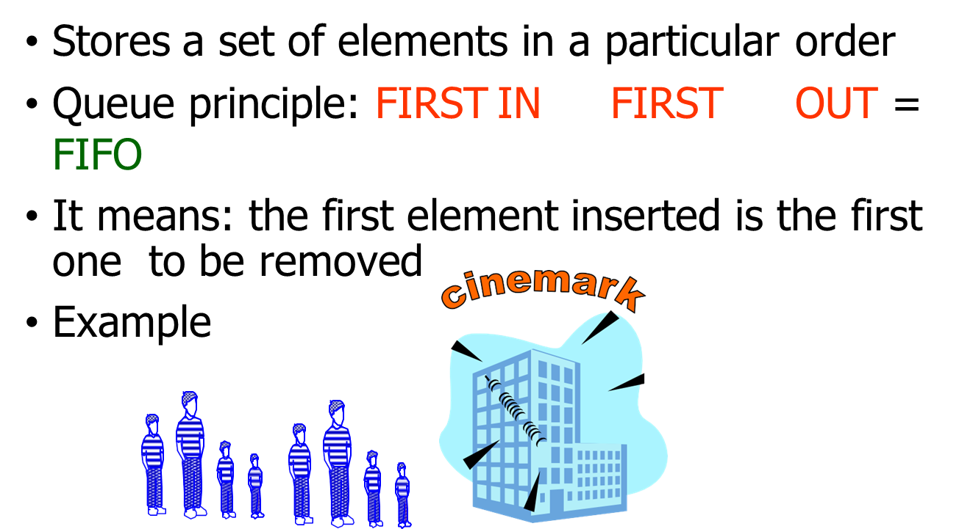
Queues

Slide 13
Queue Operations
The two primary queue operations are enqueuing and dequeuing.
To enqueue means to insert an element at the rear of a queue.
•To dequeue means to remove an element from the front of a queue.

Slide 14
Algorithm for Insertion/Enqueue
Step 1 − Check if the queue is full.
Step 2 − If the queue is full, produce overflow error and exit.
Step 3 − If the queue is not full, increment rear pointer to point the next empty space.
Step 4 − Add data element to the queue location, where the rear is pointing.
Step 5 − return success.

Slide 15
Insert Operation
void insert()
{
int num;
scanf(“%d”,&num);
// Step 1
if(rear==MAX-1)
// Step 2
printf(“\n Overflow”);
//Step 3
if(front==-1 && rear==-1)
front=rear=0;
else
rear++;
// Step 4
queue[rear]=num;
}

Slide 16
Algorithm for Deletion/Dequeue
Step 1 − Check if the queue is empty.
Step 2 − If the queue is empty, produce underflow error and exit.
Step 3 − If the queue is not empty, access the data where front is pointing.
Step 4 − Increment front pointer to point to the next available data element.
Step 5 − Return success.

Slide 17
Delete Operation
int delete()
{
int val;
// Step 1
if(front==-1|| front>rear)
{ // Step 2
printf(“Underflow”);
}
else
{ // Step 3 &4
front++;
val=queue[front];
return val;
}
}

Slide 18
Viva Questions
1. Write a program to sort a queue.
2. How queue differs from stack ?
3. Write a program to reverse a queue.
4. What is stack? How much memory is allocated to a stack? Why stack is called an abstract data type?

