Slide 1
Data Structure Lab no.-4
Aim:- Create a linked list and perform following operations:
I. Insert a new node at specified position.
II. Deletion of a node with specified position.
III. Reversal of that linked list.

Slide 2
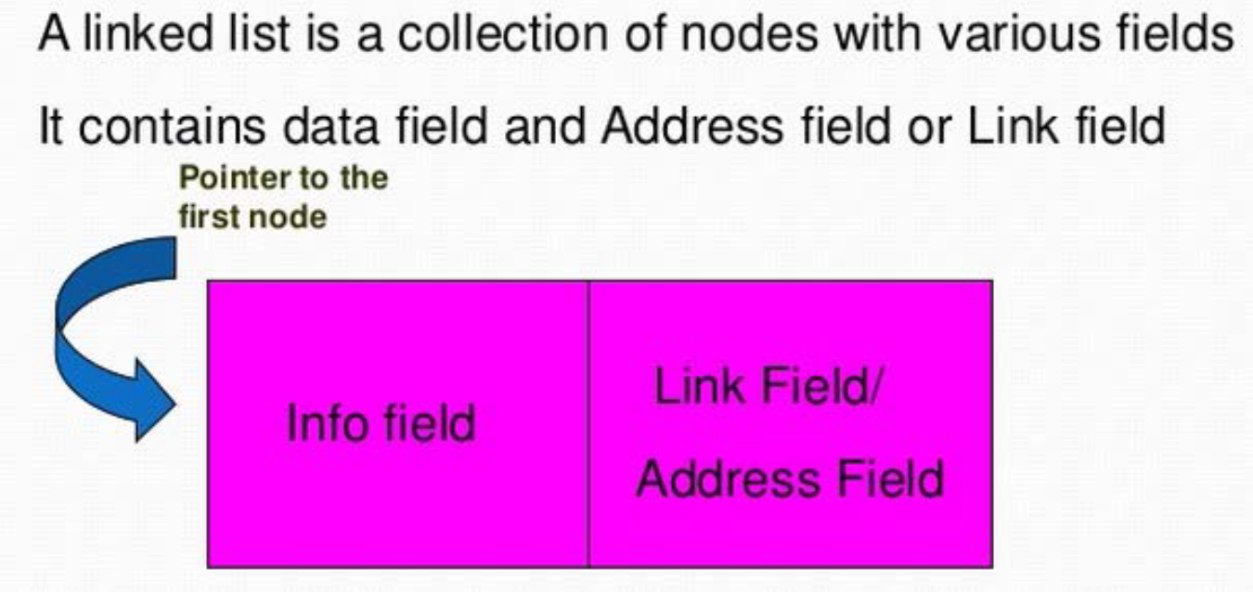
Linked List

Slide 3
Linked list consists of a sequence of nodes, each containing data fields and one or two references ("links") pointing to the next and/or previous nodes.
A linked list is a self-referential data type because it contains a pointer or link to another data of the same type.
Linked list permit insertion and removal of nodes at any point in the list in constant time, but do not allow random access.

Slide 4
A linked list node
struct Node
{
int data; //contains data about the student for example roll no
struct Node *next; //points towards the next node of linked list
};

Slide 5
Creation of linked list
/* 1. allocate node */
struct Node* new_node = new (Node);
/* 2. put in the data */
new_node->data = new_data;
/* 3. Make next of new node as Null */
new_node->next = Null;
/* 4. move the head to point to the new node */
head=start
while (head->next!=NULL)
{
head=head->next; } head->next=new_node;
}

Slide 6
Insertion at a specified position
/* Given a node prev_node, insert a new node after the given prev_node */
/* 1. allocate newnode */
struct Node* new_node =new(node);
/* 2. put in the data */
new_node->data = new_data;
/*3. check if the given prev_node is NULL */

Slide 7
if (prev_node == NULL)
{
new_node->next=start;
Start=newnode
}
/* 4.Make next of new node as next of prev_node */
new_node->next = prev_node->next;
/* 5. move the next of prev_node as new_node */
prev_node->next = new_node;
}

Slide 8
Deletion at specified position
/* traverse the linked list till the required data is fetched*/
head=start
while(head!=null && head->data!= data)
{
Prev_node=head;
head=head->data;
}
/*delete the given node*/
Prev_node->next=head->next;
}

Slide 9
Reversal of linked list
struct Node* prev = NULL;
struct Node* current = *head_ref;
struct Node* next;
while (current != NULL)
{
next = current->next;
current->next = prev;
prev = current;
current = next; }
*head_ref = prev;
}

Slide 10
Output
Input :
Enter the operation you want to perform: 1. Insert 2. Delete 3. Reverse 4. Display 5. Exit
Operation: 1
Enter the value you want to add: 67
Do you want to continue: 1. Yes 2 no
Output:
The elements of linked list is: 23->56->67->89

Slide 11
Viva-questions
Q1. What type of memory allocation is referred for Linked lists?
Q2. Describe what is Node in link list? Name the types of Linked Lists?
Q3. What is the difference between Linear Array and Linked List?
Q4. Mention the steps to insert data at the starting of a singly linked list?
Q5. For which header list, you will found the last node contains the null pointer?

