Slide 1
Data Structure Lab no.-6
Aim:- Create a circular linked list and perform following operations: Insertion at front and Deletion at end

Slide 2
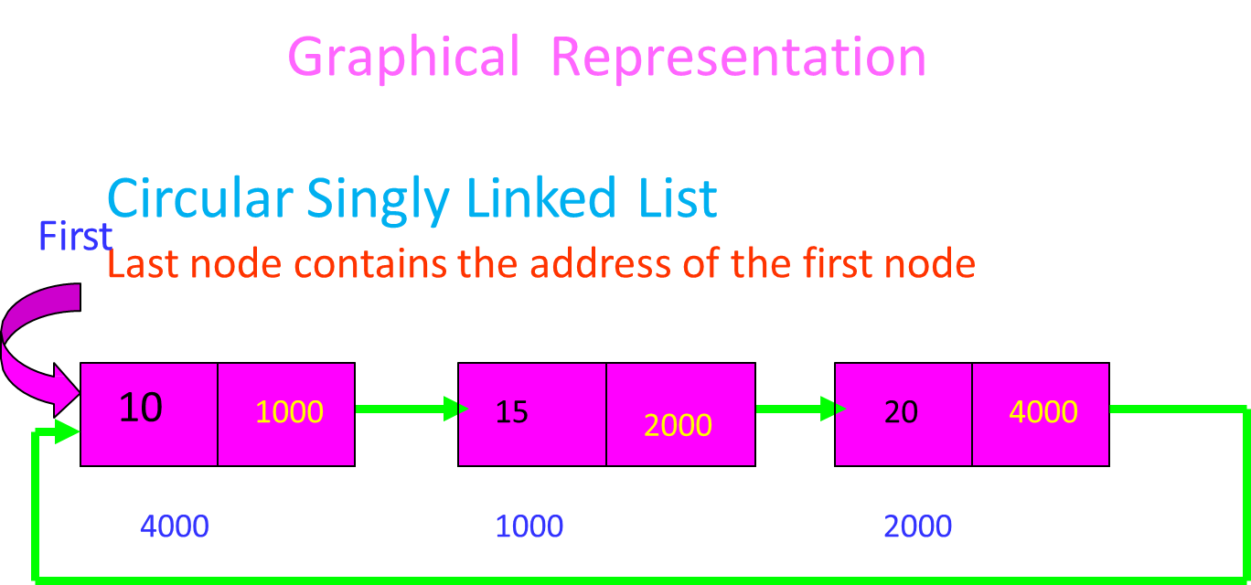
Circular Singly Linked List

Slide 3
In a circularly-linked list, the first and final nodes are linked together. This can be done for both singly and doubly linked lists.
To traverse a circular linked list, we can begin at any node and follow the list in either direction until we return to the original node.
Viewed another way, circularly-linked lists can be seen as having no beginning or end.

Slide 4
Insertion at the front
struct Node *addBegin(struct Node *last, int data)
{
if (last == NULL)
return addToEmpty(last, data);
// Creating a node dynamically
struct Node *temp
= (struct Node *)malloc(sizeof(struct Node));

Slide 5
// Assigning the data
temp -> data = data;
// Adjusting the links
temp -> next = last -> next;
last -> next = temp;
return last;
}

Slide 6
Deletion at end
void deleteNode(struct Node *head, int key)
{
if (head == NULL)
return;
// Find the required node
struct Node *curr = head, *prev;
while (curr->data != key)
{ if (curr->next == head)
{ printf("\nGiven node is not found"
in the list!!!");
break; }
prev = curr;
curr = curr -> next; }

Slide 7
// Check if node is only node
if (curr->next == head)
{
head = NULL;
free(curr);
return;
}
// If more than one node, check if it is first node
if (curr == head)
{
prev = head;
while (prev -> next != head)
prev = prev -> next;
head = curr->next;
prev->next = head;
free(curr);
}

Slide 8
// check if node is last node
else if (curr -> next == head)
{
prev->next = head;
free(curr);
}
else
{
prev->next = curr->next;
free(curr);
}
}

Slide 9
Output
Input :
// stored linked list is 67-89-90-34-56
Enter the operation you want to perform: 1. Insert 2. Delete 3. Display 4. Exit
Operation: 2
Do you want to continue: 1. Yes 2 no
Output:
67-89-90-34

Slide 10
Viva-Questions
Q1. Is there any Null pointer in circular linked list?
Q2. What is circular linked list?
Q3.Whethear a circular linked list is single way list or two way list?
Q4.Which pointer signifies the starting of circular linked list?
Q5. Describe the steps to delete the starting node of linked list.

