Slide 1
Lab no.-7 stack using link list
Implement Stack using linked list and perform following operations:: Pop ,Push and Traverse.

Slide 2

Stack
A stack is an Abstract Data Type (ADT), commonly used in most programming languages. It is named stack as it behaves like a real-world stack, for example – a deck of cards or a pile of plates, etc.

Slide 3
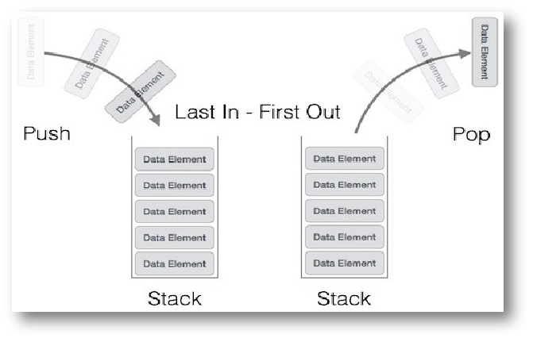
Stack Representation
Can be implemented by means of Array, Structure, Pointers and Linked List.
Stack can either be a fixed size or dynamic.

Slide 4
STACK: Last-In-First-Out (LIFO)
void push (stack *s, int element);STACK: Last-In-First-Out (LIFO)
/* Insert an element in the stack */
int pop (stack *s);
/* Remove and return the top element */
void create (stack *s);
/* Create a new stack */
int isempty (stack *s);
/* Check if stack is empty */
int isfull (stack *s);
/* Check if stack is full */

Slide 5
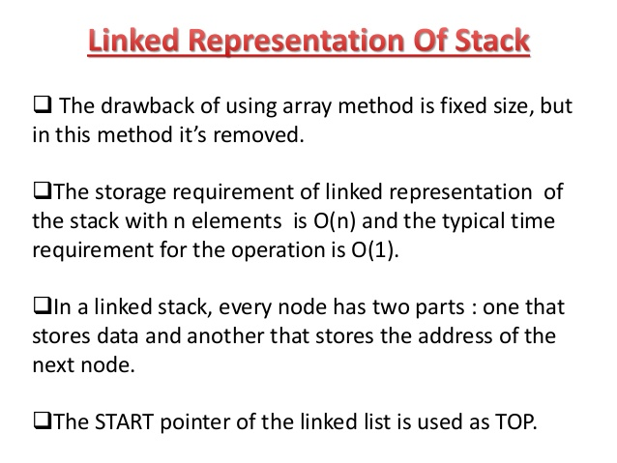

Slide 6
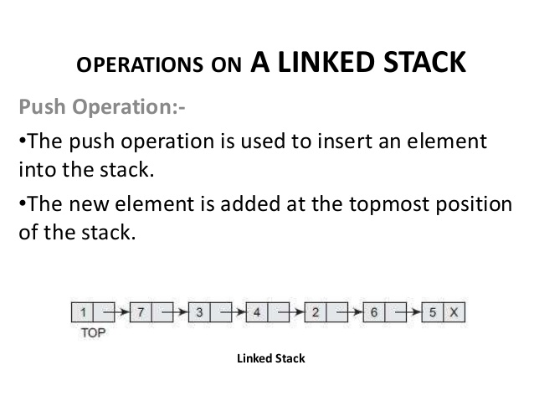

Slide 7
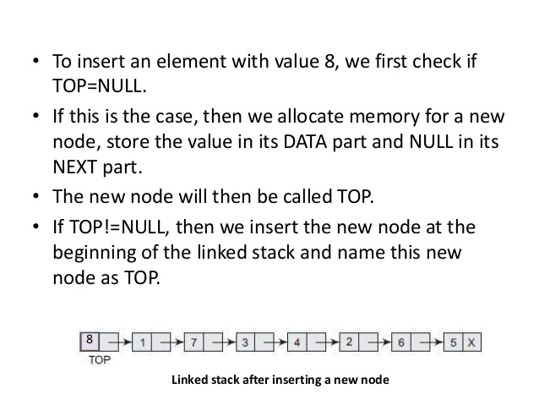

Slide 8
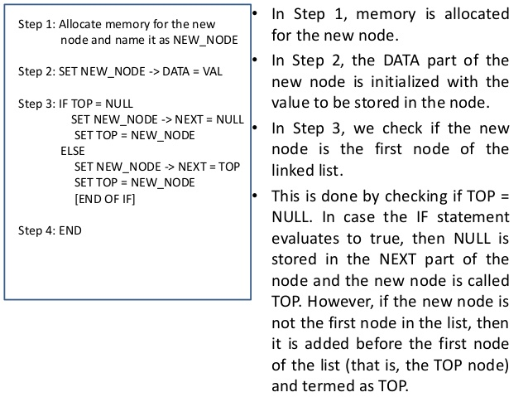

Slide 9
Function to add an element data in the stack
void push(int data)
{
// create new node temp and allocate memory
struct Node* temp;
temp = new Node();
// check if stack (heap) is full. Then inserting an element would
// lead to stack overflow
if (!temp) {
cout << "\nHeap Overflow";
exit(1);
}
// initialize data into temp data field
temp->data = data;
// put top pointer reference into temp link
temp->link = top;
// make temp as top of Stack
top = temp;
}

Slide 10
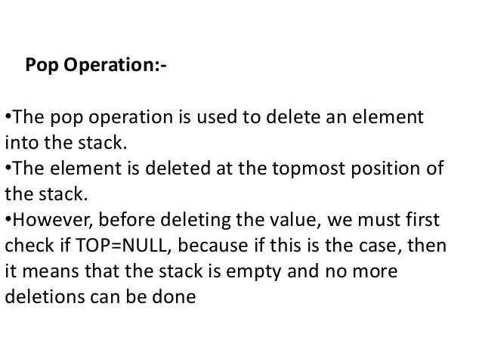

Slide 11
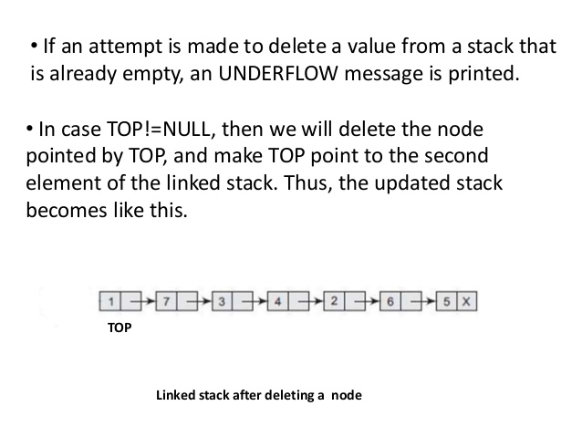

Slide 12
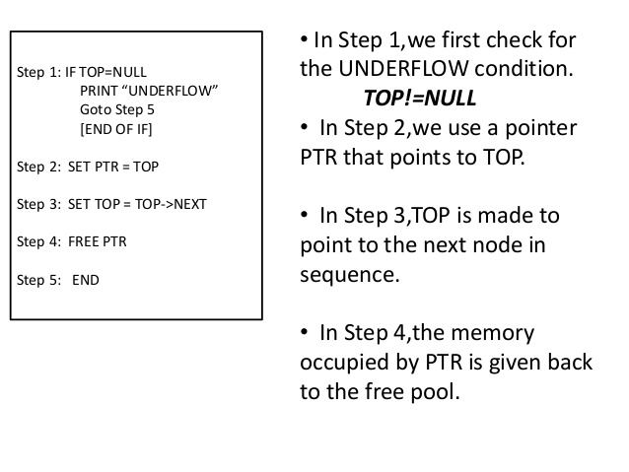

Slide 13
Function to pop top element from the stack
void pop()
{
struct Node* temp;
// check for stack underflow
if (top == NULL) {
cout << "\nStack Underflow" << endl;
exit(1);
}
else {
// top assign into temp
temp = top;
// assign second node to top
top = top->link;
// destroy connection between first and second
temp->link = NULL;
// release memory of top node
free(temp);
}
}

Slide 14
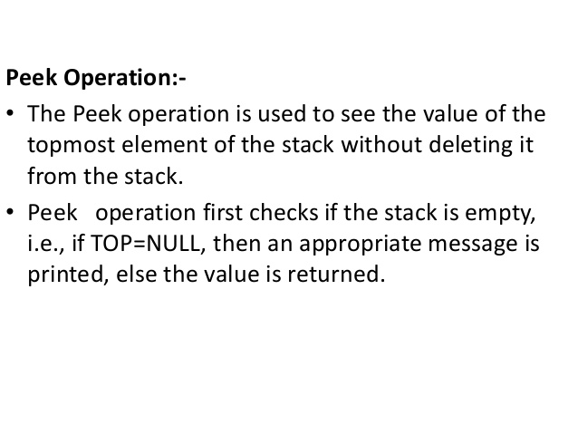

Slide 15
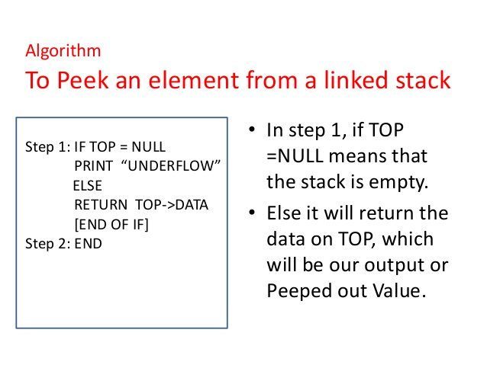

Slide 16
Function to check if the stack is empty or not
int isEmpty()
{
return top == NULL;
}
// Utility function to return top element in a stack
int peek()
{
// check for empty stack
if (!isEmpty())
return top->data;
else
exit(1);
}

Slide 17
Output:
44->33->22->11->
Top element is 44
22->11->
Top element is 22

Slide 18
Viva Questions
Q1. The following postfix expression with single digit operands is evaluated using a stack:
8 2 3 ^ / 2 3 * + 5 1 * -
Note that ^ is the exponentiation operator. The top two elements of the stack after the first * is evaluated are:
(A) 6, 1
(B) 5, 7
(C) 3, 2
(D) 1, 5
Q.2 What is the best case time complexity of deleting a node in Singly Linked list?
a) O (n)
b) O (n2)
c) O (nlogn)
d) O (1)

Slide 19
Contd...
Q.3 Which of the following statements are not correct with respect to Singly Linked List(SLL) and Doubly Linked List(DLL)?
a) Complexity of Insertion and Deletion at known position is O(n) in SLL and O(1) in DLL
b) SLL uses lesser memory per node than DLL
c) DLL has more searching power than SLL
d) Number of node fields in SLL is more than DLL
Q.4 What does ‘stack overflow’ refer to?
a) accessing item from an undefined stack
b) adding items to a full stack
c) removing items from an empty stack
d) index out of bounds exception

Slide 20
Contd...
Q.5 Consider these functions:
push() : push an element into the stack
pop() : pop the top-of-the-stack element
top() : returns the item stored in top-of-the-stack-node
What will be the output after performing these sequence of operations
push(20);
push(4);
top();
pop();
pop();
pop();
push(5);
top();
a) 20
b) 4
c) stack underflow
d) 5

