Slide 1
Data Structure Lab no.-8 The Queue Using Linked List
Aim: Implement a Linear Queue using Linked List and Perform following operations : Insert, Delete, and Display the queue elements

Slide 2
Queues
Queue: a collection whose elements are added at one end (the rear or tail of the queue) and removed from the other end (the front or head of the queue)
A queue is a FIFO (first in, first out) data structure
Any waiting line is a queue:
The check-out line at a grocery store
The cars at a stop light
An assembly line

Slide 3
Queue Operations
enqueue : add an element to the tail of a queue
dequeue : remove an element from the head of a queue
first : examine the element at the head of the queue (“peek”)
Other useful operations (e.g. is the queue empty)
It can not access the elements in the middle of the queue!

Slide 4
Queue Implementation Using a Linked List
Internally, the queue is represented as a linked list of nodes, with each node containing a data element
We need two pointers for the linked list
A pointer to the beginning of the linked list (front of queue)
A pointer to the end of the linked list (rear of queue)
We will also have a count of the number of items in the queue

Slide 5
Linked Implementation of a Queue
A queue q containing four elements
rear
q
front
4
count

Slide 6
Queue After Adding Element
New element is added in a node at the end of the list, rear points to the new node, and count is incremented
rear
q
front
5
count

Slide 7
Queue After a dequeue Operation
Node containing is removed from the front of the list (see previous slide), front now points to the node that was formerly second, and count has been decremented.
rear
q
front
4
count

Slide 8
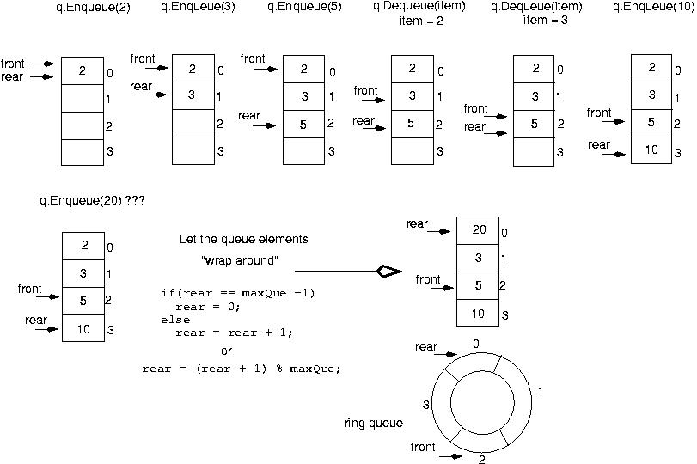
Example:

Slide 9
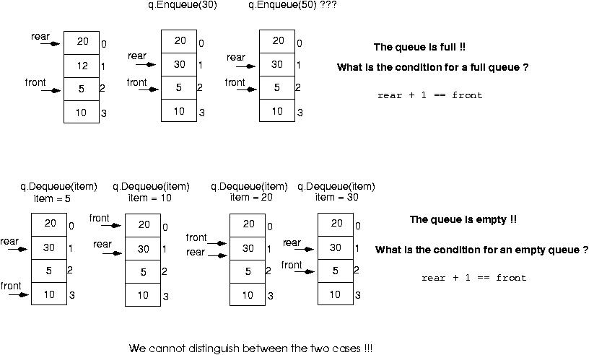

Slide 10
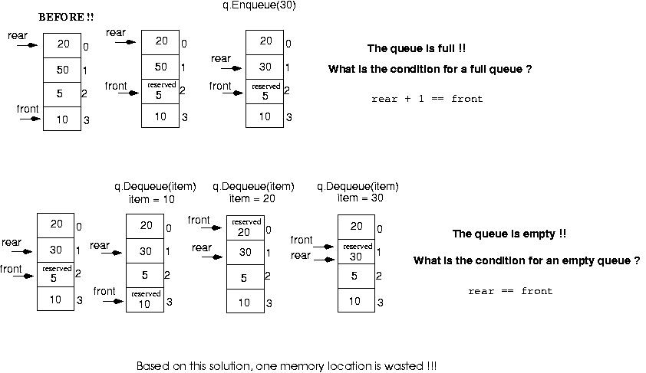
Make front point to the element preceding the front element in the queue (one memory location will be wasted).

Slide 11
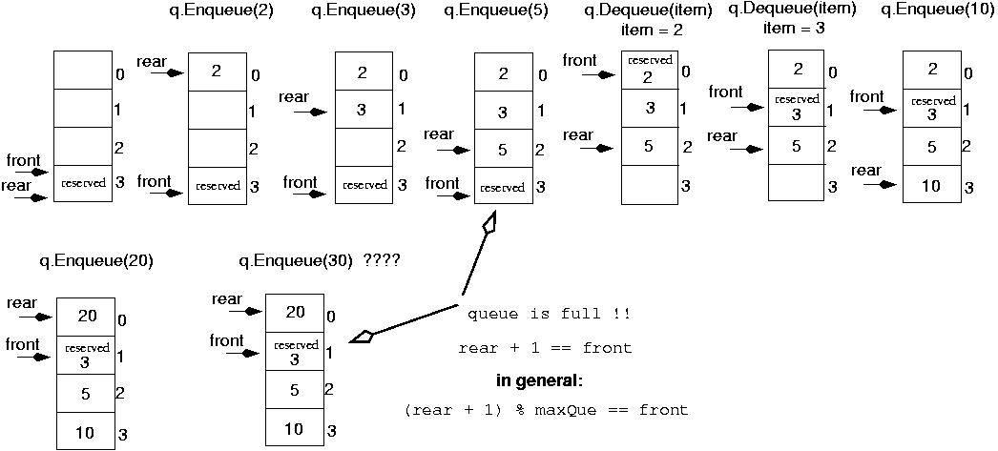
Initialize front and rear

Slide 12
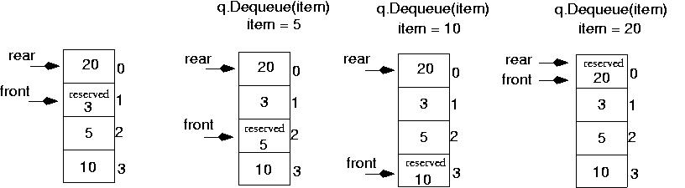
Queue is Empty Now||
Rear == Front

Slide 13
enQueue(value) - Inserting an element into the Queue
We can use the following steps to insert a new node into the queue...
Step 1 - Create a newNode with given value and set 'newNode → next' to NULL.
Step 2 - Check whether queue is Empty (rear == NULL)
Step 3 - If it is Empty then, set front = newNode and rear = newNode.
Step 4 - If it is Not Empty then, set rear → next = newNode and rear = newNode.

Slide 14
Insert an Element in the Queue:
void Insert() {
int val;
cout<<"Insert the element in queue : "<<endl;
cin>>val;
if (rear == NULL) {
rear = (struct node *)malloc(sizeof(struct node));
rear->next = NULL;
rear->data = val;
front = rear;
} else {
temp=(struct node *)malloc(sizeof(struct node));
rear->next = temp;
temp->data = val;
temp->next = NULL;
rear = temp;
}
}

Slide 15
deQueue() - Deleting an Element from Queue:
We can use the following steps to delete a node from the queue...
Step 1 - Check whether queue is Empty (front == NULL).
Step 2 - If it is Empty, then display "Queue is Empty!!! Deletion is not possible!!!" and terminate from the function
Step 3 - If it is Not Empty then, define a Node pointer 'temp' and set it to 'front'.
Step 4 - Then set 'front = front → next' and delete 'temp' (free(temp)).

Slide 16
Delete an Elememt From the Queue:
void Delete() {
temp = front;
if (front == NULL) {
cout<<"Underflow"<<endl;
return;
}
else
if (temp->next != NULL) {
temp = temp->next;
cout<<"Element deleted from queue is : "<<front->data<<endl;
free(front);
front = temp;
} else {
cout<<"Element deleted from queue is : "<<front->data<<endl;
free(front);
front = NULL;
rear = NULL;
}
}

Slide 17
display() - Displaying the elements of Queue:
We can use the following steps to display the elements (nodes) of a queue...
Step 1 - Check whether queue is Empty (front == NULL).
Step 2 - If it is Empty then, display 'Queue is Empty!!!' and terminate the function.
Step 3 - If it is Not Empty then, define a Node pointer 'temp' and initialize with front.
Step 4 - Display 'temp → data --->' and move it to the next node. Repeat the same until 'temp' reaches to 'rear' (temp → next != NULL).
Step 5 - Finally! Display 'temp → data ---> NULL'.

Slide 18
Display Elements in the Queue:
void Display() {
temp = front;
if ((front == NULL) && (rear == NULL)) {
cout<<"Queue is empty"<<endl;
return;
}
cout<<"Queue elements are: ";
while (temp != NULL) {
cout<<temp->data<<" ";
temp = temp->next;
}

Slide 19
Output
The output of the above program is as follows:
) Insert element to queue
2) Delete element from queue
3) Display all the elements of queue
4) Exit
Enter your choice : 1
Insert the element in queue : 4
Enter your choice : 1
Insert the element in queue : 3
Enter your choice : 1
Insert the element in queue : 5
Enter your choice : 2
Element deleted from queue is : 4
Enter your choice : 3
Queue elements are : 3 5
Enter your choice : 7
Invalid choice
Enter your choice : 4
Exit

Slide 20
Viva Voice Questions:
Q1 In linked list implementation of queue, if only front pointer is maintained, which of the following operation take worst case linear time?
a) Insertion
b) Deletion
c) To empty a queue
d) Both Insertion and To empty a queue

Slide 21
Q.2 In linked list implementation of a queue, front and rear pointers are tracked. Which of these pointers will change during an insertion into a NONEMPTY queue?
a) Only front pointer
b) Only rear pointer
c) Both front and rear pointer
d) No pointer will be changed
Q.3 In linked list implementation of a queue, front and rear pointers are tracked. Which of these pointers will change during an insertion into EMPTY queue?
a) Only front pointer
b) Only rear pointer
c) Both front and rear pointer
d) No pointer will be changed

Slide 22
Q.4 In linked list implementation of a queue, from where is the item deleted?
a) At the head of link list
b) At the centre position in the link list
c) At the tail of the link list
d) Node before the tail
Q.5 In linked list implementation of a queue, the important condition for a queue to be empty is?
a) FRONT is null
b) REAR is null
c) LINK is empty
d) FRONT==REAR-1

