Slide 1
Create a Doubly linked list and perform following operations: Insertion at front and Deletion at end

Slide 2
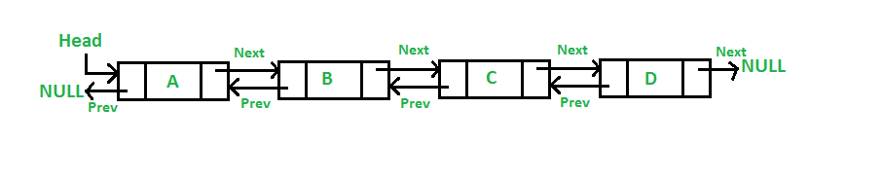
A Doubly Linked List (DLL) contains an extra pointer, typically called previous pointer, together with next pointer and data which are there in singly linked list.

Slide 3
Advantages over singly linked list
1) A DLL can be traversed in both forward and backward direction. 2) The delete operation in DLL is more efficient if pointer to the node to be deleted is given. 3) We can quickly insert a new node before a given node. In singly linked list, to delete a node, pointer to the previous node is needed. To get this previous node, sometimes the list is traversed. In DLL, we can get the previous node using previous pointer.

Slide 4
Disadvantages over singly linked list
1) Every node of DLL Require extra space for an previous pointer. It is possible to implement DLL with single pointer though. 2) All operations require an extra pointer previous to be maintained. For example, in insertion, we need to modify previous pointers together with next pointers. For example in following functions for insertions at different positions, we need 1 or 2 extra steps to set previous pointer.

Slide 5
Insertion
A node can be added in four ways 1) At the front of the DLL 2) After a given node. 3) At the end of the DLL 4) Before a given node.

Slide 6
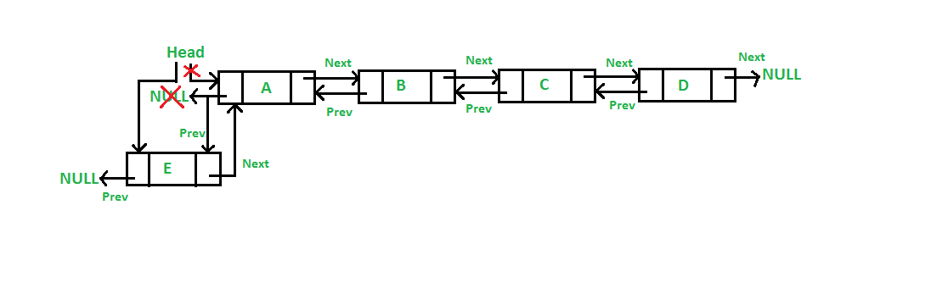
Add a node at the front
The new node is always added before the head of the given Linked List.
Newly added node becomes the new head of DLL.
For example if the given Linked List is 10152025 and we add an item 5 at the front, then the Linked List becomes 510152025.
Let us call the function that adds at the front of the list is push(). The push() must receive a pointer to the head pointer, because push must change the head pointer to point to the new node

Slide 7
Given a reference (pointer to pointer) to the head of a list and an int, inserts a new node on the front of the list. */
void push(struct Node** head_ref, int new_data)
{
/* 1. allocate node */
struct Node* new_node = (struct Node*)malloc(sizeof(struct Node));
/* 2. put in the data */
new_node->data = new_data;
/* 3. Make next of new node as head and previous as NULL */
new_node->next = (*head_ref);
new_node->prev = NULL;
/* 4. change prev of head node to new node */
if ((*head_ref) != NULL)
(*head_ref)->prev = new_node;
/* 5. move the head to point to the new node */
(*head_ref) = new_node;
}

Slide 8
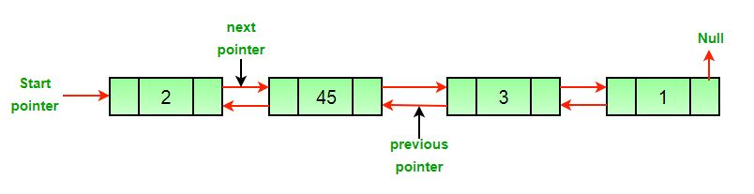
Delete a node in a Doubly Linked List
Original Doubly Linked List

Slide 9
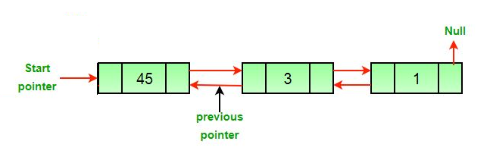
The deletion of a node in a doubly linked list can be divided into three main categories:
After deletion of head node.

Slide 10
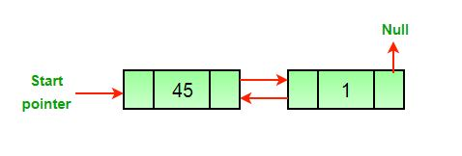
After deletion of middle node.

Slide 11
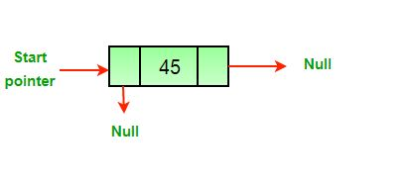
After deletion of last node.

Slide 12
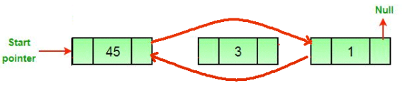
All three mentioned cases can be handled in two steps if the pointer of the node to be deleted and the head pointer is known.
If the node to be deleted is the head node then make the next node as head.
If a node is deleted, connect the next and previous node of the deleted node.

Slide 13
/* Function to delete a node in a Doubly Linked List.
head_ref --> pointer to head node pointer.
del --> pointer to node to be deleted. */
void deleteNode(Node** head_ref, Node* del)
{
/* base case */
if (*head_ref == NULL || del == NULL)
return;
/* If node to be deleted is head node */
if (*head_ref == del)
*head_ref = del->next;
/* Change next only if node to be
deleted is NOT the last node */
if (del->next != NULL)
del->next->prev = del->prev;
/* Change prev only if node to be
deleted is NOT the first node */
if (del->prev != NULL)
del->prev->next = del->next;
/* Finally, free the memory occupied by del*/
free(del);
return;
}

Slide 14
Viva Questions
Q1. What is a memory efficient doubly linked list?
Q2. What is the advantage of doubly linked list?
Q3. Why is a doubly linked list more useful than a singly linked list?
Q4. What is the difference between LinkedList and doubly linked list?

