Slide 1
Data Structure Lab no.-10 Create Binary tree using linked list
Create a Binary Tree using linked list (Display using Graphics) and perform the following operations: Tree traversals (Preorder, Postorder, Inorder) using the concept of recursion

Slide 2
Parts of a binary tree
A binary tree is composed of zero or more nodes
Each node contains:
A value (some sort of data item)
A reference or pointer to a left child (may be null), and
A reference or pointer to a right child (may be null)
A binary tree may be empty (contain no nodes)
If not empty, a binary tree has a root node
Every node in the binary tree is reachable from the root
node by a unique path
A node with neither a left child nor a right child is
called a leaf
In some binary trees, only the leaves contain a value

Slide 3
Binary tree traversal
Binary tree traversal can be done in the following ways.
Inorder traversal
Preorder traversal
Postorder traversal

Slide 4
Tree traversals
A binary tree is defined recursively: it consists of a root, a
left subtree, and a right subtree
To traverse (or walk) the binary tree is to visit each node in
the binary tree exactly once
Tree traversals are naturally recursive
Since a binary tree has three “parts,” there are six possible
ways to traverse the binary tree:
root, left, right
left, root, right
left, right, root
root, right, left
right, root, left
right, left,root

Slide 5
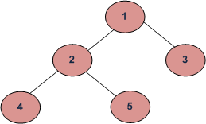
Example:
(a) Inorder (Left, Root, Right) : 4 2 5 1 3
(b) Preorder (Root, Left, Right) : 1 2 4 5 3
(c) Postorder (Left, Right, Root) : 4 5 2 3 1

Slide 6
Preorder traversal
In preorder, the root is visited first
Preorder traversal: root, left child, right child
Here’s a preorder traversal to print out all the elements in the binary tree:
void preorder(struct node *root)
{
if(root == NULL)
return;
cout << root -> data << " ";
preorder (root -> left);
preorder(root -> right);
}

Slide 7
Inorder traversal
In inorder, the root is visited in the middle
In-order traversal: left child, root, right child
■ Here’s an inorder traversal to print out all the elements in the binary tree:
void inorder(struct node *root)
{
if(root == NULL)
return;
inorder(root -> left);
cout << root -> data << " ";
inorder(root -> right);
}

Slide 8
Postorder traversal
In postorder, the root is visited last
Post-order traversal: left child, right child, root
■ Here’s a postorder traversal to print out all the elements in the binary tree:
void postorder(struct node *root)
{
if(root == NULL)
return;
postorder(root -> left);
postorder(root -> right);
cout << root -> data << " ";
}

Slide 9
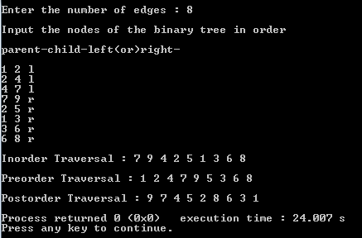
Output:
all traversal

Slide 10
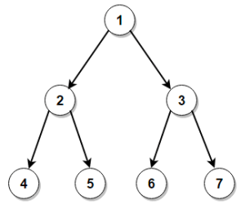
Viva Questions:
Ques.1 Calculate height of a binary tree

Slide 11
Ques.2 Inorder Tree Traversal (Iterative & Recursive Implementation)
Ques.3 Preorder Tree Traversal (Iterative & Recursive Implementation)
Ques.4 Postorder Tree Traversal (Iterative & Recursive Implementation)
Ques.5 Level Order Traversal of Binary Tree

Slide 12
Ques.6 How many child nodes there can be for any parent node in a binary tree?
Ques.7 How can you traverse a binary tree?
Ques.8 Does the last node of post-order traversal and first node of pre-order traversal of a binary tree always same?
Ques.9 How can you represent a tree in memory?
Ques.10 What is the order of nodes in in-order traversal?
Ques.11 Can a tree be called a graph also?

