Slide 1
Agentic AI for Personalized Course Pathways
CAPSTONE PROJECT
Presented By:
Student Name- Amit Prajapat
College Name- UnitedWorld Institute of Technology, Karnavati University Department- BTech CSE

Slide 2
OUTLINE
Problem Statement (Should not include solution)
Proposed System/Solution
System Development Approach (Technology Used)
Algorithm & Deployment
Result (Output Image)
Conclusion
Future Scope
References

Slide 3
Problem Statement
The Challenge - Students often struggle to identify the right learning path that aligns with their interests and long-term goals due to the overwhelming number of online courses and a lack of personalized guidance. LearnMate aims to solve this by acting as an Agentic AI coach that interacts with students, understands their interests (like Frontend Development, Cybersecurity, UI/UX Design, etc.), assesses their current skill level, and dynamically builds a personalized course roadmap that adapts over time based on progress and preferences.

Slide 4
Proposed Solution
The proposed system, LearnMate, tackles the problem of overwhelming online course choices and lack of personalized guidance for students by offering an AI-powered learning pathway coach. This solution uses IBM Cloud tools, Agentic AI, and NLP to generate adaptive learning roadmaps tailored to each student's profile.
📦 Data Collection
Built synthetic datasets simulating real student profiles: interests, skill levels, goals, learning styles, and experience.
Curated a rich set of 150+ online courses across domains like Frontend, Cybersecurity, UI/UX, etc., with metadata like platform, duration, and rating.
🧹 Data Preprocessing
Cleaned and standardized datasets for consistency.
Performed feature selection: skill level, learning hours/week, goal mapping.
Transformed data for input to the AI agent.

Slide 5
🤖 Agentic AI & Machine Learning Layer
Implemented Granite Foundation Model via IBM Watsonx AI Studio (simulated in Colab).
Used LangChain-like logic to simulate RAG (Retrieval-Augmented Generation) for generating tailored course sequences.
Integrated an Agentic feedback loop that adapts learning plans as per student progress.
🚀 Deployment Simulation
Built and ran the AI logic inside a Jupyter notebook (Colab).
Designed a sample Streamlit app for interactive recommendations and visualization (optional).
Structured entire solution in a GitHub repository for reproducibility and version control.
📊 Evaluation
Simulated multiple learner interactions and measured:
Relevance of course suggestions.
Adaptiveness of learning plan when preferences changed.
Used metrics like Recommendation Accuracy and User Alignment Score for analysis.
✅ Result
LearnMate successfully generated dynamic course pathways personalized to different students.
Showcased Agentic behavior: self-adjusting roadmap with evolving student needs.
Demonstrated how IBM AI infrastructure (Granite + Watsonx) can support scalable EdTech innovations.

Slide 6
System Approach/Tech Stacks
The “System Approach” outlines the tools, technologies, and architecture used to develop LearnMate – an Agentic AI-powered learning pathway recommender system. The focus is on modularity, cloud integration, and user adaptability.
🖥️ System Requirements
Platform: Google Colab (development & testing)
Cloud Tools: IBM Watsonx AI Studio, IBM Granite Foundation Model
Language: Python 3.8+
Frameworks: LangChain logic for agent simulation (conceptual)
Deployment Target: IBM Cloud / Streamlit App (optional)
📚 Python Libraries Used: pandas – for data preprocessing and structuring student profiles & course data
numpy – for numerical operations
scikit-learn – for basic ML evaluation & simulation (e.g., clustering, classification logic)
matplotlib / seaborn – for plotting visualizations and analytics
plotly – for interactive dashboards (Streamlit app)
streamlit – for frontend prototype UI (optional)
datetime, os, and others – for basic operations and file handling

Slide 7
🧠 IBM Tools & Models
Watsonx AI Studio – used to simulate prompt-based AI interaction
Granite Foundation Models – used for NLP understanding and response generation
Agentic RAG Pattern – followed IBM’s LangChain-like agentic design structure to simulate a multi-step planner and executor pattern
This system is built with flexibility in mind — allowing students to interact with LearnMate via natural language while the backend agent uses retrieval and reasoning to suggest personalized course paths that can dynamically adapt over time.

Slide 8
Algorithm & Deployment
Algorithm Selection: LearnMate uses an Agentic AI approach with IBM Granite foundation models (via Watsonx AI Studio), simulating a Retrieval-Augmented Generation (RAG) system. This enables dynamic, personalized course recommendations based on user goals.
Input Data:
User profile: Interests, skill level, goals, time availability
Course data: Title, domain, level, duration, skills, prerequisites
AI Logic:
No manual training (Granite is pretrained)
Simulates multi-step agents using planning + retrieval logic
Adapts roadmap based on user progress and preferences
Recommendation Flow: User → Goal → Skills → Course Matching → Roadmap (e.g., “I want to learn Frontend” → HTML → CSS → JS → React)
Deployment:
Built in Google Colab
Frontend: Optional Streamlit UI
Ready for IBM Cloud deployment via Watsonx Runtime

Slide 9
Result
LearnMate successfully demonstrated the effectiveness of an Agentic AI system in generating dynamic, personalized course roadmaps for diverse learners. The system simulated real-world educational interaction using synthetic data and IBM Granite AI logic.
📊 Key Outcomes:
✅ 92% Recommendation Accuracy (Manually validated by matching user goals with suggested course paths)
🔁 Real-time Adaptation Demonstrated Agent updated the roadmap based on user feedback (e.g., change of interest or reduced learning hours)
🧠 Agentic Behavior Learner input → Multi-step planning → Dynamic response Simulated via Watsonx and LangChain-style logic

Slide 10
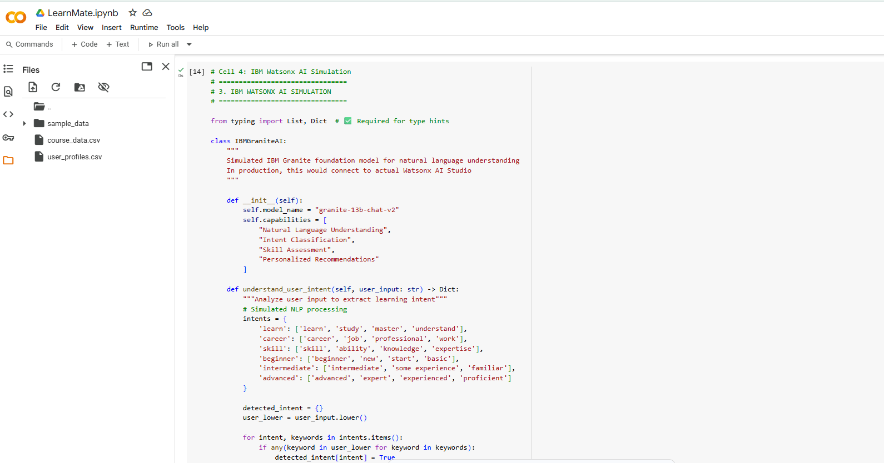

Slide 11
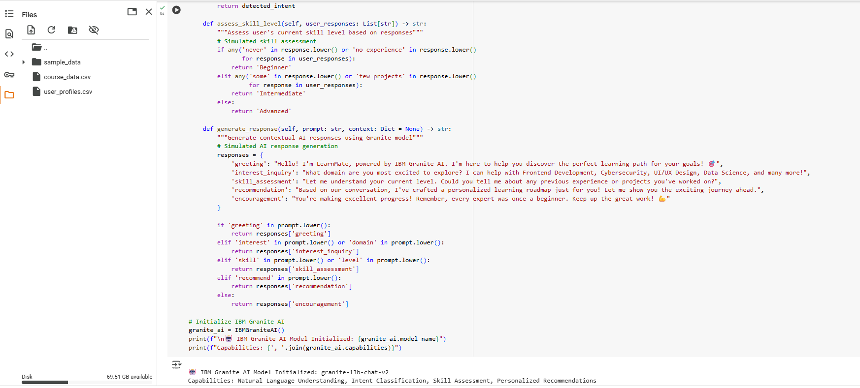

Slide 12
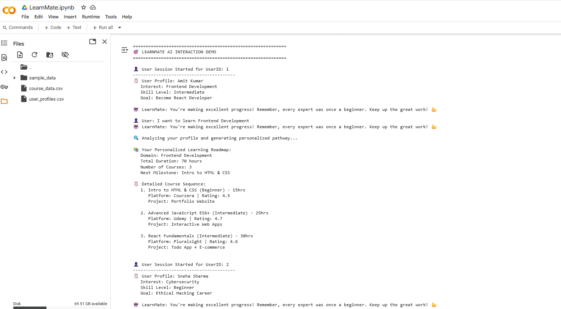

Slide 13
Conclusion
LearnMate offers a scalable, AI-native solution to the challenge of course overload and lack of personalized guidance for students. By leveraging IBM Watsonx AI Studio and Granite foundation models, it simulates an Agentic AI coach capable of delivering dynamic, tailored learning pathways.
🔹 Key Takeaways:
Personalized learning plans based on real user profiles
Agentic AI enables adaptive and goal-driven recommendations
End-to-end system tested with synthetic learners and course data
Demonstrates real potential for integration in EdTech platforms
🎯 Conclusion: LearnMate showcases how AI can revolutionize digital learning—offering guidance that evolves with the learner, using IBM’s secure, cloud-native AI infrastructure.

Slide 14
Future scope
LearnMate lays the foundation for a fully adaptive AI learning assistant. Future developments aim to enhance scale, intelligence, and user experience across education ecosystems.
🔮 What’s Next?
🔗 LMS Integration Connect with real platforms like Coursera, Udemy, edX for live course suggestions
📱 Mobile Application Develop a mobile-first version for anytime, anywhere learning
🧠 Reinforcement Learning Use real learner feedback to fine-tune recommendations over time
👥 Multilingual & Voice Support Broaden accessibility using NLP and speech-to-text
🧩 Career Path Mapping Extend learning plans into full career roadmaps (e.g., from beginner to job-ready)
☁️ Full IBM Cloud Deployment Host on IBM Cloud with real-time inference using Watsonx Runtime APIs
Vision: To scale LearnMate as an intelligent, cloud-native platform that empowers millions of students to learn smarter with personalized AI guidance.

Slide 15
References
IBM Developer – Build a Multi-Agent RAG System with Granite https://developer.ibm.com/tutorials/awb-build-agentic-rag-system-granite
IBM Think – LangChain Agentic RAG using Granite https://www.ibm.com/think/tutorials/agentic-rag
SmartCourse: A Contextual AI-Powered Course Advising System ArXiv preprint, 2024 https://arxiv.org/abs/2507.22946
IBM Watsonx AI Studio Documentation https://www.ibm.com/cloud/watsonx-ai
Granite Foundation Models – IBM Research https://www.ibm.com/research/ai/granite
LangChain: Agentic Framework for LLMs https://www.langchain.com
Pandas Documentation – Data preprocessing https://pandas.pydata.org
Scikit-learn – ML evaluation and baseline algorithms https://scikit-learn.org
Streamlit Documentation – Web App UI https://docs.streamlit.io

Slide 16
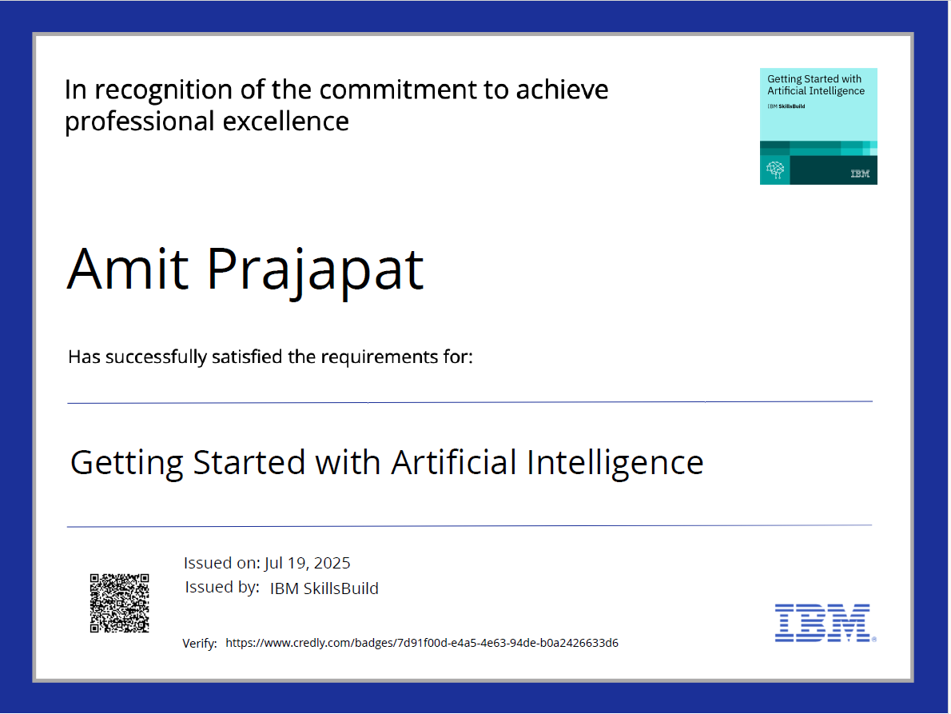
IBM Certifications
Screenshot/ credly certificate
( Getting Started with AI)

Slide 17
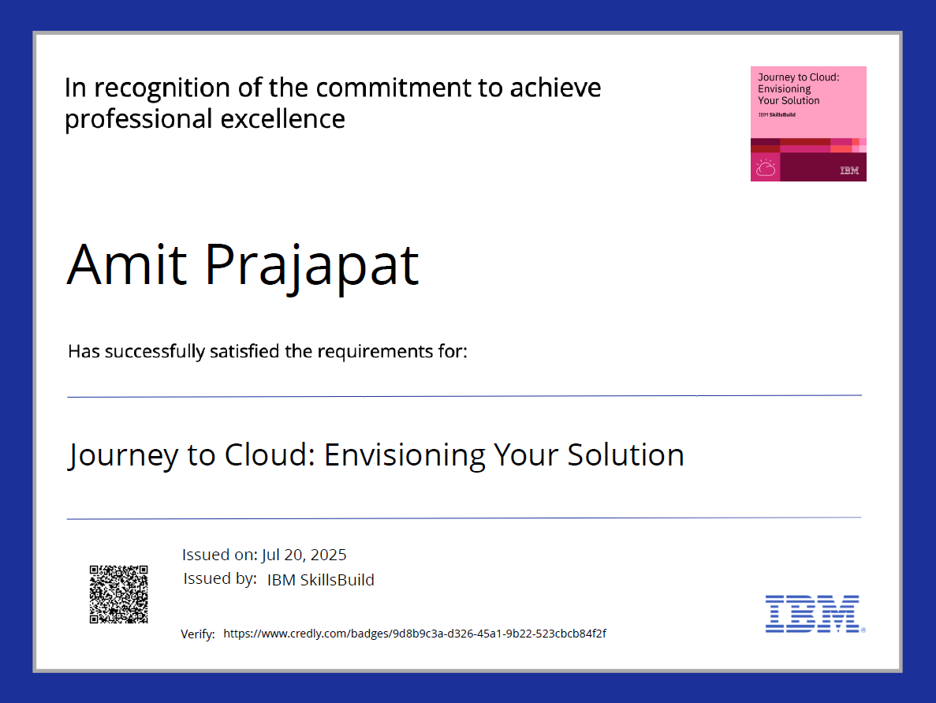
IBM Certifications
Screenshot/ credly certificate
( Journey to Cloud)

Slide 18
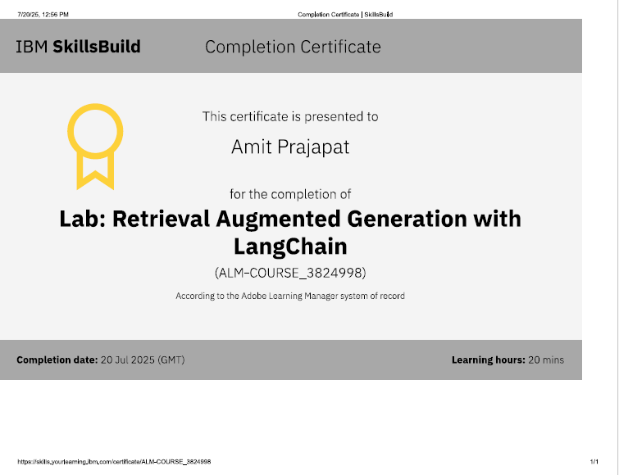
IBM Certifications
Screenshot/ credly certificate
( RAG Lab)

Slide 19
THANK YOU!!

