Slide 1
Bill Splitter Application
A Smart Way to Manage Team Expenses

Slide 2
Introduction
A bill-splitting application that helps teams manage shared expenses efficiently.
Allows users to add expenses, split costs among members, and track settlements.
Ensures transparency and accountability in expense management.

Slide 3
Key Features
User Authentication (JWT)
Create and Join Teams
Add Expenses with Split Among Members
Request and Verify Payments
Track Settlements with Status Updates
Responsive UI with Tailwind CSS

Slide 4
Technology Stack
Frontend: React.js, Tailwind CSS
Backend: Spring Boot, JWT Authentication
Database: MySQL
API: RESTful services using Spring Boot
Security: CSRF Protection, JWT-based Authentication

Slide 5
Database Schema
Users Table: Stores user details
Teams Table: Stores team information
Team Members Table: Tracks team members
Expenses Table: Stores expense details
Expense Splits Table: Records expense distributions

Slide 6
User Flow
Register/Login using JWT authentication.
Create or Join a Team.
Add Expenses and Assign Splits.
Request Payments from Members.
Team Admin Verifies & Marks Settlements.
Track Total Expenses & Pending Payments.

Slide 7
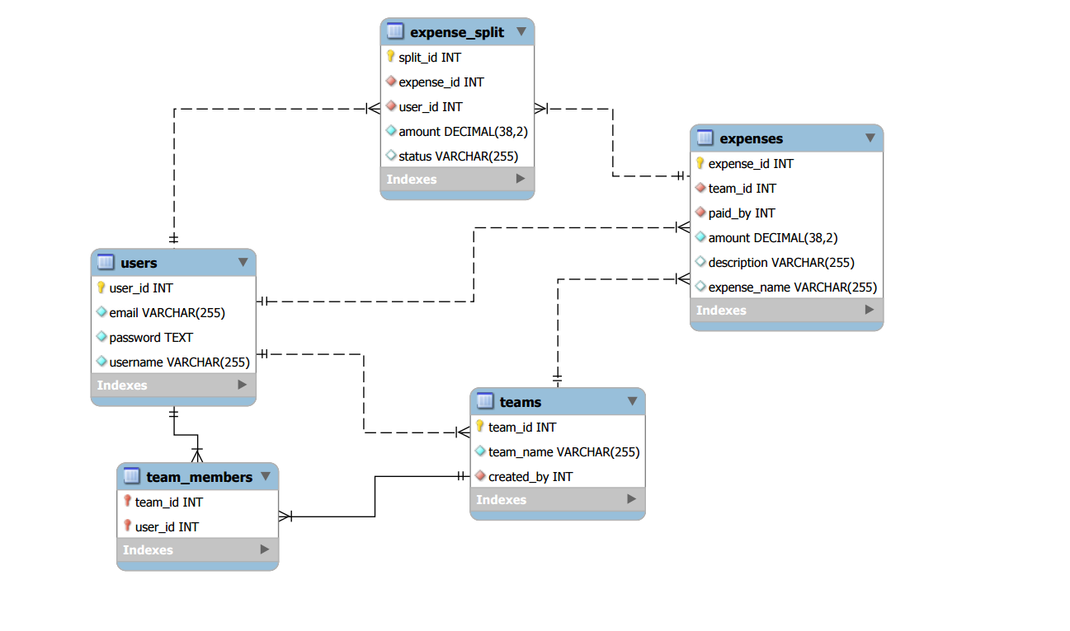
Database Diagram

Slide 8
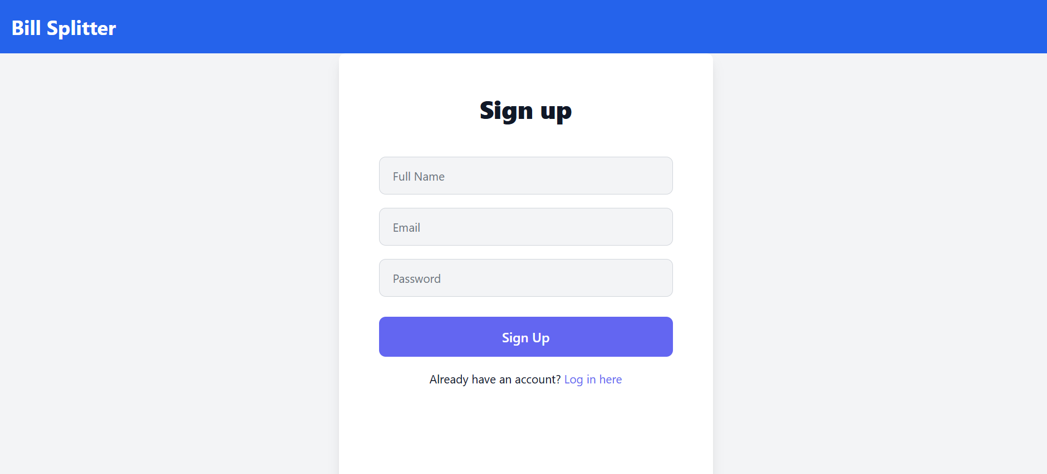
Sign Up

Slide 9
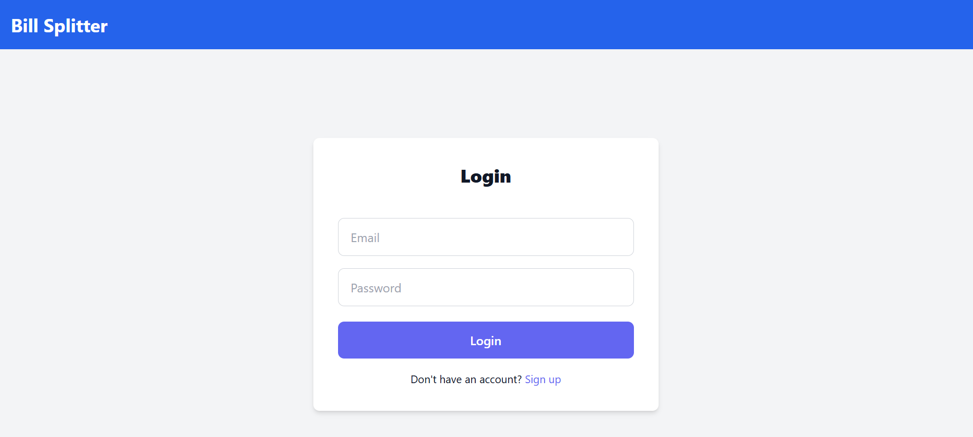
Login Page
.

Slide 10
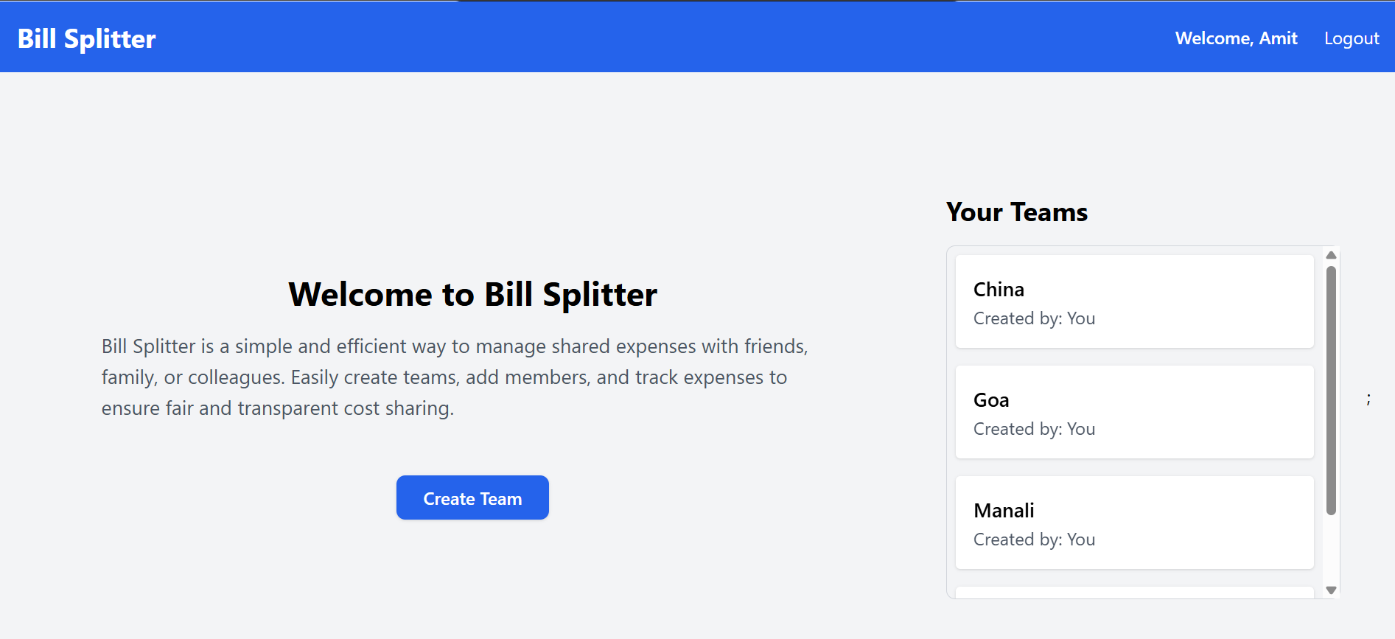
Dashboard

Slide 11
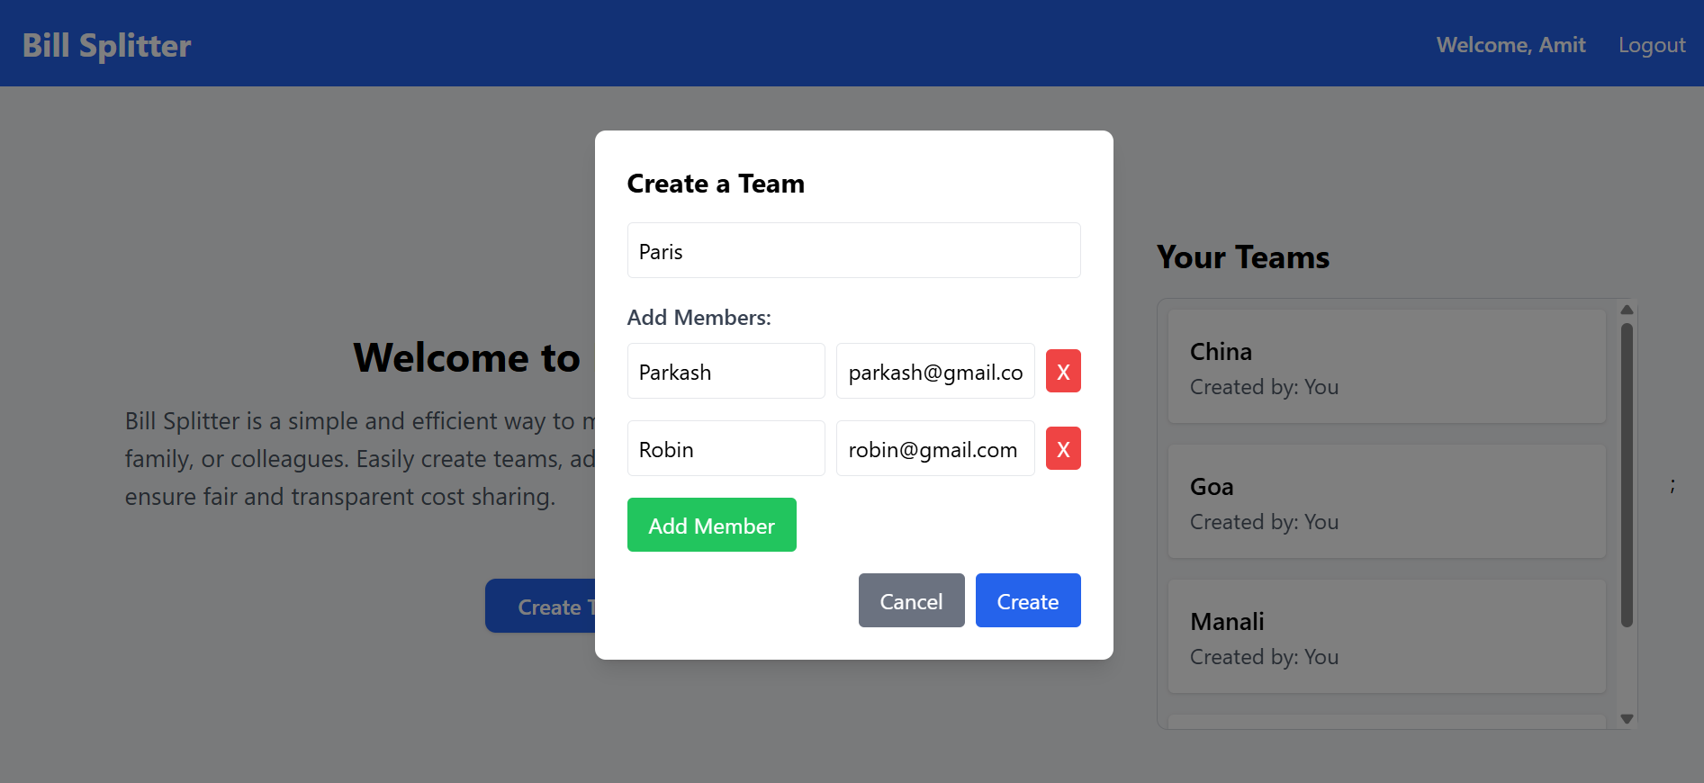
Create Team

Slide 12
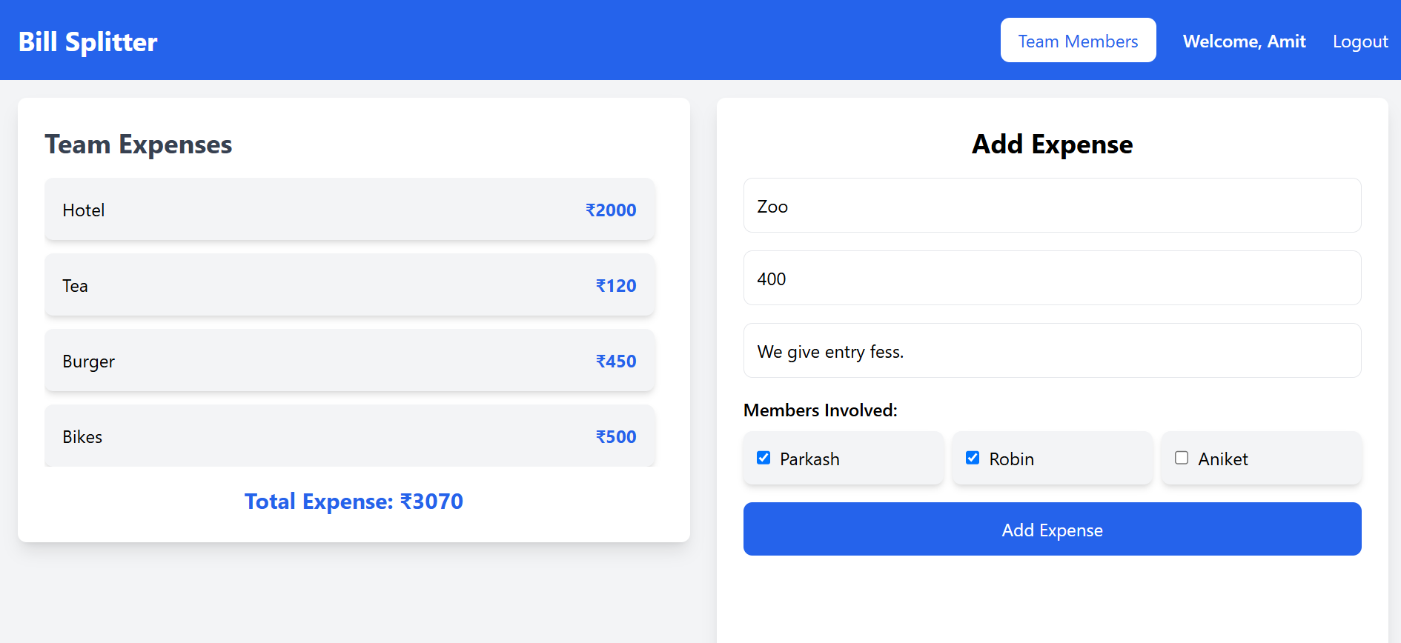
Add Expense

Slide 13
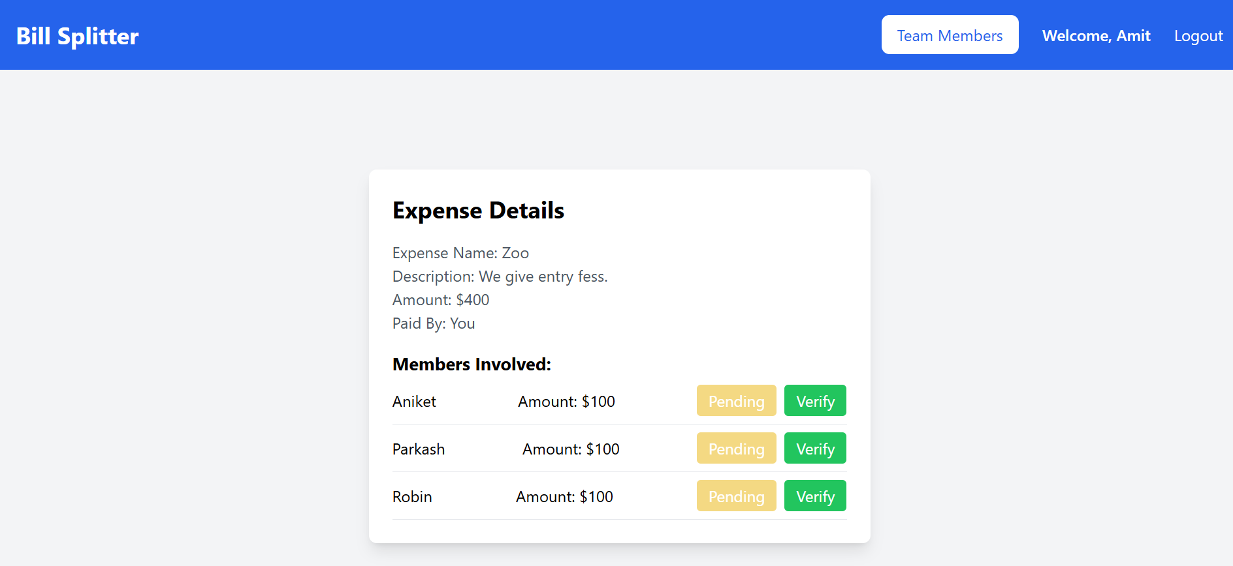
Expense Details

Slide 14
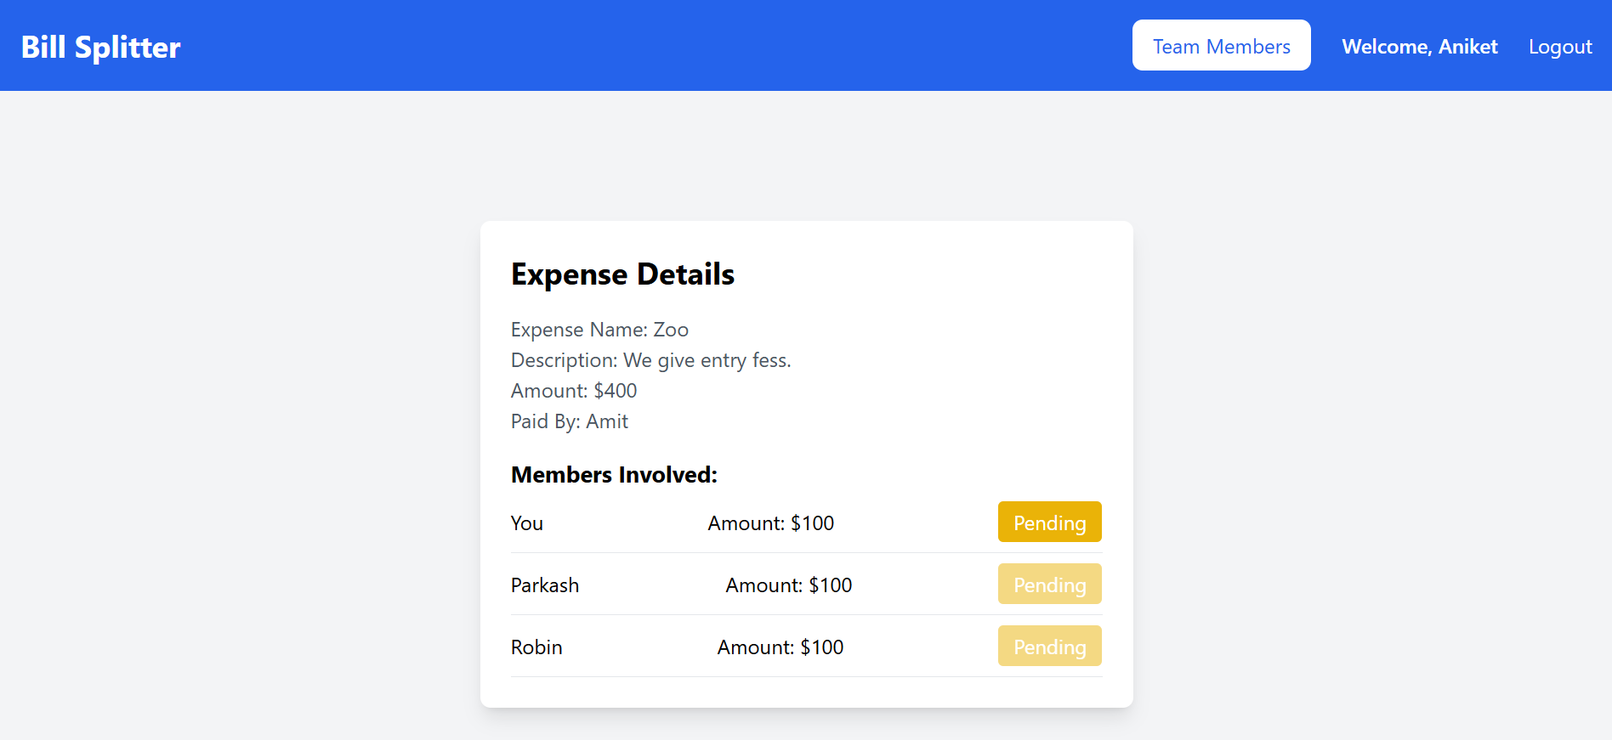

Slide 15
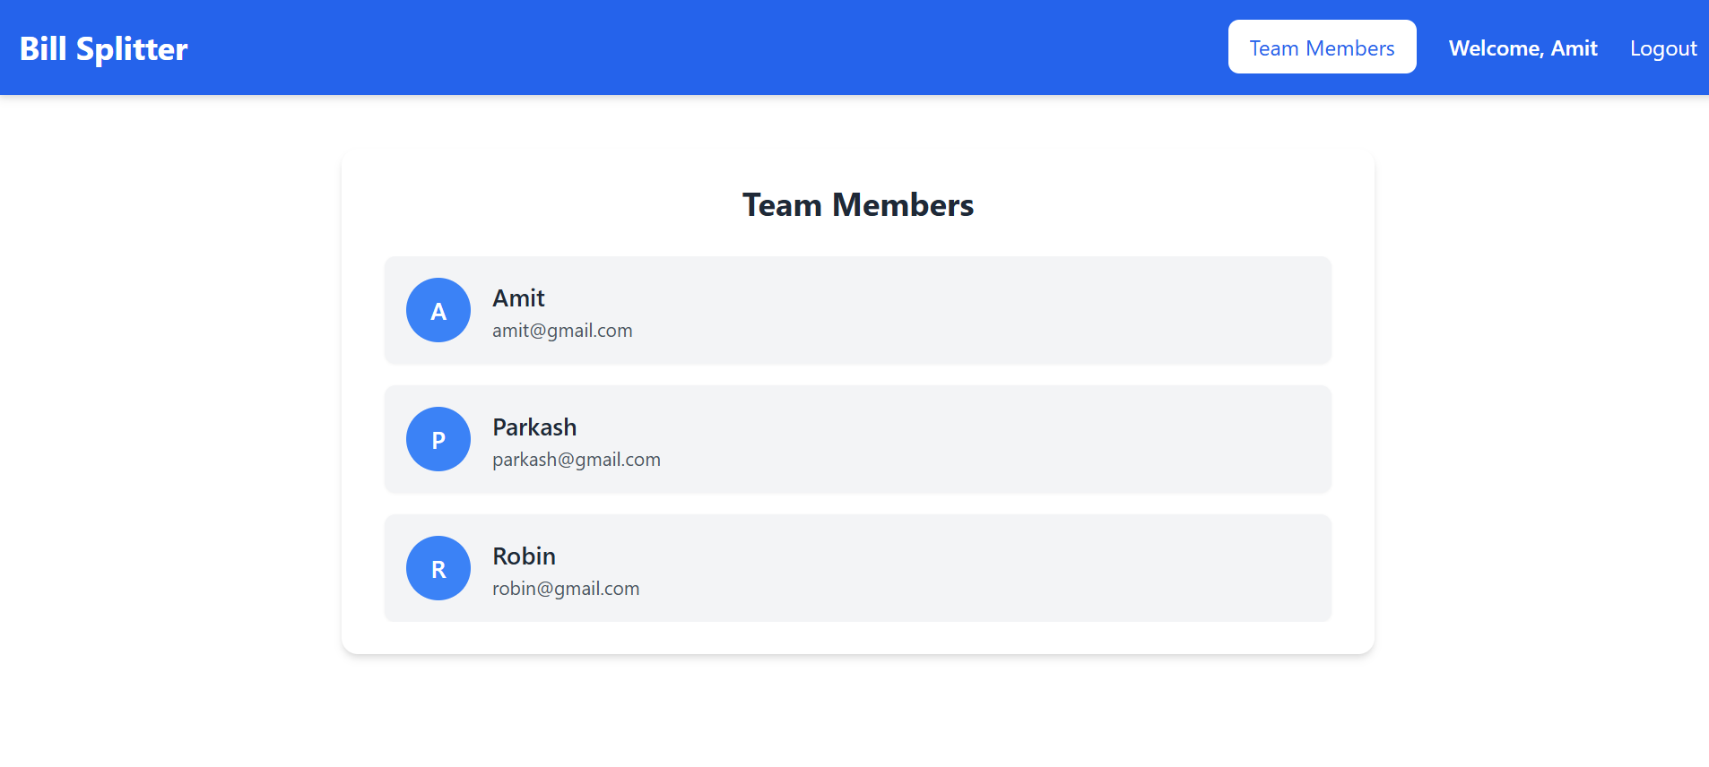
Team Members

Slide 16
Thank You

