Slide 1
Micro Credit Defaulter Model

Slide 2
Problem Statement
The telecommunication company is providing micro loan credit to their customers with primary focus on low income families.
In this use case there are multiple customers which taken loan and paid the loan amount and some defaulted on loan payment
This use case will help telecom industry to provide the loan to which type of customers.

Slide 3
Dataset
Client provided dataset.
Number of data rows : 209593
Columns:label,msisdn,aon,daily_decr30,daily_decr90,rental30,rental90,last_rech_date_ma,last_rech_date_da,last_rech_amt_ma,cnt_ma_rech30,fr_ma_rech30,sumamnt_ma_rech30,medianamnt_ma_rech30,medianmarechprebal30,cnt_ma_rech90,fr_ma_rech90,sumamnt_ma_rech90,medianamnt_ma_rech90,medianmarechprebal90,cnt_da_rech30,fr_da_rech30,cnt_da_rech90,fr_da_rech90,cnt_loans30,amnt_loans30,maxamnt_loans30,medianamnt_loans30,cnt_loans90,amnt_loans90,maxamnt_loans90,medianamnt_loans90,payback30,payback90,pcircle,pdate.

Slide 4
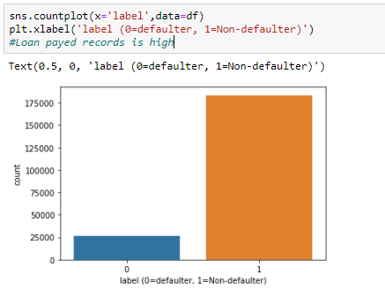
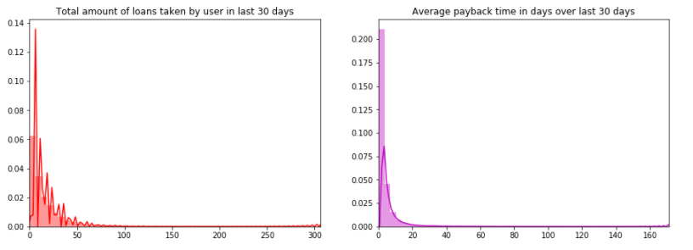
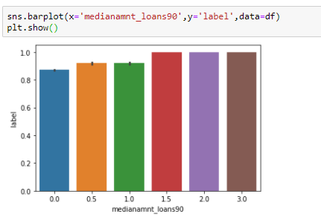
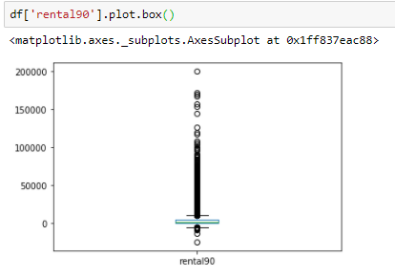
EDA

Slide 5
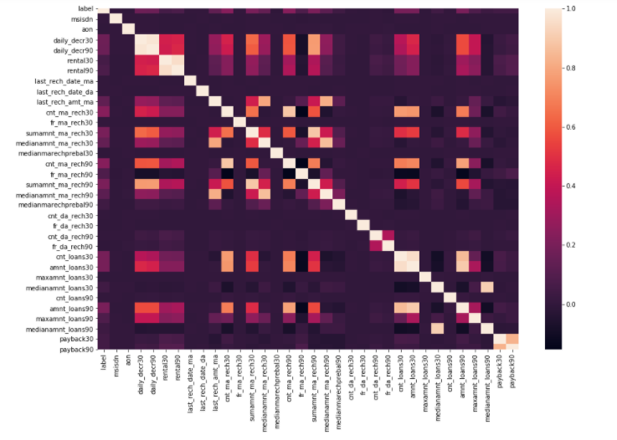
Attribute’s Correlation
The heatmap shows relation between attributes.
The attributes which are correlated are :
Customer spending Daily amount in last 30 days , spending average main account balance in last 30 days, Frequency of recharge for data account & main account in 30/90 days, loan taken in last 90 days & payback time for last 30 days.

Slide 6
Model building
The classification algorithms used for the training and testing this dataset.
Logistic Regression
Random Forest Classifier
K-Neighbors Classifier
Decision Tree Classifier
Gaussian NB

Slide 7
Key Findings and Conclusions of the Study
Removing unwanted column like msisdn number, telecom circle and date column.
As per dataset statistical analysis there is difference between the 75th percentile and max so this is an indication of the outliers in the dataset.
In this data set there are negative values which are from the total amount, age which can’t be negative.

Slide 8
Thank You

