Slide 1

Introduction to
The x86 Microprocessor
Prof. V. Kamakoti
Digital Circuits And VLSI Laboratory
Indian Institute of Technology, Madras
Chennai - 600 036.
http://vlsi.cs.iitm.ernet.in

Slide 2
Protected Mode
Memory Segmentation and Privilege Levels
    Definition of a segment
    Segment selectors
    Local Descriptor Tables
    Segment Aliasing, Overlapping
    Privilege protection
    Defining Privilege Levels
    Changing Privilege levels

Slide 3
Organization
Basic Introduction
  Structured Computer Organization
Memory Management
  Architectural Support to Operating Systems and users
Process Management
  Architectural Support to Operating Systems
    Task Switching and Interrupt/Exception Handling
Legacy Management
  Instruction set compatibility across evolving processor Architectures
  Evolution of Instruction Sets – MMX Instructions

Slide 4
Intel Processor operation modes
Intel processor runs in five modes of operations
  Real Mode
  Protected Mode
  Virtual 8086 mode
  IA 32e – Extended Memory model for 64-bits
    Compatibility mode – execute 32 bit code in 64-bit mode without recompilation. No access to 64-bit address space
    64-bit mode – 64-bit OS accessing 64-bit address space and 64-bit registers
  System Management mode
Real mode is equivalent to 8086 mode of operation with some extensions
Protected Mode is what is commonly used
Virtual 8086 mode is used to run 8086 compatible programs concurrently with other protected mode programs

Slide 5
Compilers ask
for features from the
Architecture to
induce more sophistication
in the Programming Languages
Structured Computer Organization
Programming Language level
Compiled code/ Assembly code
Advanced Addressing modes
Sophisticated Instruction set
Assembly Language level
Support for Memory Management
and Task Management
Multiuser OS - Protection, Virtual
Memory, Context Switching
Operating Systems level
Understanding
How I manage
these demands makes my
biography
interesting
Microprogramming level
Computer
Architecture
Intel
Digital Logic level

Slide 6
Memory Management
Ensured by
Segmentation
Multi User Operating Systems
  Ease of Programming
  Process Mobility in the Address Space
  Multiprocess Context switching
  Protection across Processes
    Intra process protection: Separation of Code, Data and Stack
    Inter process protection
Virtual Memory
  4GB address space for every process
Ensured by
Paging

Slide 7
Main Memory
if (j>k)
max = j
else
max = k
Code_Segment:
mov EAX, [0]
mov EBX, [4]
cmp EAX,EBX
jle 0x7 //Label_1
mov [8], EAX
jmp 0x5 //Label_2
Label_1: mov [8], EBX
Label_2: ….
0000
Code and Data
segments are separate
and both assumed
to start from 0
Operating System
(Kernel)
0700
Other User
Process
Every Memory Data
Access should add
the value stored in
Data Segment Register
By default.
0900
Our Code
Segment
Segment Register (Data)
1900
Data Segment:
0: // Allocated for j
4: // Allocated for k
8: // Allocated for max
2100
Vacant
Space
2100
Address of j: 2100
Address of k: 2104
Address of max: 2108
Our Data
Segment
2300
Vacant
Space
Ease Of Programming
2500

Slide 8
Main Memory
if (j>k)
max = j
else
max = k
Code_Segment:
mov EAX, [0]
mov EBX, [4]
cmp EAX,EBX
jle 0x7 //Label_1
mov [8], EAX
jmp 0x5 //Label_2
Label_1: mov [8], EBX
Label_2: ….
0000
Operating System
(Kernel)
0700
Other User
Process
A new process needs a
segment of size 260
The space is available
but not contiguous
0900
Our Code
Segment
Segment Register (Data)
1900
Data Segment:
0: // Allocated for j
4: // Allocated for k
8: // Allocated for max
2100
Vacant
Space
2300
New User
Process
2100
Address of j: 2100
Address of k: 2104
Address of max: 2108
Address of j: 2300
Address of k: 2304
Address of max: 2308
Our Data
Segment
Vacant
Space
2160
Vacant Space
2300
Vacant
Space
Our Data
Segment
Process Mobility
2500

Slide 9
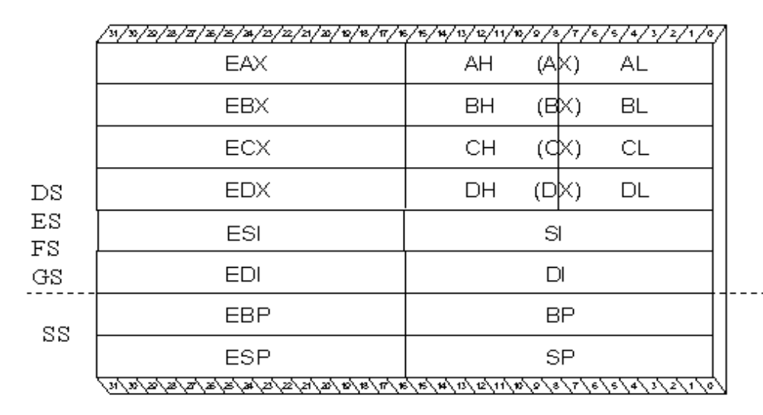
General Purpose Registers

Slide 10
64-bit and above Registers
RAX, RBX, RCX, RDX, RSI, RSP, RDI, RBP – 64 bit General purpose registers sharing space with its corresponding 32-bit registers
R8-R15, additional general purpose registers
  R8D – R15D (32 bit counter part)
  R8W – R15W (16 bit counter part)
ST0-ST7, 80 bit floating point
MMX0-MMX7, 64-bit multi media
XMM0-XMM7, 128-bit registers – used for floating point and packed integer arithmetic

Slide 11
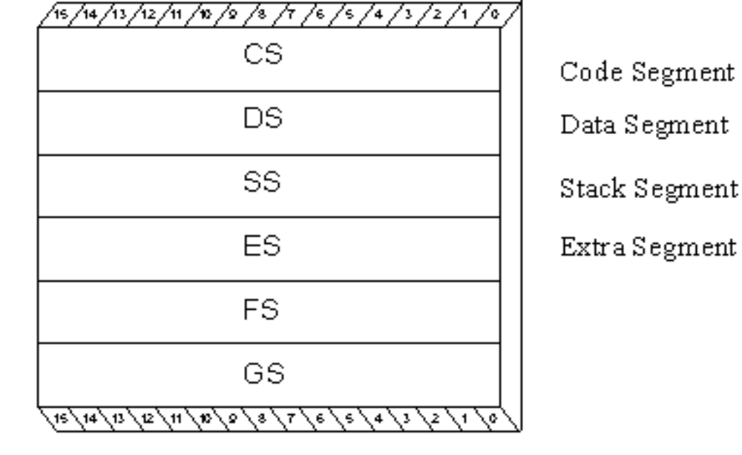
Segment Registers

Slide 12
Multiple Segments
The segment register can change its values to point to different segments at different times.
X86 architecture provides additional segment registers to access multi data segments at the same time.
  DS, ES, FS and GS
X86 supports a separate Stack Segment Register (SS) and a Code segment Register (CS) in addition.
By default a segment register is fixed for every instruction, for all the memory access performed by it. For eg. all data accessed by MOV instruction take DS as the default segment register.
An segment override prefix is attached to an instruction to change the segment register it uses for memory data access.

Slide 13
0000
mov [10], eax
- this will move the contents of eax register to memory location 0510
Opcode: 0x89 0x05 0x10
mov [ES:10], eax
this will move the contents of eax register to memory location 3510
Opcode
0x26 0x89 0x05 0x10
“0x26” is the segment override prefix.
DS
0500
CS
1500
SS
2500
3500
ES
Multiple Segments

Slide 14
Process 1
CS
CS
Process 1
DS
Process 1 in Execution
DS
Process 2
CS
Process 2
SS
SS
Process 2
DS
Process 2
in
Execution
Process 1
SS
Multiprocess Context switching

Slide 15
Other Registers
EFLAGS – 32 Bit Register
VM
RF
NT
IO
IO
OF
DF
IF
TF
SF
ZF
AF
PF
CF
PL
PL
Bits 1,3,5,15,22-31 are RESERVED.
18: AC, 19:VIF, 20: VIP, 21:ID

Slide 16
Details of the flags
CF – Carry Flag
  Set by arithmetic instructions that generate a carry or borrow. Also can be set, inverted and cleared with the STC, CLC or CMC instructions respectively.
PF – Parity Flag
  Set by most instructions if the least significant eight bits of the destination operand contain an even number of 1 bits.

Slide 17
Details of the flags
AF – Auxiliary Flag
  If a carry or borrow from the most significant nibble of the least significant byte – Aids BCD arithmetic
ZF – Zero Flag
  Set by most instructions if the result of the arithmetic operation is zero

Slide 18
Details of the flags
SF – Sign Flag
  On signed operands, this tells whether the result is positive or negative
TF – Trace Flag
  On being set it allows single-step through programs. Executes exactly one instruction and generates an internal exception 1 (debug fault)

Slide 19
Details of the flags
IF – Interrupt Flag
  When set, the processor recognizes the external hardware interrupts on INTR pin. On clearing, anyway has not effect on NMI (external non maskable interrupt) pin or internally generated faults, exceptions, traps etc. This flag can be set and cleared using the STI and CLI instructions respectively
DF – Direction Flag
  Specifically for string instructions. DF = 1 increments ESI and EDI, while DF = 0 decrements the same. Set and cleared by STD and CLD instructions

Slide 20
Details of the flags
OF – Overflow Flag
  Most arithmetic instructions set this flag to indicate that the result was at least 1 bit too large to fit in the destination
IOPL – Input Output Privilege Level flags
  For protected mode operations – indicates the privilege level, 0 to 3, at which your code must be running in order to execute any I/O-related instructions

Slide 21
Details of the flags
NT – Nested Task Flag
  When set, it indicates that one system task has invoked another through a CALL instruction as opposed to a JMP. For multitasking this can be manipulated to our advantage
RF – Resume Flag
  It is related to Debug registers DR6 and DR7. By setting this, you can selectively mask some exceptions while you are debugging code

Slide 22
Details of the flags
VM – Virtual 8086 mode flag
  When it is set, the x86 processor is basically converted into a high-speed 8086 processor.
AC (bit 18) Alignment check flag — Set this flag and the AM bit in the CR0 register to
  enable alignment checking of memory references; clear the AC flag and/or the
  AM bit to disable alignment checking.
VIF (bit 19) Virtual interrupt flag — Virtual image of the IF flag. Used in conjunction
  with the VIP flag. (To use this flag and the VIP flag the virtual mode extensions
  are enabled by setting the VME flag in control register CR4.)

Slide 23
Details of the flags
VIP (bit 20) Virtual interrupt pending flag — Set to indicate that an interrupt is pending;
  clear when no interrupt is pending. (Software sets and clears this flag; the
  processor only reads it.) Used in conjunction with the VIF flag.
ID (bit 21) Identification flag — The ability of a program to set or clear this flag indicates
  support for the CPUID instruction.

Slide 24
Protected Mode Registers
LDTR – Local Descriptor Table Register – 16 bits
GDTR – Global Descriptor Table Register – 48 bits
IDTR – Interrupt Descriptor Table Register – 48 bits
TR – Task register – 16 bits

Slide 25
Other System Registers
Control – CR0, CR2, CR3 (each 32-bits)
  CR0 is very important
    Bit 0 – PE bit – when set processor in protected mode else real mode
    Bit 3 – TS bit – The processor sets this bit automatically every time it performs a task switch. This can be cleared using a CLTS instruction
    Bit 31 – PG bit – when set paging MMU is enabled else it is disabled

Slide 26
Other System Registers
Control – CR0, CR2, CR3 (each 32-bits)
  CR2 – Read only register – deposits the last 32-bit linear address that caused a page-fault
  CR3 – Stores the physical address of the PDB – Page Directory Base register. The paging tables are to be 4KB aligned and hence the 12 least significant bits are not stored and ignored

Slide 27
Other System Registers
Debug Registers
  DR0, DR1, DR2, DR3, DR6, DR7
  DR0-DR3 can hold four linear address breakpoints so that of the processor generates these addresses a debug exception (Interrupt 1) is caused
  DR6 – Debug status register indicating the circumstances that may have caused the last debug fault
  DR7 – Debug control register. By filling in the various fields of this register, you can control the operation of the four linear address breakpoints

Slide 28
Other System Registers
Test Registers – TR6 and TR7
  Used to perform confidence checking on the paging MMU’s Translation Lookaside Buffer (TLB).

Slide 29
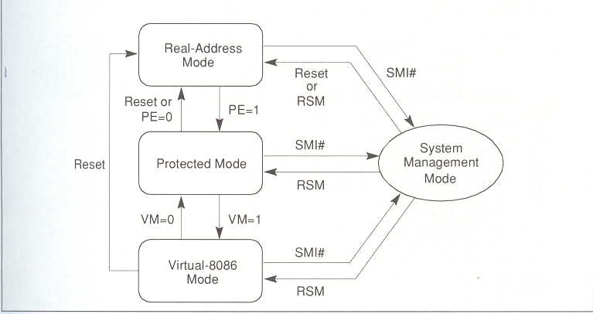

Slide 30
Test Your Understanding
There are ------- GPRs in the x86
The x86 system in protected mode has -------- enabled by default
Three salient features of using Segmentation

Slide 31
Answers
1. Eight GPRs
2. Segmentation
3. Three Features
  Code Mobility
  Logically every segment can start with zero
  Inter and Intra process protection ensuring data integrity.

Slide 32
Learnt so far
  Intel Memory Management fundamentals
    Motivation from a Computer Organization standpoint
    Intel Register set – General Purpose Registers, Segment registers and system registers
    x86 modes of operations

Slide 33
x86 Memory Management
To Learn
  Real and protected mode addressing in x86
  Virtual Memory and paging
  Addressing
  Task switching and Interrupt handling
  Legacy issues

Slide 34
Real Mode - Memory Addressing
Segment << 4 + offset = 20 bit EA
Segment size is a fixed 64K
DS = 0x1004
mov [0x1000], EAX
The mov will store the content of EAX in
0x10040 + 0x1000 = 0x11040
Why this stuff? - To get 1 MB addressing using 16-bit Segment Registers

Slide 35
Protected Mode Addressing
mov [DS:1000], EAX
Let value of DS be 0x10. This is used to select a segment descriptor in a descriptor table.
The segment descriptor contains information about the base address of the segment, to which 1000 is added to get the effective address.
The value stored in DS is called a selector.
Henceforth we discuss protected mode.

Slide 36
Protected Mode Addressing
Logical Address
SELECTOR
OFFSET
Descriptor Table
Segment Descriptor
Base Address
Linear Address

Slide 37
A process always executes from Code segment. It should not execute by accessing from adjoining Data or stack area or any other code area too.
A stack should not overgrow into adjoining segments
CS
500
Every segment is specified a start address and limit.
Architecture checks if limit is not exceeded.
1000
ES
1500
SS
2000
jmp CS:250 //This is fine
jmp CS:501 //This is a violation as limit is 500
mov [ES:498], AX //This is fine
mov [ES:498], EAX //This is a violation!!!
PUSH AX //Let SP be 498, it is fine
PUSH EAX //Let SP be 498, violation
POP AX //Let SP be 2, it is fine
POP EAX //Let SP be 2, Violation!!!
Intra and Inter process Protection

Slide 38
Process 1 should be prevented from loading CS, such that it can access the code of Process 2
Similarly for the DS,SS, ES, FS and GS
Privilege levels: [0-3] assigned to each segment.
0: Highest privilege
3: Lowest privilege
Process 1
CS
CS
Process 1
DS
DS
Process 2
CS
Process 2
SS
SS
Process 2
DS
Process 1
SS
Interprocess Protection

Slide 39
Privilege levels and Protection
Every segment has an associated privilege level and hence any code segment will have an associated privilege level.
The CPL (Current Privilege Level) of a process is the privilege level of the code segment, the code stored in which, it is executing.
A process can access segments that have privilege levels numerically greater than or equal to (less privileged than) its CPL.

Slide 40
Protection Implementation
Every segment is associated with a descriptor stored in a descriptor table.
The privilege level of any segment is stored in its descriptor.
The descriptor table is maintained in memory and the starting location of the table is pointed to by a Descriptor Table Register (DTR).
The segment register stores an offset into this table.

Slide 41
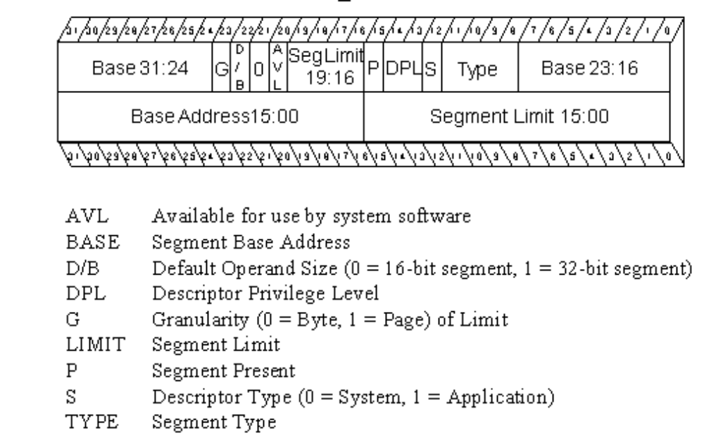
Structure of a Descriptor

Slide 42
Updating Segment registers
Segment registers (DS, ES, SS, GS and FS) are updated by normal MOV instructions.
  MOV AX, 0x10 ; MOV DS, AX
The above command is successful if and only if the descriptor stored at the offset 0x10 in the descriptor table has a privilege level numerically greater than or equal to the CPL.
A process with CPL = 3 cannot load the segment descriptor of CPL <= 2, and hence cannot access the segments.

Slide 43
Updating segment registers
The code segment register is updated by normal jump/call operations.
  jmp 0x20:0x1000
  This updates the CS by 0x20, provided the descriptor stored at offset 0x20 has a privilege level numerically greater than or equal to CPL
Other modes of updating CS register
  Numerically higher to lower Privilege Levels using CALL gates – useful for system calls.
  Any privilege level to any other privilege level using task switch.

Slide 44
Descriptor Tables
There are two descriptor tables
  Global Descriptor Tables
  Local Descriptor Tables
The global descriptor table’s base address is stored in GDTR
The local descriptor table’s base address is stored in LDTR
The two privileged instructions LGDT and LLDT loads the GDTR and LDTR.

Slide 45
Structure of a Selector
15
2
0
Index
T1
T1 = 0 GDT
= 1 LDT
Since segment descriptors are each 8 bytes, the last three bits of the selector is zero, in which one of them is used for LDT/GDT access.

Slide 46
Two process each of PL = 3 should be allotted segments such that one should not access the segments of other.
GDTR
GDT
All descriptors in GDT have
PL = 0,1,2
LDTR
LDTR
Per process
Per process
If at all each process should access memory, it has to use the descriptors in its LDTR only and it cannot change the LDTR/LDT/GDTR/GDT contents as they would be maintained in a higher privileged memory area.

Slide 47
Did You Note!!
There is an 100 % degradation in Memory access time – because every memory access is two accesses now, one for getting the base address and another for actually accessing the data.
A solution indeed: Along with the segment registers, keep a shadow registers which stores additional necessary information.

Slide 48
Visible part
Hidden part
Segment selector
Base Address, Limit, DPL.
CS
SS
DS
ES
FS
GS

Slide 49
Be Careful
add [DS:20],eax
Logical Address
0x10
20
Linear address will still be 120
Have to execute
mov DS,0x10 again to get the answer as 220, as this would update the hidden part
Descriptor Table
Base = 200
Base Address
Base = 100
Linear Address
120
Changing Base

Slide 50
Virtual Memory and Paging
It is always enough if the next instruction to be executed and the data needed to execute the same are available in the memory.
The complete code and data segment need not be available.
Use of paging to realize the stuff!
By using segmentation the processor calculates an 32-bit effective address.

Slide 51
Paging fundamentals
Each page is 4096 bytes
Physical RAM has page frames like photo frames, which is also 4096 bytes.
A page is copied into the page frame, if needed and removed to accommodate some other page.
By this, a 4 GB code can run on a 128MB physical memory
This is also called demand paging.

Slide 52
Protected Mode Addressing with paging
10
10
12
DIR
TABLE
OFFSET
PAGE FRAME
PAGE DIRECTORY
PAGE TABLE
PHYS ADDRS
4KB entries with 4 bytes per entry
4KB entries with 4 bytes per entry
PG TBL ENTRY
DIR ENTRY
If 20 bytes are used as a single level paging then page table alone is 4 MB which is inefficient. So two level paging.
Develop the page table on demand
TLB’s used to improve performance
Dirty bit accommodated in each page entry
CR3 REG

Slide 53
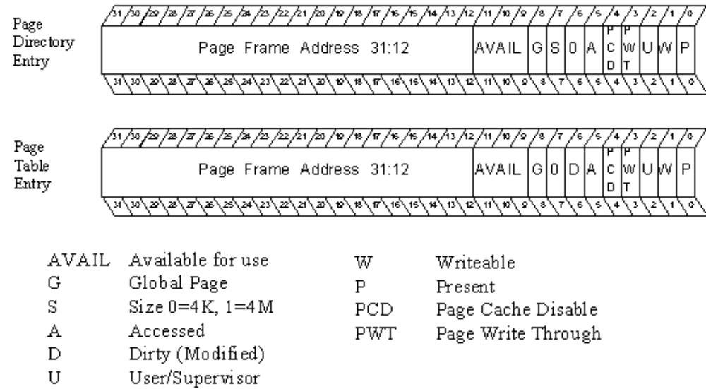
Protected Mode Addressing - Paging entries

Slide 54
Task Switching
There are different types of descriptors in a Descriptor table.
One of them is a task state segment descriptor.
jmp 0x10:<don’t’care> and that 0x10 points to a TGD, then the current process context is saved and the new process pointed out by the task state segment descriptor is loaded.
A perfect context switch.
TSS descriptor only in a GDT.

Slide 55
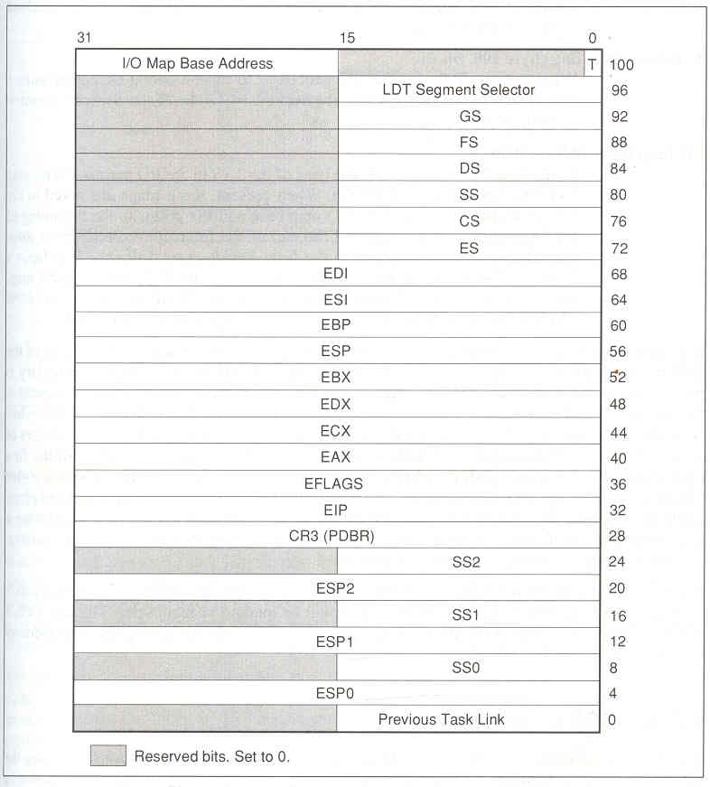
Task State Segment

Slide 56
Task Switching
Every process has an associated Task State Segment, whose starting point is stored in the Task register.
A task switch happens due to a jmp or call instruction whose segment selector points to a Task state segment descriptor, which in turn points to the base of a new task state segment

Slide 57
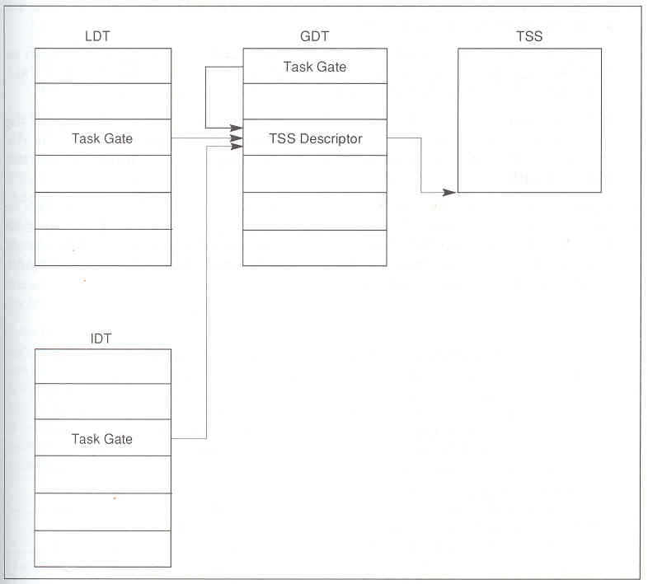
Task Switching process

Slide 58
Interrupt Handling
Processor generates interrupts that index into a Interrupt Descriptor Table, whose base is stored in IDTR and loaded using the privileged instruction LIDT.
The descriptors in IDT can be
  Interrupt gate: ISR handled as a normal call subroutine – uses the interrupted processor stack to save EIP,CS, (SS, ESP in case of stack switch – new stack got from TSS).
  Task gate: ISR handled as a task switch
    Needed for stack fault in CPL = 0 and double faults.

Slide 59
Interrupt Handling
Processor handles a total of 255 interrupts
0-31 are used by machine or reserved
32-255 are user definable
0 – Divide error, goes to first descriptor in IDT
1 – Debug
8 – Double Fault
12 – Stack Segment fault
13 – General Protection Fault
14 – Page Fault

Slide 60
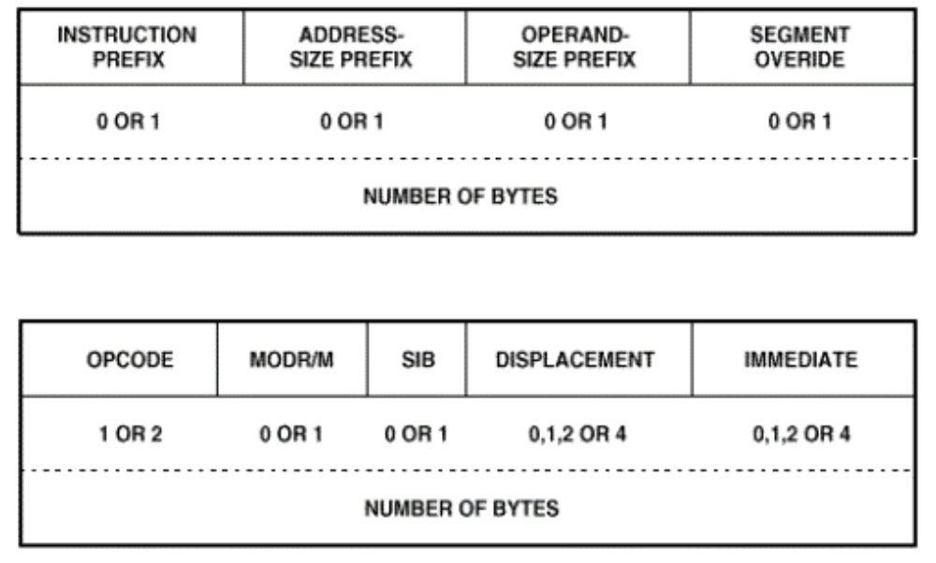
Instruction Set Architecture

Slide 61
Legacy Issues
16-bit code in 32-bit architecture
Address override prefix – 16-bit or 32-bit addresses in a 32-bit or 16-bit code segment
Operand override prefix
  Same opcode for say, add EAX,EBX and add AX,BX
  Distinguished by the operand override prefix – 16-bit or 32-bit operands in a 32-bit ot 16-bit code segment
D flag in the code segment descriptor tells the size of the code segment, which is used above.

Slide 62
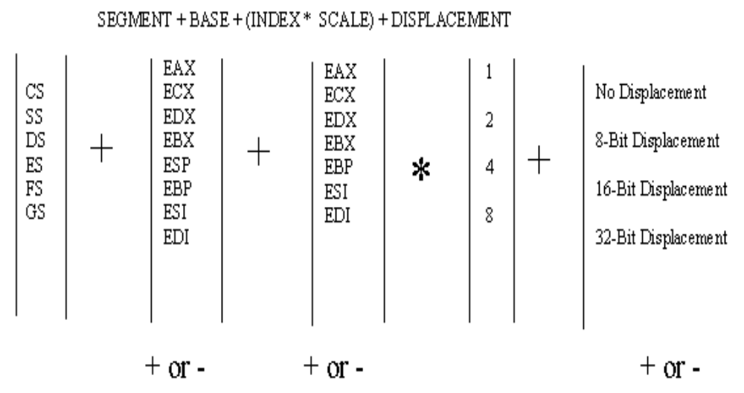
Effective Address Calculation

Slide 63
Legacy Issues
mod r/m: says if it is a memory or register access
sib: says if it is memory then what addressing is issued for effective address calculation.

Slide 64
Evolving Instruction Sets
The Multimedia Instruction set (MMX)
First Major Extension to x86 since 1985
57 new instructions
  Audio
  Video
  Speech Recognition and synthesis
  Data communication
Two byte Opcode with 0F prefix
Use of Data parallelism at the instruction opcode level to speedup computation.

Slide 65
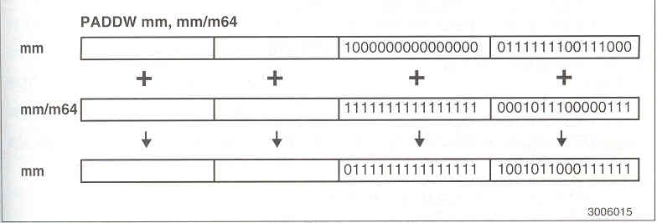

Slide 66
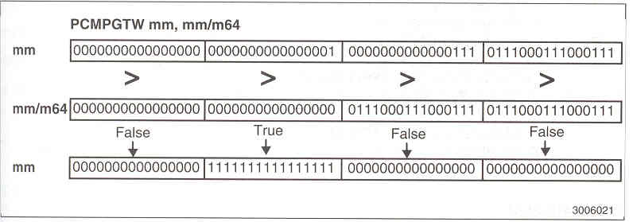

Slide 67
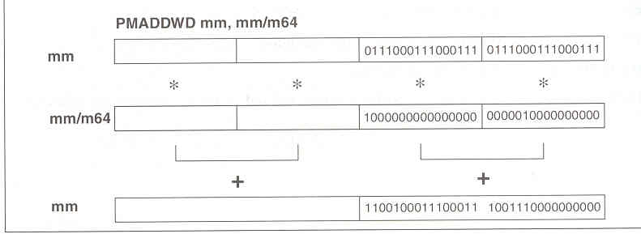

Slide 69
x86 Memory Management
To learn
  Segmentation details
  Privilege levels and switching

Slide 70
Memory Segmentation
Segment Descriptors
  80886 to 80386+
    In 8086, the program is not expected to generate a non-existent memory address. If it does, then the processor shall try to access the same and read bogus data, or crash
    In 80386+ (and above) the segment attributes (base, limit, privilege etc) are programmable and no matter how privileged the code may be, it cannot access an area of memory unless that area is described to it.

Slide 71
Insight into 80386+ segments
Segments are
  Areas of memory
  Defined by the programmer
  Used for different purposes, such as code, data and stack
Segments are not
  All the same size
  Necessarily paragraph aligned
  Limited to 64KB

Slide 72
Segment Descriptors
Describes a segment using 64-bits (0-63)
Must be created for every segment
Is created by the programmer
Determines a segment’s base address (32-bits) (Bits 16-39, 56-63)
Determines a segment’s size (20-bits) (Bits 0-15, 48-51)

Slide 73
Segment Descriptors (Cont’d)
Defines whether a segment is a system segment (=0) or non-system (=1) (code, data or stack) segment (System bit) (Bit 44)
Determines a segment’s use/type (3-bits) (Bits 41-43) after the above classification
Determines a segment’s privilege level (2 bits) (Bits 45-46) – DPL (Descriptor Privilege Level) Bits

Slide 74
Segment Descriptor (Cont’d)
Accessed (A)-bit: Bit 40, automatically set and not cleared by the processor when a memory reference is made to the segment described by this descriptor.
Present (P)-bit: Bit 47, indicates whether the segment described by this descriptor is currently available in physical memory or not.
Bits 40-47 of the descriptor is called the Access Right Byte of the descriptor.
User (U)-bit and X bit: Bit 52 (U-bit) not used and Bit 53 (X-bit) reserved by Intel

Slide 75
Segment Descriptor (Cont’d)
Default size (D)-bit: Bit 54, when this bit is cleared, operands contained within this segment are assumed to be 16 bits in size. When it is set, operands are assumed to be 32-bits.
Granularity (G)-bit: Bit 55, when this bit is cleared the 20-bit limit field is assumed to be measured in units of 1byte. If it is set, the limit field is in units of 4096 bytes.

Slide 76
Types of non-system segment descriptors
System bit S = 1
  000 – Data, Read only
  001 – Data, Read/Write
  010 – expand down, Read only
  011 – expand down, Read/Write
  100 – Code, Execute only
  101 – Code, Execute/Read
  110 – Conforming Code, Execute only
  111 - Conforming Code, Execute/Read

Slide 77
D-bit for different descriptors
Code segment
  D = 0 then 16-bit 80286 code
  D = 1 then 32-bit 80386+ code
Stack Segment
  D = 0 then stack operations are 16-bit wide, SP is used as a stack pointer, maximum stack size is FFFF (64 KB)
  D = 1 then stack operations are 32-bit wide, ESP is used as a stack pointer, maximum stack size is FFFFFFFF (4 GB)

Slide 78
G-bit for descriptors
  G = 0 then a limit field in descriptor of value p indicates we can access p-1 bytes from base
  G = 1 then a limit field in descriptor of value p indicates we can access (p * 4096) - 1 bytes from base

Slide 79
Stack/expand down segments
All offsets must be greater than limit.
In stack descriptor, D and G bits are to be the same, else contradiction.
Addressable area
FFFF
FFFF
Limit
Limit
Addressable area
Base
Non-stack
Base
Stack/expand-down

Slide 80
Descriptor Tables
Descriptors are stored in three tables:
  Global descriptor table (GDT)
    Maintains a list of most segments
    May contain special “system” descriptors
    The first descriptor is a null descriptor
  Interrupt descriptor table (IDT)
    Maintains a list of interrupt service routines
  Local descriptor table (LDT)
    Is optional
    Extends range of GDT
    Is allocated to each task when multitasking is enabled
    The first descriptor is a null descriptor

Slide 81
Locations of the tables
In Memory
Pointed out by GDTR, LDTR and IDTR for the GDT, LDT and IDT respectively.
The GDTR and IDTR are 48-bits in length, the first 16-bits (least significant) storing the size (limit) of the table and the remaining storing a 32-bit address pointing to the base of the tables
Limit = (no. of descriptors * 8) - 1
LLDT stores a 16-bit selector pointing to an entry in the GDT.

Slide 82
Segment Selectors
Out of several segments described in your GDT and LDT, which of the segment(s) that are currently being used are pointed to by the 16-bit CS,DS,ES,FS,GS and SS registers.
Each store a selector
Since descriptors are at 8-byte boundaries, the 16-bit selectors store the first most significant 13 bits to point to the corresponding descriptor.
The bit 2 is the T1 bit, which when 0 (1) implies the selector is pointing to a descriptor in GDT (LDT).
The bits (0-1) – are the Request Privilege Level (RPL) bits used for privilege assignments.

Slide 83
Loading Segment Selectors into segment registers
Whenever segment registers are loaded, the following rules are checked by the processor and if violated an exception is raised thus giving high degree of memory protection
Rule 1: Index field of the selector within limits of the GDT/LDT to be accessed – else raise a General Protection Fault exception.

Slide 84
Loading Segment Selectors into segment registers
Rule 2: Loading a selector into DS,ES,FS or GS that points to a non-readable segment results in an exception
Rule 3: For loading into SS, the segment pointed to should be readable and writable
Rule 4: For loading into CS, the segment should be executable type
Rule 5: Privilege level check rules to be described later

Slide 85
Loading segment selectors
All segment registers except CS may be loaded using MOV, LDS, LES, LFS, LGS and LSS.
The CS is loaded using a JMP or a CALL instruction – discussed later

Slide 86
Local Descriptor Table
Is defined by a system descriptor (S=0) in GDT which is pointed to by the LDT.
The 64-bit descriptor in GDT
Base
Address
31-24
0000
0000010
Base Address
23-0
Limit
15-0
Limit
19-16
P

Slide 87
Privilege levels
The need is to prevent
  Users from interfering with one another
  Users from examining secure data
  Program bugs from damaging other programs
  Program bugs from damaging data
  Malicious attempts to compromise system integrity
  Accidental damage to data

Slide 88
Privilege Protection
Continuous checking by the processor on whether the application is privileged enough to
  Type 1: Execute certain instructions
  Type 2: Reference data other than its own
  Type 3: Transfer control to code other than its own
To manage this every segment has a privilege level called the DPL (Descriptor Privilege Level) Bits 45,46

Slide 89
Descriptor Privilege Level
Privilege levels apply to entire segments
The privilege level is defined in the segment descriptor
The privilege level of the code segment determines the Current Privilege Level (CPL)

Slide 90
Type 1: Privilege Checking
Privileged Instructions
  Segmentation and Protection Based (HLT, CLTS, LGDT, LIDT, LLDT, LTR, moving data to Control, Debug and Test registers)
  Interrupt flag based (CLI, STI, IN, INS, OUT, OUTS)
  Peripheral IO based
First two types of privileged instructions can be executed only when CPL = 0, that is, these instructions can be in code segment with DPL = 0.

Slide 91
I/O instructions
The I/O based privileged instructions are executed only if CPL <= IOPL in EFLAGS register.
To add to the security the POPF/POPFD instructions which load values into the EFLAGS shall not touch the IOPL bit or IF bit if CPL > 0.

Slide 92
Type 2: Privilege Checking
Reference data other than its own
Load a selector into a DS, ES, FS and GS iff max(RPL,CPL) <= DPL
  RPL may weaken your privilege level
  Decreasing RPL will not strengthen your privilege level – Why?
  Why to decrease RPL – will discuss later
Load a descriptor into a stack iff DPL = CPL
All these are in addition to the rules for loading segment selector, that were stated in Slides 87 and 88.

Slide 93
Type 3: Privilege Checking
Transfer control to code other than its own. Essentially load a new selector into CS register
jmp across code segments with same DPL
  jmp <selector>:<offset of instruction from start of the new segment>
  call <selector>:<offset of instruction from start of the new segment>

Slide 94
Type 3: Privilege Checking
The above jmp, call and ret may be used
To move between code segments provided the destination segment is
  A code segment (executable permission)
  Defined with the same privilege level
  Marked present

Slide 95
Changing Privilege levels
Control transfer from a code of some PL to another code with some other different PL.
Using conforming code segments or a special segment descriptor called call gates.
Conforming code segments confirms with the privilege level of the calling code. So if a control transfer happens from segment S to a confirming segment T, the privilege of T would be the privilege of S.

Slide 96
Conforming Code Segment
The DPL of conforming code segment descriptor <= CPL of invoking code.
Therefore, CPL = 2 can invoke DPL = 1.
CPL = 2 cannot invoke code with DPL = 3.
Why?
  If not, you JMP back or RET to the source code segment after executing the conforming code segment. This should permit return from a numerically low privilege code to a numerically high privilege code, without check.

Slide 97
CALL GATE descriptor
Is defined by a system descriptor (S=0) in GDT which is used by the JMP or CALL.
The 64-bit descriptor in GDT
Destination Offset
15-0
Destination offset
31-16
01100
000
WC
Destination Selector (16 bits)
P, DPL
Not only the selector for the target code segment, but also the offset in the code segment from which you should start executing is specified. The source code segment can only use it like a black-box

Slide 98
Calling Higher privileged code
Code Seg
Code Seg
Code Desc
CALL
SEG
OFFSET
CALL
SEG
OFFSET
Gate – Sel + offset
Code Desc
Correct
Incorrect

Slide 99
Call Gates
Are defined like segment descriptors
Occupy a slot in the descriptor tables
Provide the only means to alter the current privilege level
Define entry points to other privilege levels
Must be invoked using a CALL Instruction

Slide 100
Call Gate accessibility
Target DPL <= Max (RPL, CPL) <= Gate DPL
For eg. CPL = 2 and the target PL = 0, you should use a Gate with PL = 2 or 3

Slide 101
Privilege levels and Stacks
The stack PL = CPL always
When changing the CPL, the processor automatically changes the stack!!!
How – using the Task State Segment (TSS)
The base of the TSS is stored in a Task register (TR) which is updated by the privileged instruction LTR
The TSS associates a stack for each code for each of the privilege levels 0, 1 and 2

Slide 102
Task Switching process

