Slide 1
Network Security
By:
Gaurav Kumar
Nishit Majithia
Rohit Sehgal

Slide 2
What is DH? Why it is used?
Diffie-Hellman
Diffie-Hellman key agreement protocol.
Allows two users to exchange a secret key.
Requires no prior secrets.
Real-time over an untrusted network

Slide 3
Application
Diffie-Hellman
Secure Sockets Layer (SSL)/Transport Layer Security (TLS)
Secure Shell (SSH)
Internet Protocol Security (IPSec)

Slide 4
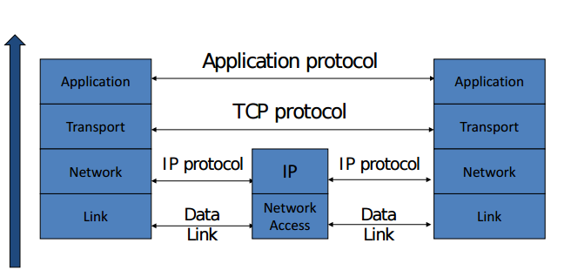
Network Protocol Stack

Slide 5
Basic Layer 2-3 Security Problems
Network packets pass by untrusted hosts
Eavesdropping, packet sniffing
Especially easy when attacker controls a machine close to victim
TCP state can be easy to guess and it enables spoofing and session hijacking

Slide 6
IPSEC
Security extensions for IPv4 and IPv6
IP Authentication Header (AH)
Authentication and integrity of payload and header
IP Encapsulating Security Protocol (ESP)
Confidentiality of payload

Slide 7
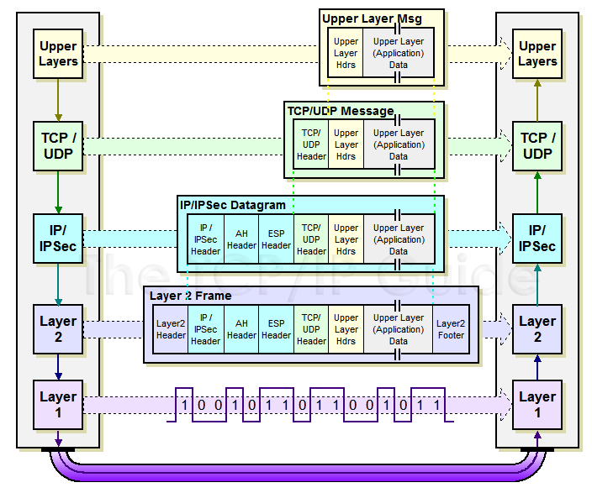
IPSEC

Slide 8
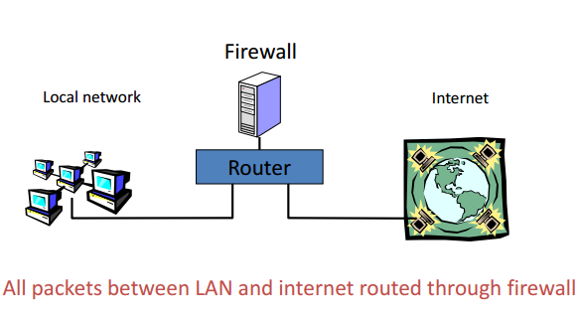
Basic Firewall concept

Slide 9
DNS
Why DNS?
How it works?

Slide 10
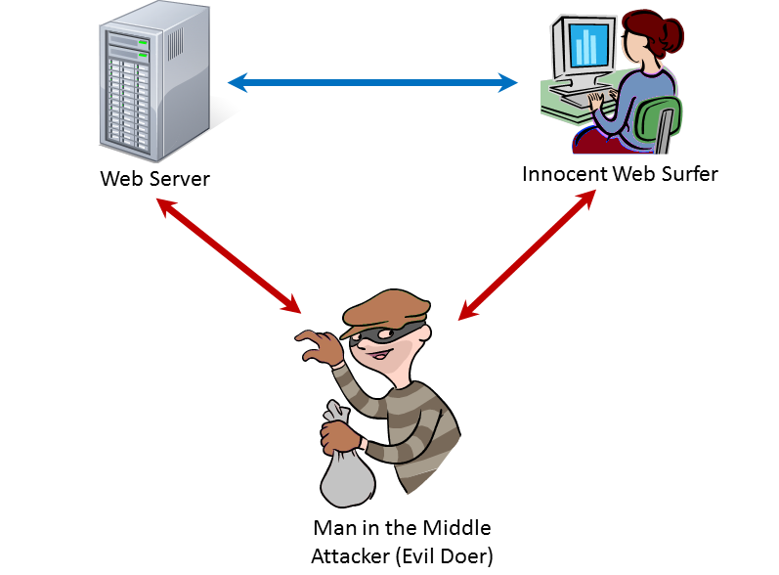
Man-in-Middle

Slide 11
Thank You

