Slide 1

Project
Version 1.0
By Pradip Kumar Saha

Slide 2
Content
Introduction
Business Process Overview
App Process Overview
Architecture
Builder
Builder Login
Procced to Register
Terms and Conditions (To be included)
Register Site
Property Specification
Site Amenities
Customer
Customer login
View Properties
Schedule Appointment
Check Eligibility
Document verification
Nominee/ Guarantor Details
Terms and Conditions
Proceed to Book
Booking Amount Payment

Slide 3
Introduction
This presentation is to develop an app to facilitate the builder to sell the properties and also on the facilitate the common people to buy their own property.
This app is developed keeping in mind that all the users are benefited and no hackle for the builder to sell their properties and the customers will be served all best deal in their finger tips.
The customer can own their own dream house by paying just 30% of face value and rest on rent in every month for the selected tenure. No bank interest no waiting to long process.
The app will be developed for iOS, Android and windows phone.

Slide 4
Business Process Overview
Builder Registration Process: The builder to register in Rent-O-Wn app with all the mentioned details like Builder name, address, contact details, registration number and builders market reputation details as mentioned in the upcoming slides
Site registration details: Builder to insert and update the site details such as the site location map, number of flats, upload the plan, amenities details etc. as mentioned in the upcoming slides
Contract to register: To register with Rent-O-Wn the builder to sign a contract with Rent-O-Wn and with a deposit of 1million ₹
Buyer Registration: The buyer to register in Rent-O-Wn app along with name, phone number, email address
Property Selection: Select of the site will defined with a search engine. The user can search the sites with location, Type of property, Rooms requirements, Budget, BHK requirement etc.
Schedule Appointment: User can schedule appointment to visit to the site as per their convenience
Select Property: User can select the property online and book and confirm booking with making 30% or more down payment of property’s face value
Contract: User to sign the contract with Rent-O-Wn the details are mentioned in the upcoming slides

Slide 5
App Process Overview
Buyer Process
Builder Process
Buyer Login
Buyer details
View Site List
Site details
Site visit
Contract
Payment details
Payment
Receipt details
Builder Login
Builder details
Builder Contact details
Site Details
Contract
Payment details
Receipt details

Slide 6
Architecture
Application Architecture Figures Here’s the figures available:
Architecture Meta Frame (AMF)
User, Business, and System Perspectives
Agile Architecture Method
Layered Architecture
Layered Architecture with Services Layer
Layered Architecture with Multi-Clients / Multi-Channel
Web Application Archetype
Mobile Application Archetype
Rich Internet Application (RIA) Archetype
Rich Client Archetype
Service Archetype

Slide 7
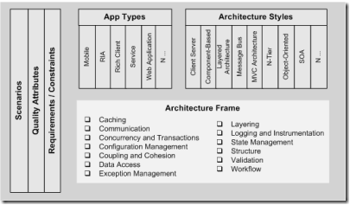
Architectural Meta Frame (AMF)

Slide 8
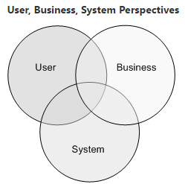
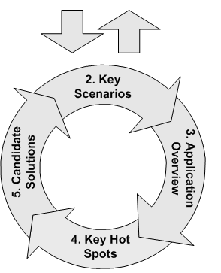
Architecture Objective

Slide 9
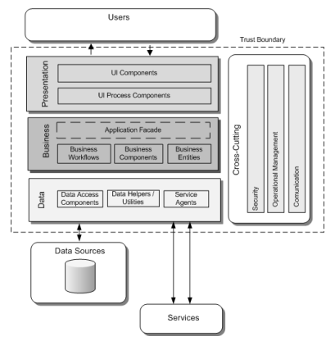
Layered Architecture

Slide 10
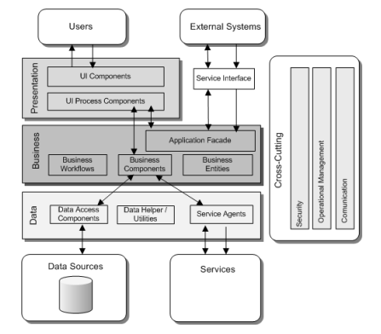
Layered Architecture with Multi-Client / Multi-Channel

Slide 11
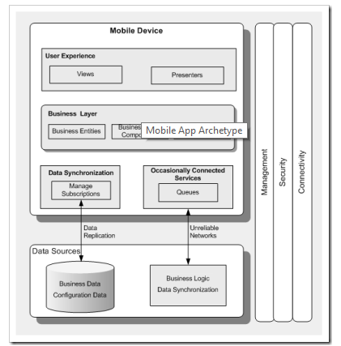
Mobile Application Archetype

Slide 12
Builder Login
Builder to register their existing and upcoming properties in the Rent-O-Wn app with the following details.
Builder Name (Mandatory)
Office Address (Mandatory)
Office Phone No (Mandatory)
Fax No
Office Location
Trade License (Mandatory)
Company Registration number (Mandatory)
Upload company registration certificate (Mandatory)
Owner name
Contact person name
Contact person phone no
Builder Overview
Builders market feedback
Proceed to Register

Slide 13
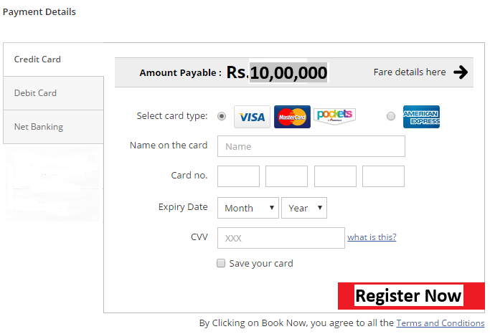
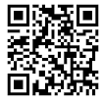
Procced to Register
Terms and condition (Defined By Pradeep)
Accept the terms and condition
Deny the terms and condition
Proceed to Pay
Once payment is done the builder
will receive invoice with unique bar code
Mandatory
Registered
Send Receipt to Mail
The user can send the receipt /Invoice to their registered mail id respectively in PDF and .jpg format

Slide 14
Register Site
To register the property the following details to be filled/inserted
Site Name
Society Name
Site Address
Address Line 1
Address Line 2
City
District
State
Pin
Nearest Land mark
Site Location - (Attach the location from google map)
Road Map

Slide 15
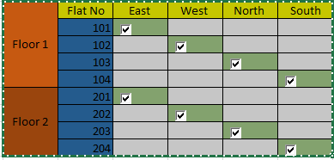
Property Specification
Builder to fill and update the list for property
No of Buildings
No of Floors
No of houses in each building
No of balcony available
House facing (South, East, West, North, etc.)
No of toilets
Kitchen (Open/ Close)
Modular kitchen (Yes/No)
Inbuilt wardrobe (Yes/ No)
Occupancy certificate (Yes/No)
Car Parking ( Yes/No)
Upload House facing details

Slide 16
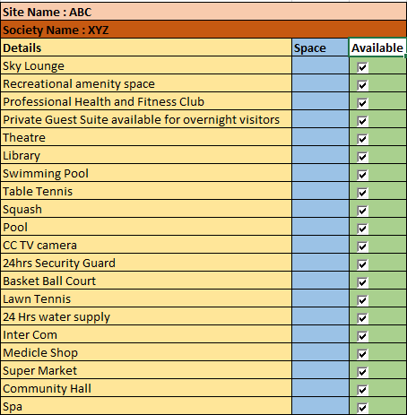
Site Amenities

Slide 17
Customer login
Customer can login using Facebook ,twitter, Gmail account or sign in to the Rent-O-Wn app
The customer can create an account by filling the following details
Name
Phone No (Mandatory)
Address
Address Line 1
Address Line 2
City
District
State
Pin
Mail id
Age
Schedule Appointment

Slide 18
View Properties
Customer can search the own dream house using the following search engine otherwise all the properties will be shown
The search engine as follows
Builder Name
Location
Budget
No of BHK
Amenities
On click of “Search” the system will fetch all the details using the search criteria
Customer can select one or multiple properties
Compare the selected properties with EMI/Rent , amenities, etc.
Save the properties
[Soft Book, Hard Book]

Slide 19
Schedule Appointment
Customer can schedule appointment to view the selected properties
To schedule appointment the following details to be filled
Name (detail will be fetched from login details)
Phone (detail will be fetched from login details)
Schedule Date
Schedule Time
Confirm
Confirmed
Confirmation mail and sms will be send to the customer

Slide 20
Check Eligibility
The customer can book a property by paying min of 30% of the face value
The rest can be paid as rent 5/7/10/15 years [Checking Age]
To check eligibility for the property fill the following details
Date of Birth
PAN Card No
Existing Loans
Salaried/ Self employed/ Business
Annual Income
Monthly Take Home
Form 16
Check Eligibility
Eligible / Not Eligible
Eligibility will be check on certain predefined criteria by Pradeep

Slide 21
Document verification
Based on customer eligibility the selected property can be booked
Terms can condition (Defined by Pradeep) [Accept/ Reject]
If the owner defaults single month rent then they have to vacate the property and serious action will be taken against the property owner
Upload Documents
Last six month salary slip
Form 16
Last 3 company appointment letters
Permanent address proof
etc.
Save
Verified
Proceed to Book

Slide 22
Nominee/ Guarantor Details
The owner need to fill up the nominee/ guarantor details which is mandatory
If by any chance the first owner fails to pay the rent then nominee/guarantor is bond to pay the rent for the specified tenure agreed for, otherwise the property will be taken by the company
Nominee/Guarantor Details [the following details to filled and upload the necessary documents]
Name
Address
Phone no
Mail id
Relationship
Pan Card
Address proof
Salaried/ self employed
Income statement
Form 16

Slide 23
Terms and Condition
The terms and conditions to be read carefully by the customer
Upon acceptation the terms and condition the user can proceed further to do the transactions

Slide 24
Proceed to Book
Customer can book their dream property by paying 30% or more by filling the following details
Property face value ( Updated from selected property)
Down payment (30% default can be edited to more than 30%)
Down Payment Amount ( system will calculate the 30% automatically and can be edited to more than the calculated amount)
Tenure ( Customer can select the tenure i.e. no of years he wants to pay the rent)
Proceed to pay

Slide 25
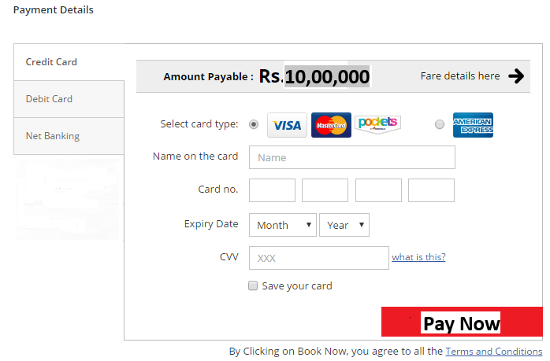
Booking Amount Payment
Customer can pay the booking amount easily
Once payment is done the builder will receive invoice with unique bar code
Confirm Payment
Print Receipt
The user can send the receipt /Invoice to their registered mail id respectively in PDF and .jpg format

