Slide 1
ARIA data pipeline
A first proposal for discussion
Built from the Agentic Hub architecture and ARIA evaluation docs.
Amit Prasad · Principal Data Engineer, AI · September 2026

Slide 2
ARIA needs three things from the data platform
1
2
3
A loop with CIS
One shared vocabulary
Every decision reproducible
Chart in, ranked recommendations out, coder decisions back. Event-driven, minutes not hours.
Every component — silver, Abstractor, graph, rules, gold — uses the same field names and values.
Each recommendation carries the versions that made it. Same chart, same rules, same answer — years later, for a CMS audit.
ARIA data pipeline — draft for discussion
2

Slide 3
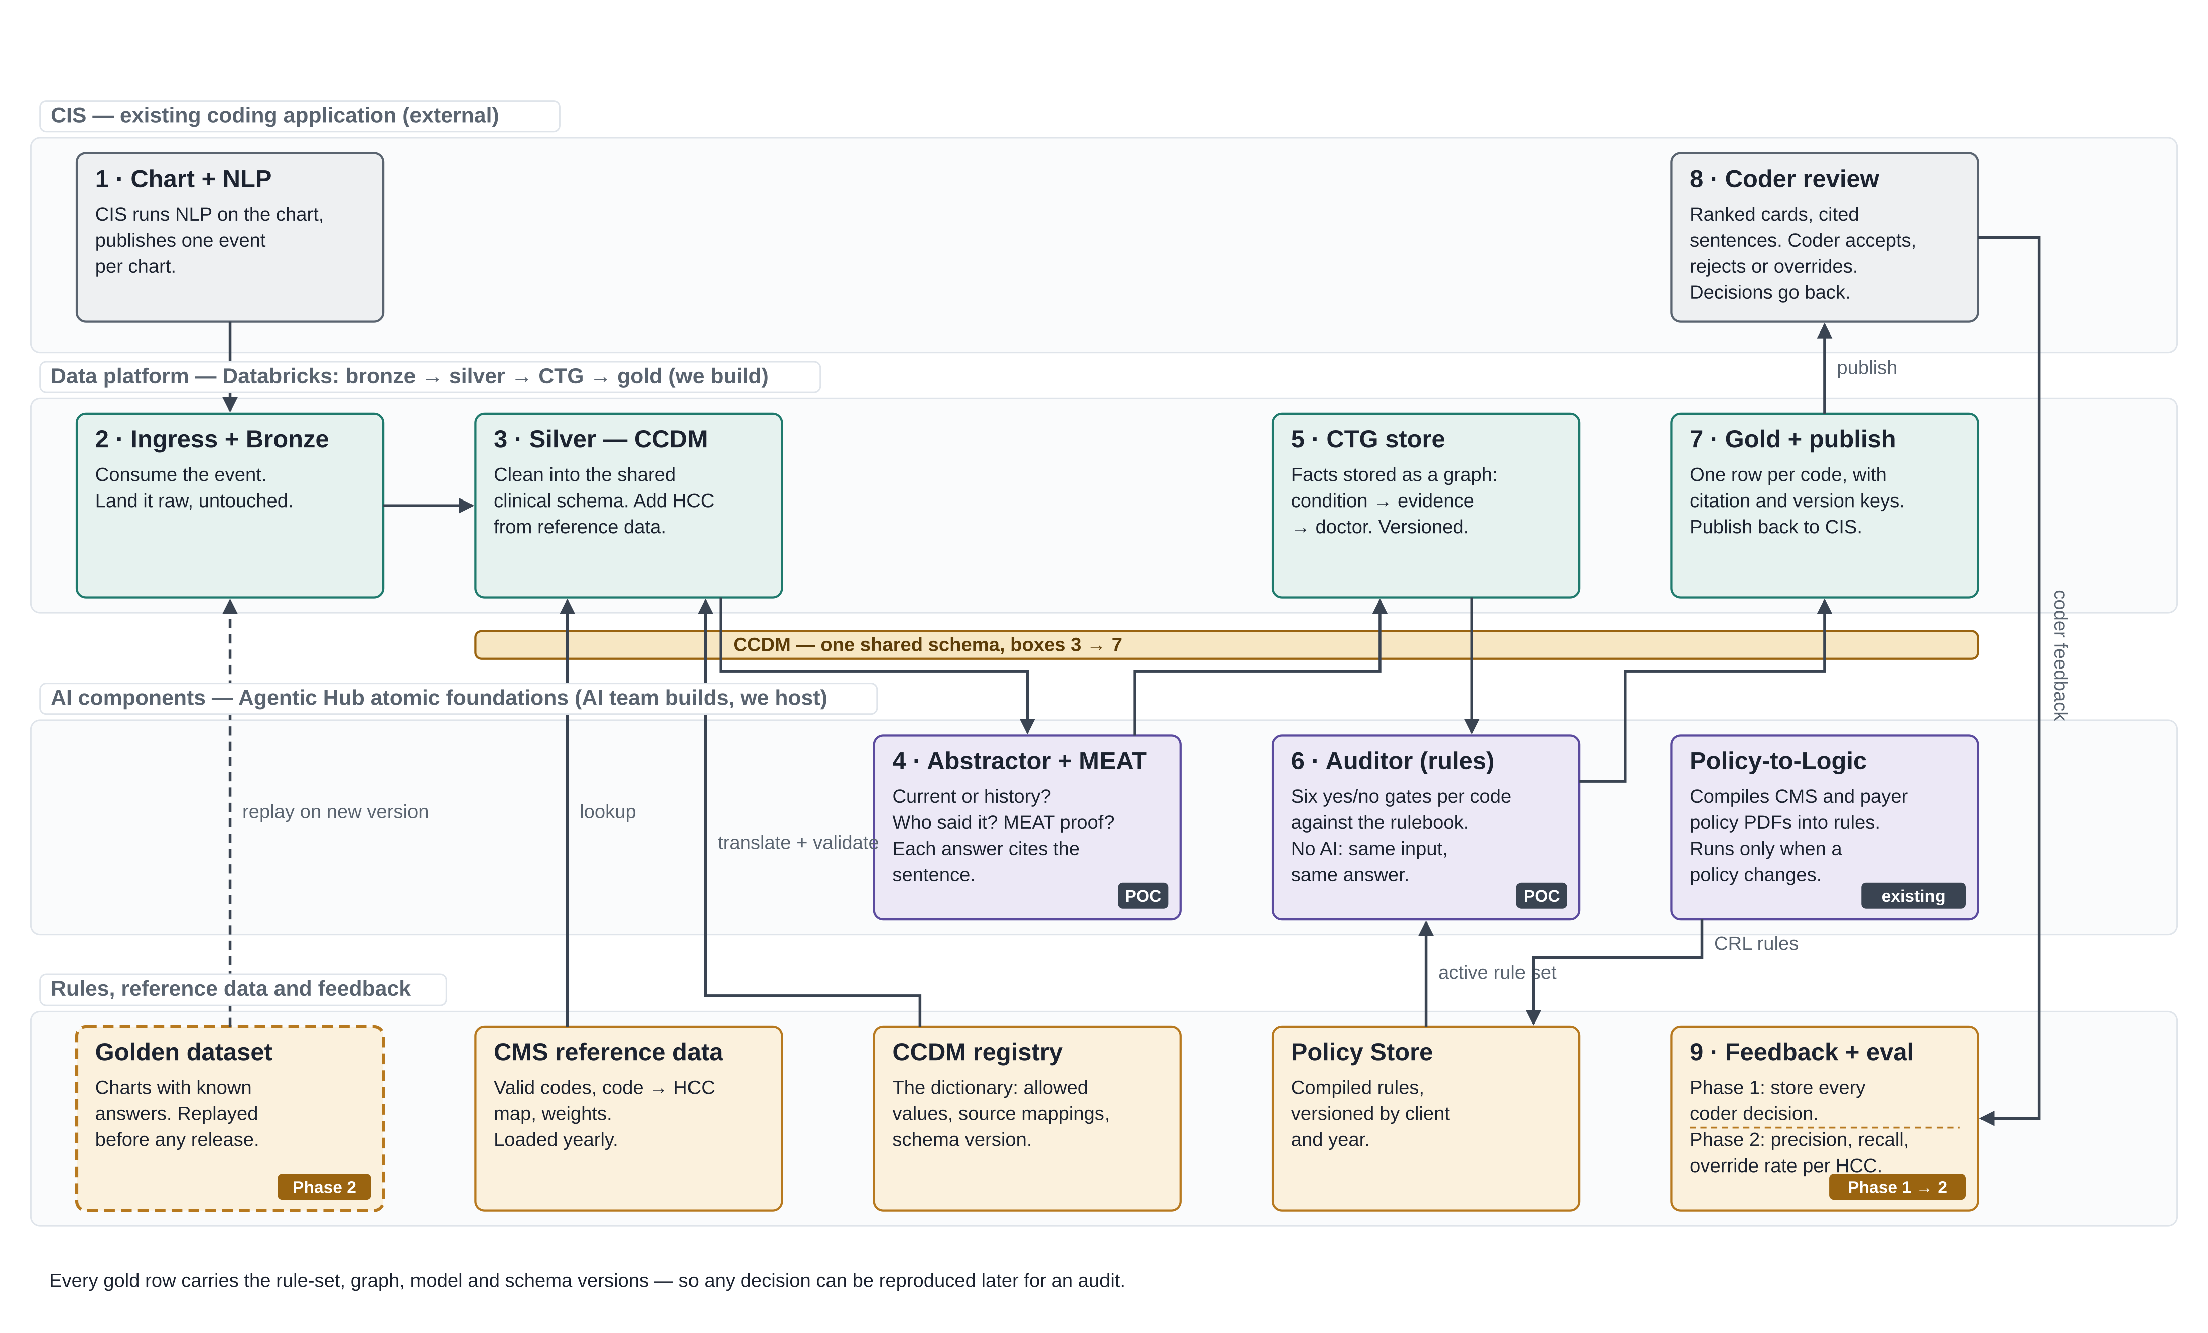
Proposed architecture — four lanes, one chart, one loop
ARIA data pipeline — draft for discussion
3

Slide 4
One chart through the loop
Maria, 72, Humana · chart CH-8841 · three diagnosis mentions
1
CIS runs its NLP, publishes one event per chart
What comes out
2
Land it raw in bronze
Diabetes with CKD · E11.22
3
Clean into the shared schema; add HCC from reference
Codeable · 93%
4
Abstractor: current? who said it? MEAT proof? — cites the sentence
CKD stage 3 · N18.30
5
Store as a graph: condition → evidence → doctor
Codeable · 90%
6
Auditor: six rule checks per code, no AI
Heart failure · I50.9
Needs a coder · 61%
7
Gold row per code with versions; publish back
Each card cites the exact sentence. The coder accepts two and overrides the third to the more specific I50.22 — about four minutes instead of twenty.
8
Coder sees ranked cards, accepts / rejects / overrides
9
Decisions stored — Phase 2 turns them into the scorecard
ARIA data pipeline — draft for discussion
4

Slide 5
Build the loop first, measure it second
Phase 1 is a complete, demonstrable loop. Phase 2 reads what Phase 1 stored.
Phase 1 — the loop
Phase 2 — the scorecard
Two event contracts with CIS: chart in, feedback out
Bronze, silver (CCDM), graph store, gold — on Delta
Abstractor and Auditor hosted as versioned jobs, wrappers if needed
Policy Store and reference data loaded
Every coder decision captured — nothing lost
Outcome: a chart flows end to end, cards appear in CIS
Nightly join: coder decisions vs our recommendations
Precision, recall, override rate — per HCC, per date of service
Every miss traced to the component that caused it
Golden dataset replayed before any new version goes live
Dashboards and drift alerts
Outcome: the evidence the eval doc needs before AutoPilot is discussed
ARIA data pipeline — draft for discussion
5

Slide 6
The shared schema is the first workstream
CCDM — one dictionary for boxes 3 to 7
The problem
Seven small tables
Each component in the POC uses its own words for the same fact — “present”, “affirmed”, “documented diagnosis”. A rule written as assertion = ACTIVE can’t run against a graph that says “affirmed”. Nothing can be reused until the words match.
Reference — loaded once
vocabulary every allowed value for every controlled field
source_map how each input’s words become CCDM words
code_reference ICD-10 → HCC → weight, by year
Chart tables — filled every chart
The proposal
encounter one row per visit
provider one row per doctor
Draft the dictionary with Reva — small, just what ARIA needs
Enforce it at silver; anything that doesn’t match is quarantined
Version it; rules record the version they were written against
Abstractor and Auditor adopt it, or get thin wrappers in and out until they do
condition_mention one row per place a condition is mentioned
evidence_span one row per supporting sentence
Every row carries chart_id and ccdm_version.
ARIA data pipeline — draft for discussion
6

Slide 7
Databricks end to end, event-driven, cloud-agnostic
Same platform the data team already runs; the GCP move becomes a lift, not a rewrite
Delta for every layer
Streaming for the per-chart path
Bronze, silver, graph, gold, evaluation — one storage format, Unity Catalog for PHI access control.
Kafka in, Structured Streaming through, Kafka out. A chart flows the moment it arrives; ten charts run in parallel.
Workflows for the scheduled work
AI components on the same workspace
Reference loads, Policy-to-Logic runs with approval, nightly metrics, golden replays.
Abstractor and Auditor hosted as versioned jobs. Moving the POC here is the first project — it forces the clean split.
ARIA data pipeline — draft for discussion
7

Slide 8
What I need from you
1
CIS team — can they publish the two events: chart-ready out, coder-feedback back?
2
Reva — are the Abstractor and Auditor separately callable today, or one script?
3
Is there a draft CCDM schema, or do we start from the taxonomy?
4
Kafka — an existing cluster, or which managed option?
5
Databricks as the runtime for the AI components too — does that fit the platform direction?
6
Which environments are approved to hold real PHI?

