Slide 1
ARIA data hub
Data pipeline design review
Notes:
Six weeks in. I've read the Agentic Hub design pages and sat with CIS twice. This is the data view of ARIA: the Agentic Hub architecture page says who computes what; this says where everything lives, who writes it, how it is versioned and replayed. I need four decisions by the end; I'll show them first.

Slide 2
What ARIA does: turn a chart into defensible codes
1
2
3
4
5
Chart
Codes
HCC
Payment
RADV audit
A doctor's notes for one visit: pages of free text.
A coder (helped by NLP) turns sentences into ICD-10 codes — and knows what not to code.
Some codes map to a payment category (E11.22 → HCC 37). History-of and "possible" never do.
CMS pays the plan per member × risk score. A wrong code is an audit finding; a missed one is lost revenue.
Years later CMS samples charts and extrapolates the error rate across the whole contract.
What a recommendation is
Pilot scope
For every code on a chart: codeable, flag, or needs a coder — with the sentence, page, the MEAT evidence, the rule and its guideline citation, and for every "no", what is missing. CoPilot now: the coder reviews and decides. AutoPilot later: confident codes filed without a coder, earned on evidence.
Three HCC categories: diabetes, chronic kidney disease, heart failure. Aetna first. Judged on precision, recall, false-accept rate, coder time per chart, override rate — per code and per date of service, never one aggregate number.
Notes:
Two minutes. I'm new to healthcare; this is the one picture I use. Chart to codes to HCC to payment, and the audit years later. The audit is why every decision needs proof. Then what a recommendation is, and the pilot scope. Move on.

Slide 3
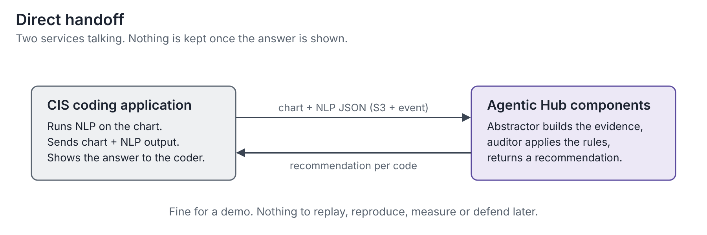
Today's picture: two services talking
CIS sends chart + NLP output, the Agentic Hub components answer, the coder sees the answer. This is the handshake and it stays exactly this. The question is only what happens to everything that passed through.
Notes:
This is the handoff as CIS sees it, and it is right: CIS sends a file, gets a file back. Nothing here changes. The next slide is the same picture with one addition.

Slide 4
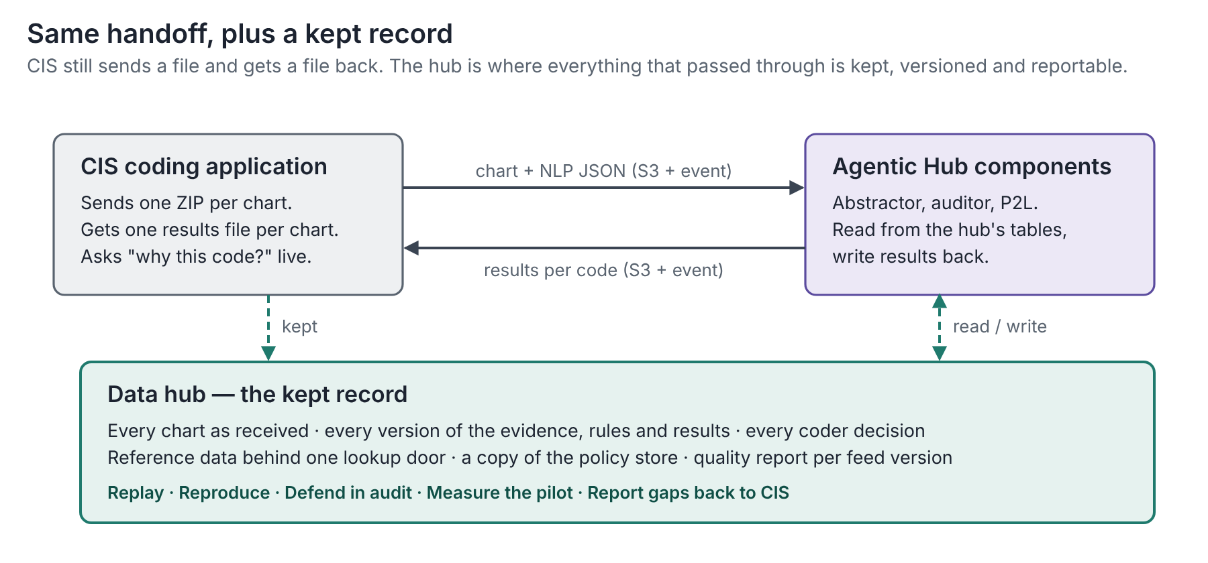
Same handshake, plus a kept record: five things only a record gives
1
Replay
The feed and the rules keep improving; re-run old charts without asking CIS to resend.
2
Reproduce
Same chart + same rules → same answer, 100%. A rule change flips zero correct charts. Both need stored runs.
3
Defend in audit
A frozen package per code — sentence, rule, gates, coder action — readable years later with no access to ARIA.
4
Measure the pilot
"The data hub (lakehouse) is the logical home of all data." — P2L build guide, key note 3
Precision, recall, false-accepts, coder time: every number is ARIA's call joined to the coder's, across thousands of charts.
What the hub does not do: improve the chart or the NLP; own the policy tool (PRM belongs to the Agentic Hub platform, the screen to CIS); sit on the November demo's critical path.
Report gaps to CIS
5
Per feed version: which fields arrived, which didn't. the nine known feed gaps become a daily number, not a hand-written page.
Notes:
The hub is not a detour for the chart. It is where the record lives. Five things only a record gives: read the five headings. The platform owner's own sentence at the bottom. And what the hub does not do, so nobody thinks we're taking on NLP quality or the policy tool.

Slide 5
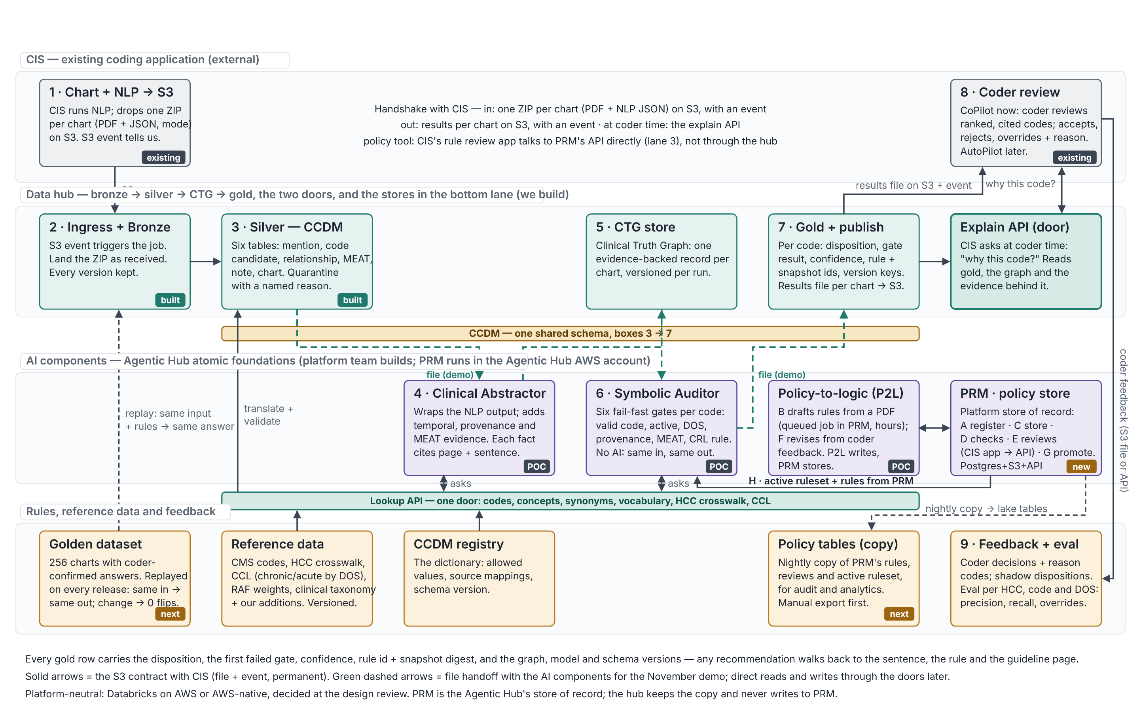
The one architecture: four lanes, one chart, one guideline, two doors
Notes:
Walk it in three passes. Numbers, one chart: CIS drops a ZIP, we keep it as received, clean it into six CCDM tables, the abstractor builds the truth graph, the auditor runs six gates with the active rules from PRM, gold stores the determination, a results file goes back, the coder decides, decisions and evaluation stored. Letters, one guideline: PDF into PRM, P2L drafts, snapshot stored, checks, coders review in CIS's screen through PRM's API, revise, promote, the auditor uses it; we copy PRM nightly. Two doors: lookup for reference data, explain for 'why this code'. Then the lanes: CIS is external; the hub is ours; the components belong to the Agentic Hub platform and PRM runs in its account; the bottom lane is the stores. Tags: built, POC, new, next.

Slide 6
Where the hub runs: two options, one decision for the platform teams
 | Databricks on AWS (today's path) | AWS-native (existing lakehouse pattern)
Tables and files | Unity Catalog: one schema per lane, Volumes for files, lineage and masking built in | S3 + lakehouse catalog, Iceberg/Delta, Lake Formation permissions
Reading the CIS bucket | Cross-account read from the workspace role; CIS adds it to the bucket policy; platform team sets up | Same bucket policy; the role lives in the hub's AWS account
Agentic Hub components and PRM | File handoff for the demo; SQL endpoint / REST doors later; nightly JDBC copy of PRM | Same cloud, possibly same account: fewer hops; Glue/EMR copy of PRM
Lakehouse write API the platform design assumes | SQL Statement API for batch; Lakebase (Postgres in Unity Catalog) if available — question for the platform team | API Gateway + Lambda over the lake, or records stay in PRM's Postgres
Time to first real chart | Days: the pipeline exists; needs bucket access and a PHI-approved workspace | Weeks: rebuild the slice, then the same access work
Risk | Another lakehouse beside the existing one — mitigated by registering ARIA's catalog in the shared inventory from day one | Rebuild cost now; the AI org's tooling is on Databricks
What we ask the platform teams: which of the two the hub should run on. The data layer (contract, CCDM tables, gold record, golden dataset, metrics) is the same either way; only the glue changes. The pipeline exists on Databricks today; we have no view on where it must live long term.
Notes:
Fixed either way: CIS is on AWS, the Agentic Hub components on Kubernetes on AWS, PRM is Postgres + S3, GCP has no environment yet. Two options, row by row, as facts not a pitch. Then hand it to the platform teams: this is their call. If asked for my view: the pipeline exists on Databricks and the data layer carries over, so I would not rebuild for slice 2.

Slide 7
Open questions, and the four decisions we need from this room
Decisions needed from this room — need today: 1 and 2 · need an owner: 3 and 4
1. Which platform does the hub run on? Databricks on AWS, or AWS-native in the existing lakehouse.
2. Who gives the hub access to real charts, and when? A role into CIS's bucket, and a PHI-approved workspace.
3. Where does the copy of PRM's rules live, and who owns the write API? A date, or an honest 'not yet'.
4. One AWS account plan or three? Is the Agentic Hub's account set up by the same team as ours?
Tracking outside this room
NLP: does CIS pre-run it, or does the hub call it? (Reva)
Golden dataset: 200 or 256 charts, and who holds it? (Reva)
File handoff acceptable for the November demo? (Reva)
One sample ZIP, and a field-by-field answer on the contract. (Binod)
Notes:
Close on decisions, not on unknowns. Read the four. Then the open items with the platform owner and CIS, which don't need this room but I want visible. Ask for the platform call first; the other three follow from it.

Slide 8
Appendix
Data blueprint · silver tables · CIS contract v0.2 · policy lane with PRM · accounts, buckets and roles

Slide 9
Data blueprint: every kind of data the hub keeps, and its rules
Data | Layer | What it is / why | Written by → read by | PHI | Versioning · keep
Chart events | Bronze | The ZIP as received, with event metadata and feed version; the replay source | Ingress job → silver, replay | PHI | Append only · years
CCDM chart tables | Silver | Six tables: chart, note, mention, code candidate, relationship, MEAT evidence | Silver job → abstractor, auditor gates, explain API | PHI | Latest per chart, versions stamped · years
Quarantine | Silver | Rows or charts that failed a rule, with reason code and owner; daily report to CIS | Silver job → data eng, CIS, NLP team | PHI | Append only · 1 year
Clinical truth graph | CTG | One evidence-backed record per chart, the auditor's facts | Abstractor → auditor, explain API | PHI | Append; graph version per run · years
Determinations | Gold | Per code: disposition, failed gate, confidence, rule + snapshot ids, all version keys | Auditor; coder action from CIS → publish, explain API, eval | PHI | Append; rerun = new version · years
Results file | Gold | One JSON per chart back to CIS, always, including 'not processed' | Publish job → CIS | PHI | Derived · 90 days
Decision package | Gold | Frozen proof per code for audit, readable without ARIA | Export job → compliance, auditors | PHI | Locked, timestamped · years
Coder feedback | Feedback | Accept / reject / override with reason code; time per chart; shadow comparison | CIS → eval, platform team | PHI | Append only · years
Policy tables (copy) | Policy | Nightly copy of PRM's rules, reviews, active ruleset | Bridge job → explain API, eval, audit | no | Per snapshot digest · forever
Reference data | Ref | CMS codes, HCC crosswalk, CCL, RAF weights, clinical taxonomy, CCDM registry | Load jobs → all, via lookup door | no | Versioned, old kept · forever
Golden dataset | Quality | 256 charts with coder-confirmed answers; gates every release | Coders + data eng → replay, eval | PHI (de-id) | Versioned set · forever
Evaluation metrics | Quality | Precision, recall, false-accepts, coder time, Kappa; per HCC, code, DOS | Eval job → leadership, platform team | no | One set per version · forever
Four rules for every row: nothing that feeds a decision is overwritten · every decision row carries its version keys · PHI tables readable only by pipeline, components and the explain API · other systems reach data through the two doors or the S3 handoffs. Full table: aria-data-blueprint (22 rows).

Slide 10
Silver: six CCDM tables, plus quarantine
Table | One row per | What it holds | Who reads it
chart | chart received | patient, encounters, DOS, facility type, payer, HCC model version, mode | everything; gates L1, L3
note | clinical note | signer + credential + NPI, co-signature, signed/unsigned, signature vs service time, addenda | gates L3, L4 (eligibility)
mention | entity the NLP found | text, page, offsets, section, note type, author, DOS, assertion (6 states), severity/stage, confidence | abstractor, explain API
code_candidate | code proposed for a mention | system (ICD-10-CM / CPT / PCS), code at full specificity, rank, confidence | abstractor, auditor L1, coder view
relationship | link between two mentions | TREATS / EVALUATES / MONITORS / INDICATES / COMPLICATES, span, confidence | abstractor, rules
meat_evidence | MEAT sentence per mention | M / E / A / T, span, section, DOS, confidence | abstractor MEAT decision, gate L5
quarantine | row that failed a check (a mention, or a whole chart) | chart_id, mention_id (null for a whole chart), reason_code, reason_detail, owner, raw_payload, quarantined_at, resolved_by_run; append-only | DEs; CIS + NLP team via the daily report (J3)
Quarantine reasons, each with an owner: confidence outside 0–1 · code at category level · mention without page/offset · 'medication' that is a verb · unknown assertion · note with no signer · unreadable ZIP (whole chart, returned as 'not processed'). A quarantined mention does not stop the chart. Every silver row stamped ccdm_version, nlp_version, feed_version.

Slide 11
CIS contract v0.2: one ZIP per chart, and what the JSON must say
Envelope
Must-have fields: what real CIS exports have today
Bucket cis-nxt-gen-data-qa (account 981971132015), prefix to be named. One ZIP per chart: <chart_id>.pdf + <chart_id>.json. S3 event to SQS or SNS. Re-sends allowed: same chart_id, new version kept. Out: one results JSON per chart received, always, including 'not processed, reason X'. At coder time: Explain API. Coder decisions back with a reason code.
Absent today: signer, credential, co-signature, signature time — the single largest gap. Also facility type, payer, HCC model version, attending NPI.
Confidence is a raw match count (−1 to 412 seen), not a 0–1 score.
Assertion: three true/false flags, not six states; family history is unreliable.
Codes: one winner, often at category level. We need every candidate at full specificity. CPT never present.
Relationships and MEAT evidence: not seen in any export.
Ask of CIS, per field: present / can add / not available. First step: one sample ZIP.

Slide 12
Policy lane: PRM is the store of record, the hub keeps the copy
Step | What happens | Where
A · Register | A guideline PDF (or bundle) goes into PRM through its API | PRM (Agentic Hub platform: Postgres + S3 + API)
B · Draft | A policy-to-logic job builds the rules: Textract + LLM, hours | P2L job, Agentic Hub account
C · Store | PRM keeps an unchangeable snapshot with a digest; rules carry fingerprints | PRM
D · Quality checks | Failures to engineering; the rest to coders | PRM
E · Review | Coders approve / minor edits / revise / reject in CIS's rule review app, via PRM's API; a verdict binds to one fingerprint | CIS screen → PRM API
F · Revise | New snapshot; only changed rules return to coders | P2L + PRM
G · Promote | Second sign-off; PRM marks the active ruleset (tenant, payer, LOB, DOS period) | PRM
H · Use | The auditor fetches the active ruleset and compiled rules | PRM API → auditor
Hub · Copy (ours) | Nightly copy of PRM's records into lake tables (Stream H; manual export first). Read by the Explain API, eval and audits. | Data hub
The auditor reads PRM at run time, over its API. The hub's copy is for the Explain API, evaluation and audit walk-back; it never drives a coding decision, and the hub never writes to PRM.

Slide 13
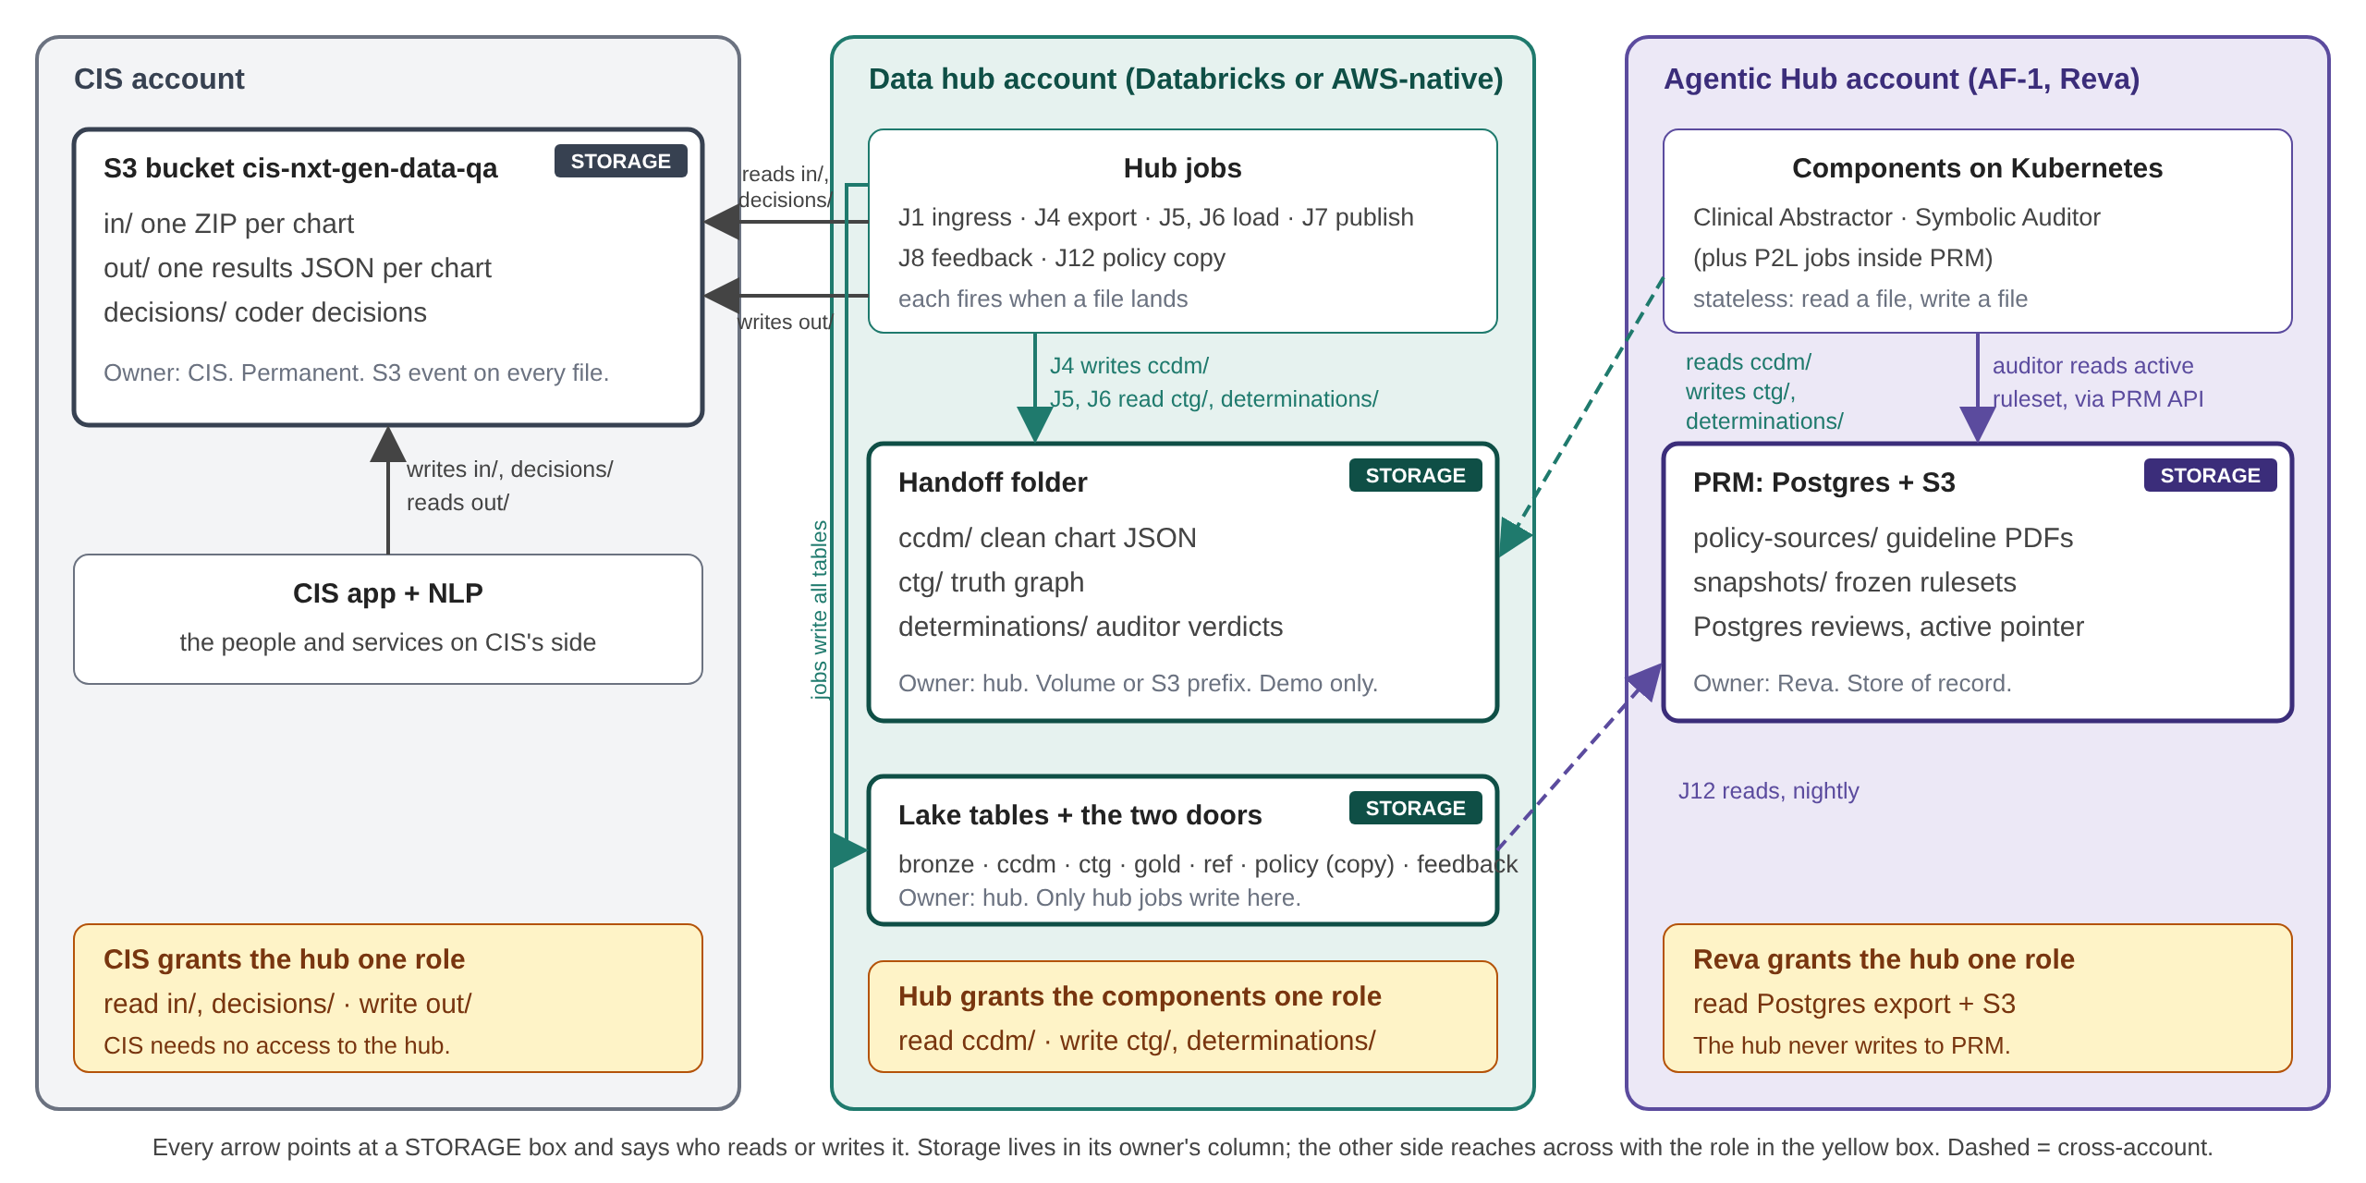
Accounts, buckets and roles: three handoffs, three grants

