Slide 1
SHADE Engine for Depression Patients
Team: Brogrammers IIIT Bangalore

Slide 2

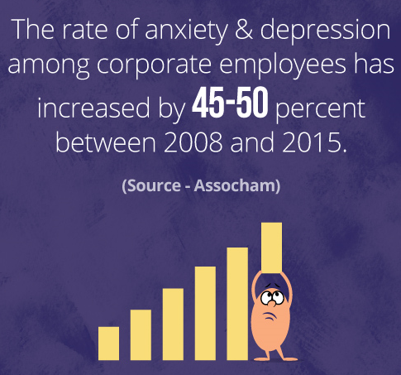

Crunching Numbers!
300 Million patients
50 Million patients
Youth
In world
In India
30-70% of Suicides

Slide 3
Why is it increasing so rapidly?
Problems at Diagnosis Level :
Getting a person’s conversations 24x7
Existing solutions in market use Social Media Activity which is text based.
But “A picture is worth thousand words” ?
What about social media platforms apart from twitter?
Problems at Treatment Level :
Scarcity of psychiatrists which is a specialized medical field.
Availability of time is a concern for patients!
Reluctancy to go to a psychiatrist at the first place!
Treatment costs per session for CBT range from $50 - $200
Proactive Measures
Reactive Measures

Slide 4
How is SHADE Engine Solving it?

Slide 5




What are the data sources and types?
Understanding user’s state of mind
Analysing different kinds of media
v/s
A girl giving gift to her father
Different forms of media describing the same situation

Slide 6


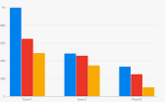
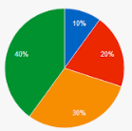
After aggregating, it’s time to analyse!
Language Translator :
Natural Language Processing :
Generation data visualizations for end users :

Slide 7
Based on the analysis, what next?
Suggestion | Description
Tips from Doctors and Psychiatrists | Topic Modelling algorithms running on open source data.
Helping the person to socialise | Suggesting Nearby places to eat, worship and explore natural beauty.
Yoga Asanas | To fight different states of emotion
Mind Relaxing Content | Songs and Funny videos!
Reflection of personality | Helping user to better understand himself.
SMS Alerts | Automated alerts to emergency contacts.

Slide 8
Automating the treatment of depression!
Cognitive Behavioural Tests (CBT) by SHADE Bot
Finding Nearby Psychiatrist Clinics
TREATMENT
Medicine Aggregator for
e-commerce
Era of IoT Devices!

Slide 9
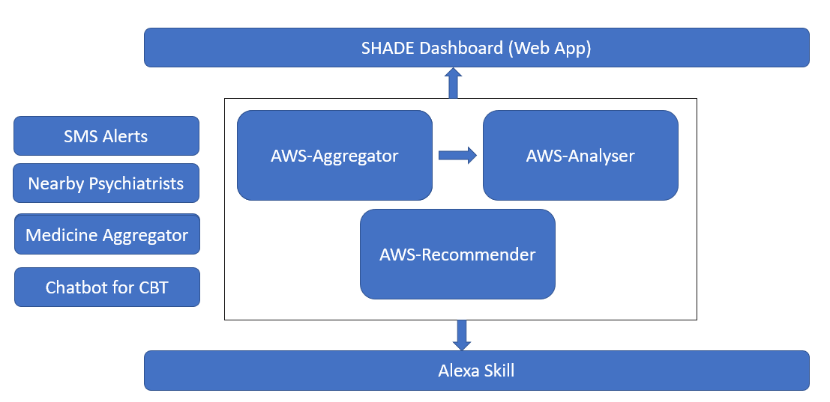
Software Architecture

Slide 10
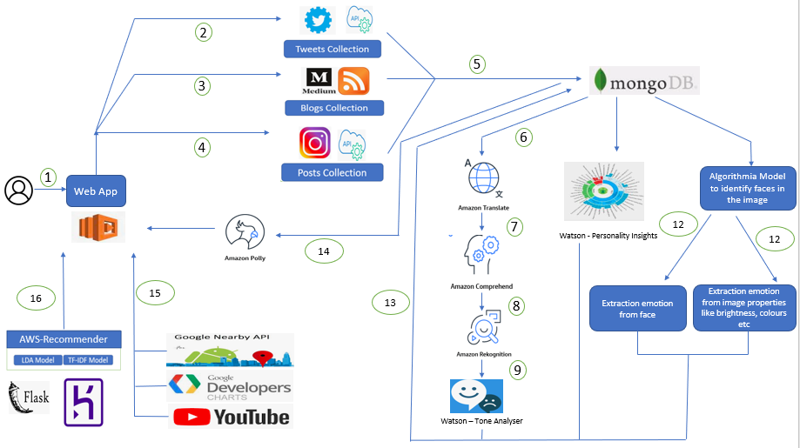
Flow Diagram

Slide 11










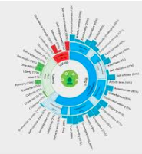











Thank You!
ML Models like LDA and TF-IDF

