Slide 1
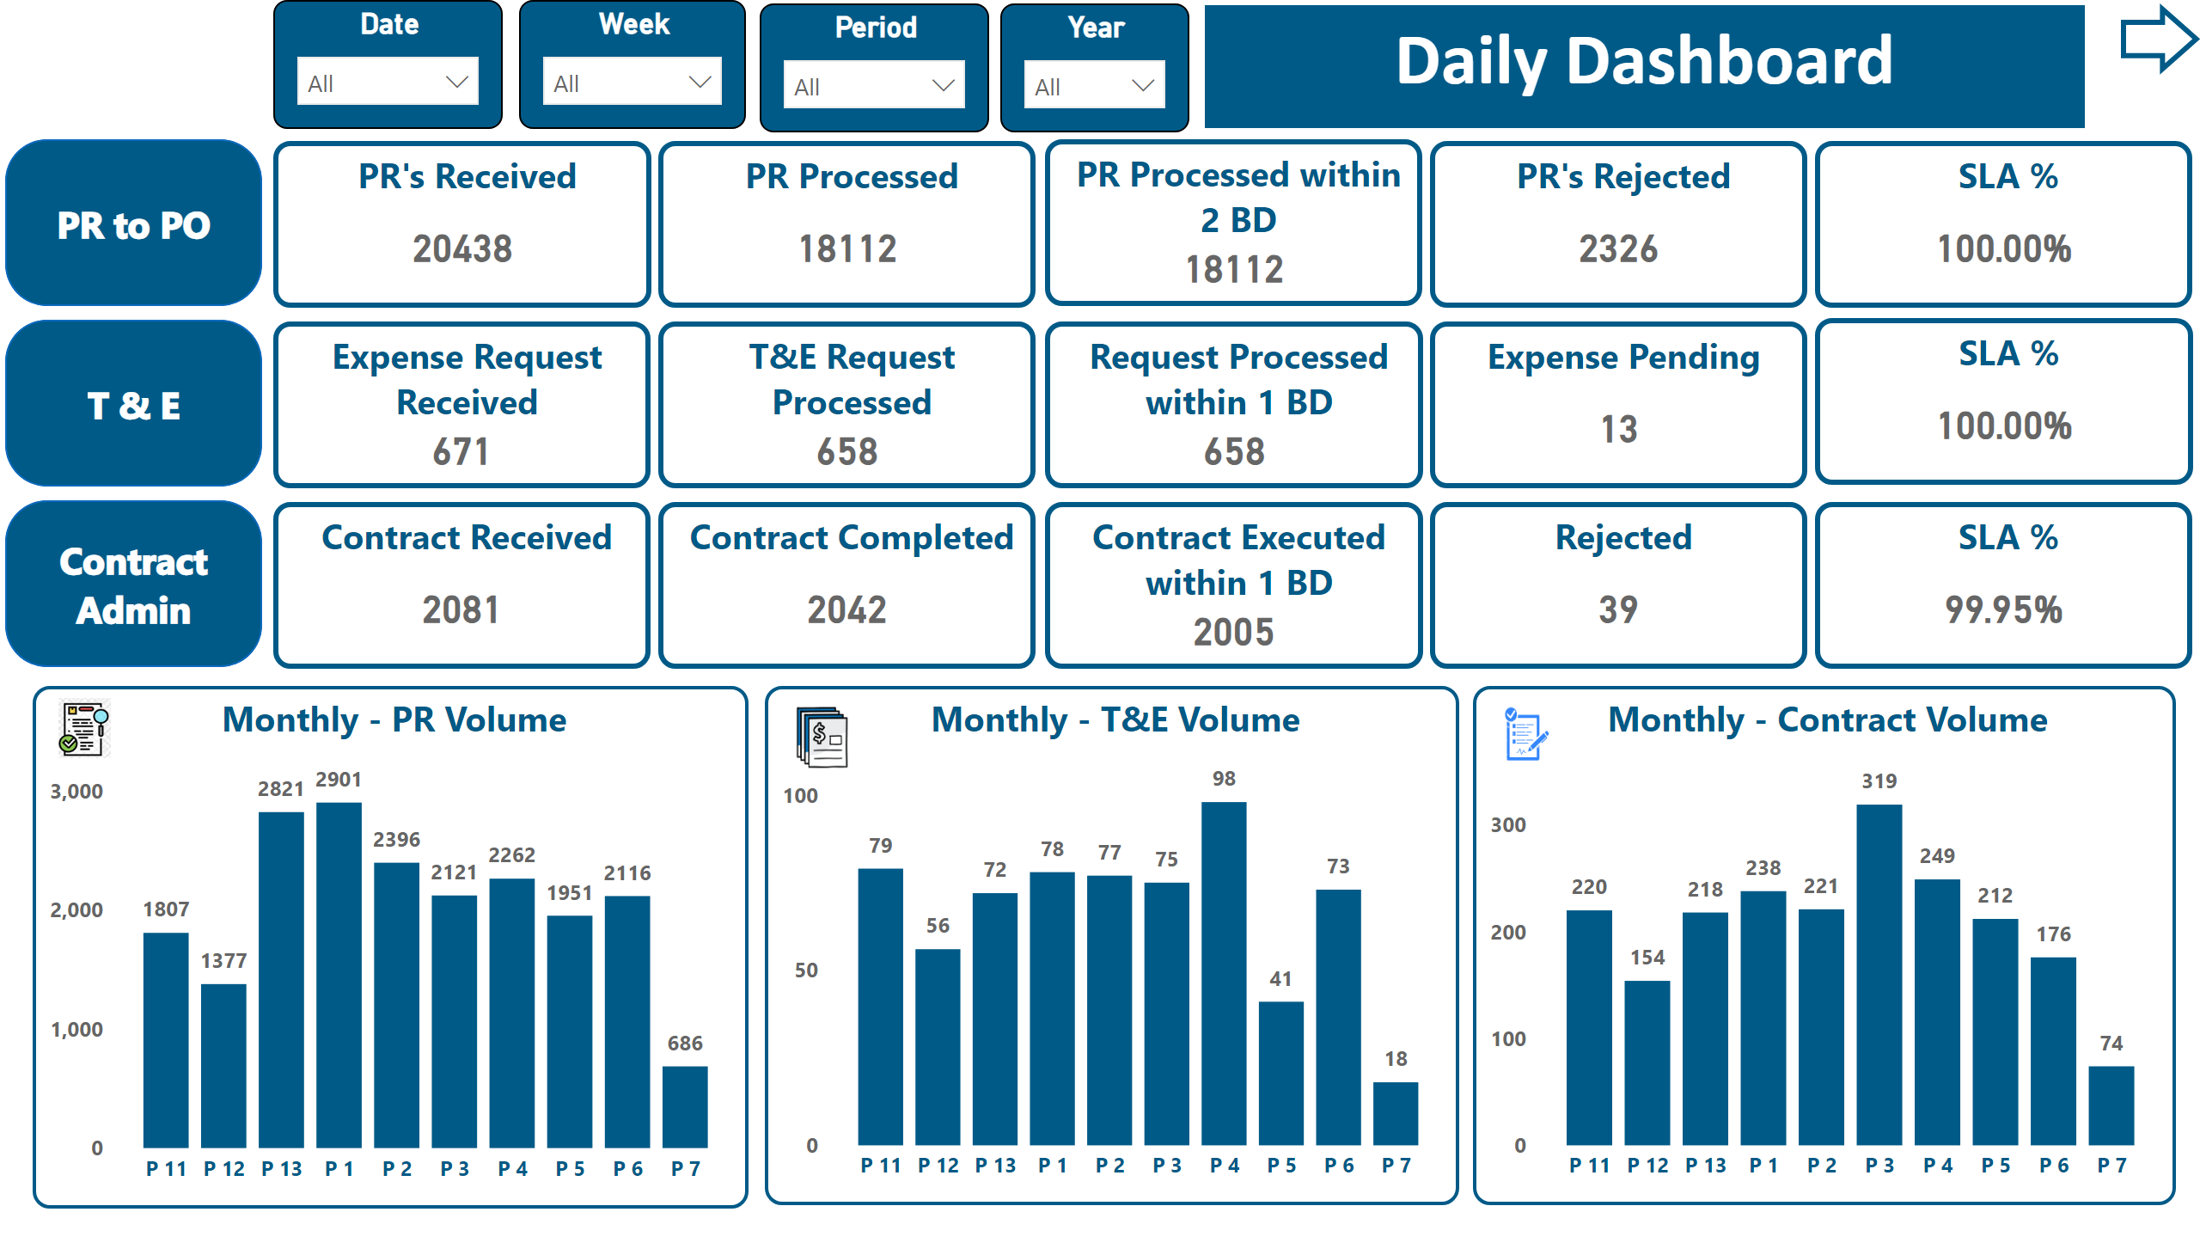
Cover Page
Notes:
PR to PO
No alt text provided
PR's Received
No alt text provided
PR Processed within 2 BD
No alt text provided
SLA %
No alt text provided
PR to PO
No alt text provided
PR to PO
No alt text provided
Expense Request Received
No alt text provided
T&E Request Processed
No alt text provided
SLA %
No alt text provided
Contract Received
No alt text provided
Contract Executed within 1 BD
No alt text provided
SLA %
No alt text provided
Monthly - T&E Volume
No alt text provided
Monthly - Contract Volume
No alt text provided
textbox
No alt text provided
image
No alt text provided
image
No alt text provided
Date
No alt text provided
Period
No alt text provided
shape
No alt text provided
Monthly - PR Volume
No alt text provided
image
No alt text provided
PR Processed
No alt text provided
Request Processed within 1 BD
No alt text provided
Contract Completed
No alt text provided
PR's Rejected
No alt text provided
Expense Pending
No alt text provided
Rejected
No alt text provided
Week
No alt text provided
Year
No alt text provided

Slide 2
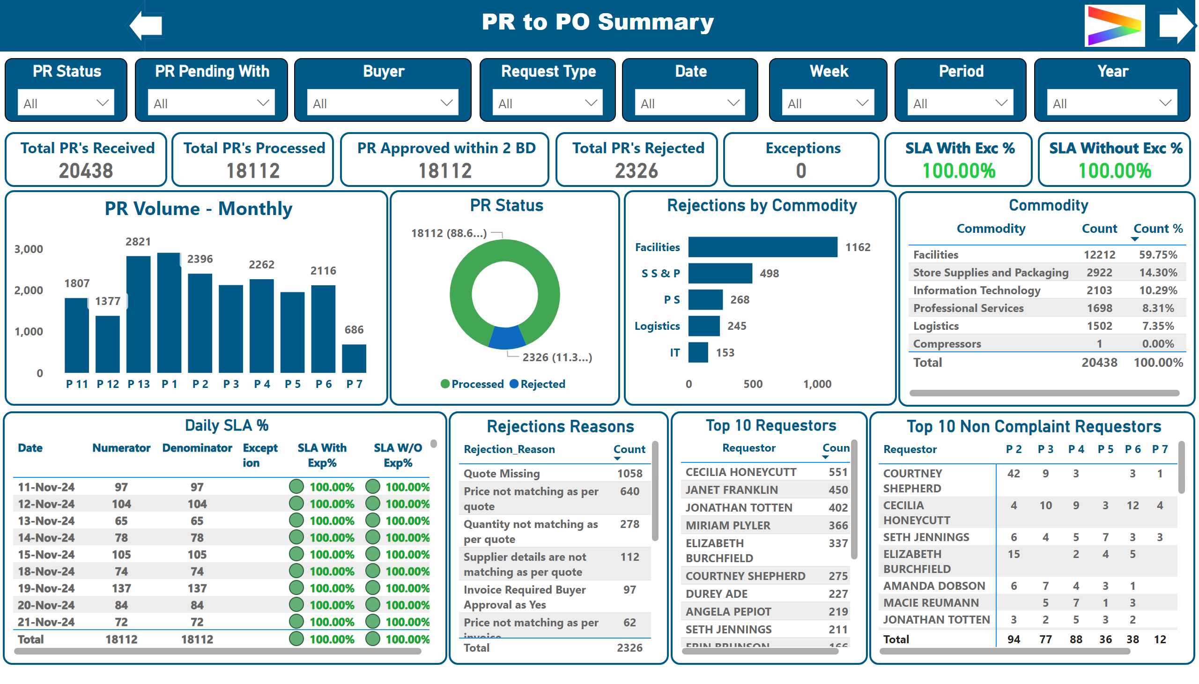
PR to PO
Notes:
Total PR's Received
No alt text provided
PR Status
No alt text provided
Top 10 Requestors
No alt text provided
Rejections by Commodity
No alt text provided
textbox
No alt text provided
image
No alt text provided
PR Status
No alt text provided
PR Pending With
No alt text provided
Buyer
No alt text provided
Year
No alt text provided
Request Type
No alt text provided
Date
No alt text provided
PR Approved within 2 BD
No alt text provided
SLA With Exc %
No alt text provided
Period
No alt text provided
shape
No alt text provided
shape
No alt text provided
Commodity
No alt text provided
Exceptions
No alt text provided
Total PR's Processed
No alt text provided
SLA Without Exc %
No alt text provided
Daily SLA %
No alt text provided
Total PR's Rejected
No alt text provided
Rejections Reasons
No alt text provided
PR Volume - Monthly
No alt text provided
Week
No alt text provided
Top 10 Non Complaint Requestors
No alt text provided

Slide 3
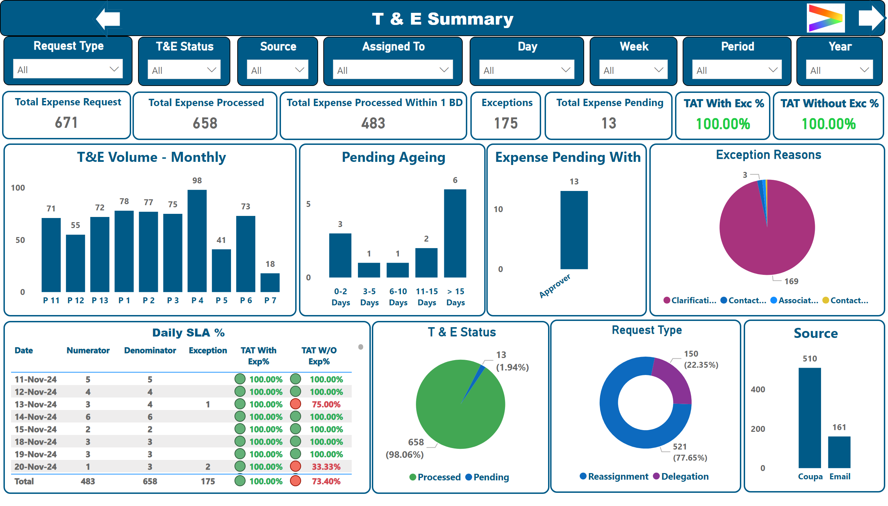
T & E
Notes:
textbox
No alt text provided
image
No alt text provided
Request Type
No alt text provided
Source
No alt text provided
T&E Volume - Monthly
No alt text provided
Request Type
No alt text provided
T & E Status
No alt text provided
T&E Status
No alt text provided
Source
No alt text provided
Assigned To
No alt text provided
Total Expense Request
No alt text provided
Total Expense Processed Within 1 BD
No alt text provided
TAT With Exc %
No alt text provided
Day
No alt text provided
Period
No alt text provided
shape
No alt text provided
shape
No alt text provided
Expense Pending With
No alt text provided
Exception Reasons
No alt text provided
TAT Without Exc %
No alt text provided
Exceptions
No alt text provided
Total Expense Processed
No alt text provided
Daily SLA %
No alt text provided
Total Expense Pending
No alt text provided
Pending Ageing
No alt text provided
Week
No alt text provided
Year
No alt text provided

Slide 4
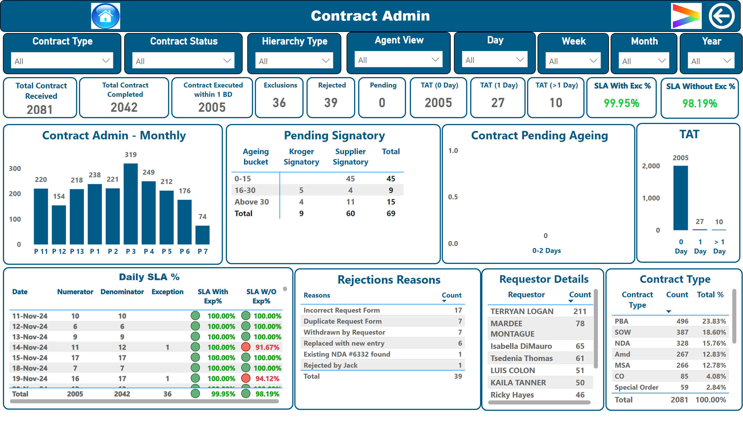
Contract Admin
Notes:
textbox
No alt text provided
Contract Admin - Monthly
No alt text provided
Contract Type
No alt text provided
Requestor Details
No alt text provided
Total Contract Received
No alt text provided
Contract Executed within 1 BD
No alt text provided
SLA With Exc %
No alt text provided
Contract Type
No alt text provided
Contract Status
No alt text provided
Hierarchy Type
No alt text provided
Week
No alt text provided
Month
No alt text provided
Agent View
No alt text provided
image
No alt text provided
actionButton
No alt text provided
image
No alt text provided
Rejected
No alt text provided
SLA Without Exc %
No alt text provided
Total Contract Completed
No alt text provided
Daily SLA %
No alt text provided
TAT
No alt text provided
TAT (1 Day)
No alt text provided
TAT (>1 Day)
No alt text provided
TAT (0 Day)
No alt text provided
Exclusions
No alt text provided
Pending
No alt text provided
Day
No alt text provided
Rejections Reasons
No alt text provided
Contract Pending Ageing
No alt text provided
Year
No alt text provided
Pending Signatory
No alt text provided

Slide 5
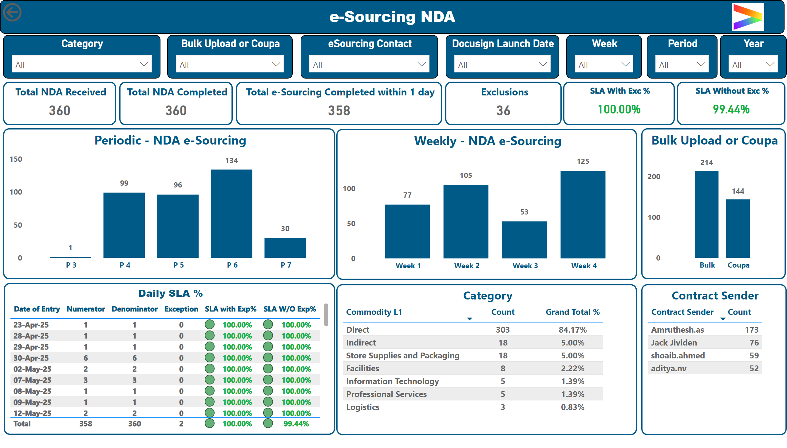
e-Sourcing NDA
Notes:
textbox
No alt text provided
image
No alt text provided
Category
No alt text provided
Bulk Upload or Coupa
No alt text provided
eSourcing Contact
No alt text provided
Week
No alt text provided
Period
No alt text provided
Year
No alt text provided
Periodic - NDA e-Sourcing
No alt text provided
Docusign Launch Date
No alt text provided
Category
No alt text provided
Bulk Upload or Coupa
No alt text provided
Daily SLA %
No alt text provided
Total NDA Received
No alt text provided
Total NDA Completed
No alt text provided
Total e-Sourcing Completed within 1 day
No alt text provided
SLA With Exc %
No alt text provided
SLA Without Exc %
No alt text provided
Exclusions
No alt text provided
actionButton
No alt text provided
Weekly - NDA e-Sourcing
No alt text provided
Contract Sender
No alt text provided

Slide 6
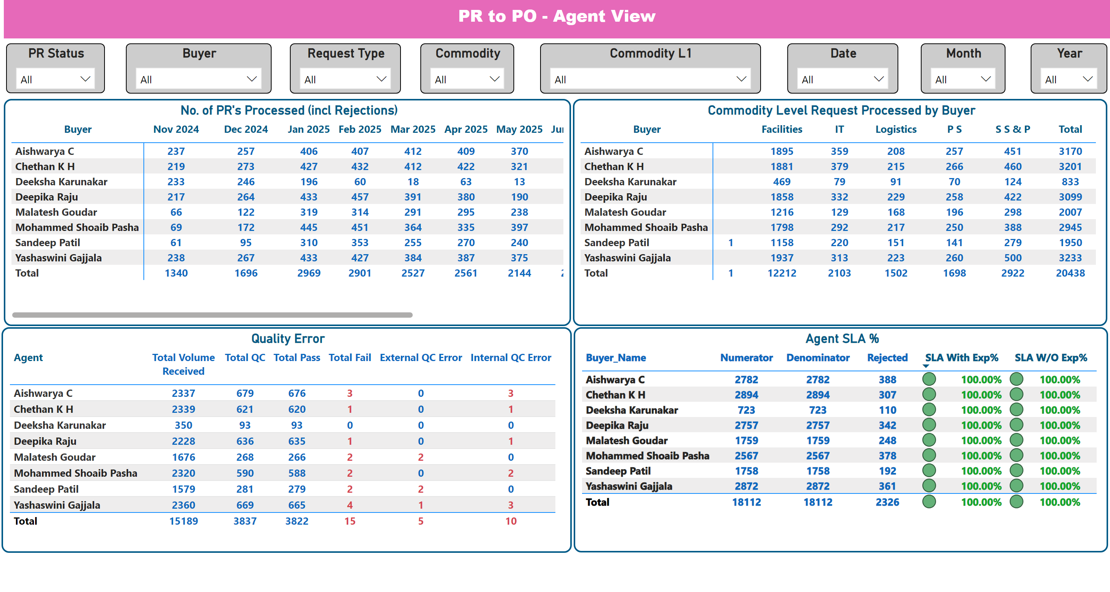
PR to PO Agent View
Notes:
No. of PR's Processed (incl Rejections)
No alt text provided
Agent SLA %
No alt text provided
Buyer
No alt text provided
Request Type
No alt text provided
PR Status
No alt text provided
Month
No alt text provided
Year
No alt text provided
Date
No alt text provided
Commodity
No alt text provided
Commodity L1
No alt text provided
textbox
No alt text provided
Quality Error
No alt text provided
Commodity Level Request Processed by Buyer
No alt text provided

Slide 7
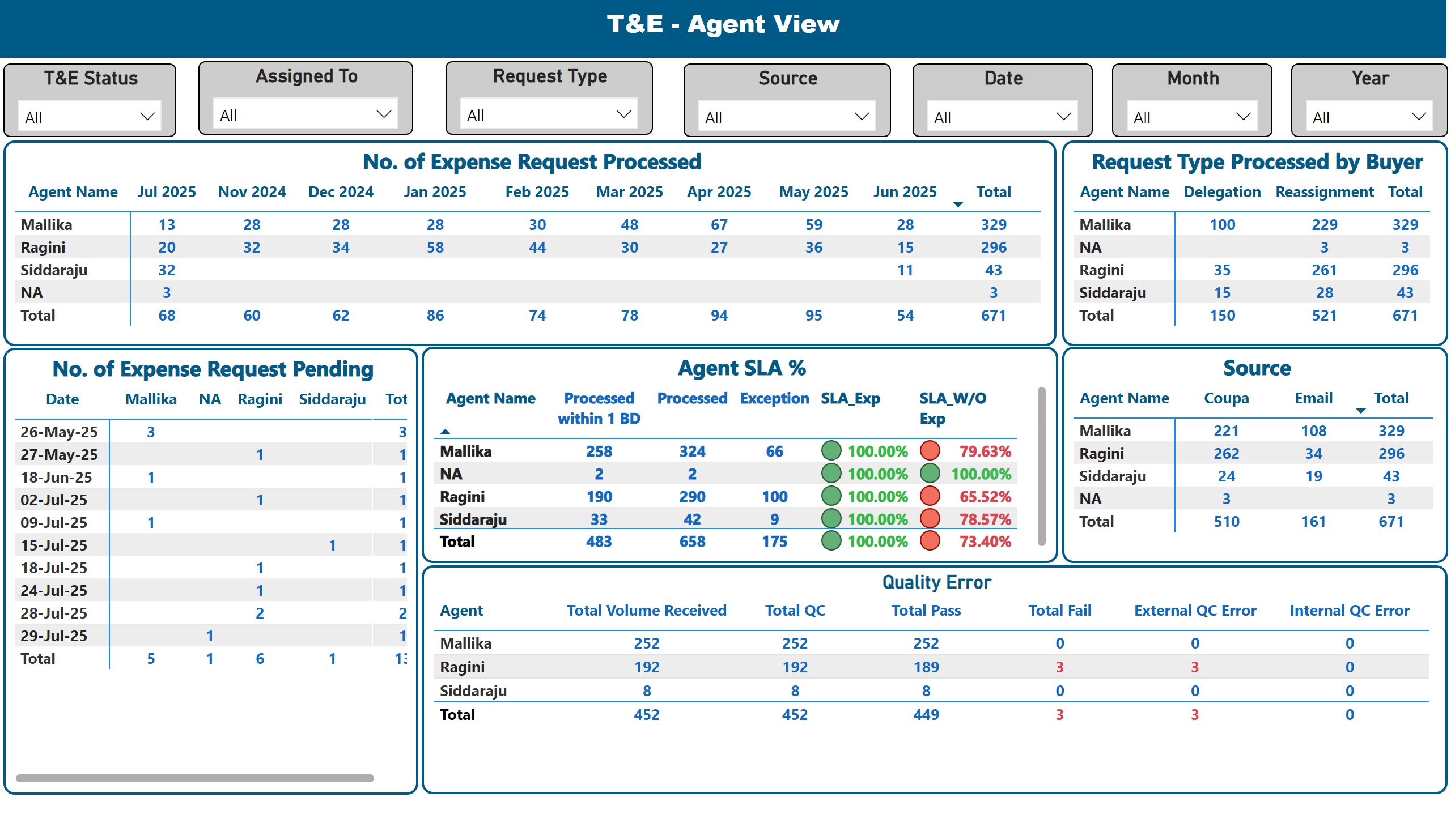
T&E_Agent View
Notes:
No. of Expense Request Processed
No alt text provided
Agent SLA %
No alt text provided
Request Type Processed by Buyer
No alt text provided
Assigned To
No alt text provided
Request Type
No alt text provided
T&E Status
No alt text provided
Month
No alt text provided
Year
No alt text provided
Date
No alt text provided
Source
No alt text provided
textbox
No alt text provided
Source
No alt text provided
No. of Expense Request Pending
No alt text provided
Quality Error
No alt text provided

Slide 8
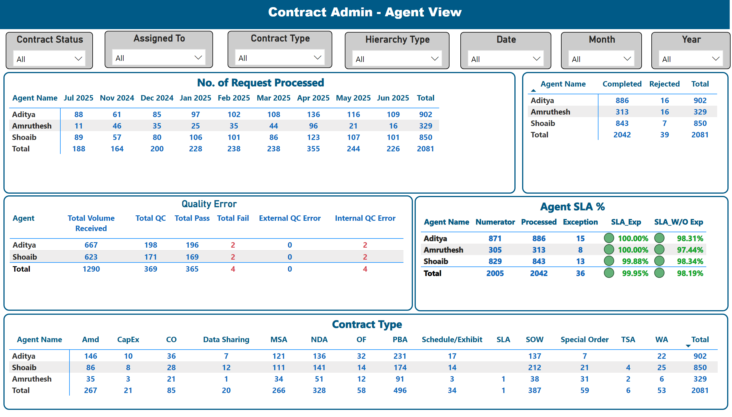
Contract Admin_Agent View
Notes:
No. of Request Processed
No alt text provided
Agent SLA %
No alt text provided
Assigned To
No alt text provided
Contract Type
No alt text provided
Contract Status
No alt text provided
Month
No alt text provided
Year
No alt text provided
Date
No alt text provided
Hierarchy Type
No alt text provided
textbox
No alt text provided
Contract Type
No alt text provided
pivotTable
No alt text provided
Quality Error
No alt text provided

Slide 9
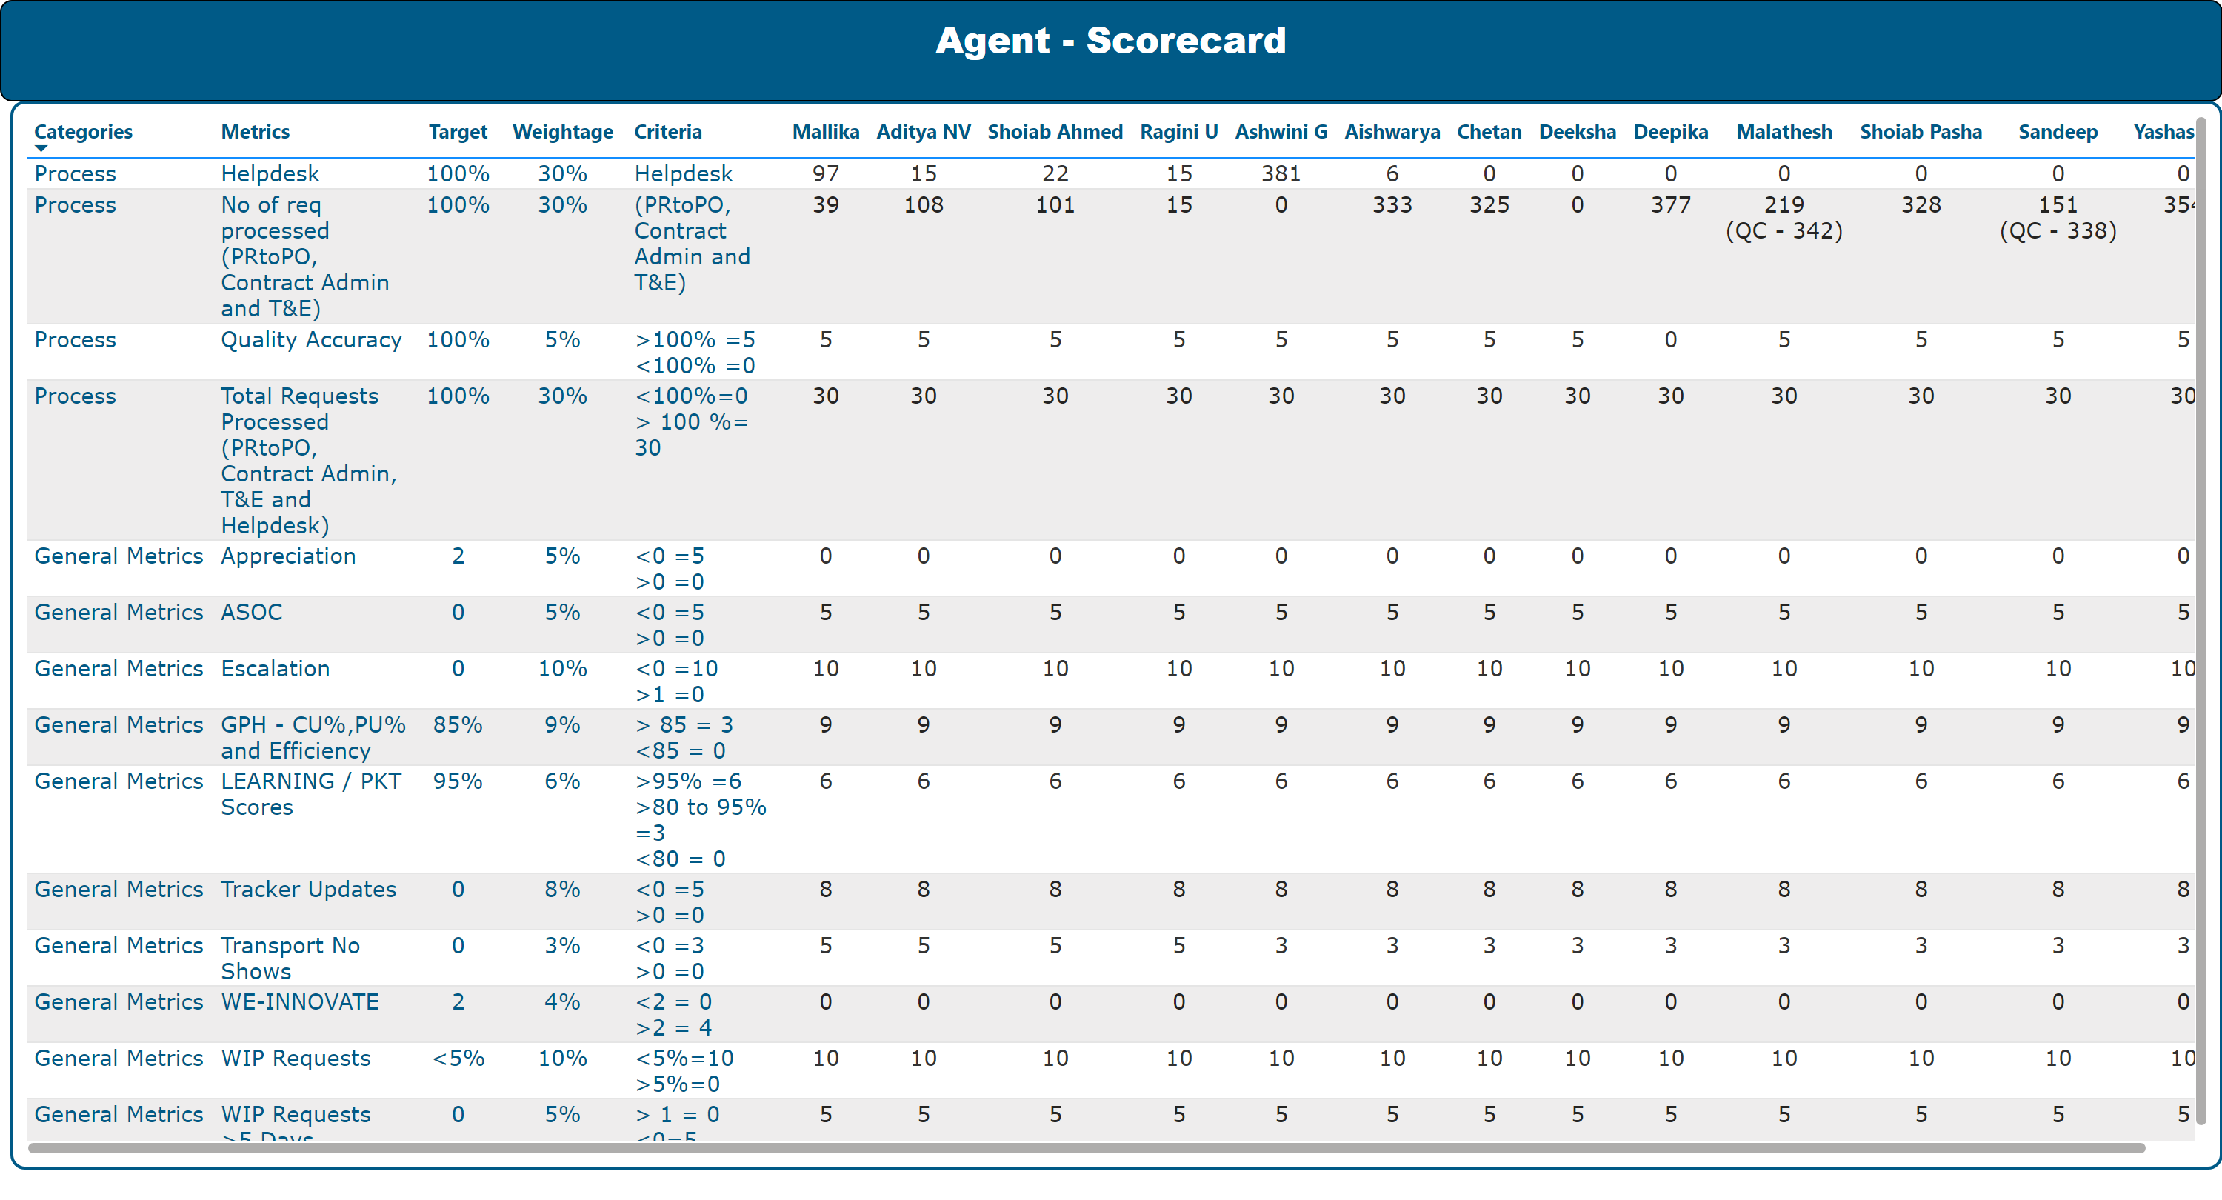
Score Card
Notes:
tableEx
No alt text provided
textbox
No alt text provided

