Slide 1
Restaurant recommender system
IBM Capstone project.

Slide 2
Recommender System
Machine learning
Exploratory analysis
Inferential analysis

Slide 3
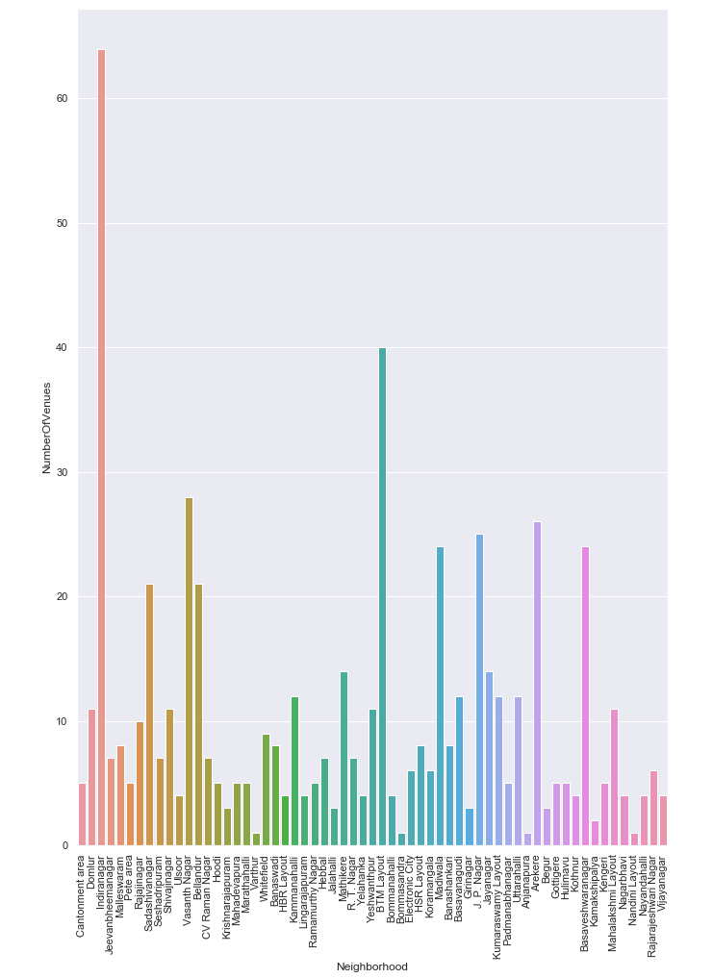
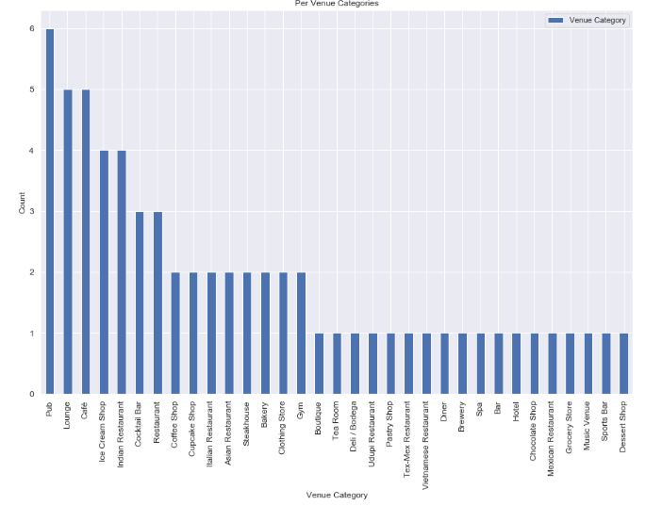

Slide 4
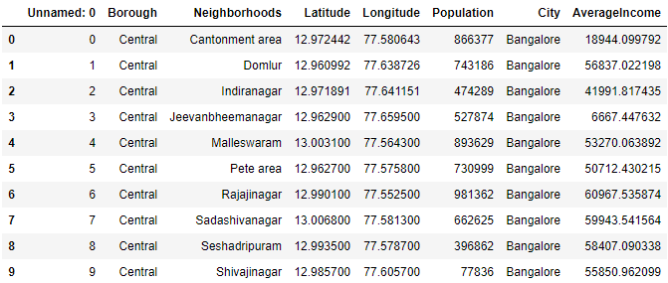
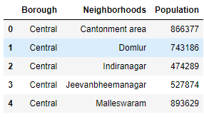
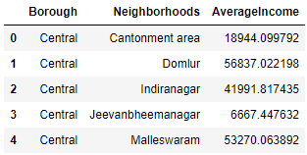

DATASETS

Slide 5
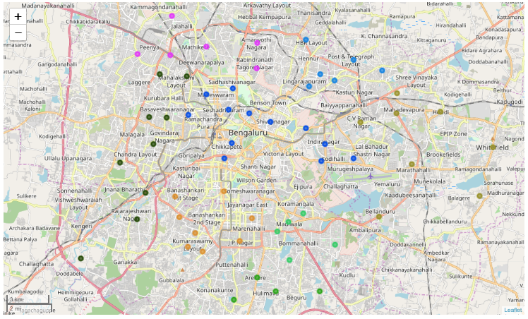
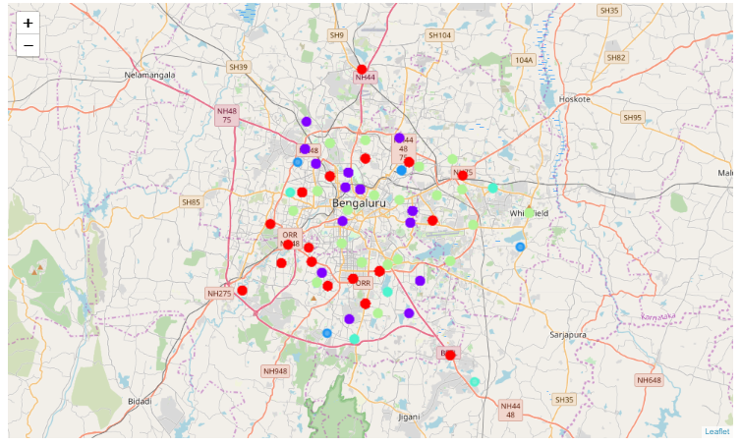
MAPING WITH CLUSTERING

Slide 6
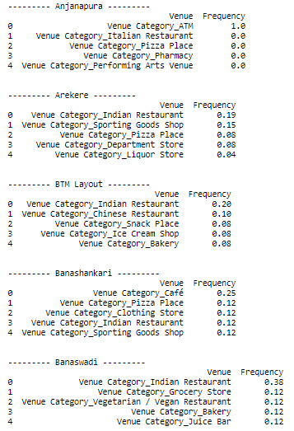

RESULTS

Slide 7
THANK YOU !
Amitabh

