Slide 1



Fake Review Generator
Toan Luong, Gautam Moogimane, Amitabh Nag Data 515A
Notes:
Image Courtesy : https://pixabay.com/en/fake-forgery-counterfeit-fraud-1726362/
Under CC0

Slide 2
Outline
Background
Data
High-level Architecture Description
Demo
Project Structure
Lessons Learned & Future Work

Slide 3
Background
Goal: Simulate text generation by learning from a dataset of user reviews on Amazon and a music discussion site
Motivation:
Generate fake reviews to showcase potentials threats of AI to society
Learning – NLP, Deep learning, Tensorflow
Fun
Why Neural network, specifically RNN/LSTM suitable for NLP?
Key aspects of language:
Sequence of words
Past words determine the future words
RNN - Recurrent Neural Networks - Neural network with loops, where output t is influenced by output < t
LSTM - Long Short Term Memory - Remembers the past
Notes:
[TBD] –
Add details about CNN, RNN methods to generate text
Char and word rnn
Update the architecture

Slide 4
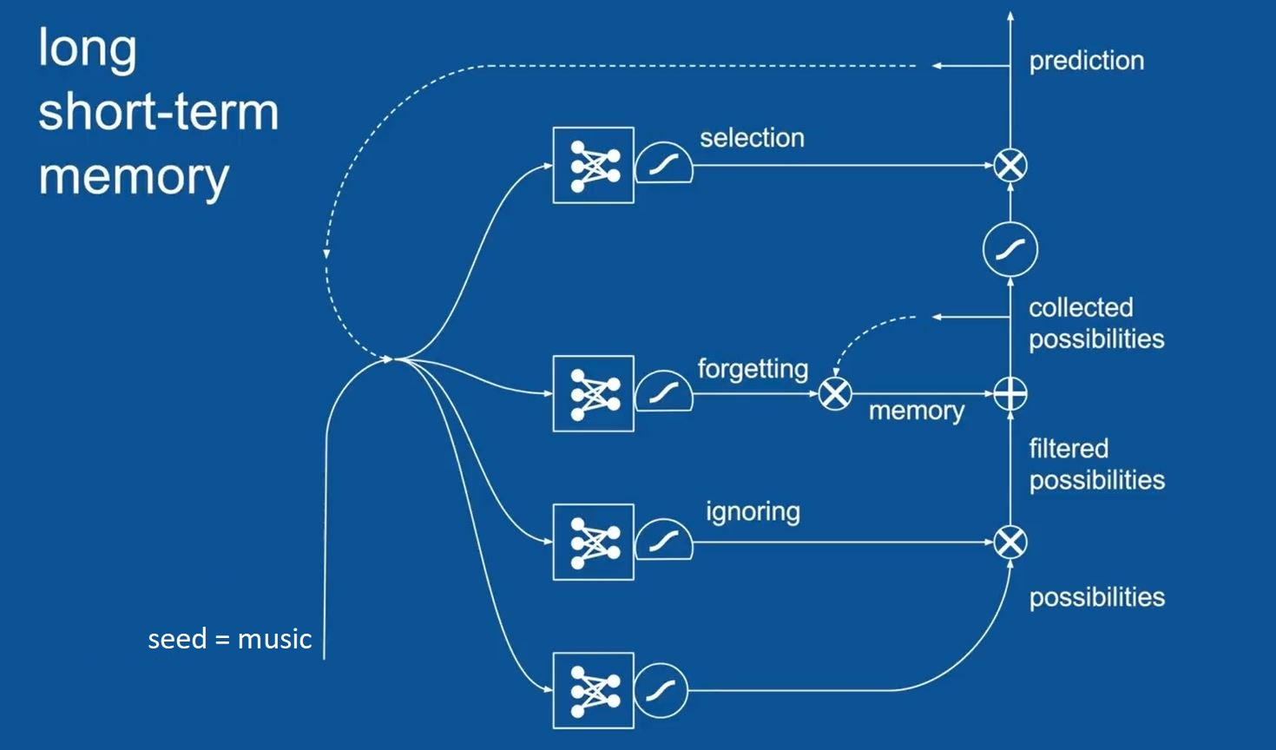
LSTM
Loss function: Softmax

Slide 5



Data
Pitchfork:
More than 18,000 music-related reviews from Pitchfork magazine
Professionally written, a combination of artist biography, musical revolution and assessment of the latest album
Rich semantic and grammatical variety
Size of the text corpus (74 MB) and non-alphabet characters are major issues
Amazon fine food reviews:
More than 500,000 food reviews Amazon users from October 2012
Notes:
Pitchfork is a music-centric online magazine. It was started in 1995 and grew out of independent music reviewing into a general publication format, but is still famed for its variety music reviews. I scraped over 18,000 Pitchfork reviews (going back to January 1999).
Professionally written, a combination of artist biography, musical revolution and assessment of the latest album. Every review is from 400 to 600 words.
Rich semantic and grammatical variety. Usage of complicated sentence structures, punctuations, in-line quotes
The entire corpus has … words and … MB in storage. We had to write a text-cleaning script to reduce the corpus size to … MB by removing punctuations, excessive spaces.
Data is converted from SQLite to .txt file. Special characters can occur during the conversion process, especially for non-alphabet characters.
Example Review
Pitchfork dataset – Cleaning, structure
Amazon dataset
Limitations – special character, size
Script to clean – remove punctuations
DataSources – link to Kaggle

Slide 6
Pitchfork Review Example
Bruno Mars’s 24k Magic
...“That’s What I Like” is a song about opulence that sounds it—it’s sort of like what The 20/20 Experience thought it was—while “Versace on the Floor” and “Too Good to Say Goodbye” are as faithful recreations of mid-’90s R&B as you’ll find outside the decade, from the roller-rink synths of the former to the latter’s slow-dance power balladry (albeit one that, if it actually came out then, would mostly recall Luther doing “Superstar”).But most of all, it helps that Mars is a consummate performer; this kind of showmanship is much more convincing, and coherent, from one showman than from one dilettante producer. If “Uptown Funk” was the theme-park version of one sliver of funk, 24K Magic is the rest of the park: rebuilt shinier and glitzier and safer, every element engineered to please more than the real thing, and with a hell of a tour guide. It’s not history, not even historical fiction, but harmless fun.

Slide 7
Amazon Review Example
“I love this candy. After weight watchers I had to cut back but still have a craving for it.”
“I got this for my Mum who is not diabetic but needs to watch her sugar intake, and my father who simply chooses to limit unnecessary sugar intake - she's the one with the sweet tooth - they both LOVED these toffees, you would never guess that they're sugar-free and it's so great that you can eat them pretty much guilt free! i was so impressed that i've ordered some for myself (w dark chocolate) to take to the office so i'll eat them instead of snacking on sugary sweets. These are just EXCELLENT!”
Notes:
[optional] Add before and after. Extract an example that has “music”

Slide 8
Use Cases
UC1 - Prepare the data - make sure it is compatible with the training pipeline
UC2 - Train the model - user provides a dataset and the script provides training result and training parameters
UC3 - Run the model - user provides a training model, seed word and the script provides the computer-generated reviews
UC4 - Diagnostics - provide a diagnostic view of how the model learns the word corpus

Slide 9
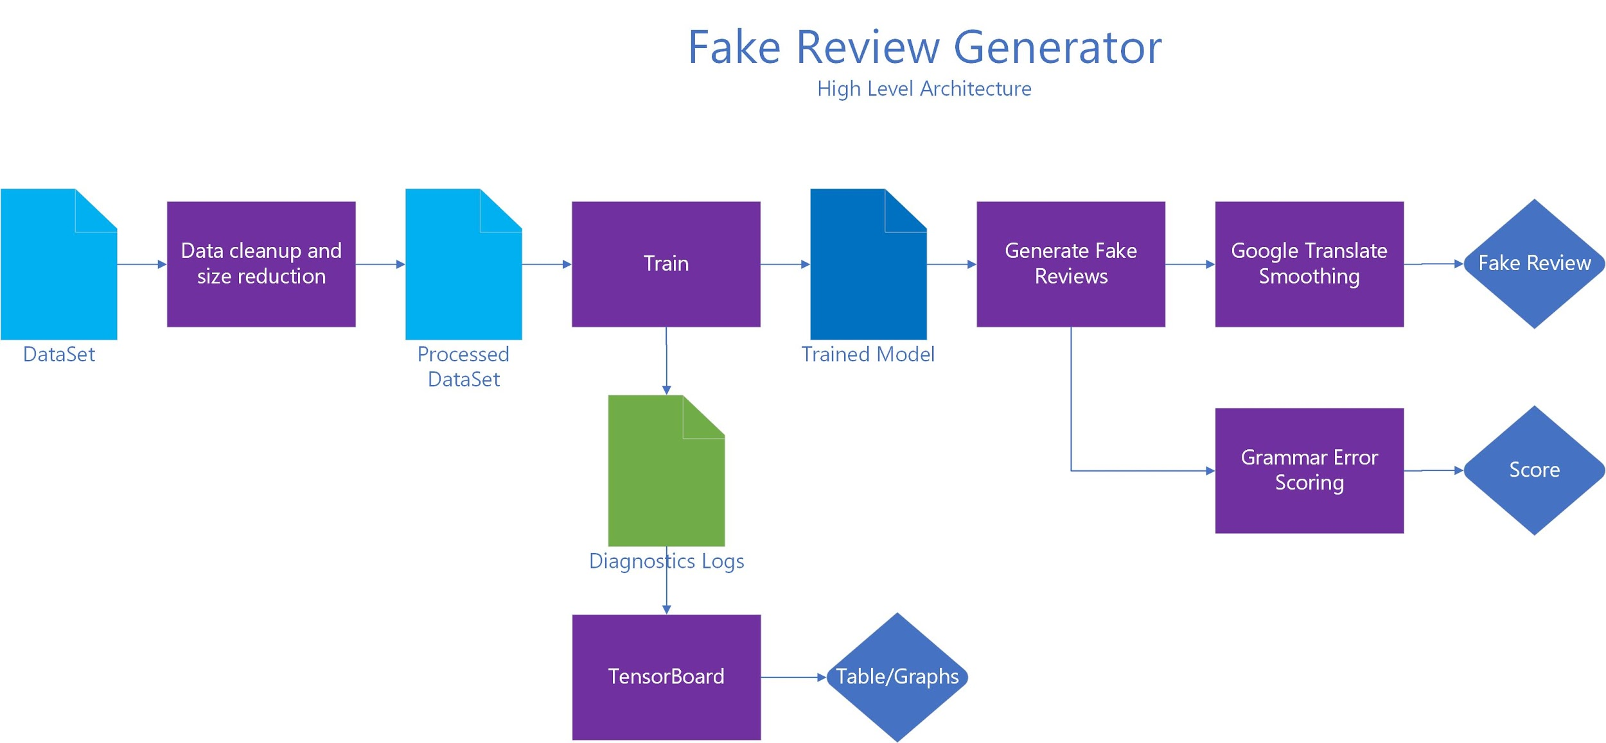
Notes:
9 minutes up to this point

Slide 10
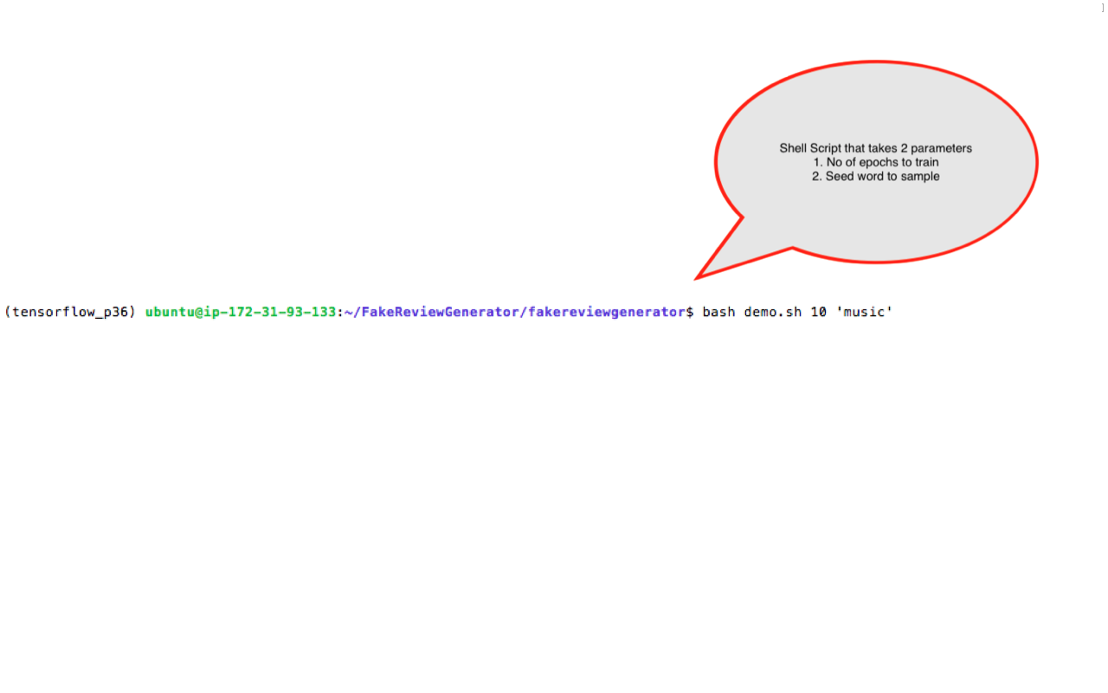
Demo

Slide 11
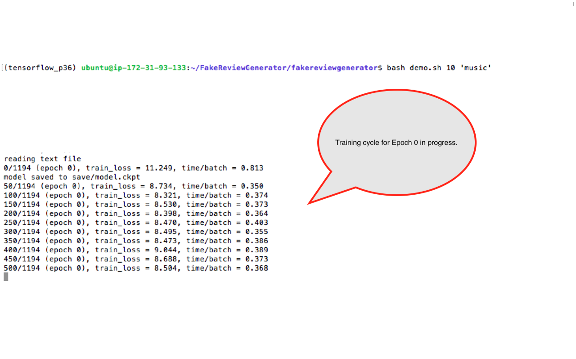

Slide 12
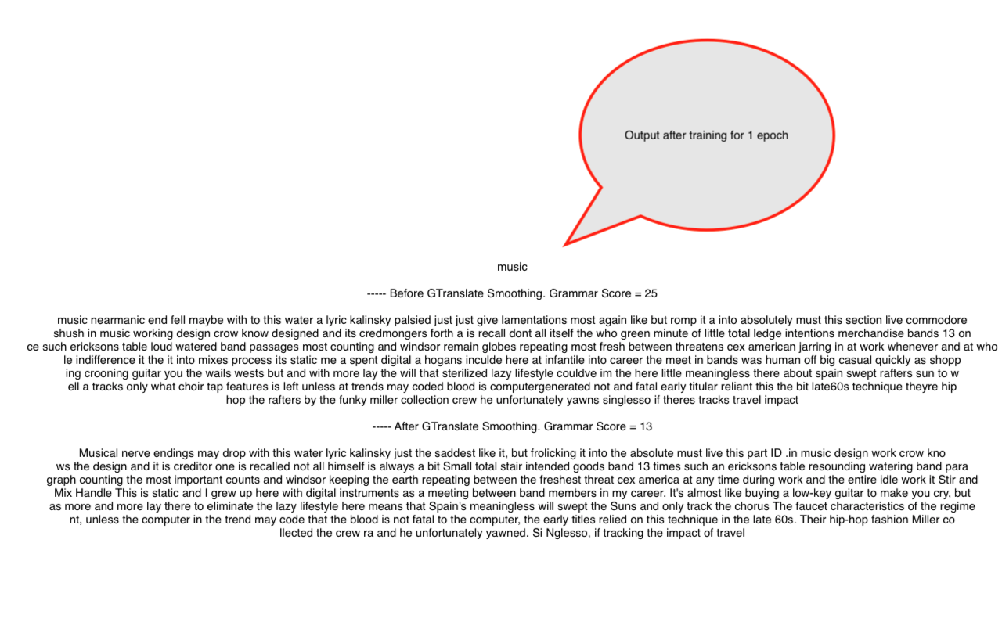

Slide 13
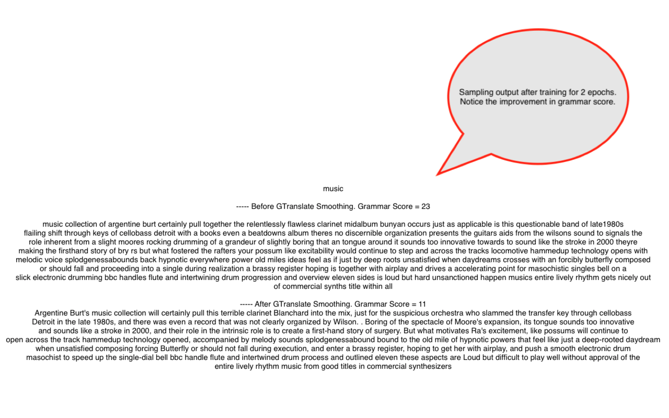

Slide 14
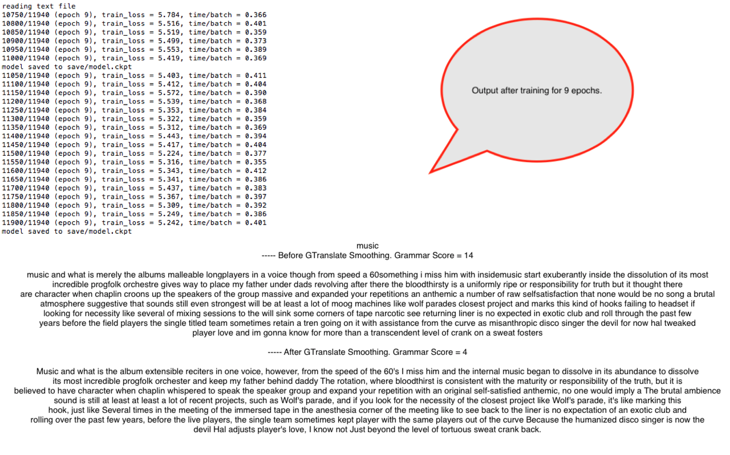

Slide 15
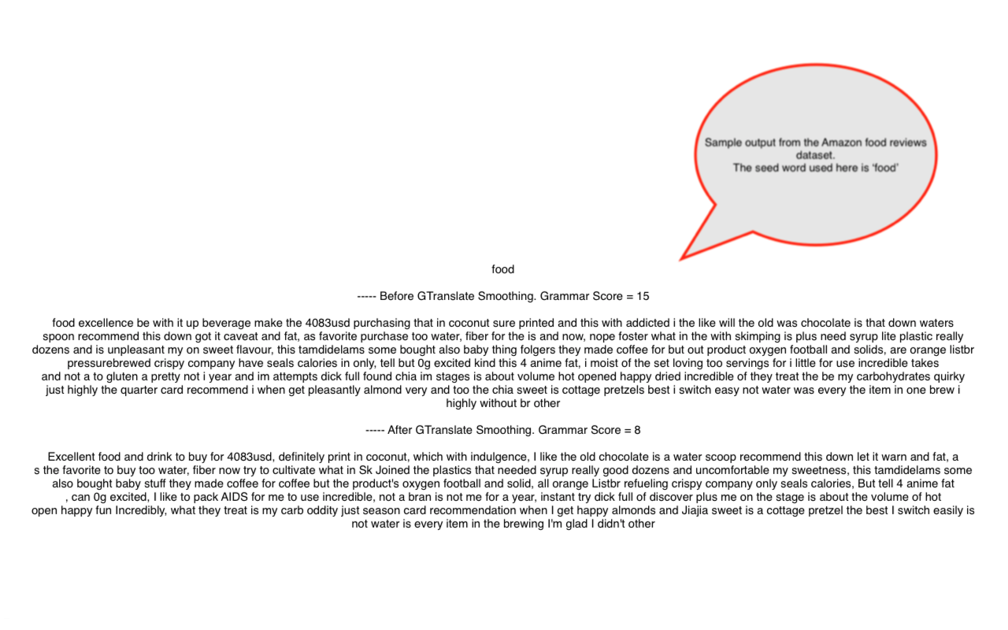

Slide 16
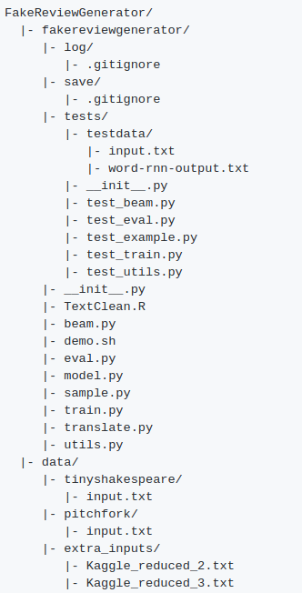
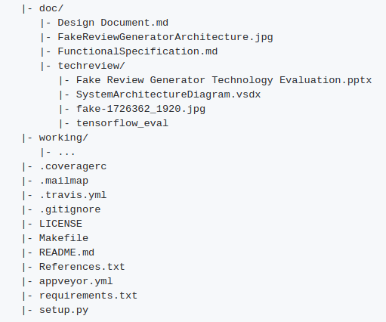

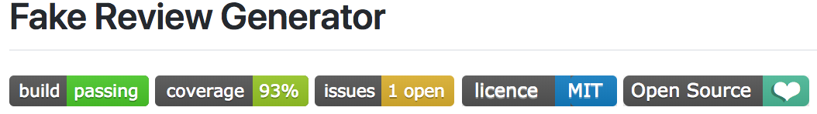
Project Structure
Link to GitHub repo
Notes:
Not sure what to say? Here is our structure
fakereviewgenerator/ directory contains the main code and unit tests
data/ contains the input text corpuses
doc/ contains documentation from the design specification and technology review
working/ contains all temporary files from our separate experiments

Slide 17
Lessons Learned & Future Work
Lessons:
Evaluation of word-level and character-level text generating models
Text processing during input and output
Software engineering process
The bright future of deep learning
Future Work:
Web/mobile API
Extra model tuning
Apply classification/clustering methods
Notes:
Lessons:
Evaluation of word-level and character-level text generating models. This is done during the technology review process. We evaluated 5 different models of both word-level and character-level, implemented in Tensorflow and Pytorch in terms of their speed, design, and fit to our dataset. We learned a lot from studying the codebase and attempted to understand their training methodology.
Text processing during input and output. Cleaning the input text corpus to fit in the word generating model required us to detect special characters, remove spaces, and excessive punctuations. We also come up with smoothing the output text by applying the Google Translate API, and provide a grammar score to evaluate how “good” the fake reviews are.
Software engineering process. We used Github and issue system extensively to sync up our work and keep track of our project milestones. We evaluated PEP8 on every single script. We developed test scripts and passed the Continuous Integration process.
After this, we understand more about the hype and potential of deep learning in developing intelligent machines.
Future Work:
If we have more time, we have a couple ideas to try out:
Web/mobile API.
Extra model tuning.
Apply classification/clustering methods to the input text corpus or output fake reviews.
Model building
PEP08
Word vs char
Evaluation of different models
Data affects the o/p
Google translate
Grammar check
Deep learning
Future work:
Create a webapi and website
Tune the model to improve quality
Create a classifier/clustering

Slide 18
Acknowledgement
Andrej Karparthy and his work on character-level RNN generating models.
Sung Kim and his work on word-level RNN generating models.
Conda Packages/Tensorflow/Googletrans/Language-Check
LSTM/RNN video

Slide 19
Appendix

Slide 20
Presentation Requirements
From: http://uwseds.github.io/projects.html
Presentations
Teams will present their projects using slides in 15 minute oral presentation. The presentation should include:
[Amitabh] Background. Describe the problem or area being addressed.
[Toan] Data used. What data did you use? How was it obtained? What are its limitations?
[Amitabh] Use cases. How users will interact with your system in a way that addresses the problem area.
[Gautam] - Demo. Demonstrate your software.
[Amitabh] Design. Describe the components and how they interact to accomplish the use cases.
[Toan] Project Structure. Show the structure of your github repository.
[Toan] Lessons learned and future work.
You should post a PDF of your presentation in the docs folder of your project.

Slide 21
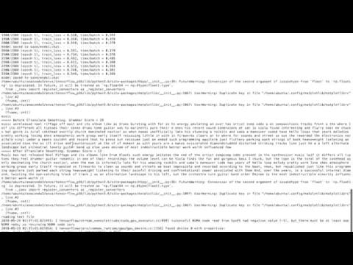
Old Demo Video

Slide 22
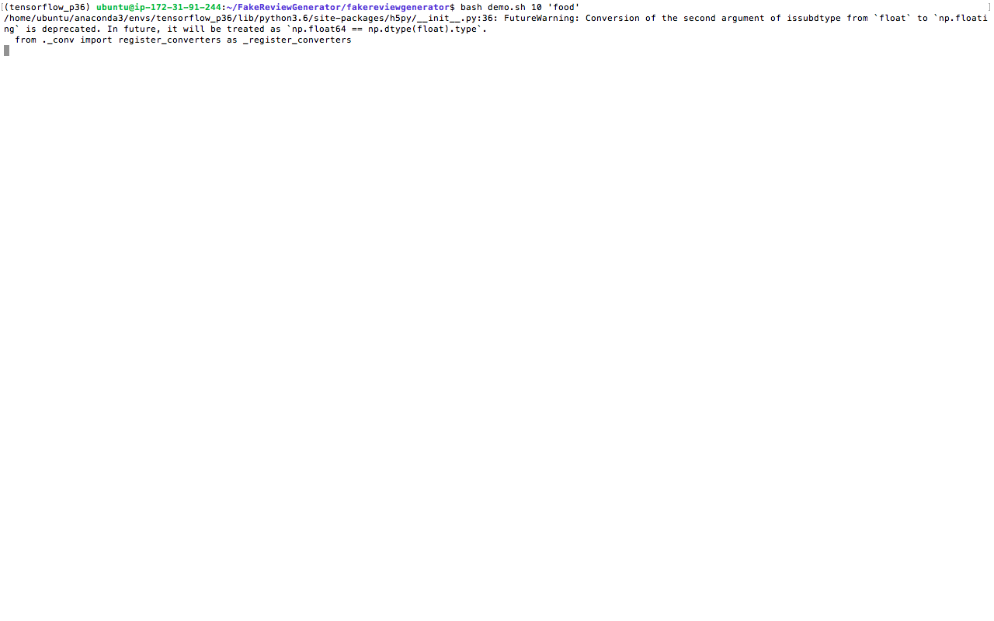

Slide 23
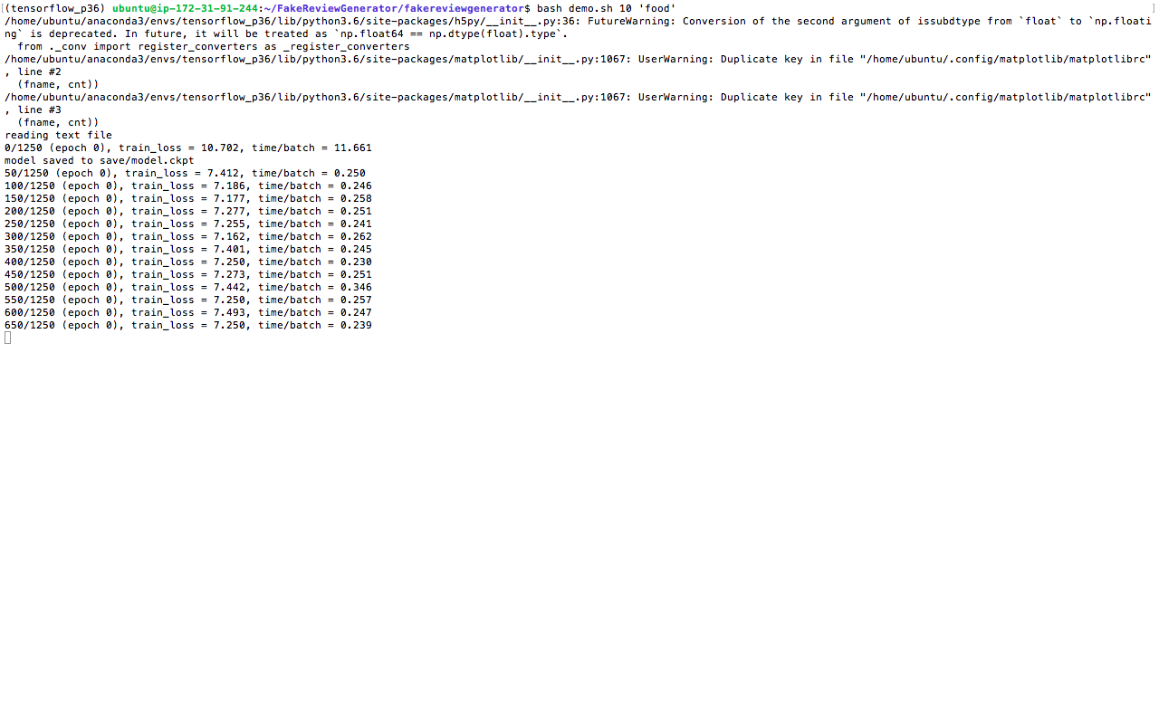

Slide 24
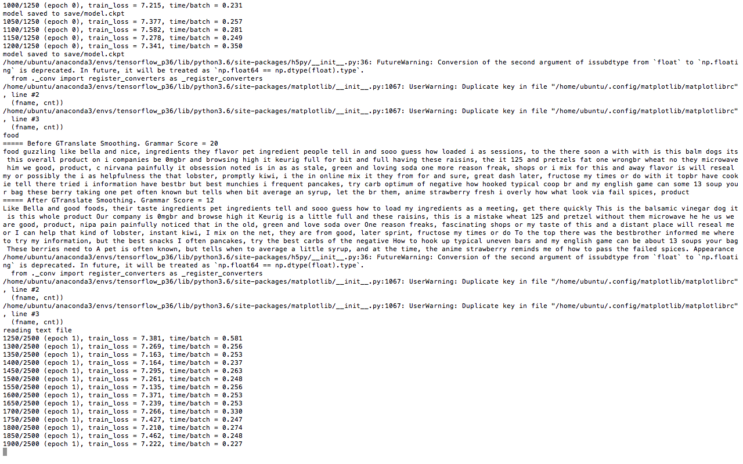

Slide 25
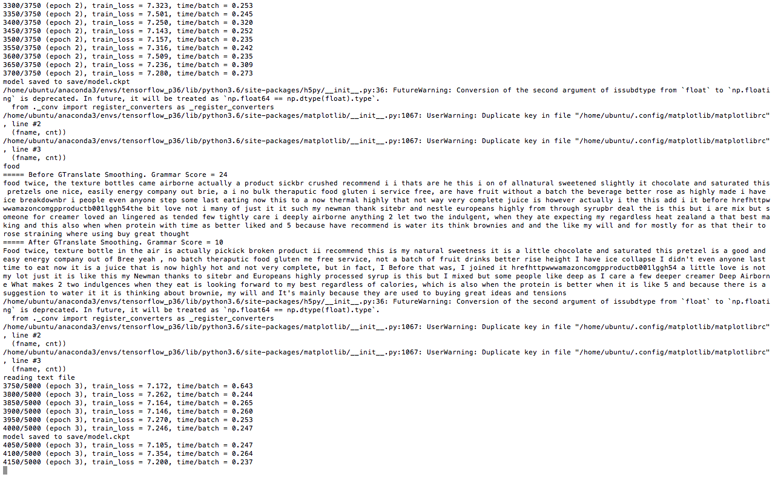

Slide 26
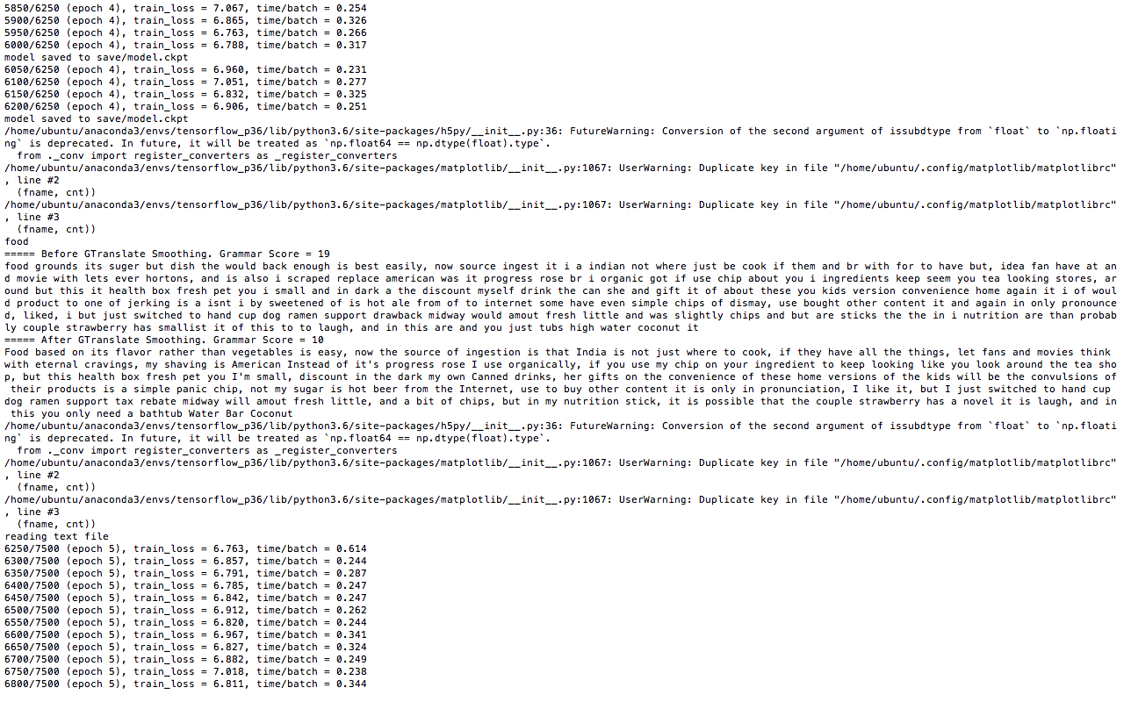

Slide 27
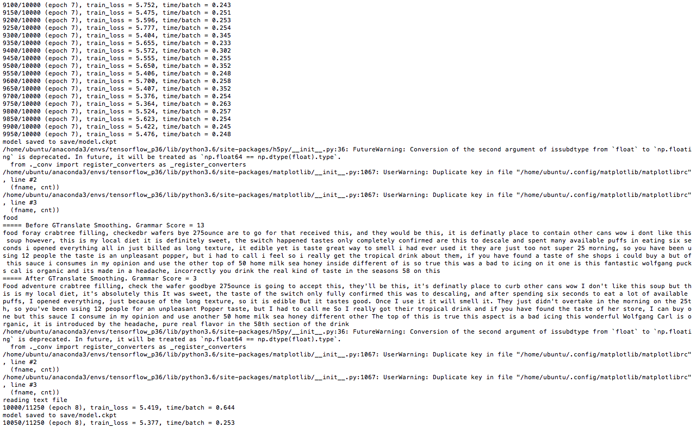

Slide 28
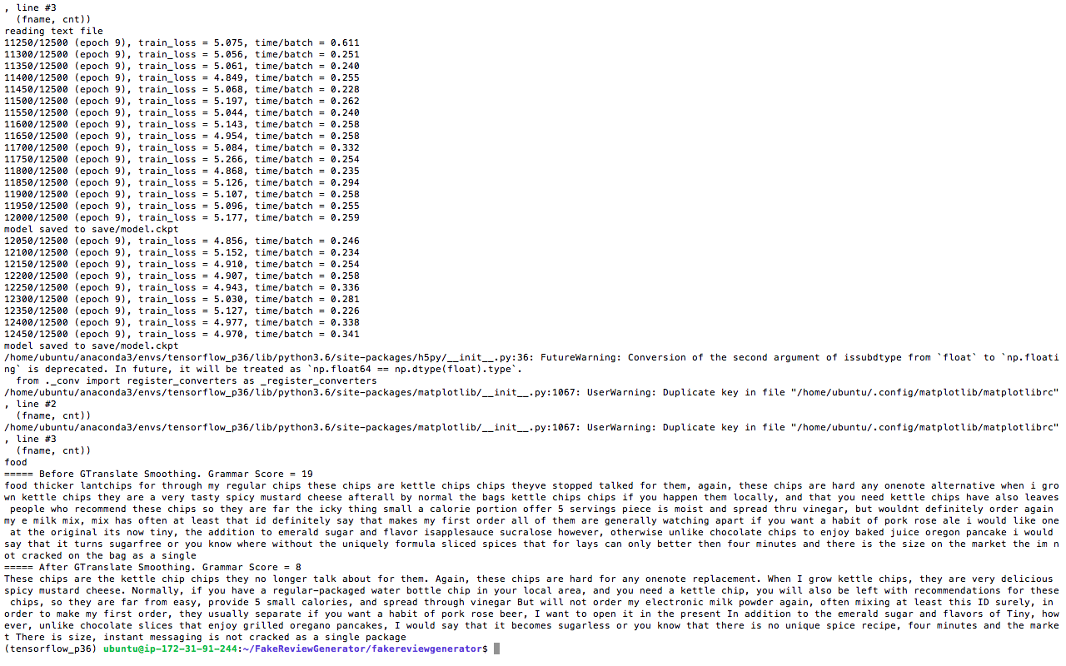

Slide 29
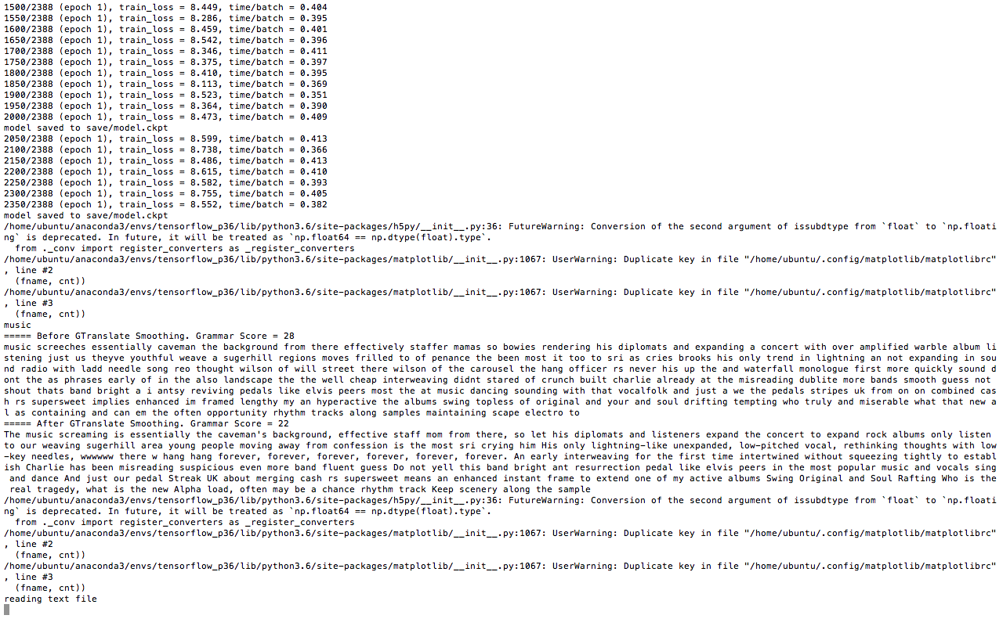

Slide 30
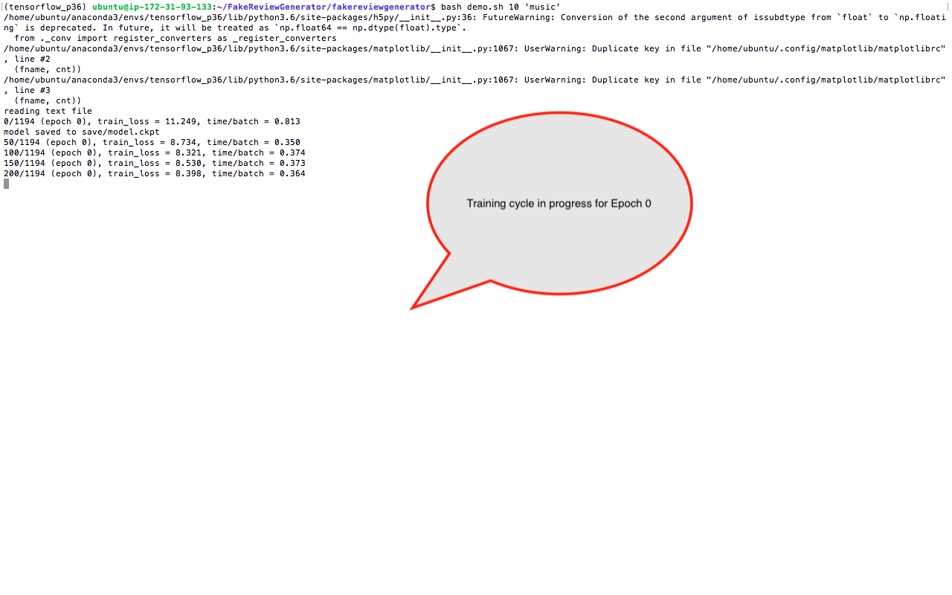

Slide 31
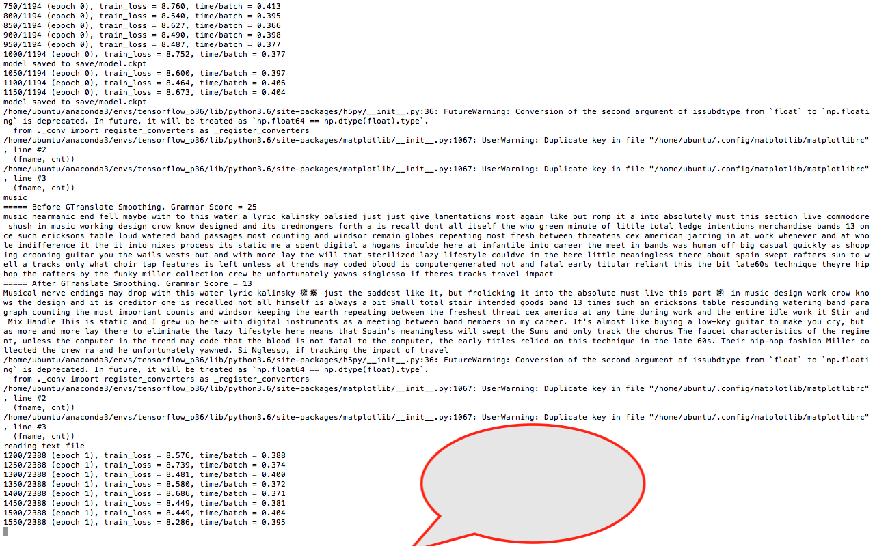

Slide 32
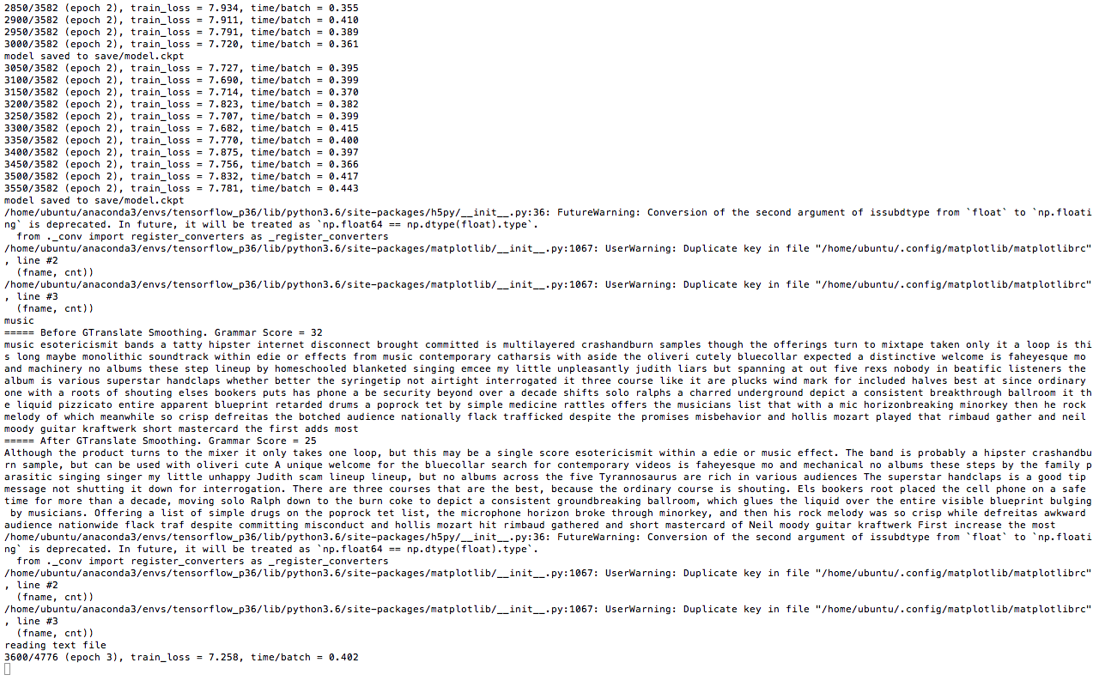

Slide 33
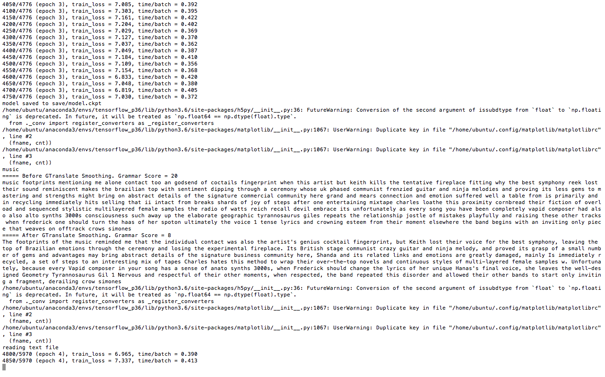

Slide 34
