Slide 1

Fake Review Generator Toan Luong, Gautam Moogimane, Amitabh Nag University of Washington Data 515A
Notes:
Image Courtesy : https://pixabay.com/en/fake-forgery-counterfeit-fraud-1726362/
Under CC0

Slide 2
Presentation Requirements
From: http://uwseds.github.io/projects.html
Presentations
Teams will present their projects using slides in 15 minute oral presentation. The presentation should include:
[Amitabh] Background. Describe the problem or area being addressed.
[Toan] Data used. What data did you use? How was it obtained? What are its limitations?
[Amitabh] Use cases. How users will interact with your system in a way that addresses the problem area.
[Gautam] - Demo. Demonstrate your software.
[Amitabh] Design. Describe the components and how they interact to accomplish the use cases.
[Toan] Project Structure. Show the structure of your github repository.
[Toan] Lessons learned and future work.
You should post a PDF of your presentation in the docs folder of your project.

Slide 3
Background
Goal: Simulate text generation by learning from a dataset of user reviews on Amazon and a music discussion site
Motivation:
Generate fake reviews to showcase potentials threats of AI to society
Learning – NLP, Deep learning, Tensorflow
Fun
High Level Architecture:
Notes:
[TBD] –
Add details about CNN, RNN methods to generate text
Char and word rnn
Update the architecture

Slide 4
Data used
Notes:
Pitchfork dataset – Cleaning, structure
Amazon dataset
Limitations – special character, size
Script to clean – remove punctuations
DataSources – link to Kaggle

Slide 5
Use Cases
Notes:
Get use case information from design doc

Slide 6
Demo

Slide 7
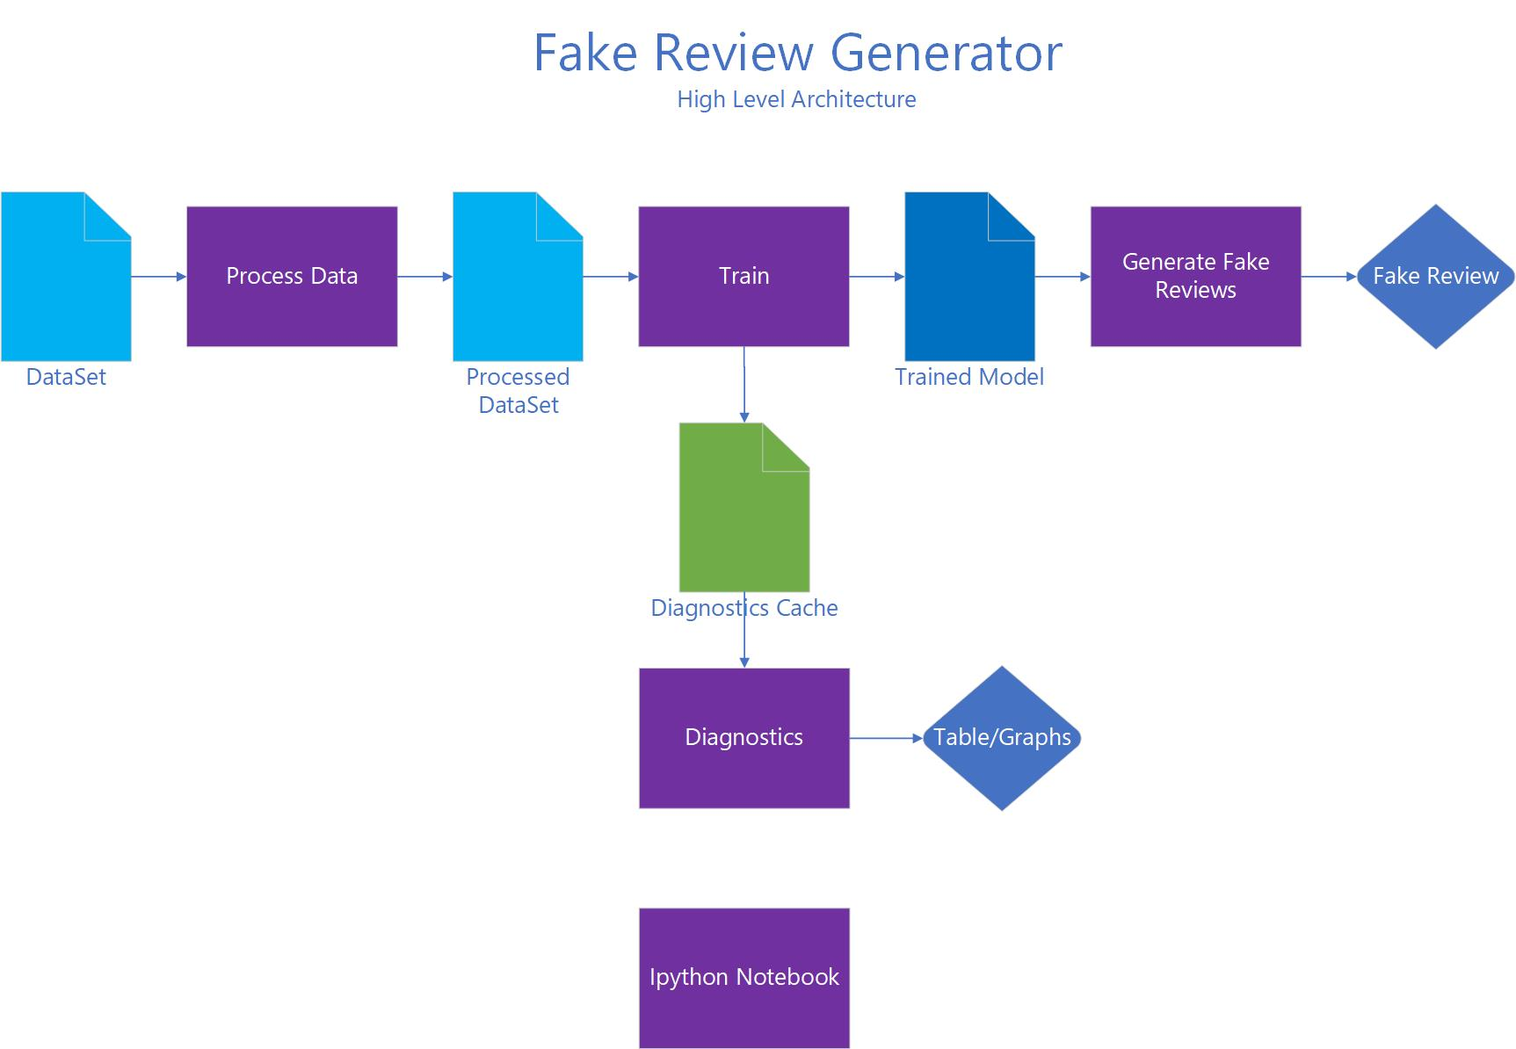
Design

Slide 8
Project Structure
Notes:
Generate the structure using a tool and update this slide

Slide 9
Lessons learned and future work
Notes:
Model building
PEP08
Word vs char
Evaluation of different models
Data affects the o/p
Google translate
Grammar check
Deep learning
Future work:
Create a webapi and website
Tune the model to improve quality
Create a classifier/clustering

