Slide 1
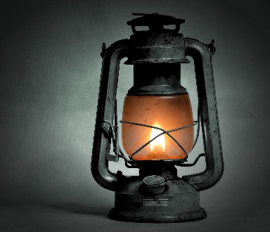

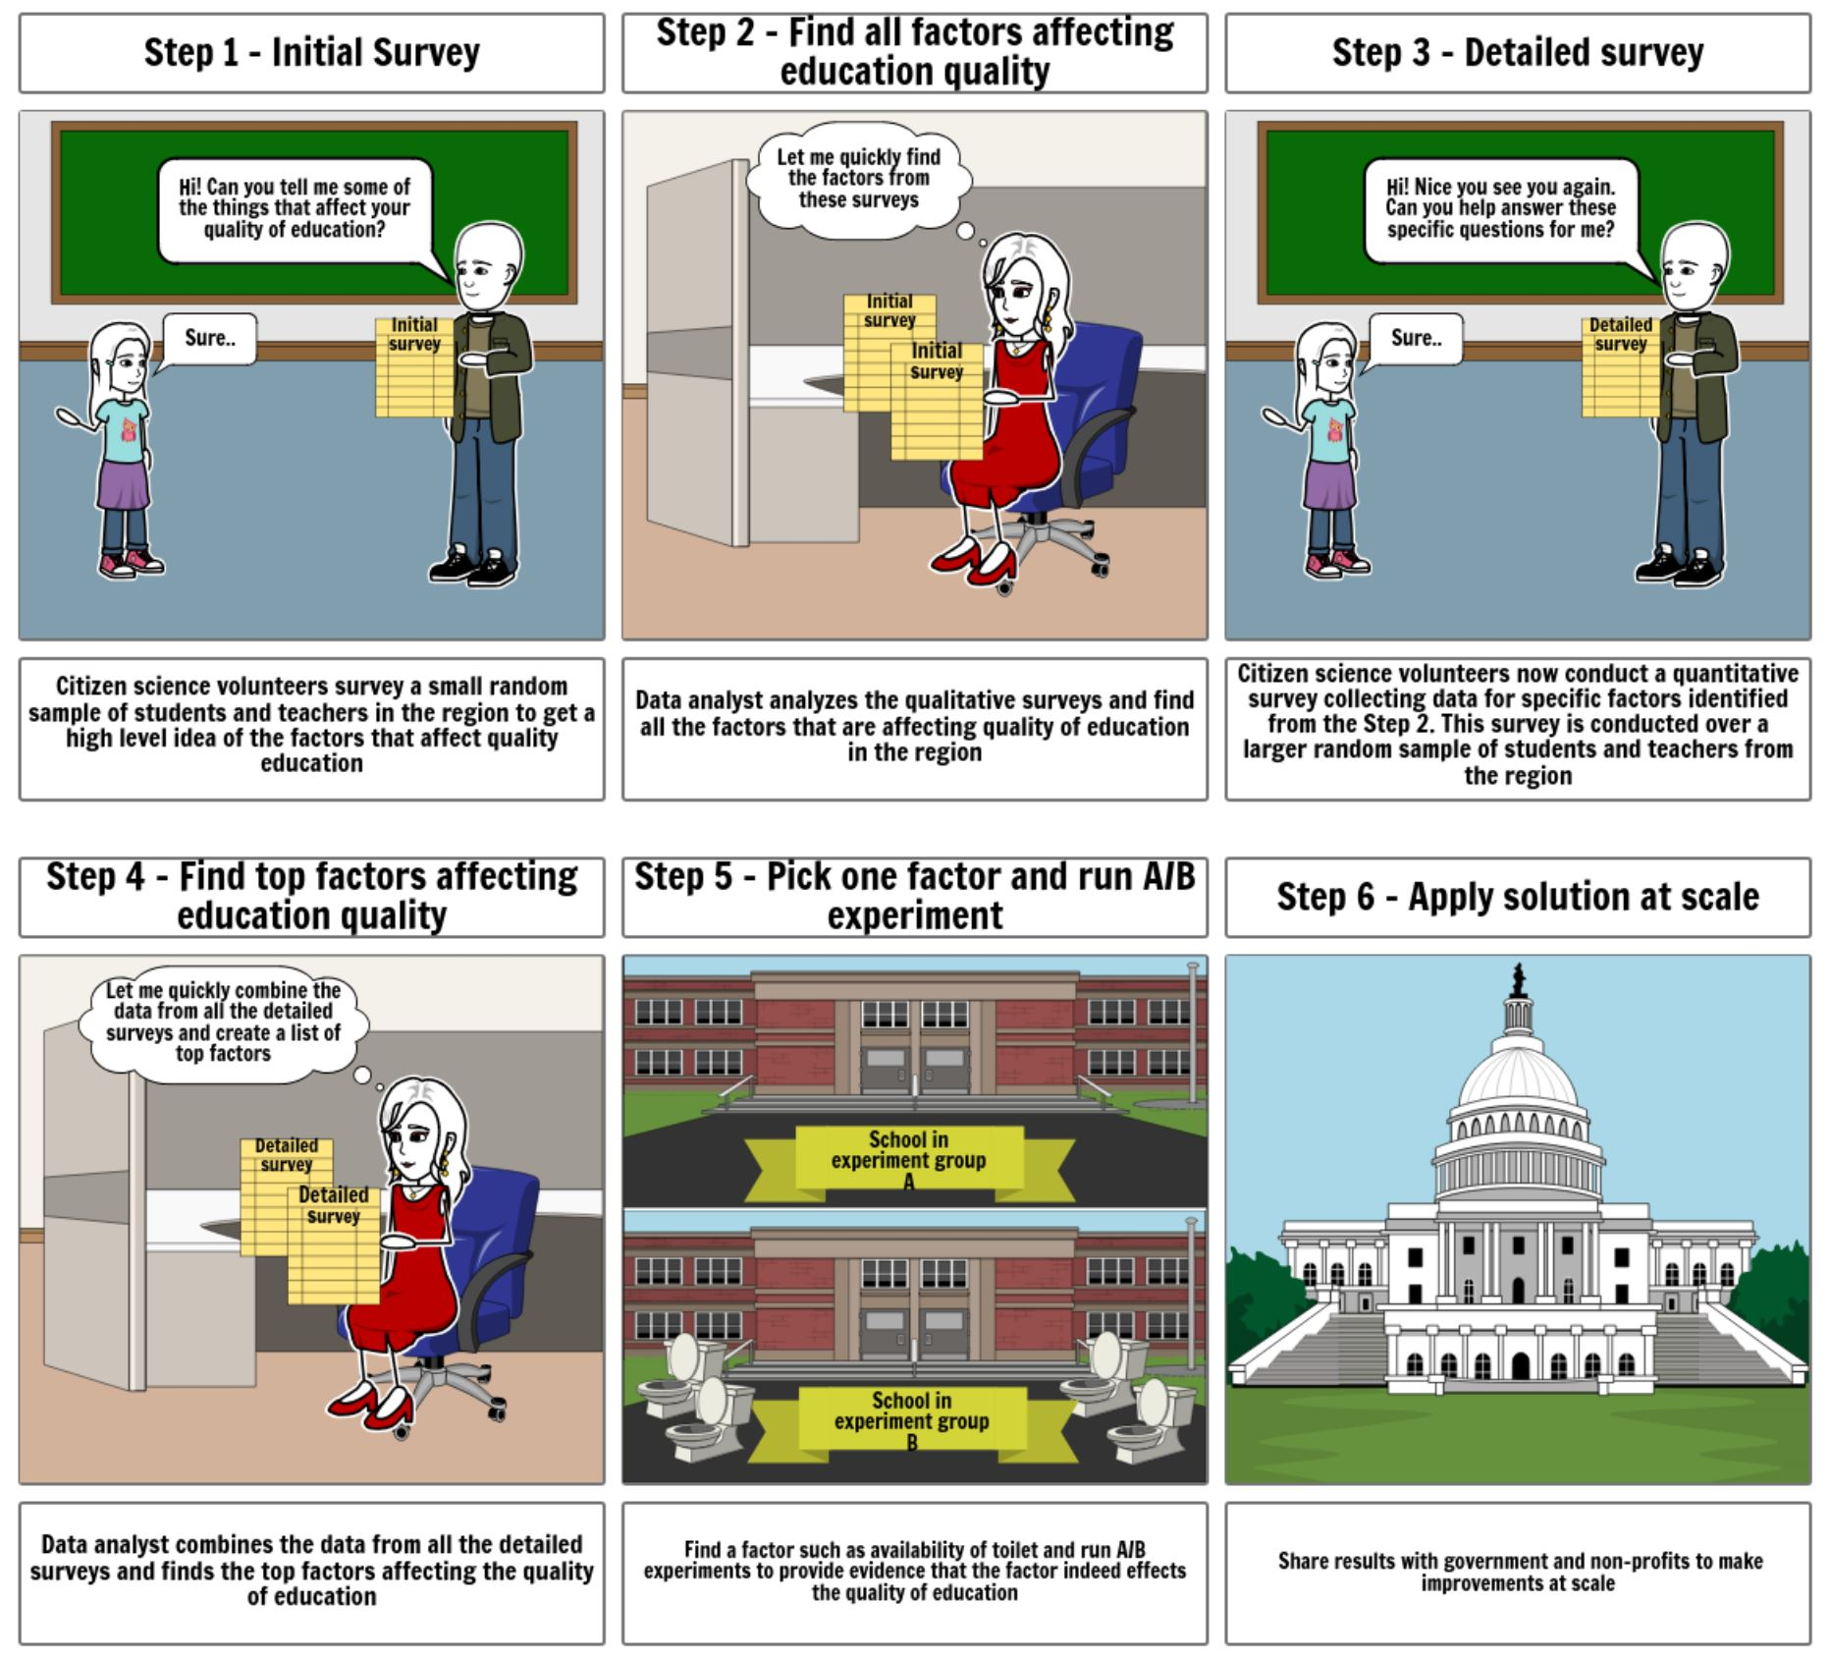
Project Light
Amitabh Nag
Problem
Access to quality K-12 education is a challenge around the world. United Nations have made it as a one of the sustainable development goals. There are multiple factors affecting the quality education. However, there is a lack of data driven consensus on what those factors are and how much they affect the education quality. Moreover, these factors can differ from one region to another. Hence a one size fits all approach does not work
Solution
I propose Project Light – a data and experiment driven framework to improve education quality. This framework can be used globally, but still allows regional adaptation thru local data. Project Light is a four-stage cyclical framework:
Qualitative Survey -> Quantitative Survey -> Experimentation -> Scale -> Qualitative Survey
1. Qualitative Survey
Data question: What are the possible factors affecting education quality?
2. Quantitative Survey
Data question: What are the top factors?
3. Experimentation
Data question: Can experiment prove that by influencing the factor, quality of education really improves?
4. Scale
Question: How can the factor be improved at scale?
Qualitative survey of teachers, students by Citizen science volunteers
Quantitative survey of teachers, students, school administrators by Citizen science volunteers
Program Lead coordinates survey, analysis and funding for a region
Data analyst find all the factors from the surveys
Data analyst find top factors from the data
Quantitative survey includes granular data for each factor. E.g. number of toilets in a school
Program Lead coordinates experimentation and funding activities for a region
Program lead coordinates with government and non-profit to secure funding and apply learning from the experiment to a larger scale
Run A/B experiment on multiple schools changing one of the factors such as toilet availability
Inspiration
DUB talk by Julia K. Parrish on “Paper, Pencil, Smartphone, App: Optimizing Data Quality and Participant Retention in Hands-on Citizen Science” inspired me to think about quality and consistent data collection using Citizen Science volunteers.

