Slide 1
A Deep Learning Approach to Residue-Level NES–CRM1 Binding Prediction
Amitai Turkel, Yedaaya Zivan, Ori Kitsberg, Yifa Admoni
Notes:
Today I’ll present a deep learning pipeline for identifying which residues in Nuclear Export Signals (NESs) bind to the CRM1 receptor. This work combines structural biology, language models, and sequence-based learning.

Slide 2
Biological Motivation
Why NES–CRM1?
NESs export proteins from the nucleus via CRM1.
CRM1 has 5 hydrophobic pockets that bind specific residues.
Accurate residue-level prediction is key for understanding nuclear export and targeting CRM1 in cancer.
Notes:
NESs are short, leucine-rich motifs. They control cellular localization of key proteins and bind CRM1 at 5 defined sites. Predicting which residues bind CRM1 helps both biology and drug discovery.

Slide 3
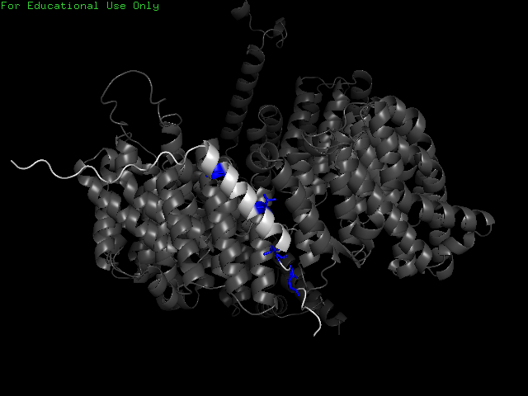
Dataset & Labeling Strategy
Data Source:
AlphaFold-predicted CRM1–NES complexes
Labels assigned using top-5 closest residues to CRM1 atoms
Notes:
We used AlphaFold structures, identified NES and CRM1 chains, and labeled the 5 closest residues as "binders"—reflecting CRM1's 5 pockets.

Slide 4
Model Overview
Architecture:
Input: ESM2 embeddings (protein language model)
Backbone: BiLSTM for sequence context
Output: Top-5 residue prediction via sigmoid + ranking
Pipeline Summary:
Structure parsing
Label generation
ESM2 embeddings
BiLSTM classification
Evaluation
Notes:
Our approach is sequence-only: we use ESM2 to embed peptides, then apply a BiLSTM to predict binding residues. We constrain the model to predict 5 per sequence.
חישבנו עד כמה המודל טוב לפי כמה חיבורים נכונים הוא חזה מתוך ה-5.

Slide 5
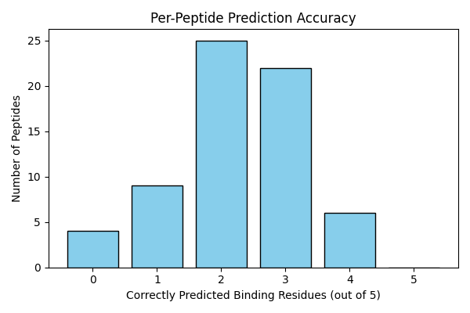
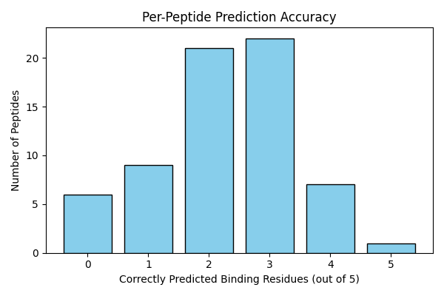
Results & Insights
Model Performance (Best Config):
Precision: 0.45
Recall: 0.45
F1 Score: 0.45
Weight
Without Weight
Notes:
While modest, the model outperforms random guessing (F1 ≈ 0.20). Performance was highest on shorter peptides. Longer sequences made residue selection harder.
עשינו גרסה ממושקלת, שנותנת באימון משקל גבוה יותר ל-1 (כי הוא רואה פחות 1 כי רוב הרצף הוא 0) אבל ראינו שזה לא שיפר באופן ניכר את התוצאות.

Slide 6
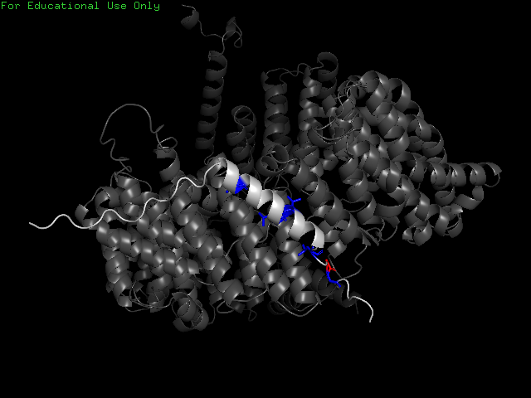
Visual Example - pos_FA68_E357_al
True lable:
Weighted model predication:
Notes:
Here’s a visual example from the test set. The model captures most true binders, though some are missed or incorrectly added. Weighted loss helped recall but slightly hurt precision.

Slide 7
Limitations & Future Work
Limitations
Next Steps
Labels from AlphaFold, not experimental
Train based sequence-only: lacks explicit 3D input
Assumes exactly 5 binders per peptide
Integrate known NES motif patterns into the model
Instead of binary labels, predict per-residue binding confidence
Integrate structure (e.g., distance maps)
Notes:
While powerful, our model has limitations: AlphaFold noise, no 3D context, and fixed-size output. Future work should incorporate structure or motif awareness.
המודל משתמש במבנים של אלפא פולד-בעצמם יכולים להיות לא מדוייקים, האימון לא רואה מבנים, רק רצפים, הנחנו שיש בדיוק 5 חומצות מינו שמתחברות, הנחה שלא בהכרח מדוייקת במציאות ואולי מגבילה את הביצועים של המודל.
הצעות להמשך- לשלב מבנים באימון, לשלב מידע על רצפים ידועים של נסים (כמו שראינו שיש) ולחזות הסתברויות במקום בינארי.

Slide 8
Summary
Sequence-based model predicts CRM1-binding NES residues
Uses ESM2 embeddings + BiLSTM + top-5 strategy
F1 ≈ 0.45: >2× better than random
Notes:
To conclude, this project shows how pretrained protein models and sequence-based learning can approach structural tasks like binding site prediction.

