Slide 1

SMART INDIA HACKATHON 2026
TITLE PAGE
Problem Statement ID – 26127
Problem Statement Title-City-Wide AI Engine for Multi-Camera ANPR Trajectory Tracking and Urban Traffic Analytics
Theme- Smart Automation
PS Category- Software
Team ID-15
Team Name- INNOVISION

Slide 2
IDEA/APPROACH DETAILS
TEAM
INNOVISION
HOW IT ADDRESSES THE PROBLEM
Isolated Camera Silos-Common vehicle/plate identity + camera ID + timestamp links vehicle sightings across cameranodes.
Manual Vehicle Search-A single plate query retrieves relevant sightings across the camera network instead of manual footage review.
No City-Level Traffic Intelligence-Aggregated detections generate density, flow-direction, trajectory and congestion analytics.
Unreliable OCR-Quality gating + temporal voting reduces incorrect plate identification caused by blurry, noisy or poor-quality frames.
PROPOSED SOLUTION
Developed a city-wide AI engine that transforms existing CCTV feeds into a searchable vehicle intelligence system for multi-camera ANPR, trajectory tracking and urban traffic analytics.
Vehicle detection and classification using YOLO11 for cars, motorcycles/two-wheelers, buses and trucks.
Multi-object tracking using ByteTrack to maintain persistent vehicle identities across frames.
Automatic number plate recognition (ANPR) using selective plate detection and EasyOCR.
Quality-gated OCR filters plate crops based on sharpness, contrast and size before recognition.
Temporal voting combines multiple OCR readings to confirm a reliable plate instead of trusting a single frame.
Cross-camera vehicle search allows a specific plate to be queried across the camera network.
GIS-based dashboard visualizes vehicle locations, chronological trajectories and camera-wise sightings.
Aggregated vehicle data provides traffic density, flow-direction, trajectory and congestion analytics.
Designed for deployment from single-camera → multi-camera → zone-level → city-wide scale.
INNOVATION AND UNIQUENESS
Temporal OCR Voting-Multiple OCR observations → repeated agreement → confirmed plate
Cost-Aware Track Selection-Plate processing only on stable, useful tracks → reduced computational load.
Quality-Gated OCR-Sharpness + contrast + size filtering → cleaner OCR input.
Modular Scalability-Detection → Tracking → ANPR → API → Dashboard can be deployed and scaled independently.

Slide 3
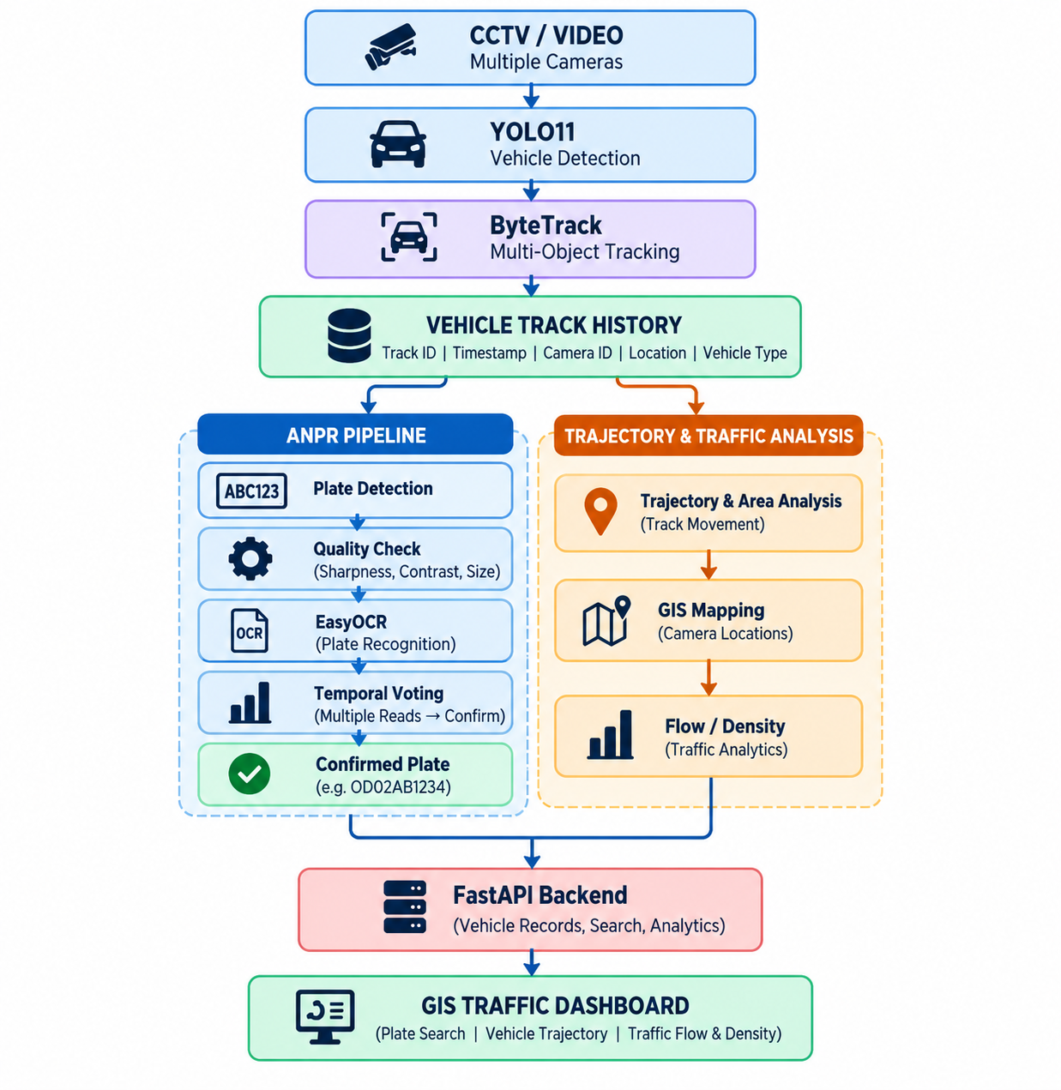


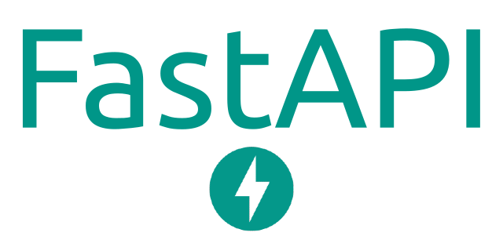

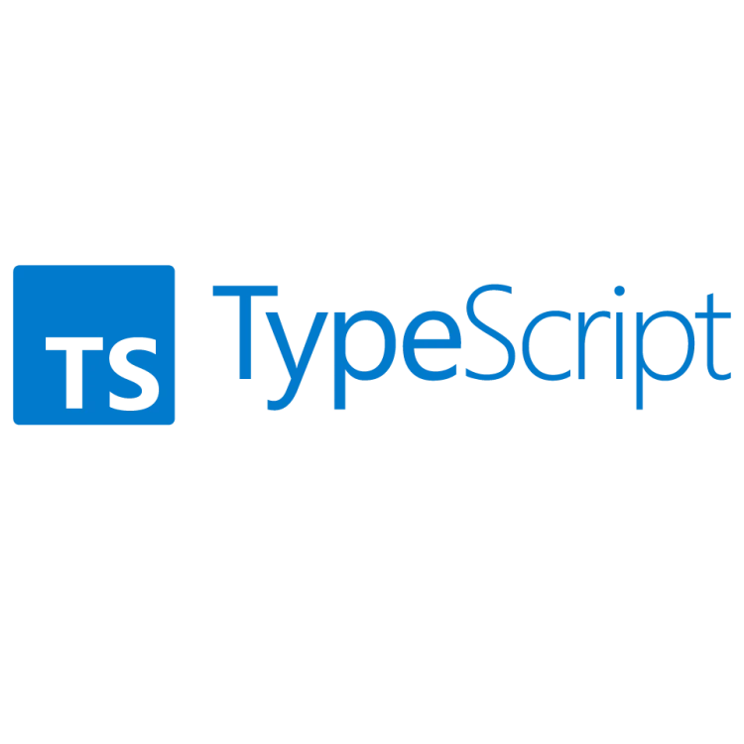


TECHNICAL APPROACH
TEAM
INNOVISION
Technology | Role in the System
YOLO11 / Ultralytics | Real-time vehicle detection & classification — identifies cars, bikes, buses and trucks
ByteTrack | Multi-object tracking — maintains persistent vehicle IDs across frames
OpenCV | Video & image processing — frame handling, cropping and preprocessing
EasyOCR | Number plate recognition — extracts plate text from detected plate regions
 | Backend API layer — serves vehicle records, search and traffic analytics
+ | GIS dashboard — interactive vehicle search, trajectory and traffic visualization
PostGIS / Database | Vehicle, camera and geospatial daData storage & geospatial queries — vehicle, camera, timestamp and location datata storage
Python | Core AI/CV development — integrates detection, tracking and ANPR pipeline
ARCHTITECHURE PIPELINE

Slide 4
FEASIBILITY AND VIABILITY
TEAM
INNOVISION
Technical Feasibility
Built using open-source AI/CV technologies — YOLO11, ByteTrack, EasyOCR and OpenCV.
Works with existing CCTV/video feeds, reducing the need for new camera infrastructure.
Modular pipeline allows individual components to be improved or replaced without redesigning the entire system.
Deployment Feasibility
Can begin with a single-camera prototype and expand to multiple cameras.
CPU-based processing can support initial pilots, with GPU acceleration available as deployment scale increases.
GIS dashboard provides a centralized interface for vehicle search, trajectory and traffic analytics.
.
Operational ROADMAP
PROTOTYPE
↓
1 CAMERA
↓
MULTI-CAMERA
↓
ZONE LEVEL
↓
CITY-WIDE
COST VIABILITY
LOW SOFTWARE COST
Open-source AI frameworks
Existing CCTV infrastructure
Deployable on local/cloud computer

Slide 5
FEASIBILITY AND VIABILITY
TEAM
INNOVISION
ANALYSIS OF THE FEASIBILITY
Modular
Existing CCTV
Open-Source Stack
Detection, tracking, ANPR, API & dashboard can be built and deployed independently.
Uses existing video infrastructure for pilot deployment.
YOLO11, ByteTrack, EasyOCR & OpenCV reduce cost and lock-in.
CHALLENGES → STRATEGIES
Low-Quality Video
Quality Filtering
Night • rain • glare • blur
Sharpness • contrast • size checks
?
OCR Errors
Temporal Voting
Similar characters, noisy reads
Multiple reads → confirmation
Computational Load
Cost-Aware Processing
Multiple camera streams at once
Process only stable, relevant tracks
Camera Coverage & Sync
Incremental Deployment
Positions • timestamps • blind spots
Calibrate one node → expand zone by zone
DEPLOYMENT ROADMAP
Prototype
Current stage
Single-Camera Pilot
One location
Multi-Camera
One junction
Zone-Level
A district / area
City-Wide Rollout
Full-scale deployment
@SIH Idea submission- Template
5
4

Slide 6
TEAM
INNOVISION
FEASIBILITY & VIABILITY
SIH
SMART INDIA
HACKATHON 2025
Practical. Scalable. Real-World Impact.
1
ANALYSIS OF THE FEASIBILITY OF THE IDEA
WORKING PROTOTYPE EVIDENCE
Open-Source
Technology Stack
Works with
Existing Infrastructure
Modular &
Scalable Architecture
Vehicle Detection & Tracking
ANPR Output
GIS Dashboard
YOLO11 • ByteTrack • EasyOCR • OpenCV
No proprietary licensing cost. Built on widely supported open-source tools.
Uses existing CCTV camera infrastructure. No new hardware required for pilot deployment.
Detection → Tracking → ANPR → Backend API → GIS Dashboard
Each component is independently deployable, enabling phased implementation and easy scaling.
Vehicle Detection & Tracking
ANPR Output
GIS Dashboard
Real-time detection and persistent vehicle IDs
Number plate recognition with high accuracy
Vehicle trajectory and traffic visualization
2
POTENTIAL CHALLENGES
AND RISKS
3
STRATEGIES FOR OVERCOMING THESE CHALLENGES
Low-Quality Video
Quality Filtering
✓
Improves detection and OCR accuracy
Night, rain, glare, blur and poor camera angles can reduce detection and OCR accuracy.
Apply sharpness, contrast and size checks before sending plate crops to OCR.
OCR Errors
Temporal Voting
✓
Reduces false reads and increases reliability
Similar characters, dirt or damaged plates can lead to incorrect readings.
Combine multiple OCR observations of the same tracked vehicle before confirming the plate.
Computational Load
Cost-Aware Processing
✓
Optimizes compute usage and enables real-time performance
Processing multiple camera streams simultaneously can increase CPU/GPU requirements.
Run expensive plate/OCR processing only on stable and relevant vehicle tracks.
Camera Synchronization & Coverage
Incremental Deployment
✓
Ensures accurate tracking and scalable deployment
Different camera positions, timestamps and blind spots can affect cross-camera trajectory reconstruction.
Start with single camera → multi-camera → zone → city-wide, while calibrating camera locations and timestamps.
4
DEPLOYMENT ROADMAP
1
2
3
4
5
From prototype to city-wide impact
Prototype (Current Stage)
Single Camera Pilot
Multi-Camera
Zone-Level Deployment
City-Wide Rollout
Single camera, end-to-end pipeline
Deploy at one location to validate performance
One junction, several nodes
A district / area
Full-scale deployment across the city
Safer Roads | Smarter Cities | Better Tomorrow
4

Slide 7
IMPACT AND BENEFITS
TEAM
INNOVISION
Operational Impact
Faster Vehicle Search Reduces manual CCTV footage review and accelerates vehicle identification.
Cross-Camera Tracking Connects vehicle movement across multiple surveillance locations.
Faster Emergency & Law Enforcement Response Enables quicker investigation and identification during incidents.
Traffic & Urban Impact
Real-Time Traffic Insights Improves traffic monitoring and decision-making.
Reduced Traffic Congestion Supports smoother traffic flow through data-driven insights.
Smarter City Planning Provides traffic movement data for better infrastructure planning.
Impact Area | Benefit
Social Benefit | Safer roads through faster vehicle identification and incident response.
Economic Benefit | Data-driven traffic and infrastructure planning, reducing time and resources required for manual CCTV monitoring.
Environmental Benefit | Smoother traffic flow can reduce unnecessary vehicle idling and associated emissions.

Slide 8
RESEARCH AND REFERENCES
TEAM
INNOVISION
1. ByteTrack Research Paper
ByteTrack: Multi-Object Tracking by Associating Every Detection Box Zhang et al., ECCV 2022.
ByteTrack Official Paper & Repository
This is a proper academic reference and should definitely be included.
2. Ultralytics YOLO11
Official documentation for the vehicle detection model used in your project.
Ultralytics YOLO11 Documentation
Note: YOLO11 does not currently have a formal standalone research paper; Ultralytics provides its official software citation.
3. EasyOCR
Official repository and documentation.
EasyOCR Official Repository
4. OpenCV
Official computer vision documentation.
OpenCV Official Documentation
KEY REFERENCES
[1] Zhang et al. — ByteTrack: Multi-Object Tracking by Associating Every Detection Box, ECCV 2022.
[2] Ultralytics — YOLO11: Real-Time Object Detection Documentation, 2024.
[3] EasyOCR — Open-Source Optical Character Recognition Framework.
[4] OpenCV — Open Source Computer Vision Library.

