Slide 1
Deployments in Salesforce
By Technical Amit

Slide 2
1 - Agenda
What is Deployment?
Types of Deployment

Slide 3
What is Deployment
A Salesforce implementation is the entire process of installing and setting up Salesforce. Larger in scope than a deployment, implementation also includes customizing Salesforce to fit your business.
A Salesforce deployment is a single, specific activity that takes place at the tail end of a project — typically, the act of moving changes from a sandbox environment over to your sandbox or production environment and pushing them live to end users and customers alike.

Slide 4
Types of Deployment
Inbound Deployment – Inbound deployment is the deployment which is coming in from any other related salesforce environment.
Outbound Deployment – Outbound deployment is the deployment which is going out from the environment to another environment.

Slide 5
2 - Agenda
Types of Environment in Salesforce
Production
Sandbox
What is Sandbox?
Types of Sandbox
Developer
Developer Pro
Partial Copy
Full

Slide 6
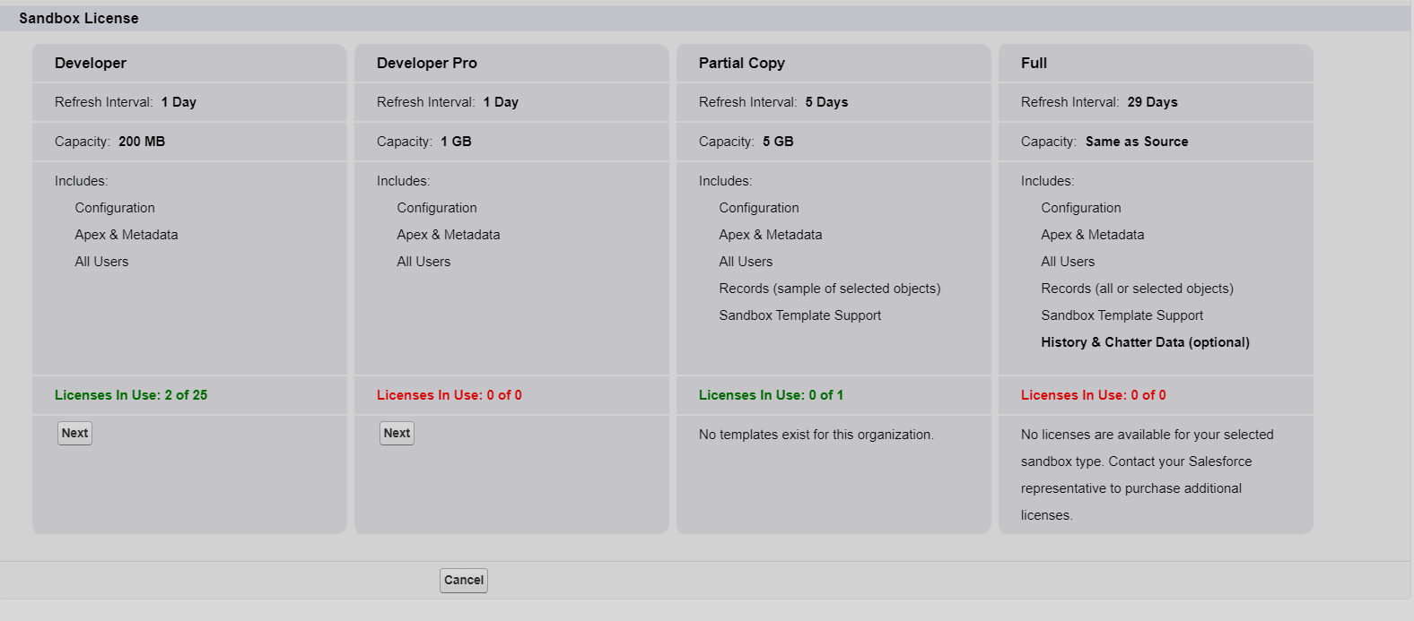

Slide 7
3 - Agenda
Different ways to deploy the code from one Salesforce Org to Another Salesforce Org.
Create a Sandbox
Change the Deployment Setting

Slide 8
Different Ways to Deploy changes from One org to Another
Change Set
Apache Ant
Salesforce DX
Workbench
Unmanaged Package

Slide 9
Create a Sandbox
Login to Salesforce production org
Navigate to Setup -> Sandboxes

Slide 10
4 - Agenda
Introduction to Change Set
Types of Change Set
Create a Custom Object & Fields
Create an Outbound Change Set
Upload an Outbound Change Set

Slide 11
What is Change Set in Salesforce?
Use change sets to send customizations from one Salesforce org to another.
For example, you can create and test a new object in a sandbox org, then send it to your production org using a change set.
Change sets can contain only modifications you can make through the Setup menu.
For example, you can’t use a change set to upload a list of contact records. Change sets contain information about the org. They don’t contain data, such as records.

Slide 12
Types of Change Set in Salesforce?
Inbound Change Set
Outbound Change Set

Slide 13
Create a Custom Object & Fields
Create a Custom Object Invoice & Invoice Line Item
Create a M-D field from Invoice Line Item to Invoice
Create a Custom Tab for Invoice Object

Slide 14
4.1 Why code coverage is required?
Before you can deploy your code or package it for the Lightning Platform​ AppExchange, at least 75% of Apex code must be covered by tests, and all those tests must pass. In addition, each trigger must have some coverage.
Ensure that Your Apex Class and Triggers are working as Expected
Meeting the code coverage Requirement for the Deployment
To test your functionality
High-quality apps delivered to the production org, which makes production users more productive
High-quality apps delivered to package subscribers, which increase your customers trust

Slide 15
Agenda
Deployment/Validation Options in Salesforce
Deploy an Inbound Change Set

Slide 16
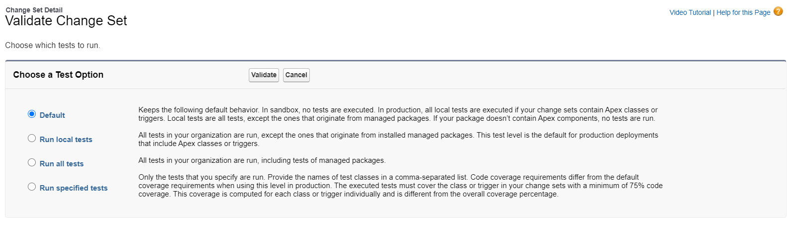
Deployment Options in Salesforce

Slide 17
Agenda
Deploy Component Permissions using Change Set
Deploy Permission Set & Profile Using Change Set

Slide 18
Agenda
Deploy WFR Rules
Deploy Process Builder
Deploy Lightning Flow Builder

Slide 19
Scenario for WFR
Whenever a new account is created then send an email to account Owner and a specific user
Whenever a new opportunity is created then update the related account Annual Revenue Field.

Slide 20
Scenario for Process Builder
Create a New picklist field on Account ( Status ) and when the status is changes then update all related invoices status same as account status.

Slide 21
Agenda
We are going to deploy the following components
Apex Class
Apex Trigger
VisualForce Pages
Aura Component

Slide 22
Agenda
Benefits of Change Set
Limitations of Change Set

Slide 23
Benefits of Change Set
Provide a nice native UI for picking changes that need to be moved between orgs
When you move that change it gives you a decent representation of code coverage and progress.
Provides a nice audit trail and shows what changes were deployed when

Slide 24
Limitations of Change Set
It’s hard to add all the components that you wanted to deploy
Can not deploy profiles
Deployment Can't be automated so governance around change management can be a tricky and manual process.
Hard to have as part of development flow with the need to recreate the changeset every time you want to move the change to another org (e.g. dev -> QA -> UAT -> Prod)
Only works with connected orgs, so you need to establish a trust relationship between orgs that can make experimentation more tricky
Doesn't allow for destructive changes (deleting objects, fields, class, trigger, & etc.)

Slide 25

Agenda
Introduction to Apache Ant
Configure Apache Ant in Your PC For Windows

Slide 26
Introduction to Apache Ant
ANT is a free tool provided by Apache which can be used for script building operations and in case of Salesforce we can use ANT to retrieve & deploy metadata from one salesforce environment to another salesforce environment. ANT is much faster than the Change Set that we have discussed in earlier videos
Setup ANT for windows
Download and Install Java in your PC
Download the ANT Binary
Set the Path for Java & ANT
Test the setup

Slide 27
Setup Apache ANT in MAC OS
Download Apache ANT for MAC
Extract and Rename the folder to ant
Look for Bash profile and if not then create a new One
Go to Bin folder of Apache ANT
Set Environment Variables
Test & Enjoy

Slide 28
Steps
Step1 - Download Apache ANT & Extract to your location where you wanted to have
tar xvfz apache-ant-1.9.7-bin.tar.gz
Step 2 - Rename folder to ant in order to make the work easy
Step 3 - Go to base directory to create a bash profile if not
Cd ~
List our files in our home directory and look for .bash_profileLs –a
Step 4 - We can create a .bash_profile from terminal as well.
Below we create a new bash profile and also open it in text edit with 2 simple commands
touch ~/.bash_profile
open -e ~/.bash_profile
Step 5 - Got to ant bin folder Run pwd to see the complete path which will look like below
/Users/amit/Desktop/ant/bin
Step 6 - Set the Path export ANT_HOME=${PATH}:/Users/amit/Desktop/ant/bin
export PATH=${PATH}:$ANT_HOME/bin
export PATH=${PATH}:/Users/amit/Desktop/ant/bin
Step 7 - ant -v and Enjoy

Slide 29
Agenda
Prepare Required Component to Deploy using Apache Ant
Build.properties
Build.xml
Package.xml
Walkthrough

Slide 30
Agenda
Retrieve & Deploy using Apache ANT
Deploy to unrelated Salesforce ORG using ANT

Slide 31
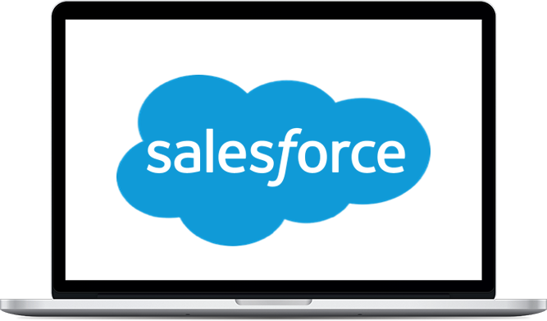


Agenda
Retrieve Package using ANT
Deploy package using ANT

Slide 32
Agenda
Retrieve ChangeSet using ANT
Deploy ChangeSet using ANT

Slide 33
ANT Target Dependency
Use Case – You wanted to run the deploy command and before performing the actual deployment you wanted to fetch the latest data from the source org.
<target name="deploy" depends="retrieve, retrievePkg, retrieveChangeSet">

Slide 34
Agenda
Delete Objects from production using ANT
Delete Class from Production using ANT

Slide 35
Agenda
Introduction to package in Salesforce
Types of Package
When to use Which Package

Slide 36
Packages in Salesforce
A package is a container for something as small as an individual component or as large as a set of related apps. After creating a package, you can distribute it to other Salesforce users and organizations, including those outside your company.
Types of Package
Unmanaged Package - Unmanaged packages are typically used to distribute open-source projects or application templates to provide developers with the basic building blocks for an application
Managed Package - Managed packages are typically used by Salesforce partners to distribute and sell applications to customers. These packages must be created from a Developer Edition organization

Slide 37
Deployment using UnManaged Package
Create a Package
Upload a Package
Deploy a Package

Slide 38
Introduction to Workbench
Workbench is a tool provided by Salesforce which can be used to perform below action.
Execute REST API
Execute SOAP API
Execute SOQL
Retrieve/Deployment
Data Import
And many more

Slide 39
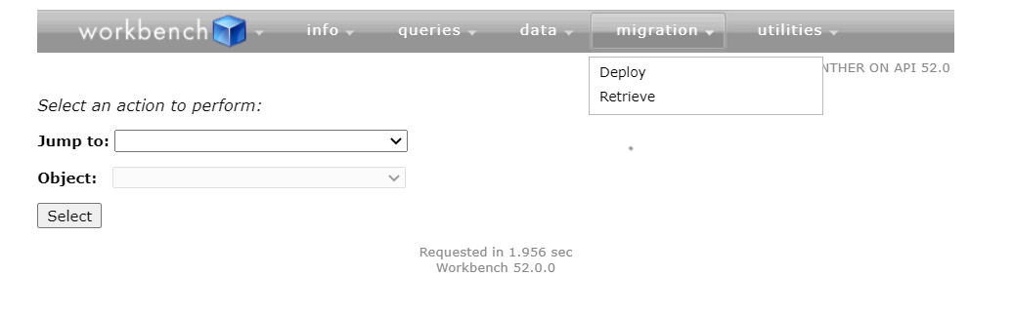
Retrieve using workbench

Slide 40
Agenda
Introduction to SFDX
Install Salesforce DX into your Machine

Slide 41
Introduction to SFDX
Salesforce DX adds new tools that streamline the entire development life cycle.
It improves team development and collaboration, facilitates automated testing and continuous integration, and makes the release cycle more efficient and agile.
What you can do with SFDX
Salesforce Development
Salesforce Deployment
Package Development
CI/CD

Slide 42
Agenda
Setup Salesforce DX Project
Authenticate to Salesforce ORG
Retrieve the Data Using SFDX
Resource – Setup VS Code for Salesforce
Setup Visual Studio Code

Slide 43
Deployment using SFDX
Part 1
Authenticate to target org - sfdx auth:web:login -r https://test.salesforce.com -a Dev2
Perform the Deployment or validation - sfdx force:source:deploy -p force-app/main/default -c -u Dev2
Part 2
Resources
https://developer.salesforce.com/docs/atlas.en-us.sfdx_cli_reference.meta/sfdx_cli_reference/cli_reference_auth_web.htm#cli_reference_auth_web_login
https://developer.salesforce.com/docs/atlas.en-us.sfdx_cli_reference.meta/sfdx_cli_reference/cli_reference_force_mdapi.htm#cli_reference_force_mdapi_deploy

Slide 44
Deployment using SFDX – Part 2
Part 2
Authenticate - sfdx auth:web:login -r https://test.salesforce.com -a Dev1
Convert the sfdx folders to source driven folders - sfdx force:source:convert -r force-app/main/default -d src
Perform the deployment - sfdx force:mdapi:deploy -u Dev1 -c -w 20 -d src
Resources
https://developer.salesforce.com/docs/atlas.en-us.sfdx_cli_reference.meta/sfdx_cli_reference/cli_reference_auth_web.htm#cli_reference_auth_web_login
https://developer.salesforce.com/docs/atlas.en-us.sfdx_cli_reference.meta/sfdx_cli_reference/cli_reference_force_mdapi.htm#cli_reference_force_mdapi_deploy

Slide 45
Agenda
What is DevHub?
What is Scratch Org?
Enable DevHub in Salesforce Developer Org & Production Org
Authorize to DevHub from VS Code Project

Slide 46
What is DevHub & Scratch ORG
The Developer Hub (Dev Hub) lets you create and manage scratch orgs. The scratch org is a source-driven and disposable deployment of Salesforce code and metadata, made for developers and automation.
A scratch org is fully configurable, allowing developers to emulate different Salesforce editions with different features and preferences.
Scratch orgs are a central feature of Salesforce DX, an open developer experience for developing and managing Salesforce apps across their entire lifecycle.

Slide 47
Agenda
Modify the Scratch Org Def File
Create a Scratch Org
Open Scratch Org
Org Tour

Slide 48
Walk through
Authorize a DevHub - sfdx force:auth:web:login –setdefaultdevhubusername
Create Scratch org - sfdx force:org:create -f config\project-scratch-def.json --setalias deploymentdemo --durationdays 1 --setdefaultusername --json –loglevel
Open Scratch org - sfdx force:org:open –a org-alias

Slide 49
Agenda
Deploy Changes to Scratch org
Pull Changes from Scratch Org

Slide 50
Walk through
Deploy Code to Scratch org – sfdx force:source:push
Pull Code from Scratch org – sfdx force:source:pull

Slide 51


Agenda
Version Control System
Introduction to GIT
Introduction to GitHub
Install GIT
Signup for GitHub if not already
!=

Slide 52
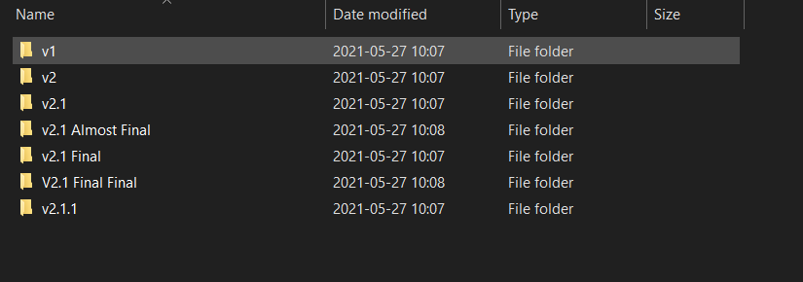
Version Control System
Version control, also known as source control, is the practice of tracking and managing changes to software code. 4
Benefits
A complete long-term change history of every file
Branching and merging
Traceability

Slide 53
Introduction to GIT
Git is an open-source, version control tool created in 2005 by developers working on the Linux operating system
Git is an example of a DVCS (hence Distributed Version Control System).
Rather than have only one single place for the full version history of the software as is common in once-popular version control systems like CVS or Subversion (also known as SVN),
In Git, every developer's working copy of the code is also a repository that can contain the full history of all changes.
!=

Slide 54
Introduction to GitHub
GitHub is a company founded in 2008 that makes tools which integrate with git
You do not need GitHub to use git, but you cannot use GitHub without using git.
There are many other alternatives to GitHub, such as GitLab, BitBucket, Azure DevOps.
All of these are referred to in git-speak as “remotes”, and all are completely optional
You do not need to use a remote to use git, but it will make sharing your code with others easier
!=

Slide 55
Agenda
How Git & GitHub works
Create your First Local Repo
git init “repo-name”
Add a File in Repo
notepad yourname.txt
Add file to staging Area
git add . Or git add filename
Commit Changes
git commit –m “Message Here”
!=

Slide 56
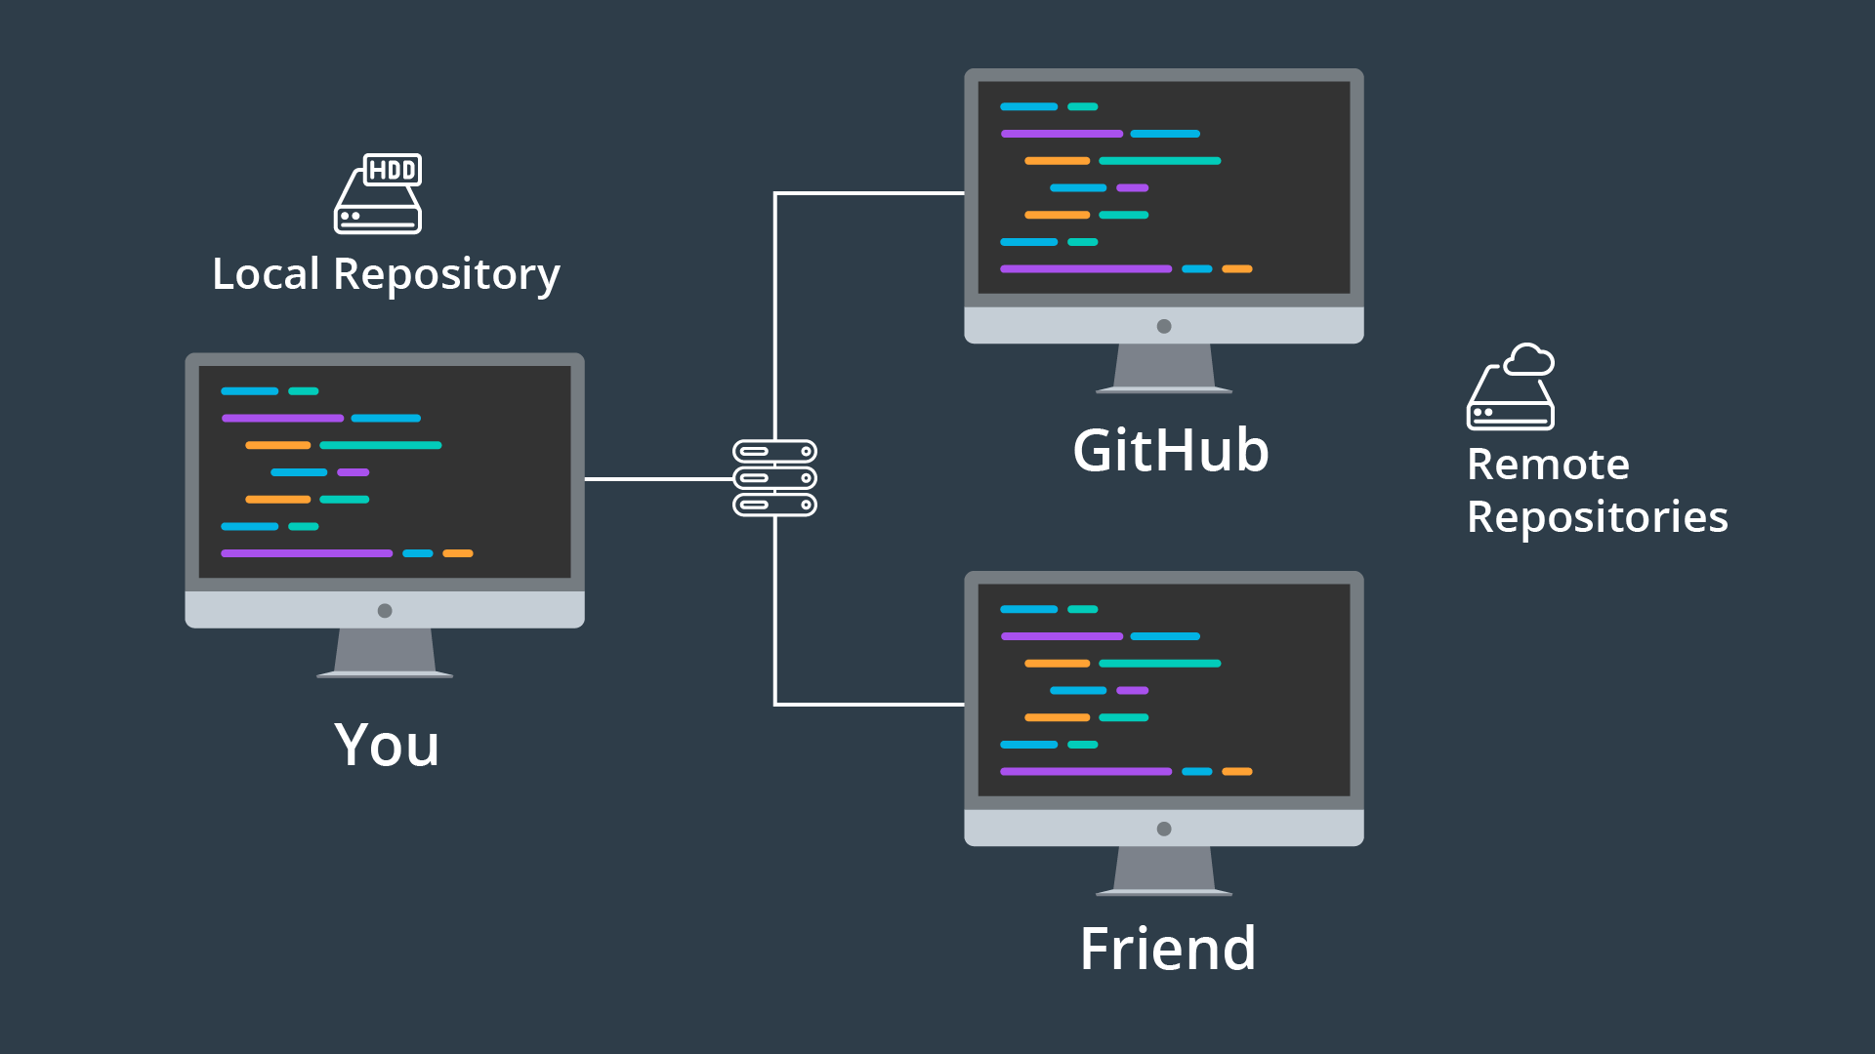
How Git & GitHub Works
!=

Slide 57
Agenda
Create Remo Repo in GitHub
Associate the Local repo with Remote Repo
git remote add origin “url to origin”
Pull the changes from Remote
git pull origin branchname
Push the changes from Local to Remote
git push origin branchname
!=

Slide 58
Agenda
Create Branch in Local Repo
git branch branch-name
git checkout –b branch-name
Push Newly Created Branch in Remote
git push origin branch-name
Pull the Remote Changes to Local
git pull origin branch-name
Add few more files
Manual add the files
Create the branch in Remote Repo
Pull the remote branch to Local Repo
!=

Slide 59
Agenda
What is Pull Request
Create & Merge a Pull Request
How to delete a branch
git branch -d <local-branch>
git branch -D <local-branch>
git push origin --delete <remote-branch-name>
!=

Slide 60
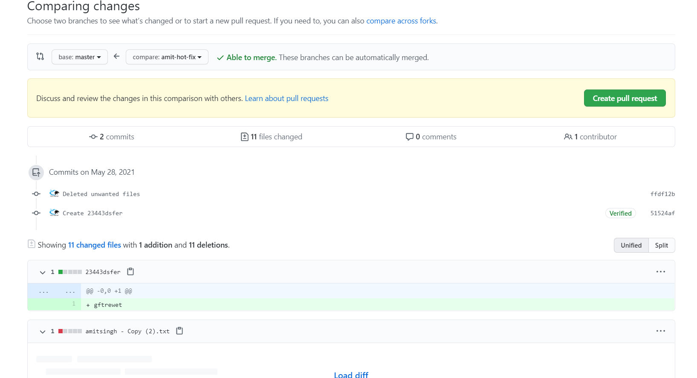
Pull Request
Pull requests let you tell others about changes you've pushed to a branch in a repository on GitHub.
Once a pull request is opened, you can discuss and review the potential changes with collaborators and add follow-up commits before your changes are merged into the base branch.
!=

Slide 61
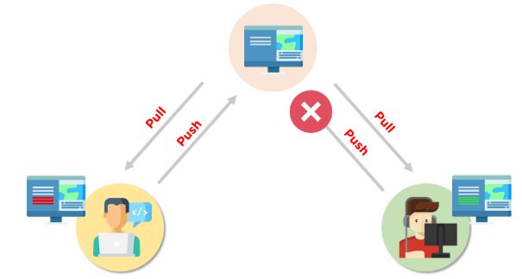
Merge Conflict
Merge conflicts occur when competing changes are made to the same line of a file, or when one person edits a file and another person deletes the same file. For more information, see "About merge conflicts.
!=

Slide 62
Agenda
Git Config Commands
git config –global user.name <name>
Clone Existing Repo
git clone “git-repo-link”
Check GitHub Logs
git log
git log –graph
git log -p
Check file difference
git diff
Stash Commands
git stash
git stash apply
Graphical Interface
gitk

Slide 63

Agenda
Introduction to Jenkins
Software Installation

Slide 64
Introduction to Jenkins
Jenkins is a software that allows continuous integration. Jenkins will be installed on a server where the central build will take place.
What is Continuous Integration?
Continuous Integration is a development practice that requires developers to integrate code into a shared repository at regular intervals.
This concept was meant to remove the problem of finding later occurrence of issues in the build lifecycle.

Slide 65
Jenkins Installation
Visit https://www.jenkins.io/download/ Url and download the .war file for Windows PC .
Download the appropriate file for other PCs like Linux or MAC.
If you are using any other PC like Mac or Linux go ahead and install the installer and follow the instructions given to complete the setup.
For the windows PC – Find the location where you have downloaded the Jenkins war file. Open the command prompt and then hit below command.
java –jar your_war_file.here –httpPort=9999
You can change the port no if you want.

Slide 66
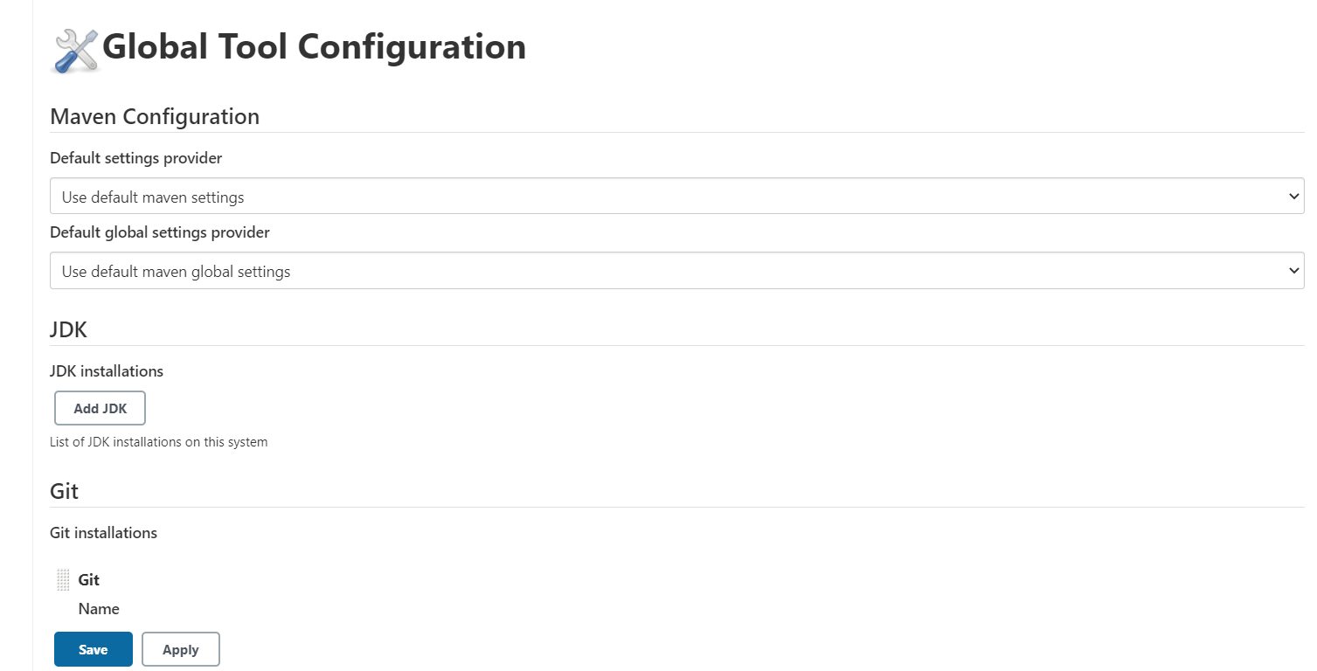
Agenda
Setup ANT, JAVA & GIT in Jenkins
Setup a Jenkins Pipeline

Slide 67
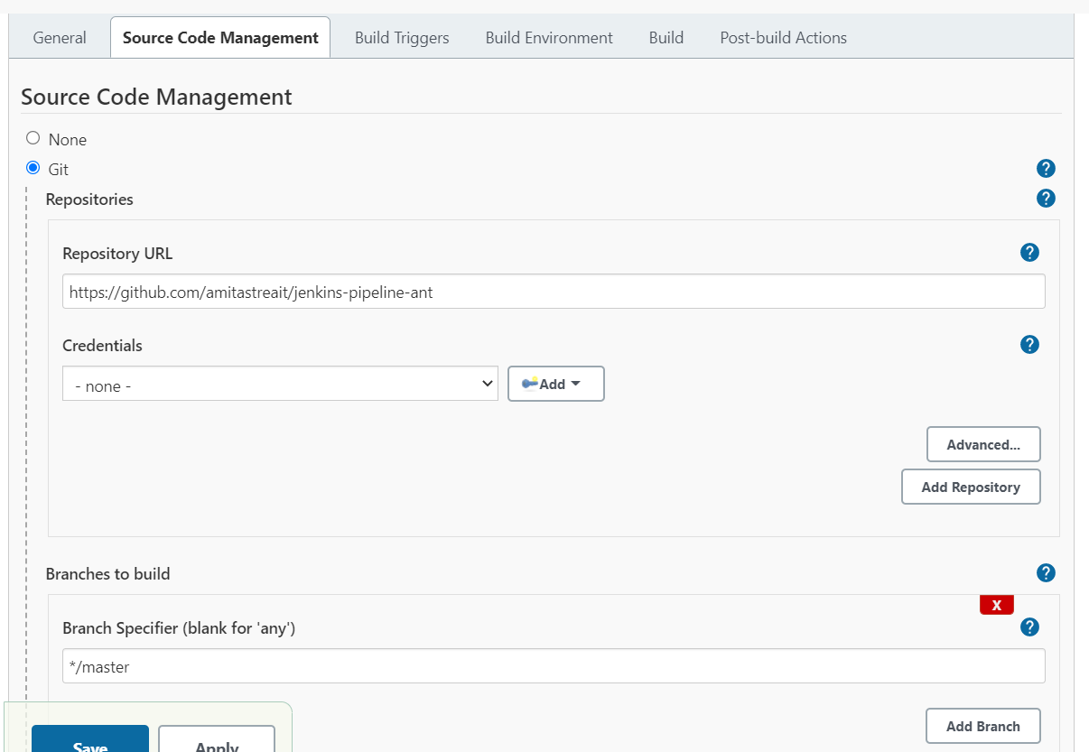
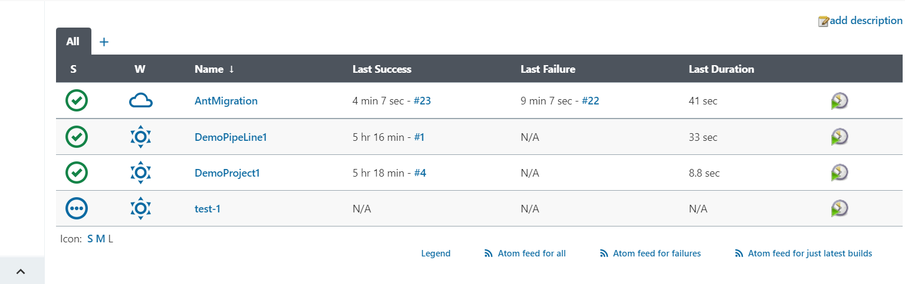
Agenda
Setup Jenkins Project to use Apache ANT for Deployment

Slide 68
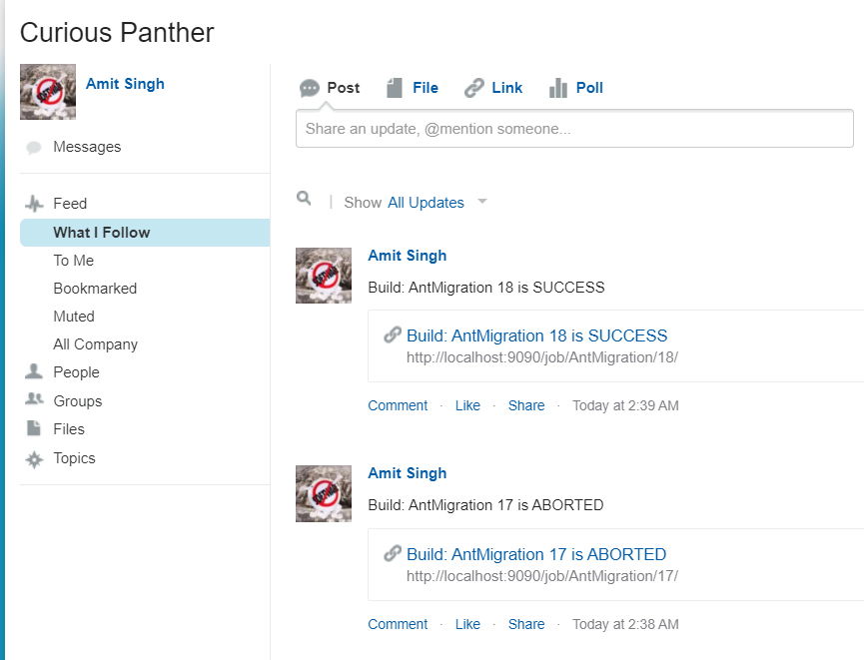
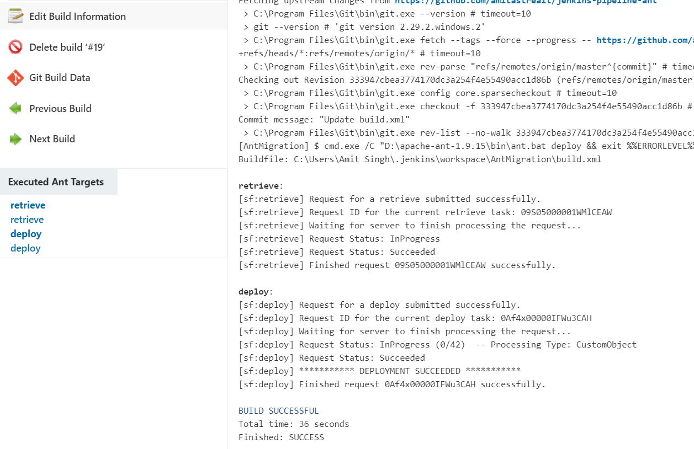
Scenario
Develop a Jenkins job which will run in every 5 minutes, retrieve the data from one org and then deploy it to production.
Also post the chatter notification if the build is success or not.

Slide 69
Agenda
What is Continuous Integration?
What is Continuous Delivery?
What is Continuous Deployment?

Slide 70
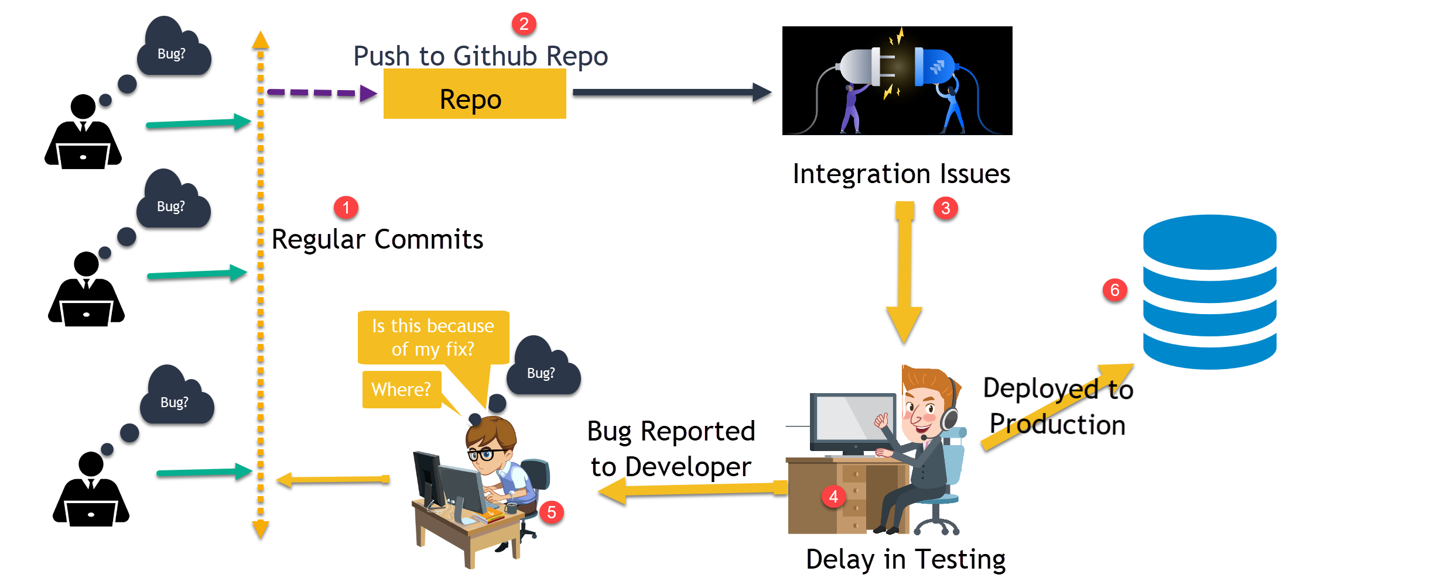
The Problem Statement

Slide 71
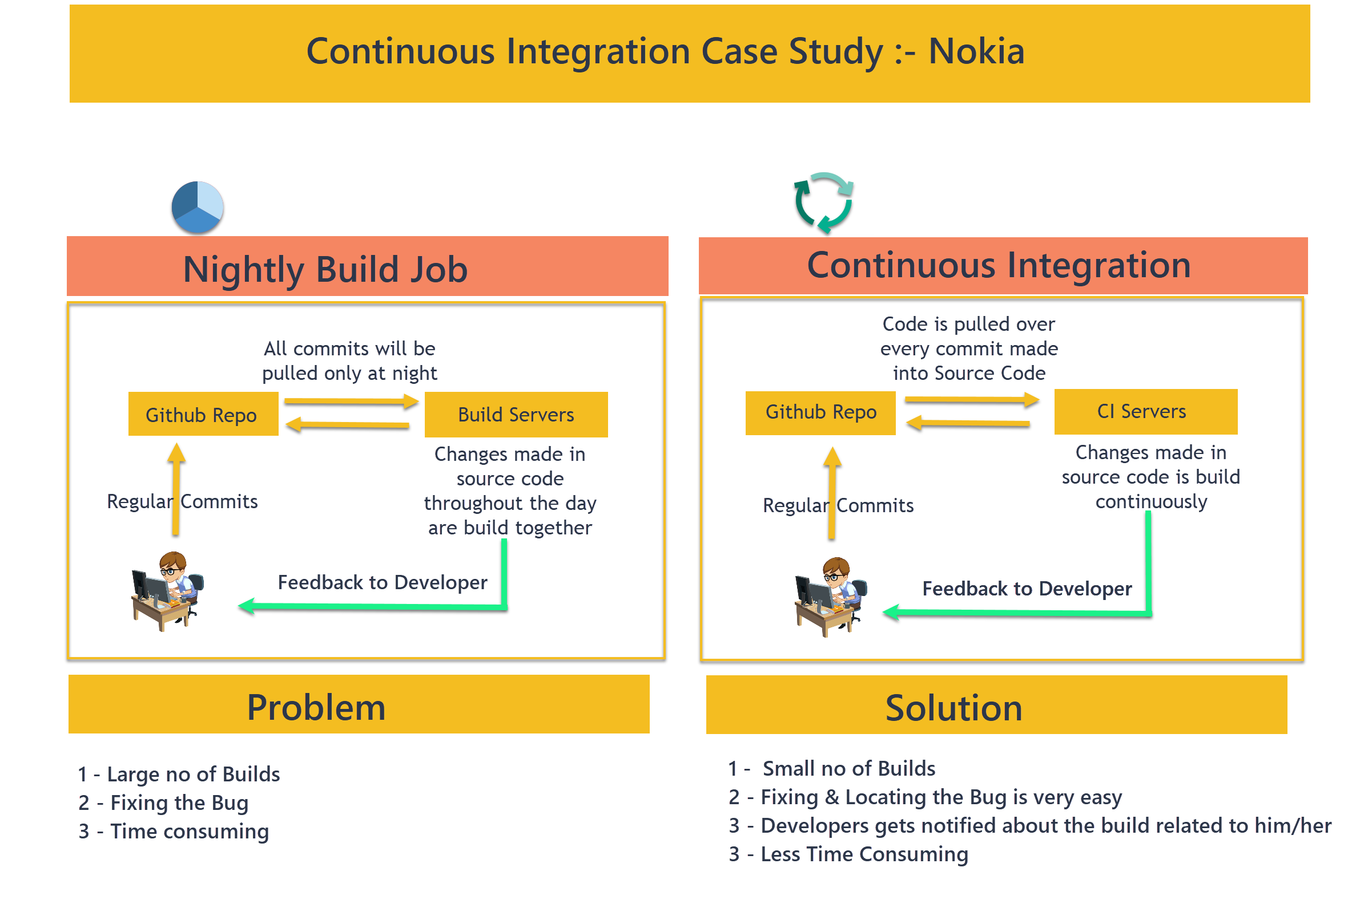

Slide 72
Continuous Integration
Continuous Integration- The code in any Developer Branch is always ready to merge with Master branch at regular interval.
Continuous Delivery- CI + Automatic release creation every time a new build has been created or validated, from where you can deploy the code to production with just a button Click.
Continuous Deployment- CI + CD + Production Deployment

Slide 73
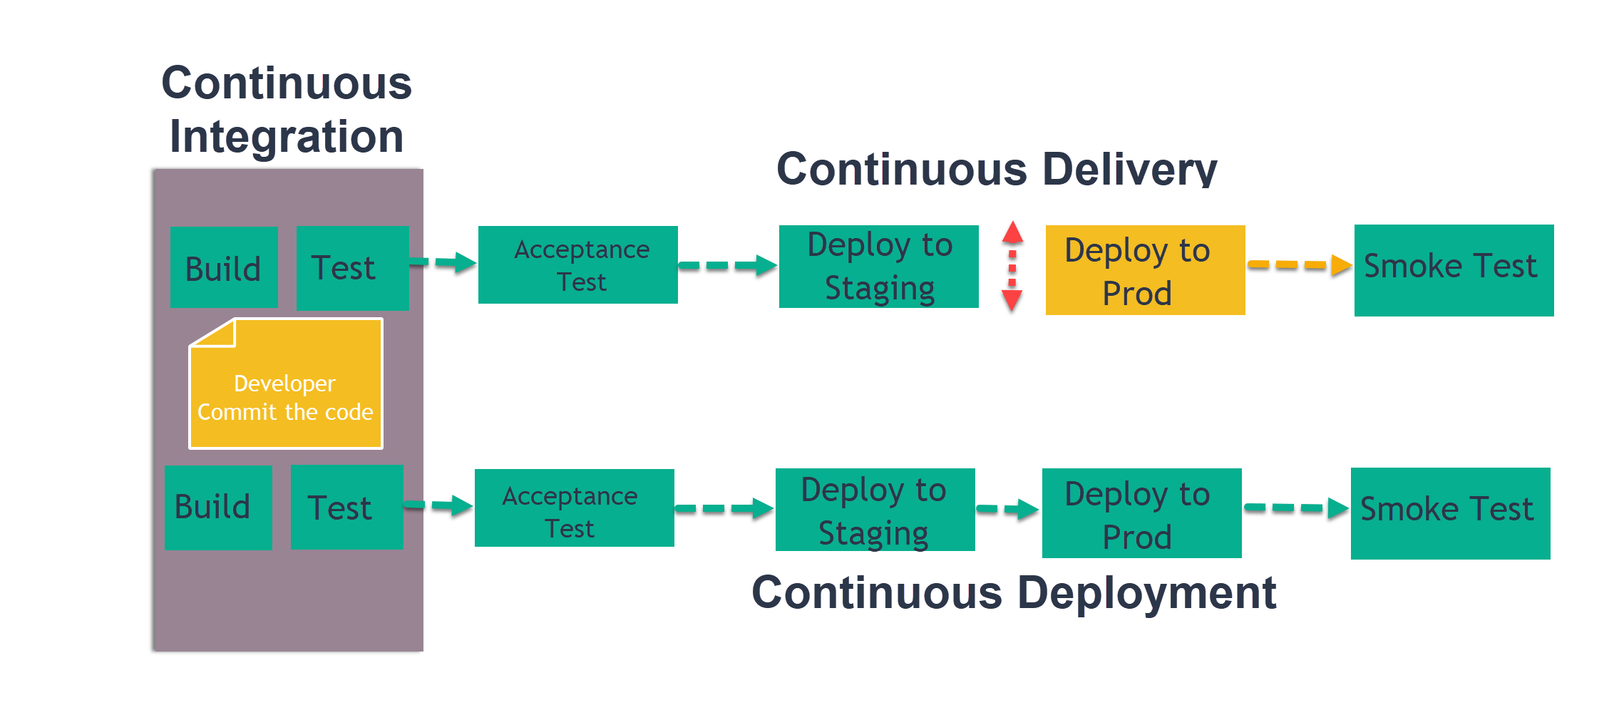

Slide 74
Agenda
What is Pipeline?
A CI/CD pipeline introduces monitoring and automation to improve the process of application development, particularly at the integration and testing phases, as well as during delivery and deployment. Although it is possible to manually execute each of the steps of a CI/CD pipeline, the true value of CI/CD pipelines is realized through automation.

Slide 75
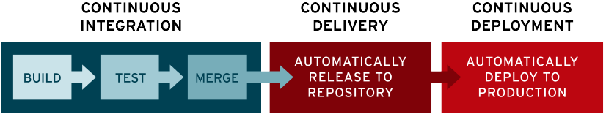
Elements of a CI/CD pipeline
Build - The stage where the application is compiled.
Test - The stage where code is tested. Automation here can save both time and effort.
Release - The stage where the application is delivered to the repository.
Deploy - In this stage code is deployed to production.

Slide 76
Agenda ( Connect Salesforce using JWT & SFDX )
Install openssl. Software can be downloaded from https://code.google.com/archive/p/openssl-for-windows/downloads
For Mac OS you can download from https://mac.filehorse.com/download-openssl/ link
Generate Certification in Local System using openSSL
Create a Connected Application in Salesforce
Authenticate SFDX using JWT

Slide 77
Steps to Generate SSL Certificate and Key file
Generate Private Key - openssl genrsa -des3 -passout pass:x123 -out server.pass.key 2048
Generate Key file using private key - openssl rsa -passin pass:x123 -in server.pass.key -out server.key
Generate the certificate file - openssl req -new -key server.key -out server.csr
Generate the SSL certificate - openssl x509 -req -sha256 -days 365 -in server.csr -signkey server.key -out server.crt

Slide 78
Steps to Create Connected Application in Salesforce
For Lightning environment navigate to Setup -> App Manager -> New Connect App
For classic environment navigate to Setup -> Create -> Apps -> Scroll down to Connected App section then Click New
Provide Connected App Name and Contact Email. API Name will automatically be populated.
Check Enable OAuth Settings under API (Enable OAuth Settings) section.
Enter http://localhost:1717/OauthRedirect for Callback URL
Check Use digital signatures checkbox and upload your server.crt file that you generated using command prompt.
Scroll down and save the application. If it prompts, select continue.
Now Click on manager and then Click Edit Policies See select "Admin approved users are pre-authorized" for Permitted Users under OAuth Policies to avoid "Not approved for access in salesforce" issue.
Go ahead and save the application
Scroll down and Click on “Manage Profiles” and then select the appropriate profiles. So that the users with selected profiles can took the advantage of connected app.
Now, go back to the connected application and copy the Consumer Key. Paste is somewhere we will use this while testing the flow.

Slide 79
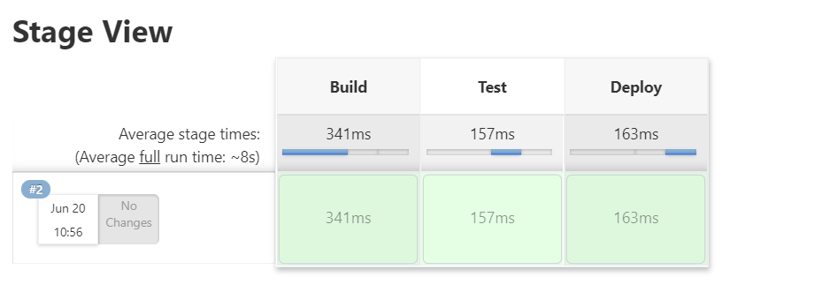
Agenda
Create a Jenkins Pipeline project
Work on Sample Jenkinsfile
See the demo
Configure the Jenkins environment Variable inside windows PC

Slide 80
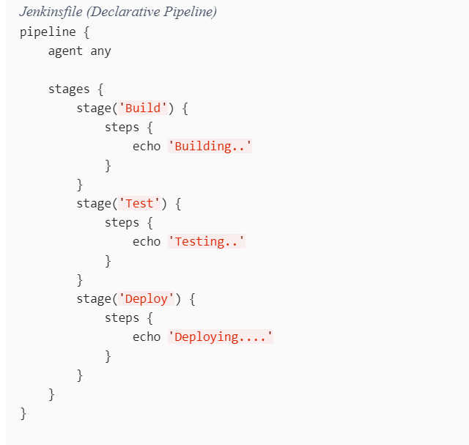
Pipeline Syntax

Slide 81
Configure Environment Variable
HUB_ORG_DH:- The username for the Dev Hub org, such as amit@gmail.com
SFDC_HOST_DH:- The login URL of the Salesforce instance that is hosting the Dev Hub org. The default is https://login.salesforce.com
CONNECTED_APP_CONSUMER_KEY_DH :- The consumer key that was returned after you created a connected app in your Dev Hub org.
JWT_CRED_ID_DH:- The credentials ID for the private key file that you stored in the Jenkins Admin Credentials interface

Slide 82
Create a Jenkins Pipeline project using SFDX
Project Overview
You have recently joined a company TechFuge India Pvt. Ltd. and they have asked you to setup a CI/CD pipeline using Jenkins and SFDX.
They already have a SFDX project which is being monitored from GtiHub.
With Every deployment you need to import some data for Account & Contacts as well.
Once the deployment is done you need to assign the permission to Admin user so that admin user can access the custom fields available included into the project.
And as a final step you need to Open the org

Slide 83
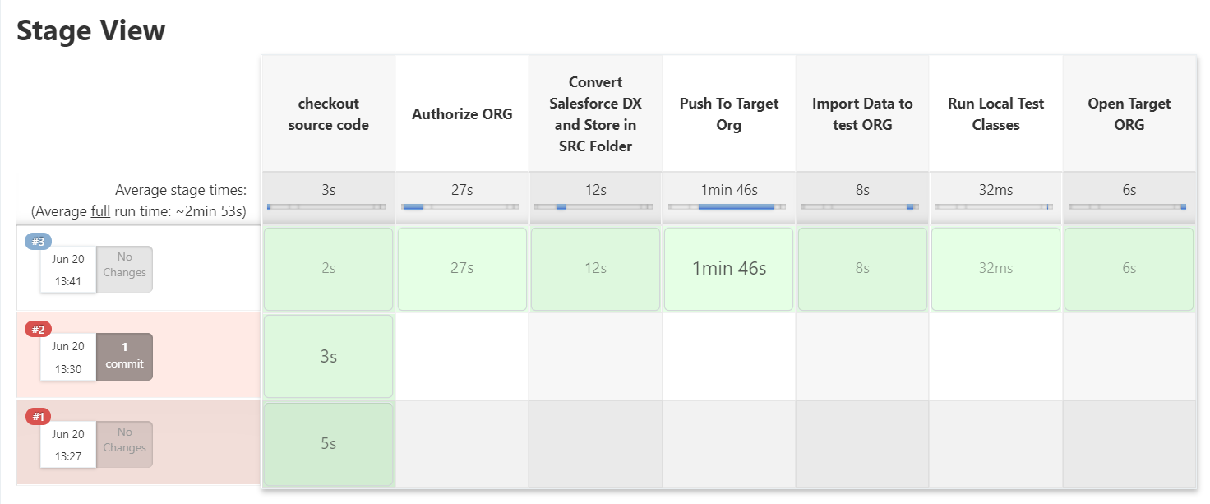
Create a Jenkins Pipeline project using SFDX

Slide 84
Create a Jenkins Pipeline project using SFDX
Project Overview
You have recently joined a company TechFuge India Pvt. Ltd. and they have asked you to setup a CI/CD pipeline using Jenkins and SFDX.
They already have a SFDX project which is being monitored from GtiHub.
With Every deployment you need to import some data for Account & Contacts as well.
Once the deployment is done you need to assign the permission to Admin user so that admin user can access the custom fields available included into the project.
And as a final step you need to Open the org
Note: - We need to implement this for the Sandbox ORG

Slide 85
Steps
Create Connected application inside sandbox org using the same key and certificate file.
Add the Environment variables inside windows machine
Modify the Jenkins file to refer the newly created environment variables

Slide 86
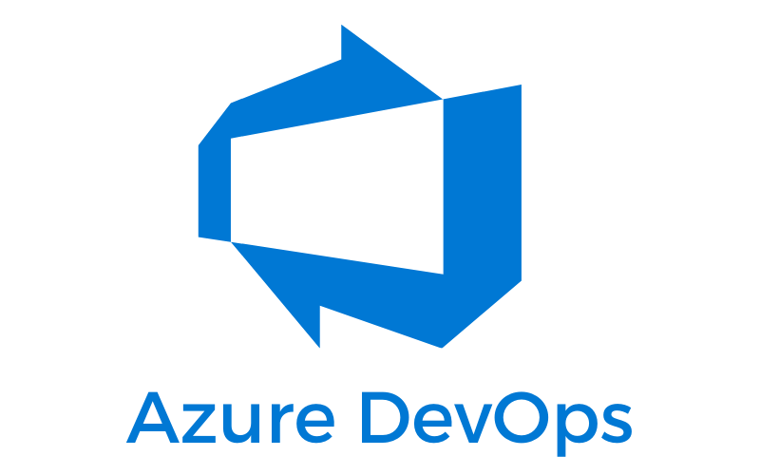
Agenda
What is Azeure DevOps?
Signup for the Azure DevOps Account using GitHub
Create Your First Project
Walkthrough of DevOps Dashboard

Slide 87
Introduction
Azure DevOps is a tool provided by Microsoft which is widely known for Implementing CI/CD
You can also manage your sprint, Task, Bug, User Story & Many More.
Azure DevOps has it’s own Repository System or You can also use GitHub with DevOps
Developing the pipeline and Releases is very easy with DevOps
You can use Apache Ant Pipeline or SFDX Pipeline

Slide 88
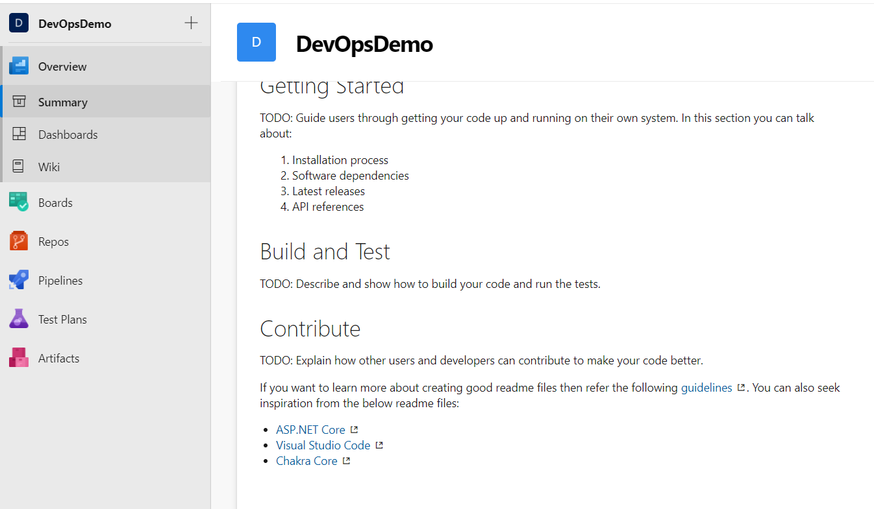
Agenda
Connect GitHub Repo in DevOps
Create your very first pipeline
Create your first release in DevOps

Slide 89
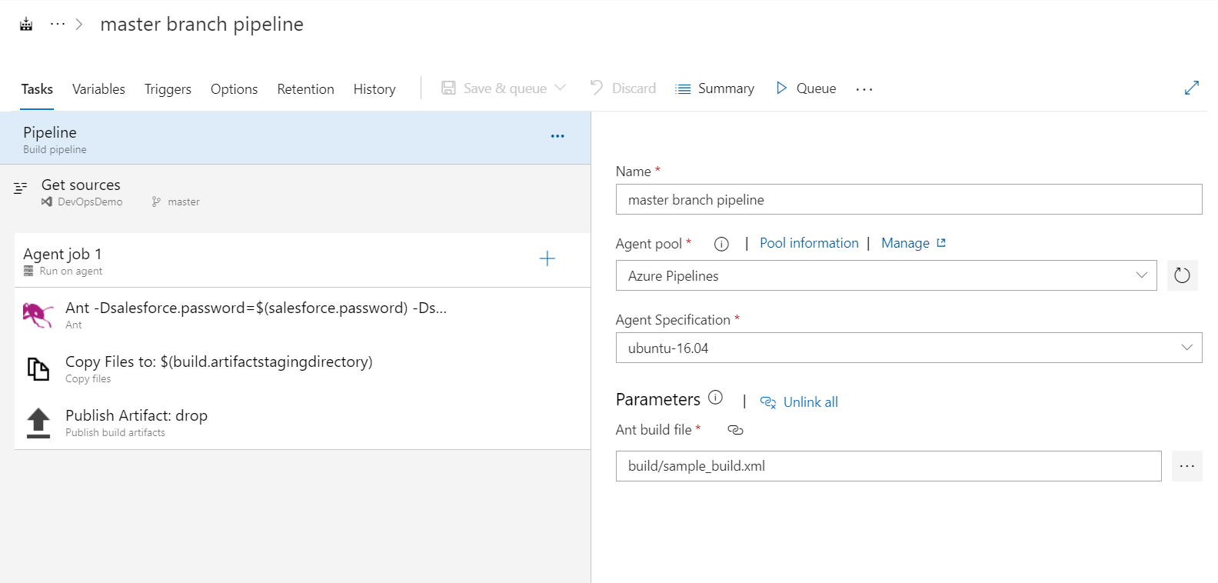
Agenda
Prepare Ant build.xml file
Create your very pipeline using Apache ANT
Create your first release using that Apache Pipeline created in Steps 2

Slide 90
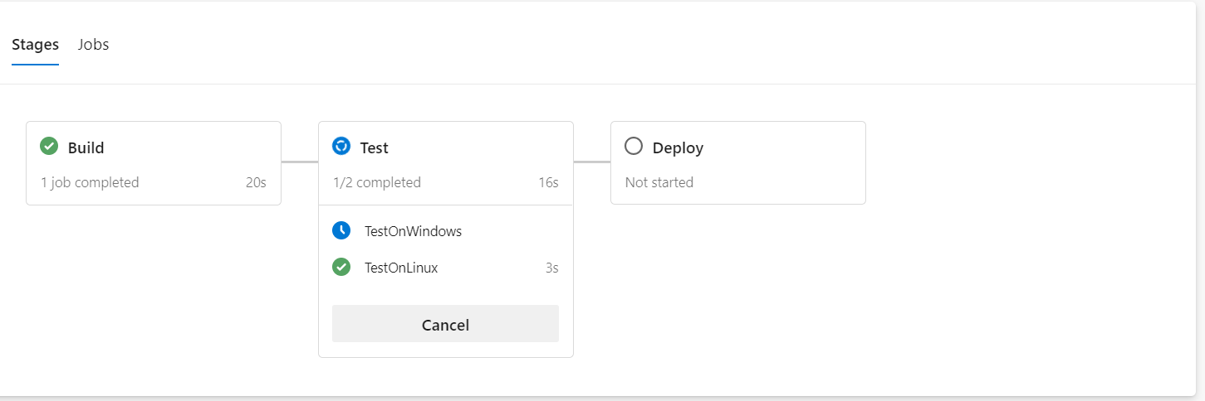
Agenda
Pipeline Structure walkthrough
Create your First Pipeline using Yml with Jobs and Stages

Slide 91
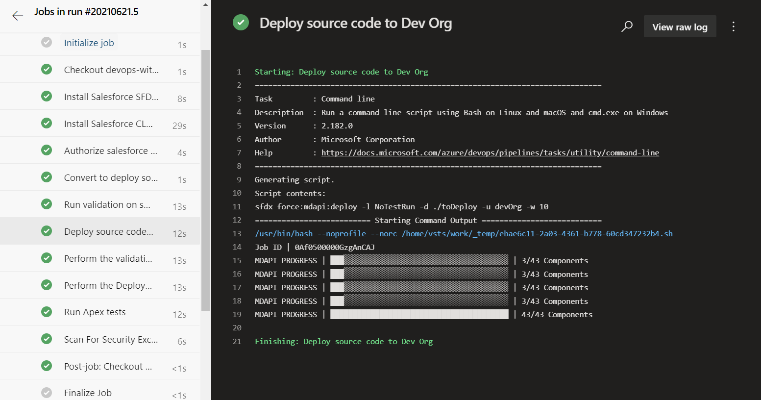
Agenda
Prerequisite to develop a SFDX Pipeline
Pipeline Structure walkthrough
Develop your first SFDX pipeline
Live Demo

Slide 92
Prerequisite to develop a SFDX Pipeline
Connected Application Setup in Target Org with Digital Signature
A Server.key file inside your Azure or GitHub Repo
Basic Understanding of yaml files

Slide 93
Agenda
Introduction to Github Action
Create very first action for your repo

Slide 94
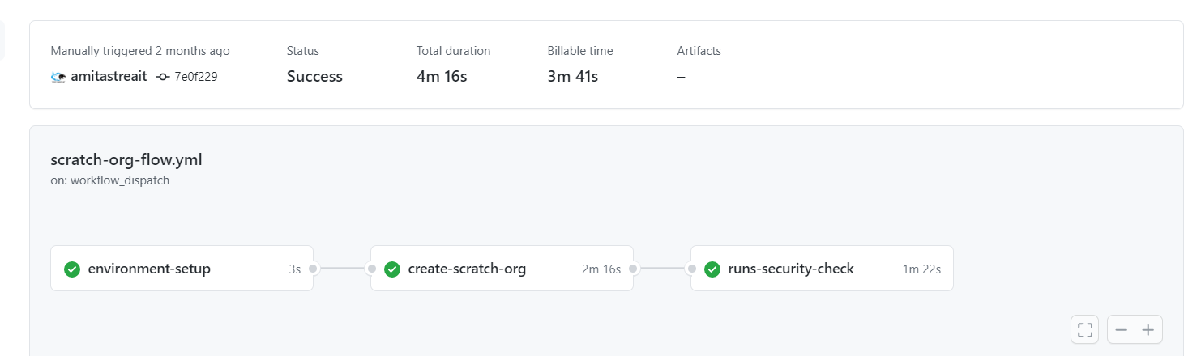
Introduction
Automate, customize, and execute your software development workflows right in your repository with GitHub Actions.
You can discover, create, and share actions to perform any job you'd like, including CI/CD, and combine actions in a completely customized workflow.
GitHub Actions also uses yml format to create the workflows.

Slide 95
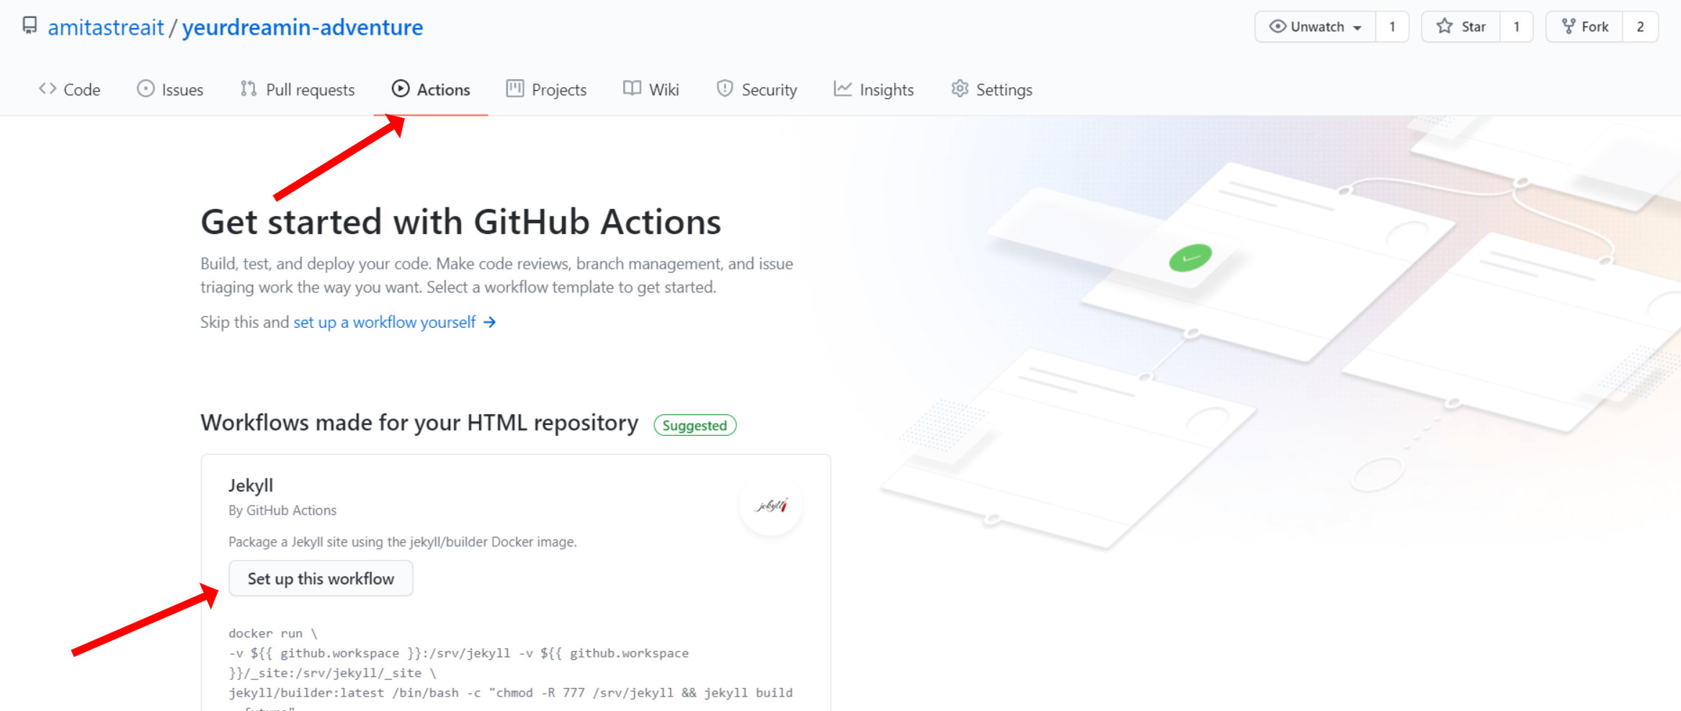
Setup your first GitHub Action

Slide 96
Prepare GitHub Repo to use SFDX
Connected application setup with digital certificate in Target org
Consumer Key for target org
User name of Target ORG
URL of the Target ORG
Server.key file inside repo

Slide 97
Develop GitHub Action using SFDX

Slide 98
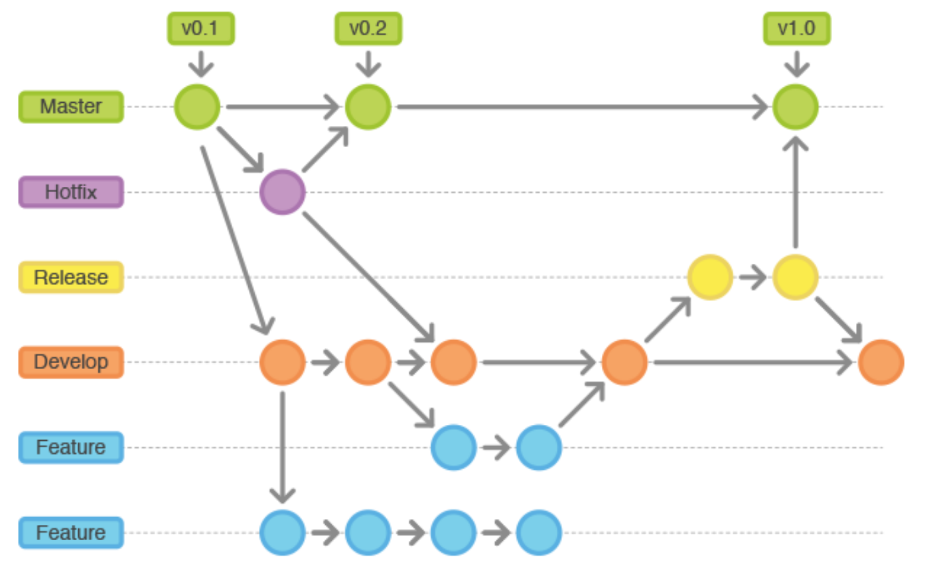
Branching Strategy for CI/CD
Pic Credit – Medium.com

Slide 99

Introduction to BitBucket
Introduction to BitBucket
Signup for BitBucket Account

Slide 100
Introduction to BitBucket
Bitbucket is a Git-based source code repository hosting service owned by Atlassian
Bitbucket is more than just Git code management. Bitbucket gives teams one place to plan projects, collaborate on code, test, and deploy.
We can create free account and work there

Slide 101
Agenda
Generate SSH Key for BitBucket Account
Add SSH Key in BitBucket Account

Slide 102
Generate SSH Key for BitBucket Account
Step 1. Set up your default identity
Run ssh-keygen command from the command prompt
You will find the SSH Key file - /c/Users/<username>/.ssh/id_rsa
Here is the URL with the steps for both windows and Mac - https://support.atlassian.com/bitbucket-cloud/docs/set-up-an-ssh-key/
To validate the SSH Key – run ssh -T git@bitbucket.org from the Command prompt

Slide 103
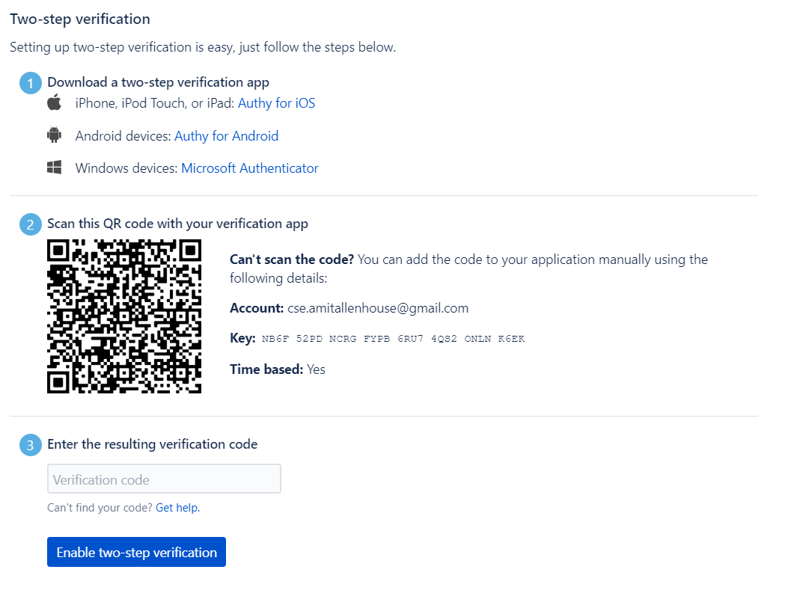
Enable Multi Factor Authentication for BitBucket

Slide 104
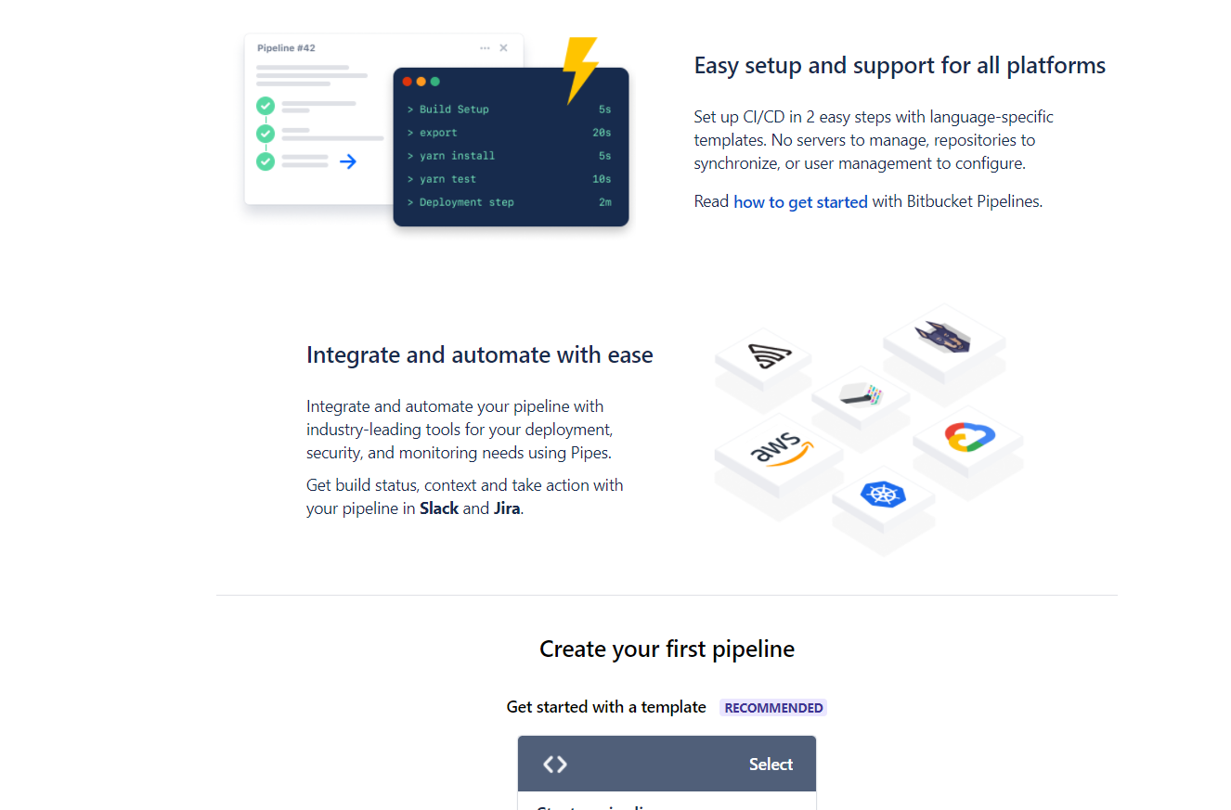
Create Your First Pipeline using Bitbucket

Slide 105
Develop Branch Specific Pipeline using Bitbucket

Slide 106
Develop PR Specific Pipeline using Bitbucket
pull-requests:
development:
- step:
name: 'Run Step from PR'
script:
- echo 'I am from PR in Developmet branch'
- step:
name: 'Perform Validation due to PR'
script:
- echo 'I am from PR in Developmet branch'

Slide 107
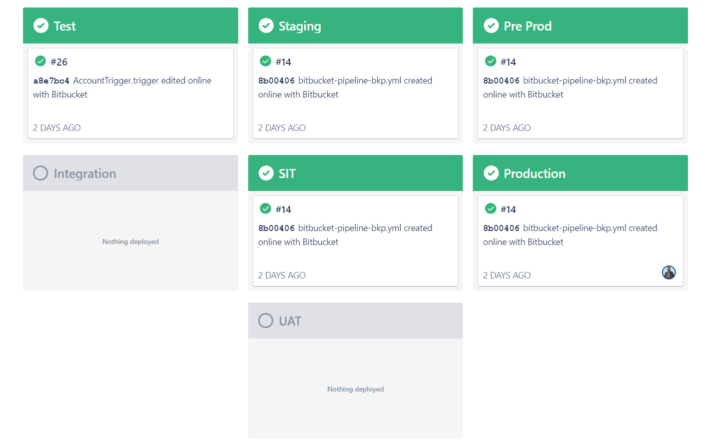
Develop a Pipeline using SFDX

Slide 108


