Slide 1
[Faridabad - India]
[29th Aug 2020]
[Ways to externalize the Mule Logs]

Slide 2
Agenda
Community Introduction
Ways to Externalize the Logs in Mule 4
Q & A session
Quiz
Networking time

Slide 3
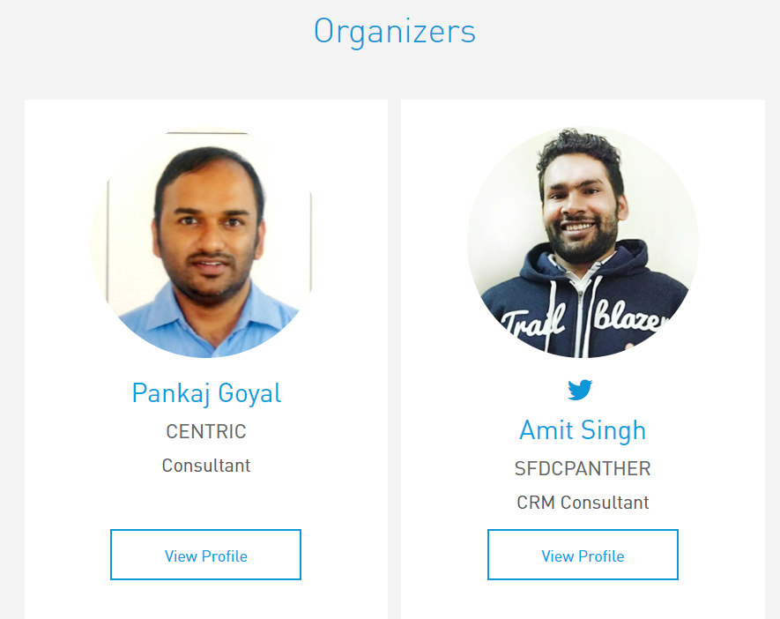
Organizers
Welcome everyone! Thanks for joining us!

Slide 4


Surprises!
Participate in an online Quiz to win the instructor-led training classes and certification exam vouchers. (3 Winners!)
Be geared up for the quiz sessions at the end ☺

Slide 5
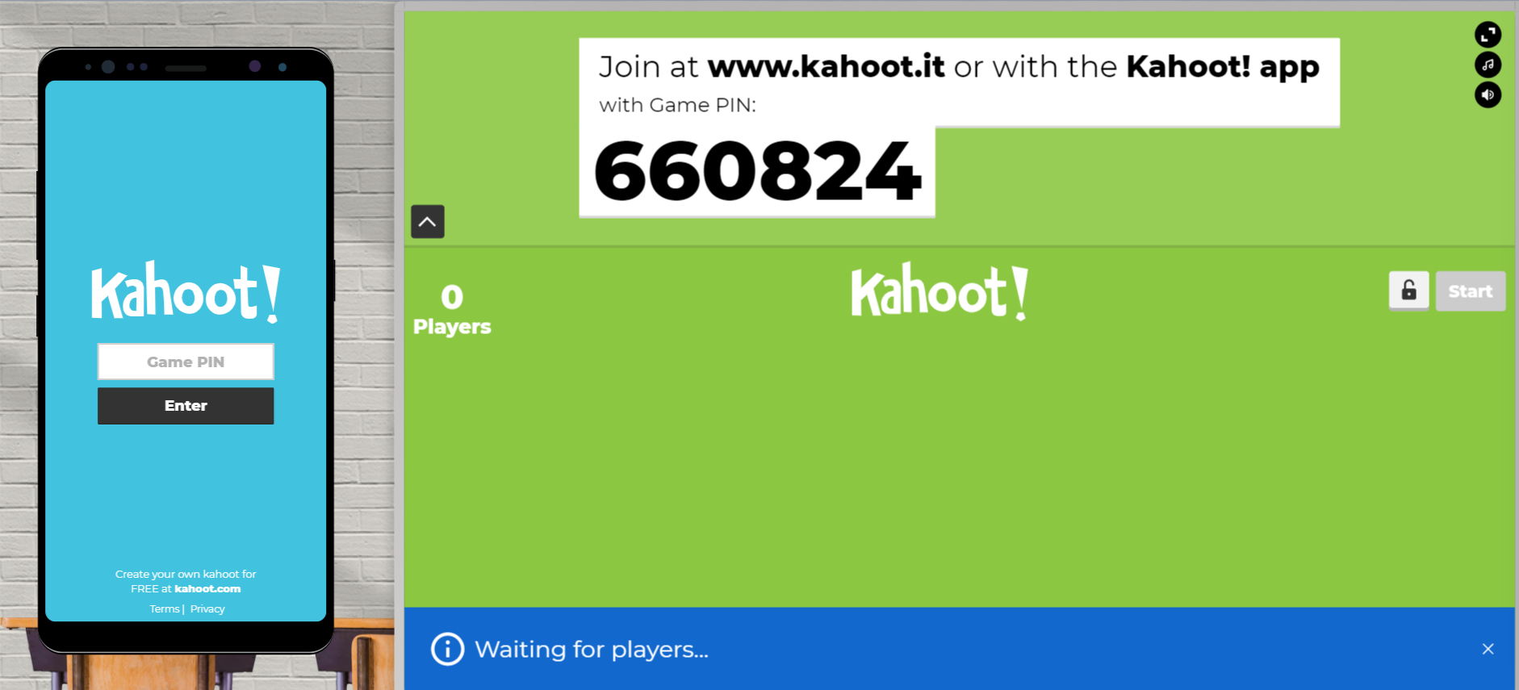

Slide 6
Share:
  Tweet/share in LinkedIn , facebook, Instagram with your pictures with the hashtag #FaridabadMuleMeetup #MuleSoftMeetup
  Also use #BringMuleSoftConnectToFaridabad to reach our wish to MuleSoft ☺
  Invite your network to join: https://meetups.mulesoft.com/Faridabad/

Slide 7
[WAYS TO EXTERNALIZE LOGS IN MULE 4]

Slide 8
Q & A

Slide 9
QUIZ time

Slide 11
Announce - QUIZ Winners!

Slide 12
Take a stand !
Nominate yourself for the next meetup speaker and suggest a topic as well.
Either for our virtual meetup speaker, or in-person meetup speaker.
Surprise swag for upcoming Speakers.

Slide 13
What’s next
Share:
  Tweet/share in LinkedIn , facebook, Instagram with your pictures with the hashtag #FaridabadMuleMeetup #MuleSoftMeetup
  Also use #BringMuleSoftConnectToFaridabad to reach our wish to MuleSoft ☺
  Invite your network to join: https://meetups.mulesoft.com/Faridabad/
Feedback:
  Contact MuleSoft at meetup@mulesoft.com for ways to improve the program
  Your Feedback is Food for us
Our next meetup:
  Date: TBD
  Location: TBD
  Topic: TBD

Slide 14
THANK YOU ☺
#Everyone for becoming a part of such a great #community.

