Slide 1
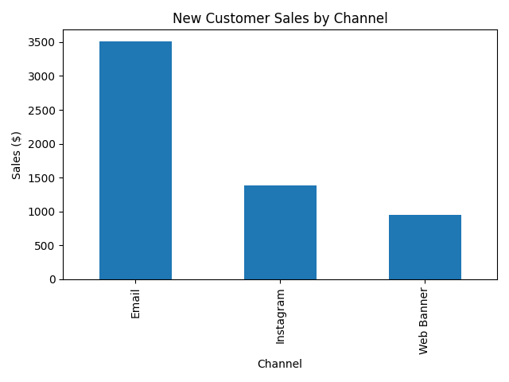
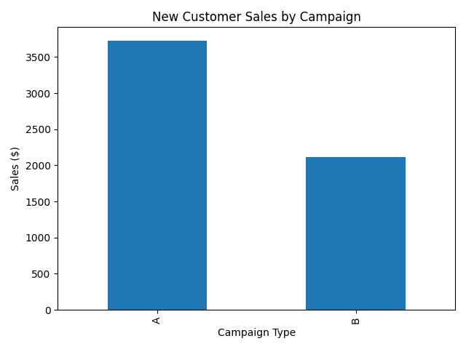
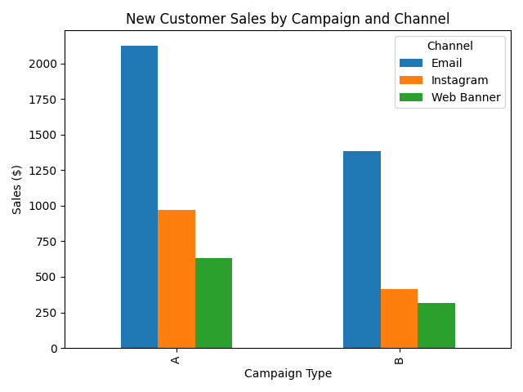
Created-Three Insight-Focused Charts (New Customers Only)
Recommendation:
Double down on the top-performing campaign–channel combination for new customers, as it consistently generates the highest new customer sales across channels .
The data shows that new customer revenue is concentrated in this combination, making it the most effective lever for driving incremental growth rather than relying on existing customers.

