Slide 1




Bike sharing demand analysis
NextHikes IT Solutions | Data analysis with Excel
How time, weather and holidays shape hourly bike rentals
Presented by: Amita Yadav
Notes:
Good morning everyone. My project is a demand analysis for a city bike sharing service, done completely in Excel. I looked at about six weeks of hourly rental data to understand when and why people rent bikes. By the end I will share a dashboard, a short forecast and some practical recommendations.

Slide 2






Agenda: from raw data to recommendations
01
02
03
Problem and objectives
Data and preparation
Key metrics
What we want to learn and why
Three files merged into one table
Total rentals and who rides
04
05
06
Demand drivers
Dashboard and forecast
Recommendations
Hour, weekday, weather, temperature
Interactive view, anomalies, next 24 hours
Actions, limitations and next steps
Notes:
Here is the plan for today. First I explain the business problem and the data. Then I show how I cleaned and prepared the data in Excel. After that we go through the main findings, the dashboard and a simple forecast. I will finish with recommendations and the limits of this analysis.

Slide 3


Goal: explain what drives hourly rentals to plan the fleet
Decisions this supports
Key question
How do time, weather and holidays affect the number of bikes rented each hour?
Fleet
Place bikes where riders need them
Time: hour of day, weekday vs weekend
Weather: sky, temperature, humidity
Calendar: working days and holidays
Staffing
Plan rebalancing and repair crews
Marketing
Target casual and weekend riders
Notes:
The business question is simple: what makes people rent more or fewer bikes in a given hour? I looked at three groups of factors: time, weather and the calendar. The answers help the company decide where to put bikes, when to schedule staff, and who to target with marketing.

Slide 4
Three source files combine into 1,000 hourly records
D1
D2
D3
Final dataset
1,000
Dataset 1
Dataset 2
Dataset 3
610 rows x 10 cols
610 rows x 7 cols
390 rows x 16 cols
Time and weather
Conditions, rentals
Later hours
hourly records
Date, hour, calendar flags, weather, temperature
Feels-like temp, humidity, wind, rental counts
Records 611 to 1,000, all 16 fields
1 Jan to 14 Feb 2011
Winter (season 1) only
D1 and D2 cover the same 610 hours, keyed on "instant"
D3 adds records 611 to 1,000 in the 16-column format
Notes:
The data came in three separate files. The first two describe the same 610 hours: one has time and weather, the other has feels-like temperature, humidity, wind and the rental counts. They share the column instant, which is the record number. The third file adds 390 more hours with all 16 columns. Together they give 1,000 hourly records from 1 January to 14 February 2011, which is winter only.

Slide 5

Merge, append, clean: one analysis-ready table
Dataset 1
610 x 10
Dataset A
610 x 16
Final dataset
1,000 x 16
+ 15 features
bands, flags, labels, shares
Dataset 2
610 x 7
Merge on "instant"
all keys matched
+ append Dataset 3
(390 x 16)
Cleaning steps
Dropped extra index column (Unnamed: 0) in D2
Checked duplicates: none found
Filled 11 blank feels-like temperatures
Kept temperatures as given (no conversion)
Sorted D3 by instant before appending
Noted 64 missing hours; 14 Feb is partial
Notes:
This slide shows how I built one clean table. First I merged Dataset 1 and Dataset 2 on the instant column, and every row matched. Then I appended Dataset 3 underneath to reach 1,000 rows. I removed an extra index column, filled 11 blank feels-like temperatures with the average of the neighbouring rows, and found no duplicates. Finally I added 15 new columns to make the analysis easier.

Slide 6
15 new features built with core Excel formulas
Feature | Excel function | What it does
Day_Type | IF | Working day vs weekend / holiday
Weather and season names | VLOOKUP | Turn codes into readable labels
Time, temp and humidity bands | INDEX-MATCH | Group hours and readings into bands
Peak flag | IF + AND / OR | Mark weekday commute hours
Casual_Share | Calculated field | Casual rentals / total rentals
Record_ID | TEXT, LEFT, RIGHT, LEN | Readable unique key per hour
Analysis functions
SUMIFS
totals by group
AVERAGEIFS
average per hour by group
COUNTIF
hours per category
CORREL
strength of links
STDEV
spread, z-scores
Notes:
To answer the business questions I added helper columns with formulas. An IF formula marks working days, VLOOKUP turns weather codes into words, and INDEX-MATCH puts each hour into time, temperature and humidity bands. For the analysis I used SUMIFS, AVERAGEIFS, COUNTIF, CORREL and STDEV. Every feature is a live formula, so the workbook updates if new data is added.

Slide 7


Commuters drive demand: 92% of rentals are by registered riders
58,304
53,383
4,921
58.3
5 PM
Total rentals
Registered
Casual
Avg per hour
Peak hour
1,000 hours
91.6% of rentals
8.4% of rentals
median 49
~140 rentals/hour
Notes:
Here are the headline numbers. In 1,000 hours there were 58,304 rentals, and almost 92 percent came from registered members, who are mostly commuters. Only about 8 percent came from casual riders, which is a growth opportunity. An average hour sees about 58 rentals, while the busiest hours reach 249. The busiest hour of the day on average is 5 PM with about 140 rentals.

Slide 8
Two commute peaks: 8 AM and 5 PM drive the day
Notes:
This chart shows the average number of rentals for each hour of the day. There are two clear peaks: about 128 rentals at 8 AM and about 140 at 5 PM, the daily maximum. The registered line has the same shape, so commuters create these peaks. Casual riders rise gently from 11 AM to 4 PM. At night, from midnight to 5 AM, demand stays under 20 per hour.

Slide 9
Weekends shift the mix: casual riders more than double
2.5x
casual riders per hour at weekends
Notes:
This chart compares each day of the week. From Monday to Friday registered riders dominate and demand is steady at about 57 to 68 rentals per hour. At weekends registered rentals drop by about 34 percent, but casual rentals rise from 3.3 to 8.2 per hour. So weekends are a leisure market, and that is where offers for casual riders belong.

Slide 10
Rain cuts demand: light rain hours see ~46% fewer rentals
-46%
rentals per hour, light rain vs clear
Notes:
Weather makes a real difference. Clear hours average about 61.7 rentals per hour, and cloudy or misty hours are almost the same at 58.6. Light rain or snow drops this to 33.2, about 46 percent fewer. Heavy rain occurred in only one hour, so I would not draw any conclusion from that bar.

Slide 11

Warm, dry hours see more rides, but the links are weak
r = 0.23
temperature vs rentals: a weak link
Notes:
Here I grouped hours into temperature and humidity bands. Warm hours average 85.7 rentals versus 47.7 in cold hours, and humid hours have fewer rentals. But the correlations are small: 0.23 for temperature, -0.25 for humidity and 0.10 for wind speed. So time of day matters far more than these readings in this winter data.

Slide 12
43% of all rentals happen in working-day peak hours
97%
registered share of working-day peak hours
Notes:
This funnel narrows all rentals down step by step. About 71 percent happen on working days. The working-day peak hours alone carry 43 percent of everything, that is 25,033 of 58,304 rentals. About 97 percent of those peak rentals are by registered riders, so a few hours of the working week matter most.

Slide 13
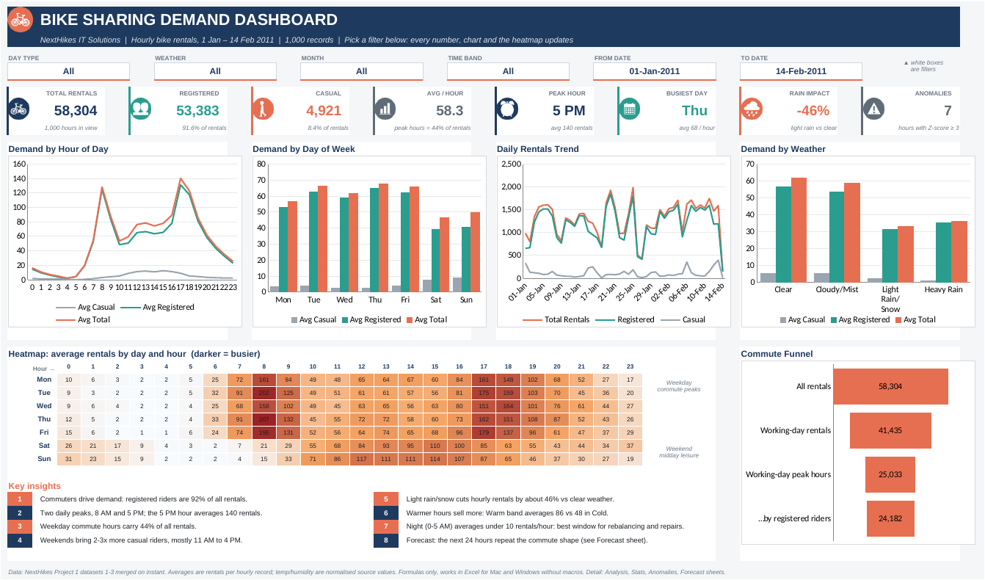




One-page Excel dashboard answers these questions interactively
6 filters
Day type, weather, month, time, dates
8 KPI cards
Totals, mix, peak, rain, anomalies
Charts and heatmap
Day-by-hour busy slots at a glance
Commute funnel
All rentals to working-day peak hours
Notes:
I brought all the findings together in one dashboard page in Excel. Filters for day type, weather, month, time band and dates update every number and chart. Below them are eight KPI cards, charts by hour, weekday, date and weather, a day-by-hour heatmap and the commute funnel. It uses only formulas, so it works in any version of Excel without macros.

Slide 14
Demand is predictable: few outliers and a usable forecast
MAE 21
rentals per hour forecast error
Notes:
The daily chart shows a regular weekly rhythm, with lower demand at weekends and a few bad-weather dips; 14 February is a partial day. Only 7 of 1,000 hours had a z-score of 3 or more against the same hour, and all were busy hours, so I kept them as real demand. The 48-hour forecast uses FORECAST.ETS with 24-hour seasonality and is off by about 21 rentals per hour. Its MASE of 0.98 means it is only slightly better than a naive guess, so it is a starting point for staffing.

Slide 15





Six actions to match bikes and staff to demand
Stock before the peaks
Use the night window
Win weekend riders
Fill office and transit stations before 8 AM and 5 PM
Rebalance and repair bikes between midnight and 5 AM
Leisure offers and day passes for casual users
Plan for rain
Staff to the forecast
Collect a full year
Expect ~46% fewer rides; shift crews to maintenance
Use the 24-hour forecast to plan shifts
Add spring and summer data to confirm patterns
Notes:
Based on the findings, I suggest six actions. Fill office and transit stations before 8 AM and 5 PM, and use the quiet night hours for moving bikes and repairs. Attract casual riders at weekends with leisure offers, and plan for rainy days when demand drops by almost half. Use the forecast to plan staff, and collect a full year of data to check these patterns in other seasons.

Slide 16
Conclusion: commute, calendar and weather drive demand
Key takeaways
Limitations
92% of rentals come from registered riders
Demand peaks at 8 AM and 5 PM
43% of rentals fall in working-day peak hours
Weekends bring 2.5x more casual riders per hour
Light rain cuts hourly rentals by about 46%
Only 6 weeks of data, winter only
64 hours missing from the timeline
Temperature and humidity are normalised units
Correlation is not causation
Thank you
Questions and feedback are welcome
Notes:
To sum up, bike demand is driven mainly by commuters, so the working-day rush hours matter most. Weekends bring more casual riders, and rain reduces demand a lot. Please keep in mind that this is only six weeks of winter data with some missing hours, and that correlation does not prove cause and effect. Thank you for listening, and I am happy to take any questions.

