Slide 1
SmartCalc
A calculator app built with Python and Tkinter
NextHikes IT Solutions
Amita Yadav
Notes:
Good morning. My project is SmartCalc, a calculator desktop app I built in Python using the Tkinter library, as Project 2 of my NextHikes IT Solutions internship course.

Slide 2
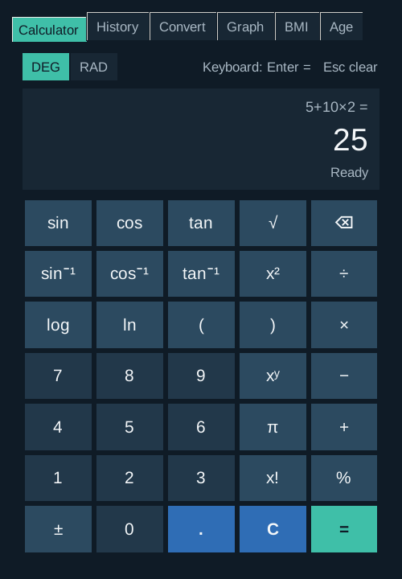
Why I built SmartCalc
Why I built it
Brief: a working calculator with a GUI
Daily sums, science and health in one app
Learn Python apps from start to finish
What makes it different
Six tabs keep features clear, not crowded
Works with mouse clicks and the keyboard
Clear error message for wrong input
Safe: never runs typed text as code
Notes:
The brief asked for a calculator with a screen, clickable buttons, the four basic operations, equals and clear. SmartCalc does all of that. I wanted it to be useful every day, so I added scientific functions, a saved history of past answers, a unit and currency converter, a graph plotter, a BMI checker and an age calculator. Each one sits on its own tab so the screen never looks crowded. You can use it with the mouse or the keyboard, wrong input like a plus b shows a clear error, and it never runs typed text as program code, which keeps it safe.

Slide 3
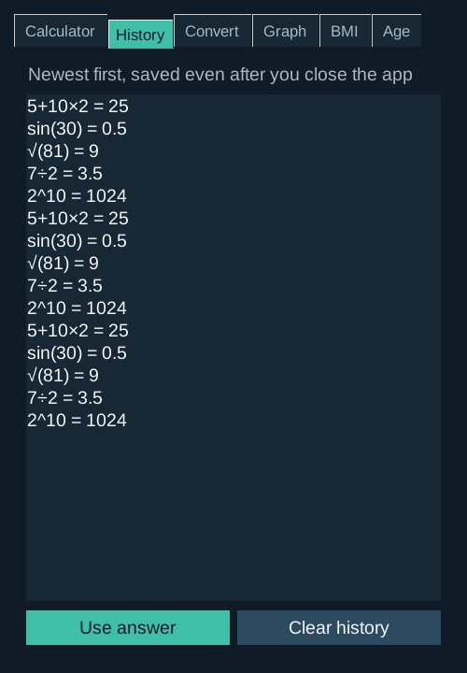
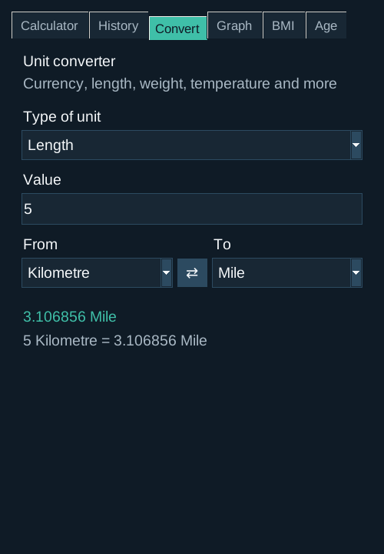
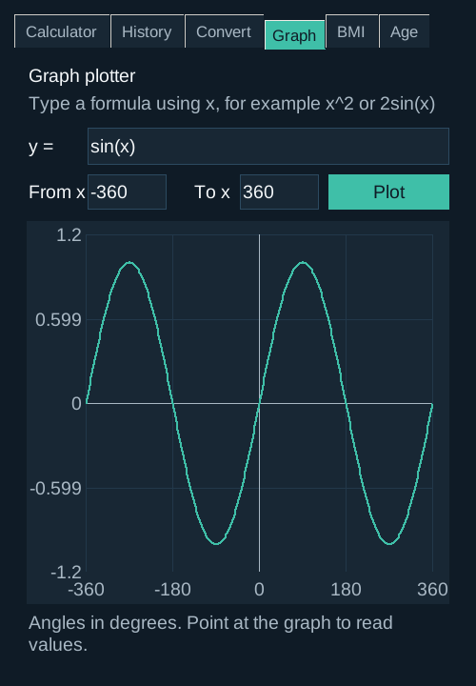
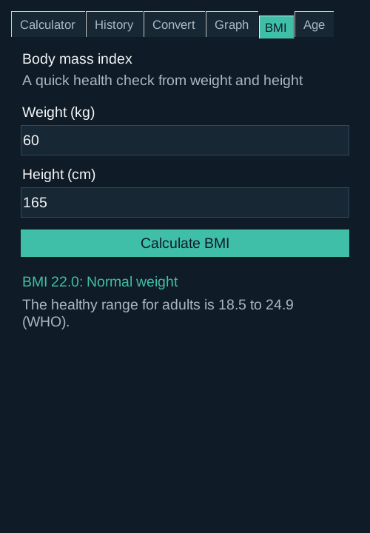
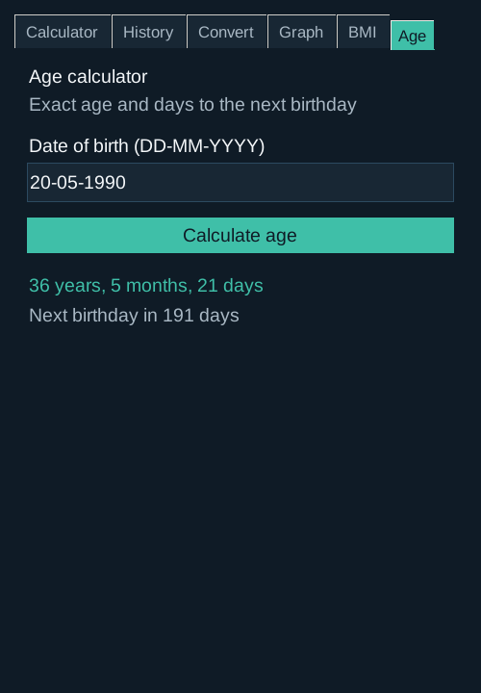
Features and output
Calculator
History
Convert
Graph
BMI
Age
+ − × ÷, %, sin, log, √
Kept after closing
Currency, length, weight and more
Plots any formula of x
BMI and health category
Exact age, next birthday
Notes:
These are real screenshots of the app. On the Calculator tab, 5 plus 10 times 2 gives 25, because multiplication is done first. The sum moves to the small line and the answer is shown once in large text. Separate DEG and RAD buttons choose degrees or radians for sin, cos and tan. Function buttons work on the number on screen, so 81 then the root button gives 9 straight away. The History tab lists every answer, newest first, and it is saved to a file so it is still there the next time you open the app. The Convert tab changes units of length, weight, volume, speed, time and temperature, and also converts currency using today's exchange rates from the internet. The answer updates as you type. The Graph tab draws any formula of x, such as sin x or x squared minus 4, and shows the value at any point you hover over. The BMI tab gives body mass index and its WHO category, and the Age tab gives exact age in years, months and days.

Slide 4
How it works
1
2
3
4
Input
main.py
calculator_engine.py
Output
Click a button or type on the keyboard
Builds the window, tabs and buttons
Checks the input and does the maths
Answer on screen, saved to history file
Two files keep the window separate from the maths
main.py: the face of the app, what you see
calculator_engine.py: the brain, all calculations
test_calculator_engine.py: 22 automatic checks
Notes:
When you click a button or press a key, main.py, which builds the window, passes the text to calculator_engine.py. The engine reads the sum piece by piece, only allows numbers, operators and the listed functions, and returns the answer or a friendly error. main.py then shows the answer and adds it to the history, which is saved to a small file in the home folder so it comes back next time. Keeping the window code and the maths in separate files makes the code easier to read and lets me test the maths automatically with the test file.

Slide 5
Tools, libraries and research
Research and references
Python 3.12
Tkinter and ttk
Programming language
Window, tabs, graph canvas
GeeksforGeeks: Python GUI calculator with Tkinter
Python docs: tkinter, ttk, math, ast
WHO BMI, NIST units, ECB exchange rates
Session feedback from the NextHikes tutor
Phone and Windows calculators for layout ideas
math
ast
sin, log, √, factorial
Reads sums safely
datetime and json
urllib and threading
Dates and saved history
Live exchange rates
unittest
VS Code and GitHub
Automatic tests
Write and share code
Notes:
I wrote the app in Python 3.12 in VS Code. Tkinter and its ttk widgets build the window, buttons and tabs, and its Canvas draws the graphs. The math library gives sin, log, square root and factorial. The ast library lets the app read a typed sum safely without running it as code. datetime works out ages, json saves the history to a file, urllib downloads exchange rates in the background using threading so the window never freezes, and unittest checks the maths automatically. The code is shared on GitHub. My starting point was the GeeksforGeeks Tkinter calculator from the course portal, then the official Python documentation, the WHO BMI categories, the NIST tables for unit conversion factors, the European Central Bank exchange rates through the free Frankfurter service, and the tutor's feedback in our review session.

Slide 6
Challenges and how I solved them
Challenge | Solution
eval() would run any typed code | Own safe reader that allows only maths
One DEG/RAD toggle confused users | Two separate DEG and RAD buttons
Letters like a + b typed in | Shows "Error: Invalid input"
Answer was shown twice | Sum on small line, answer shown once
0.1 + 0.2 showed 0.30000000000000004 | Answers rounded to 12 digits
Button colours ignored on Mac | ttk buttons with the clam theme
Huge numbers crashed the app | Shows "The answer is too large"
History was lost when the app closed | Saved to a file, reloaded at start
Exchange rates need the internet | Saved for offline use, clear error
tan(x) spikes flattened the graph | Scale ignores extremes, gaps at jumps
Still open: only one formula can be plotted at a time
Notes:
The biggest challenge was safety. Many example calculators use Python's eval function, which would run any code typed into the box. I replaced it with my own reader that only accepts numbers, operators and known functions. Following the tutor's feedback I split degrees and radians into two buttons, made wrong input like a plus b show an error, and stopped the answer appearing twice. I also rounded answers so 0.1 plus 0.2 shows 0.3, used ttk buttons so colours work on a Mac, and caught very large numbers that used to crash the app. At first the history was lost every time the app closed, so I now save it to a small file and load it again at start. Exchange rates change every day, so the app downloads them in the background and saves the last ones, which means it still works offline. When I plotted tan x, its huge spikes squashed the rest of the graph flat, so the scale now ignores the most extreme values and the line breaks at sudden jumps. One thing still open is that only one formula can be plotted at a time.

Slide 7
Conclusion
=
✓
Meets the brief
Screen, buttons, + − × ÷, = and C
✓
Goes further
Thank you
Graphs, currency, units, history, BMI, age
✓
What I learned
Tkinter layout, keyboard events, testing
Questions are welcome
✓
Next
Amita Yadav
Plot two formulas together, save graphs
NextHikes IT Solutions
Notes:
To conclude, SmartCalc meets every point in the brief and adds scientific maths, a saved history, a unit and currency converter, a graph plotter, a BMI checker and an age calculator. Building it taught me how Tkinter lays out a window, how to handle keyboard events, and how to test code automatically. Next I would like to plot two formulas on the same graph and save graphs as pictures. Thank you. I am happy to take any questions.

