Slide 1
Typescript

Slide 2
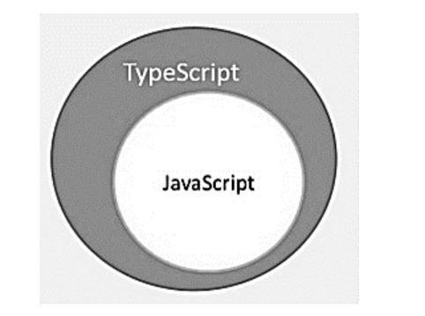
TypeScript - Overview
By definition, “TypeScript is JavaScript for application-scale development.”
TypeScript is a strongly typed, object oriented, compiled language. It was designed by Anders Hejlsberg (designer of C#) at Microsoft. TypeScript is both a language and a set of tools. TypeScript is a typed superset of JavaScript compiled to JavaScript. In other words, TypeScript is JavaScript plus some additional features.

Slide 3
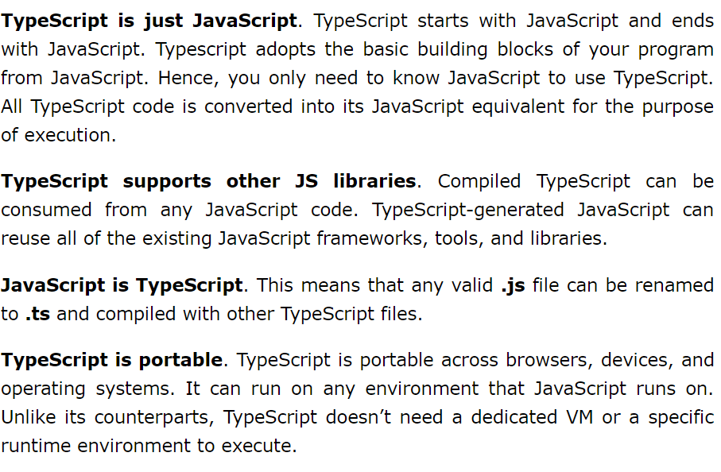
Features of TypeScript

Slide 4
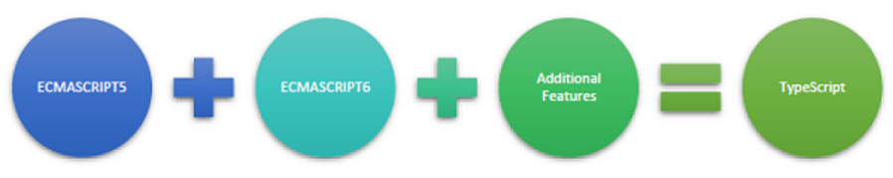
TypeScript and ECMAScript
The ECMAScript specification is a standardized specification of a scripting language. There are six editions of ECMA-262 published. Version 6 of the standard is codenamed "Harmony". TypeScript is aligned with the ECMAScript6 specification.
TypeScript adopts its basic language features from the ECMAScript5 specification, i.e., the official specification for JavaScript. TypeScript language features like Modules and class-based orientation are in line with the EcmaScript 6 specification. Additionally, TypeScript also embraces features like generics and type annotations that aren’t a part of the EcmaScript6 specification.

Slide 5
TypeScript - Environment Setup
npm install -g typescript
1. Install node in your Machine .
2. npm install –g typescript

Slide 6
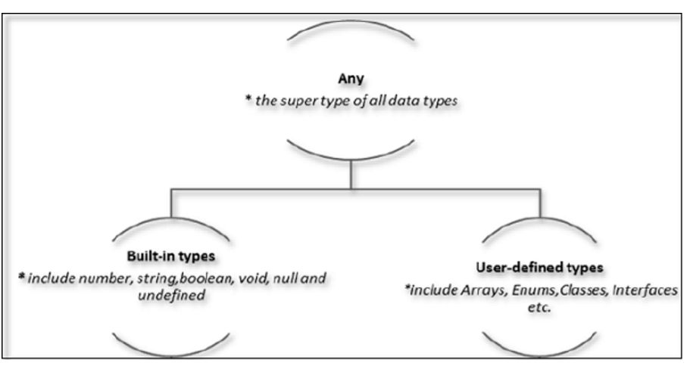
TypeScript - Types
TypeScript provides data types as a part of its optional Type System. The data type classification is as given below −

Slide 7
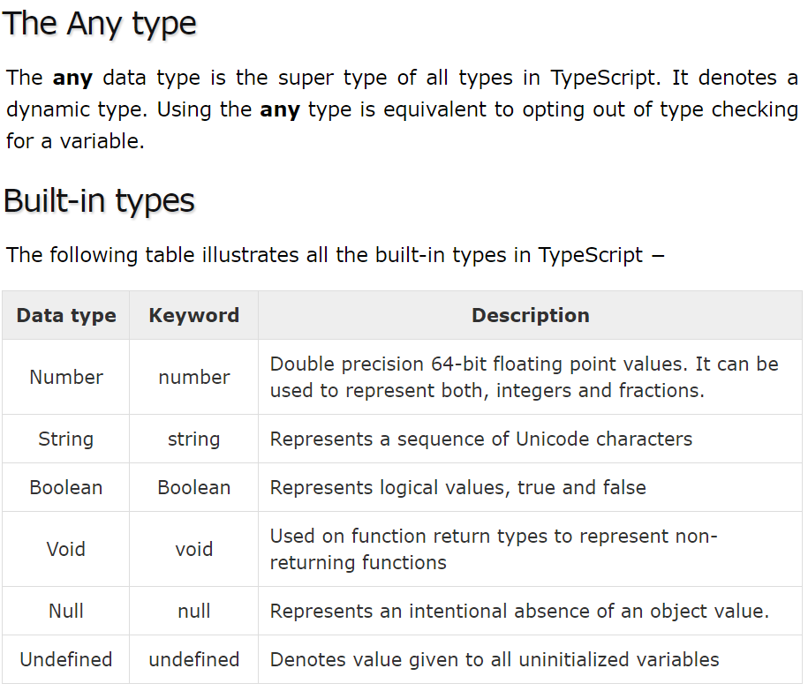

Slide 8
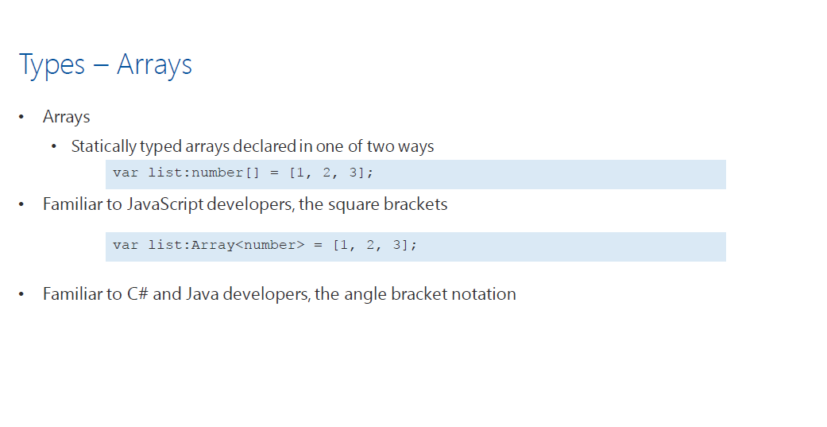
Types-Arrays

Slide 9
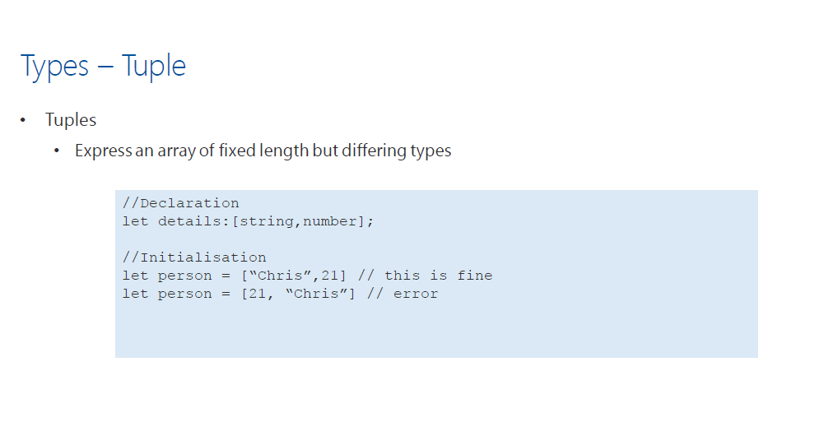
Types Tuple

Slide 10
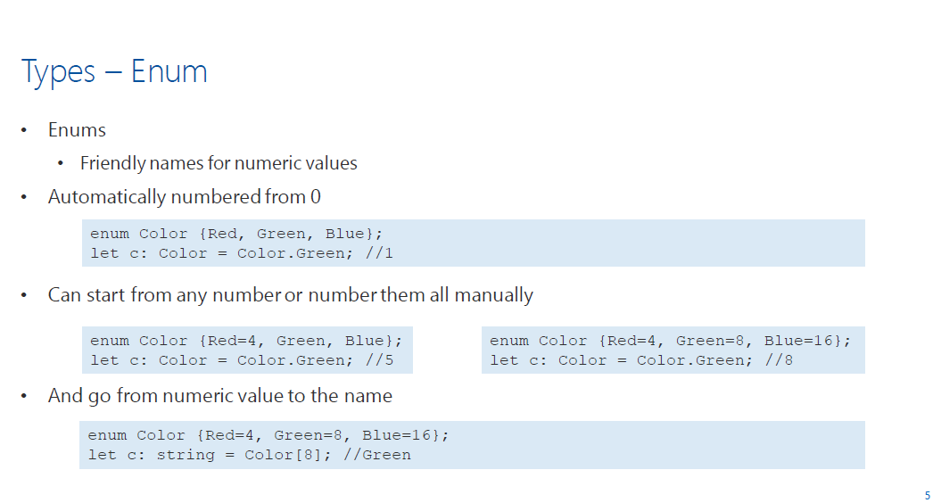
Type -Enum

Slide 11
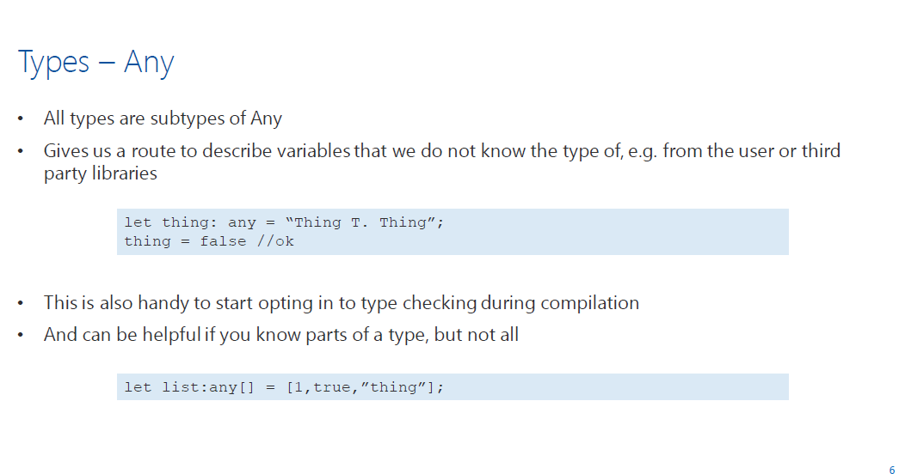
Type-Any

Slide 12
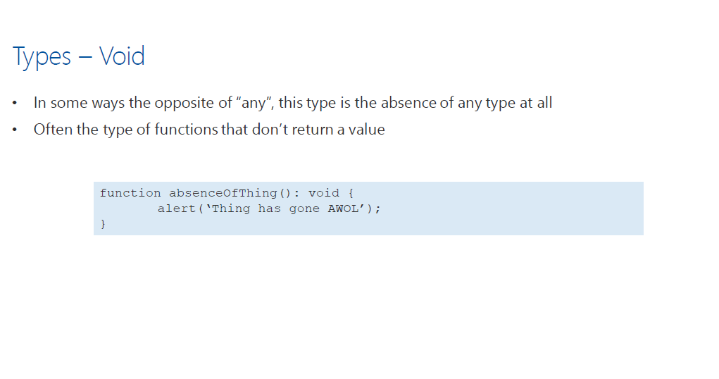
Type-Void

Slide 13
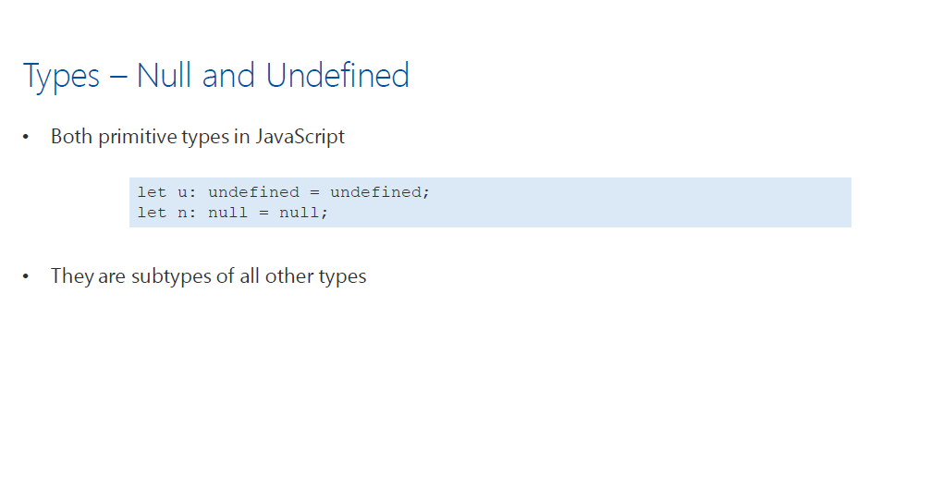
Type: Null

Slide 14
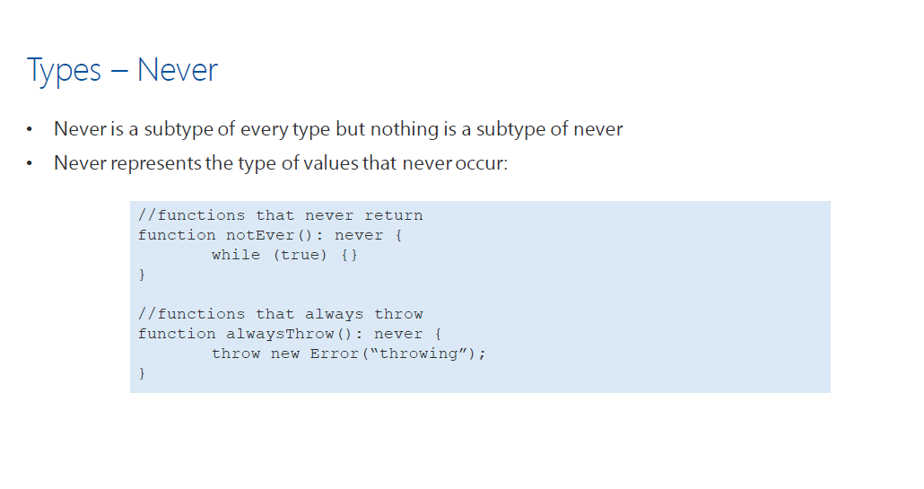
Types : Never

Slide 15
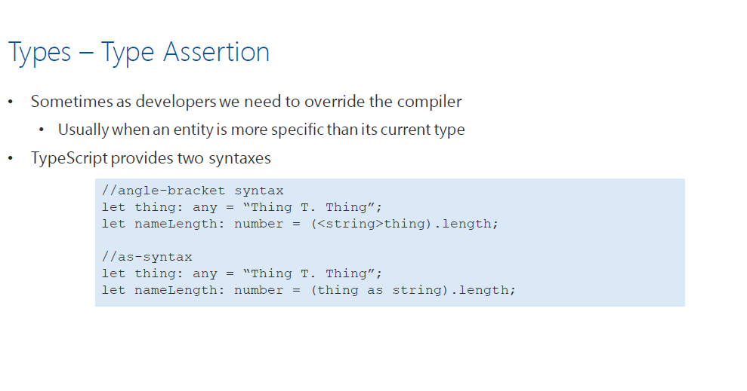
Types: Type Assertion

Slide 16

Classes & Objects

Slide 17
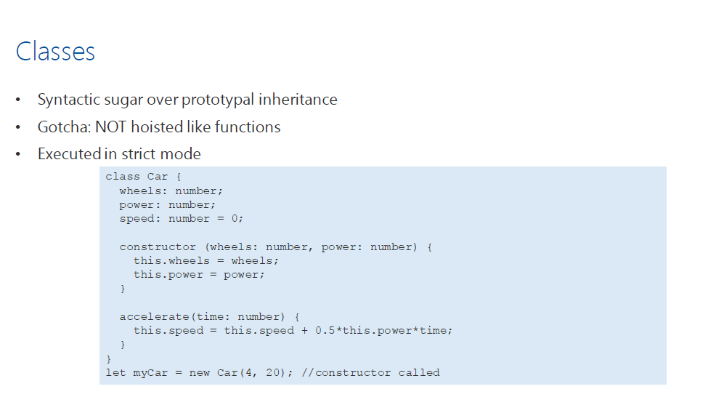
Classes

Slide 18
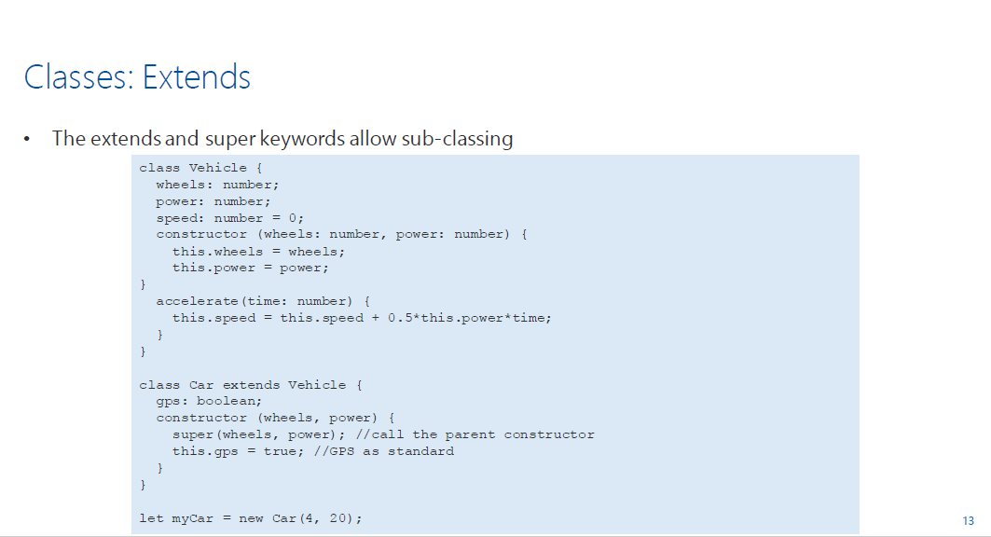
Classes:Extends

Slide 19
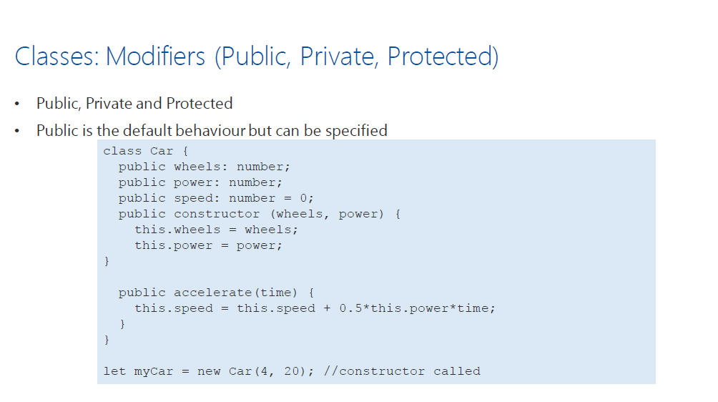
Classes: Modifiers

Slide 20
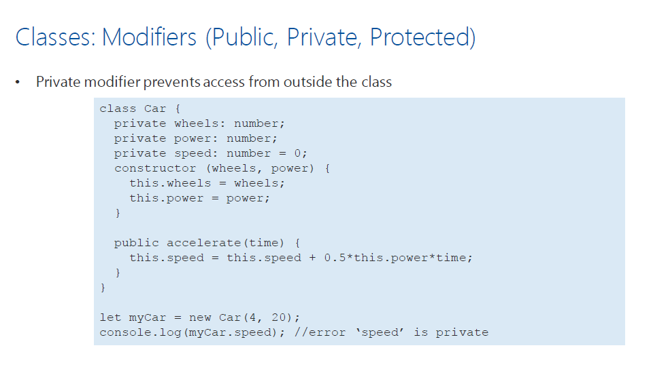
Classes: Modifiers

Slide 21
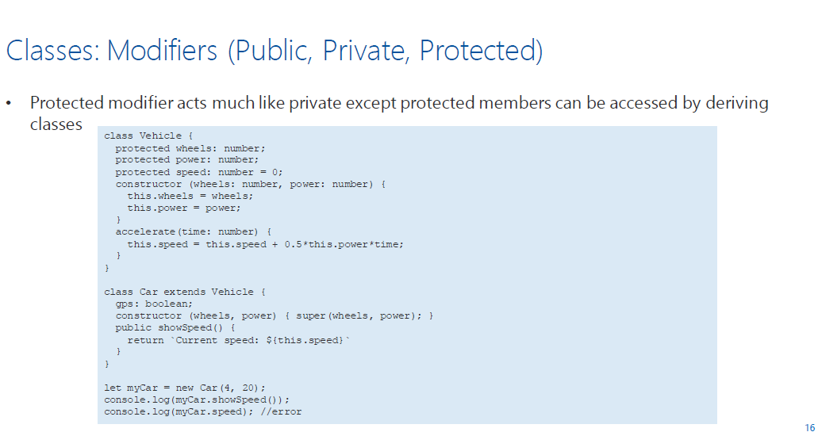
Classes: Modifiers

Slide 22
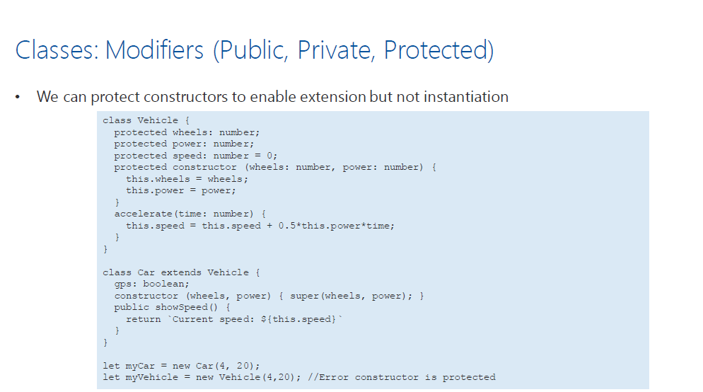
Classes: Modifiers

Slide 23
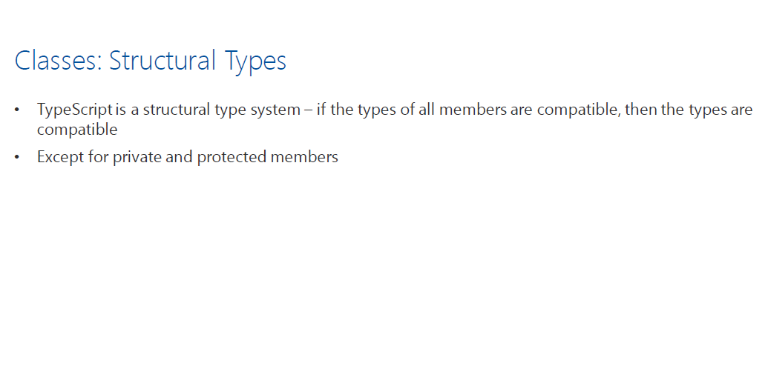
Classes: Structural Type

Slide 24
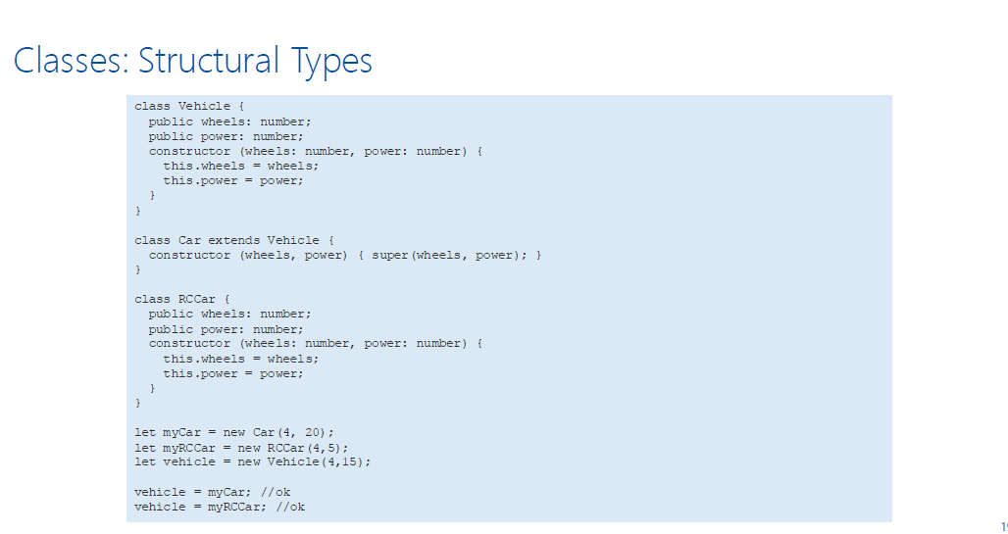
Classes: Structural Type

Slide 25
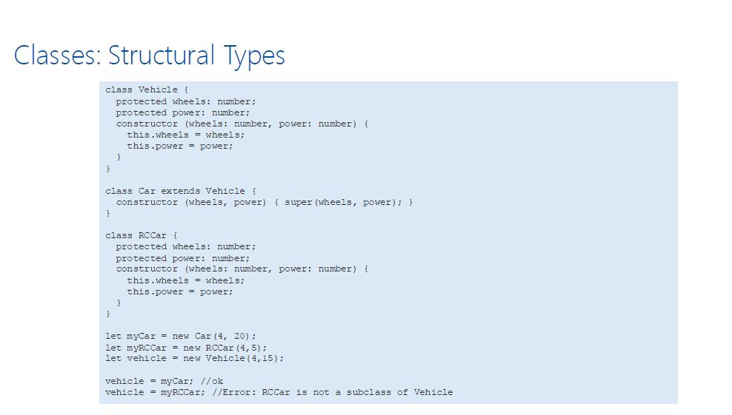
Classes: Structural Type

Slide 26
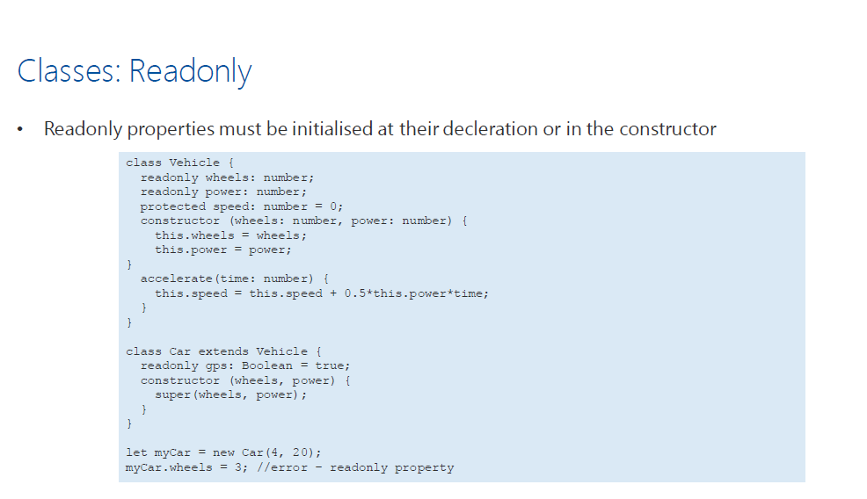
Class: Readonly

Slide 27
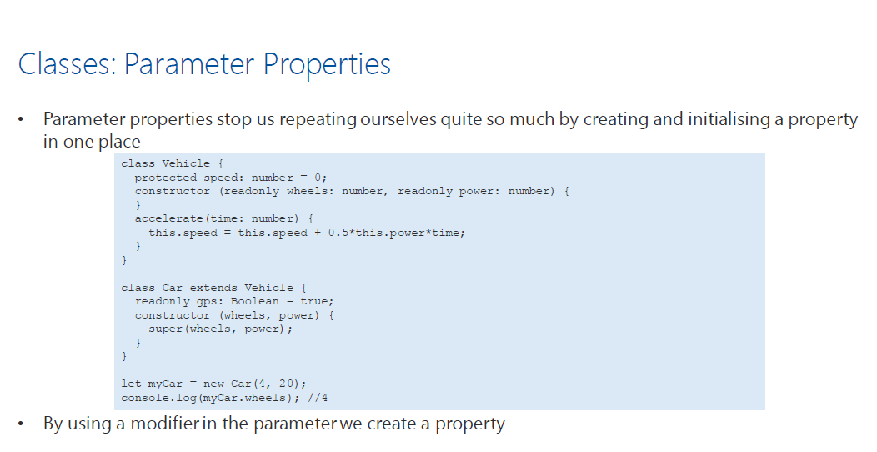
Classes: Parameter properties

Slide 28
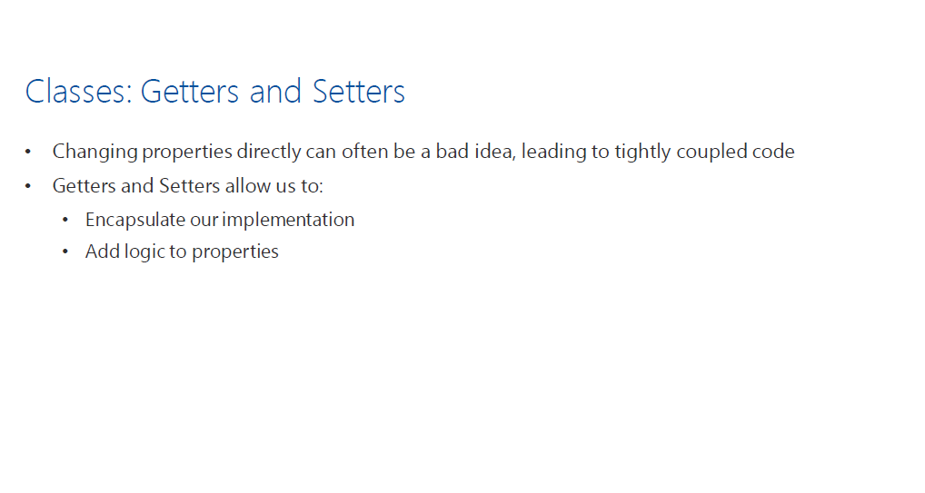
Classes: Getters/Setters

Slide 29
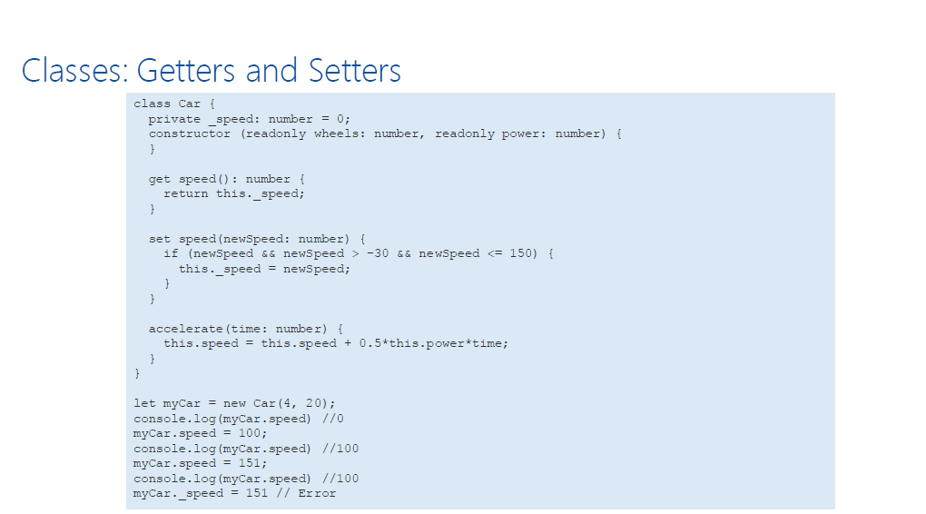
Classes: Getters/Setters

Slide 30
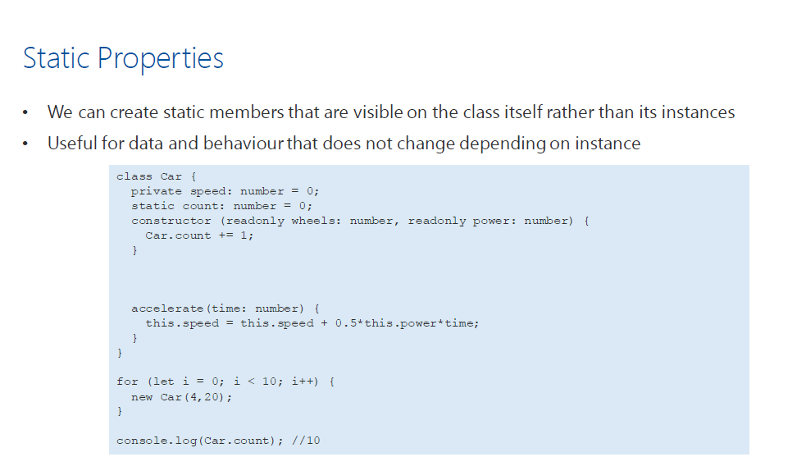
Static Properties

Slide 31
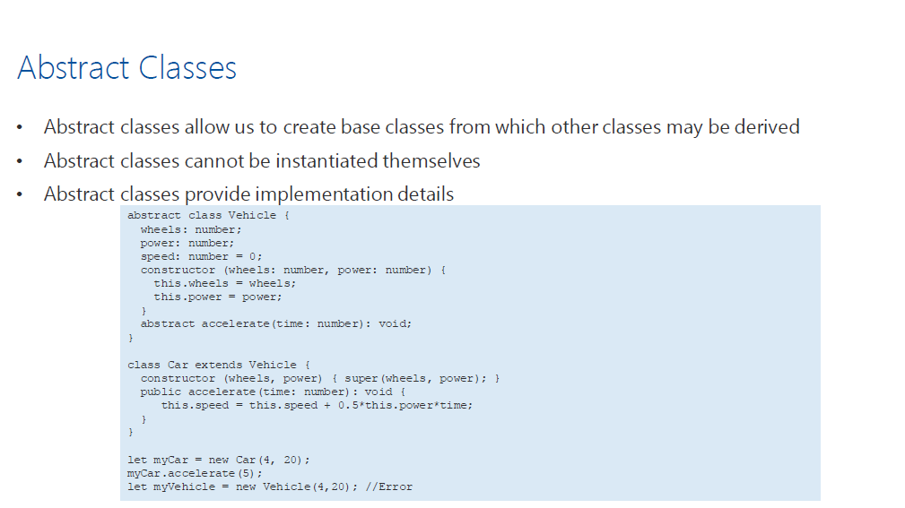
Abstract Classes

Slide 32
Thanks

