Slide 1
Software Project Lab
Multilevel Regularized Markov Clustering Algorithm
Presented by:
Amit Kumar Baranwal
Kumar Ankit
(B.Tech, Computer Science & Engg., 2nd year, IT BHU)

Slide 2
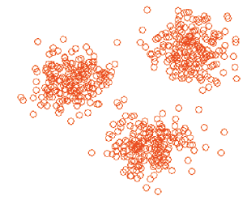
Introduction
Finding patterns in data, or grouping similar groups of data-points together into clusters.
Clustering algorithms for numeric data: Lloyd’s K -means, EM clustering, spectral clustering etc.

Slide 3
Graph clustering:
Undirected graphs
Clustering of vertices on basis of edge structure.
Defining a graph cluster?
In its loosest sense, a graph cluster is a connected component.
In its strictest sense, it’s a maximal clique of a graph.
Many vertices within each cluster.
Few edges between clusters.

Slide 4
Preliminaries: Notations and Definitions
Stochastic flow or flow: The flow between two vertices vi and vj.
Markov Chain: A mathematical system that undergoes transitions from one state to another, between finite possible states.
Column Stochastic Matrix:
Each column in the adjacency matrix A, of the graph is normalized to sum to 1.

Slide 5
Markov Clustering Algorithm
Iteratively applies the following 3 steps to flow matrix(Algorithm 1):
Expansion: Spreads the flow out of a vertex
Inflation: Strengthens intra-cluster flow and weakens inter-cluster flow
Pruning: Remove the entries below threshold value and renormalize.

Slide 6
Analysis
Complexity: O(N³), where N is the number of vertices.
Inflation can be done in O(N²) time
Limitations of MCL:
Lack of Scalability: MCL is quite slow
Fragmentation of Output: It outputs too many clusters.

Slide 7
Regularized MCL
Solves the fragmentation problem.
During Expansion, the flow matrix is multiplied by Canonical Transition Matrix.
M=MxMg
Thus prevents the columns from diverging too much and hence not producing separate clusters.

Slide 8
Multilevel Regularized MCL
Flow values resulting from simulations on coarser graphs can effectively be used to initialize the flow for simulations on bigger graphs.
Three stages:
Coarsening : Coarsen graph into a series of smaller graphs until we have a graph of manageable size.
Curtailed R-MCL:R-MCL for few iterations (say 2)
R-MCL on initial Graph: R-MCL until convergence on final graph.

Slide 9
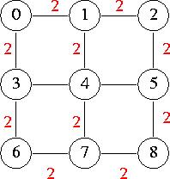
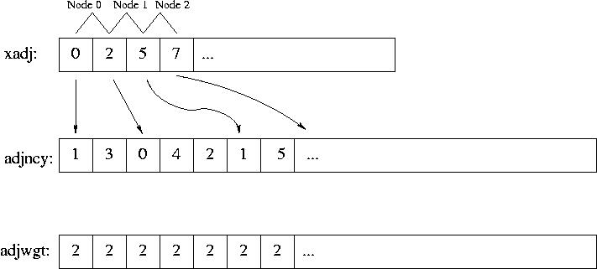
Graph Representation
All data stored in arrays
- xadj holds pointers to adjncy and adjwgt
that hold connected nodes and edge
weights
- for j, such that xadj[i] <= j < xadj[i+1]:
adjncy[j] is connected to i,
adjwgt[j] is weight of edge connecting
i,j

Slide 10
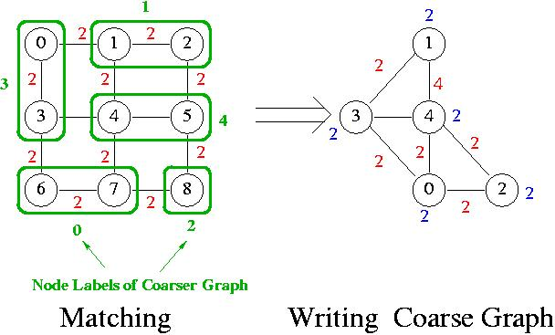
Coarsening Algorithm

Slide 11

Coarsening: Matching

Slide 12
Phase I : Coarsening can be subdivided into three stages:
Matching
Mapping
Creating a coarse graph
Matching: Maximal Matching is constructed.
Mapping: The matched edges are mapped to new
vertices in the coarsened graph.
Creating: Matched vertices are collapsed, edges between
Matched vertices is removed.

Slide 13
Phase II: Curtailed R-MCL
R-MCL run for two iterations referred to as Curtailed R-MCL.
The flow values at the end of this Curtailed R-MCL projected on to the refined graph of the current graph , and R-MCL is run again for a few iterations on the refined graph, and this is repeated until we reach the original graph.
Phase III: R-MCL on initial graph
With flow values initialized from the previous phase, R-MCL is run on the final graph until convergence. The flow matrix at the end is converted into a clustering in the usual way, with all the nodes that flow into the same “attractor” node being assigned into one cluster.

Slide 14
Experimental Results:
Table 1: Results showing number of clusters formed on running the three algorithms as implemented by us.
Source of test graphs:
http://www.weizmann.ac.il/mcb/UriAlon/groupNetworksData.html
No. of clusters | Graph1 | Graph2 | Graph3
MCL (r=2) | 23 | 10 | 5
R-MCL (r=2) | 23 | 10 | 5
MLR-MCL (r=2) | 17 (c=10) | 9 (c=5) | 3 (c=2)

Slide 15
THANK
YOU....

