Slide 1
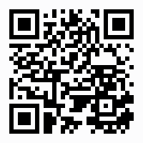
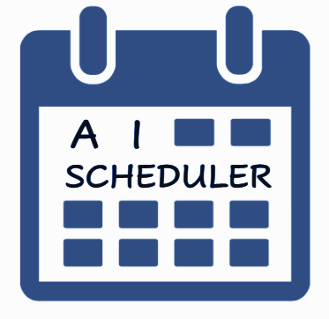




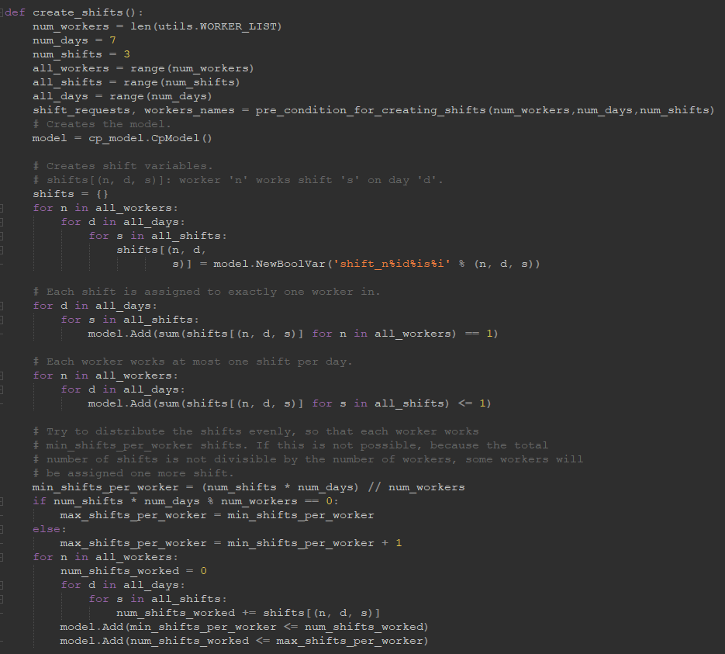

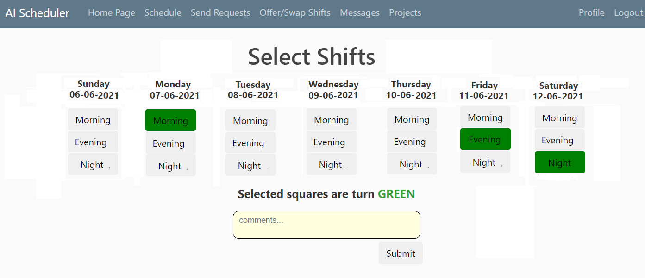

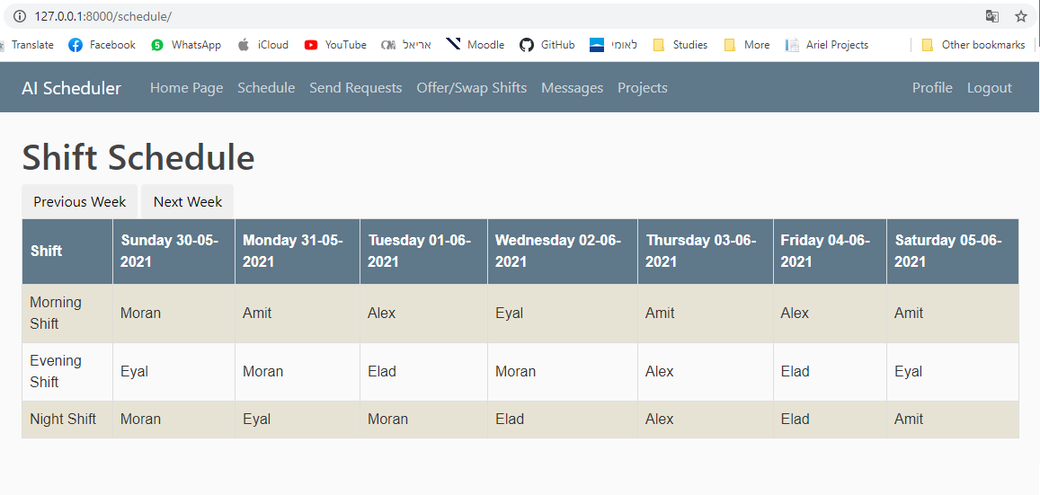



[Poster Describe Research or Software Development Project]
Amit Bibi (203262647) Moran Oshia (3132929633) Alex Chagan (206262123) Instructed by Dr.Elad Horev
Logo
AI - SCHEDULER
Contribution/project goal
Easy way to create a shifts board and manage it.
Introduction
In a world where procedures become automated, we are replacing manual shift creation with automation and fairness.
Even better, we make the submission of the shifts easier and more automated for the employees themselves, not only the employers.
Selected Approach
Website Code & DB:
Python, Django package, HTML, JS, CSS, Firebase
Scheduling shifts:
OR-Tools - Solving combinatorial optimization problems.
Suggesting shifts:
ML - Logistic Regression Algorithm with Sklearn package.
Our Solution
Suggetting Shifts:
The algorithm will recognize the most frequent shifts of the worker and suggests shifts board for next week.
Creating And Display Shifts:
The algorithm create the shifts for the manager and offer alternatives if no one submitted.
Future Goals:
Infrastructure:
We will create a Linux virtual machine in Azure portal with a docker image.
Projects:
We will create a platform for managers to track the progress of employee tasks
https://github.com/amitbb93/AI-Scheduler

