Slide 1
CF
CareerForge AI
Build your resume.
Create your portfolio.
Get AI suggestions.
An AI-powered resume and career development platform for students, fresh graduates, and job seekers.
Amit Singh Bisht (01013702025) Vivek Kumar (04713702025)

Slide 2
THE PROBLEM
Building a career profile is scattered
and needlessly expensive
Students and fresh graduates struggle with resume formatting and structure, while existing platforms lock full customization, templates, and PDF export behind paid plans — and offer no real portfolio or feedback tools at all.
🧩
💳
🤷
Scattered Tools
Paywalled Basics
No Real Feedback
Separate apps for resumes, portfolios, and career guidance — nothing talks to each other.
Templates, PDF export, and customization often sit behind a subscription.
No way to know if a resume is actually good — no scoring, no suggestions.
CareerForge AI — Project Overview
2

Slide 3
OUR SOLUTION
CF
One platform for your entire
career story
CareerForge AI brings resume building, portfolio creation, and AI-assisted career guidance into a single, centralized, free platform — so nothing gets lost between five different tools.
Sign Up
→
Build Resume
→
Add Portfolio
→
Get AI Feedback
→
Download PDF
CareerForge AI — Project Overview
3

Slide 4
KEY FEATURES
Everything a job seeker needs, built in
🔐
📄
🎨
⬇️
Secure Authentication
Resume Builder
3 Resume Templates
One-Click PDF Export
JWT-based registration & login with hashed passwords
Multi-section form with a real-time live preview
Classic, Modern & Minimal — switch instantly
Paginated PDF generation, client-side
🌐
🤖
📊
🌙
Portfolio Builder
AI Resume Review
Smart Dashboard
Dark Mode
A shareable page for your projects & skills
Real scores & feedback via Groq (Llama 3.3)
Profile-completion tracking at a glance
Theme preference saved across sessions
CareerForge AI — Project Overview
4

Slide 5
TECHNOLOGY STACK
Built on a modern, full-stack foundation
Frontend
Backend
Database
AI & Tools
Angular (Standalone)
ASP.NET Core Web API
Microsoft SQL Server
Groq API — Llama 3.3 70B
TypeScript
C#
Entity Framework Core
jsPDF + html2canvas
HTML5 / CSS3
JWT + BCrypt Auth
Swagger, Postman, Git
CareerForge AI — Project Overview
5

Slide 6
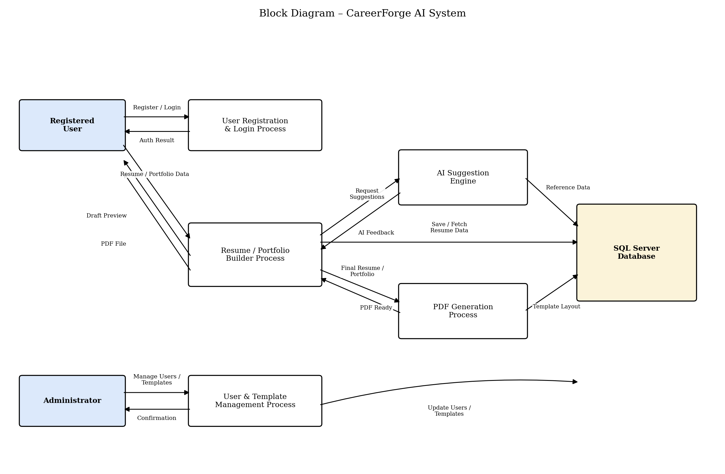
SYSTEM ARCHITECTURE
A three-tier architecture
Angular frontend → ASP.NET Core Web API → SQL Server, with the AI Suggestion Engine and PDF Generation running as dedicated processes.
CareerForge AI — Project Overview
6

Slide 7
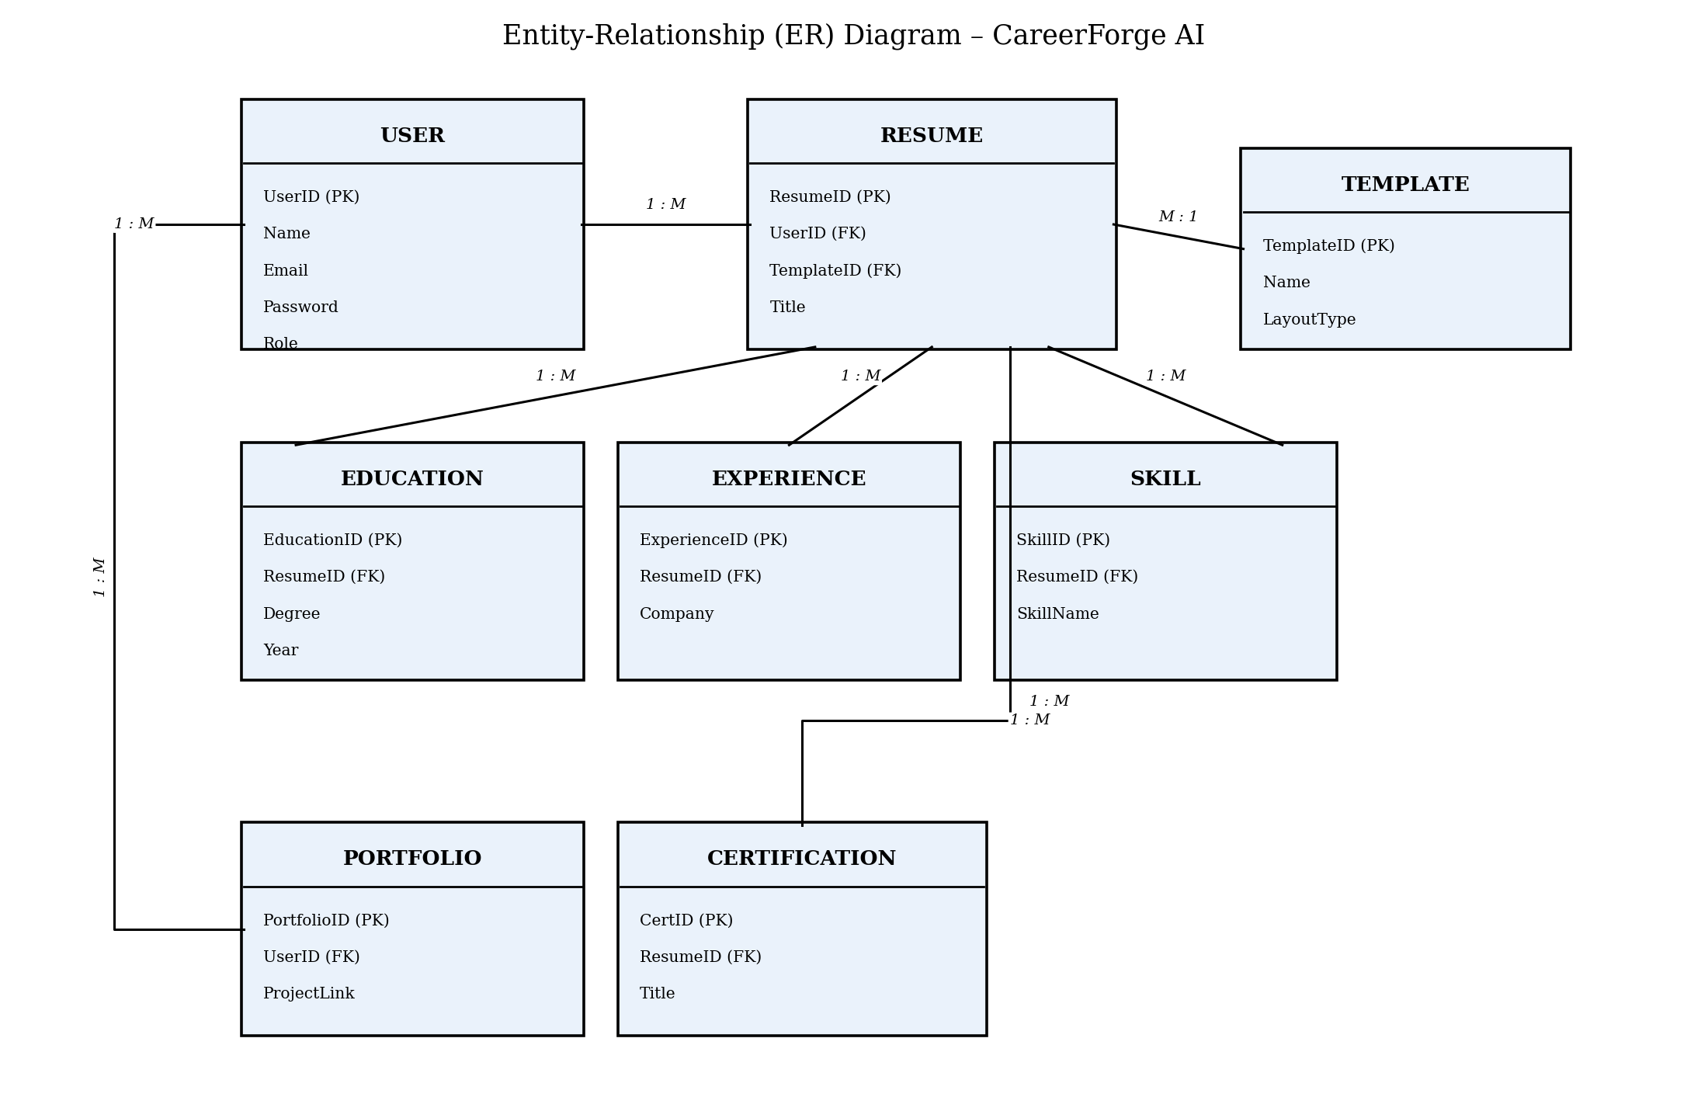
DATABASE DESIGN
Entity-Relationship Model
CareerForge AI — Project Overview
7

Slide 8
POWERED BY GROQ · LLAMA 3.3 70B
Real AI feedback, not a checklist
Every resume is sent to a large language model, which returns genuine, structured feedback — not keyword matching.
0-100
0-100
0-100
0-100
Overall Score
Grammar Score
ATS Match Score
Skills Score
Plus written feedback and specific suggestions for missing skills — all generated on demand from the AI Suggestions screen.
CareerForge AI — Project Overview
8

Slide 9
FUTURE SCOPE
What's next for CareerForge AI
ATS Resume Score Checker
Job Recommendation System
1
2
Dedicated ATS-compatibility scoring
Suggested listings based on resume content
Cover Letter Generator
Mock Interview Module
3
4
AI-drafted, role-specific cover letters
Simulated interview practice with feedback
Email & OTP Verification
Job Portal Integration
5
6
Stronger account security at sign-up
Direct application submission
CareerForge AI — Project Overview
9

Slide 10
CF
Thank You
Questions & feedback welcome.
Amit Singh Bisht · Vivek Kumar
BCA · Institute of Information Technology & Management, New Delhi
github.com/amitbisht2406-cmd/CareerForge-AI
linkedin.com/in/amitbisht2406
amitbisht2406@gmail.com

