Slide 1



MindReader
Installation guide

Slide 2
MindReader
a machine who can supposedly discern what another person is thinking
Created with PHP and Font Awesome
Queries? Mail me: amit.bk03@gmail.com

Slide 3
MindReader
a machine who can supposedly discern what another person is thinking
Created with PHP and Font Awesome
Queries? Mail me: amit.bk03@gmail.com

Slide 4
MindReader
Created with PHP and Font Awesome

Slide 5
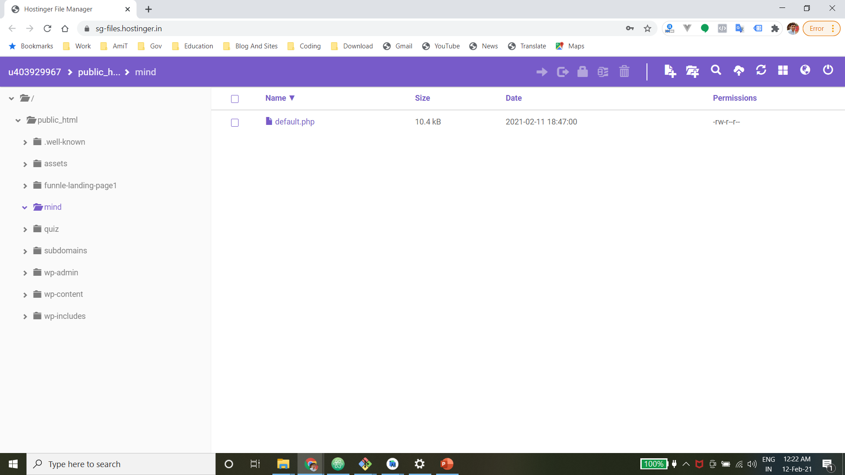
Open your CPanel (In my case I am using Hostinger)
You need to have domain pointed to some directory. (In my case I have pointed subdomain)
Open that directory, where you want to upload project.

Slide 6
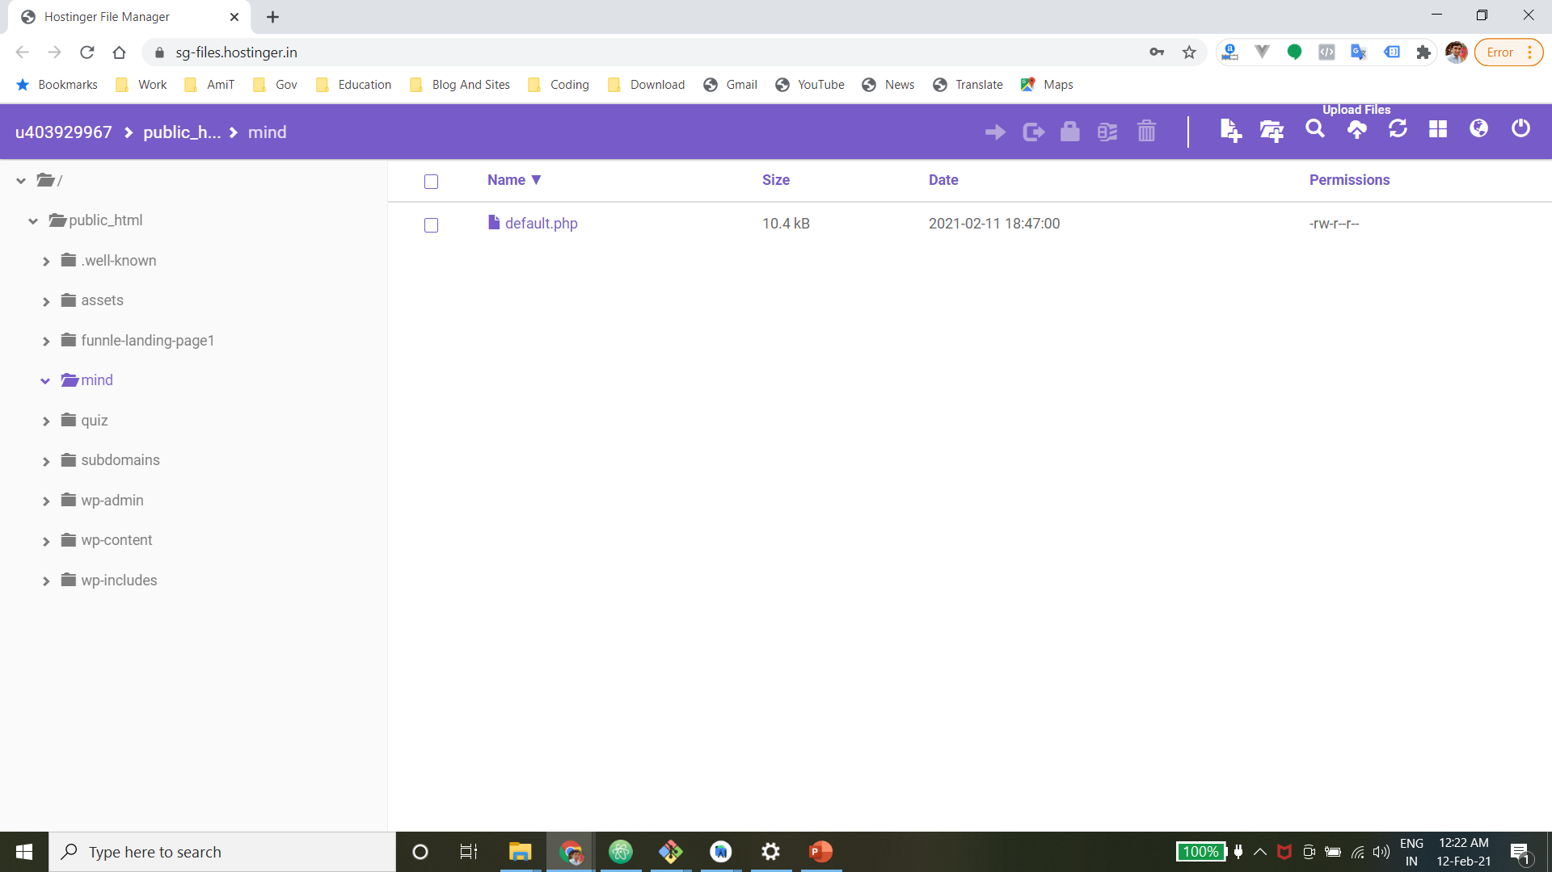
Click on upload button

Slide 7
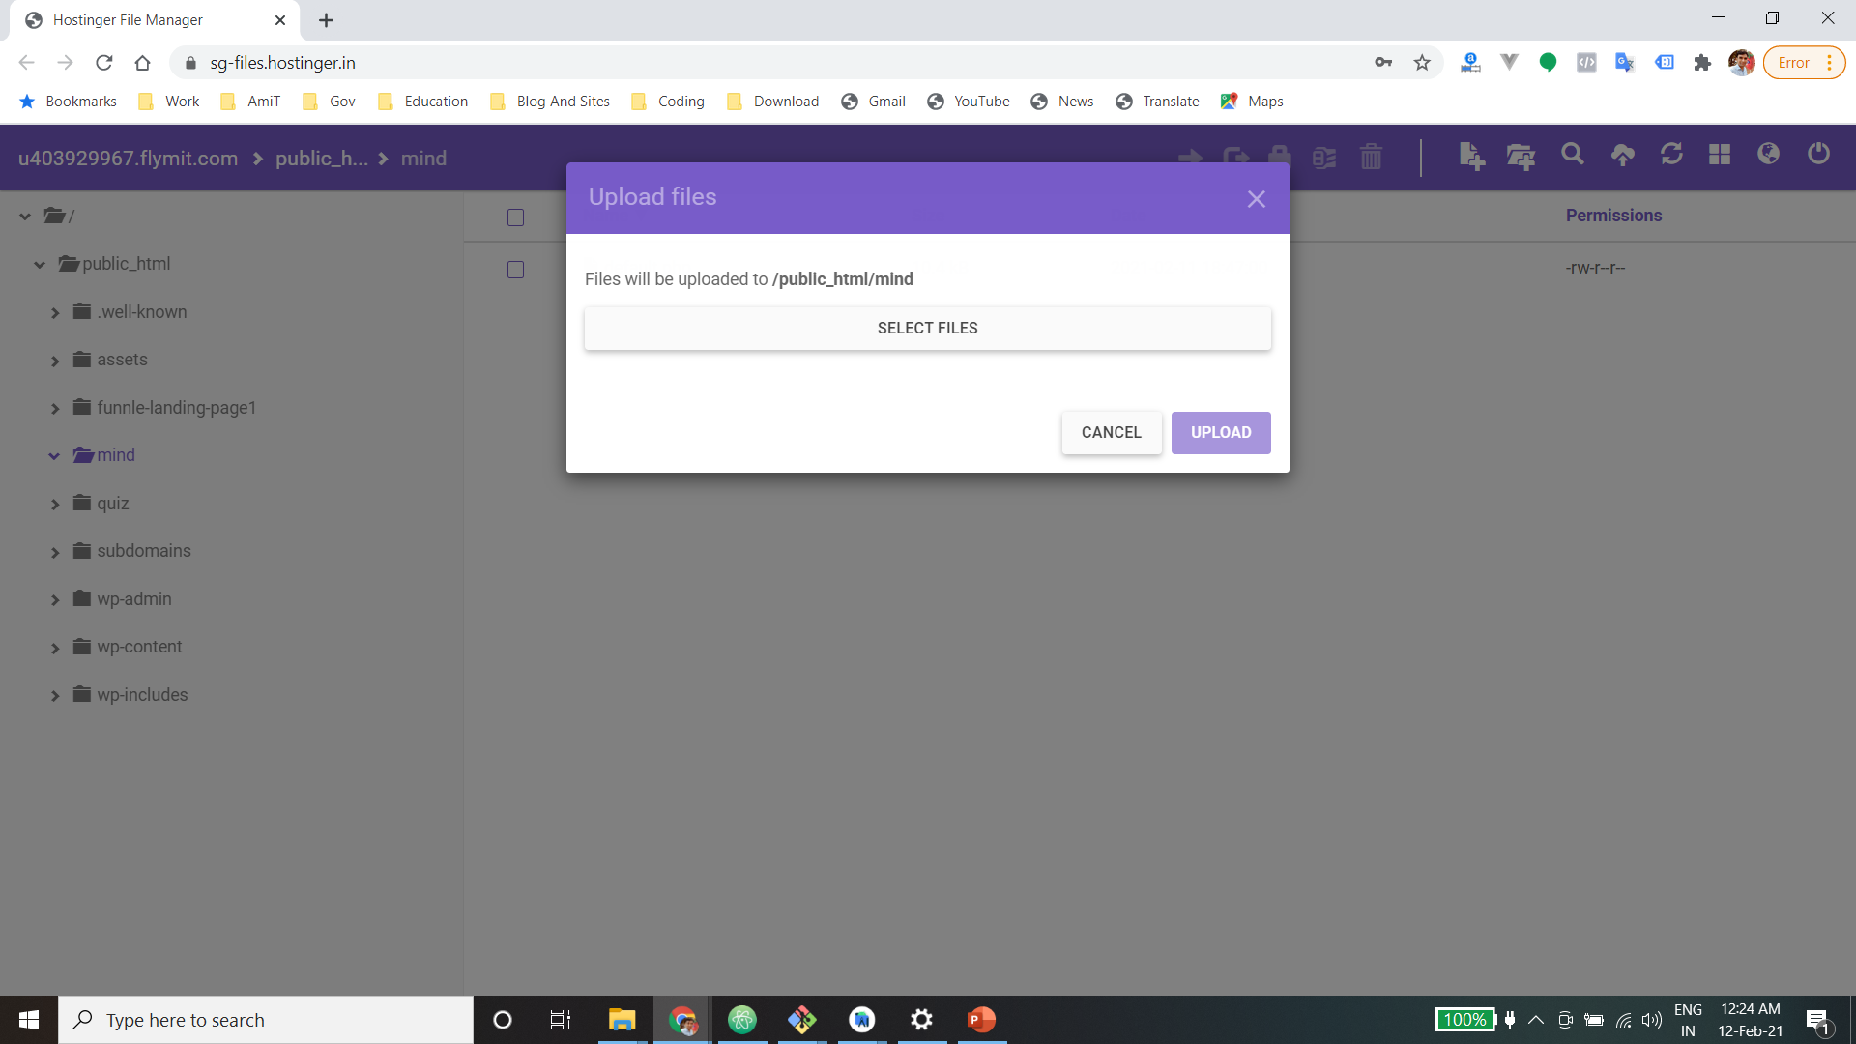
Click on select files

Slide 8
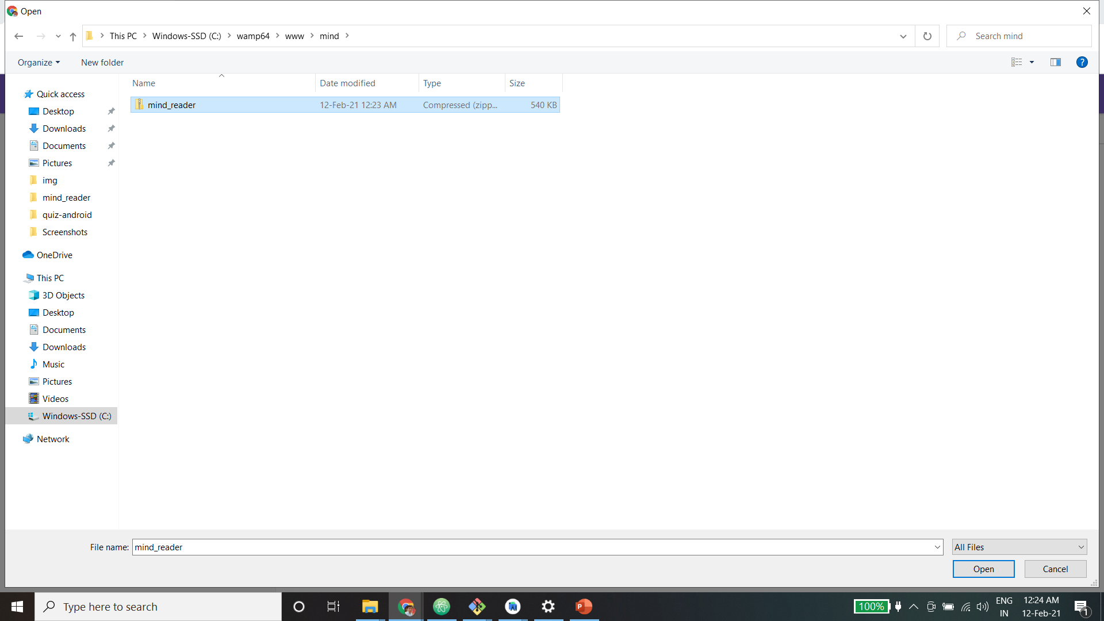
Select zip file to upload

Slide 9
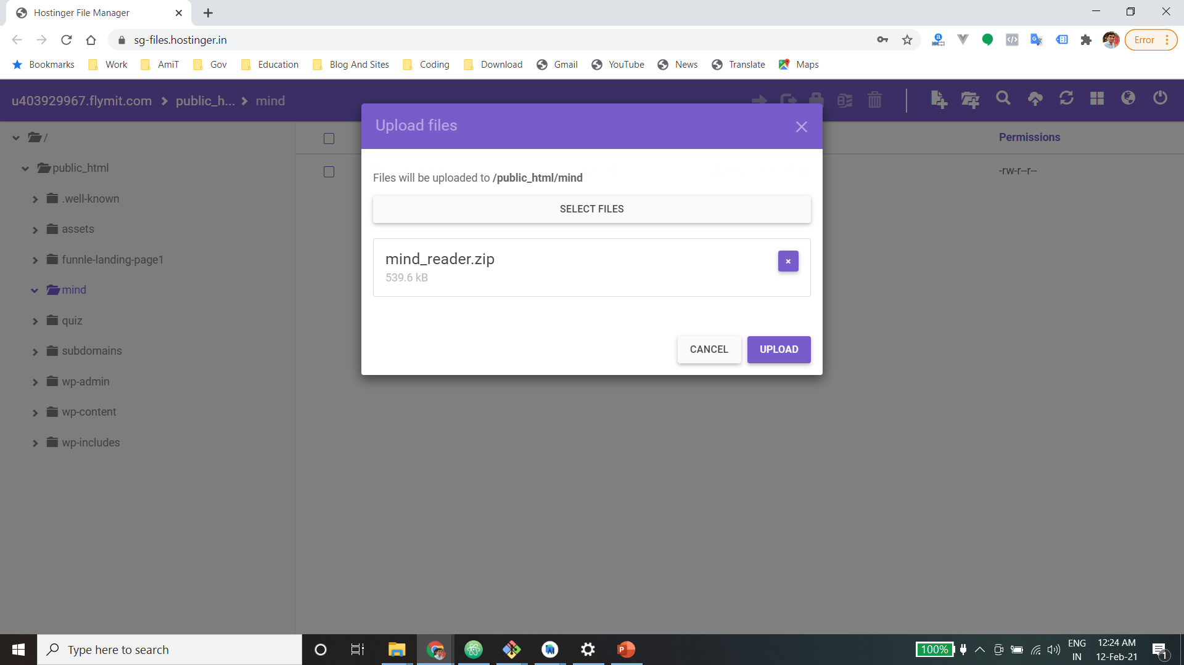
File will be selected
Now click on upload button

Slide 10
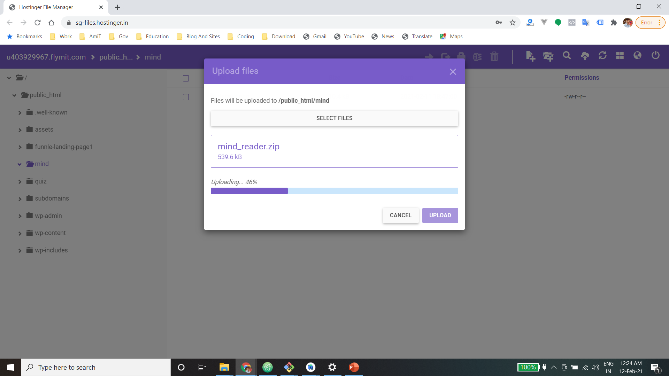
Uploading will be started
Wait until this

Slide 11
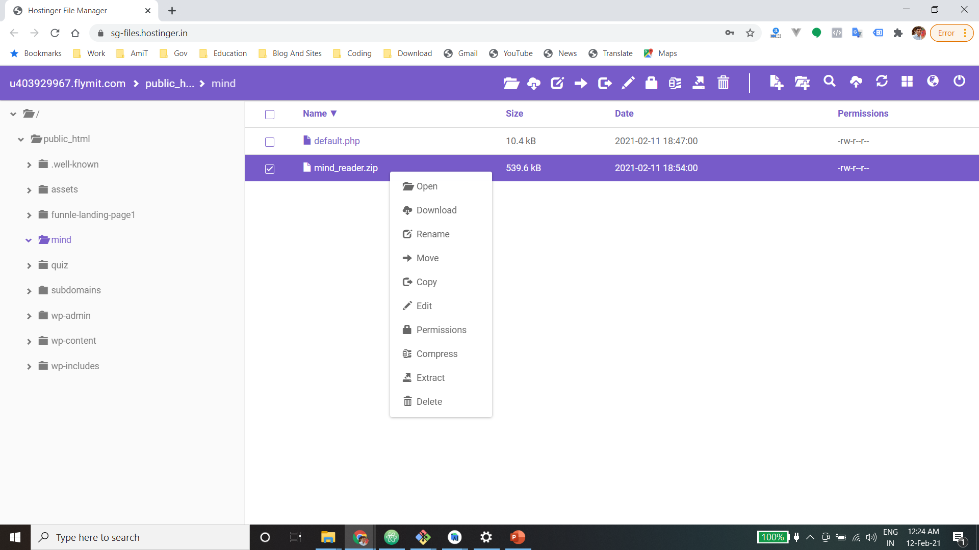
After uploading, right click on that file

Slide 12

Click on Extract option

Slide 13
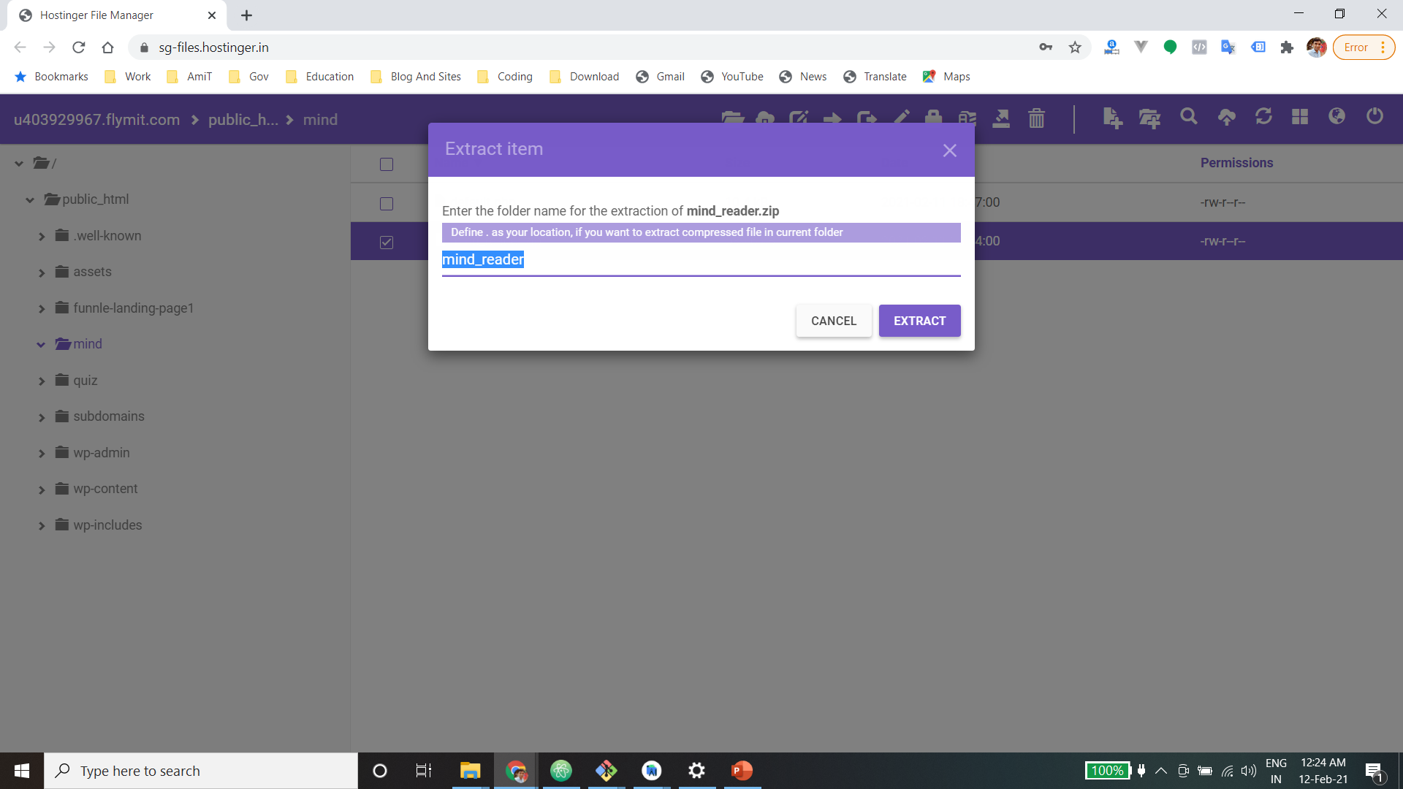
Change directory to /
And click on Extract button

Slide 14
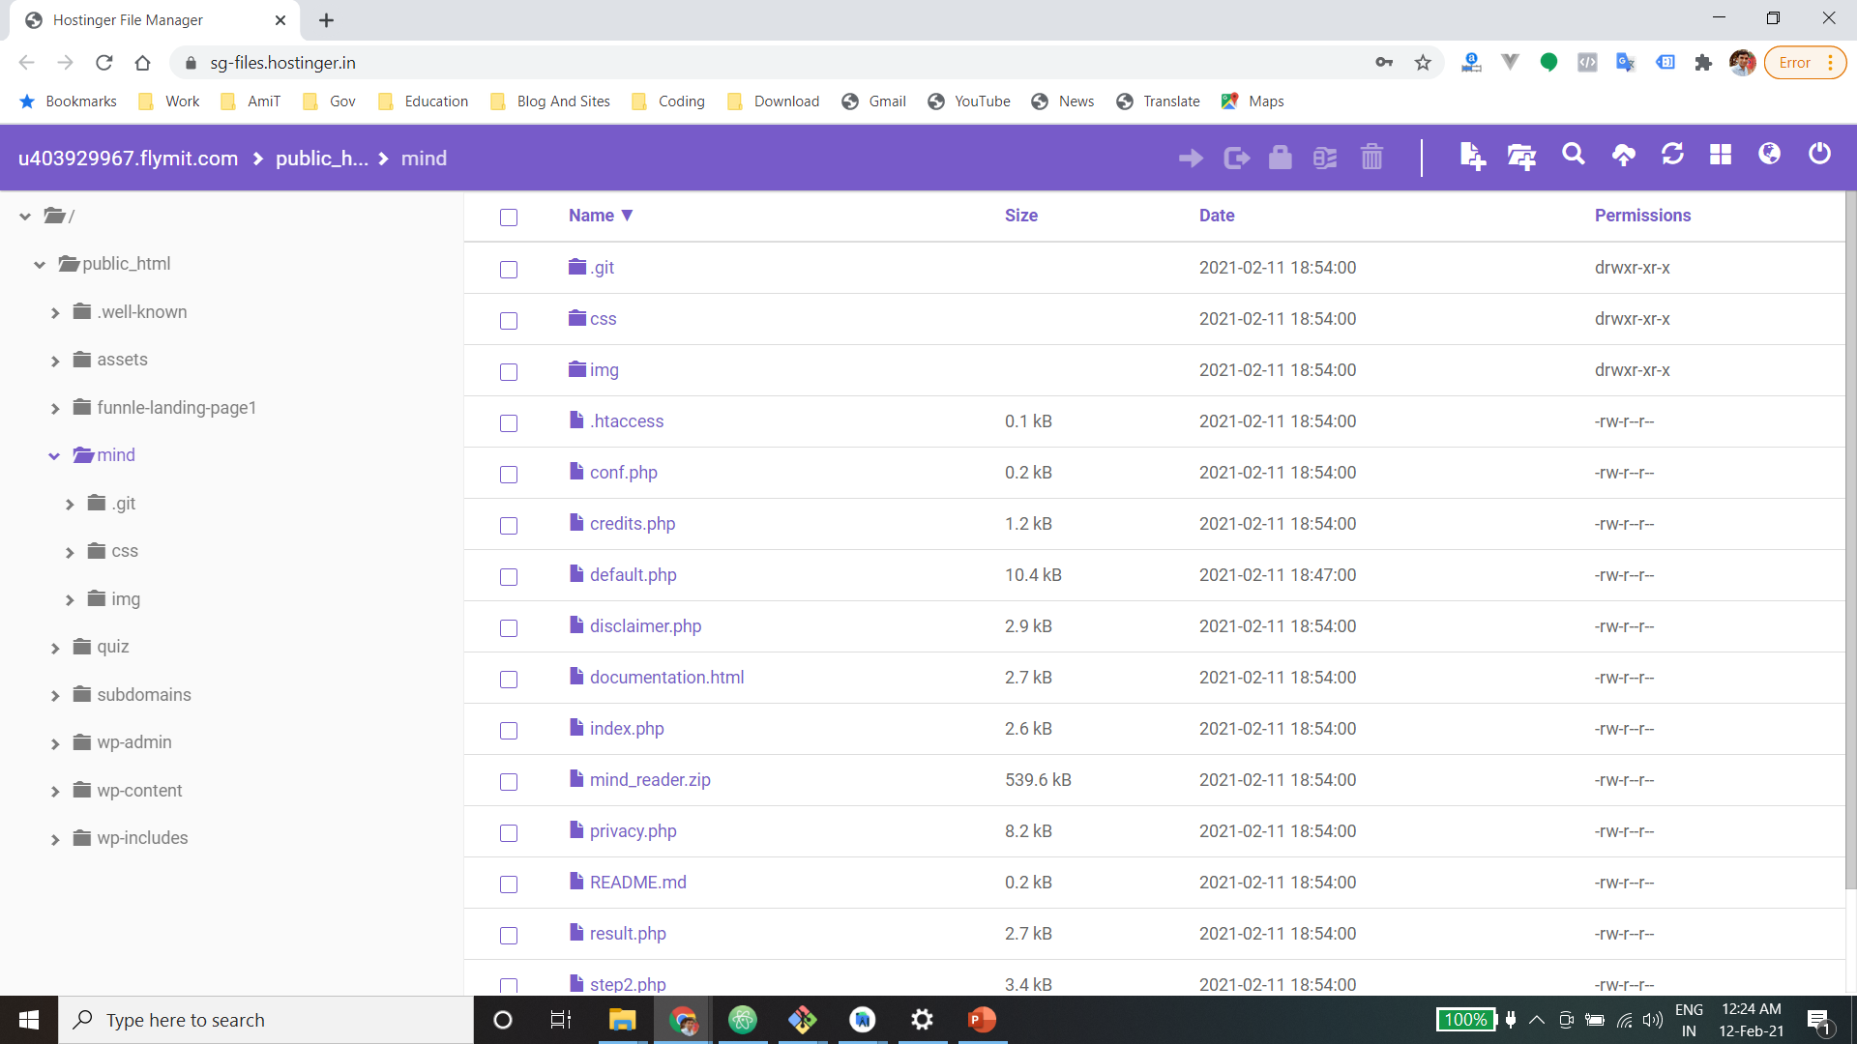
Files will be extracted

Slide 15
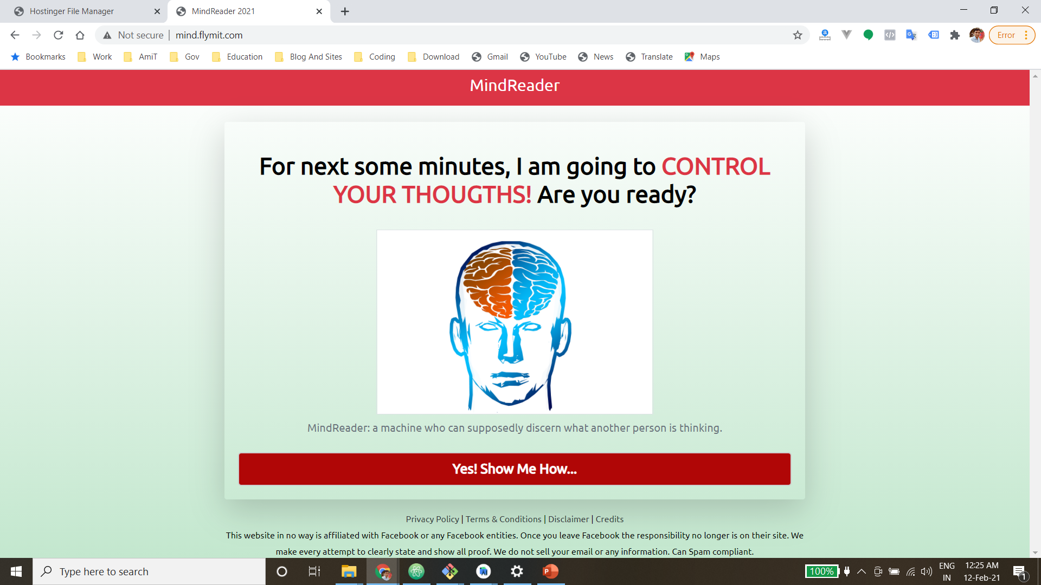
Now check by opening your domain

Slide 16
Thank you!

