Slide 1
Summary of the Analysis
MERKLE SOKRATI DATA ANALYSIS

Slide 2
Assignment 1 Analysis
INTRODUCTION:
Data consists of Facebook and Google Ad (Aug-19-July20) campaigns which shows the performance of different age-groups on different dimensions.
The data has been analyzed in python3 using jupyter notebook
and other standard Data science libraries and following results are obtained for effective decision making and performance improvement.

Slide 3
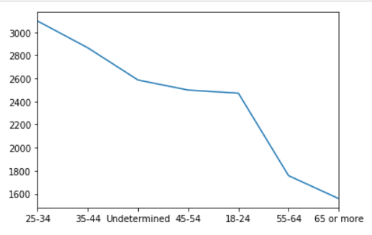
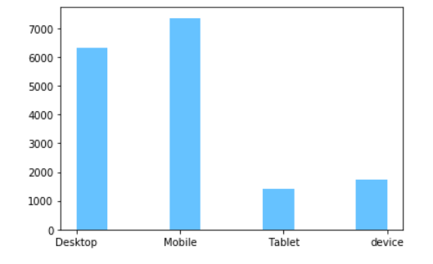
Age and device Distribution in the data
Age group of 25-34 has most occurences in the data while Age group of 65+ has less frequency
The data contains most frequency for desktop and mobile devices. The device data type and tablet has comparatively low frequency in the data.

Slide 4
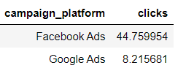
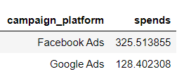
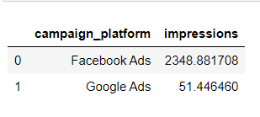
Comparisons between Facebook and Google Ads with respect to the clicks, spend and impressions
The above tables describe the average clicks, spends and impressions for the campaigns.
The outcome from Facebook Ads has excelled Google Ads in every department.
The Clicks, spends and impressions from Facebook Ads are quite higher than Google Ads.

Slide 5
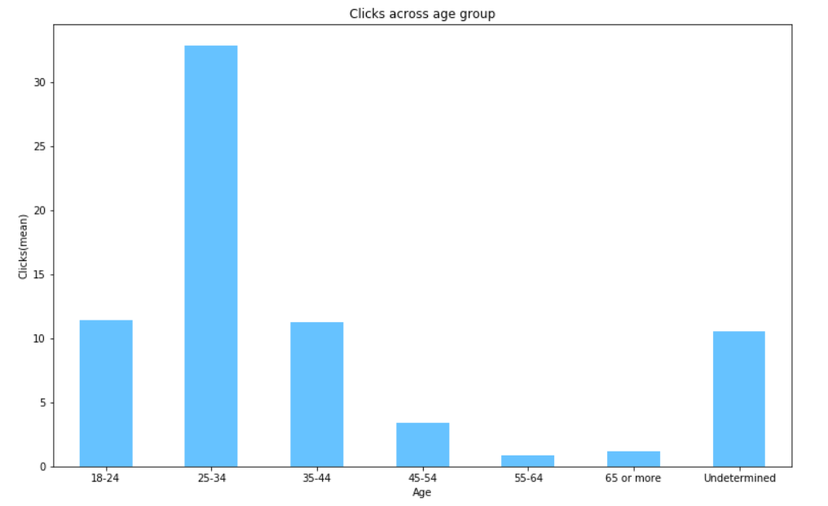
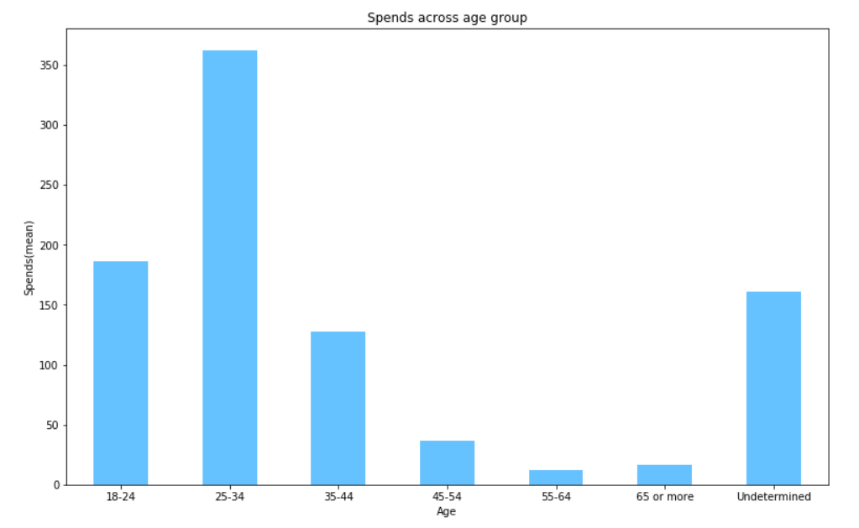
Average clicks and spends across different age groups are displayed in the graph above
Age group of 25-34 has most average clicks and spends while lowest clicks and spends has been observed in the age group of 54-64
Age group of 18-44 can be concluded as ideal age group for displaying ads

Slide 6
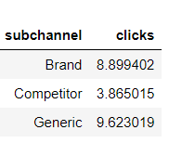
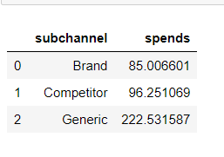
Google Ads Analytics
Google Ads have 3 sub-channels :
Brand
Competitor
Generic
The average clicks for Generic and Brand channels are higher and Competitor channel marked lowest average clicks at 3.86(clicks).
The spends for Generic channel has marked the most. Competitor has more spends than Brand despite having lower clicks than the latter.

Slide 7
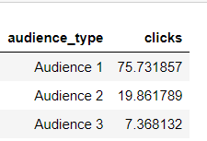
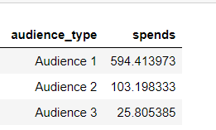
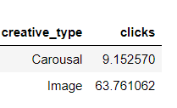
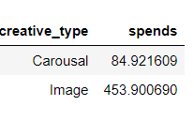
Facebook Ads Analytics
The above table consists of average clicks and average spends across different audience type
Facebook Ads have Carousal and Image as creative type. Image tends to be more attractive and hence has gained more average clicks and spends.

Slide 8
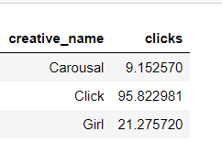
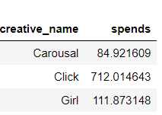
Facebook Ads Analytics
Facebook Ads has 3 Creative names
Corousal, Click, Girl
Click has more gained more average clicks than the other creative names and also has a lot more spends than the other types.

Slide 9
Model for predicting clicks
The data for each of the campaign is very different and has different attributes
E.g) Facebook has audience, creative type while google has sub-channels.
Hence, different models are built for each campaign.
Models were trained using Machine Learning techniques and following results were obtained .
Models were designed to predict the clicks based on various features.
Model For Google Ads
Mean absolute error: 2.11
Median absolute error: 0.97
Model For Facebook Ads
Mean absolute error: 7.9
Median absolute error: 1.87

Slide 10
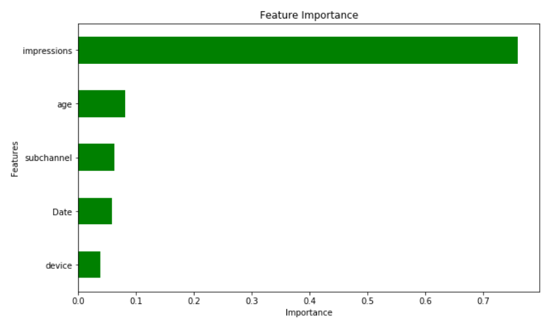
Important Features for Predicting Clicks (Goggle Ads)

Slide 11
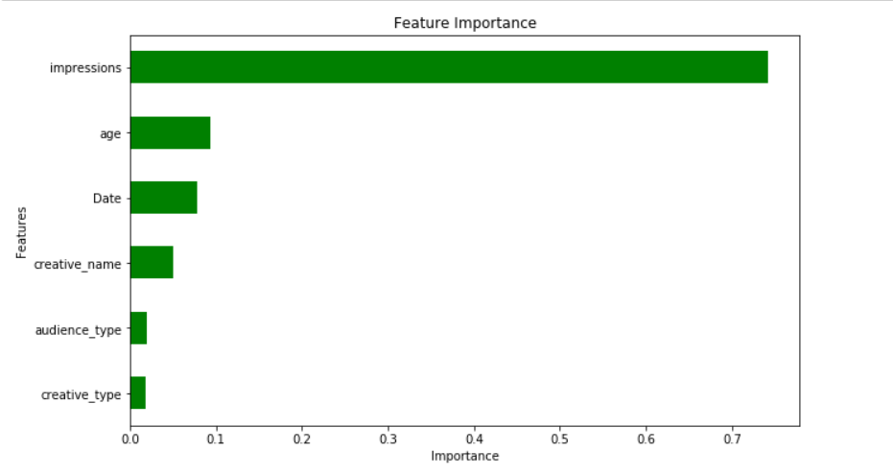
Important Features for Predicting Clicks (Facebook Ads)

Slide 12
Conclusion
Facebook Ads seems to be more effective than Google ads as they have more average clicks, spends and impressions
Age Group plays an important role. The ideal target audience should be between age group 18-44.
Generic is the most sub channel with highest average clicks and spends for Google Ads.
Audience1,corousal(creative name) and image(creative type) are most important factors of Facebook Ads in terms of gaining clicks.
The most important features for predicting clicks in Google Ads are: impression, age, sub-channel, date and device
The most important features for predicting clicks in Google Ads are: impression, age, date, creative name, audience type and creative type

Slide 13
Assignment-2
Results

Slide 14
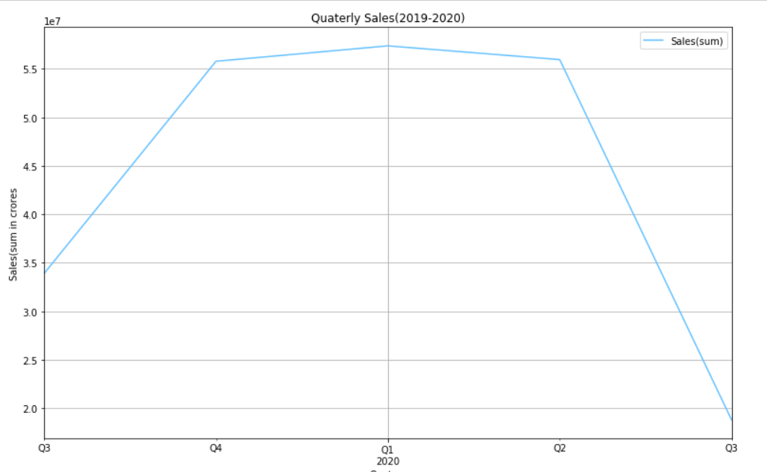
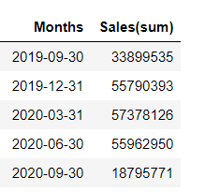
1) What is the monthly and quaterly sales data by SKU?
Quaterly Sales

Slide 15
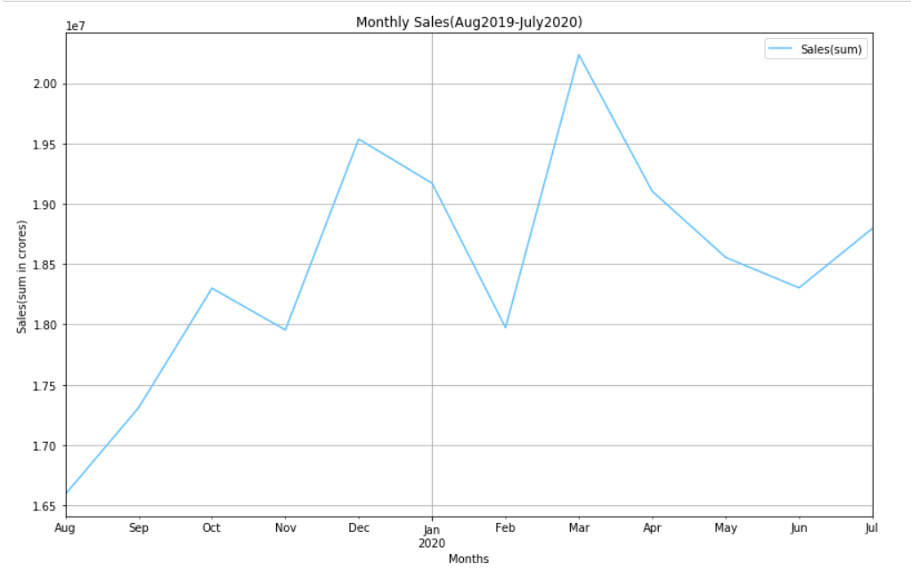
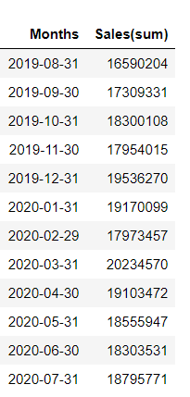
Monthly Sales

Slide 16
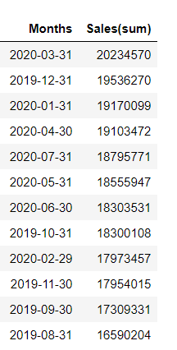
2) Which are the top 3 months in terms of overall sales?
Top 3 months in terms of total sales are:
March 2020
December 2019
January 2020

Slide 17
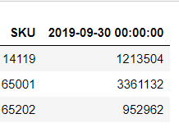
3) Which SKU are outliers in terms sale in any month?
Outliers in the month of August(2019)
SKUs ‘14119’, ‘65001’ and ‘65202’ are outliers in the month of August.

