Slide 1
A
Aegis
Autonomous AI agents
for ticket operations
Triage. Investigate. Resolve. With tool use. Visible reasoning. 96 tests green.
Demo build • Notion-style UI • Mock Gemini fallback

Slide 2
What we built
A Django sub-app you install, mount, and migrate. Five lines.
1
2
3
4
Autonomous agents
User-based access
AI services
Production hooks
Triage → Investigator →
Resolver. ReAct loop with
tool use. Visible reasoning.
Multi-agent handoff.
Admin sees all tickets.
Regular users see only their
own. Enforced in views,
HTMX, REST API.
Gemini structured outputs.
Mock client for offline
demos. Per-call cost tracking.
Retry / circuit-breaker.
Celery (sync default).
DRF REST API.
Django admin integration.
96 passing tests.
Quickstart
pip install -e . ▸ python manage.py migrate aegis ▸ python manage.py aegis_demo --analyze ▸ runserver

Slide 3
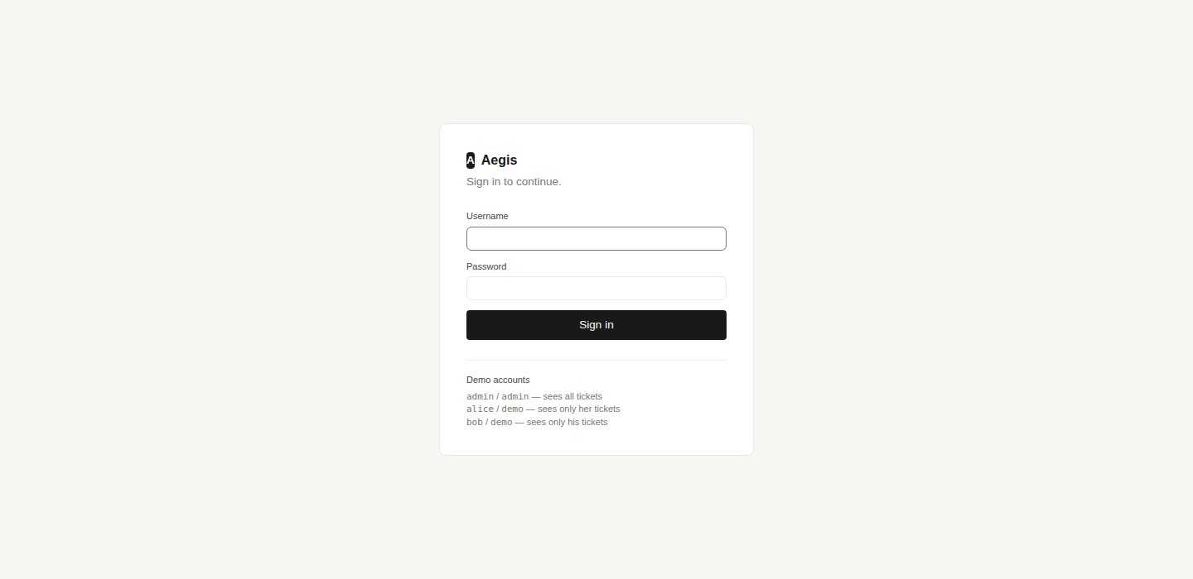
Sign in
/accounts/login/ — Aegis is user-based: who you are decides what you see.
ACTIONS ON THIS SCREEN
Django auth
Standard sessions. Works with your existing auth backend, SSO, OIDC, etc.
Three demo accounts
admin (staff) sees everything; alice and bob each see only their own.
Locked routes
Queue, detail, create, CSV, REST API — all require login.
Logout link
Sidebar 'Sign out' once authenticated.

Slide 4
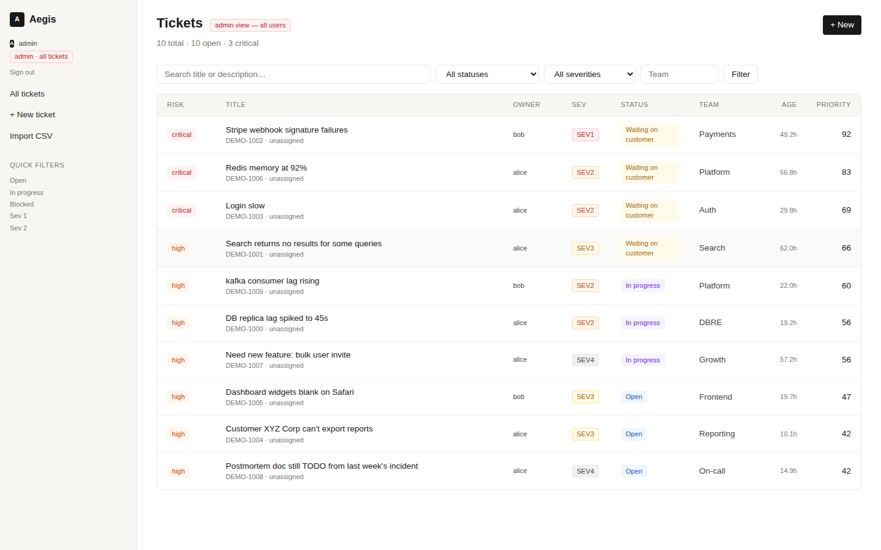
Admin queue — sees everything
Staff users see all tickets, plus an Owner column showing who owns each one.
ACTIONS ON THIS SCREEN
Owner column
Only admins see who owns each ticket — alice, bob, or unowned.
Admin badge
Header pill 'admin view — all users' makes the elevated scope obvious.
Sidebar identity
Username + red 'admin · all tickets' pill replaces 'your tickets only'.
Counts span everyone
'10 total / 10 open / 3 critical' = the whole organization.
Same UI
No separate admin app — staff see the same screen with extra columns.

Slide 5
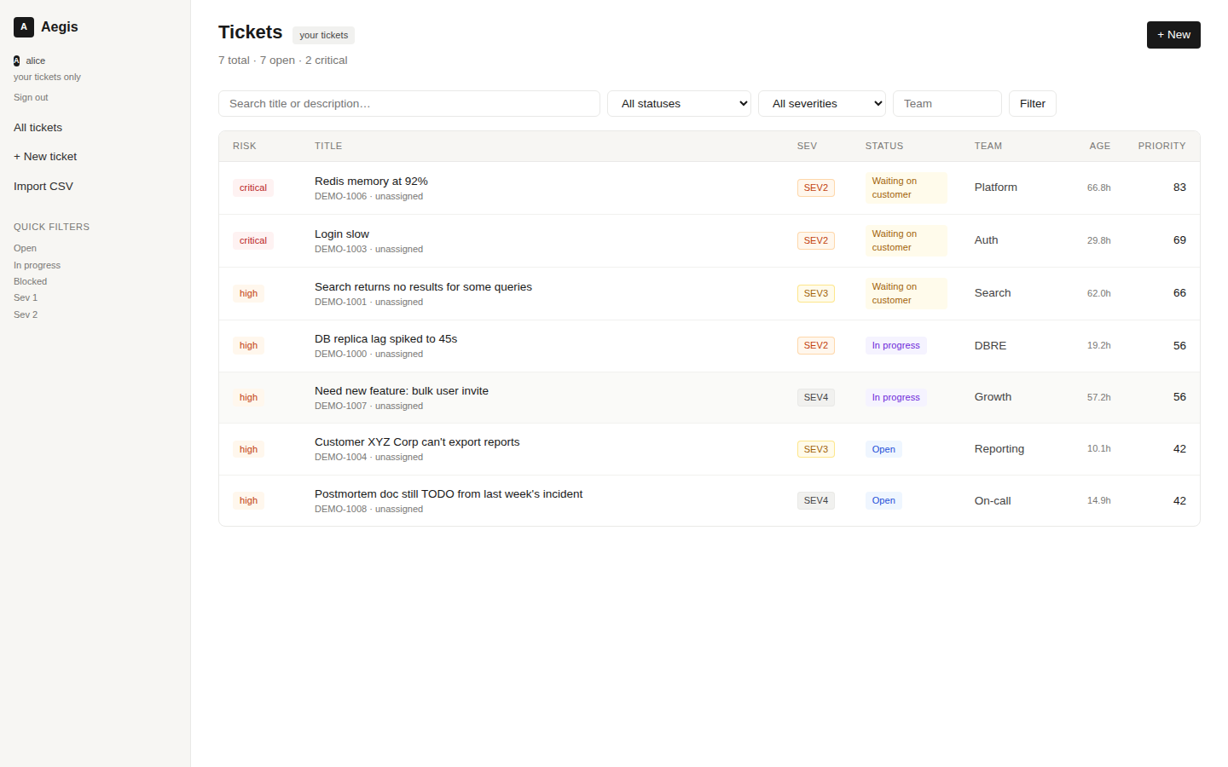
User queue — own tickets only
Same / signed in as alice. Zero leakage from bob or unowned tickets.
ACTIONS ON THIS SCREEN
Scoped query
filter_for_user(qs, request.user) at the queryset level — applied in views AND API.
No owner column
Owner column is hidden when not admin (no point showing 'alice' on every row).
Different counts
'7 total' for alice vs '10 total' for admin on the same dataset.
Detail page guards
Visiting another user's /t/<id>/ returns 404. Same for HTMX endpoints.
REST API enforces too
get_queryset() uses the same helper; can't bypass via JSON.

Slide 6
How the agents work
Three specialized agents in a ReAct loop, with real tool use, automatic handoff.
T
I
R
Triage agent
Investigator agent
Resolver agent
Initial assessment
+ severity
Deep technical
investigation
Communicate +
remediation prep
TOOLS
TOOLS
TOOLS
• search_similar_tickets
• check_recent_deployments
• query_metrics
• check_partner_status
• query_metrics
• check_recent_deployments
• search_similar_tickets
• check_partner_status
• post_to_slack
• request_info_from_user
• update_ticket_field
HANDOFF LOGIC
On any new ticket, Triage runs first. If it recommends sev1/sev2 → Investigator joins.
Resolver always runs last to communicate + propose remediation. All visible in the agent timeline.

Slide 7
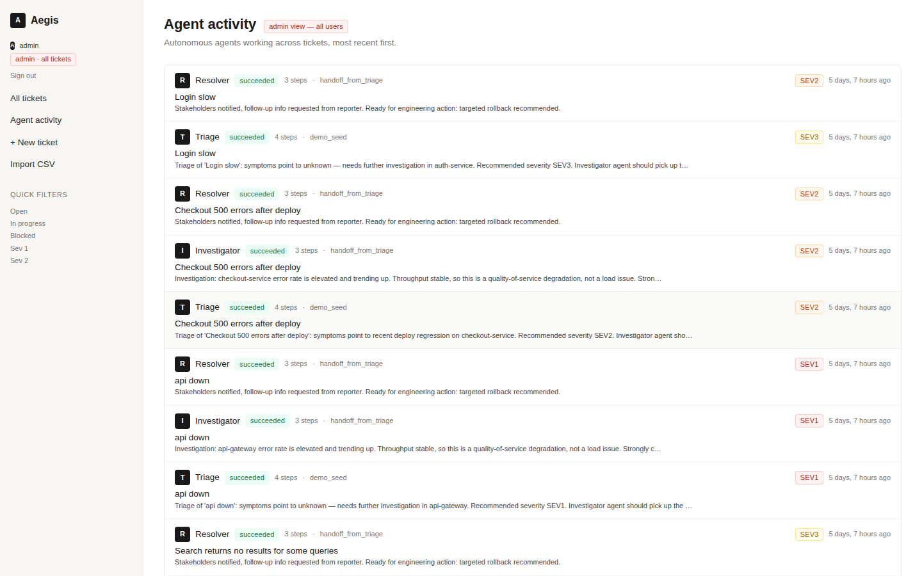
Agent activity — org-wide feed
/agents/ — every autonomous run across every ticket. Newest first.
ACTIONS ON THIS SCREEN
Multi-agent runs visible
Each line = one agent run. Triage, Investigator, and Resolver appear together for the same ticket.
Severity recommendations
Right-side pills show what the agent recommended (SEV1, SEV2, etc.).
Trigger source
'demo_seed', 'handoff_from_triage', 'auto_on_create' — tracks WHY each agent ran.
Step counts
Number of ReAct steps the agent took before reaching a conclusion.
Scoped by user
Admin sees all; users see only runs on their own tickets.

Slide 8
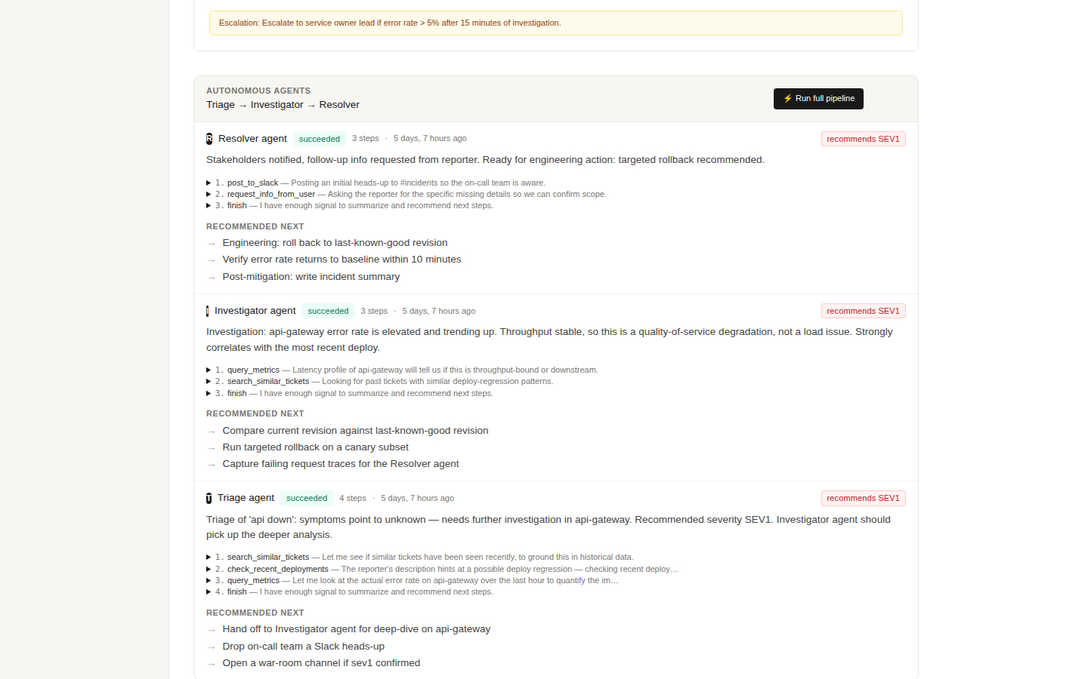
Per-ticket agent timeline
/t/<id>/ — every agent that touched this ticket, with thought + tool calls + recommendations.
ACTIONS ON THIS SCREEN
Multi-agent timeline
Triage → Investigator → Resolver, each with its own step list.
Visible reasoning
Click any step to see the AI's thought, the tool arguments, and the observation.
⚡ Run full pipeline
Manually trigger the pipeline. Useful for re-running after the ticket changes.
Recommendations per agent
Each agent contributes specific next-actions to the human reviewer.
Severity flag
When agents disagree with the reporter's severity, a recommendation pill appears.

Slide 9
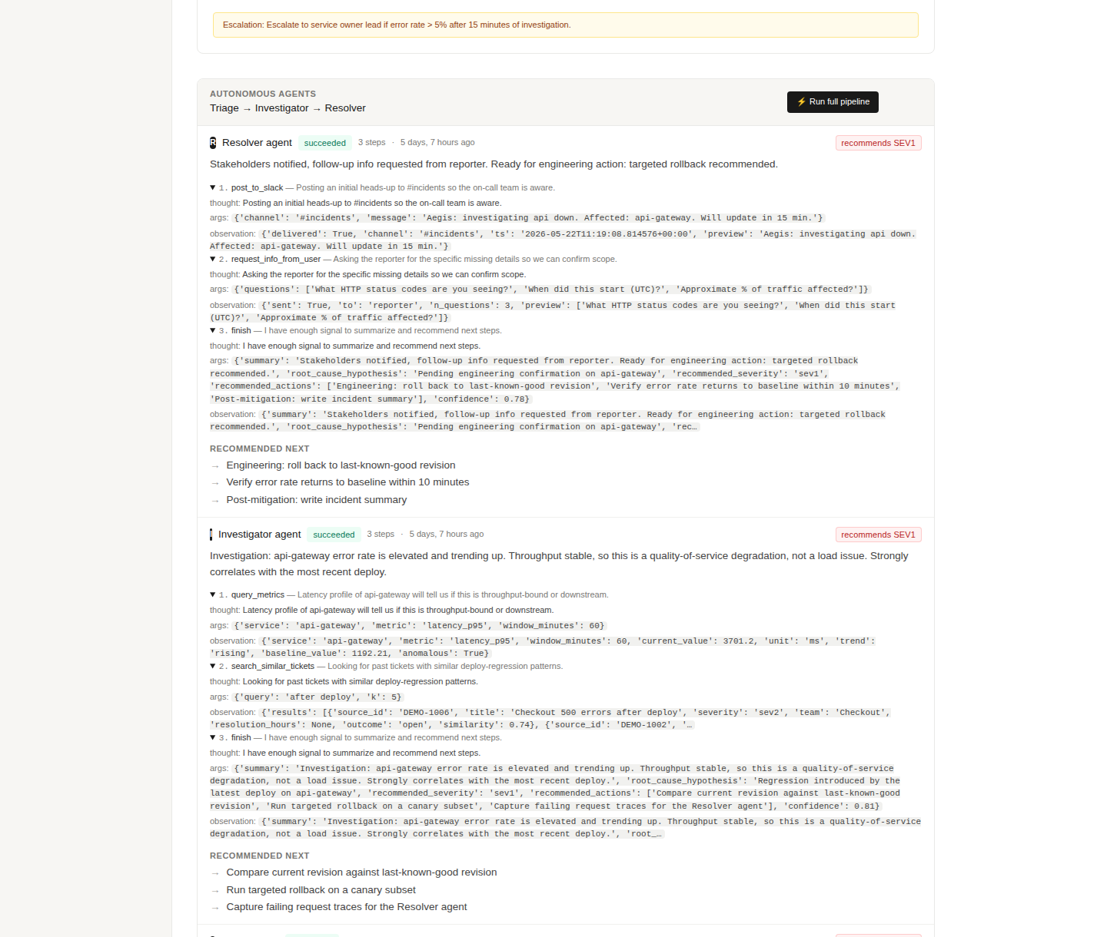
Visible reasoning — every step explained
Each step shows the agent's thought, tool name + arguments, and the observation it got back.
ACTIONS ON THIS SCREEN
Thought
Why the agent chose this tool. 1-2 sentences in plain English.
Tool + args
Exact tool call: query_metrics(service='api-gateway', metric='error_rate', window_minutes=60)
Observation
What the tool returned. Real data: error_rate 7.40%, trend rising, anomalous=True.
ReAct loop
Thought → Action → Observation → repeat. Agent stops when it calls finish().
Auditable
Every step persisted in the database. Replayable. Explainable. No black box.

Slide 10
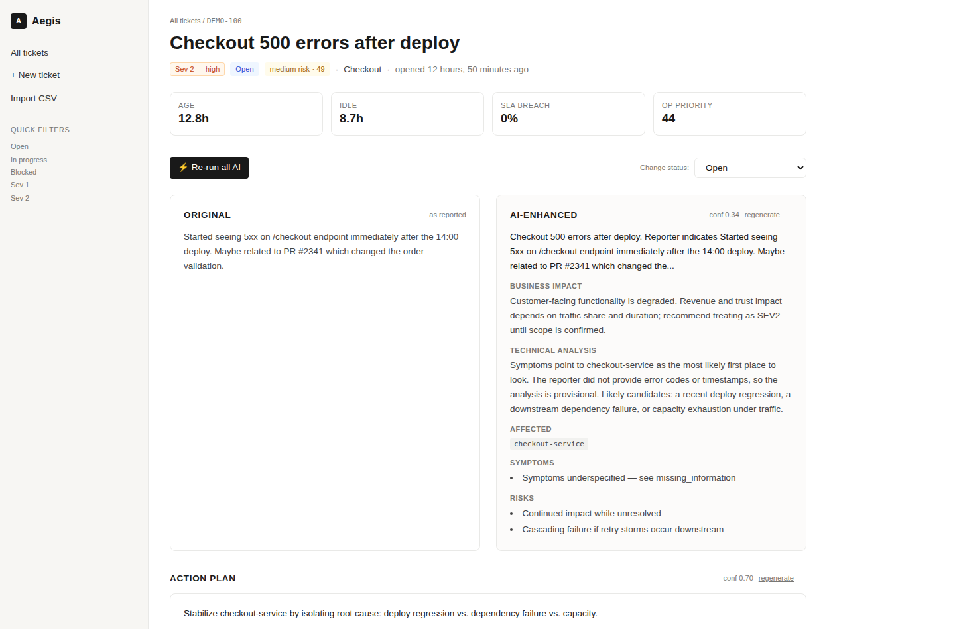
Ticket detail — top
/t/<id>/ — KPI strip, original vs AI-enhanced, status controls.
ACTIONS ON THIS SCREEN
KPI strip
Age, idle time, SLA breach probability, operational priority.
⚡ Re-run all AI
Regenerates enhancement, plan, and missing-info in one click.
Change status
Inline dropdown updates via HTMX, no page reload.
Side-by-side
Original report on left, AI-rewritten structured analysis on right.
Severity suggestion
If AI disagrees with reporter's severity, a yellow banner suggests the new one.

Slide 11
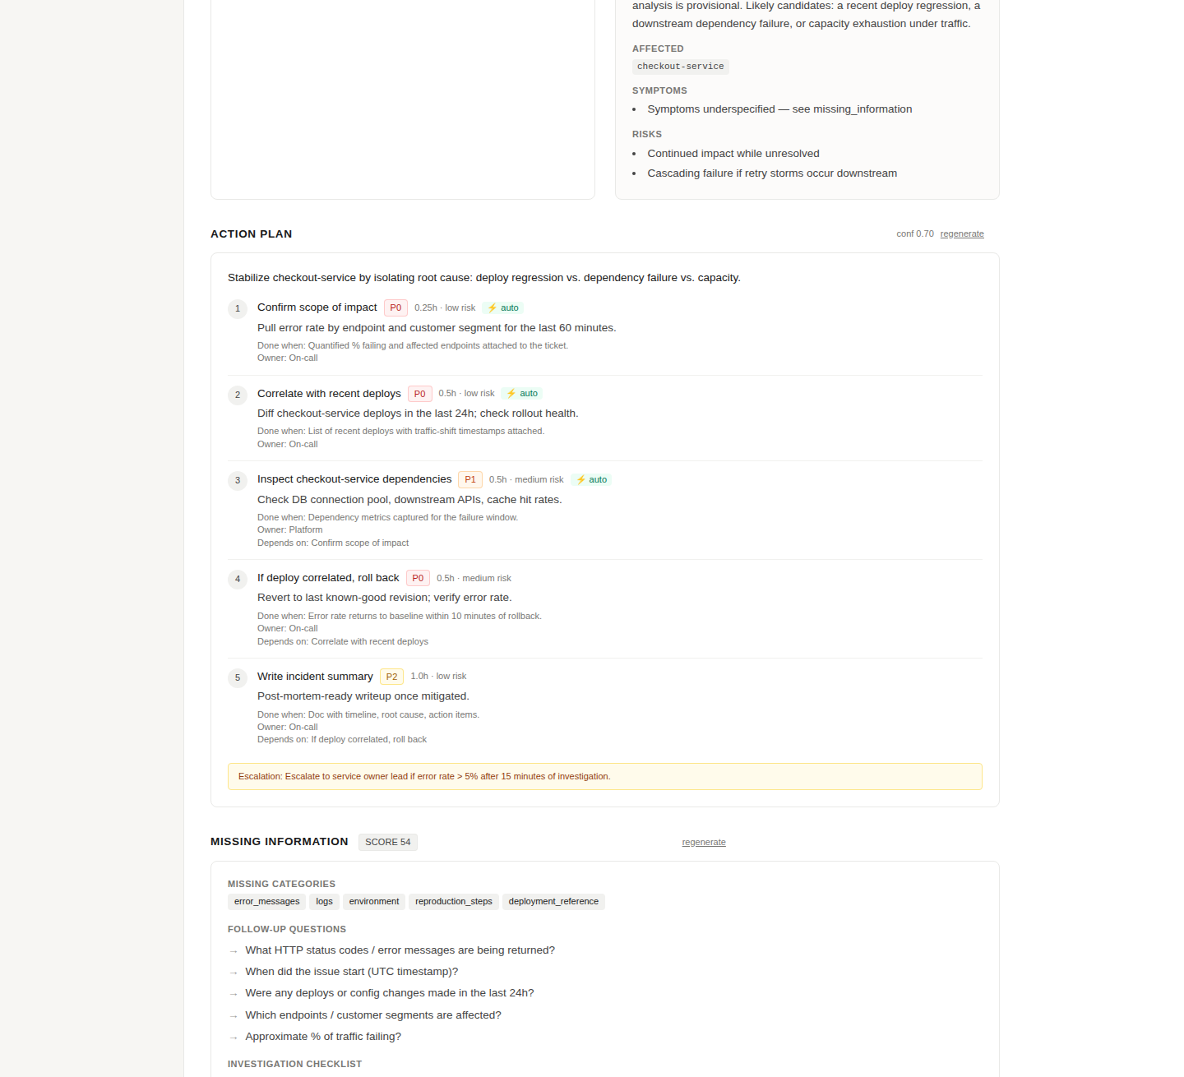
Ticket detail — action plan
Scroll down on the same page to see the AI's plan and information gaps.
ACTIONS ON THIS SCREEN
Numbered actions
3–8 ordered steps. Each has priority, effort estimate, risk level.
Success criteria
Every step says what 'done' looks like — checkable.
Owner suggestion
AI suggests the team / role for each step.
Dependencies
Action 4 'depends on' action 2 — chain is explicit.
Escalation banner
AI flags when to escalate (e.g. error rate > 5% after 15 min).
Missing info checklist
Follow-up questions + investigation checklist.

Slide 12
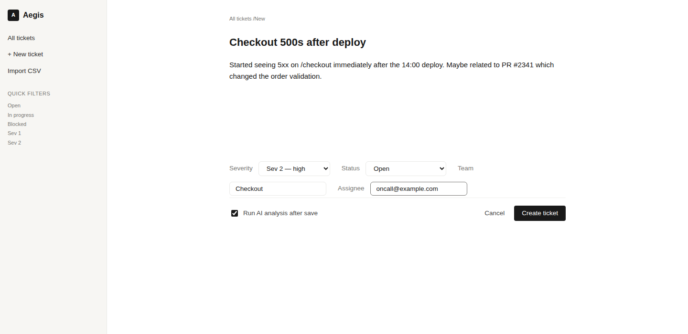
Create ticket
/new/ — Notion-style writing UI. Title and description are the focus; metadata is secondary.
ACTIONS ON THIS SCREEN
Minimal form
Title and description take 90% of the canvas. Metadata is small.
Severity / team / assignee
Inline pills, not a heavy form. Use defaults if you don't care.
Run AI analysis
Checkbox: when ticked, the full AI pipeline runs on save.
Create ticket
Saves and redirects straight to the detail view.

Slide 13
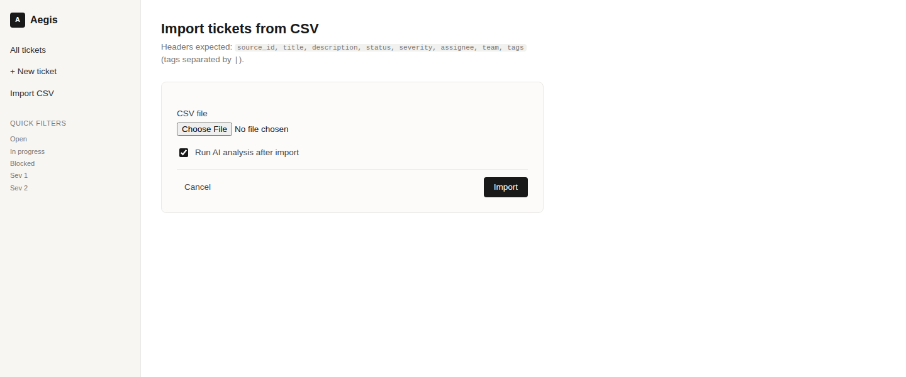
Bulk import (CSV)
/upload/ — One-shot import of many tickets, with optional AI analysis on each.
ACTIONS ON THIS SCREEN
CSV file picker
Headers expected: source_id, title, description, status, severity, assignee, team, tags.
Run AI on import
Checkbox runs enhancement + plan + missing-info on every new ticket.
Idempotent
Re-uploading the same file updates existing tickets in place (by source_id).
Import
Returns to queue with a flash message: 'Imported N new, updated M.'

Slide 14
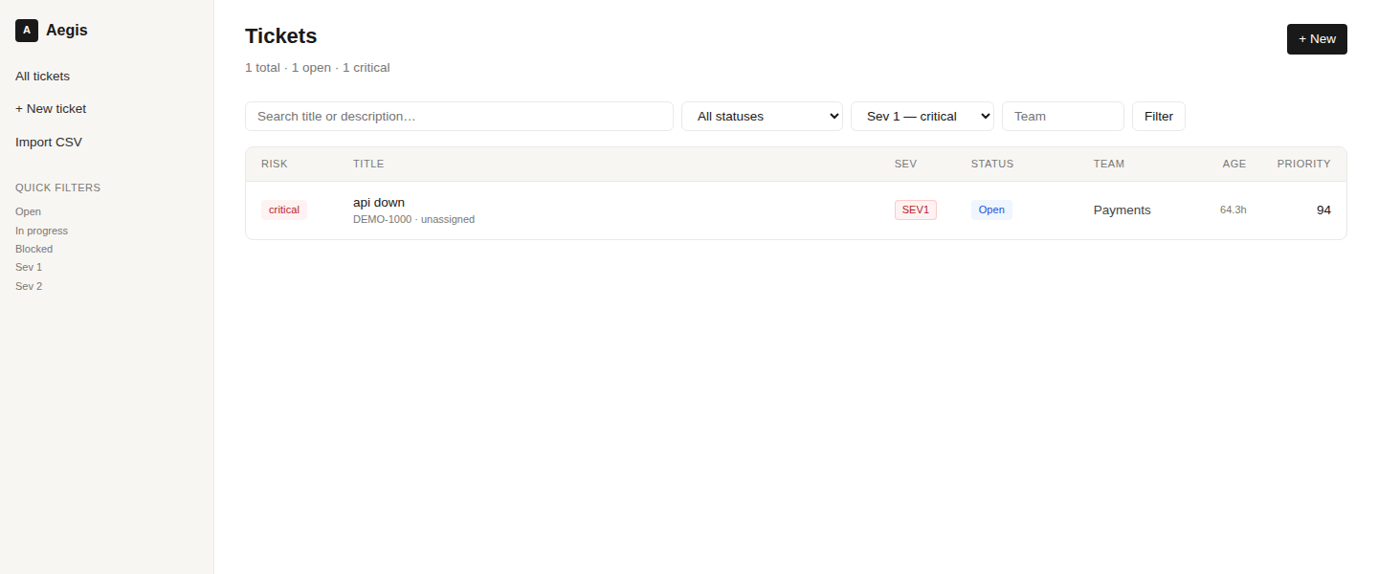
Filtered queue
/?sev=sev1 — Same queue, scoped by severity. Filters live in the URL.
ACTIONS ON THIS SCREEN
URL-based filters
Shareable links: send a teammate /?sev=sev1&team=Payments.
Cursor pagination
Page size in AEGIS['TICKET_LIST_PAGE_SIZE'], cursor-based for scale.
Live counts
Header shows total / open / critical for the current filter.

Slide 15
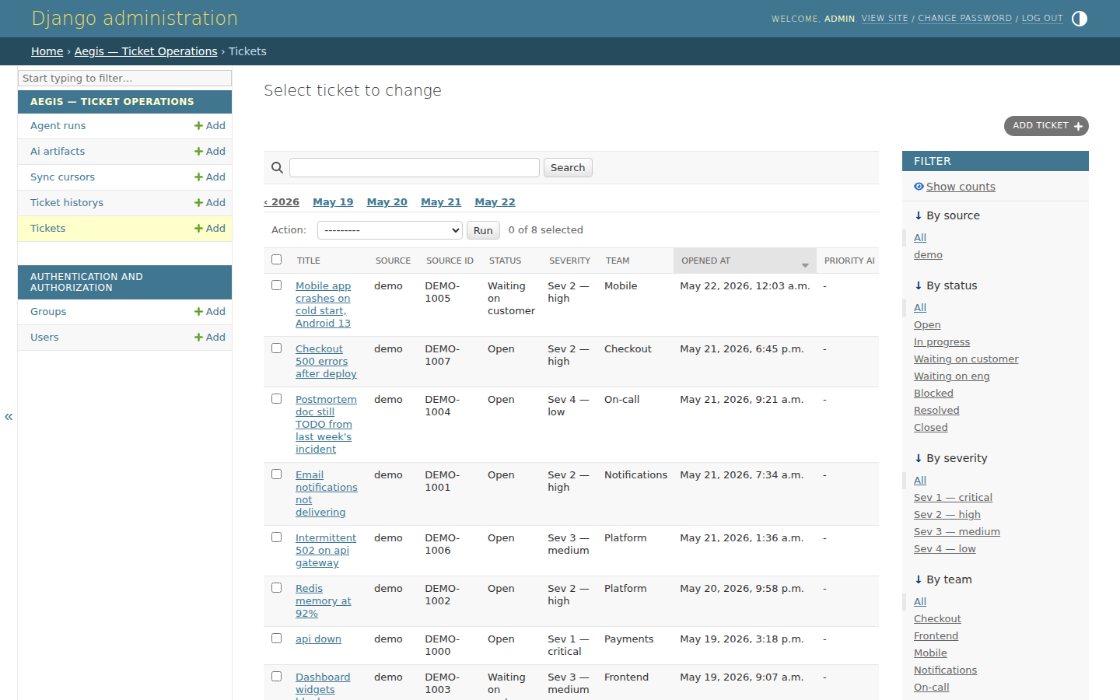
Django admin — tickets
/admin/aegis/ticket/ — Full Django admin for the data model.
ACTIONS ON THIS SCREEN
Standard Django admin
Tickets, history, AI artifacts, agent runs, sync cursors — all editable.
Filters / search
By source, status, severity, team. Search title and description.
Date hierarchy
Drill in by year / month / day to debug bursts.
Bulk actions
Built-in Django admin actions, e.g. mark resolved.

Slide 16
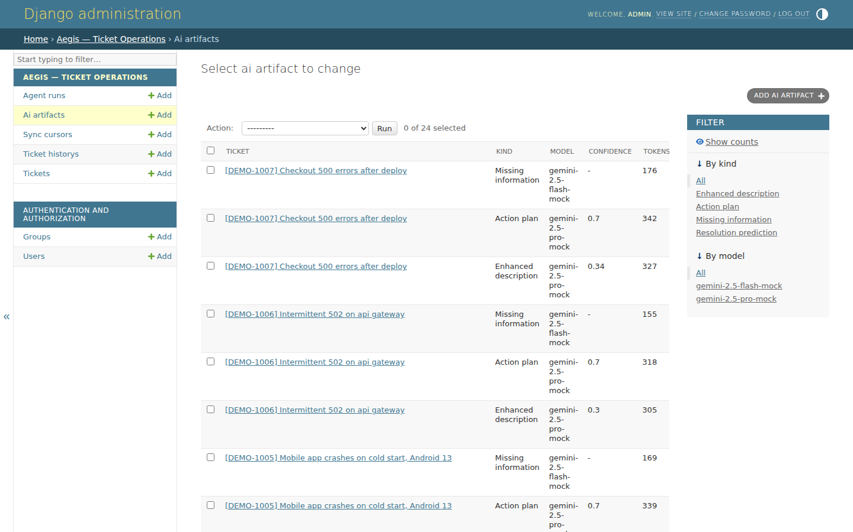
Django admin — AI artifacts
/admin/aegis/aiartifact/ — Cost transparency: every Gemini call persisted with tokens, latency, cost.
ACTIONS ON THIS SCREEN
Per-call ledger
Every enhance / plan / missing-info call is a row here.
Model + version
Track which Gemini model + prompt version produced what.
Token + cost columns
Sum these for per-day / per-team / per-ticket spend.
Confidence score
Filter low-confidence runs to find prompts that need work.
Mock vs real
Mock model = 'gemini-2.5-pro-mock', zero cost. Visible at a glance.

Slide 17
Architecture
Bounded contexts. Pluggable connectors. AI under a single facade.
Ingestion
• Connectors (ABC) — jira, csv, manual, +your own
• Incremental sync via cursor
• REST API + webhooks + management commands
AI services
• Gemini client with structured outputs (pydantic)
• MockGeminiClient — content-aware, schema-valid, $0
• Per-artifact cost / tokens / latency persisted
Core + UI
• Ticket, History, AIArtifact, AgentRun, SyncCursor
• HTMX-driven Notion-style UI (no SPA needed)
• DRF REST API + admin + signals + Celery hooks

Slide 18
Live demo plan
Six steps, ~3 minutes. Works without an API key.
01
Sign in as alice
alice / demo — show 'your tickets only' badge, 7 tickets visible.
02
Open a Sev 1 ticket
Show enhanced description, AI action plan.
03
Scroll to agent timeline
Triage → Investigator → Resolver. Each with thought + tool calls visible.
04
Expand a step
Show actual tool args and observation — 'query_metrics returned error_rate 7.4%'.
05
Open /agents/
Org-wide agent activity feed — every autonomous run across the org.
06
Switch to admin
admin / admin → see all 10 tickets + all agent runs from all users.

Slide 19
Drop it into your existing project
Five lines. Five minutes.
# 1. install
pip install -e ./aegis-pkg
# 2. settings.py
INSTALLED_APPS += ["rest_framework", "aegis"]
AEGIS = {
"GEMINI_API_KEY": os.environ.get("GEMINI_API_KEY", ""),
# leave empty → uses deterministic MockGeminiClient
}
# 3. urls.py
urlpatterns += [
path("ops/", include("aegis.urls")), # UI at /ops/, API at /ops/api/
]
# 4. migrate
python manage.py migrate aegis
# 5. done. Open /ops/ in your browser.
Default permissions = AllowAny (demo). Add IsAuthenticated in your project's REST_FRAMEWORK settings for prod.

Slide 20
Where it stands today
96
3
7
$0
tests passing
specialized agents
(Triage, Investigator, Resolver)
agent tools
(metrics, deploys, Slack, …)
cost to run the demo
Next
→ Real Gemini
Set GEMINI_API_KEY → real model, same code path.
→ Async
Flip AEGIS["USE_CELERY"] = True for background workers.
→ More connectors
Implement Connector ABC for Zendesk / Freshdesk / ServiceNow.
Aegis — built today, demo-ready tomorrow.

