Slide 1
⚡
Flowforge
A Power Automate clone in Django
Workflow engine • REST API • Webhook + scheduled triggers • 28 built-in connectors • Encrypted credentials
62
2.7k
10
28
files
LOC
step types
connectors

Slide 2
⚡ Flowforge
OVERVIEW
Build automations the way Power Automate does — in your stack
WHAT IT DOES
TECH STACK
Define workflows as JSON: triggers + ordered step tree
Steps call connectors (HTTP, email, Outlook, Slack…) or run logic (condition, loop, parallel, try/catch)
Three trigger types: manual button or API, cron schedule, public webhook with token
Every step records inputs, outputs, errors, timing — full audit trail per run
Expression language: {{ steps.fetch.output.body.price }}
Django 5
Models, admin, DRF API, templates
Celery + Redis
Async execution, beat scheduling
django-celery-beat
Cron → PeriodicTask sync
cryptography.Fernet
Encrypted Connection credentials
Microsoft Graph
Outlook send / list / get
AST sandbox
Safe expression evaluation
Flowforge — Django + Celery workflow engine
2 / 13

Slide 3
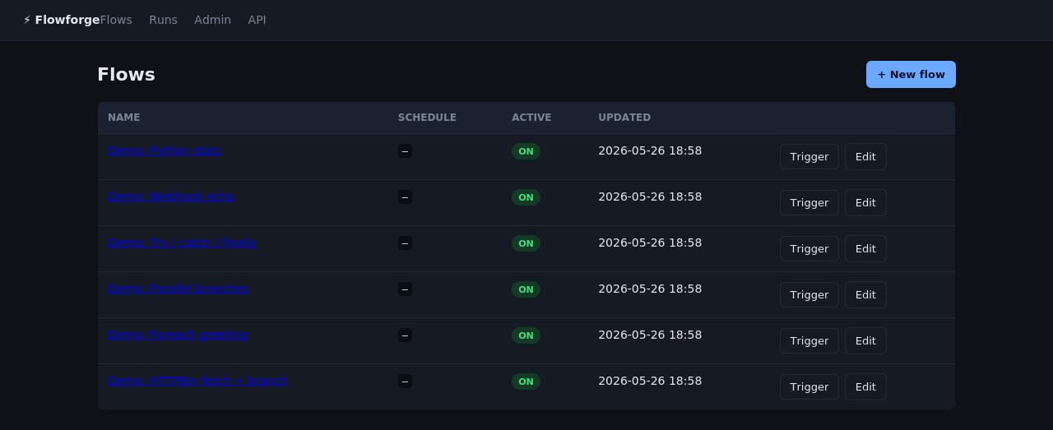
⚡ Flowforge
UI · FLOW LIST
All your flows at a glance
Active toggle
Quickly enable / disable a flow without deleting it. Inactive flows ignore both manual triggers and scheduled runs.
Schedule column
Cron expression visible inline. A signal keeps a django-celery-beat PeriodicTask in sync whenever the value changes.
One-click trigger
Runs a flow against the Celery worker pool. Manual triggers from the UI, the REST API, and webhooks all hit the same executor.
Flowforge — Django + Celery workflow engine
3 / 13

Slide 4
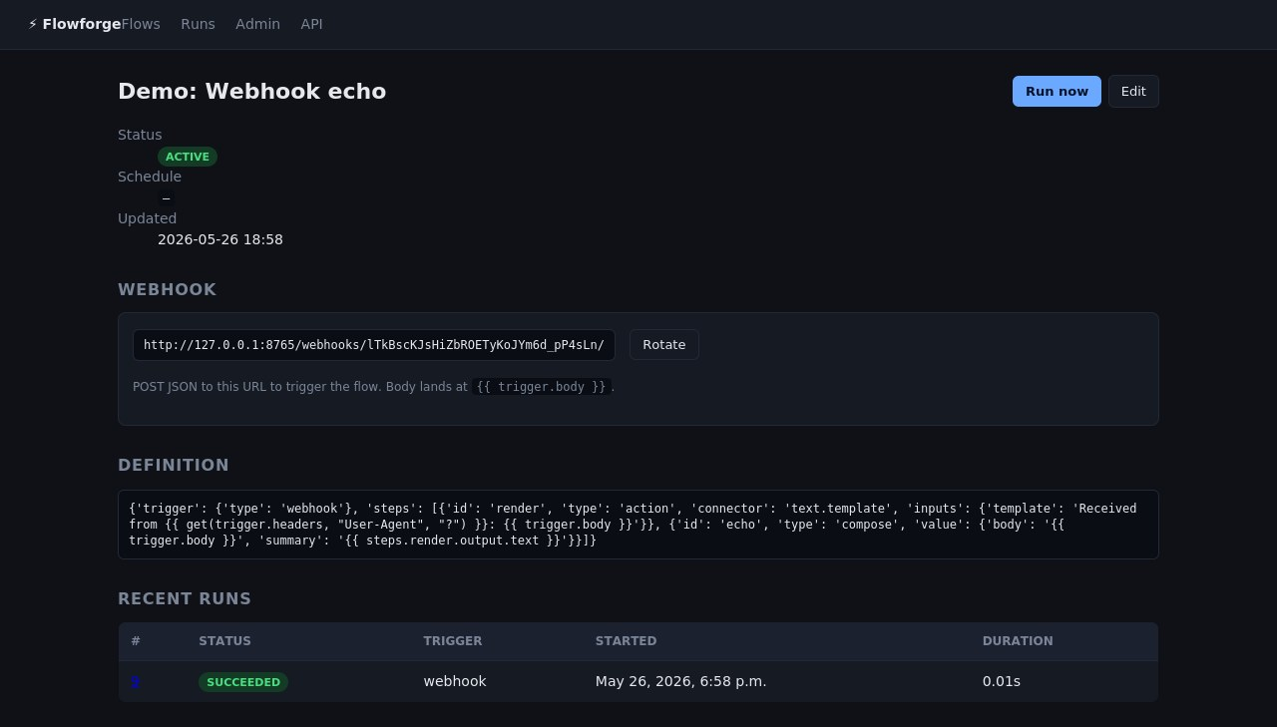
⚡ Flowforge
UI · FLOW DETAIL
Webhook triggers with rotatable tokens
Unique URL per flow
Tick the Webhook box and the flow gets a public endpoint at /webhooks/<token>/.
Rotate when needed
Compromised tokens are one click away from being replaced. Old token stops working immediately.
Body + headers + query
All three are exposed to expressions: {{ trigger.body.x }}, {{ trigger.headers["X-Hub"] }}, {{ trigger.query.foo }}.
Flowforge — Django + Celery workflow engine
4 / 13

Slide 5
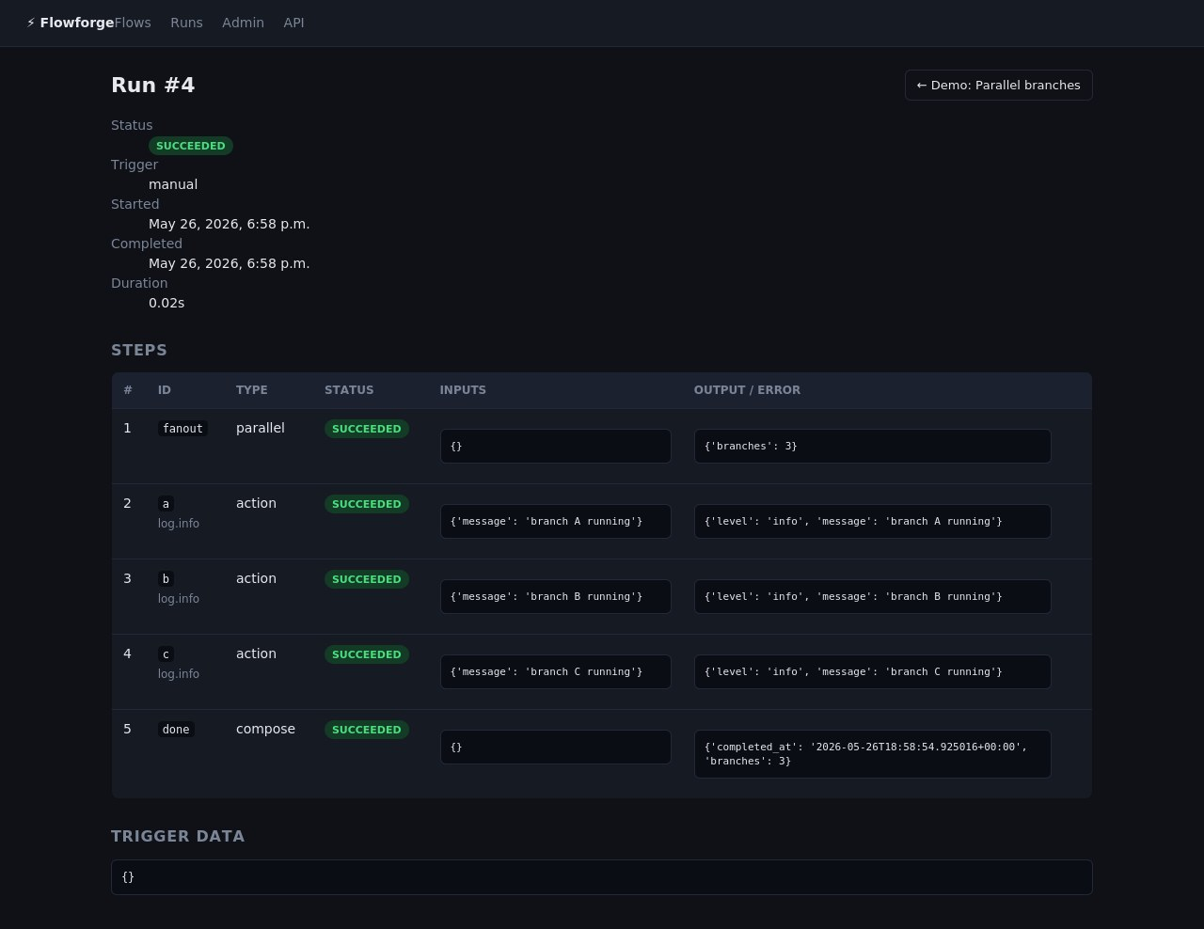
⚡ Flowforge
UI · RUN DETAIL (PARALLEL EXECUTION)
Per-step trace with full audit history
Every step recorded
id, type, status, inputs, output, timing — persisted to StepRun. No mysteries when something goes wrong.
Parallel fanout
Step #1 is the fanout, steps #2–#4 are the three branches that ran concurrently in a ThreadPoolExecutor.
Compose step closes
Step #5 reads outputs from all three branches via the shared context — wall time ≈ 0.02s, not 3 × single-branch time.
Flowforge — Django + Celery workflow engine
5 / 13

Slide 6
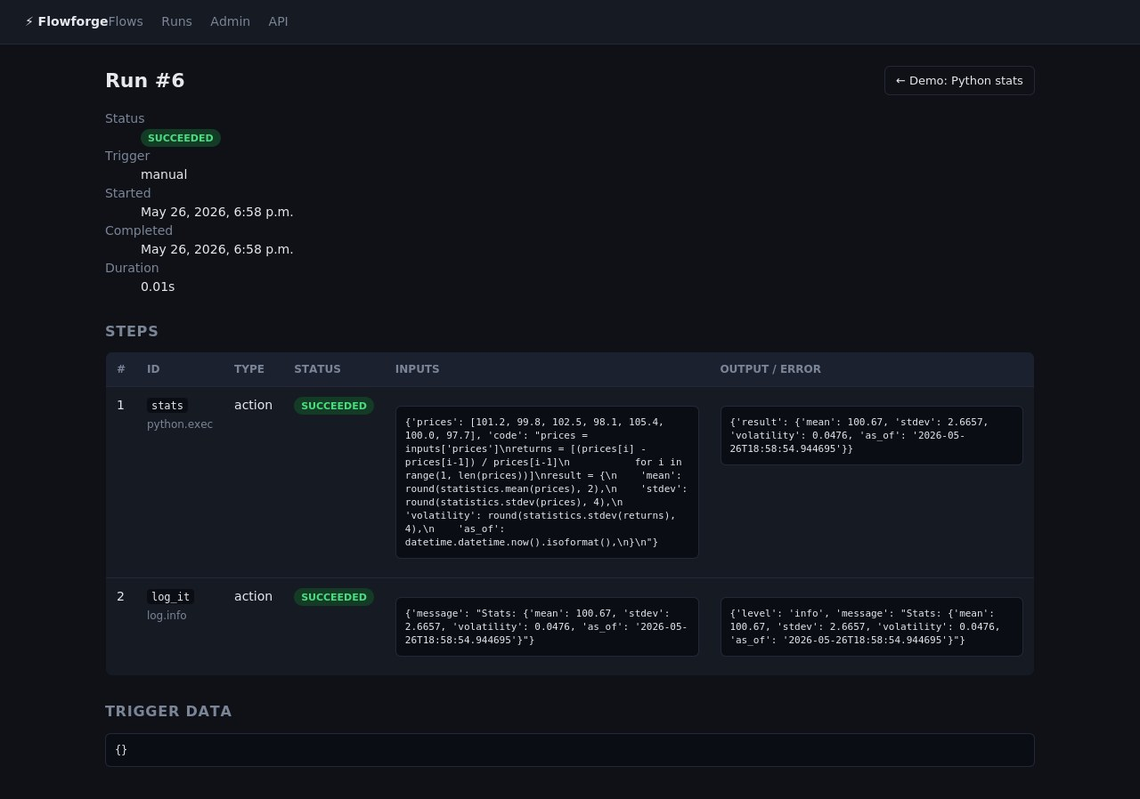
⚡ Flowforge
UI · PYTHON.EXEC CONNECTOR
Drop-in Python for one-off transforms
Sandboxed Python in a step
Run real Python — math, statistics, datetime, json all available. Set result = … to return.
Restricted globals
import os, __import__, open are all blocked. Toggle off entirely via FLOWFORGE_ALLOW_PYTHON_EXEC.
Real example output
Computed {mean: 100.67, stdev: 2.6657, volatility: 0.0476} from a NIFTY price series in ~10ms.
Flowforge — Django + Celery workflow engine
6 / 13

Slide 7
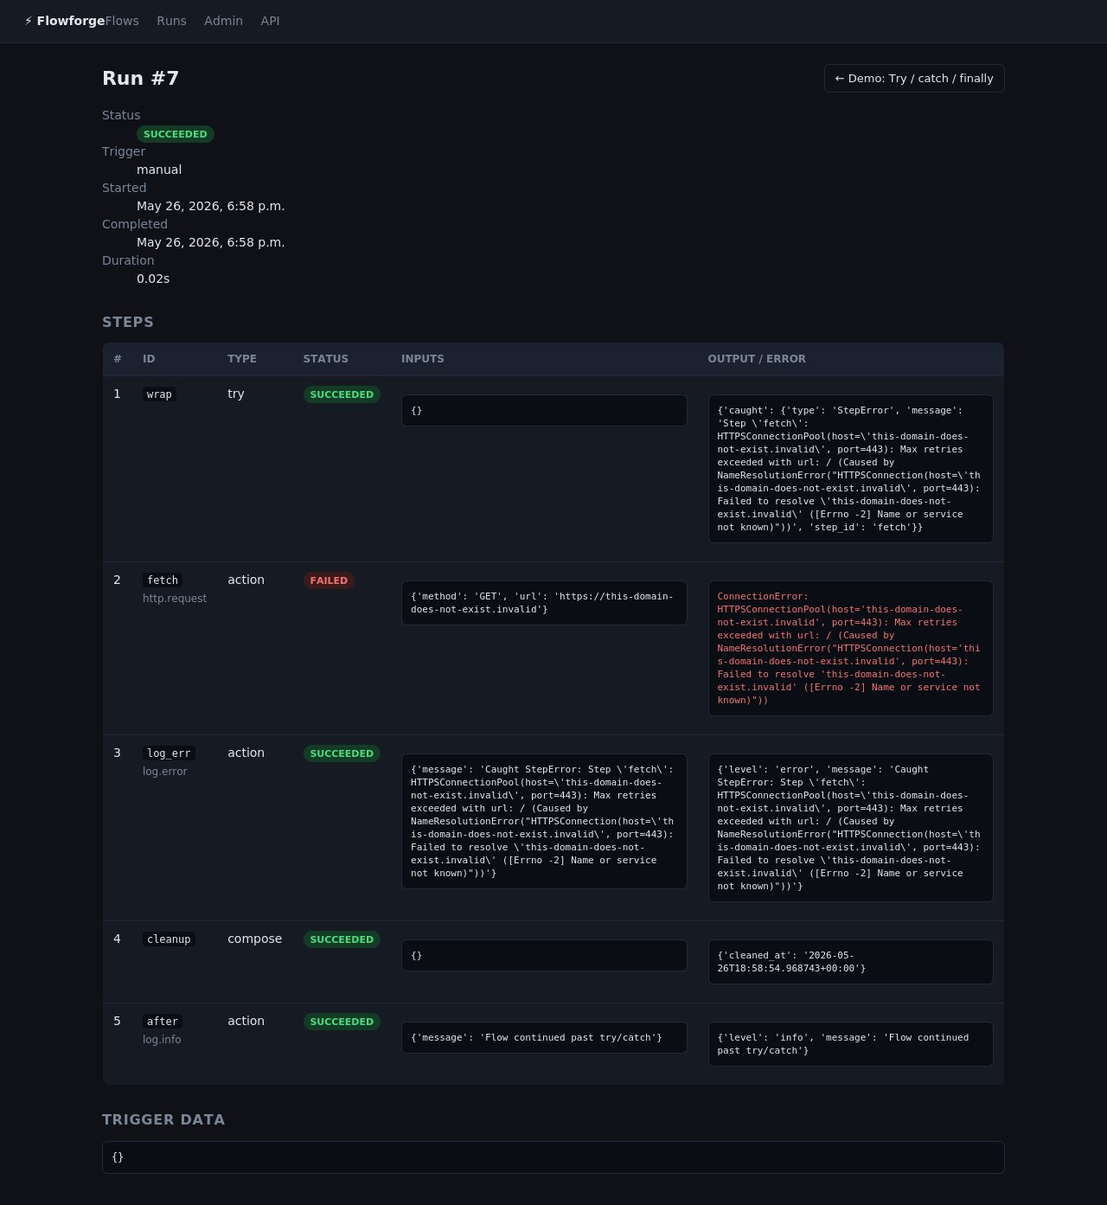
⚡ Flowforge
UI · RUN DETAIL (ERROR HANDLING)
Structured try / catch / finally
Try block runs first
Steps inside try execute in order until one raises. Subsequent try-steps are skipped.
Catch sees the error
{{ error.type }}, {{ error.message }}, {{ error.step_id }} bound inside the catch branch.
Finally always runs
Cleanup, logging, metric emission — guaranteed regardless of which path executed.
Flowforge — Django + Celery workflow engine
7 / 13

Slide 8
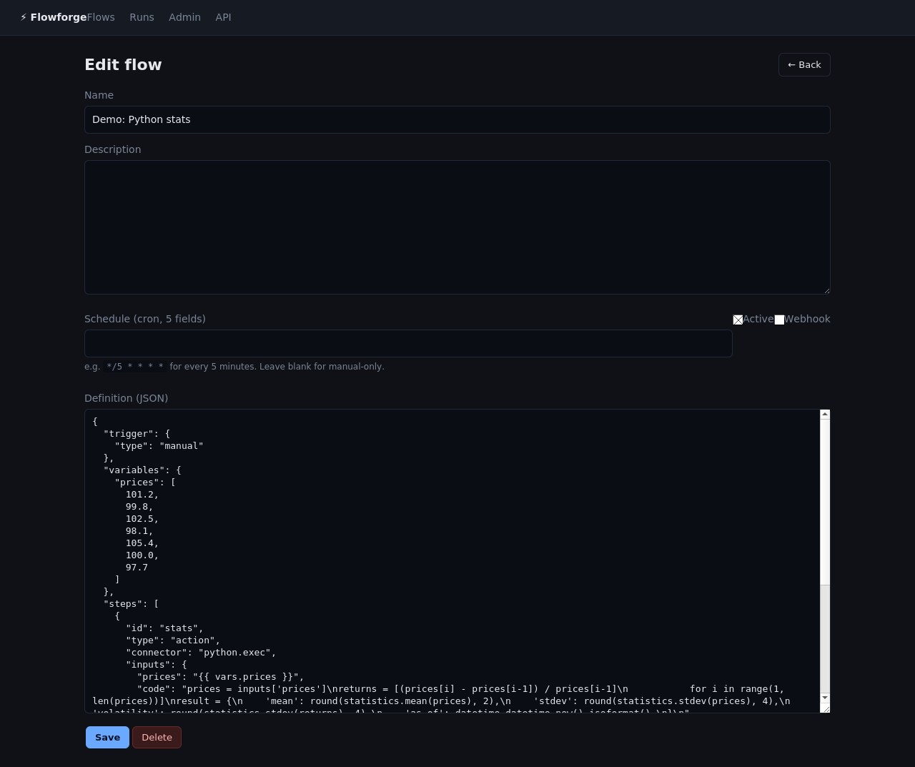
⚡ Flowforge
UI · FLOW EDITOR
JSON-first authoring (visual builder is next)
Schedule + Active + Webhook
Three switches govern when and how a flow can fire. Cron is validated by croniter before save.
Pure JSON definition
Until a DAG editor lands, the textarea is the canvas. Parsed and validated on submit; syntax errors are surfaced inline.
Roadmap
react-flow or litegraph drop in cleanly — the JSON schema is already DAG-friendly.
Flowforge — Django + Celery workflow engine
8 / 13

Slide 9
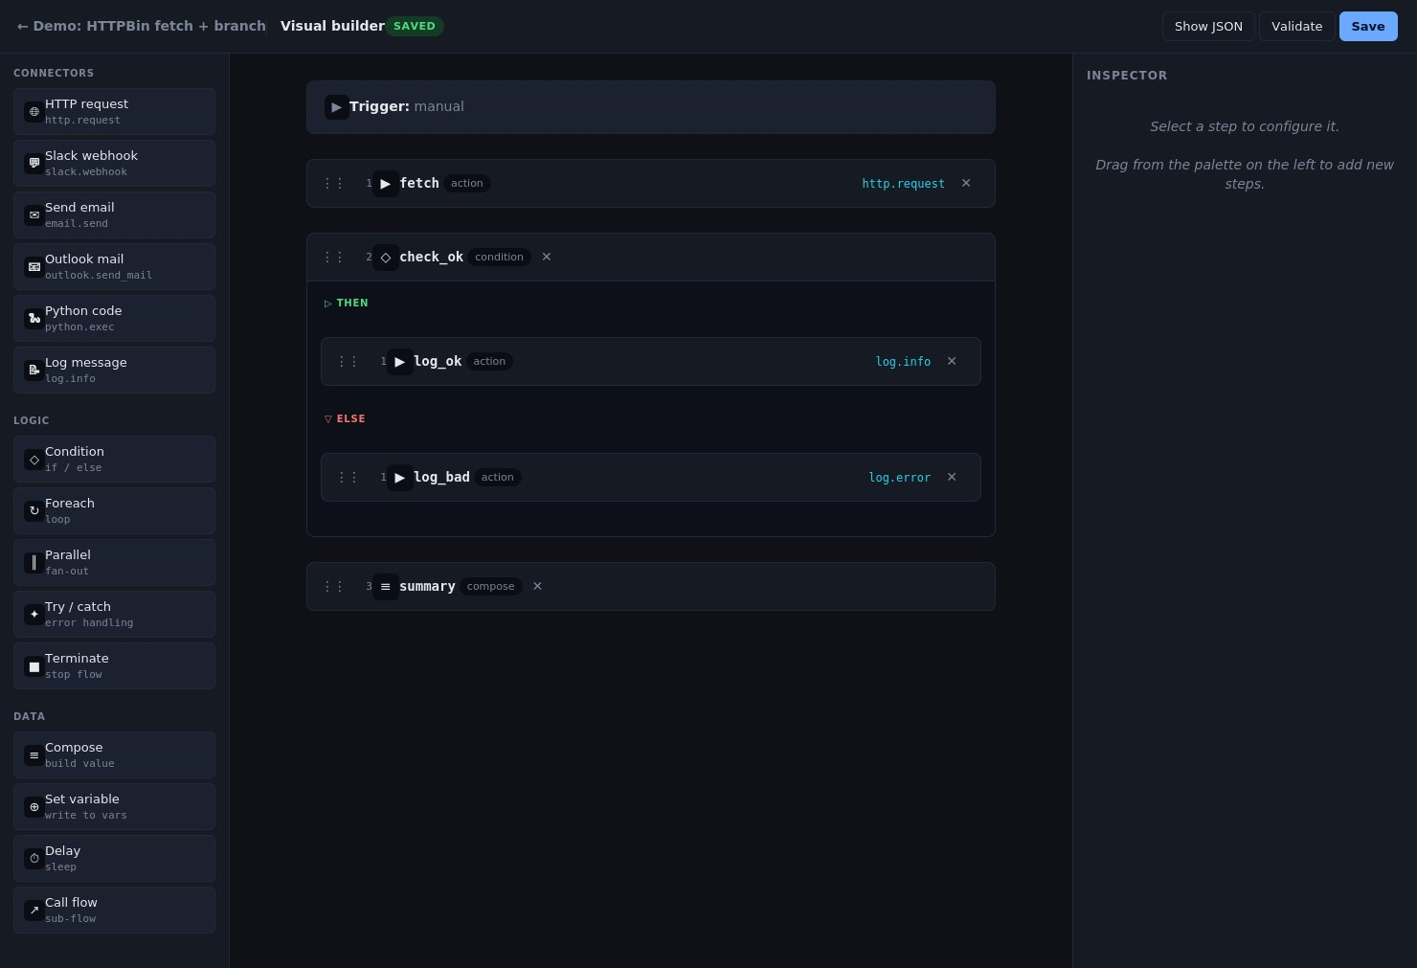
⚡ Flowforge
UI · VISUAL BUILDER
Drag-and-drop flow builder
Palette · canvas · inspector
Three-column layout. Drag step templates from the left onto any drop-zone in the canvas; configure the selected step on the right.
Nested containers render inline
Condition steps show THEN / ELSE branches; parallel steps show one column per branch; try shows TRY / CATCH / FINALLY.
Saves through the same REST API
Cmd-S or Save button writes back to PUT /api/flows/<id>/. Status pill in the header tracks dirty / saved state.
Flowforge — Django + Celery workflow engine
9 / 13

Slide 10
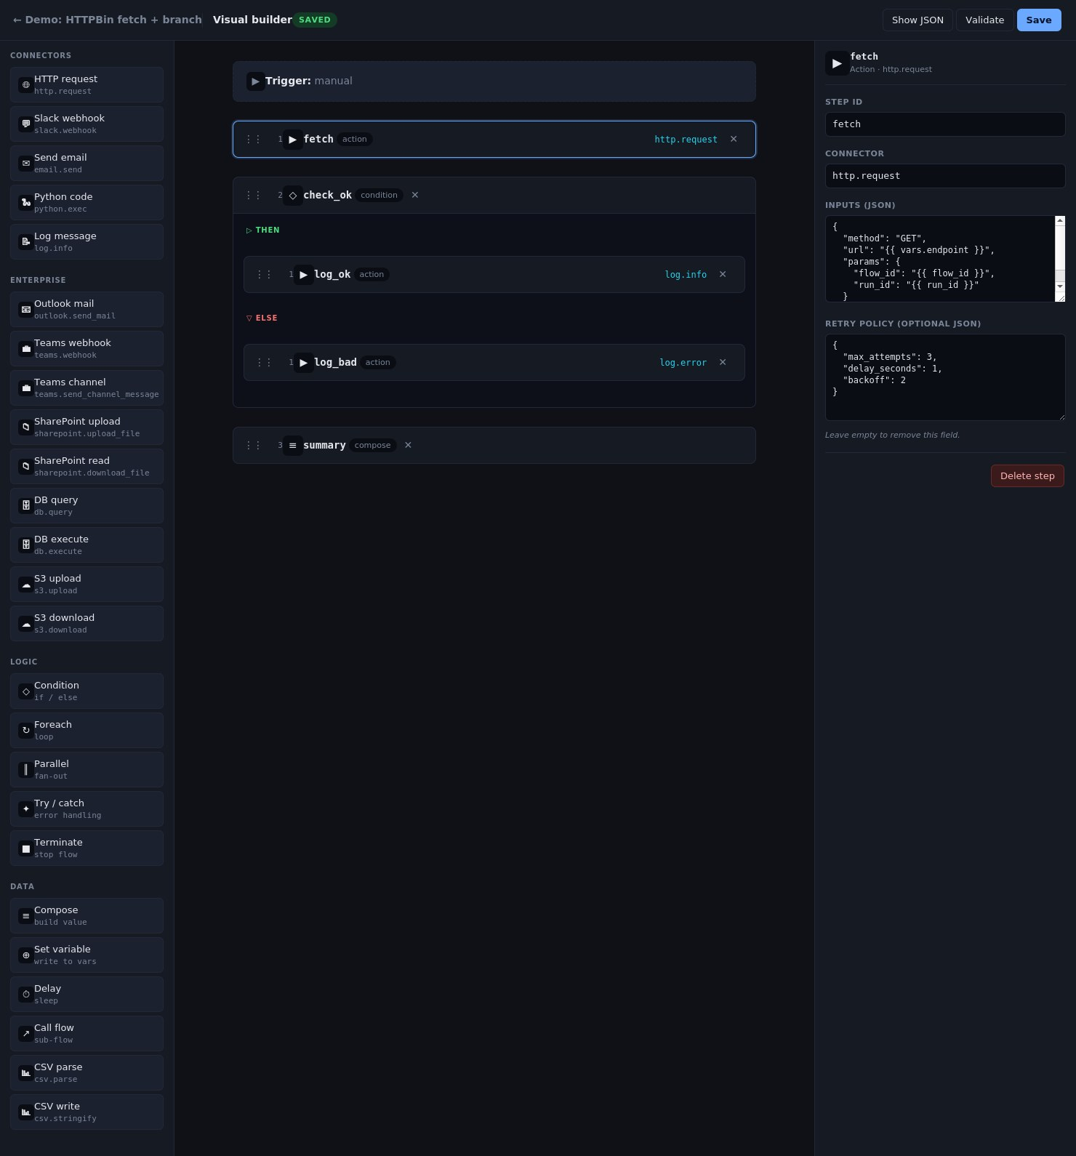
⚡ Flowforge
UI · VISUAL BUILDER (INSPECTOR)
Inspector reflects whatever step is selected
Per-type form
Action gets connector + inputs JSON + retry policy. Condition gets the expression. Parallel gets Add branch. Each step type gets the fields it actually needs.
JSON fields validate inline
Type into the Inputs textarea, commit on blur. Invalid JSON is flagged in place; structural changes (id, connector) live-update the canvas.
Same source of truth
The builder edits the same definition the executor reads. "Show JSON" opens a dialog to paste a full definition back if you'd rather hand-edit.
Flowforge — Django + Celery workflow engine
10 / 13

Slide 11
⚡ Flowforge
CONNECTORS
Twenty-eight connectors built in, registry is open
CATEGORY
CONNECTOR
PURPOSE
HTTP & messaging
http.request
Generic HTTP — basic/bearer/header auth, form bodies, multipart
request.send
Alias of http.request
slack.webhook
POST to a Slack Incoming Webhook
email.send
Send via Django's email backend
Microsoft 365
outlook.send_mail
Send via Graph (client credentials or pre-acquired token)
(shared token cache)
outlook.list_messages
List inbox / folder with $filter / $search
outlook.get_message
Fetch a single message by id
teams.webhook
Post a MessageCard to a Teams webhook URL
teams.send_channel_message
Post to a Teams channel via Graph
sharepoint.upload_file
Upload to SharePoint / OneDrive
sharepoint.download_file
Read a file's contents
sharepoint.list_items
List children of a folder
Database
db.query
SELECT via Django connections (parameterised)
db.execute
INSERT / UPDATE / DELETE in a transaction
Object storage
s3.upload
Upload to S3 / MinIO / R2 / B2 (boto3)
s3.download
Download as text or base64
s3.list
List objects under a prefix
s3.delete
Delete an object
Code & data
python.exec
Restricted Python sandbox (set result = …)
csv.parse
Parse CSV text into rows (header-aware)
csv.stringify
Serialise rows back to a CSV string
json.parse
Parse JSON
json.stringify
Serialise any value to JSON
text.template
Render a {{ … }} template into text
data.pick
Pick a subset of keys
Observability
log.info
INFO log line
log.error
ERROR log line
log.debug
DEBUG log line
Flowforge — Django + Celery workflow engine
11 / 13

Slide 12
⚡ Flowforge
ARCHITECTURE
How it runs
RUN IT LOCALLY
Browser / cURL
Celery Beat
(cron)
$ pip install -r requirements.txt
$ docker compose up -d redis
$ python manage.py migrate
$ python manage.py seed_flows
# three terminals:
$ python manage.py runserver
$ celery -A flowforge worker -l info
$ celery -A flowforge beat -l info
Django + DRF
Redis broker
Engine
executor
SQLite / Postgres
Celery Worker
Then open http://localhost:8000/flows/
Flowforge — Django + Celery workflow engine
12 / 13

Slide 13
Where it goes next
Done · in progress · queued
✓ Shipped
▷ Next
○ Ideas
10 step types (action, condition, foreach, parallel, try, call_flow, …)
Manual / cron / webhook triggers
Retries with exponential backoff
Encrypted Connection credentials
28 connectors: Outlook, Teams, SharePoint, S3, DB…
Sandboxed python.exec
Run history with per-step trace
Visual DAG editor (react-flow)
Resumable approval / wait steps
Rate limiting on webhooks + API
Redis-backed token cache for Outlook
SharePoint / Drive connector
Database query connector
Telegram / Discord alerts
Sub-flow library + version pinning
Built end-to-end, verified end-to-end.

