Slide 1
Pricing Precision
Maximizing Revenue Through Price Elasticity
Amit Chandhok
June 5, 2025

Slide 2
Agenda
1. Business Context
2. Exploratory Insights
3. Modelling Framework
4. Demand Forecasting
5. Implementation Roadmap
6. Conclusion
7. Q&A
Appendix: Technical backup if required

Slide 3


Business Context
Problem Statement
Objective
Online retail’s inaugural pricing strategy operated in the dark with no historical data to guide decisions, resulting in revenue leakage and missed strategic opportunities
Increase overall revenue with a new pricing plan backed by predictive models

Slide 4
Prospective Growth
$57,468
$103,271
PRIOR REVENUE
FORECASTED REVENUE
Measured impact of 3 key SKUs from Q1 2010
Potential 79% lift in Q1 revenue for the same SKUs

Slide 5
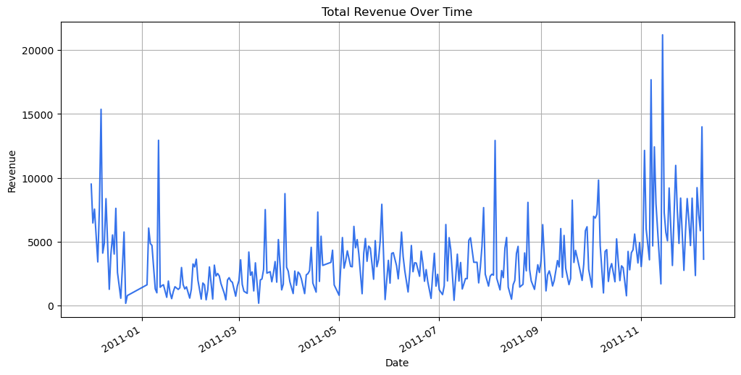
Exploratory Insights
Seasonality is pronounced, with spikes in sales clearly visible during the holiday season, indicating a critical period for promotional efforts

Slide 6
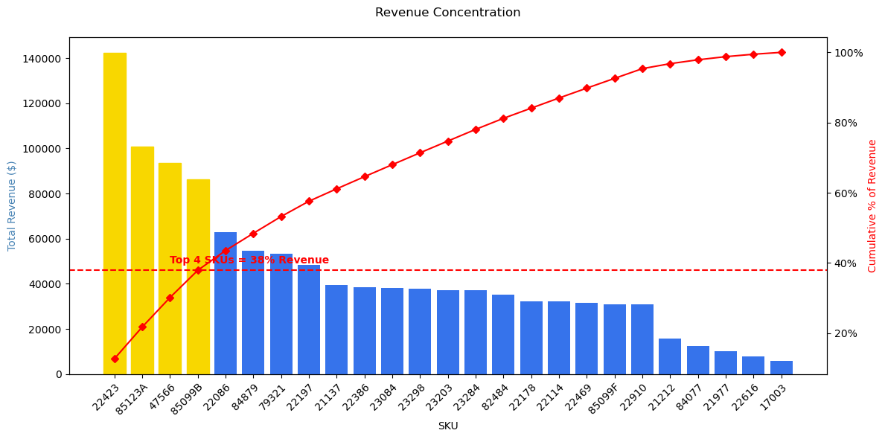
Exploratory Insights
The top 4 SKUs drive approximately 40% of total revenue within the top 25 SKUs, highlighting significant revenue concentration

Slide 7
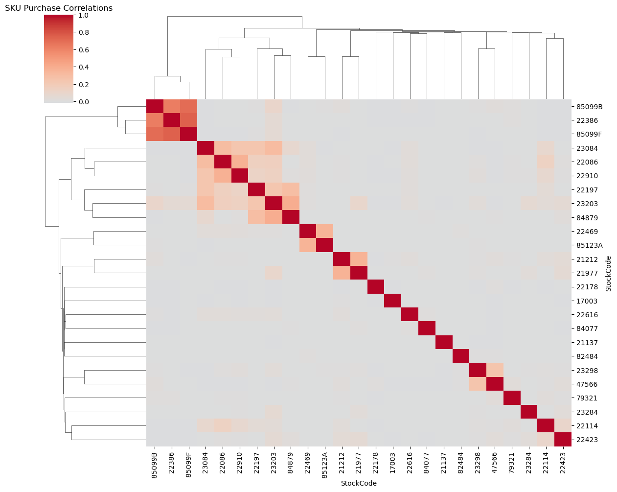
Exploratory Insights
Significant purchase correlations among SKUs suggest potential for optimized bundling strategies to leverage cross-SKU demand and manage price elasticity effectively

Slide 8
Modelling Framework
Model | Pros | Cons | Log-Log Comparison
Linear Regression | Simple, interpretable | Assumes linearity in levels, poor fit for % based effects | Log-log better captures relative changes
XGBoost | Captures non-linear pricing thresholds and complex interactions | Black box, lacks interpretability of elasticity | Less suited when transparency is required
Panel Regression | Controls for SKU fixed effects and cross-SKU price impacts | May overcomplicate SKU level tactical decisions | More strategic level insights, less actionable for SKU pricing
Log-Log Regression | Models % change in sales vs. % change in price directly, handles heteroskedasticity | Requires log transformation which may be less intuitive at first | Preferred when elasticity is core metric of interest

Slide 9
Modelling Framework
Categorical features
Temporal features
Lag features
Log log regression applies a higher weight for larger numbers which need to be encoded
Extracted month, day of week and quarter to capture seasonality patterns and shopping behaviour trends
Included prior period sales as predictors to capture temporal autocorrelation.

Slide 10
Model Evaluation Summary
How well it fits:
On average, the models explain about 65% of the variation in sales across SKUs (R² = 0.65)
Forecast Accuracy:
On average, predictions are within 47 units of actual sales (MAE = 47)
Price Impact:
18 out of 25 products show a meaningful link between price and demand (p-value < 0.05)

Slide 11
Results for end users to make decisions
17003
Highlights
22178
Highlights
21977
Elasticity: -2.54
Elasticity p-value < 0.05
Consistent R² scores (~0.65)
Key Takeaways
Low MAE scores
Highly price sensitive, a 1% decrease in price results in a 2.54% increase in sales. Consider price-based promotions to lift volume.
Elasticity: 0.01
Elasticity p-value > 0.05
High and consistent R² (~0.8)
Price has no measurable impact. Focus on seasonality or bundling strategies instead.
Key Takeaways
Highlights
Elasticity: -1.06
Elasticity p-value < 0.05
MAE ~20 units
Test R²: 0.17
Price moderately affects demand, but the model generalizability is weak. Use targeted, short term pricing experiments to validate before scaling.
Key Takeaways
Elasticity CI Upper: 0.98

Slide 12
Opportunities to improve our model
Missing features:
1. Competitor pricing changes
2. Inventory Effects
3. Promotion data
4. Improve product categories
Isolated modelling:
1. No cross SKU (compliments/substitutes) effects
2. Integrate a dashboard for interpretability
Simplified time effects:
1. Elasticity assumed static across time
Short time horizon:
1. Limited test periods reduce generalizability. Incorporate rolling time-based cross validation
Limitations & Next Steps

Slide 13
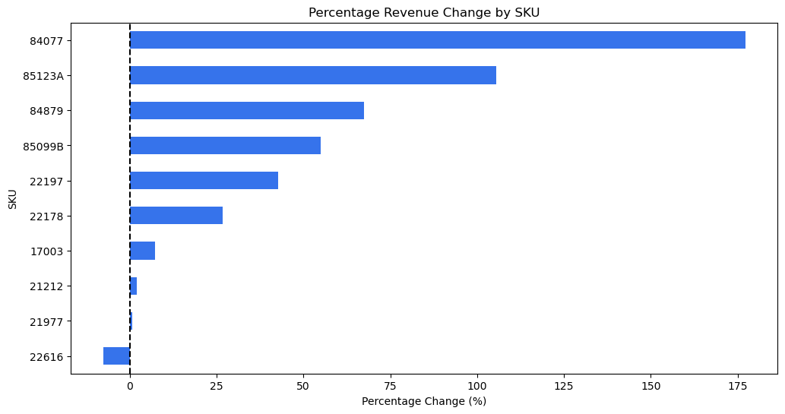
Demand Forecasting
Forecasted demand using prior year sales + SKU level elasticity
Projected +65% revenue increase, or $76,645 lift
Largest gains concentrated in high elastic SKUs with price reductions

Slide 14

Recommendation
Follow Pricing Plan
Monitor & Test
Hold & Reassess
SKUs: 17003, 22197, 85099B, 85123A
Statistically significant elasticity estimates. Clear, consistent demand response to price. Forecasted 79% revenue lift in Q1 under proposed plan.
SKUs: 21977, 22616, 84077
Run A/B tests to understand price changes. Lower statistical confidence with varying model performance.
SKUs: 21212, 22178, 84879
Maintain current pricing while collecting more data. Price elasticity not statistically significant and revenue impact is uncertain or negative. Current model lacks predictive power for these SKUs.

Slide 15
Conclusion
Key Findings:
~65% of SKUs show statistically significant price sensitivity
Top SKUs drive majority of projected lift
Predictive model can explain ~65% of variation in sales
Impact:
Proposed pricing plan could yield Q1 lift of 79%
Next Steps:
Expand model to include promotions, competitor pricing and seasonality

Slide 16
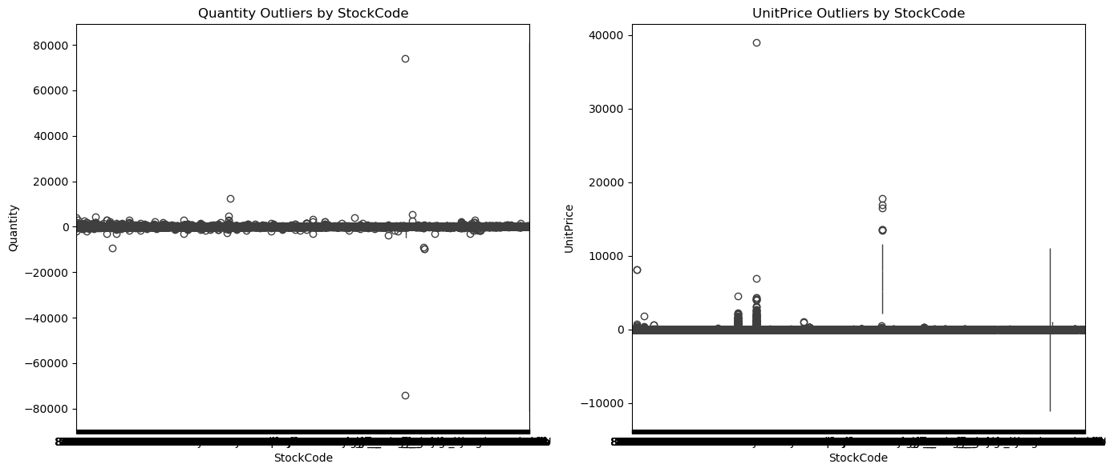
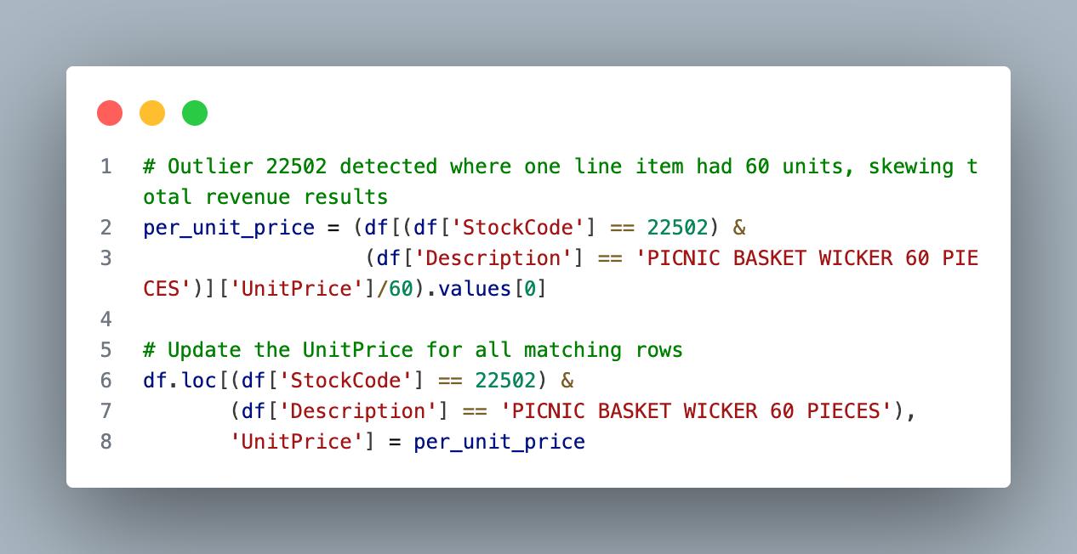
Technical Appendix: Outlier Detection
Created boxplots for quantity and unit prices to check for outliers.
SKU 22502 had 2 entries that represented 60 units rather than 1. I divided the unit price by 60 to get the actual unit price.
This analysis removed SKU 22502 from the top 20 SKUs by revenue since it was reliant on an outlier.
Outlier shown for quantity represents a cancellation, not a true outlier.

Slide 17
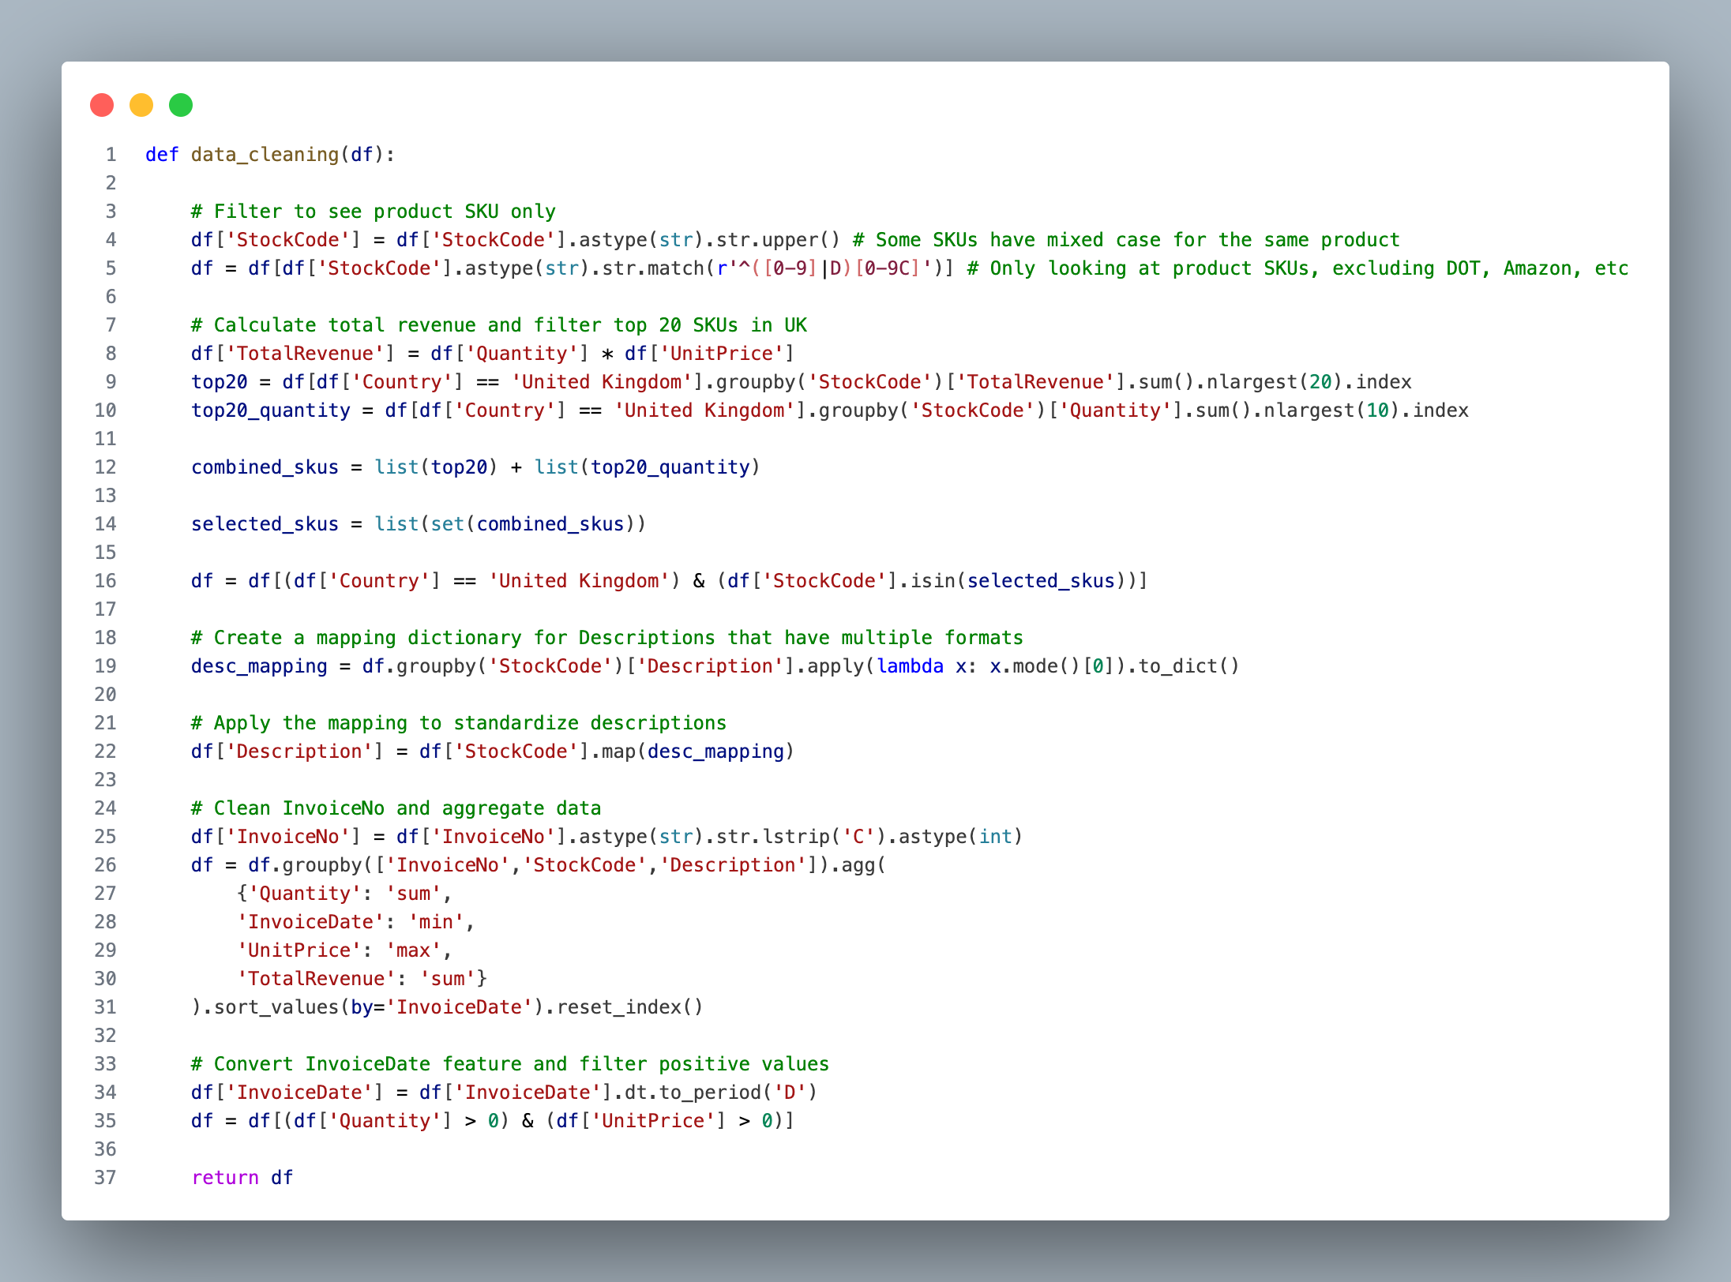
Technical Appendix: Data Cleaning
Normalized StockCodes to all be in upper case and group codes where suffix was “c” instead of “C.”
Filtered out all StockCodes that were not SKUs, not from United Kingdom and not in the top 20 by revenue. Included top 10 by quantity since promo plan had StockCodes ranked by quantity.
Mapped descriptions to match their most common description to help with forming product categories.
Aggregated cancellations into original invoice and filtered quantities and prices below 0 to help with log transformations.

Slide 18
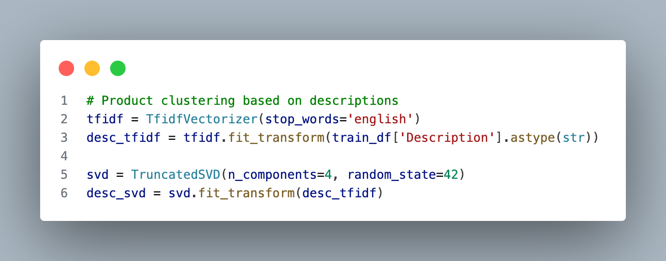
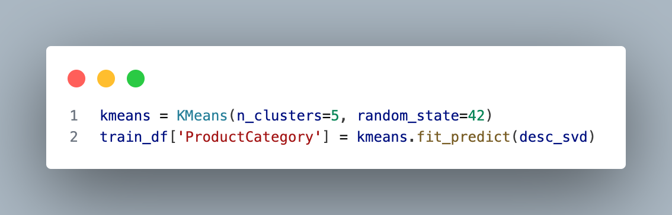
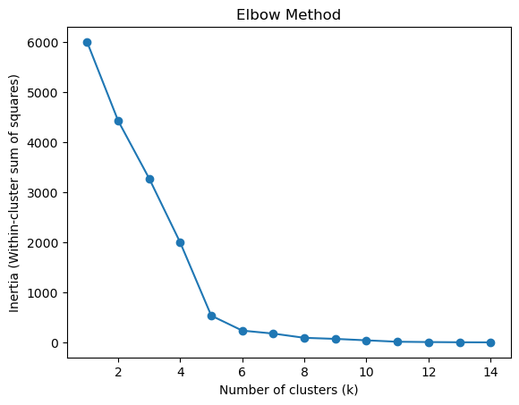
Technical Appendix: Product Categories
Utilized TF IDF to convert words to numbers based on frequency to highlight “important” words like “Small.”
Truncated the number of important words to 4 to help summarize the description.
Utilized the elbow method that helps understand the optimal number of groups where groups are not overfitting and yet have similarities.
Built 5 distinct product categories using K Means clustering.

Slide 19
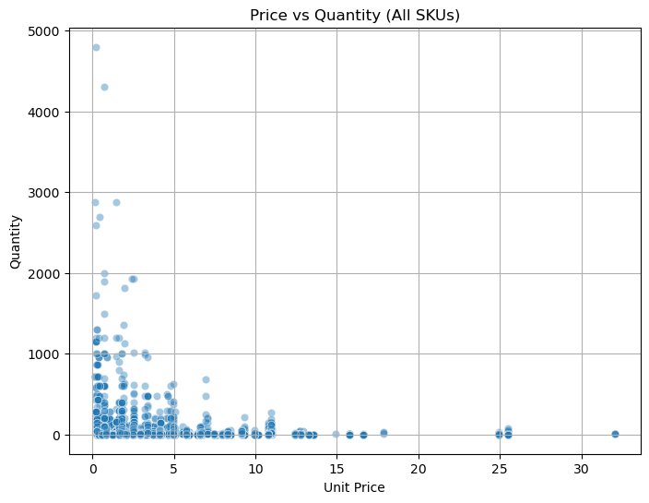
Technical Appendix: EDA
No clear linear pattern
Long tail stretching right and up.
Setup for a log transformation

