Slide 1

BREAST CANCER EDA

Slide 2
Data Set Information
The dataset contains cases from a study that was conducted between 1958 and 1970 at the University of Chicago's Billings Hospital on the survival of patients who had undergone surgery for breast cancer.
Here the objective is to predict whether the patient will survive after 5 years or not based upon the patient’s age, year of operation and the number of positive axillary nodes.
Attribute Information:
Age of patient at time of operation (numerical)
Patient's year of operation (year - 1900, numerical)
Number of positive axillary nodes detected (numerical)
Survival status (class attribute)
1 = the patient survived 5 years or longer
2 = the patient died within 5 year
The dataset comprises of 306 observations and 4 columns.

Slide 3
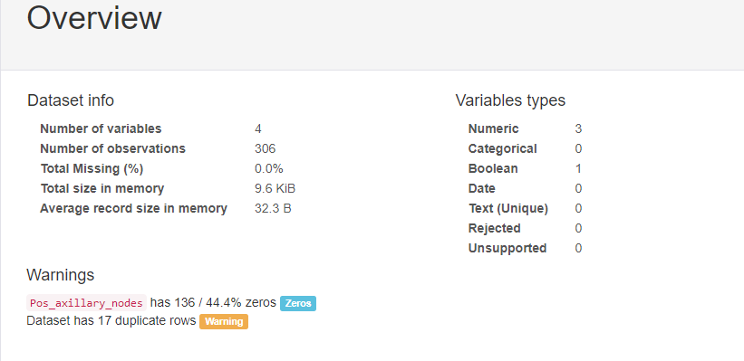
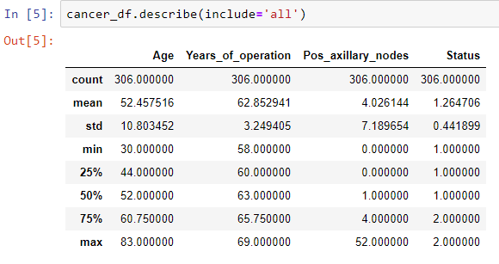
Pandas Profiling Report
We can observe that data is acceptable as data is not skewed, Age values are in realistic range and we can use 17 duplicates rows also as this is clinical data & age is not captured in Months / Days.

Slide 4
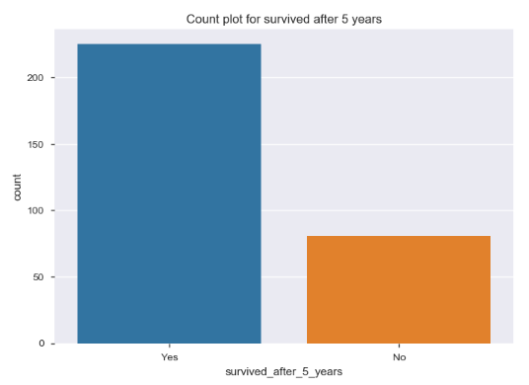

How many survived after 5 years.

Slide 5
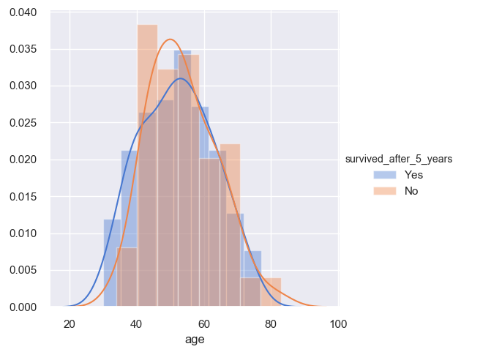
Survival vs Age
We can see that there is major overlapping, which states that survival chances are irrespective of patients age.
We can assume that patients within age group 30-40 are more likely to survive and 40-60 are less likely to survive.

Slide 6
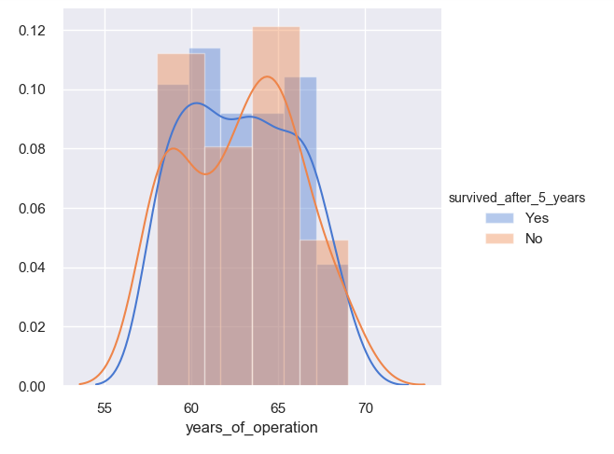
Survival vs Year of Operation
This graph only tells how many of the operations were successful and how many weren’t. This cannot be a parameter to decide the patient’s survival chances.
However, it can be observed that in the years 1960 and 1965 there were more unsuccessful operations.

Slide 7
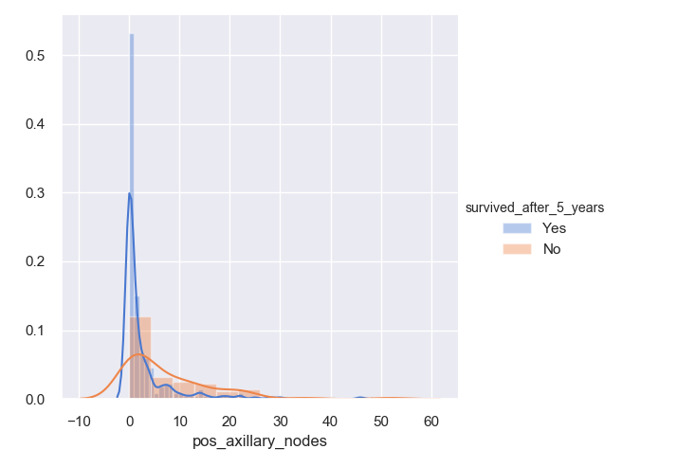
Survival vs No. of positive axillary nodes
Almost 80% of patients has less than 5 positive axillary nodes.
Patients with no nodes or 1 nodes are more likely to survive.
There are very few chances of survival when there are 25 or more nodes.

Slide 8
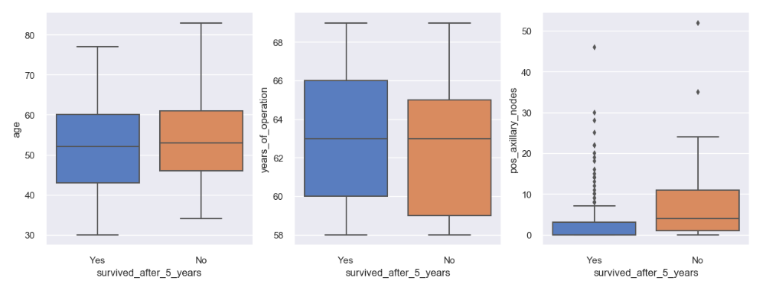
Patients with more than 1 nodes are not likely to survive. More the number of nodes, lesser the survival chances.
A large percentage of patients who survived had 0 nodes.
Survival chance is inversely proportional to the number of positive axillary nodes. We also saw that the absence of positive axillary nodes cannot always guarantee survival.
Patient’s age and operation year alone are not deciding factors for survival. Yet, people less than 35 years have more chance of survival.

Slide 9
Thank You

