Slide 1


Advanced Time Series Analytics: Models, Methods, and Applications
.

Slide 2





Overview
Understanding Time Series Fundamentals
Develop a deep understanding of stationary processes, linear models, and the mathematical foundations of time series analysis
Implementing Advanced Models
Build practical skills in implementing and evaluating MA, AR, ARMA, ARIMA, SARIMA, and transfer function models
Applying Critical Analysis
Learn to select appropriate models for different data characteristics and business problems
Mastering Python Tools
Gain proficiency with Python libraries for time series analysis including statsmodels, pandas, and scikit-learn

Slide 3
Recap: Components of Time Series
Trend Component
Seasonality Component
Irregular Component
The long-term progression of the series, representing the persistent increasing or decreasing direction in the data. Trends can be linear, exponential, or more complex patterns.
Periodic fluctuations that recur at regular intervals due to seasonal factors. Common examples include daily, weekly, monthly, or quarterly patterns.
The random, unpredictable fluctuations in the data after removing trend and seasonality. Also known as the "residual" or "noise" component.
Denoted as St, seasonality has a fixed and known frequency. Its identification is crucial for developing accurate forecasting models, especially in retail, energy, and economic applications.
Represented as It, ideally, this component should follow a white noise process with constant variance and zero autocorrelation, which is essential for valid statistical inference.
Mathematically expressed as Tt in the decomposition model: Yt = Tt + St + It (additive) or Yt = Tt × St × It (multiplicative)

Slide 4




Recap: Moving Average and Smoothing Techniques
Simple Moving Average (SMA)
Calculates the arithmetic mean of a fixed window of observations: SMAt = (Yt + Yt-1 + ... + Yt-k+1)/k where k is the window size
Weighted Moving Average (WMA)
Assigns different weights to observations, typically giving more weight to recent data: WMAt = (w1Yt + w2Yt-1 + ... + wkYt-k+1)/(w1 + w2 + ... + wk)
Exponential Smoothing
Updates the smoothed value using a weighted average of the previous smoothed value and the current observation: St = αYt + (1-α)St-1 where α is the smoothing parameter (0 < α < 1)
Adaptive Smoothing
Dynamically adjusts the smoothing parameter based on forecast errors, allowing the model to adapt to changing patterns in the data

Slide 5

Recap: Autocorrelation Function (ACF)
Definition
Properties
The autocorrelation function measures the linear relationship between lagged values in a time series. For a stationary process Yt, the ACF at lag k is defined as:
Values range from -1 to 1
ρ(0) = 1 (a series is perfectly correlated with itself)
For stationary processes, ρ(k) = ρ(-k)
For a white noise process, ρ(k) = 0 for all k > 0
ρ(k) = Cov(Yt, Yt-k) / Var(Yt)
Where ρ(k) represents the correlation between observations separated by k time units.
Applications
Identifying non-randomness in data
Determining appropriate time series models
Detecting seasonality (regular spikes at seasonal lags)
Validating model assumptions through residual analysis

Slide 6



Recap: Portmanteau Tests for Noise Sequences
Box-Pierce Q Test
Ljung-Box Test
Application in Model Validation
Tests whether a series of observations are independent. The test statistic is:
A more accurate test for small samples, with the statistic:
These tests are crucial for validating time series models by checking whether the residuals approximate white noise. A significant test statistic indicates autocorrelation remains in the residuals, suggesting model inadequacy.
Q = n∑k=1h rk2
Q* = n(n+2)∑k=1h (rk2)/(n-k)
Where n is the sample size, h is the number of lags being tested, and rk is the sample autocorrelation at lag k.
Under the null hypothesis of independently distributed observations, Q* follows a chi-square distribution with h degrees of freedom.

Slide 7








Recap: Transformations for Gaussian Processes
Box-Cox Transformation
Logarithmic Transformation
Yt* = (Ytλ - 1)/λ if λ ≠ 0; log(Yt) if λ = 0
Yt* = log(Yt)
Stabilizes variance in exponentially growing series and handles right-skewed data
Family of power transformations that includes logarithmic transformation as a special case
Differencing
Square Root Transformation
Yt* = Yt - Yt-1
Yt* = √Yt
Removes trend and achieves stationarity, a prerequisite for many time series models
Useful for count data following Poisson distribution

Slide 8
Stationary Processes: Foundations
Definition
Importance in Time Series Analysis
A strictly stationary process has a joint distribution that remains unchanged when shifted in time. In practice, we often work with weak (second-order) stationarity, which requires:
Stationarity is fundamental because:
It ensures statistical properties remain consistent over time
Most time series models assume stationarity
Constant mean: E[Yt] = μ for all t
Non-stationary data can lead to spurious relationships and invalid inference
Constant variance: Var(Yt) = σ2 for all t
Autocovariance depends only on time lag: Cov(Yt, Yt+h) = γ(h) for all t and h
Transformations like differencing can often make non-stationary series stationary

Slide 9
Testing for Stationarity
Visual Inspection
Augmented Dickey-Fuller (ADF) Test
Examining time series plots for obvious trends, changing variance, or seasonal patterns that indicate non-stationarity. While subjective, this provides initial insights into the data's characteristics.
Tests the null hypothesis that a unit root is present (non-stationary). The test statistic is compared against critical values; rejection of the null suggests stationarity. The ADF regression model includes lagged differences to account for serial correlation.
KPSS Test
ACF Analysis
Kwiatkowski-Phillips-Schmidt-Shin test uses the null hypothesis that the series is stationary around a deterministic trend. The test complements the ADF test, as conflicting results can indicate different types of non-stationarity.
The autocorrelation function of a stationary series should decay quickly to zero. Slow decay indicates non-stationarity. Examining the pattern of the ACF plot helps identify both non-stationarity and potential model structures.

Slide 10





Stationary Processes: Python Implementation
Import Libraries
from statsmodels.tsa.stattools import adfuller, kpss
Prepare Data
Load and preprocess time series data
Conduct Tests
Apply ADF and KPSS tests to assess stationarity
Transform if Needed
Apply differencing or other transformations
Verify Results
Retest transformed series for stationarity
# ADF Test implementation def adf_test(timeseries): result = adfuller(timeseries) print(f'ADF Statistic: {result[0]}') print(f'p-value: {result[1]}') print('Critical Values:') for key, value in result[4].items(): print(f'\t{key}: {value}') if result[1] <= 0.05: print("Strong evidence against the null hypothesis - Stationary") else: print("Weak evidence against the null hypothesis - Non-stationary")

Slide 11
Linear Processes: Theoretical Framework
Definition
Properties
A linear process is a stationary process that can be represented as a linear combination of past and present white noise terms:
Mean: E[Yt] = μ
Variance: Var(Yt) = σ2∑j=0∞ ψj2
Autocovariance: γ(h) = σ2∑j=0∞ ψjψj+h
Yt = μ + ∑j=0∞ ψjεt-j
For the process to be stationary, the coefficients must satisfy ∑j=0∞ |ψj| < ∞, ensuring the series converges.
Where μ is the mean, ψj are constants with ψ0 = 1, and εt is white noise with mean 0 and variance σ2.

Slide 12
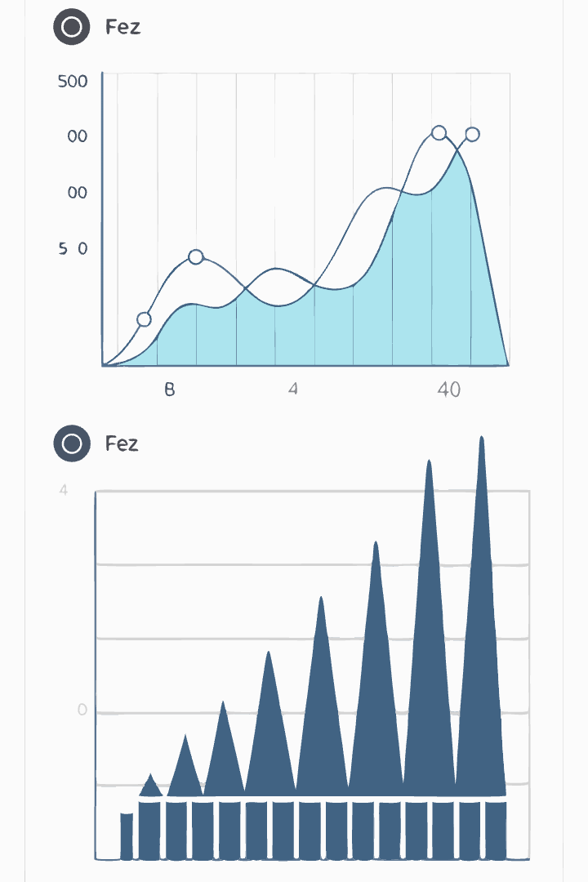




Linear Processes: Applications and Examples
Linear Filtering
Transforming a time series through a weighted sum of its values (e.g., moving averages are simple linear filters)
Signal Processing
Extracting signals from noisy data using linear operations
Spectral Analysis
Decomposing time series into frequency components
Forecasting
Linear processes form the foundation for many forecasting models including ARMA and ARIMA
The linear process framework provides a versatile theoretical foundation for many time series models. Its mathematical tractability allows for analytical derivation of statistical properties, making it central to both theoretical developments and practical applications in time series analysis.

Slide 13
Moving Average (MA) Models: Fundamentals
Definition
Key Properties
Invertibility Condition
A Moving Average model of order q, denoted MA(q), is defined as:
Always stationary regardless of parameter values
For an MA(q) process to be invertible (expressible as an infinite AR process), all roots of the polynomial 1 + θ1z + θ2z2 + ... + θqzq = 0 must lie outside the unit circle.
Yt = μ + εt + θ1εt-1 + θ2εt-2 + ... + θqεt-q
Autocorrelation cuts off after lag q
Where μ is the mean of the series, εt are white noise error terms, and θ1, θ2, ..., θq are the model parameters.
Represents series as weighted average of current and past shocks
Invertibility ensures a unique MA representation and is essential for estimation and forecasting.
Finite memory - only affected by the q most recent error terms

Slide 14




Moving Average (MA) Models: Parameter Estimation
Prepare data
Ensure stationarity and select appropriate MA order
Apply estimation method
Use maximum likelihood or method of moments
Perform diagnostics
Check residuals for white noise properties
Generate forecasts
Use estimated parameters for prediction
Parameter estimation for MA models is more complex than for AR models due to the non-linear relationship between parameters and autocorrelations. Maximum likelihood estimation is typically preferred over method of moments for its efficiency and consistency. The likelihood function for MA models doesn't have a closed-form solution, requiring numerical optimization methods like Newton-Raphson or Broyden-Fletcher-Goldfarb-Shanno (BFGS) algorithms.

Slide 15

Moving Average (MA) Models: Python Implementation
Fit MA Model
Load and Prepare Data
Implement and fit an MA model of appropriate order using statsmodels:
Import Required Libraries
Load your time series data and ensure it's properly formatted for analysis:
Begin by importing the necessary Python packages for time series analysis and visualization:
# Fit MA(2) model - ARIMA(0,0,2) model = ARIMA(ts, order=(0,0,2)) results = model.fit() print(results.summary())
# Example: monthly airline passengers data = pd.read_csv('airline_passengers.csv', index_col='Month', parse_dates=True) ts = data['Passengers']
import numpy as np import pandas as pd import matplotlib.pyplot as plt from statsmodels.tsa.arima.model import ARIMA from statsmodels.graphics.tsaplots import plot_acf

Slide 16
Moving Average (MA) Models: Diagnostics and Forecasting
Residual Analysis
Check if residuals approximate white noise using ACF plots and Ljung-Box test:
residuals = results.resid plot_acf(residuals) from statsmodels.stats.diagnostic import acorr_ljungbox lb_test = acorr_ljungbox(residuals, lags=10) print(lb_test)
Forecasting
Generate and plot forecasts for future periods:
forecast = results.forecast(steps=12) plt.figure(figsize=(10, 6)) plt.plot(ts.index, ts, label='Observed') plt.plot(pd.date_range(start=ts.index[-1], periods=13, freq='M')[1:], forecast, label='Forecast') plt.legend()
Evaluate Forecast Accuracy
Assess model performance using error metrics:
from sklearn.metrics import mean_squared_error train = ts[:-12] test = ts[-12:] model = ARIMA(train, order=(0,0,2)) results = model.fit() forecast = results.forecast(steps=12) rmse = np.sqrt(mean_squared_error(test, forecast)) print(f'RMSE: {rmse}')

Slide 17
Autoregressive (AR) Models: Fundamentals
Definition
Key Properties
Stationarity Condition
An Autoregressive model of order p, denoted AR(p), represents the current value as a linear combination of its p previous values plus an error term:
Autocorrelation decays gradually (doesn't cut off abruptly)
For an AR(p) process to be stationary, all roots of the characteristic polynomial φ(z) = 1 - φ1z - φ2z2 - ... - φpzp = 0 must lie outside the unit circle.
Partial autocorrelation cuts off after lag p
Mean: E[Yt] = c/(1-φ1-φ2-...-φp) if stationary
Yt = c + φ1Yt-1 + φ2Yt-2 + ... + φpYt-p + εt
For AR(1): |φ1| < 1 For AR(2): φ1 + φ2 < 1, φ2 - φ1 < 1, |φ2| < 1
Variance is finite and constant if stationary
Where c is a constant, φ1, φ2, ..., φp are the parameters, and εt is white noise.

Slide 18




Partial Autocorrelation Function (PACF)
Definition
Model Identification
The partial autocorrelation at lag k measures the correlation between Yt and Yt-k after removing the linear dependence on Yt-1, Yt-2, ..., Yt-k+1. It represents the additional correlation explained by adding Yt-k to the model.
The PACF is particularly useful for identifying the order of an AR model. For an AR(p) process, the PACF "cuts off" after lag p, showing significant values for lags ≤ p and insignificant values thereafter.
Implementation
ACF vs. PACF
In Python, the PACF can be calculated and plotted using statsmodels:
Using both ACF and PACF helps distinguish between AR and MA processes: - AR(p): ACF tails off, PACF cuts off after lag p - MA(q): ACF cuts off after lag q, PACF tails off - ARMA(p,q): Both ACF and PACF tail off
from statsmodels.graphics.tsaplots import plot_pacf plot_pacf(ts, lags=20) plt.show()

Slide 19
Autoregressive (AR) Models: Parameter Estimation
Yule-Walker Equations
Least Squares Estimation
A system of linear equations based on the theoretical relationship between AR parameters and autocorrelations: ρ(1) = φ1 + φ2ρ(1) + ... + φpρ(p-1) ρ(2) = φ1ρ(1) + φ2 + ... + φpρ(p-2) ... ρ(p) = φ1ρ(p-1) + φ2ρ(p-2) + ... + φp
Treats the AR model as a regression problem, minimizing the sum of squared residuals. For an AR(p) model, this involves regressing Yt on its p lagged values, yielding estimates of the parameters φ1, φ2, ..., φp.
Maximum Likelihood Estimation
Conditional Sum of Squares
Assumes Gaussian errors and maximizes the likelihood function of the observed data given the parameters. This approach is asymptotically efficient and becomes especially important for more complex models like ARMA.
A computationally efficient approximation to maximum likelihood, conditioning on the first p observations. This method is particularly useful for large datasets or when computational resources are limited.

Slide 20
Autoregressive (AR) Models: Python Implementation
Fit AR Model
Setup and Data Preparation
# Fit AR(3) model model = AutoReg(ts, lags=3) results = model.fit() print(results.summary()) # Extract coefficients print("AR Coefficients:") print(f"Constant: {results.params[0]}") for i, coef in enumerate(results.params[1:], 1): print(f"φ_{i}: {coef}")
import numpy as np import pandas as pd import matplotlib.pyplot as plt from statsmodels.tsa.ar_model import AutoReg from statsmodels.graphics.tsaplots import plot_acf, plot_pacf # Load data data = pd.read_csv('temperature.csv', index_col='Date', parse_dates=True) ts = data['Temperature']
Determine AR Order
# Plot PACF to identify AR order plt.figure(figsize=(12, 6)) plot_pacf(ts, lags=20) plt.title('PACF for Temperature Data') plt.show() # Based on PACF, let's use AR(3)

Slide 21
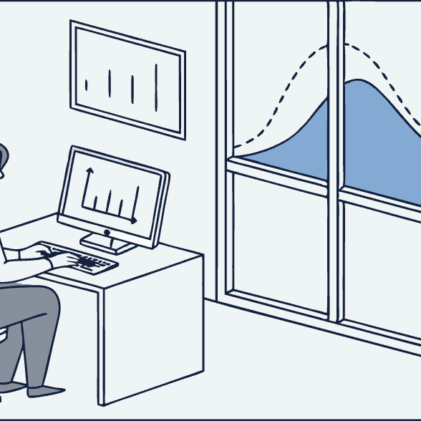

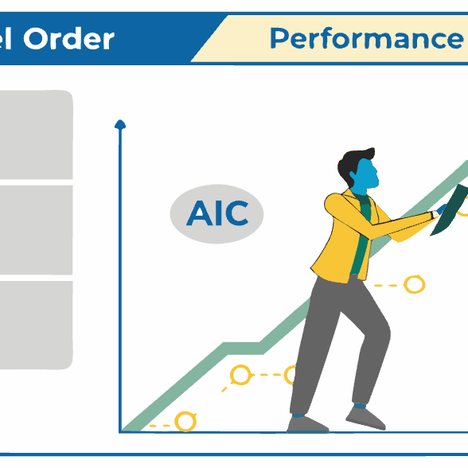
Autoregressive (AR) Models: Forecasting and Diagnostics
# Generate in-sample predictions in_sample_pred = results.fittedvalues # Generate out-of-sample forecasts forecast = results.forecast(steps=10) # Plot results plt.figure(figsize=(12, 6)) plt.plot(ts.index, ts, 'b-', label='Observed') plt.plot(ts.index, in_sample_pred, 'r--', label='In-sample Predictions') forecast_idx = pd.date_range(start=ts.index[-1], periods=11, freq='D')[1:] plt.plot(forecast_idx, forecast, 'g--', label='Forecasts') plt.fill_between(forecast_idx, forecast - 1.96*results.sigma2**0.5, forecast + 1.96*results.sigma2**0.5, color='g', alpha=0.2) plt.legend() plt.title('AR(3) Model: Observations, Fitted Values, and Forecasts') plt.show()

Slide 22
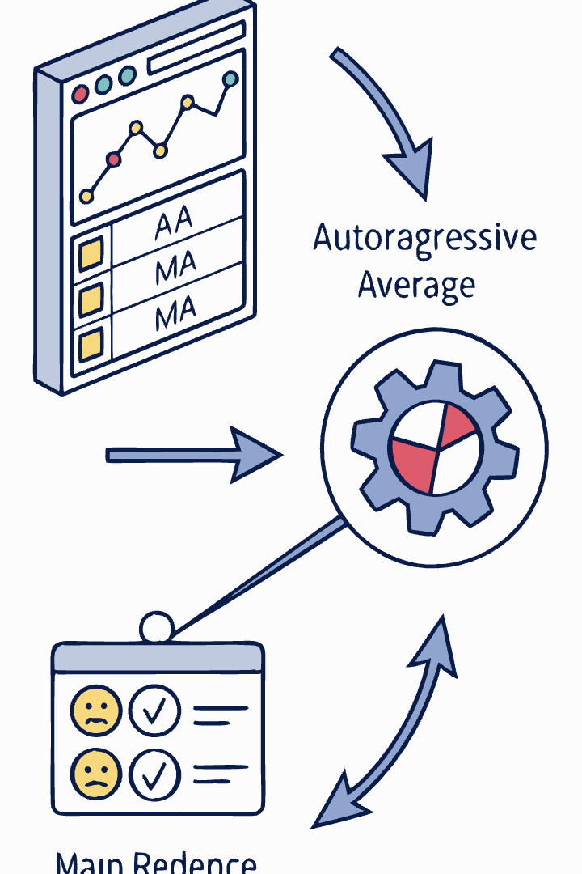
Autoregressive Moving Average (ARMA) Models: Fundamentals
p
q
AR Order
MA Order
Number of autoregressive terms (lagged values) included in the model
Number of moving average terms (lagged error terms) included in the model
p+q+1
Parameters
Total number of parameters to estimate (p AR coefficients, q MA coefficients, plus constant)
An ARMA(p,q) model combines autoregressive and moving average components to capture complex temporal dependencies in stationary time series data. The model is defined as:
Yt = c + φ1Yt-1 + ... + φpYt-p + εt + θ1εt-1 + ... + θqεt-q
ARMA models are more parsimonious than pure AR or MA models when the data exhibits both types of behavior, often requiring fewer total parameters to achieve the same fit quality.

Slide 23
ARMA Models: Mathematical Properties
Stationarity and Invertibility
Autocorrelation Function
Model Representation
An ARMA(p,q) model must satisfy both stationarity and invertibility conditions:
For an ARMA(p,q) process, the ACF follows a mixture of exponentials and damped sinusoids after lag q. The exact pattern depends on the roots of the characteristic equations.
ARMA models can be expressed using lag operator notation:
φ(B)Yt = c + θ(B)εt
Stationarity: All roots of AR polynomial 1 - φ1z - ... - φpzp = 0 must lie outside the unit circle
Where φ(B) = 1 - φ1B - ... - φpBp and θ(B) = 1 + θ1B + ... + θqBq are the AR and MA polynomials, and B is the backshift operator (BYt = Yt-1).
For large lags (k > q), the ACF satisfies the difference equation:
Invertibility: All roots of MA polynomial 1 + θ1z + ... + θqzq = 0 must lie outside the unit circle
ρ(k) = φ1ρ(k-1) + φ2ρ(k-2) + ... + φpρ(k-p)

Slide 24
ARMA Models: Model Identification
Residual Diagnostics
Use Information Criteria
Check if residuals from the fitted model resemble white noise using ACF plots and Ljung-Box tests. Significant autocorrelations in residuals indicate model inadequacy.
Examine ACF and PACF
Fit multiple candidate models and compare using information criteria: - Akaike Information Criterion (AIC): -2ln(L) + 2k - Bayesian Information Criterion (BIC): -2ln(L) + k·ln(n) Where L is the likelihood, k is the number of parameters, and n is the sample size. Lower values indicate better models, with BIC penalizing complexity more heavily.
Ensure Stationarity
Plot and analyze the sample ACF and PACF: - Pure AR(p): ACF tails off gradually, PACF cuts off after lag p - Pure MA(q): ACF cuts off after lag q, PACF tails off gradually - ARMA(p,q): Both ACF and PACF tail off gradually
Before fitting an ARMA model, verify that the time series is stationary using tests like ADF and KPSS. If non-stationary, apply appropriate transformations like differencing.

Slide 25





ARMA Models: Python Implementation
Order Selection
Data Preparation
Determine optimal p and q using ACF, PACF, and information criteria
Import libraries, load data, and ensure stationarity
Model Fitting
Estimate parameters using maximum likelihood
Forecasting
Generate predictions with confidence intervals
Diagnostics
Validate model assumptions through residual analysis
# Grid search for optimal ARMA order import itertools p_range = range(0, 3) q_range = range(0, 3) best_aic = float("inf") best_order = None for p, q in itertools.product(p_range, q_range): if p == 0 and q == 0: # Skip ARMA(0,0) continue try: model = ARIMA(ts, order=(p, 0, q)) results = model.fit() if results.aic < best_aic: best_aic = results.aic best_order = (p, 0, q) except: continue print(f"Best ARMA order: ARMA{best_order[0], best_order[2]} with AIC: {best_aic}")

Slide 26




Stationary Conditions: Theoretical Overview
Strict Stationarity
Weak Stationarity
Characteristic Equation
Unit Circle Test
A time series is strictly stationary if its joint probability distribution remains unchanged when shifted in time. For any set of time points t1, t2, ..., tn and any lag h, the joint distribution of Yt1, Yt2, ..., Ytn is identical to that of Yt1+h, Yt2+h, ..., Ytn+h.
A time series is weakly (or second-order) stationary if: 1. The mean is constant over time: E[Yt] = μ for all t 2. The variance is constant over time: Var(Yt) = σ2 for all t 3. The autocovariance depends only on the time lag: Cov(Yt, Yt+h) = γ(h) for all t and h
The stationarity condition can be visualized by plotting the roots of the characteristic polynomial in the complex plane. If all roots lie outside the unit circle, the process is stationary. This provides a geometric interpretation of the stationarity conditions.
For an ARMA(p,q) model, stationarity requires that all roots of the AR characteristic polynomial φ(z) = 1 - φ1z - φ2z2 - ... - φpzp = 0 lie outside the unit circle (i.e., have modulus greater than 1).

Slide 27
Specific Stationarity Conditions by Model Type
Model
Stationarity Condition
Interpretation
AR(1)
|φ1| < 1
The process is stationary when the AR coefficient has absolute value less than 1. When φ1 = 1, we have a unit root process (random walk).
AR(2)
φ1 + φ2 < 1 φ2 - φ1 < 1 |φ2| < 1
These three inequalities define a triangular region in the (φ1, φ2) plane where the process is stationary.
MA(q)
Always stationary
MA processes are always stationary regardless of parameter values, as they are finite linear combinations of white noise.
ARMA(p,q)
All roots of AR polynomial outside unit circle
Stationarity depends only on the AR part of the model. The condition ensures exponential decay of the impulse response function.
When we have higher-order AR or ARMA models, directly checking the inequalities becomes impractical. Instead, we typically rely on numerical methods to compute the roots of the characteristic polynomial and verify they lie outside the unit circle. Statistical software packages perform these checks automatically when fitting models.

Slide 28
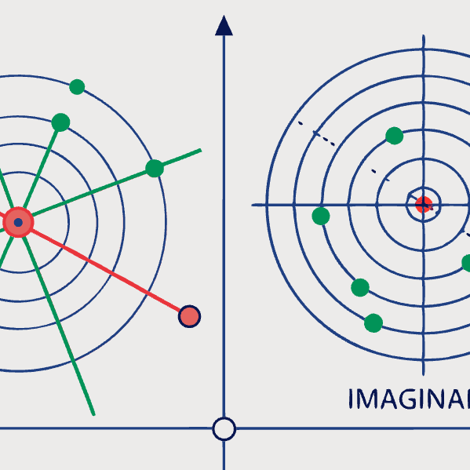

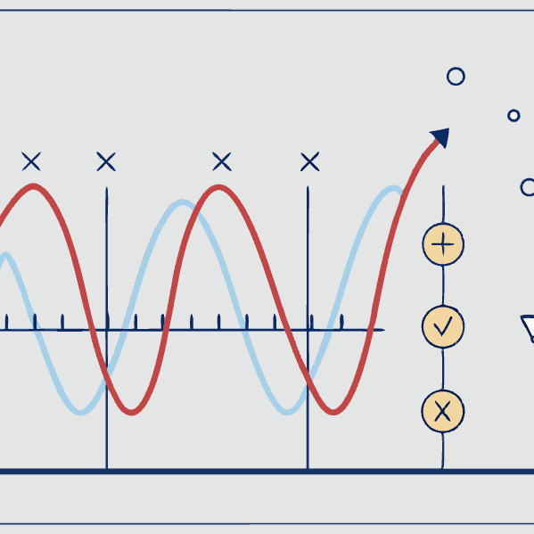
Testing Stationarity Conditions in Python
# Check stationarity conditions for AR(p) model from numpy import roots, abs def check_ar_stationarity(ar_params): """ Check if AR model with given parameters is stationary Parameters: ----------- ar_params : array-like AR parameters [φ₁, φ₂, ..., φₚ] Returns: -------- is_stationary : bool True if model is stationary root_abs : array Absolute values of roots """ # Create characteristic polynomial (add leading 1) ar_poly = np.r_[1, -ar_params] # Find roots r = roots(ar_poly) # Check if all roots are outside unit circle root_abs = abs(r) is_stationary = np.all(root_abs > 1.0) return is_stationary, root_abs # Example usage params = [0.7, -0.2] # AR(2) parameters is_stat, root_abs = check_ar_stationarity(params) print(f"AR(2) with params {params} is stationary: {is_stat}") print(f"Absolute values of roots: {root_abs}")

Slide 29
Non-stationary Time Series Models: Trends and Unit Roots
Deterministic Trend Models
Stochastic Trend Models
A time series with a deterministic trend can be represented as: Yt = f(t) + εt where f(t) is a deterministic function of time (often linear or polynomial) and εt is a stationary process. Removing the trend component through detrending creates a stationary series.
A series with a stochastic trend (unit root process) can be written as: Yt = Yt-1 + εt This is a random walk where shocks have permanent effects. Differencing (Yt - Yt-1) rather than detrending is required to achieve stationarity.
Unit Root Tests
Trend-Stationary vs. Difference-Stationary
Statistical tests to determine whether a series contains a unit root include: - Augmented Dickey-Fuller (ADF) test - Phillips-Perron (PP) test - Kwiatkowski-Phillips-Schmidt-Shin (KPSS) test These tests help distinguish between deterministic and stochastic trends, guiding the appropriate transformation approach.
A trend-stationary process becomes stationary after removing a deterministic trend, while a difference-stationary process requires differencing. Mistaking one for the other leads to either overdifferencing or underdifferencing, both resulting in model misspecification.

Slide 30
Seasonal Time Series Models: Concepts and Patterns
Seasonal Patterns
Detecting Seasonality
Modeling Approaches
Seasonality refers to regular, predictable patterns that repeat over fixed intervals (seasons). Common examples include:
Several methods help identify seasonal patterns:
Several approaches exist for handling seasonality:
Visual inspection of time plots
Seasonal dummy variables (in regression models)
Annual cycles in retail sales (holiday shopping)
Seasonal subseries plots (values for each season plotted separately)
Seasonal differencing (removing seasonal dependencies)
Quarterly patterns in corporate earnings
Autocorrelation function (peaks at seasonal lags)
Seasonal ARIMA models (incorporating seasonal AR and MA terms)
Monthly variations in temperature data
Spectral analysis (identifying frequency components)
Weekly patterns in website traffic
Daily cycles in electricity consumption
Seasonal decomposition techniques (STL, X-13-ARIMA-SEATS)
Seasonal decomposition methods (isolating the seasonal component)
Specialized models like TBATS for complex seasonality

Slide 31




Dealing with Seasonality: Preprocessing Techniques
Identify Seasonal Period
Determine the length of the seasonal cycle (s) through visual inspection, domain knowledge, or ACF plots. Common periods include 12 for monthly data, 4 for quarterly data, and 7 for daily data with weekly patterns.
Seasonal Differencing
Apply the seasonal differencing operator ∇sYt = Yt - Yt-s to remove seasonal patterns. This transforms a seasonally non-stationary series into a stationary one by comparing values to those from the same season in the previous cycle.
Seasonal Decomposition
Decompose the series into trend, seasonal, and residual components using methods like STL (Seasonal and Trend decomposition using Loess) or classical decomposition. The decomposition can be additive (Yt = Tt + St + Rt) or multiplicative (Yt = Tt × St × Rt).
Seasonal Adjustment
Remove the seasonal component to produce a seasonally adjusted series, which can then be modeled using non-seasonal techniques. This is commonly used in economic time series analysis to identify underlying trends.

Slide 32





Autoregressive Integrated Moving Average (ARIMA) Models
Understanding ARIMA(p,d,q)
A comprehensive framework for modeling non-stationary time series
Integration Parameter (d)
Number of differencing operations required for stationarity
Autoregressive Component (p)
Number of lagged values used in the prediction
Moving Average Component (q)
Number of lagged error terms in the model
ARIMA = Differencing + ARMA
Apply ARMA modeling to appropriately differenced data
The ARIMA model extends ARMA to handle non-stationary data through differencing. It's defined as ARIMA(p,d,q) where p is the AR order, d is the degree of differencing, and q is the MA order. An ARIMA process becomes stationary after d differencing operations. The model can be written using the backshift operator B as:
φ(B)(1-B)dYt = c + θ(B)εt

Slide 33
ARIMA Models: Identification and Estimation
Test for Stationarity
Apply statistical tests like ADF or KPSS to determine if differencing is needed. Visual inspection of time plots and ACF can also indicate non-stationarity through trends or slow decay in autocorrelations.
Apply Differencing
If the series is non-stationary, apply first-order differencing: ∇Yt = Yt - Yt-1. Check the differenced series for stationarity. Repeat if necessary, though d > 2 is rare in practice. This determines the integration order d.
Identify ARMA Orders
After achieving stationarity, examine the ACF and PACF of the differenced series to identify appropriate AR order p and MA order q. Alternatively, use information criteria (AIC, BIC) to select the optimal model from a range of candidates.
Estimate Parameters
Fit the ARIMA(p,d,q) model using maximum likelihood estimation. This process yields estimates of the AR coefficients (φ1, ..., φp), MA coefficients (θ1, ..., θq), and the variance of the white noise process.
Diagnostic Checking
Validate model adequacy through residual analysis. Residuals should approximate white noise, showing no significant autocorrelation. Apply Ljung-Box tests at multiple lags to confirm randomness.

Slide 34
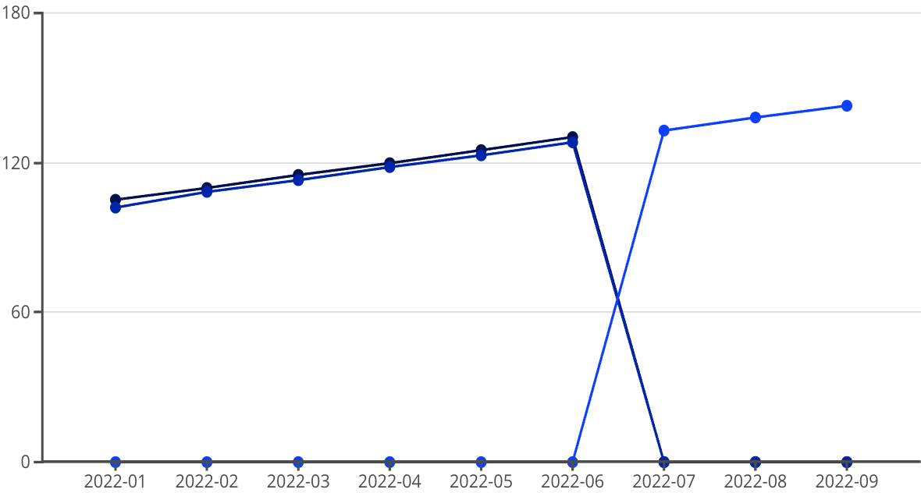
ARIMA Models: Python Implementation
Observed
Fitted
Forecast
import pandas as pd import numpy as np import matplotlib.pyplot as plt from statsmodels.tsa.arima.model import ARIMA from statsmodels.tsa.stattools import adfuller import pmdarima as pm # Load and prepare data data = pd.read_csv('sales_data.csv', parse_dates=['Date'], index_col='Date') ts = data['Sales'] # Determine differencing order using ADF test def determine_d(series, alpha=0.05): d = 0 test_result = adfuller(series) while test_result[1] > alpha and d < 2: d += 1 series = series.diff().dropna() test_result = adfuller(series) return d # Find optimal p, d, q automatically model = pm.auto_arima(ts, seasonal=False, trace=True, error_action='ignore', suppress_warnings=True, stepwise=True) print(f"Best ARIMA model: {model.order}") # Fit final model p, d, q = model.order arima_model = ARIMA(ts, order=(p, d, q)) results = arima_model.fit() print(results.summary()) # Forecast future values forecast_steps = 12 forecast = results.forecast(steps=forecast_steps) forecast_index = pd.date_range(start=ts.index[-1], periods=forecast_steps+1, freq='M')[1:] forecast_series = pd.Series(forecast, index=forecast_index) # Plot results plt.figure(figsize=(12, 6)) plt.plot(ts, label='Observed') plt.plot(results.fittedvalues, color='red', label='Fitted') plt.plot(forecast_series, color='green', label='Forecast') plt.fill_between(forecast_index, forecast - 1.96 * np.sqrt(results.prediction_variance), forecast + 1.96 * np.sqrt(results.prediction_variance), color='green', alpha=0.2) plt.legend() plt.title(f'ARIMA{model.order} Forecast') plt.show()

Slide 35
Seasonal ARIMA (SARIMA) Models: Framework
p,d,q
P,D,Q
s
Non-seasonal Components
Seasonal Components
Seasonal Period
Standard ARIMA parameters for regular (non-seasonal) patterns
Additional parameters for modeling seasonal patterns
Length of the seasonal cycle (e.g., 12 for monthly data)
The SARIMA model, denoted as SARIMA(p,d,q)(P,D,Q)s, extends ARIMA to incorporate seasonal patterns through additional seasonal autoregressive, differencing, and moving average components. Using backshift operator notation, the model can be written as:
φ(B)Φ(Bs)(1-B)d(1-Bs)DYt = c + θ(B)Θ(Bs)εt
Where:
φ(B) is the non-seasonal AR polynomial of order p
Φ(Bs) is the seasonal AR polynomial of order P
θ(B) is the non-seasonal MA polynomial of order q
Θ(Bs) is the seasonal MA polynomial of order Q

Slide 36
SARIMA Models: Identification and Estimation
Identify Seasonal Period
Determine the seasonal frequency (s) of the data
Test for Stationarity
Check both regular and seasonal stationarity
3
Apply Differencing
Use regular and/or seasonal differencing as needed
Select Model Orders
Determine p, d, q, P, D, Q using ACF/PACF analysis
Estimate Parameters
Fit the model using maximum likelihood estimation
Identifying appropriate orders for a SARIMA model is more complex than for non-seasonal models, as we need to examine both regular and seasonal patterns in the ACF and PACF. Key patterns to look for:
Regular AR(p): Decay in ACF, cut-off after lag p in PACF
Regular MA(q): Cut-off after lag q in ACF, decay in PACF
Seasonal AR(P): Decay in seasonal lags of ACF, cut-off after lag P×s in PACF
Seasonal MA(Q): Cut-off after lag Q×s in ACF, decay in seasonal lags of PACF

Slide 37
SARIMA Models: Python Implementation
import pandas as pd import numpy as np import matplotlib.pyplot as plt from statsmodels.tsa.statespace.sarimax import SARIMAX from statsmodels.graphics.tsaplots import plot_acf, plot_pacf from statsmodels.tsa.seasonal import seasonal_decompose # Load and prepare data data = pd.read_csv('retail_sales.csv', parse_dates=['Date'], index_col='Date') ts = data['Sales'] # Perform seasonal decomposition to confirm seasonality decomposition = seasonal_decompose(ts, model='multiplicative') fig = decomposition.plot() plt.tight_layout() plt.show() # Determine optimal parameters # For illustration, we'll use SARIMA(1,1,1)(1,1,1)12 for monthly data p, d, q = 1, 1, 1 P, D, Q, s = 1, 1, 1, 12 # Fit SARIMA model model = SARIMAX(ts, order=(p, d, q), seasonal_order=(P, D, Q, s), enforce_stationarity=False, enforce_invertibility=False) results = model.fit() print(results.summary()) # Diagnostic checking residuals = results.resid fig, axes = plt.subplots(2, 2, figsize=(15, 8)) axes[0, 0].plot(residuals) axes[0, 0].set_title('Residuals') axes[0, 1].hist(residuals, bins=30) axes[0, 1].set_title('Residual Distribution') plot_acf(residuals, ax=axes[1, 0]) plot_pacf(residuals, ax=axes[1, 1]) plt.tight_layout() plt.show() # Forecasting forecast_steps = 24 forecast = results.get_forecast(steps=forecast_steps) forecast_index = pd.date_range(start=ts.index[-1], periods=forecast_steps+1, freq='M')[1:] forecast_mean = forecast.predicted_mean forecast_ci = forecast.conf_int() # Plot forecasts plt.figure(figsize=(12, 6)) plt.plot(ts, label='Observed') plt.plot(forecast_mean, color='red', label='Forecast') plt.fill_between(forecast_index, forecast_ci.iloc[:, 0], forecast_ci.iloc[:, 1], color='pink', alpha=0.3) plt.legend() plt.title(f'SARIMA({p},{d},{q})({P},{D},{Q}){s} Forecast') plt.show()

Slide 38
Transfer Function Models: Introduction
Basic Concept
Mathematical Representation
Applications
Transfer function models extend univariate time series models to incorporate the effect of external variables (inputs) on the target series (output). They represent how the input signal is "transferred" to the output with possible time lags and transformations.
A basic transfer function model can be written as:
Economic forecasting (e.g., impact of interest rates on housing prices)
Yt = v(B)Xt + Nt
Environmental modeling (e.g., relationship between rainfall and river flow)
Where:
Yt is the output series
Marketing analysis (e.g., effect of advertising on sales)
Xt is the input series
v(B) is the transfer function operator
Process control in manufacturing
These models are particularly valuable when there are known external factors influencing the time series of interest, allowing for more accurate forecasting and better understanding of system dynamics.
Biological systems modeling
Nt is the noise component, typically modeled as an ARIMA process

Slide 39










Transfer Function Models: Specification and Estimation
Cross-Correlation Analysis
Prewhitening
Identify transfer function structure using CCF between prewhitened series
Transform input series to white noise and apply same transformation to output
Model Specification
Determine the orders of numerator and denominator polynomials
Diagnostic Checking
Validate model adequacy through residual analysis
Parameter Estimation
Fit the model using maximum likelihood estimation
The general form of a transfer function model with multiple inputs can be written as:
Yt = ∑i=1k [ωi(B)/δi(B)]BbiXit + [θ(B)/φ(B)]εt
Where ωi(B) and δi(B) are polynomials in the backshift operator, bi represents the delay, and the last term represents the ARMA noise process.

Slide 40
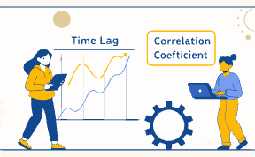


Transfer Function Models: Python Implementation
Identifying Transfer Function Structure
The cross-correlation function (CCF) between prewhitened input and output series helps identify the appropriate transfer function structure, showing the delay and duration of the input's effect on the output.
Impulse Response Analysis
The impulse response function visualizes how the output responds to a unit impulse in the input variable, providing insights into the dynamics of the relationship and the persistence of effects.
Improved Forecasting Performance
Transfer function models typically provide more accurate forecasts than univariate models when there are significant external influences, as they incorporate additional information from predictor variables.
from statsmodels.tsa.statespace.sarimax import SARIMAX # Load data (output and input series) data = pd.read_csv('advertising_sales.csv', parse_dates=['Date'], index_col='Date') y = data['Sales'] # Output series x = data['Advertising'] # Input series # Fit transfer function model # Using SARIMAX with exogenous variables model = SARIMAX(y, exog=x, order=(1,1,1), seasonal_order=(0,0,0,0)) results = model.fit() print(results.summary()) # Create forecasts with future values of input variable future_x = pd.Series([...]) # Future advertising values forecast = results.get_forecast(steps=12, exog=future_x)

Slide 41
Tutorial Questions: Stationary and Linear Processes
1
Stationarity Testing
2
Theoretical Understanding
3
Visual Analysis
Implement the Augmented Dickey-Fuller test on the provided dataset. Report the test statistic, p-value, and conclusion about stationarity. If the series is non-stationary, apply appropriate transformations to achieve stationarity.
For an AR(2) process, the stationarity condition requires that |___| < 1. Fill in the blank and explain the mathematical derivation of this condition using the characteristic polynomial.
Generate three time series: a white noise process, a random walk, and an AR(1) process with φ = 0.8. Plot each series and their respective ACF. Explain the key differences in their behavior and autocorrelation patterns.
4
Analytical Problem
5
Practical Application
Given a linear process Yt = ∑j=0∞ ψjεt-j with ψj = 0.5j, calculate the mean, variance, and autocorrelation function at lag 1 and lag 2.
Using the provided economic dataset, test if the logarithmic transformation followed by first differencing achieves stationarity. Compare this approach with direct first differencing without logarithmic transformation. Which approach is more appropriate and why?

Slide 42




Tutorial Questions: AR, MA, and ARMA Models
Model Identification
Given the ACF and PACF plots of a time series, determine the appropriate model (AR, MA, or ARMA) and its order. Justify your answer based on the pattern observed in the plots.
Simulation Exercise
Write Python code to simulate an ARMA(2,1) process with parameters φ1 = 0.7, φ2 = -0.3, and θ1 = 0.5. Generate 1000 observations, plot the series, and calculate its sample ACF and PACF.
True/False with Explanation
3
True or False: "An MA(2) process can be represented as an infinite order AR process if it is invertible." Explain your answer and provide the conditions for invertibility of an MA(2) process.
Parameter Estimation
Using the statsmodels library, fit an ARMA(1,1) model to the provided dataset. Report the estimated parameters, their standard errors, and interpret the model in terms of its autocorrelation structure.
Forecasting Comparison
Compare the forecasting performance of AR(2), MA(2), and ARMA(1,1) models on the given dataset using cross-validation. Calculate RMSE, MAE, and MAPE for each model and discuss which model performs best and why.

Slide 43

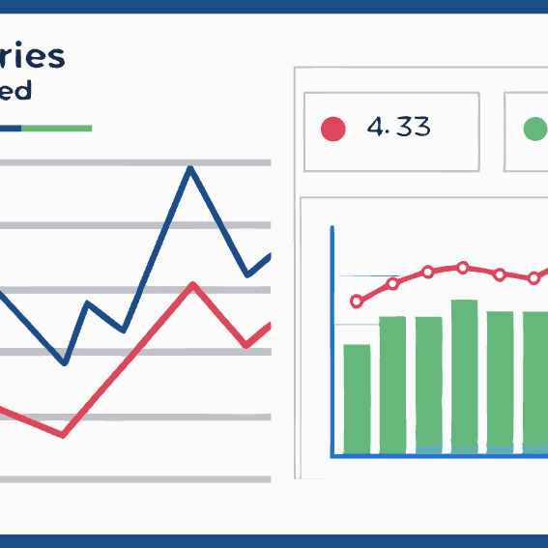
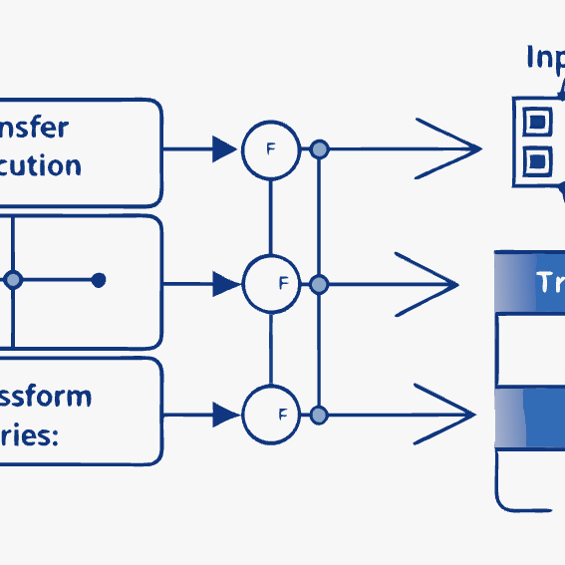
Tutorial Questions: ARIMA, SARIMA, and Transfer Function Models
ARIMA Implementation: Write a function that automatically determines the optimal ARIMA(p,d,q) model for a given time series using AIC. Your function should try different combinations of p, d, and q (with maximum values of 2, 2, and 2 respectively) and return the best model along with its parameters.
Seasonal Analysis: Given monthly retail sales data, identify if seasonality is present. If so, determine the appropriate seasonal period and apply a SARIMA model. Compare the forecasting accuracy with a non-seasonal ARIMA model.
Multiple Choice: Which of the following is NOT a valid approach to handle seasonality? a) Seasonal differencing, b) Including seasonal dummy variables, c) Taking logarithms of the data, d) Using seasonal ARIMA models.
Transfer Function Analysis: Using the provided input series (advertising expenditure) and output series (product sales), develop a transfer function model. Identify the delay in the effect of advertising on sales and estimate the dynamic multiplier effect.
Integrated Process Properties: Explain the difference between a trend-stationary process and a difference-stationary process. How would your modeling approach differ for each type?

Slide 44




Course Summary and Further Resources
Key Textbooks
Python Libraries
Practice Datasets
Advanced Topics
"Time Series Analysis and Its Applications" by Shumway & Stoffer provides an excellent theoretical foundation with R examples. "Forecasting: Principles and Practice" by Hyndman & Athanasopoulos offers a more practical approach with comprehensive online resources.
Extend your skills with specialized Python packages including statsmodels for model fitting, pmdarima for automatic ARIMA modeling, prophet for Facebook's forecasting tool, and sktime for machine learning with time series.
Continue your time series journey by exploring state space models, GARCH for volatility modeling, vector autoregression (VAR), spectral analysis, and deep learning approaches using RNNs and LSTMs for complex time series problems.
Apply your knowledge to public datasets like the M4 Competition data, UCI's time series repository, or domain-specific collections from Kaggle. Real-world applications across finance, weather, energy, and health domains offer rich exploration opportunities.

