Slide 1
Does education have a positive impact on life expectancy?
Yafit Dajan, Amit Edenzon

Slide 2
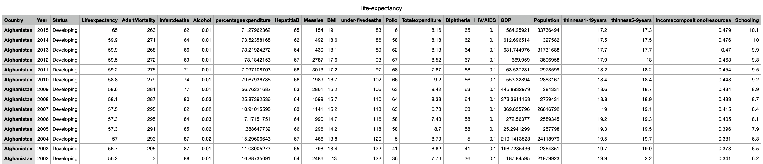
Data

Slide 3
Data
Columns of interest

Slide 4
Steps
1. Ensure data types are appropriate and that there is no missing data
2. Obtain statistical summaries (compute statistics)
3. Find and remove outliers
4. Test the hypothesis
4.1. set confidence level
4.2. test variable distribution
4.3. check for correlation
4.4. test dependencies between variables
4.5. approach hypothesis from different angle
5. Conclude analysis

Slide 5
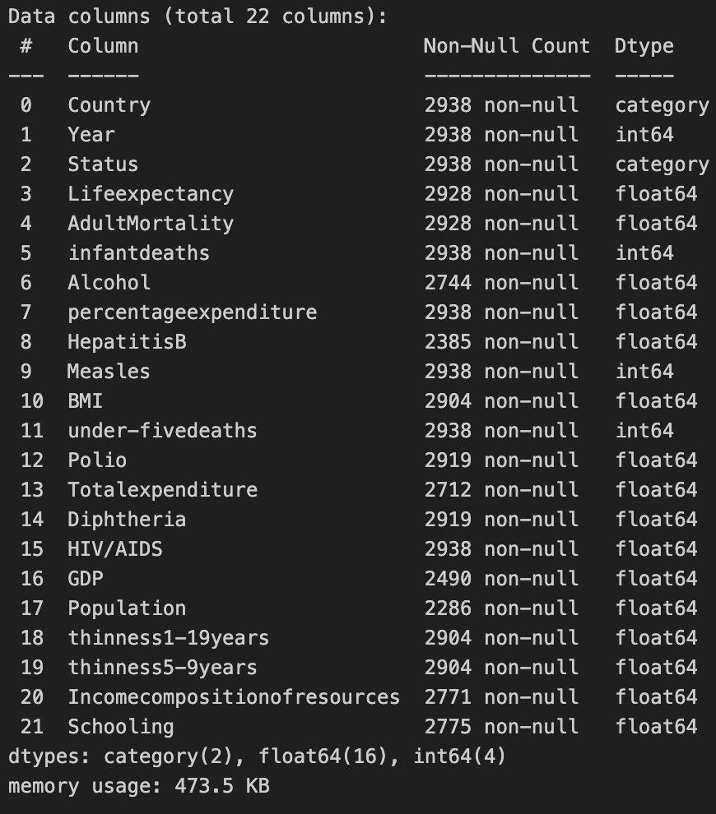
Ensure data types are appropriate
Country’s D-type was originally object, it has been changed to categorical data
Status’s D-type was originally object, it has been changed to categorical data
All the other d-types are numerical and are possible to analyze.

Slide 6
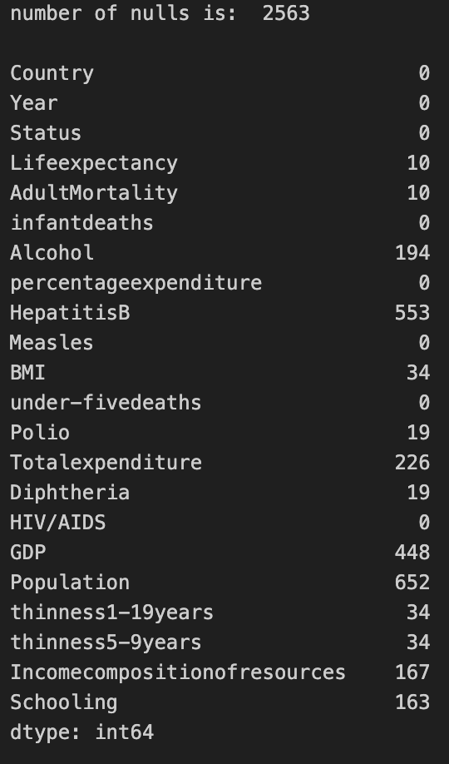

Ensure that there is no missing data
The percentage of missing data (null data) is:
which is less then 5%, so there is no need for imputation, this percent won't effect the overall data.
so we removed all rows with null values in them.

Slide 7
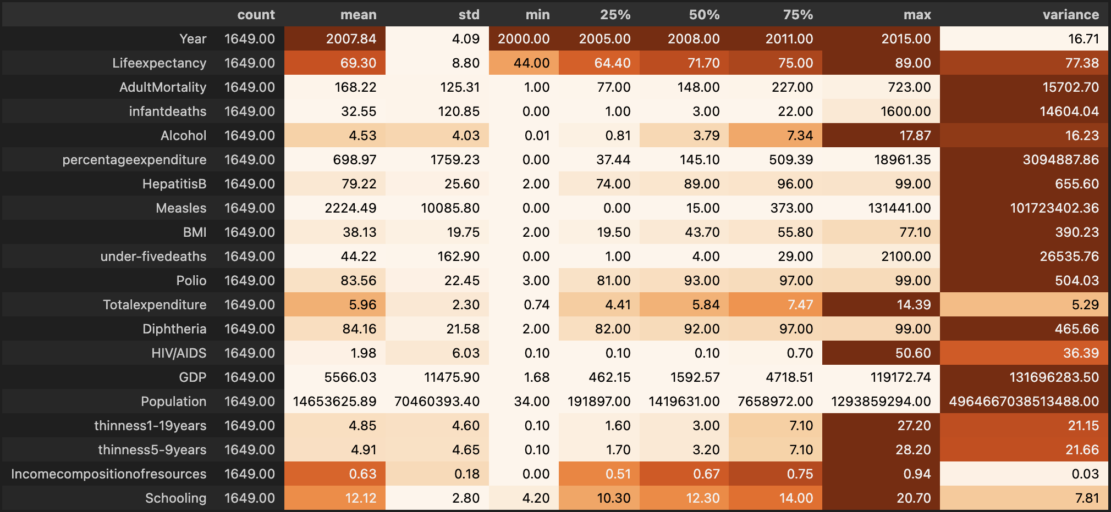
Statistical summaries

Slide 8
Statistical summaries
[0,1] value

Slide 9
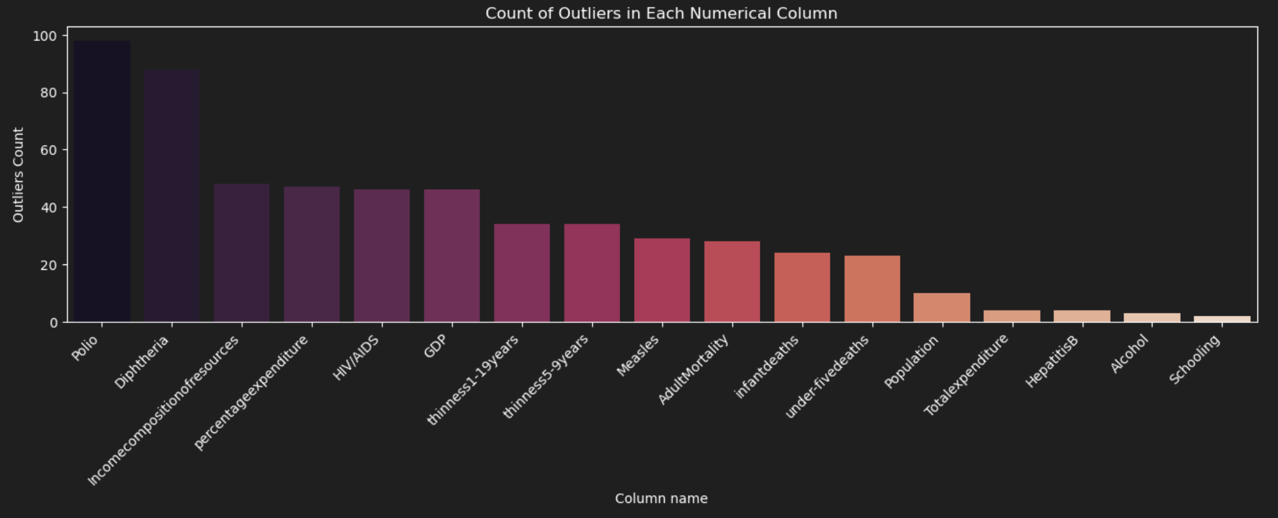
Find and remove outliers

Slide 10

Find and remove outliers
- Outliers are chosen by the 3-sd method [mean – 3sd, mean + 3sd] -

Slide 11
Find and remove outliers
We need to choose how to handle the outliers;
Remove all outliers
Remove only relevant outliers
(-) Risk of removing too much data, if quarter of the data is outliers, maybe it’s not really outliers
(-) Risk of deleting data that is not really outlier, for example if there is a country with an extreme population (big or small) we will delete it’s entire row
(+) Removing all data that can heavily affect our test’s result according to relations/ correlations/ dependencies between variables
(+) Easy to do
(-) Can potentially leave “harmful” data that will impact other tests and divert the data to a “wrong” mean.
(-) More work selecting which outliers to delete, and which to leave
(+) Minimizes risk of deleting fake outliers (like in the population example)
(+) More calculated deletions, asserting that most of the data stays untouched

Slide 12
Find and remove outliers
We need to choose how to handle the outliers;
Remove all outliers
Remove only relevant outliers
(-) Risk of removing too much data, if quarter of the data is outliers, maybe it’s not really outliers
(-) Risk of deleting data that is not really outlier, for example if there is a country with an extreme population (big or small) we will delete it’s entire row
(+) Removing all data that can heavily affect our test’s result according to relations/ correlations/ dependencies between variables
(+) Easy to do
(-) Can potentially leave “harmful” data that will impact other tests and divert the data to a “wrong” mean.
(-) More work selecting which outliers to delete, and which to leave
(+) Minimizes risk of deleting fake outliers (like in the population example)
(+) More calculated deletions, asserting that most of the data stays untouched
We chose the “only relevant” option, so we won’t “harm” the db

Slide 13
Find and remove outliers
Our relevant columns of choice were:
Schooling
Income composition
Rows before removing outliers: 1649
Rows after removing outliers: 1599

Slide 14
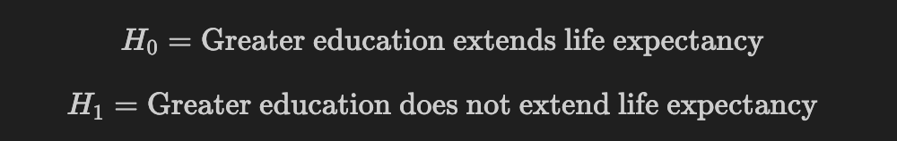
Test the hypothesis
Should we really stay at school?

Slide 15
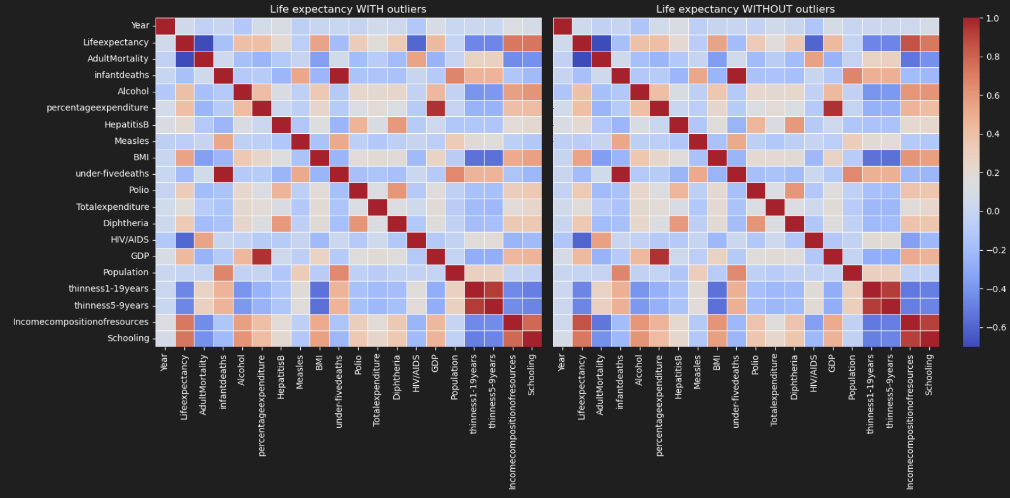
Correlation test

Slide 16
Correlation test
we can see that there is a correlation between Life expectancy and Schooling, but this does not answer our hypothesis, but it does give us a glimpse of knowledge about the relation between our candidates.
in order to answer our hypothesis we need to understand the distribution of our data to know which tests to take (parametric vs non parametric).

Slide 17
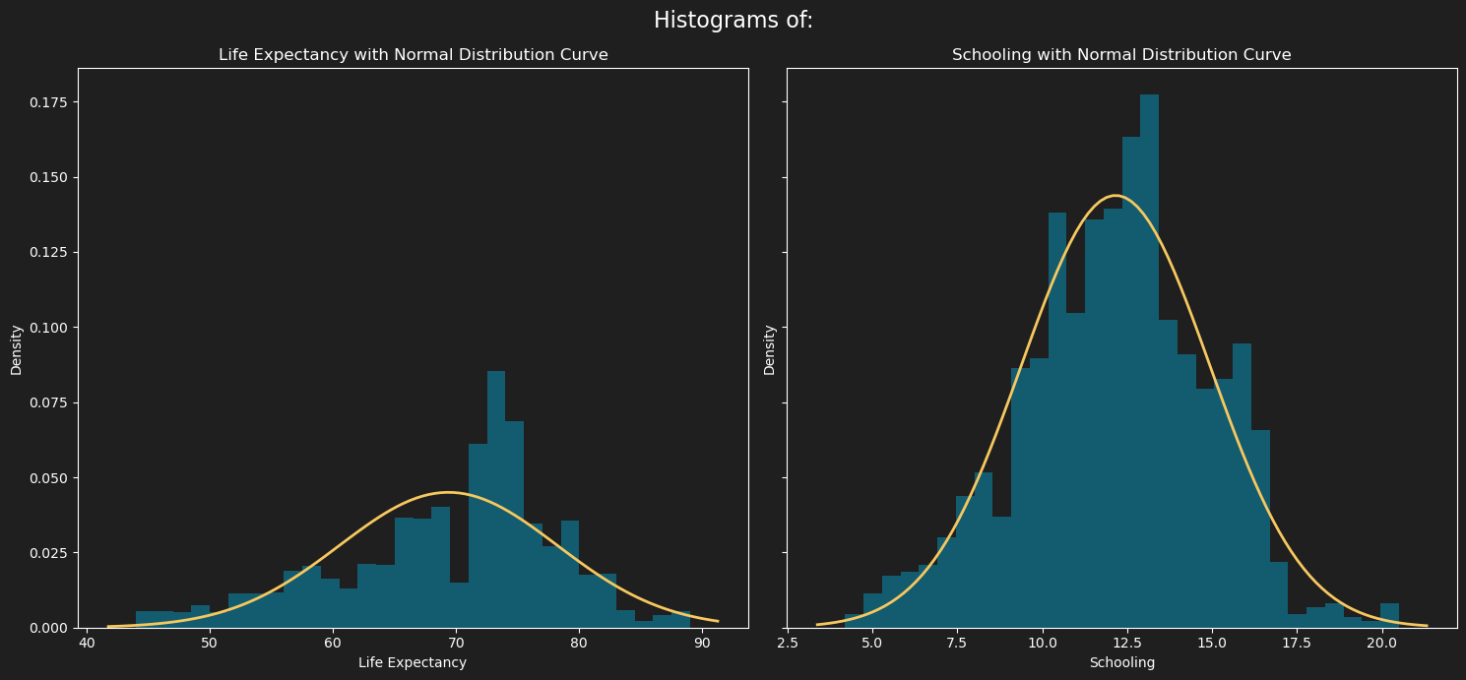
Life expectancy & schooling distribution

Slide 18
Life expectancy & schooling distribution
looks
not related
looks
related

Slide 19
Life expectancy & schooling distribution
In these histograms, we can definitely see that Life expectancy is not normal because it is not centered against the middle and not really following the normal curve,
but Schooling really does fit the normal distribution.
so let's test it!

Slide 20
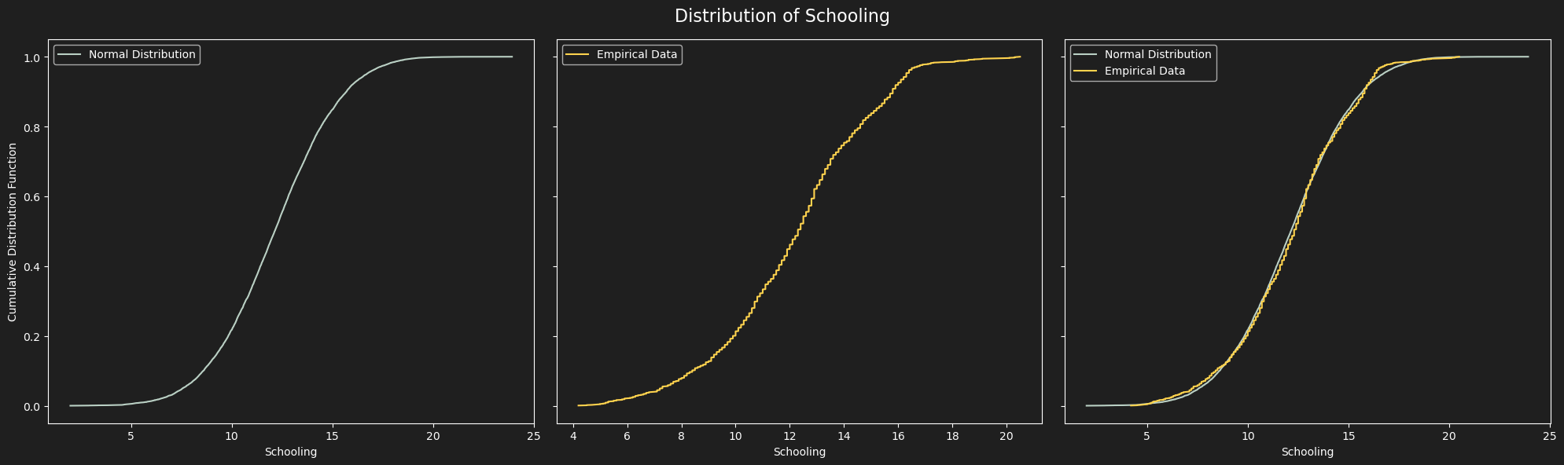
Schooling distribution
normal distribution with the mean and sd from the schooling statistic
empirical data is the data from the db
looks
fitting

Slide 21
Schooling distribution
We went with Kolmogorov-Smirnov test…
p-value is bigger than 0.05, so it denies H₀ – the distribution is not normally distributed, which means H₁ - that schooling indeed is normally distributed!

Slide 22
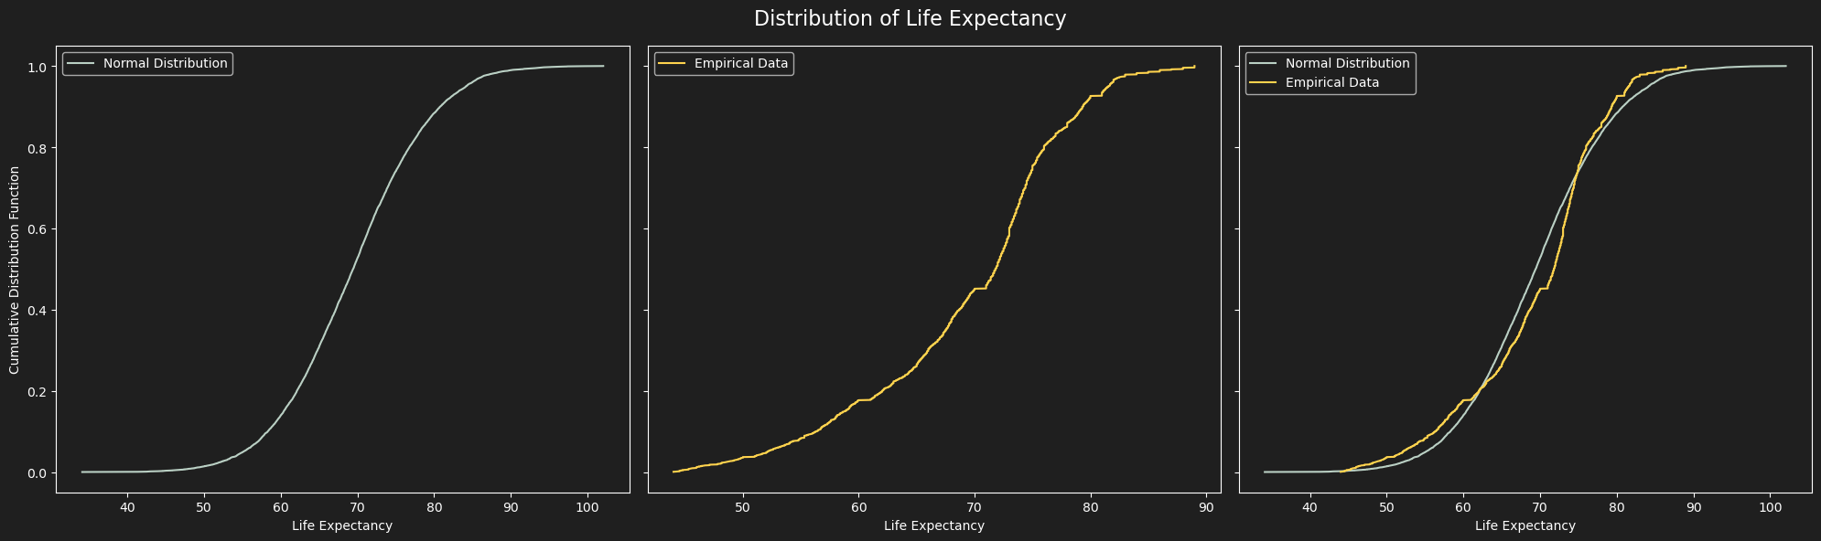
Schooling distribution
normal distribution with the mean and sd from the LE statistic
empirical data is the data from the db
Looks kind of fitting? But not really

Slide 23
Schooling distribution
We went with Kolmogorov-Smirnov test…
p-value is much smaller than 0.05, so it approves H₀ – the distribution is not normal, which means that life expectancy is not normally distributed! (against common sense)

Slide 24
Non parametric tests
because we are trying to find a correlation between normal-distribution and non-normal-distribution datasets, we can't use parametric test.
so in order to test the hypothesis, we will use few non-parametric tests…
Pearson's correlation
Spearman's correlation
Linear regression

Slide 25
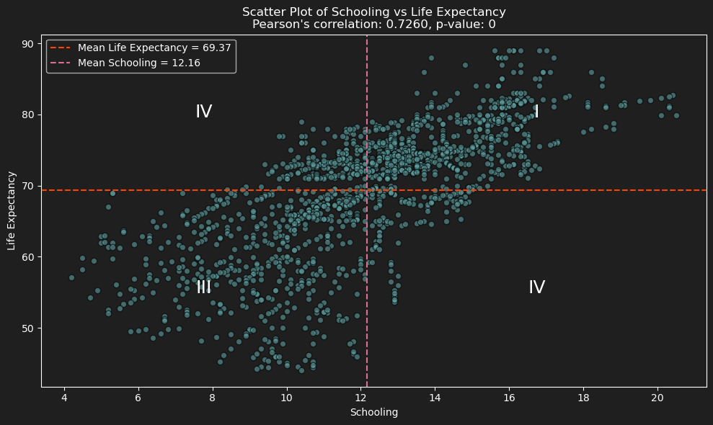
Pearson's correlation coefficient

Slide 26
Pearson's correlation coefficient
Pearson's correlation coefficient is a value between -1, to 1 that indicates the correlation/dependency between two variables, where:
1 means a perfect positive relation
0 means no relation
-1 means a perfect negative relation
we can see that most of our data is in quarters I & III, which means that Pearson's correlation coefficient is going to be positive (of course we already calculated it...)
our coefficient is 0.7276 which indicates high positive correlation, meaning:

Slide 27
Spearman's correlation coefficient
Spearman’s test results:
correlation: 0.7713271306591092
p-value: 1.02862914e-315
Correlation is even a little higher than Pearson’ coefficient, which empowers the strong positive relation between schooling and life expectancy.
The p-value is almost 0 because the H₀ in Spearman’s test is that there is no relation between the variables so we must accept H₁ - the variables have correlation.
Now that we know that there is a correlation between schooling and life expectancy, let’s apply linear regression and try to find a prediction formula.

Slide 28
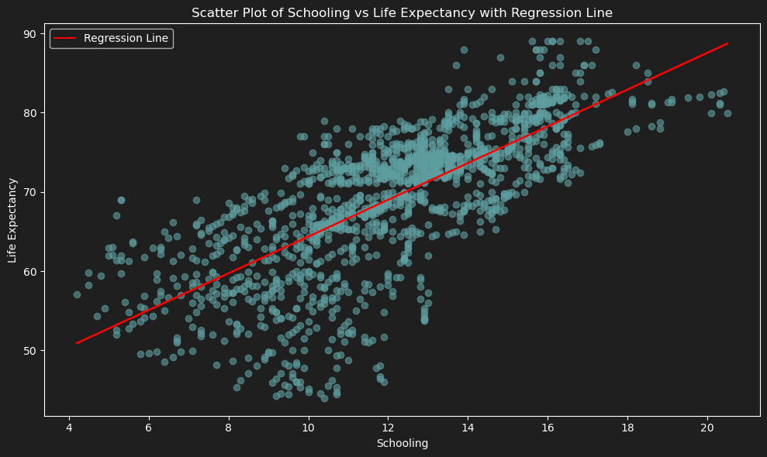
Linear regression

Slide 29
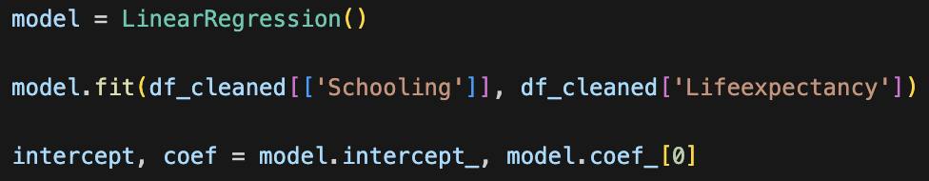

Linear regression
The data scatter does seem to follow a linear regression, so let's calculate the linear regression equation.
And the result is:

Slide 30
Linear regression
The data scatter does seem to follow a linear regression, so let's calculate the linear regression equation.
And the result is:
Intercept
coef

Slide 31
Linear regression
Predicted life expectancy for schooling of 15 years (highschool + bachelor’s degree): 75.9
Predicted life expectancy for schooling of 17 years (highschool + bachelor’s degree + master’s degree): 82.92
guess it is a good thing that we are here...

Slide 32
Real world relation
A relation between schooling and life expectancy is proven, but why is it?
does higher schooling predicts high income which affects life expectancy for the good?
We have another interesting column in our dataset, Income composition of resources:
Human Development Index in terms of income composition of resources (index ranging from 0 to 1), in other words, it just means income level after normalization.
Let's try and find a connection between all three...

Slide 33
Real world relation
but this actually makes sense!
Education equips individuals with knowledge about healthy lifestyles, disease prevention, and the importance of regular medical care, improving overall health and life expectancy.
Higher income individuals can afford medications and advanced medical procedures, which contribute to better health outcomes and longer life expectancy.
Higher income can minimize financial stress and provide resources for leisure activities, exercise, and relaxation.
Lower stress levels and healthier lifestyle choices, such as balanced diets and physical activity which all lead to longer life expectancy.
theory aside, let's test it.

Slide 34
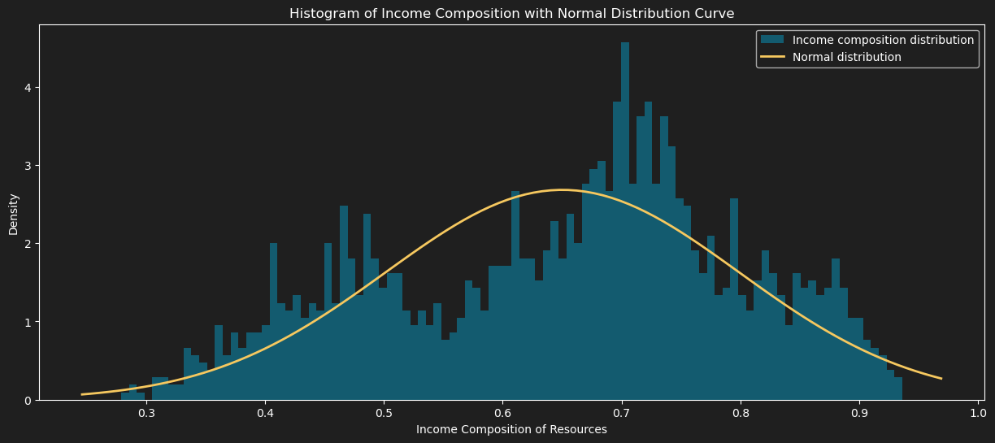
Income composition distribution

Slide 35
Income composition distribution
not even close…
p-value is much smaller than 0.05, so it approves H₀ – the distribution is not normal, which means that income composition of resources is not normally distributed!

Slide 36
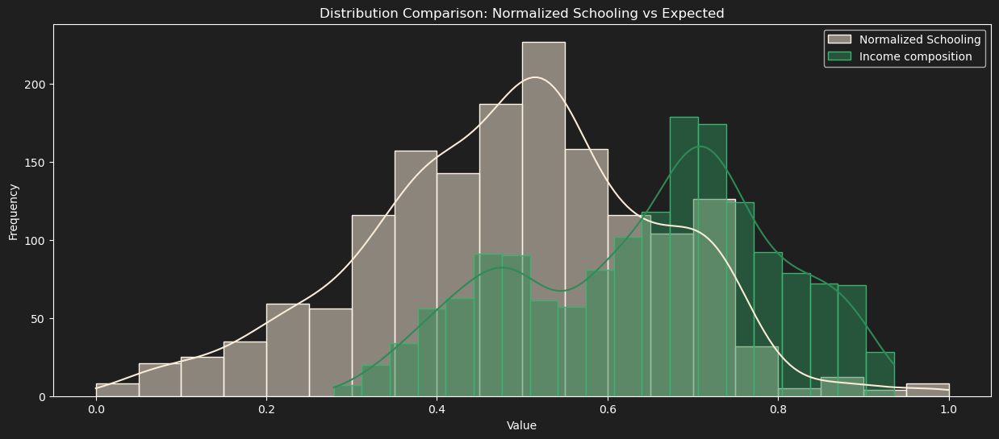
Non parametric tests
the graphs are a lot alike, they just need some adjustment so its easier to see, and as we know,
movement does not affect any correlation…

Slide 37
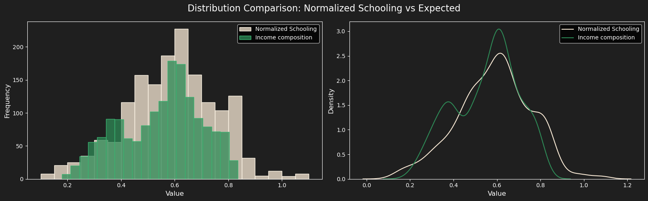
Non parametric tests

Slide 38
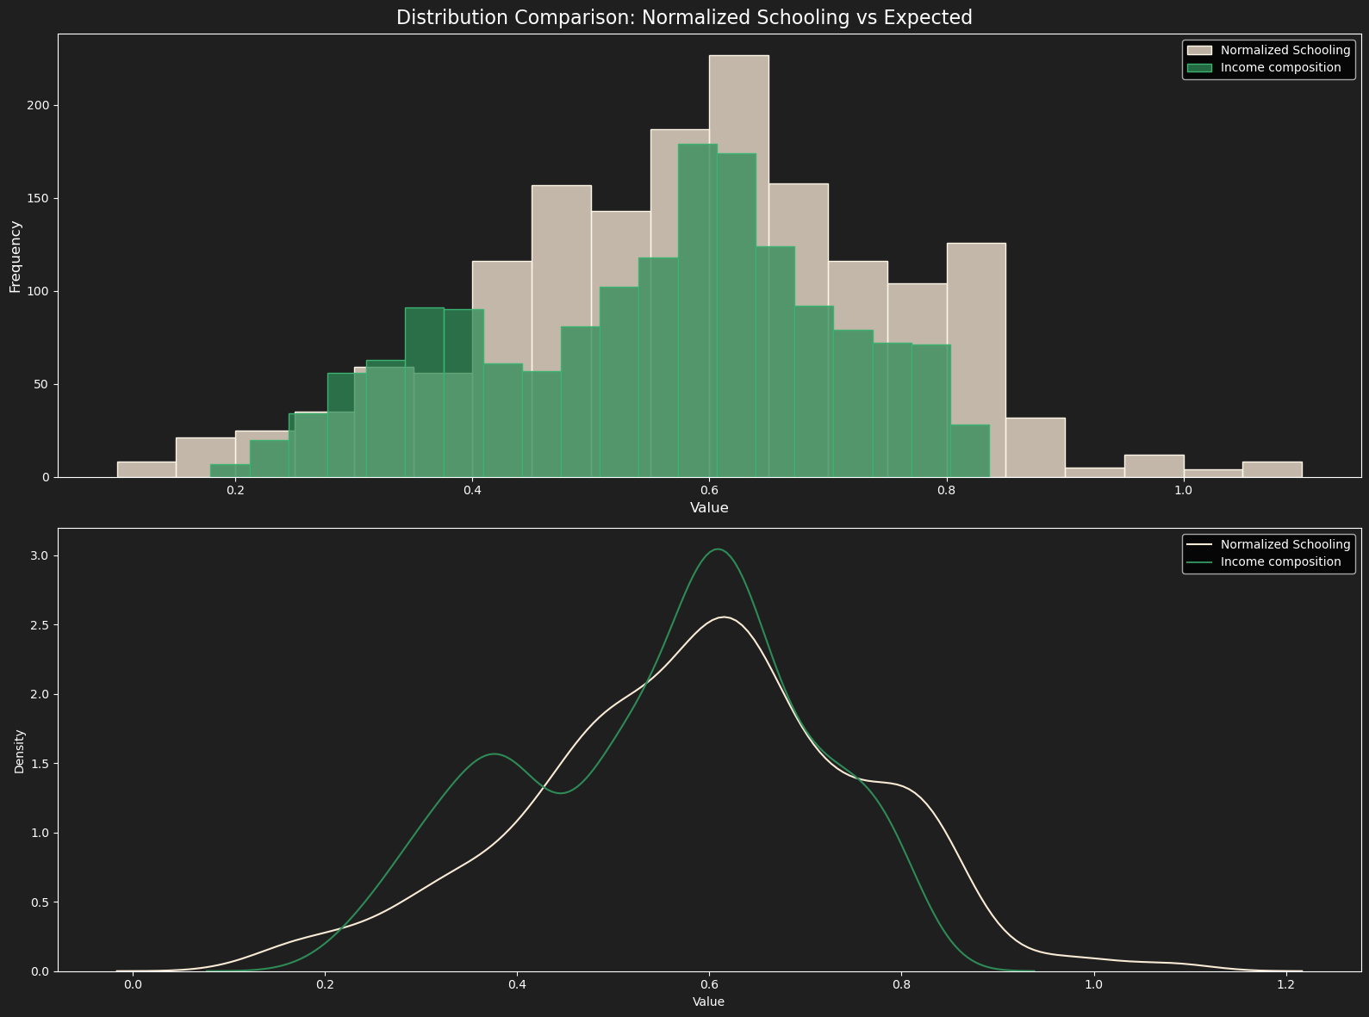
Non parametric tests
We can see that the only statistically significant difference between the expected frequencies (Income composition) and the observed (schooling) is near 0.35
But other than that, they seem pretty dependent on one another, so let's perform chi-squared.

Slide 39
Non parametric tests
We can see that the only statistically significant difference between the expected frequencies (Income composition) and the observed (schooling) is near 0.35
But other than that, they seem pretty dependent on one another, so let's perform chi-squared.

Slide 40
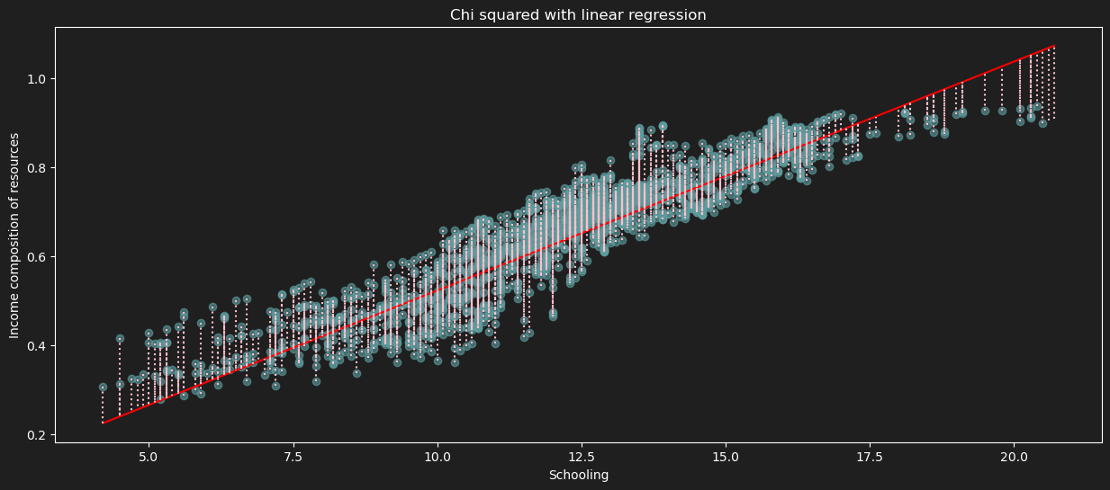
Chi – squared

Slide 41
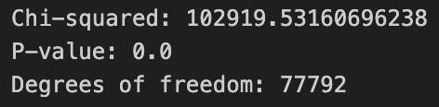
Chi – squared
Chi – squared results are:
our p-value is 0, meaning that there is no statistically significant difference between schooling and income composition, so it proves that schooling and income composition are dependent on each other, so let's apply linear regression to visually see the relation.

Slide 42
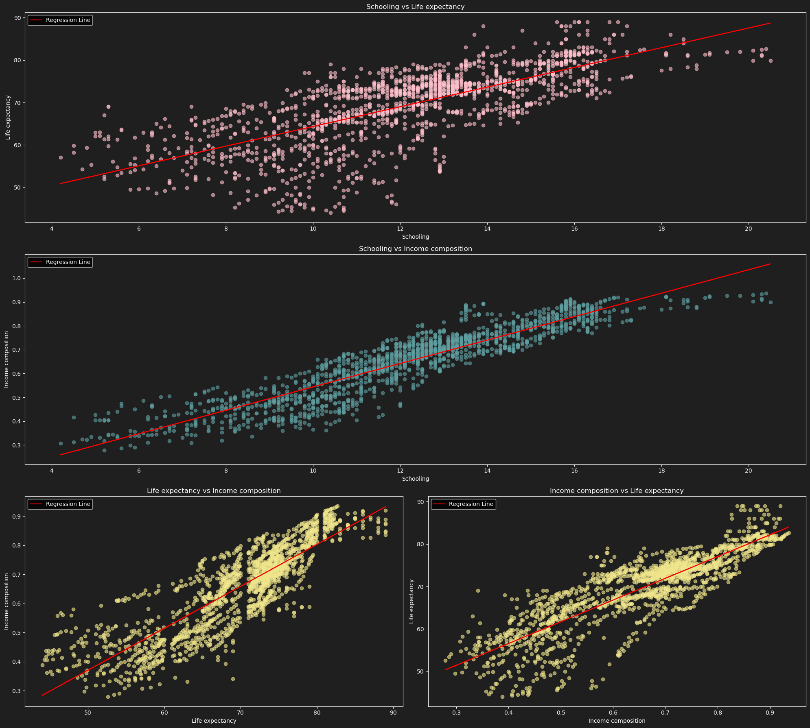
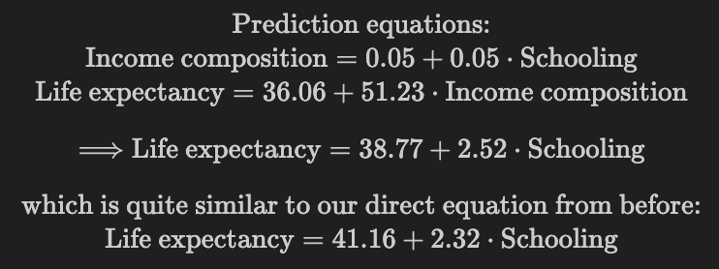
Linear regression ( between all columns of interest )
These linear regressions prove that there is a relation between all three variables: Schooling, Income composition and Life expectancy!
The outcomes of the linear regressions are:

Slide 43
Linear regression ( between all columns of interest )
These linear regressions prove that there is a relation between all three variables: Schooling, Income composition and Life expectancy!
The outcomes of the linear regressions are:
There are the same graphs just flipped between the X-axis and Y-axis to see the correlation between life expectancy x income composition both ways.

Slide 44
Conclusion
In conclusion, at a confidence level of 95%, where schooling is normally distributed, we found a direct positive relation between schooling and life expectancy.
We also found that schooling has a positive correlation with income, and income has a direct positive relation with life expectancy!
so stay in school, earn more, live longer :)

Slide 45
Future Hypothesis
Find correlation between other features and life expectancy
Strengthen the conclusion results by using other tests (maybe normalize the life expectancy, and perform parametric tests, that have stronger results).
Find a exercise to life expectancy dataset and join them to get a more efficient way to improve life expectancy, and to find balance.

