Slide 1
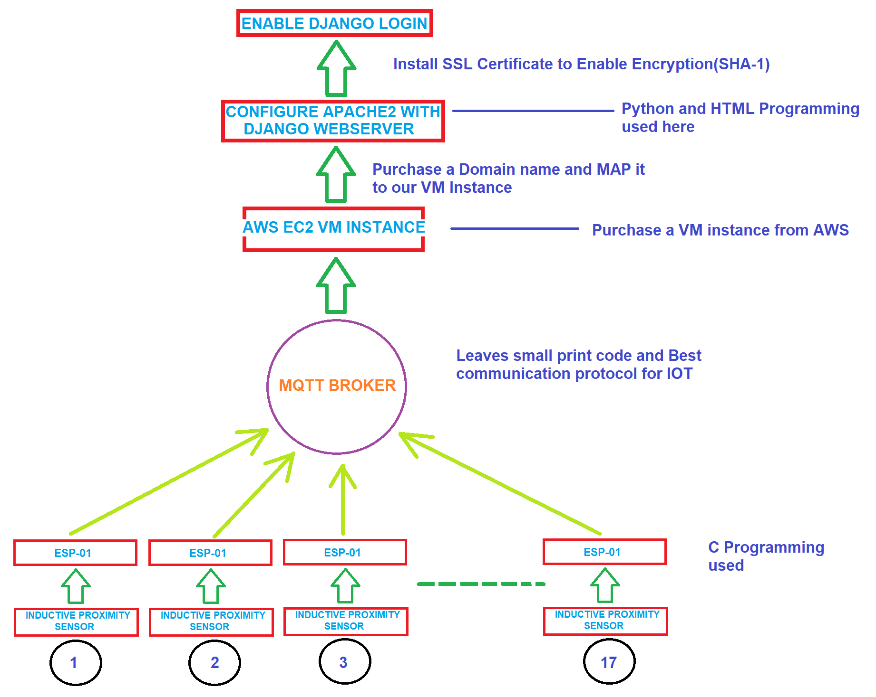
PROTOTYPE DESIGN FOR THIS JOB

Slide 2
COMPONENTS USED:
ESP-01:-Cheapest Wifi Module
Inductive Proximity sensor:-Robust, No touch needed, can detect holes. Best sensor for drilling purposes.
PCB Design:-Low Electrical Noise, No chance of loose connection or short circuit, Compact size, Low chance of Error
Logic level converters(According to used modules)
Configuring Apache2 with Django:- It is very stable , gives high performance and fastest way to implement as compared to Enginx with Django or with Wordpress.
AWS EC2 VM Instance:- Flexible to use, cheaper as compared to Google Cloud, Microsoft Azure etc..
MQTT:- Lightweight messaging protocol for use in cases where clients need a small code footprint.
MQTT uses transport layer security (TLS) encryption with username password protected connections.
Optional certification can also be used that requires clients to provide certificate file that matches with the server’s.
A subscriber can subscribe to multiple publishers

Slide 3
BUDGET Details:
ESP-01*17--------------------------------------------------------------------$1.5*17=$25.5-30
Inductive Proximity Sensors*17------------------------------------------$3*17=$51-60
Domain name from GODaddy.com with SSL certificate-------------$6(per year)
AWS EC2 VM instance------------------------------------------------------$0(Free for 1 year)
PCB Printing*17--------------------------------------------------------------$20-25
Labour Cost(As Per Labour Guidelines)
TOTAL BUDGETS:$102.5-121

Slide 4
Total Working Days To Implement:
Prototype Development:5-6 Days
Hardware(ESP-01, Proximity Sensor and Logic converters) Implementation on Drill Machines:6-7 Days
Configuring Hardware, Firmware Program to Cloud-4-5 Days
Testing and Debugging of whole JOB:10-12 Days
PCB designing and Printing: 5-6 Days
Final Implementation and Final Test:4-5 Days
Total Working Days To Implement:34-41 Days

Slide 5
Total Persons to be hired for this JOB and Their SKILLS:
Hardware Engineer(PCB Design)-1
Firmware Engineer(ESP-01)-1
IOT Enginner(AWS, Django web server Design)-1
Total Persons to be hired for this JOB:3

