Slide 1

ST. PAUL’S COLLEGE OF SCIENCE & MANAGEMENT
PROJECT NAME: “RIYA’S BAKERY MANAGEMENT”
Submitted by: RIYA VAISHNAV
Submitted to: Ms. Simran Sharma

Slide 2
CONTENTS
Acknowledgement
Introduction
Problem statement
Objective
Languages used
Software used
Modules
Proposed system
Need for system
Advantages
Disadvantages
Information
Project pictures
Future scope
Conclusion

Slide 3
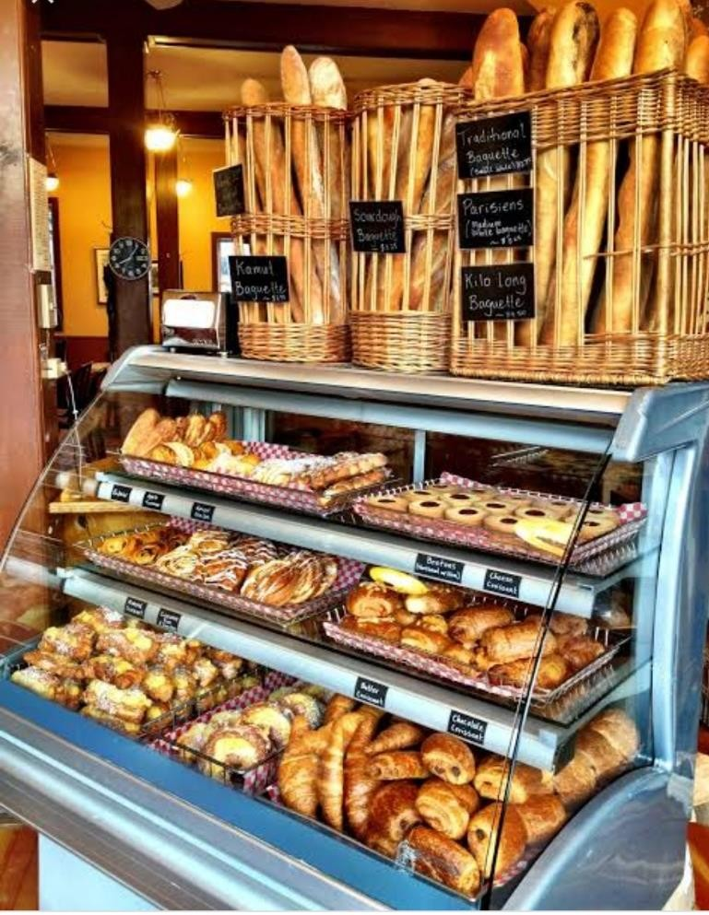
ACKNOWLEDGEMENT
“RIYA’S BAKERY MANAGEMENT”

Slide 4
INTRODUCTION
Baking is a manner of cooking food by exposing it to direct heat or heated stones for long time under controlling temperature.
Baking is not just limited to cakes, breads and biscuits but practically a wide range of sweet and savory foods such as pies, cookies, tarts, Baati (Indian baked bread consumed in north-west region), Rodga (Indian baked bread consumed in east Maharashtra region of india) and snacks can be baked.
It is used as food sweetener.
It is used for introducing chocolate flavor to the food.
They are used for decorating sweet baked products.

Slide 5
PROBLEM STATEMENT
The purpose of website is established fact that internet users are increasing today.
The BAKERY MANAGEMENT has to handle records for many cookies and maintenances was difficult. Thought it has used an information system. It was totally manual.
All the details of the cookies and cake.
A database has been used to enforce constraints and to store data.
Easy to handle and feasible.

Slide 6
OBJECTIVE
The objective of BAKERY MANAGEMENT SYSTEM is to handle entire activity of the bakery.
The system contains database where all the information will be stored safely.
Provides online booking for the food.
Reduce the time.
All the transaction are online.
Proper use of human resources.
Development of the bakery service.

Slide 7
EXITING SYSTEM
Exiting system provides information on about bakery management.
Exiting system guide users properly.
Mannual system.
Limited knowledge.

Slide 8
FRONTEND (LANGUAGE USED)
HTML
CSS

Slide 9
BACKEND
PHP (Server side language)
MYSQL(Database)

Slide 10
SOFTWARE USED
XAMPP SOFTWARE
NOTEPAD++ / SUBLINE TEXT EDITOR

Slide 11
MODULES
User registration page
Login to account
Contact us

Slide 12
PROPOSED SYSTEM
User friendly interface.
Fast access to database.
Less error.
More storage capacity.
Less paper work.
Secured and consistent database.
All transactions are computerized.

Slide 13
NEED FOR SYSTEM
Time consuming.
Maintaining register is complex.
Maintenance tedious work.
Maintain the consistency of database.
It will maintain the record in the database in such a way that it can be easily retrieved back whenever needed.

Slide 14
ADVANTAGES
User friendly.
Complete reports.
Highly flexible.
Highly reliable.
Highly usable.
Simple and easy to use.

Slide 15
DISADVANTAGE
Online system require high-speed internet connectivity.
Risk of computer virus.
Complicated to operate

Slide 16
INFORMATION
The bakery management system provides you with your bakery’s data.
Daily sales, staff, accounting, customer, delivery reports and more can be run on your bakery’s POS system.
Data comparison is another features that will give you a better insight into your ways and methods.
All information is on a single platform and can be accessed from anywhere.
“As a bakery owner, Inventory control and CRM tool are things that are my top priorities in a bakery technology system.”-Riya Vaishnav, Founder, The Riya’s Bakery.

Slide 17
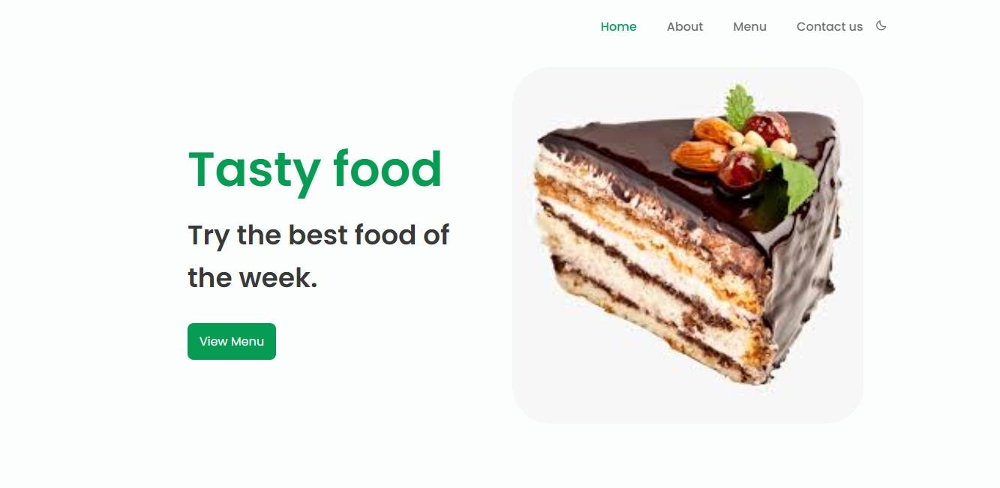
HOME PAGE

Slide 18
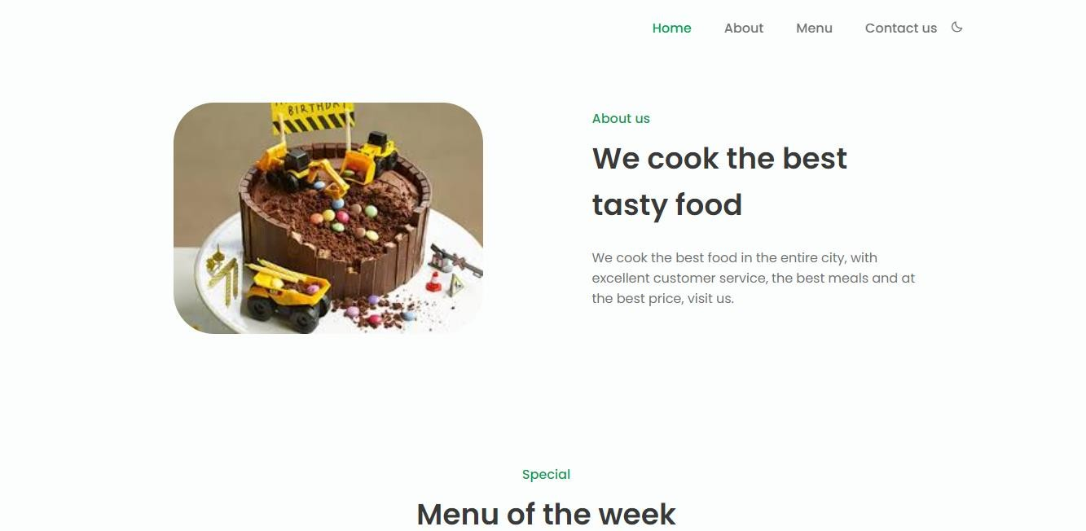
HOME PAGE

Slide 19
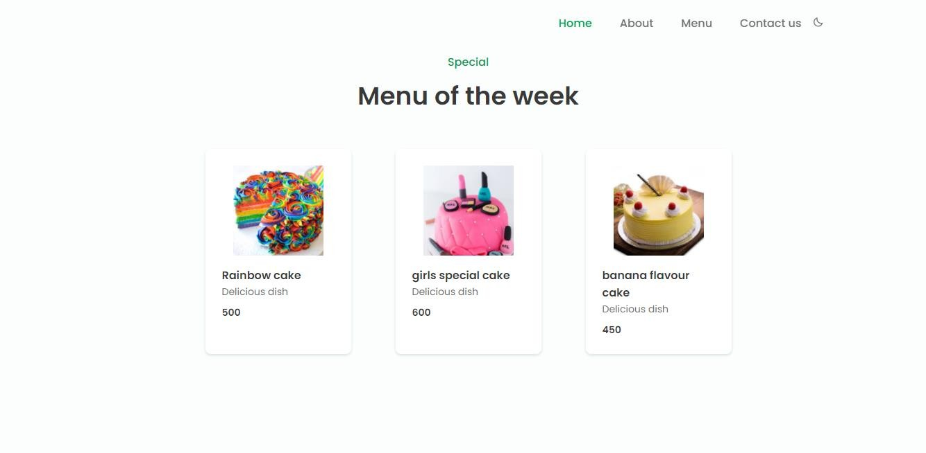
MENU

Slide 20
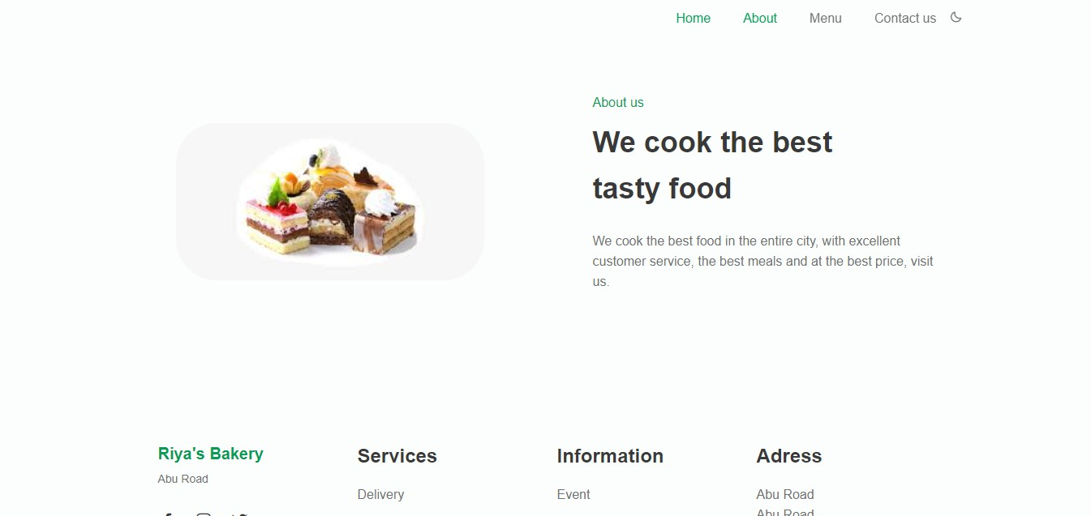
MENU

Slide 21
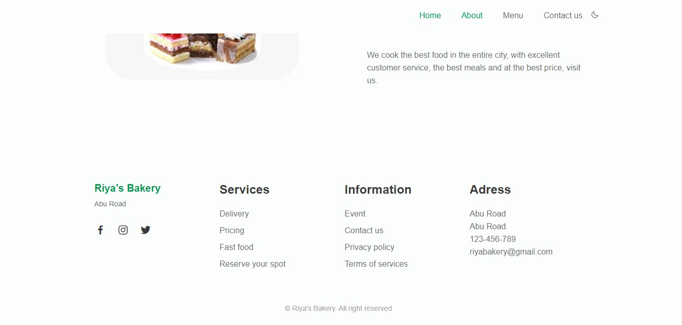
MENU

Slide 22
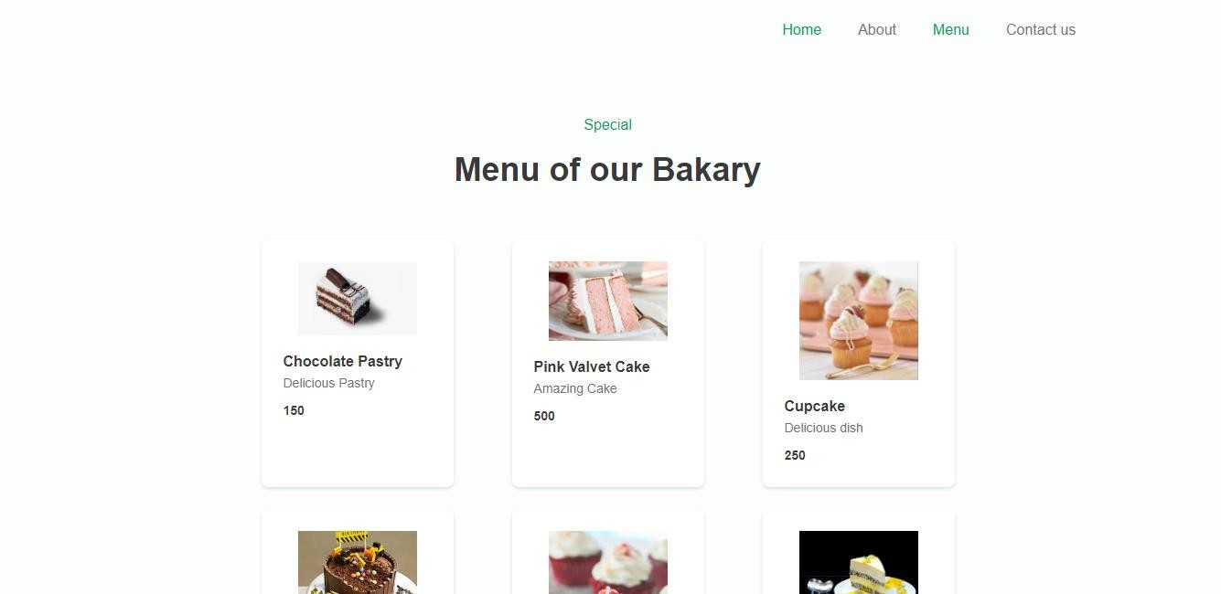
MENU

Slide 23
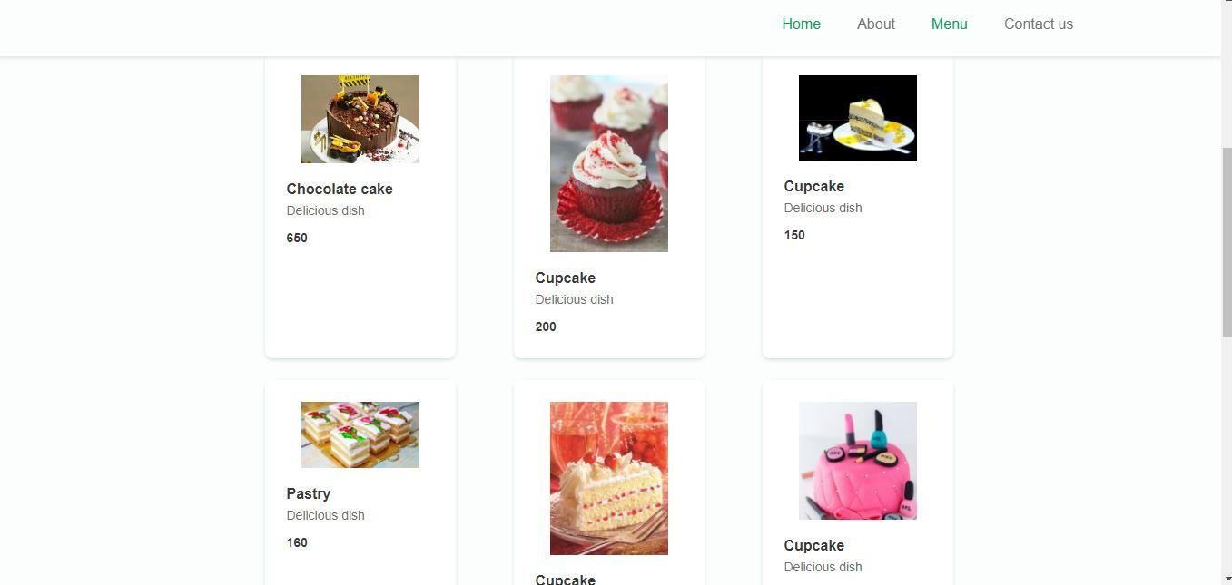
MENU

Slide 24
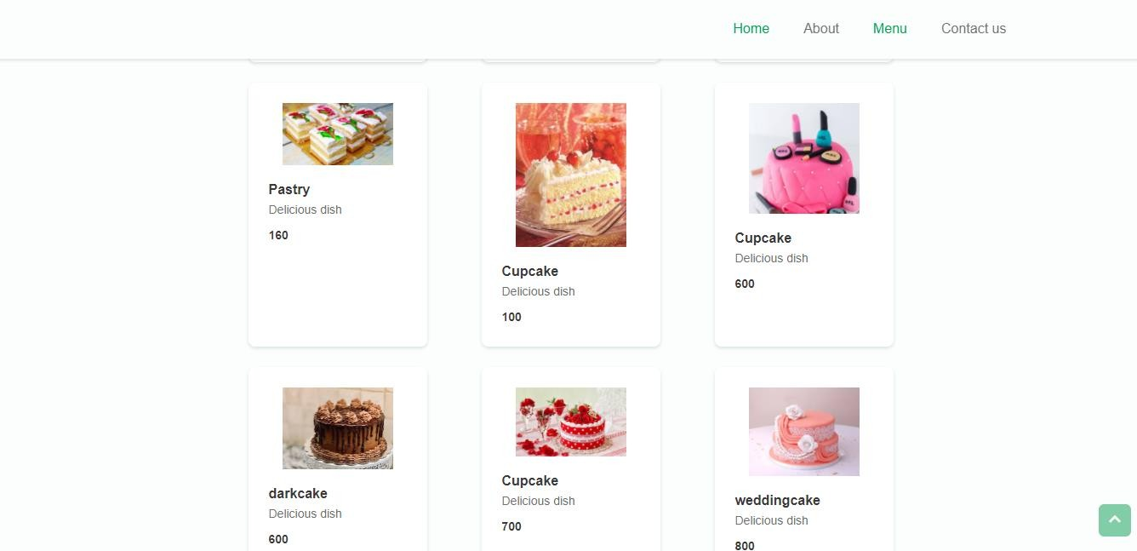
MENU

Slide 25
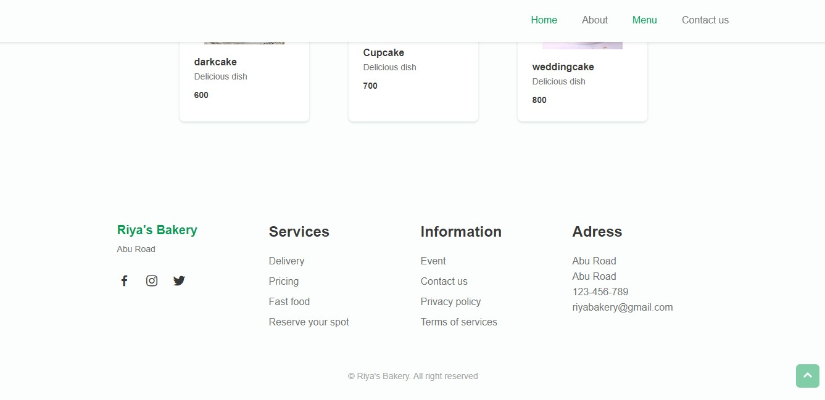
FOOTER SECTION

Slide 26
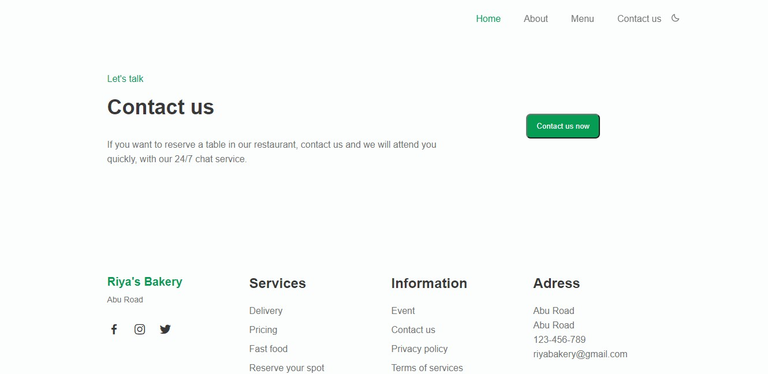
CONTACT US

Slide 27
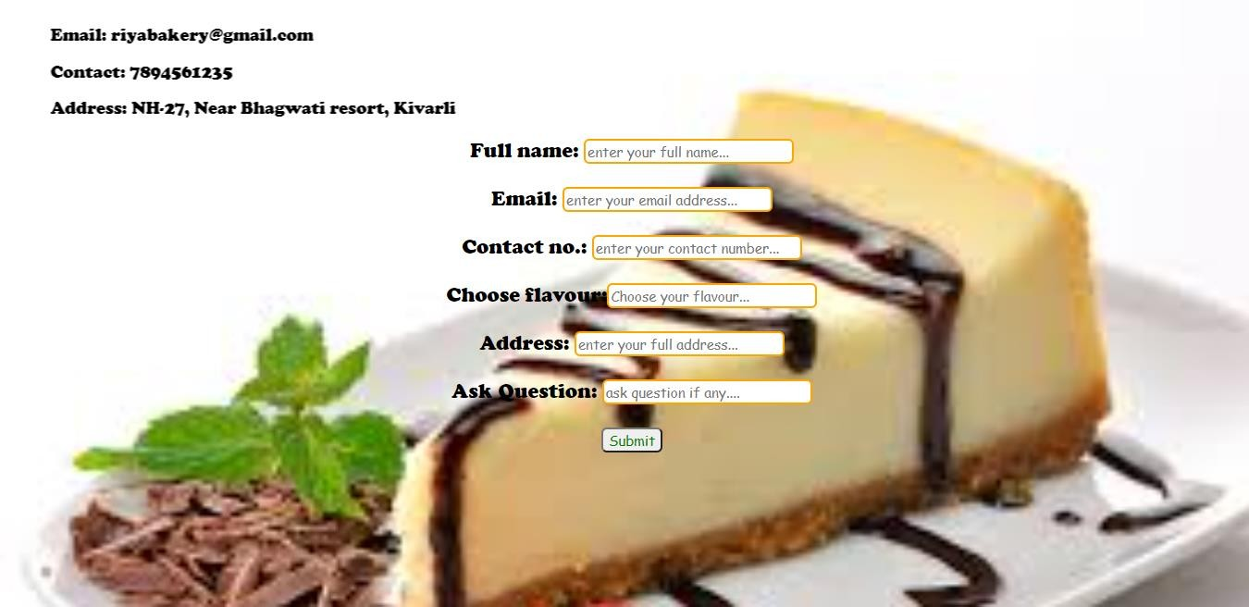
REGISTRATION PAGE

Slide 28
FUTURE SCOPE
We will host the platform on online servers to make accessible worldwide.
We can give more advance software for college website including more facilities.
Integrate multiple load balancers to distribute the loads of the system.
Create the master and slave database structure to reduce the overload of the database queries.
Implement the backup mechanism for taking backup of codebase and database on regular basis on different servers.

Slide 29
CONCLUSION
A description of the background and context of the project and its relation to work already done in the area
Made statement of the aims and objectives of the project.
The description of Purpose, Scope, and applicability.
We define the problem on which we are working in the project.
We describe the requirement specifications of the system and the actions that can be done on these things.
We included features and operations in detail, including screen layouts.

Slide 30
THANK YOU

