Slide 1

ST. PAUL’S COLLEGE OF SCIENCE & MANAGEMENT
PROJECT NAME: SCHOOL MANAGEMENT SYSTEM
SUBMITTED BY: SAKSHI PAL
SUBMITTED TO: MS. SIMRAN SHARMA GUIDED TO: MR. SUNIL SHARMA
ST. PAUL'S COLLEGE OF SCIENCE & MANAGEMENT DEPARTMENT OF BCA

Slide 2
OVERVIEW
Acknowledgement
Introduction
Problem statement
Objective
Languages used
Software used
Modules
Proposed system
Need for system
Advantages
Disadvantages
Information
Project pictures
Future scope
Conclusion

Slide 3
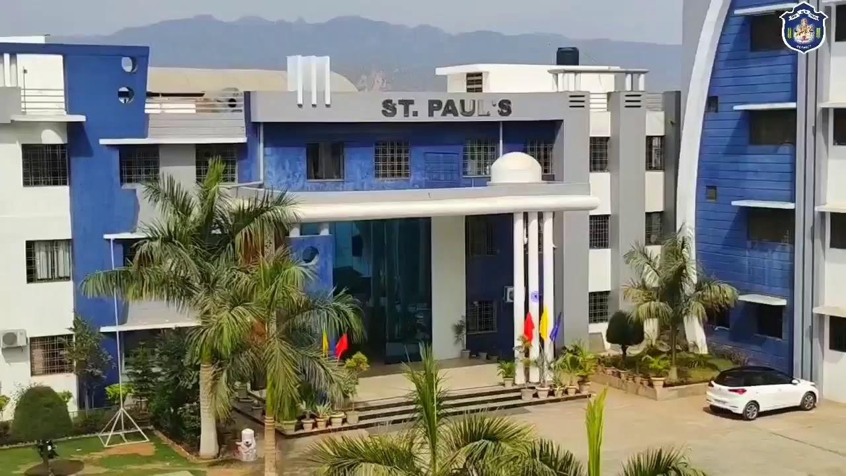
ACKNOWLEDGEMENT
“SCHOOL MANAGEMENT SYSTEM”

Slide 4
INTRODUCTION
SCHOOL MANAGEMENT SYSTEM is a user friendly and atomization website for every school.
To better perform the school administrative activities of educational institute and to assure parents the real-time progress security of there children, educational institutes utilizes School Management software now days.
Enables quick and easy communication between parents, students, and teachers from the web or mobile application.
SCHOOL MANAGEMENT SYSTEM plays an essential role in the current educational system.

Slide 5
PROBLEM STATEMENT
The purpose of website is established fact that internet users are increasing today.
The SCHOOL MANAGEMENT has to handle records for many number of students and maintenances was difficult. Thought it has used an information system. It was totally manual.
All the details of the students are maintained in a single record.
A database has been used to enforce constraints and to store data.
Easy to handle and feasible.

Slide 6
OBJECTIVE
The objective of SCHOOL MANAGEMENT SYSTEM is to handle entire activity of the school.
The system contains database where all the information will be stored safely.
Provides online registration of the admission.
Reduce the time.
All the transaction are online.
Proper use of human resources.
Development of the school service.

Slide 7
LANGUAGES USED
OS: Windows13
Database: MySQL
Frontend: HTML, CSS, JAVASCRIPT
Backend: PHP

Slide 8
SOFTWARE USED
XAMPP SOFTWARE
NOTEPAD++ / VISUAL STUDIO CODE

Slide 9
MODULES
User registration page
Login to account
Contact us

Slide 10
PROPOSED SYSTEM
User friendly interface.
Fast access to database.
Less error.
More storage capacity.
Less paper work.
Secured and consistent database.
All transactions are computerized.

Slide 11
NEED FOR SYSTEM
Time consuming.
Maintaining register is complex.
Maintenance tedious work.
Maintain the consistency of database.
It will maintain the record in the database in such a way that it can be easily retrieved back whenever needed.

Slide 12
ADVANTAGES
User friendly.
Complete reports.
Highly flexible.
Highly reliable.
Highly usable.
Simple and easy to use.

Slide 13
DISADVANTAGES
Online system require high-speed internet connectivity.
Risk of computer virus.
Complicated to operate.

Slide 14
INFORMATION
Teacher information
A SCHOOL MANAGEMENT SYSTEM not only gives information about information. It can provide real-time information about teacher activities also.
School administrator can access a particular teachers class schedule, daily reports of the teacher etc.
With the help of artificial intelligences SCHOOL MANAGEMENT SYSTEM can even monitor the performance of teachers and give real-time suggestions to improve the teaching quality.

Slide 15
INFORMATION
Student information
Attendance, homework, discipline, grades and achievements! Every information that is related to students can be easily accessed using a SCHOOL MANAGEMNT SYSTEM.
The student database in a SCHOOL MANAGEMENT SYSTEM contains much information about students such a their Examination grades, Parental information, Medical history, Details related to school fee etc.

Slide 16
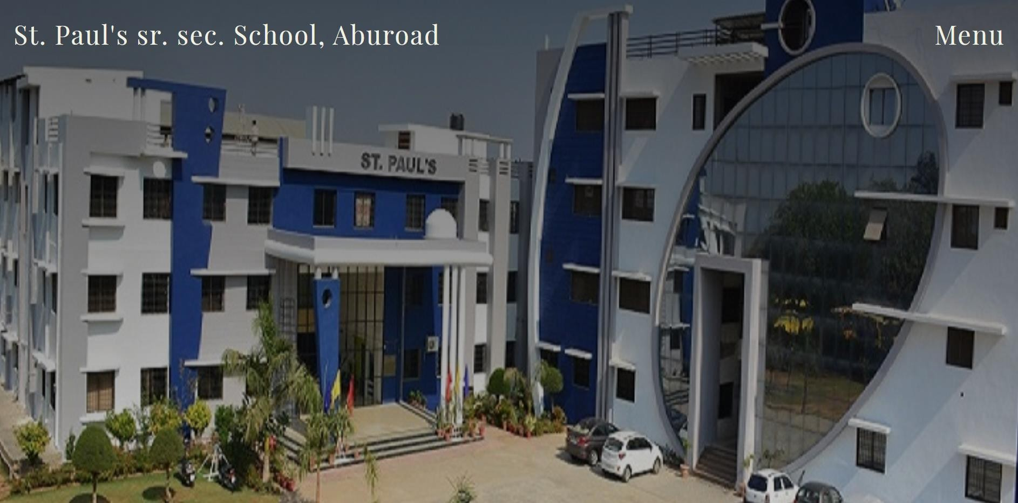
FRONT PAGE

Slide 17
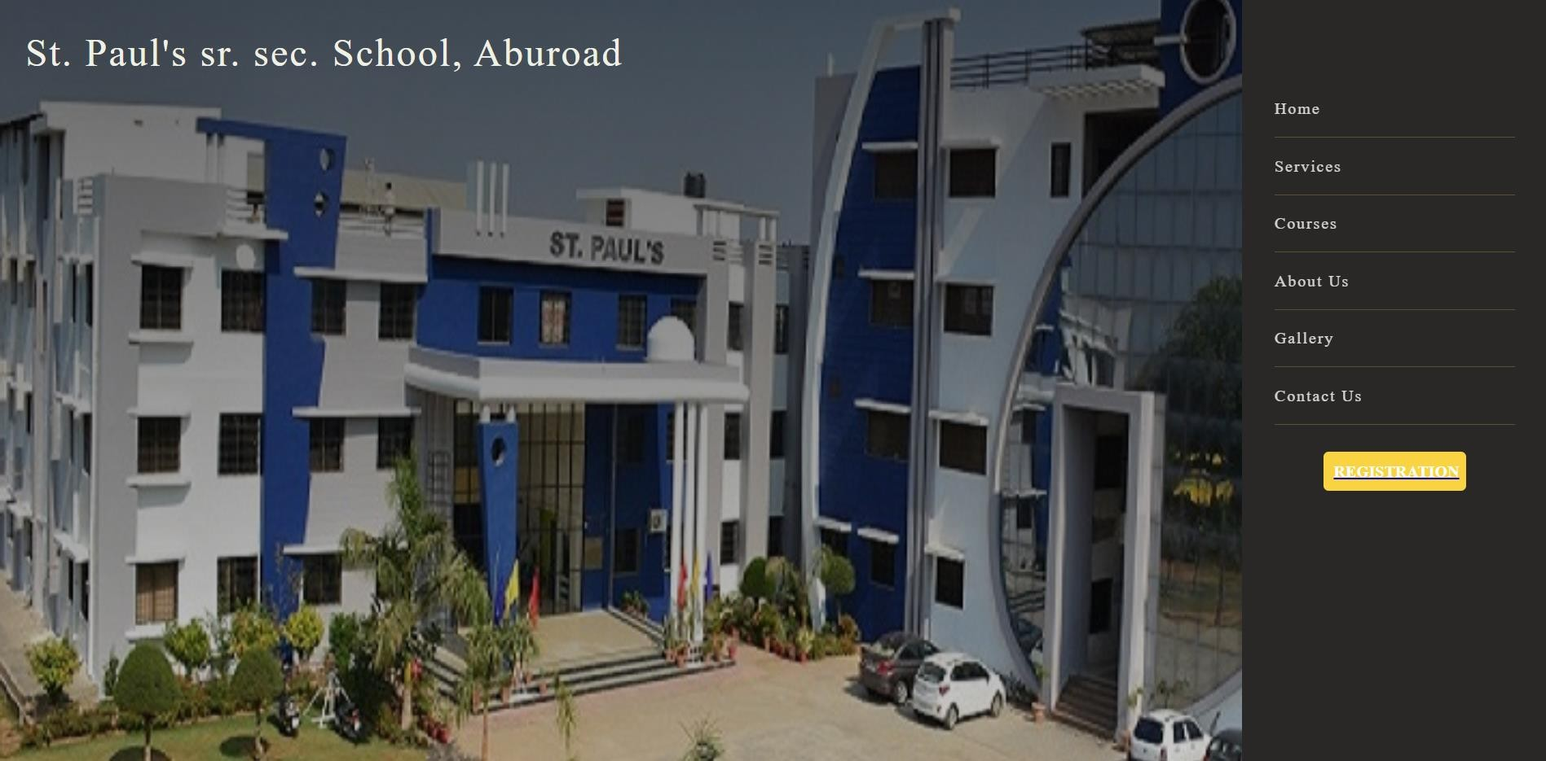
RESPONSIVE HOME PAGE

Slide 18
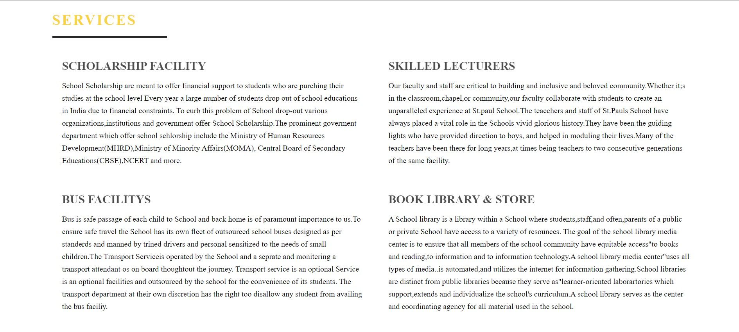
SERVICE SECTION

Slide 19

COURSES SECTION

Slide 20

COURSES SECTION

Slide 21

COURSES SECTION

Slide 22
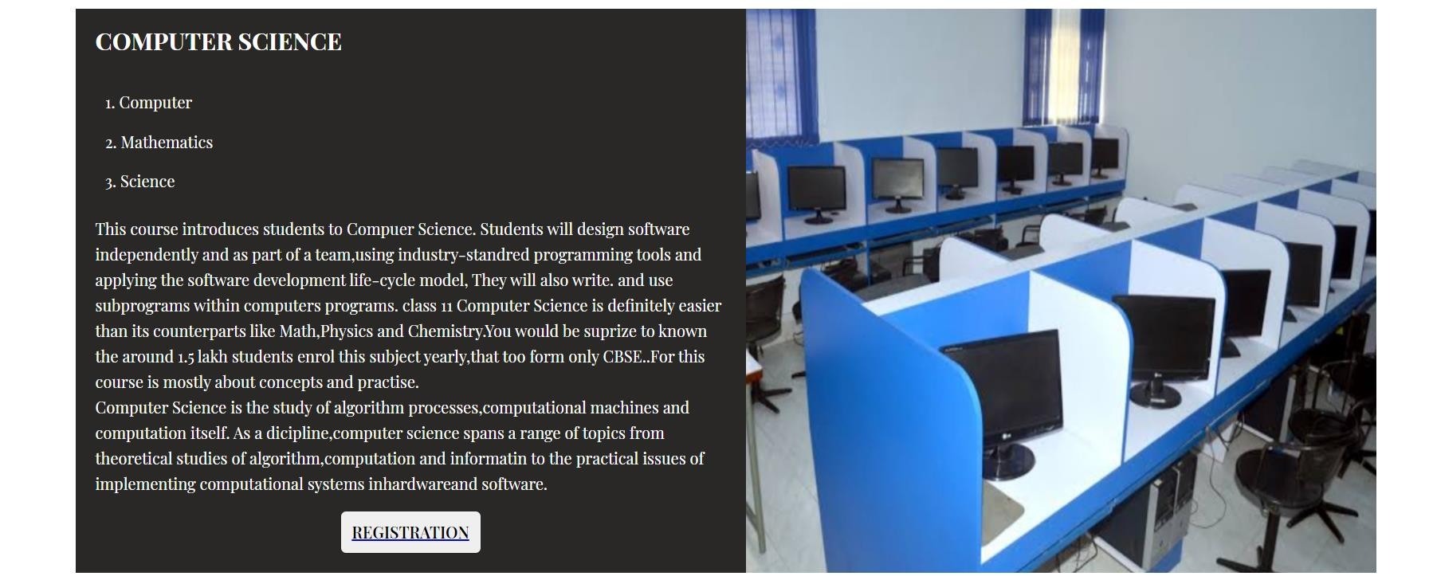
COURSES SECTION

Slide 23
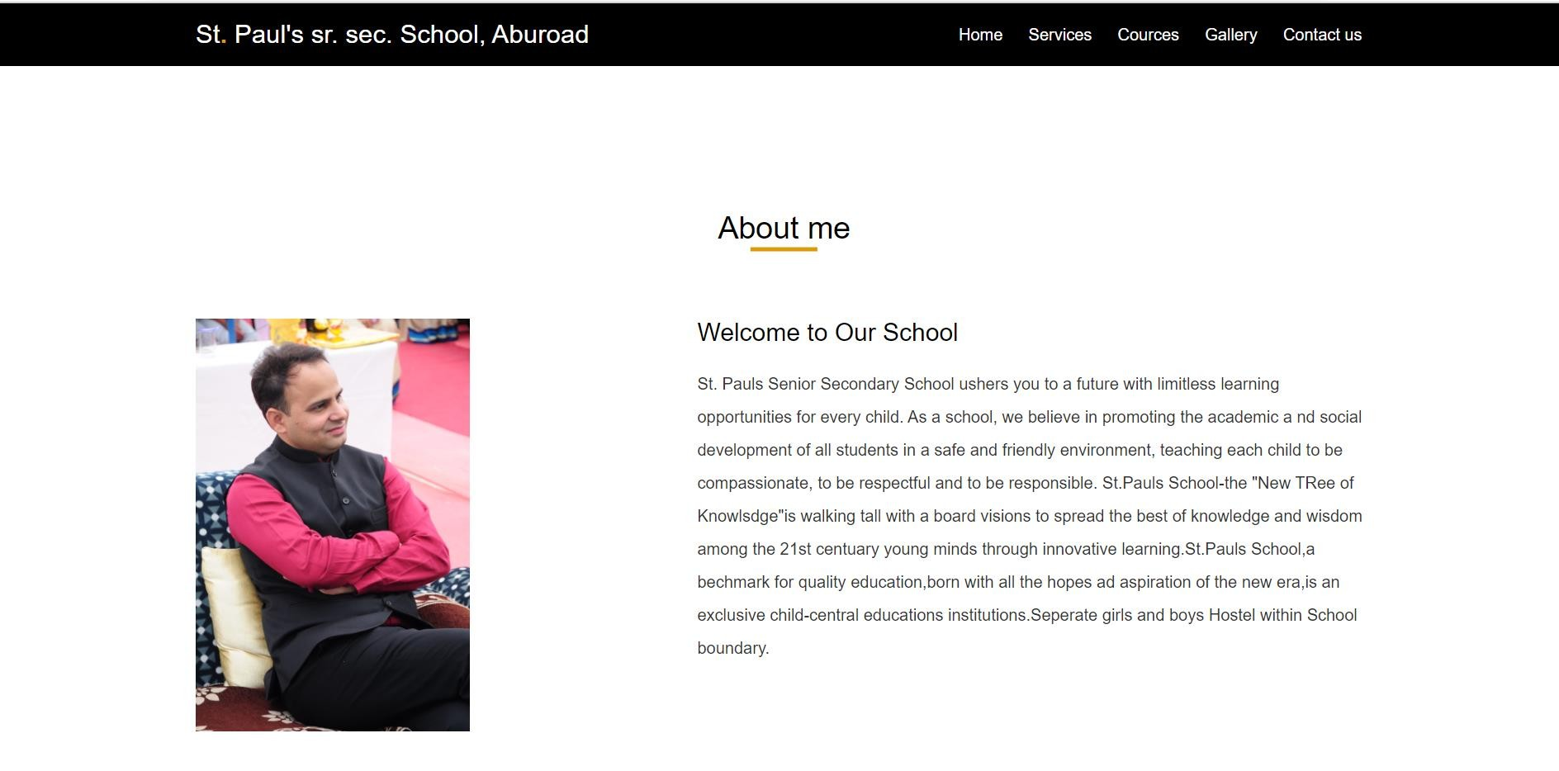
ABOUT US PAGE

Slide 24
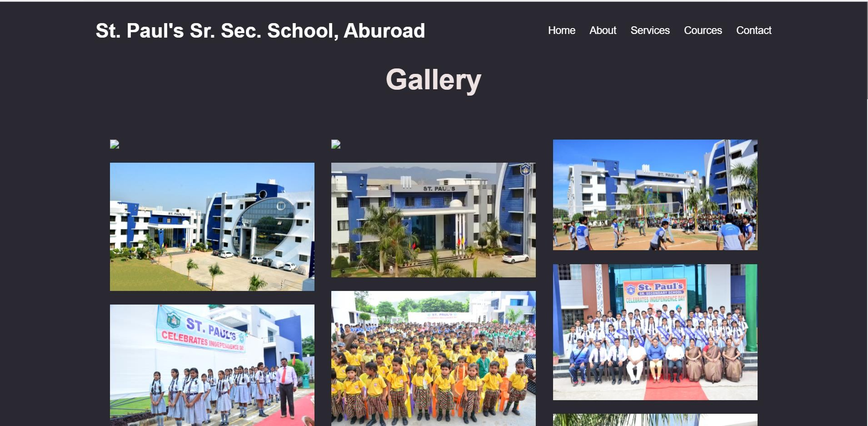
GALLERY PAGE

Slide 25
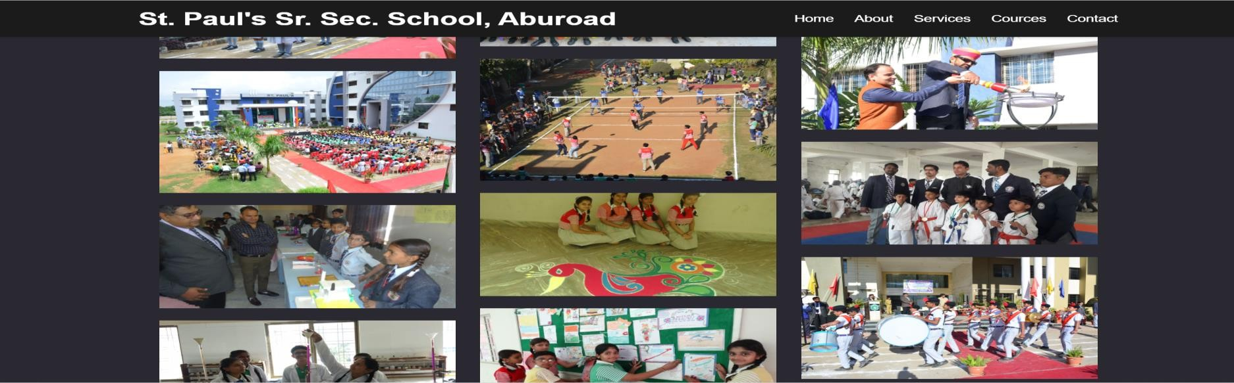
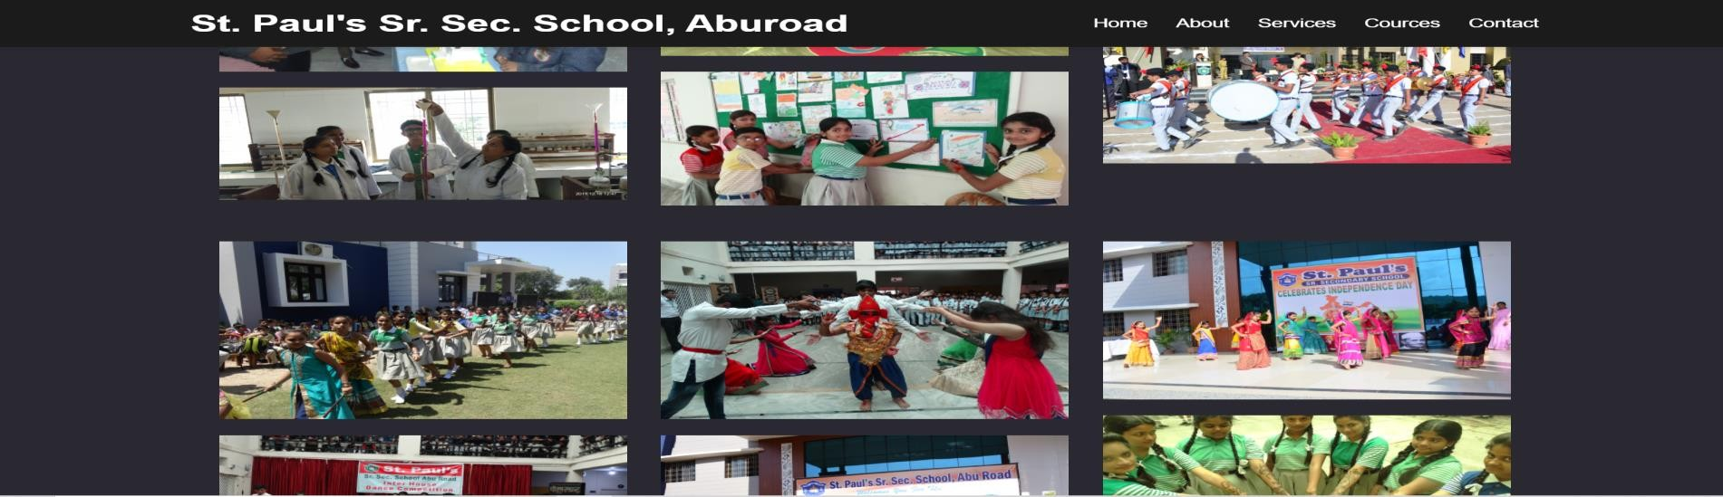
GALLERY PAGE

Slide 26
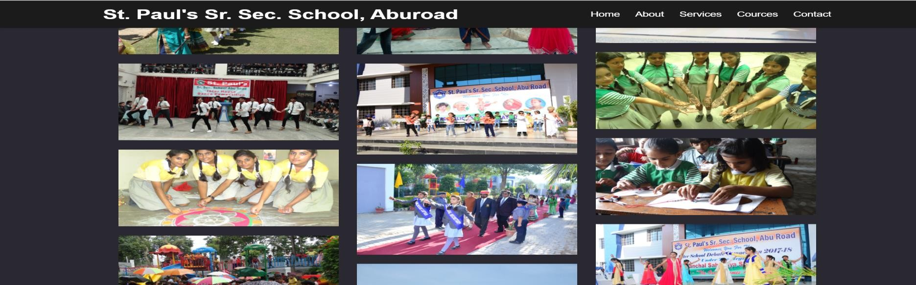
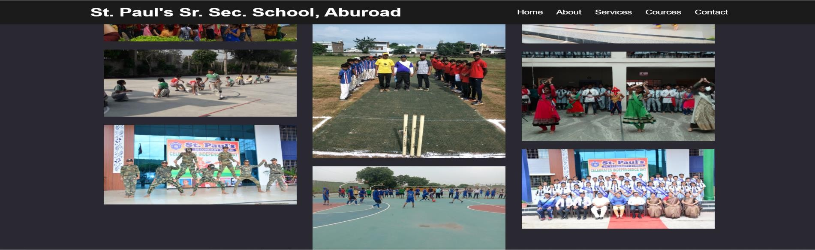
GALLERY PAGE

Slide 27
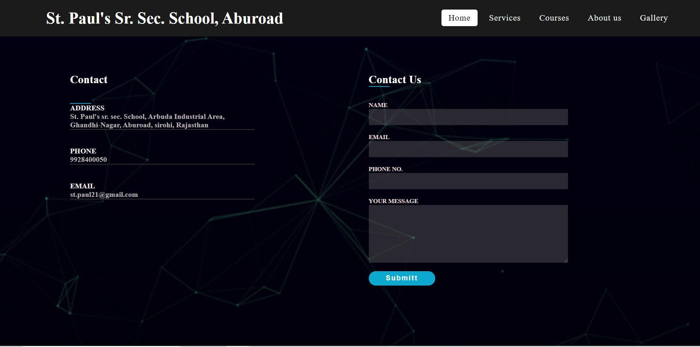
CONTACT PAGE

Slide 28
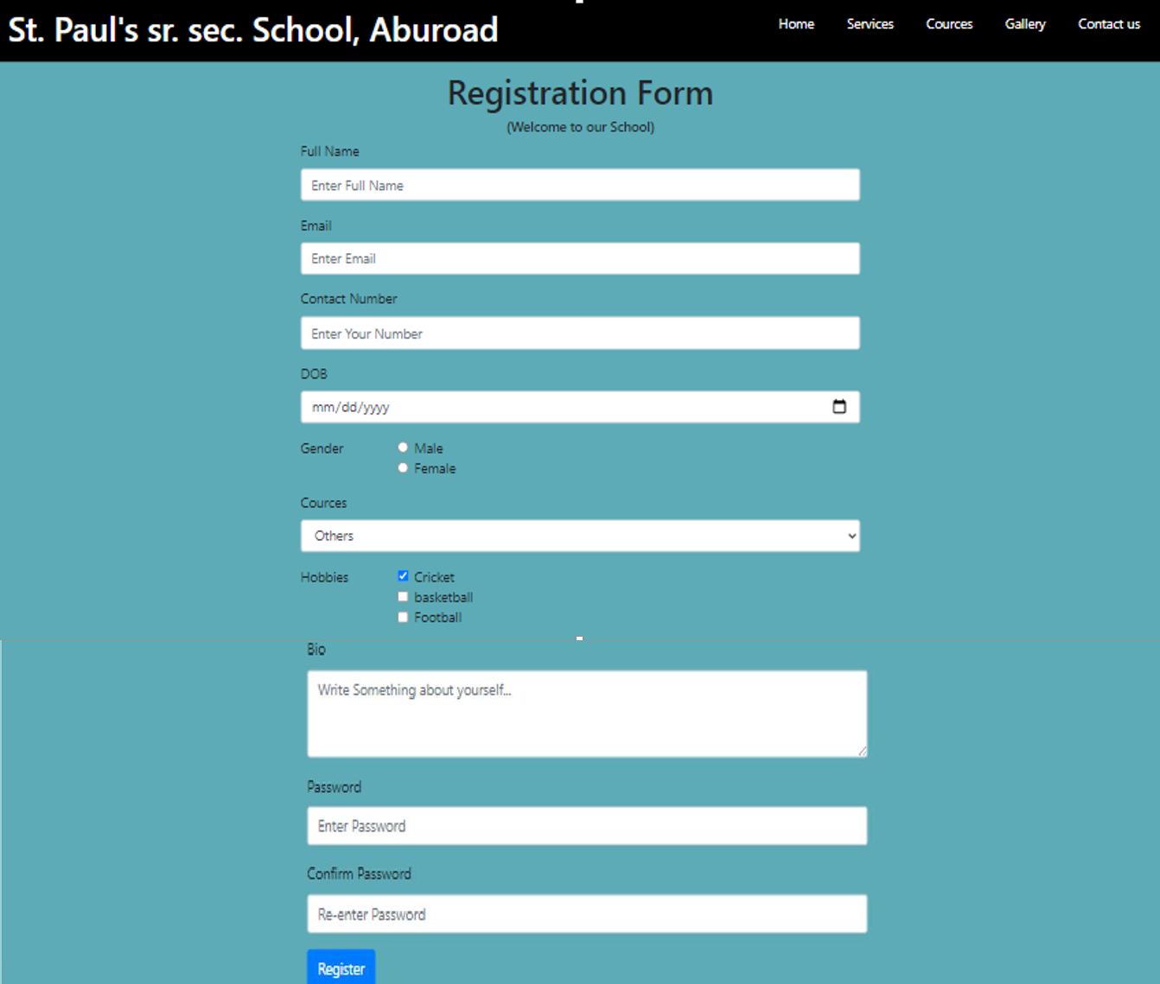
REGISTRATION PAGE

Slide 29
FUTURE SCOPE
We will host the platform on online servers to make accessible worldwide.
We can give more advance software for college website including more facilities.
Integrate multiple load balancers to distribute the loads of the system.
Create the master and slave database structure to reduce the
overload of the database queries.
Implement the backup mechanism for taking backup of codebase and database on regular basis on different servers.

Slide 30
CONCLUSION
A description of the background and context of the project and its relation to work already done in the area
Made statement of the aims and objectives of the project.
The description of Purpose, Scope, and applicability.
We define the problem on which we are working in the project.
We describe the requirement specifications of the system and the actions that can be done on these things.
We included features and operations in detail, including screen layouts.

Slide 31
THANK YOU

