Slide 1










IIM Calcutta x Monitor Deloitte | Campus Case Challenge
Final Round | Presentation to the Monitor Deloitte Panel
The Growth Gambit
Rasmitra Beverages: winter premixes and spices to earn revenue when concentrates do not
Where to play
Premixes (Q3 FY22), spices (Q4 FY22)
How to win
GT-first; distributors serve Q-com
What it is worth
18.5% base, 27.5% stretch; 30% gated
Team: Quadria
Amit Gupta | Abhishek | Aahana | Aaishi
amitg2027@email.iimcal.ac.in
Indian Institute of Management Calcutta
Scan: live model
Category screen and growth model
No login needed
Same model, public mirror
Contents: 1 Mandate and answer | 2 Diagnosis | 3-4 Where to play | 5-6 What to launch and consumer proof | 7-8 Go-to-market | 9 Launch engine | 10-12 What it is worth, risks and the ask | Appendix A1 Assumptions, A2 Sources

Slide 2





1. The Mandate and Our Answer
FINAL ROUND
Rasmitra is a profitable one-season, two-region, one-channel business; we answer the Board's five questions with a winter-first, gated programme
Where Rasmitra stands, FY21 (Exhibits 1, 4, 6)
Our answer, question by question
Rs 560 Cr
Revenue; 4.8% CAGR vs 11-17% for adjacent foods
88%
Revenue from the core concentrates category
Governing thought: earn the right in winter first. Launch winter premixes under Rasmitra in Q3 FY22 and spices under 'Swaad by Rasmitra' in Q4 FY22, sell through the kirana and our own distributors, and gate every rupee. Base case 18.5% new-product share in FY24; 30% only with stretch levers and a gated third category.
58%
Annual volume shipped Mar-Jul
51%
Plant utilisation; 34% in Q3 (Oct-Dec)
Where to play
Four of eight categories pass the Board's constraints. Launch premixes and spices; hold RTC (FGD pick) and pickles as a gated FY23 option; refuse namkeen, staples, dairy and RTD.
Slide
3, 4
1
74%
Revenue from two home regions
85%
Revenue through general trade; Q-com 1.3%
What to launch
8 packs plus a low-sugar variant on a Rs 10 / 49 / 99 ladder. Mother brand on the winter drinks, endorsed 'Swaad' on spices. Make premixes on idle Q3 lines; buy the spice grind.
Slide
5, 6
2
4 of 6
Launches since FY17 delisted or stalled
~11 mo
Idea-to-shelf; peers 6-8 months
How to take it to market
GT-first with Rs 10 trial packs; the same 390 distributors service dark stores; quick-commerce gets regular packs only at per-gram parity. Rs 35 Cr launch A&P, BTL-led.
Slide
7, 8
3
2.4%
A&P as % of sales; peers 4-7%
4.2%
New-product share of revenue today
How to get there on time
A 6-month stage-gate (from ~11) with a kill rule, owner and budget tranche at every gate; a monthly Launch Council chaired by the MD.
Slide
9
4
The Board mandate, FY22-FY24
What it is worth
Rs 108.5 Cr new-category sales in FY24; company Rs 757 Cr; base pays back in FY26E; only Rs 52 Cr of the Rs 75 Cr is spent, Rs 5 Cr of it capex.
Slide
10-12
5
Targets
New-product revenue from under 5% to 30% of topline
Company revenue toward Rs 900 Cr
Categories that sell when concentrates do not
Constraints
Do not dilute the mother brand
Do not break distributor economics
Rs 75 Cr programme budget, capex-light
What it adds up to, FY24
18.5%
New-product share, base case (from 4.2%)
Rs 757 Cr
Company revenue, base; Rs 852 Cr stretch
27.5% | 30.2%
Stretch | stretch + RTC from FY23
~54%
Mar-Jul share of sales, from 58%
FY26E
Base payback; stretch inside FY24
The MD's brief: "Tell me which categories we earn the right to enter... and do not tell me what you think the consumer wants: go and ask them."
Tensions resolved: 01 the core keeps funding the plan; 02 speed comes from gates, not from skipping tests; 03 the sharbat brand never vouches for masala; 04 distributors service every channel and no kirana is undercut on price per gram.
We commit to 18.5% and show the gated path to 30%: winter first, spices second, a third category only if both pass.
Sources: Case Exhibits 1, 4, 5, 6 and Board mandate (Section 1a); team category model (FY24 base, stretch, payback); team Excel model (budget). Assumptions on A1.
1

Slide 3



2. Diagnosis: Three Gaps Hold Rasmitra Back
FINAL ROUND
Growth is capped by a winter gap in the plant, a reach gap outside two regions and GT, and a process gap that lets weak launches reach the shelf
Winter gap: plant idles Oct-Dec (Exh. 4.1)
Reach gap: two regions, thin distribution (Exh. 4.2)
Channel gap: growth is where we are smallest (Exh. 3)
Channel | Rs Cr | Share | YoY | Partner margin | Trade spend
GT, distributor | 381.0 | 68.0% | 3.6% | 25% | 6.5%
GT, wholesale | 95.0 | 17.0% | 1.8% | 21% | 4.0%
Modern trade | 42.0 | 7.5% | 9.5% | 28% | 14.0%
E-commerce | 12.3 | 2.2% | 22.0% | 32% | 18.0%
Quick-commerce | 7.3 | 1.3% | 46.0% | 38% | 24.0%
Institutional | 22.4 | 4.0% | 6.0% | 14% | 3.0%
Total | 560.0 | 100% | 4.8% | 24% | 7.0%
So what: a product that peaks Oct-Feb uses capacity we already pay for (Q3 at 34%).
So what: Regions 3-4 at 22% / 13% distribution are the reach lever for the stretch case.
So what: Q-com grows 46% but costs 38% margin + 24% trade spend: a brand channel, not a profit one.
Only the flagship makes money (Exh. 2)
Process gap: six launches, four failures (Exh. 6)
Against peers of similar size (Exh. 1, 6)
Aloe vera RTD
FY18 | Delisted m14
MT only, no GT pull
Herbal digestive
FY19 | Live, 1.1%
Same plant, pack, route
Iced tea premix
FY21 | Delisted m9
Vendor missed spec; Rs 2.2 Cr lost
Launches a year
Rasmitra 1.2
Peers 8-14
Idea-to-shelf, months
Rasmitra ~11
Peers 6-8
Imported pack, no retailer margin
Fruit jam
FY19 | Delisted m11
Never resourced to scale
Premium variant
FY20 | Live, 2.2%
18% over leader, no sampling
Energy drink
FY21 | Stalled
A&P, % of revenue
Rasmitra 2.4%
Peers 4-7%
Online share of revenue
Rasmitra 3.5%
Peers 9-14%
So what: Rs 67.5 Cr of RTD loses 10.5%; a new line must clear 20% contribution at GT terms.
So what: the one success reused plant, pack and route; 3 of 6 skipped concept, pack or price tests.
So what: more launches need a faster, gated process and A&P closer to peers (Rs 35 Cr planned).
Fix the winter gap with product, the reach gap with distribution, the process gap with gates: every later slide maps to one of the three.
Sources: Case Exhibits 1, 2, 3, 4.1, 4.2 and 6 (FY21). Launches a year: 6 launches in FY17-FY21 (Exh. 6). Peer ranges as stated in the case.
2

Slide 4

3. Where to Play: Eight Categories Screened to Four
FINAL ROUND
We applied the Board's constraints before attractiveness; four categories pass, and size and growth decide the order
From longlist to launch
Board-constraint check (pass = both fits >= 4)
Score of the four that pass, and the four that do not
8 categories in the Exhibit 5 longlist
Category | Kirana route | Off-season sales | Pays GT terms | Distr. fit | Contract mfg | Capex | Budget fit | Result
Spices | Yes | Yes | Yes | 5.0 | High | Low | 5.0 | Pass
RTC mixes | Yes | Yes | Yes | 5.0 | High | Medium | 4.0 | Pass
Pickles | Yes | Yes | Yes | 5.0 | High | Low | 5.0 | Pass
Premixes | Yes | Yes | Yes | 5.0 | High | Low | 5.0 | Pass
Namkeen | Yes | Yes | Yes | 5.0 | Medium | High | 2.0 | Out: budget
Staples | Yes | Partly | No | 3.0 | Medium | High | 2.0 | Out: both
Dairy desserts | No | No | Partly | 1.7 | Low | High | 1.0 | Out: both
Juices & RTD | Yes | No | Partly | 3.0 | Medium | High | 2.0 | Out: both
4 pass distributor fit and budget fit (both >= 4)
2 launch in FY22: premixes (Q3), spices (Q4)
1 gated FY23 option: RTC first, then pickles
What we refuse, and why
Market map (Exh. 5): growth vs brand adjacency
Weights we applied (points of 100)
3-yr CAGR
Namkeen
Out on budget: in-house capex high, contract mfg only medium, adjacency 2.9
5
Adjacency (1-5)
35 Market size (log scale)
Juices/RTD
Premixes
35 3-yr growth (linear 8-17%)
Spices
Staples
Out on both: 4-8% gross margin cannot pay GT terms; needs a plant
4
Staples
Pickles
100
15 Distributor fit
RTC
15 Budget fit
Dairy desserts
Out on both: a chilled route our distributors do not run
3
Namkeen
Dairy
Juices & RTD
Out on both: same summer season; Product C already at -10.5% EBITDA
2
Robustness: spices leads whenever size gets 35+ points; a growth-led weighting favours RTC. A second, 8-criteria screen puts spices and premixes top two (slide 4).
8%
10%
12%
14%
16%
18%
Bubble area = FY21 market size (Rs 6,400 Cr to Rs 2,40,000 Cr). Dark green = launch; light green = gated; grey = refused.
Constraints first, attractiveness second: namkeen, staples, dairy and RTD look big on paper but fail the Board's own rules.
Sources: Case Exhibit 5 (market size, CAGR, organised share, margins, 3P availability, capex, adjacency, counter-seasonality); team category model (score: size on a log scale Rs 6,400-2,40,000 Cr, growth linear 8-17%). Avendus (Aug 2021).
3

Slide 5

4. Where to Play: Premixes First, Spices Second
FINAL ROUND
Premixes are the closest step from our plant, shelf and shopper; spices bring the size; RTC waits for proof at the FY23 gate
Innovation ambition matrix: one step at a time
Why premixes over RTC mixes (a Tension 03 call)
Sequencing: earn the right, then scale
New occasions
 | Premixes | RTC mixes
Market FY21 / 3-yr growth | Rs 6,400 Cr / 14% | Rs 9,800 Cr / 17%
Brand adjacency (Exh. 5) | 4.6 | 3.6
Organised share | 55% | 61%
In-house capex | Low | Medium
Gross margin | 42-50% | 40-48%
Peak season vs our plant | Oct-Feb; Q3 plant at 34% | Year-round
Consumer pull (9 answers) | 2 picks | 4 picks
Exhibit 6 analogue | Premium variant: worked | No analogue
Q3 FY22
Premixes: pilot winter in Regions 1-2
Dairy, RTD: refused
Feb FY22
Scale gate on in-season repeat data
Adjacent shoppers
Spices ('Swaad')
Q4 FY22
Spices under 'Swaad by Rasmitra'
RTC / pickles: FY23 gate
FY23 gate
Third category (RTC first) only if both pass
Existing shoppers
Concentrates (core)
Winter premixes
FY23-24
Regions 3-4 and Q-com at scale
Premium variant FY20
Same plant & shelf
Existing products
Adjacent products
New products
RTC wins on size and on the FGD vote, so it is first in line for the FY23 gate. Premixes win on every Board constraint and on the one launch that worked.
Real-world precedents (the case is fictional)
Core | adjacent | transformational, after Nagji & Tuff (Monitor Group, HBR 2012). Placement is the team's judgment.
Cross-check: our 8-criteria weighted screen
Rasna, snacks (2017)
A concentrates brand's earlier diversifications failed to create much impact: do not stretch far
Counter-seasonal by design: Mar-Jul share of sales
Category | Attract. 40% | Right to win 40% | Counter-season 20% | Score
Spices | 4.1 | 4.7 | 5 | 4.53
Premixes | 4.0 | 4.8 | 5 | 4.52
Pickles | 4.1 | 4.6 | 5 | 4.47
RTC mixes | 4.1 | 4.3 | 5 | 4.37
Namkeen | 3.8 | 3.5 | 5 | 3.88
Staples / RTD / dairy | 2.3-3.1 | 1.7-3.4 | 1-3 | 2.13-2.68
Premixes sell 90% of volume Oct-Feb; spices sell evenly through the year.
Every rupee of new sales lowers the summer dependence the Board wants removed, without cutting the core.
Rasna Healthy Day (Dec 2022)
Rs 10 single-serve millet soup aimed at winter: a concentrates brand can fill winter
Paper Boat, chikki (2016)
A drinks brand built one tight food range first
Hamdard RoohAfza Fusion (2016)
The sharbat brand travelled into drinks, not food
Premixes earn the right, spices bring the size: two categories that pass every Board rule, launched one quarter apart, with RTC next in line.
Sources: Case Exhibits 1, 4.1, 5, 6; team FGDs (pick-one question); team 8-criteria screen; Bain (Zook, 2004): 1 in 4 adjacency moves succeeds; Business Standard (2017); Indian Retailer (Dec 2022); Wikipedia: Paper Boat; Business Today (Sep 2016); Nagji & Tuff, HBR (2012).
4

Slide 6
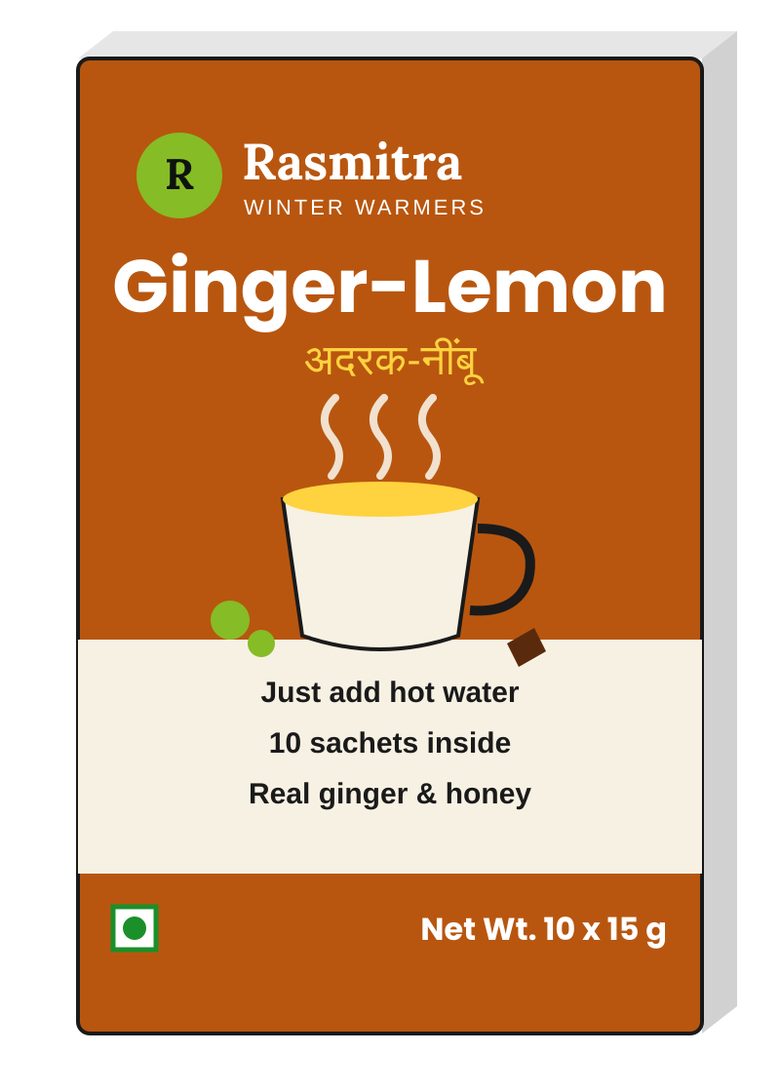
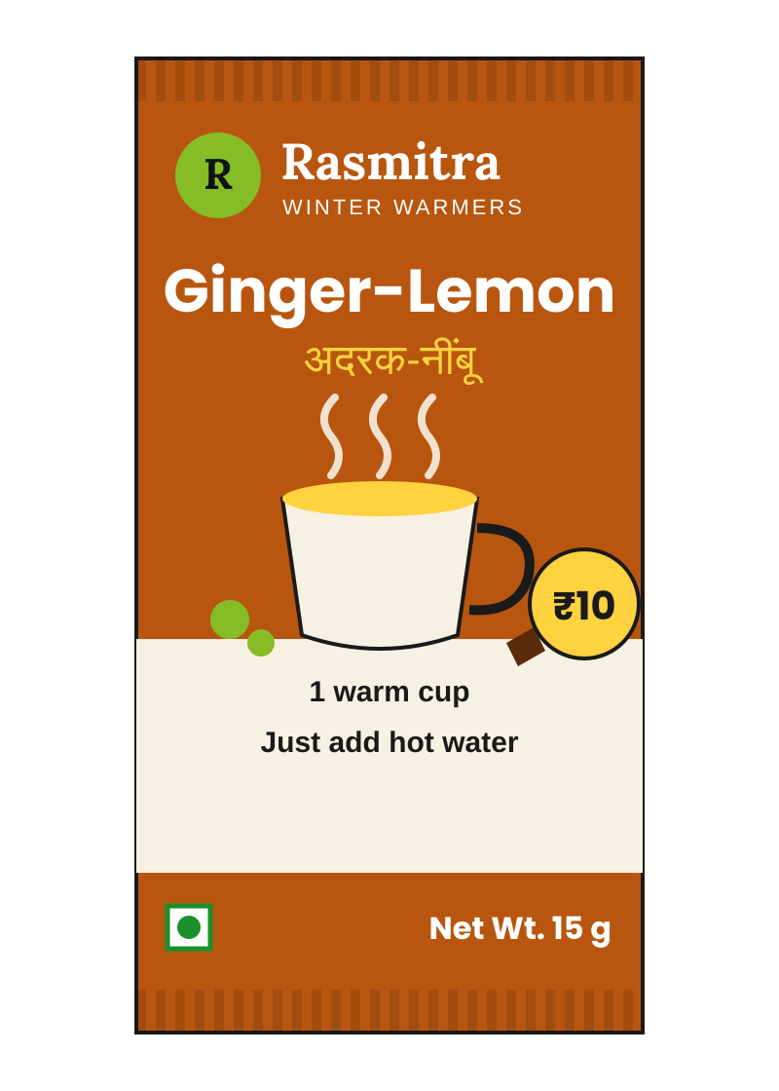
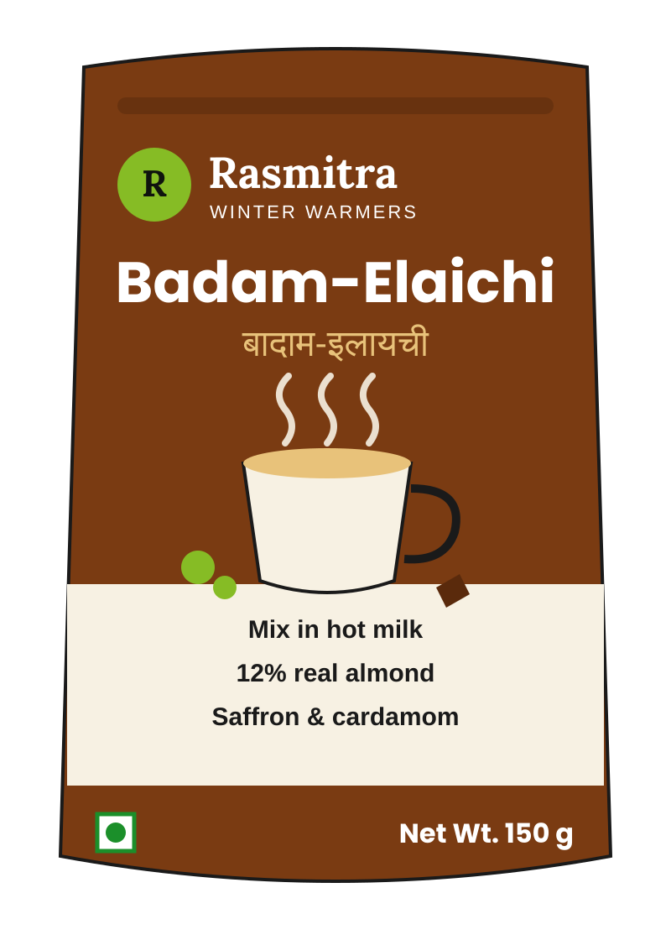
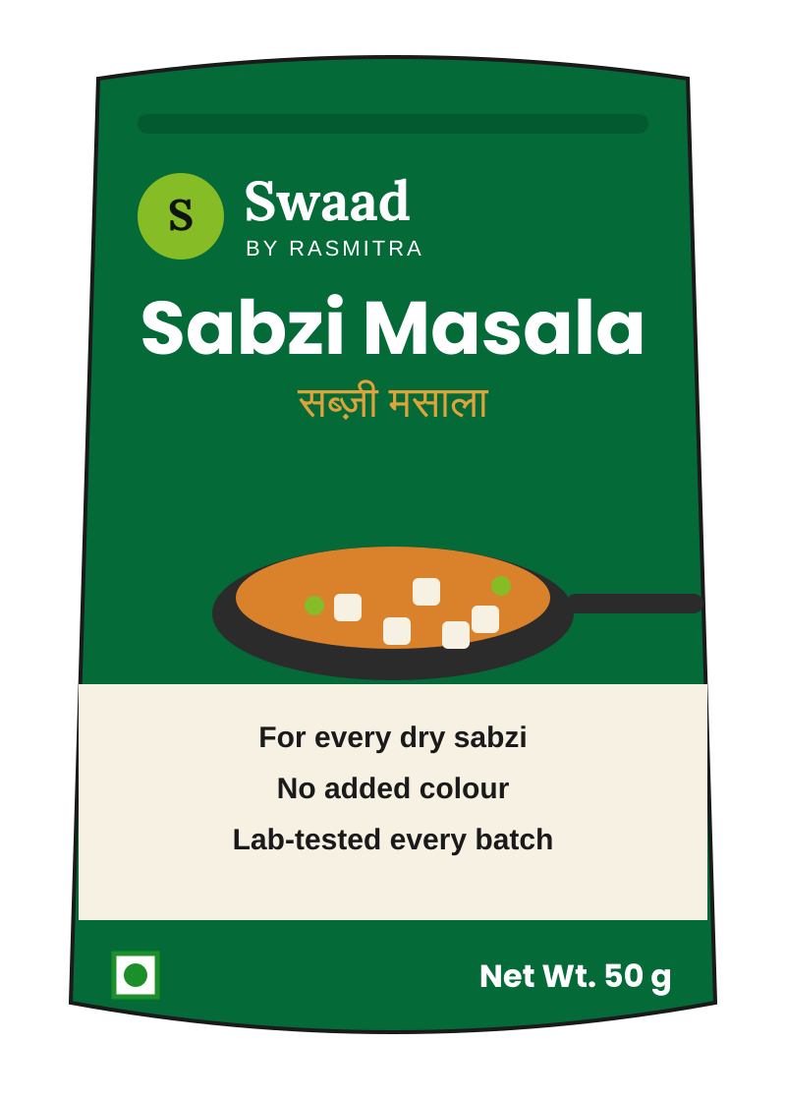
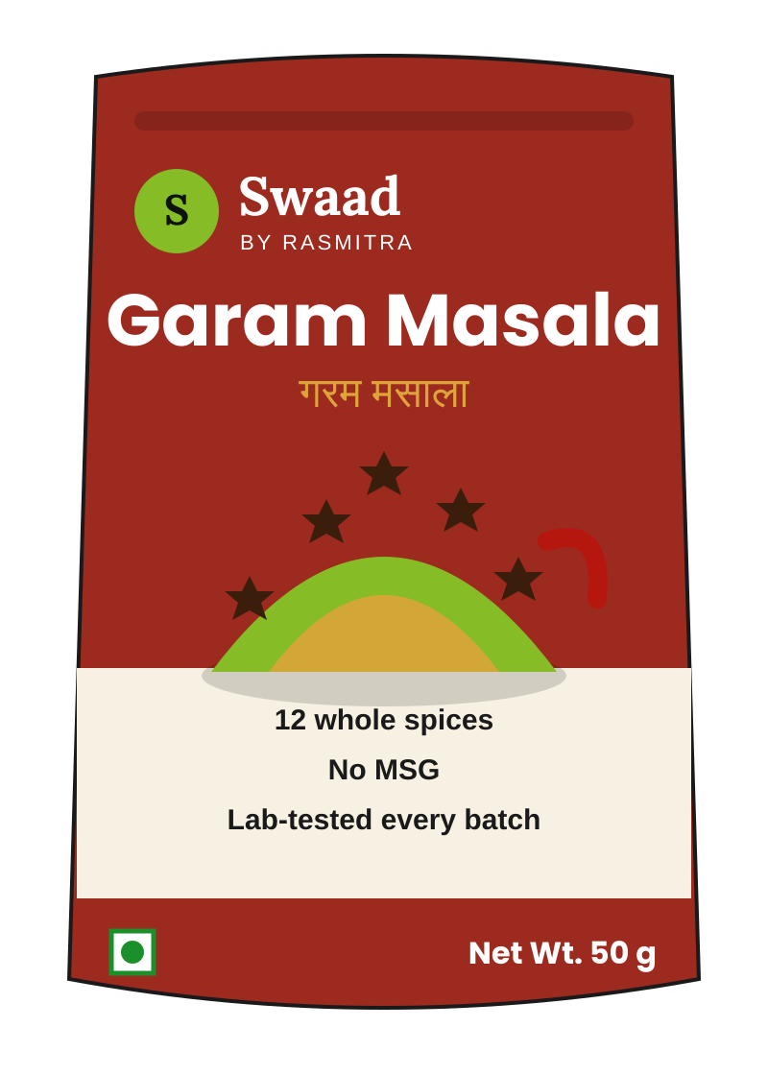


5. What to Launch: The Offer, the Packs and the Brand
FINAL ROUND
Eight packs and a low-sugar variant on one price ladder: a warm drink under the name consumers trust, and a masala that proves itself on purity
Brand architecture
Concept packs, front of pack (backs carry FSSAI label, NABL batch test)
Design choices on pack
RASMITRA
Mother brand: concentrates, sharbat
Mother brand on winter drinks
FGDs trust the name for a warm drink
Sub-brand leads on spices
'Swaad' large; 'by Rasmitra' small
Rasmitra Winter Warmers
Master-brand extension
Swaad by Rasmitra
Endorsed sub-brand
Purity on the back
NABL tests for pesticide and ethylene oxide
Ginger-Lemon 10 x 15 g
Rs 99
Ginger-Lemon sachet
Rs 10
Badam-Elaichi 150 g
Rs 99
Sabzi Masala 50 g
Rs 49
Garam Masala 50 g
Rs 49
Low-sugar variant
"Usually too sweet" (FGD 1); 78% pay for healthy F&B
Ginger-lemon (regular, low-sugar)
Sabzi masala
The offer, category by category
Make or buy, and why
Badam-elaichi milk mix
Garam masala
 | Winter premixes | Spices
Products | Ginger-lemon hot drink (regular and low-sugar); badam-elaichi milk mix | Everyday sabzi masala; garam masala
Packs / MRP | Rs 10 single sachet; Rs 99 10-sachet pack; Rs 99 150g pouch | Rs 10 trial (8g / 5g); Rs 49 50g pouch
Positioning | The family's warm drink, from the sharbat they trust | Everyday masala you can trust; lab-tested every batch
Who buys | Office-goers, students, PG residents; homemakers | Homemakers; value buyers at the kirana (Rs 10-49)
Make / buy | MAKE on idle Q3 powder lines, after a line trial at gate 3 | BUY grind (contract mfg, 3P availability high); MAKE blend + pack
GM / contribution | 38.5% / 25.6% | 34.1% / 19.9%
Launch | Q3 FY22, first winter; Regions 1-2 pilot | Q4 FY22, one quarter later
MAKE
Premixes
Powder lines idle in Q3 (34% use); existing formulation skills; no new capex beyond Rs 5 Cr small capex
Held at the FY23 gate: RTC mixes (FGD pick), then pickles; brand decided with concept-test data
Why two brands: "If they've always made sharbat, why would I buy garam masala from them?" (FGD 1). Drinks keep the name; spices borrow trust but lead with 'Swaad'.
BUY + MAKE
Spices
Grind bought from contract makers (Exh. 5: high availability, low capex); we blend, pack and test in-house
Price-pack ladder: trial buys reach, regular packs carry profit
Profit: 30.9-32.9% GT contribution
RULE
Both
Two vendors at spec before the launch gate (energy drink lesson)
Profit: 26.8-28.2% GT contribution
Rs 99
Premix 10-sachet / 150g
Reach: GT and campus only; 9-22% contribution
Rs 49
Spices 50g pouch
Rs 10
Trial sachet / pouch
What goes in the carton: a warm drink from the sharbat brand they trust, and an everyday masala that proves its purity on the back.
Sources: team SKU plan and Excel model (packs, MRPs, COGS, margins); Case Exhibits 2, 5, 6; team FGDs; Deloitte-FICCI (Oct 2024): 78% willing to pay a premium for healthy F&B; The Week (May 2024); FSSAI Labelling and Display Regulations 2020. Concept art is fictional.
5

Slide 7
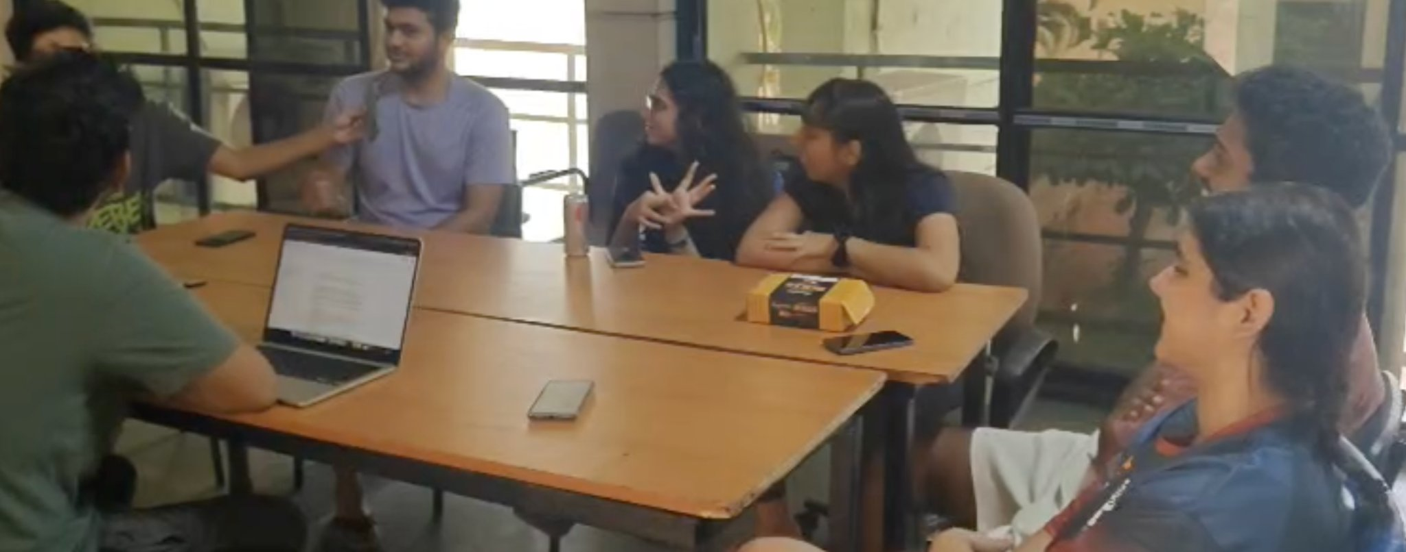
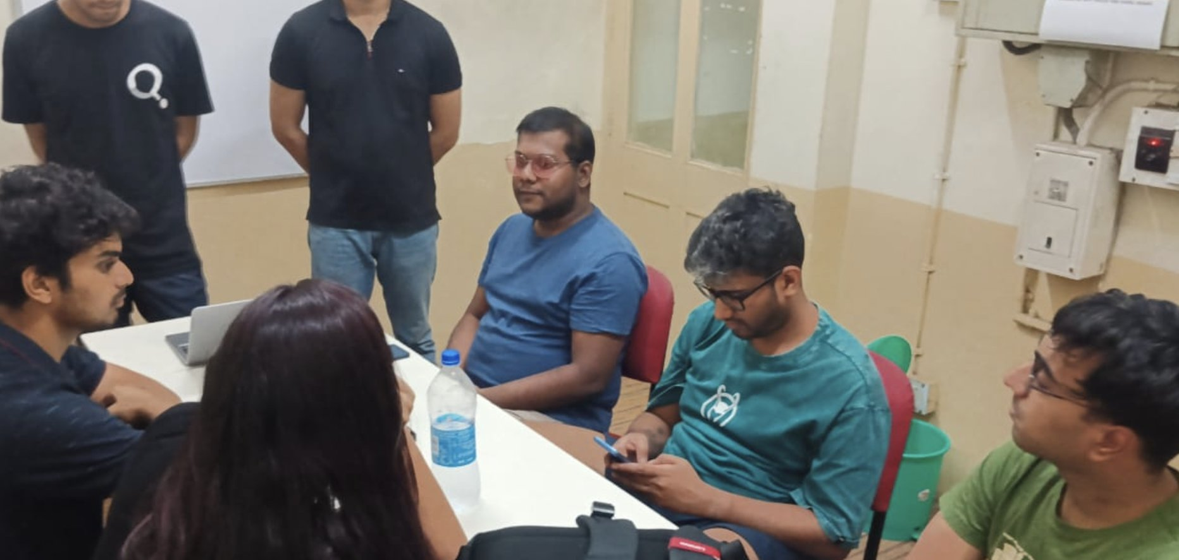

6. Consumer Evidence: What 11 Consumers Told Us
FINAL ROUND
Consumers trust Rasmitra for a winter drink but not for masala, and every group asked for a Rs 10-15 trial pack; four parts of the plan changed
Who we spoke to
Proof: discussion photos
Group | Participants (age) | Who they are | Profiles covered | Format
FGD 1: young working adults | Pooja (29), Rahul (27), Anjali (25), Neha (22); Mayank (26), Sayan (23) also present | Pooja buys for her household; Rahul shares a flat and orders on Q-com; Neha works in an office | 2 working professional; 4 young independent | ~10 min, Hinglish, moderated
FGD 2: college students | Aman (22, MBA, hostel), Riya (21, UG, PG), Karan (23, engg., hostel), Sneha (22, PG, own flat), Aditya (20, UG, hostel) | Hostel students cannot cook; Riya and Sneha cook; Aditya and Riya use Blinkit and Zepto | 3 student / hostel; 4 young independent | ~10 min, college common room, moderated
Not in the FGDs | Homemaker 35-50; value-conscious kirana buyer 35-55 | Tested at the concept gate (n=200 per region) before spices scale | Homemaker; value buyer | Concept test, gate 2
What we heard, and what it changed
FGD 1: working adults
FGD 2: students
Theme | FGD 1: working adults | FGD 2: students | What we changed or confirmed
Brand stretch | "If they've always made sharbat, why would I buy garam masala from them?" (Pooja) | "For drinks, yes. Makes sense" (Aditya). Masala under another name "might feel more natural" (Sneha) | CHANGED: 'Swaad' leads the spice pack; mother brand stays on premixes
Trial | "Small trial pack is better" (Pooja). "A small Rs 10 pouch" (Neha) | "Single sachet first", then a pack of ten (Riya, Aditya); free tasting on campus (Karan) | CONFIRMED: Rs 10 trial packs before Rs 49/99; campus sampling added to BTL
Premix product | Premixes "usually too sweet" (Pooja); "for travel or office" (Neha) | Ginger tea "especially in winter" (Riya); Rs 15 sachet "fine" (Aditya) | CHANGED: low-sugar ginger-lemon added; office, hostel and winter use
Spices habit | Everest: "bas, aadat hai" (Pooja); would switch on a friend's word | "Don't need another masala brand unless it's doing something better" (Sneha) | CONFIRMED: plan only 3% share; lead on lab-tested purity; kill if repeat < 25%
Channel | "I discover products online, but I don't always purchase them there" (Neha) | Won't "open Blinkit for one sachet" (Aman); campus store first (Karan) | CONFIRMED: kirana and campus for trial; Q-com for regular packs
Ready-to-cook | First pick for Rahul and Anjali; Rs 30 "I'd definitely try" (Anjali) | Riya and Aman pick it, but "not everyone has a kitchen" (Riya) | CHANGED: RTC moves ahead of pickles for the FY23 gate
Pick one to try (9 answered)
What drives repeat purchase
Taste first: "If the taste is bad, even free... why would I buy again?" (Pooja)
Price and pack tests
Consistency: "The next one tastes different" (Neha)
Product tested | Price put to the group | What they said | Read-across to our plan
Ginger tea premix sachet | Rs 15 single sachet | "Fifteen is fine" (Aditya); street chai is Rs 10-15; one sachet first, then a pack of ten | Rs 10 sachet and Rs 99 10-pack sit at or below this
Masala trial pack | Rs 10 / Rs 20 | Rs 10 "fine for trying" (Pooja); Sneha picks masala at Rs 20 "I'll actually use it" | Rs 10 trial pack confirmed
RTC paneer gravy, 2 servings | Rs 50 / 49, then Rs 30 | Rs 50 fine only if paneer and water; Rs 30 "try once"; Aman would rather order | RTC option: Rs 30 trial, Rs 49-50 regular
Channel price gap | Rs 40 kirana vs Rs 35 Blinkit | Depends on the basket; campus store wins for one sachet | Per-gram parity is enough; no Q-com discount
Availability: "If I can't find it again, I'll forget about it" (Anjali)
Real convenience: Under 10 minutes or it is not convenience (FGD 2)
Directional only: 11 consumers, 9 active voices, aged 20-29, urban. Older homemakers and value buyers, who drive spices volume, are tested at gate 2.
The name sells the winter drink, not the masala: premixes launch under Rasmitra; spices lead with 'Swaad' and prove themselves through Rs 10 trial packs.
Sources: team FGD transcripts (FGD 1: young working adults; FGD 2: college students); independent consumers recruited by the team. Quotes lightly edited from Hinglish; names as given by participants.
6

Slide 8






7. Go-to-Market: Who Buys, Where and at What Price
FINAL ROUND
Trial happens in the kirana and on campus, discovery on quick-commerce, and every channel sells at the same price per gram
Five target buyers
Channel architecture: how GT and quick-commerce coexist
FY24 new-line sales by channel
Homemaker, 35-50
Spices bought on habit; switches on purity and word of mouth
Rs 49 spice pouch | kirana
Lever | General trade (78.5%) | Quick-commerce (10.9%) | Modern trade (10.6%)
Role | Trial and volume, Regions 1-4 | Discovery, metros, students/PGs | Visibility, winter gondolas
Packs | Rs 10 trial + Rs 49/99 regular | Rs 49/99 regular only; no trial packs | Regular packs; winter bundles
Price rule | MRP per gram is the anchor | Per-gram price within +/-5% of GT, platform discounts included | Per-gram parity
Who services | 390 distributors | Same distributors to dark stores | Distributor / key accounts
Partner margin / trade spend | 25% / 6.5% (Exh. 3) | 38% / 24% (Exh. 3) | 28% / 14% (Exh. 3)
Credit days | 21 | 32 | 45
Contribution, regular pack | 27-33% | -8% to +1%: brand channel | 15-22%
78.5% General trade
10.9% Quick-commerce
Value kirana buyer, 35-55
Rs 10-20 packs; listens to the retailer
Rs 10 trial | kirana
Rs 108.5 Cr
10.6% Modern trade
Student / hostel, 19-24
Ginger tea in winter; one sachet at a time
Rs 10 sachet | campus store
Young independent, 23-30
Finds on reels and Q-com, buys nearby
Rs 99 pack | Q-com, kirana
Exhibit 6: 79% through GT fixes the jam failure (MT-only, no pull).
One price per gram, everywhere
Why Q-com matters, and why it needs rules
Working professional, 27-38
Low-sugar premix for the office
Rs 99 low-sugar | MT, Q-com
~35%
of FMCG companies' online sales came through Q-com in FY24 (Deloitte-FICCI)
Kirana (GT)
Sabzi 50g at Rs 49
Rs 0.98 per g
Quick-commerce
Sabzi 50g, regular only
Rs 0.93-1.03 per g
Modern trade
Sabzi 50g or bundles
Rs 0.98 per g
Distribution expansion: numeric distribution
2/3
of e-grocery orders in 2024 were quick-commerce (Bain-Flipkart)
Rules that follow
Trial packs only in GT, where they still earn 9-22%; on Q-com they lose 26-43%.
Q-com price within +/-5% of GT per gram, platform discounts included, so no kirana is undercut.
Q-com capped at ~11% of new-line sales as a discovery and student/PG channel.
MT gets regular packs and winter bundles for visibility.
Oct 2024
Distributors' federation alleged predatory Q-com pricing (Business Standard)
46%
our Q-com growth in FY21, from 1.3% of revenue (Exh. 3)
Trial in the kirana, discovery on quick-commerce, one price per gram everywhere: growth without a channel war.
Sources: Case Exhibits 3, 4.2, 6; team Excel model (FY24 channel mix and contribution); team category model (reach lever: Regions 3-4 to 30% / 22%); Deloitte-FICCI (Oct 2024); Bain-Flipkart, How India Shops Online 2025; Business Standard (22 Oct 2024).
7

Slide 9



8. Go-to-Market: Distributors, Salesforce and Marketing
FINAL ROUND
Every new line runs through our 390 distributors and adds 24% to their gross margin; A&P is BTL-led and timed to the winter season
Distributor economics, FY24 base (Rs lakh a year each)
Per-pack contribution by channel (FY24, team Excel)
Marketing: Rs 35 Cr launch A&P (A&P 2.4% of sales today; peers 4-7%)
+24%
gross margin per distributor, earned Oct-Feb when they carry little today. Net of handling and financing: ~Rs 55,000 each a year.
Pack | MRP | GT | MT | Q-com
Ginger-lemon 15g sachet | 10 | 22.2% | 2.0% | -26.4%
Ginger-lemon 10-sachet | 99 | 32.9% | 21.9% | 1.1%
Badam-elaichi 15g sachet | 10 | 20.2% | -0.1% | -28.8%
Badam-elaichi 150g | 99 | 30.9% | 19.8% | -1.4%
Sabzi masala 8g trial | 10 | 10.2% | -10.5% | -40.9%
Sabzi masala 50g | 49 | 28.2% | 16.0% | -6.3%
Garam masala 5g trial | 10 | 8.8% | -11.9% | -42.6%
Garam masala 50g | 49 | 26.8% | 14.6% | -7.9%
Marketing calendar (team plan)
Oct
Nov
Dec
Jan
Feb
Mar-Jul
Aug-Sep
Distributor P&L on new lines | Rs Cr | Basis
New-line sales at MRP | 143.9 | Rs 108.5 Cr net / 75.4%
of which through GT | 113.0 | 78.5% GT share
Distributor gross margin | 7.4 | 6.6% of GT sell-out
Net after handling, financing | 2.2 | 1.9% of GT sell-out
Per distributor: gross / net | Rs 1.9 L / 0.55 L | vs ~Rs 7.8 L gross today
Rs 10 sampling, kirana
Profit lives in the Rs 49 and Rs 99 packs in GT (27-33%); trial packs are a reach tool, and they never go on Q-com.
Campus stalls, tasting
Salesforce and incentives (Rs 5 Cr field selling)
Regional TV and CTV
Winter-range training
Incentive per bill
Reels, Q-com ads
In-pack with concentrates
All 390 distributor teams before each October launch
Paid on new-line lines per invoice, not on volume alone
Winter racks, POSM
Why distributors back it
Winter orders when concentrates are idle (Q3 is 15% of volume)
Discovery routes consumers named
Friends and family: in-pack sachets with summer concentrates (Anjali, Pooja, Aman, Sneha)
Instagram reels with real kitchens (Riya, Aditya)
Q-com new-launch shelves (Aditya, Anjali)
Campus stalls and free tasting (Karan, Aman)
Dark stores serviced through them: Q-com adds to their P&L
Reach targets
Dark-store coverage
Every GT SKU earns the distributor a positive net margin
Regions 3-4 numeric distribution 22% / 13% to 30% / 22%; sales head reviews quarterly
Distributors map and service Q-com dark stores in metros
Same 21-day credit cycle as the core range
Distributors win too: every new SKU and every dark store runs through them, and trial packs stay off quick-commerce where they lose money.
Sources: team Excel model (SKU_Channel_Model, Distributor_Econ, A&P split); Case Exhibits 2, 3, 4.1, 6; team FGDs (discovery routes). Channel contribution after partner margin, trade spend and freight. Marketing calendar is the team plan.
8

Slide 10

9. The Launch Engine: A 6-Month Stage-Gate With Kill Rules
FINAL ROUND
Every gate has a date, an owner, a kill rule and a budget tranche; each Exhibit 6 failure maps to the gate that would have stopped it
Five gates, 26 weeks (from ~11 months; peers 6-8)
Discover
Wk 0-4
Concept
Wk 5-8
Product & pack
Wk 9-14
Price & trade
Wk 15-18
Test market
Wk 19-26
Evidence: Interviews, FGDs, kirana visits; category screen
Kill if: Board fit >= 4
Owner: Strategy
Would have stopped: Promoter-led ideas
Evidence: Concept test, n=200 per region
Kill if: Top-2-box >= 40%
Owner: Marketing
Would have stopped: 3 of 6 untested
Evidence: Blind test vs leader; 2 vendors at spec; NABL tests; line trial
Kill if: Below parity; < 2 vendors
Owner: R&D, QA
Would have stopped: Energy drink write-off
Evidence: Price ladder; retailer and distributor clinic
Kill if: GT regular-pack contribution < 20%; price > leader +5%
Owner: Sales, Finance
Would have stopped: Aloe vera, iced tea
Evidence: 2 districts, GT + Q-com, 8 weeks
Kill if: Repeat < 25% by week 8
Owner: Launch Council
Would have stopped: Jam: MT only
Exhibit 6 post-mortem: which gate stops each failure
Faster and more frequent
Roadmap FY22-FY24 (fiscal quarters)
Launch | Year | What went wrong | Gate | Rule in our plan
Aloe vera RTD | FY18 | Imported pack priced out the retailer margin | Price & trade | Contribution >= 20% on regular pack at Exh. 2 trade margins
Mixed fruit jam | FY19 | Listed only in MT; no GT pull | Test market | Test in GT + Q-com; 79% of sales planned through GT
Herbal digestive | FY19 | Never resourced to scale | Scale decision | Budget released per gate, with a rollout tranche
Iced tea premix | FY21 | Priced 18% above leader; no sampling | Price & trade | Price <= leader +5%; Rs 10 trial + sampling plan
Energy drink | FY21 | Vendor could not meet spec; Rs 2.2 Cr lost | Product & pack | Two vendors signed at spec before launch
Premium variant | FY20 | Worked: existing formulation, plant, pack, route | (model to copy) | Premixes reuse plant, shelf and distributor
FY22
FY23
FY24
Premix gates 1-4
Premixes: pilot
Premixes: national
Spice gates
Months; peers 6-8 (shown at 7). Cadence target 8-10 SKUs a year vs peers' 8-14 launches.
Launch Council
Spices launch
Chaired by the MD; meets monthly
Regions 3-4, Q-com
Decides on a one-page evidence pack
3rd category gate
Killed SKUs return their budget
3rd category ramp
FY23: picks the third category
Feb scale gate
Idea-to-shelf from ~11 months to 6: faster because each gate has a date, an owner and a kill rule, not because tests are skipped.
Sources: Case Exhibit 6 and Section 1c (Tension 02); team stage-gate design; team roadmap. Growth simulator (tab 5) replays the iced tea and aloe vera launches through these gates.
9

Slide 11
10. What It Is Worth: Building Rs 108.5 Cr of New Revenue
FINAL ROUND
Small shares of large markets: Rs 77 Cr of spices is 0.10% of the market and Rs 31.5 Cr of premixes is 0.44%, built bottom to top from Exhibit 5
FY24 build, base case: market x organised x reach x realisation x share x multiplier x ramp
Spices
Rs 1,06,675 Cr
Market FY24
x
42%
Organised
x
8%
Our reach
x
75.4%
Net realisation
x
3%
Our share
x
1.0
Multiplier
x
95%
Launch ramp
=
x
Rs 77.0 Cr
FY24 revenue
Premixes
Rs 9,482 Cr
Market FY24
x
55%
Organised
x
8%
Our reach
x
75.4%
Net realisation
x
10%
Our share
x
1.0
Multiplier
x
100%
Launch ramp
=
x
Rs 31.5 Cr
FY24 revenue
New-product revenue by line (Rs Cr, net)
Company revenue build (Rs Cr)
Two models, one plan: we commit to the lower number
Total 23.5
Total 36.5
Total 93.0
Total 139.8
Line | FY21 | FY22 | FY23 | FY24
Legacy range (4.8% p.a.) | 536.5 | 562.2 | 589.2 | 617.5
Today's new products (10% p.a.) | 23.5 | 25.9 | 28.5 | 31.3
Winter premixes | - | 7.3 | 20.7 | 31.5
Spices | - | 3.3 | 43.8 | 77.0
Company revenue | 560.0 | 598.7 | 682.2 | 757.3
New-product share | 4.2% | 6.1% | 13.6% | 18.5%
 | Top-down (plan) | Bottom-up (Excel)
Driver | Share of reached market | Outlets x packs per outlet a week
Spices FY24 | Rs 77 Cr (0.10% of market) | Rs 185 Cr (0.23% at MRP)
Categories | Spices + premixes | + condiments
Status | Conservative; reasoned shares | Velocities not yet validated
Market growth behind it (Exh. 5 CAGRs)
Category | CAGR | FY21 | FY24 | Our FY24 share
Spices | 11% | 78,000 | 1,06,675 | 0.10%
Premixes | 14% | 6,400 | 9,482 | 0.44%
Pickles / RTC (options) | 13% / 17% | 12,500 / 9,800 | 18,036 / 15,696 | Gated
Velocity check: Rs 297 a month per stocking outlet for spices (~6 Rs 49 packs), Rs 291 for premixes in season, with half our 4.5 L outlets stocking.
New-product share: 4.2% FY21, 6.1% FY22, 13.6% FY23, 18.5% FY24. Ramps: premixes 30/75/100%, spices 5/60/95% (launch one quarter later).
A conservative build: two categories reach 18.5% at a tenth of a percent of the spices market; pilot data replaces every estimate at each gate.
Sources: Case Exhibits 1, 5; team category model (top-down build, replicated to the decimal); team Excel model (bottom-up velocities). Net realisation 75.4% of MRP (Exh. 2-3). FY24 market = FY21 x (1 + CAGR)^3.
10

Slide 12
11. Unit Economics, P&L and the Rs 75 Cr
FINAL ROUND
Regular packs earn 27-33% in GT; the base case turns EBITDA-positive in FY24 and recovers its cash in FY26E, spending Rs 52 Cr of the Rs 75 Cr
Rs 99 ginger-lemon 10-sachet in GT: where the rupee goes
Incremental P&L and cash, base case (Rs Cr)
Rs 75 Cr: allocation and release
99
-24.75
 | FY22 | FY23 | FY24 | FY25E | FY26E
New-category sales | 10.6 | 64.5 | 108.5 | 125.9 | 140.8
Contribution | 2.5 | 14.0 | 23.4 | 27.1 | 30.3
Programme A&P, R&D-QA, selling | -12.0 | -18.0 | -17.0 | -10.6 | -11.4
Incremental EBITDA | -9.5 | -4.0 | 6.4 | 16.5 | 18.9
Change in working capital | -0.7 | -3.5 | -2.8 | -1.1 | -1.0
Capex | -1.0 | -2.0 | -2.0 | -1.0 | -1.0
Free cash flow | -11.2 | -9.4 | 1.6 | 14.4 | 16.9
Cumulative pre-tax FCF | -11.2 | -20.6 | -19.1 | -4.6 | 12.3
35 Launch A&P, sampling
18 Working-capital envelope
74.25
-44
Rs 75
Cr
7 Development, testing, QA
5 Field selling, training
5 Small capex
-5.82
24.43
5 Contingency (unspent)
Use | FY22 | FY23 | FY24 | Total | Treatment
Launch A&P | 8 | 14 | 13 | 35 | Opex
Working capital | 4 | 7 | 7 | 18 | Reserve; base uses Rs 7 Cr
Development, QA | 3 | 2 | 2 | 7 | Opex
Field selling | 1 | 2 | 2 | 5 | Opex
Small capex | 1 | 2 | 2 | 5 | Capex
Contingency | 1 | 2 | 2 | 5 | Funds 3rd-category gate
Total | 18 | 29 | 28 | 75
MRP
Retailer +
distributor
Net realisation
COGS
Trade, freight
Contribution
Rs per pack. Contribution 32.9% of net realisation; trade spend and freight are the balance in the team Excel.
Cumulative FCF by scenario (Rs Cr)
Pack-level unit economics, general trade (Rs)
+72
Pack | MRP | Net real. | COGS | Contrib.
Ginger-lemon 10-sachet | 99 | 74.25 | 44.0 | 32.9%
Badam-elaichi 150g | 99 | 74.25 | 45.5 | 30.9%
Sabzi masala 50g | 49 | 36.75 | 23.0 | 28.2%
Garam masala 50g | 49 | 36.75 | 23.5 | 26.8%
Rs 10 trial packs (4) | 10 | 7.50 | 4.35-5.35 | 9-22%
+12
Capex-light by design
Rs 5 Cr capex in Rs 75 Cr; premixes use idle Q3 lines
Only Rs 52 Cr is spent; WC and contingency are reserves
Base working capital 6.4% of sales: Rs 7.0 Cr in FY24
Downside loss capped at the spend released before a gate stops it
-31
Category contribution after channel mix: premixes 25.6%, spices 19.9% (Exh. 2 flagship: 27.3%).
Capex-light and gated: base case cash-positive in FY26E, stretch inside three years, downside capped by the gates.
Sources: team Excel model (pack COGS, margins, budget, working capital 6.4% of sales); team category model (volumes, scenarios); Case Exhibits 2, 3. FY25E-26E: market CAGR at full ramp, sustaining A&P 6% of sales + Rs 3 Cr, capex Rs 1 Cr. Pre-tax, excludes depreciation.
11

Slide 13
12. The Path to 30%, the Risks and Our Ask
FINAL ROUND
18.5% is the commitment; 30% needs reach and spices share to beat plan and a third category to pass its gate, so we ask the Board to fund gates, not a forecast
What has to be true: FY24 share by reach and spices share
Bridge from base to 30% (FY24 new-product share)
Risk map (team assessment)
Spices share / reach | 6% | 8% | 10% | 12%
2% | 13.1% | 15.6% | 17.9% | 20.1%
3% (base) | 15.4% | 18.5% | 21.3% | 23.9%
4% | 17.6% | 21.1% | 24.4% | 27.4%
5% | 19.7% | 23.6% | 27.2% | 30.5%
6% | 21.6% | 26.0% | 29.9% | 33.4%
Downside
11.7%
High
1
Base: spices + premixes
18.5%
+ pickles (base)
20.1%
Med
3
4
2
Stretch: reach 10%, share x1.5
27.5%
Stretch + pickles
29.9%
Low
5
Premixes at base. Only 5% share at 12% reach (30.5%) and 6% at 12% (33.4%) clear 30%. One point of spices share = Rs 25.7 Cr in FY24.
Stretch + RTC
30.2%
Low
Med
High
30% target
Likelihood (rows) x impact on FY24 share (columns)
Levers and how we pull them
Lever | From - to | FY24 effect | How | Gate / owner
Reach | 8% to 10-12% | +2.8 to +5.4 pts | Regions 3-4 distribution 22% / 13% to 30% / 22%; distributor-serviced Q-com | Sales head; quarterly
Spices share | 3% to 4-5% | +2.6 to +5.1 pts | Rs 10 trial packs, in-pack sampling with summer concentrates, retailer schemes | Brand team; repeat >= 25%
Share multiplier | 1.0 to 1.5 | +9.0 pts with reach | Both categories outperform plan in test markets | Launch Council
Third category | None to RTC or pickles | +1.6 to +2.7 pts | Launch FY23 only if premixes and spices pass test market | FY23 Board gate
1
Spices share stalls below 3%: Habit-led buying ("bas, aadat hai"); Rs 10 trial + sampling; kill at repeat < 25%
2
Premix winter slips: A missed October costs a season; spec and vendors locked by July
3
Q-com conflict and losses: Regular packs only, per-gram band, distributor-serviced
4
Working capital over envelope: Excel NWC Rs 21.9 Cr vs Rs 18 Cr reserved in a 3-category case; release per gate
Decisions we ask the Board for today
5
Vendor misses spec: Two vendors at spec before the launch gate
1
Approve Rs 75 Cr
released gate by gate: Rs 18 Cr in FY22
2
Start premixes now
concept-to-shelf for the Q3 FY22 winter, Regions 1-2
3
Set up the Launch Council
MD-chaired, monthly, with kill rights at every gate
4
Hold us to 18.5%
and decide the push to 30% at the FY23 gate
Board scorecard, FY24 base
Measure | FY21 | FY24 | Target
New-product share | 4.2% | 18.5% | 30%
Company revenue, Rs Cr | 560 | 757 | ~900
Honest arithmetic: two categories get to 18.5%; 30% is reachable only with reach, share and a third launch, each behind a gate.
Sources: team category model (sensitivity grid and scenarios replicated); team Excel model (working capital); Case Exhibits 1, 4.2, 6; team FGDs. Risk placement is the team's judgment. Simulator tab 3 reproduces the grid live.
12

Slide 14
Explore the numbers live
Category screen and growth model
Change weights, reach, share and ramps; every number in this deck recomputes
claude.ai/artifact/TEa5SgsMFq1L6yyBw3a9u6
THANK YOU
Questions and discussion
No-login mirror
The same model on a public page, for any browser
amitg2027-del.github.io/rasmitra-growth-simulator/model.html
Appendix
A1 Assumptions (single page, as the case requires)
A2 Sources and live links: models, simulator, Google Sheet, secondary sources
Team Quadria | IIM Calcutta

Slide 15
A1. Assumptions
APPENDIX
Every figure not in Exhibits 1-6 is an explicit team estimate, applied consistently; the simulator lets the panel change each one
Area | Assumption | Value | Source
Core business | Legacy range grows at its FY18-21 rate | 4.8% p.a. | Exhibit 1
Today's new products | Herbal digestive, premium variant and others grow | 10% p.a. from Rs 23.5 Cr | Exhibit 1; team
Market size and growth | FY21 size grown at Exhibit 5 CAGR | Spices 11%, premixes 14% | Exhibit 5
Reach | Share of category sales through outlets we serve | 8% base; 10% stretch FY24 | Team category model
Our share (year three) | Spices / premixes / pickles / RTC | 3% / 10% / 5% / 4% | Team category model
Net realisation | Share of MRP kept (flagship, Exh. 2). At the planned 78.5/10.6/10.9 GT/MT/Q-com mix it is 73.3%: base 18.1%, stretch + RTC 29.7% | 75.4% (73.3% sensitivity) | Exhibit 3; team model
Launch ramps | Premixes 30/75/100%; spices 5/60/95%; 3rd category 0/15/75% | Base | Team category model
Scenario multipliers | Stretch x1.5 share, reach to 10%; downside x0.6 share, one-season slip | As stated | Team category model
Contribution margin | After partner margin, trade spend and freight, channel-weighted | Spices 19.9%; premixes 25.6% | Team Excel model
Programme spend | A&P 8/14/13; R&D-QA 3/2/2; selling 1/2/2; capex 1/2/2; WC 18; contingency 5 | Rs 75 Cr | Team Excel model
Working capital | Receivables, inventory less payables | 6.4% of sales | Team Excel model
FY25E-26E | Market CAGR at full ramp; sustaining A&P 6% of sales + Rs 3 Cr; capex Rs 1 Cr | Extension | Team estimate
Velocity check | Half of our 4.5 lakh outlets stock each category; premixes sell 5 months | GT: Rs 291-297 per outlet a month | Team category model
Distributor economics | 390 distributors; gross 6.6%, net 1.9% of GT sell-out; GT 78.5% of new-line sales | Rs 1.9 L / 0.55 L each | Team Excel model
Seasonality | Core sells 58% in Mar-Jul; spices, pickles, RTC sell evenly (5 of 12 months in Mar-Jul); premixes 10% | Mar-Jul ~54% in FY24 | Exhibit 1; team estimate
Exhibits govern: where public data and the case differ, the case figure is used; demand estimates are replaced by pilot data at each gate.
Sources: Case Exhibits 1-6; team category model; team Excel model 'Rasmitra_Financial_Model'.
A1

Slide 16
A2. Sources and Links
APPENDIX
Every source behind this presentation, with live links to the models; click any link in the PPT or PDF
Live links: models and tools
Secondary sources (each checked against the original)
Link | What it holds | Address
Category screen and growth model | Team top-down model: screen, weights, scenarios, assumptions. QR on cover | claude.ai/artifact/TEa5SgsMFq1L6yyBw3a9u6
Growth simulator | 5 tabs: screen, growth, what has to be true, packs front/back, stage-gate | claude.ai/artifact/8m7DvmjMwMNyDfwxoNqZCB
No-login mirrors | Model (second QR on cover) and simulator on GitHub Pages; open in any browser | amitg2027-del.github.io/rasmitra-growth-simulator/model.html amitg2027-del.github.io/rasmitra-growth-simulator
Financial model (Google Sheet) | View-only, live formulas. Deck_TopDown tab = slides 10-12; other tabs = bottom-up model | docs.google.com/spreadsheets/d/1nZSGHXq3_sRKb0EueC1a_8jHta1uloNFJPVZoNb5j6Y
Workbook and code | Model as .xlsx and simulator source | github.com/amitg2027-del/rasmitra-growth-simulator
Source | What we use | Slide
Deloitte & FICCI, 'SPURring growth in FMCG, retail and e-commerce', 7 Oct 2024 | 78% willing to pay a premium for healthy F&B | 5
Retail4Growth on the Deloitte-FICCI report, 8 Oct 2024 | Q-com about 35% of FMCG online sales, FY24 | 7
Bain & Flipkart, 'How India Shops Online 2025' | Q-com two-thirds of e-grocery orders, 2024 | 7
Business Standard, 22 Oct 2024: distributors allege predatory pricing | Why Q-com runs at per-gram parity | 7, 8
Avendus Capital, 10 Aug 2021: branded spices study | Branded spices to Rs 50,000 Cr by 2025 | 3
The Week, 21 May 2024: FSSAI clears MDH, Everest samples | Purity as the spice promise | 5
FSSAI (Labelling and Display) Regulations, 2020, compendium | Pack label checklist | 5
Bain & Co. (Zook), 'Hard-core growth', 2004 | 1 in 4 adjacency moves succeeds | 4
Business Standard, 26 Feb 2017: 'Rasna's health trump card' | Rasna's earlier diversification | 4
Indian Retailer, Dec 2022: Rasna forays into health and wellness | Rs 10 winter soup sachet | 4
Wikipedia: Paper Boat | Chikki 2016; ~5 lakh outlets | 4
Business Today, 8 Sep 2016: RoohAfza Fusion | Sharbat brand into ready-to-drink | 4
Nagji & Tuff (Monitor), 'Managing your innovation portfolio', HBR 2012 | Core / adjacent / transformational | 4
Lafley & Martin, 'Playing to Win', HBR Press 2013 | Where to play / how to win structure | 1-12
Case data and primary research
Source | Used for
The Growth Gambit case, IIM Calcutta x Monitor Deloitte: Exhibits 1-6 | Every company figure; where public data differs, the exhibit governs
FGD 1: young working adults (6, ages 22-29); transcript and photo | Slides 5-6: brand stretch, trial packs, low-sugar premix
FGD 2: college students (5, ages 20-23); transcript and photo | Slides 6-7: Rs 10-15 sachet, campus stores, RTC demand
Interview plan: 5 consumer profiles (team) | Slide 7 personas; older profiles tested at gate 2
Team category model and team bottom-up Excel model | Slides 3, 10-12 and A1; both linked above
Everything is open to check: both models, the simulator and the financial model are view-only links anyone can open.
All web sources accessed October 2026. Team models and transcripts are the team's own work. Photos of both focus groups are on slide 6.
A2

