Slide 1
R Shiny
Two-fold functionality
Reactivity and conversion to HTML
You don’t need any HTML or web development knowledge
Web-hosting

Slide 2
Examples…..
https://shiny.rstudio.com/gallery/
A quick helpful tutorial:
https://deanattali.com/blog/building-shiny-apps-tutorial/ - 1-before-we-begin

Slide 3
The three key components to a Shiny app
User interface – (ui)
All HTML code is drafted in here through predefined shiny input and design functions
Raw HTML can also be used, making it extremely flexible
This code (and any other code not in “server) is only ran once – when the app is first fired up on the server
Server function – server(input, output)
All reactive computation and output occurs in this function
You MUST label your server arguments “input” and “output”
This function is ran each time a new user logs into the site
shinyApp(ui, server)
A convenient wrapper to run both functions

Slide 4
The simplest shiny app
-- Library(Shiny)
-- ui <- fluidPage(
titlePanel(“Yes, this is actually an app”))
-- server <- function(input, output) { }
-- ShinyApp(ui, server)

Slide 5
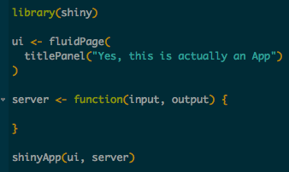
Simplest Shiny App

Slide 6
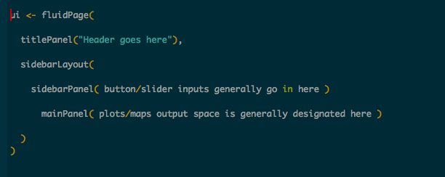
The UI - “Standard” visual appearance

Slide 7
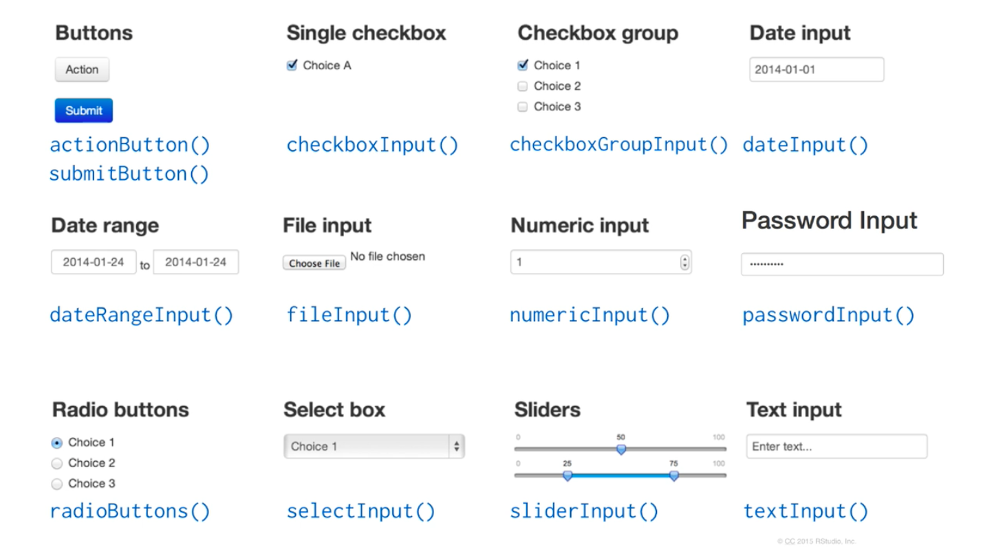
The UI – Reactive input types

Slide 8
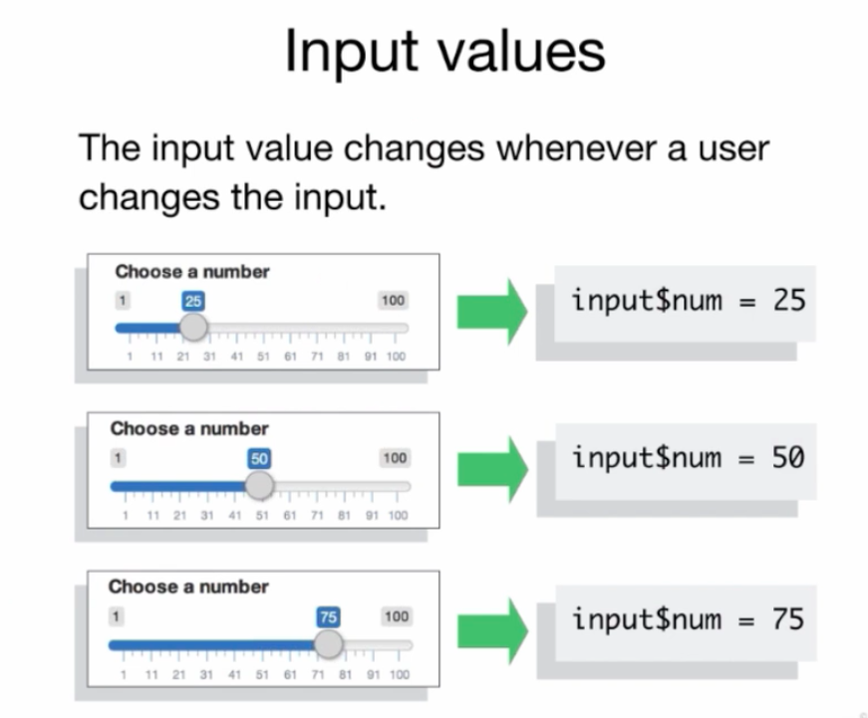
UI – Input Example

Slide 9
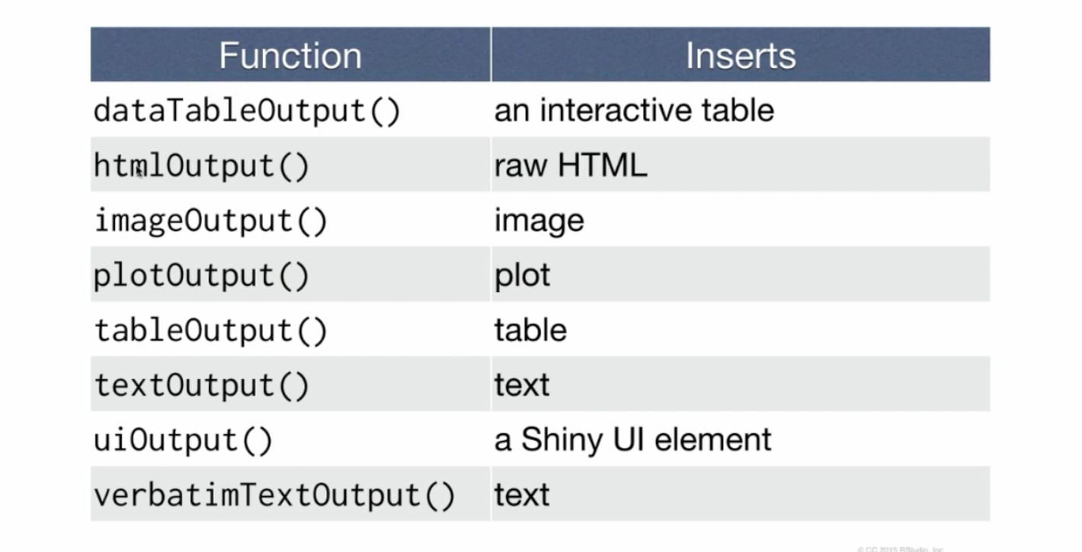
The UI – Outputs

Slide 10
UI – Output Example
This creates the space for a plot, does not generate the plot itself

Slide 11
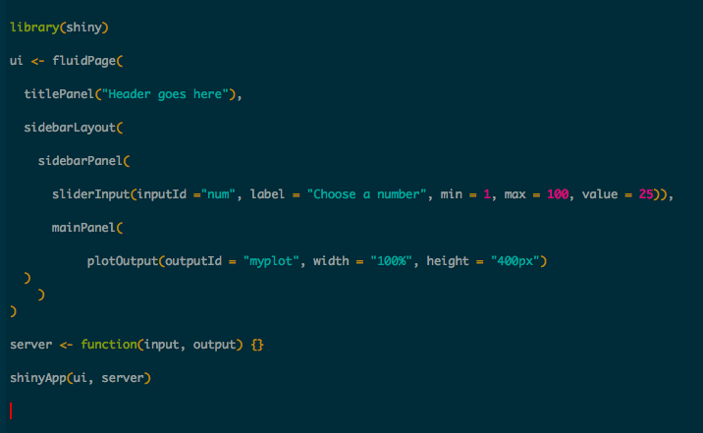

Slide 12
Server function
Import values via input$
Perform calculations
Render plots/tables/etc using Render() function
Send output via output$

Slide 13
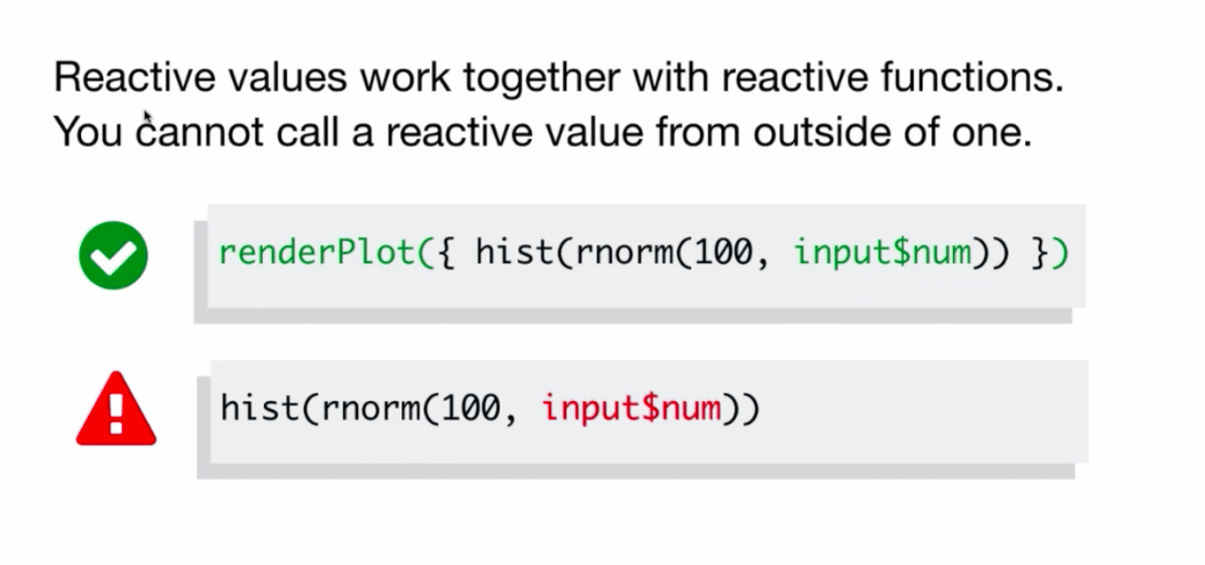

Slide 14
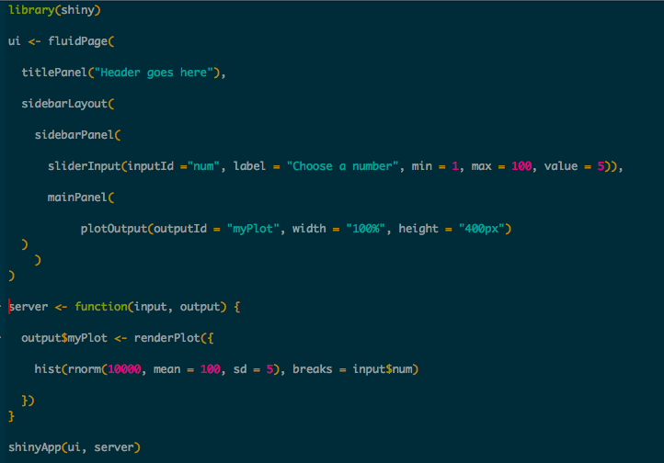
UI + Server

Slide 15
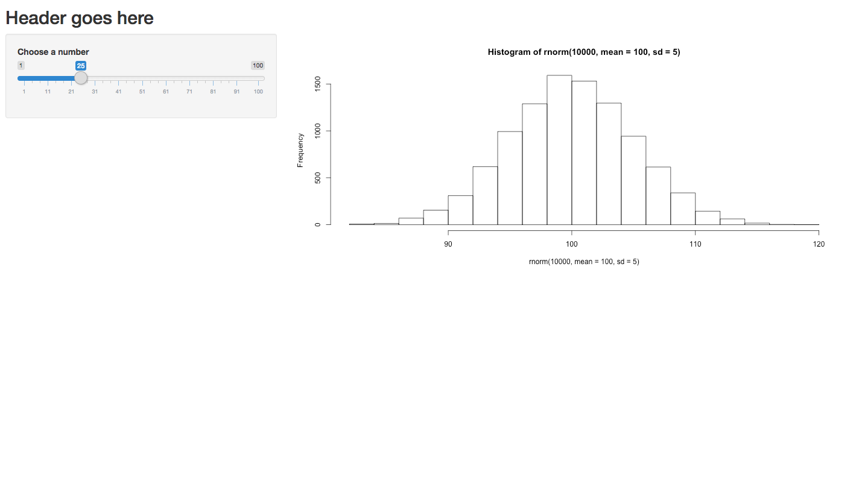

Slide 16
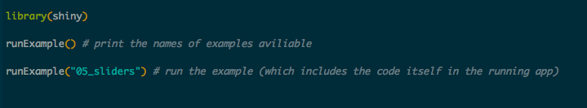
Some helpful examples built into the Shiny package

