Slide 1
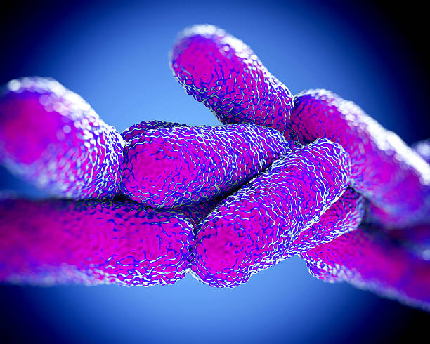
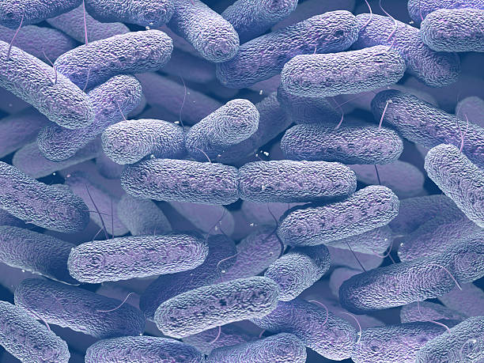
BactiVision
R-8-23-2
Amit Shitrit
Cyrine Salame
Supervisor: Zeev Frenkel
Notes:
Hello my name is *** my partner is *** Today we will present our project A CNN-Powered method to help in parasite bacterial identification && segmentation so lets begin ☺

Slide 2
About Us
01.
Problem Definition Introduction
Table of
Contents
Background
02.
Microbiology
Back & Front
03.
U-Net Architecture GUI Diagrams
04.
Thanks
Questions
Thanks
Notes:
As you can see we are going to talk about the problem, the solution,
a general scientific background and a general background on the U-Net architecture.
In addition to that we will show a short video of the gui, we will leave time for questions and that's it

Slide 3

01.
About us
Problem Definition && Introduction

Slide 4
Problem Definition
-Over 10K Different Type Of Bacteria
-Many Methods to identify The Bacteria
-Limited Workforce
-Process Takes Lot Of Time
Notes:
Today there are thousands of types of bacteria, and the identification process is
becoming more difficult from moment to moment, in addition to
this the professional and medical workforce is not able to cope with the work pressure,
therefore, a fast and efficient system is needed to help meet these needs.

Slide 5
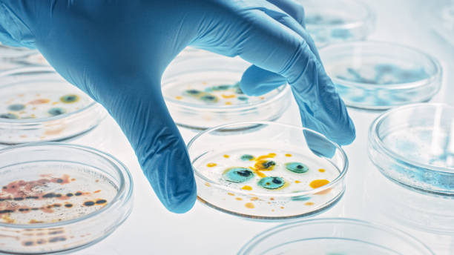
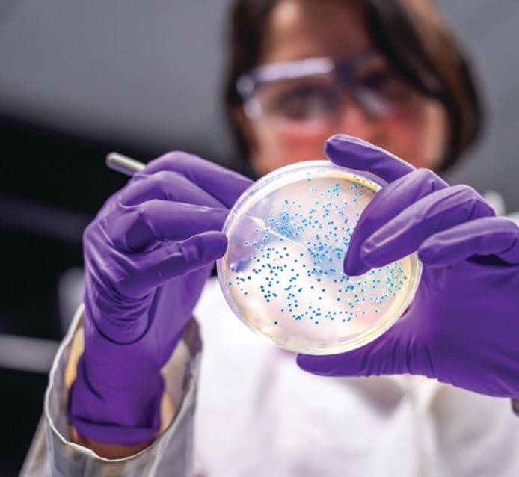
Mission
Vision
Prototype with 70% Correct Prediction
Complete Software
Notes:
Our vision is a system that will know how to classify all bacteria known to humans in over 95 percent.

Slide 6
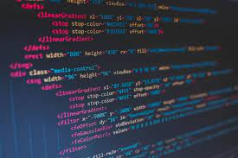
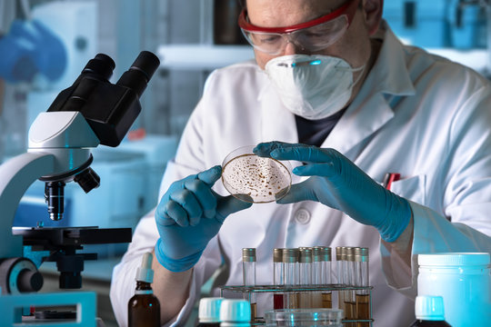
The Idea
What we do?
-A Machine Learning Based System
-Use U-Net Architecture
-Optimal Prediction && Segmentation Ability
Notes:
Our idea is a machine learning system that uses U-net architectures for segmentation tasks and AlexNet for prediction tasks,
combined with Otsu image processing algorithms.
U-Net architecture is known for its ability to handle images with small objects. Additionally, the system will be able to generate
quality statistics for large datasets of bacteria through segmentation operations of this architecture. AlexNet will help us determine
the type of bacteria. Otsu will assist us in creating a segmentation image which is an input for the U-Net architecture.

Slide 7
Development Process
Literature Review
Microbiology, Bacterial, Gram Stain, Identify Methods
Data Collection
DataSet Of Bacterial Samples
Data Pre-processing
Resizable, Tag, Organize, Normalizing
Software Development
Front & Back include U-Net && AlexNet Architecture
Result && Conclution
Calculation and evaluation of research results
Notes:
In the first stage of the project, we studied the subject in depth, in fields such as...
In the second stage, we collected a large dataset of images, which totaled 8GB.
The third stage involved pre-processing where we organized the dataset into folders and labels.
In the next step, we implemented the backend and frontend.
In the final stage, we conducted in-depth research on the project results.

Slide 8
02.
Background
Microbiology && Mathematical

Slide 9
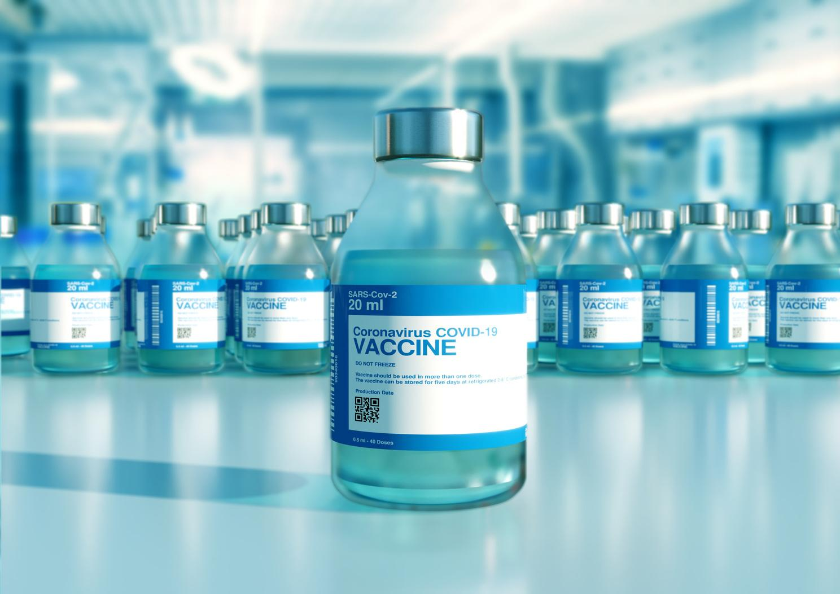
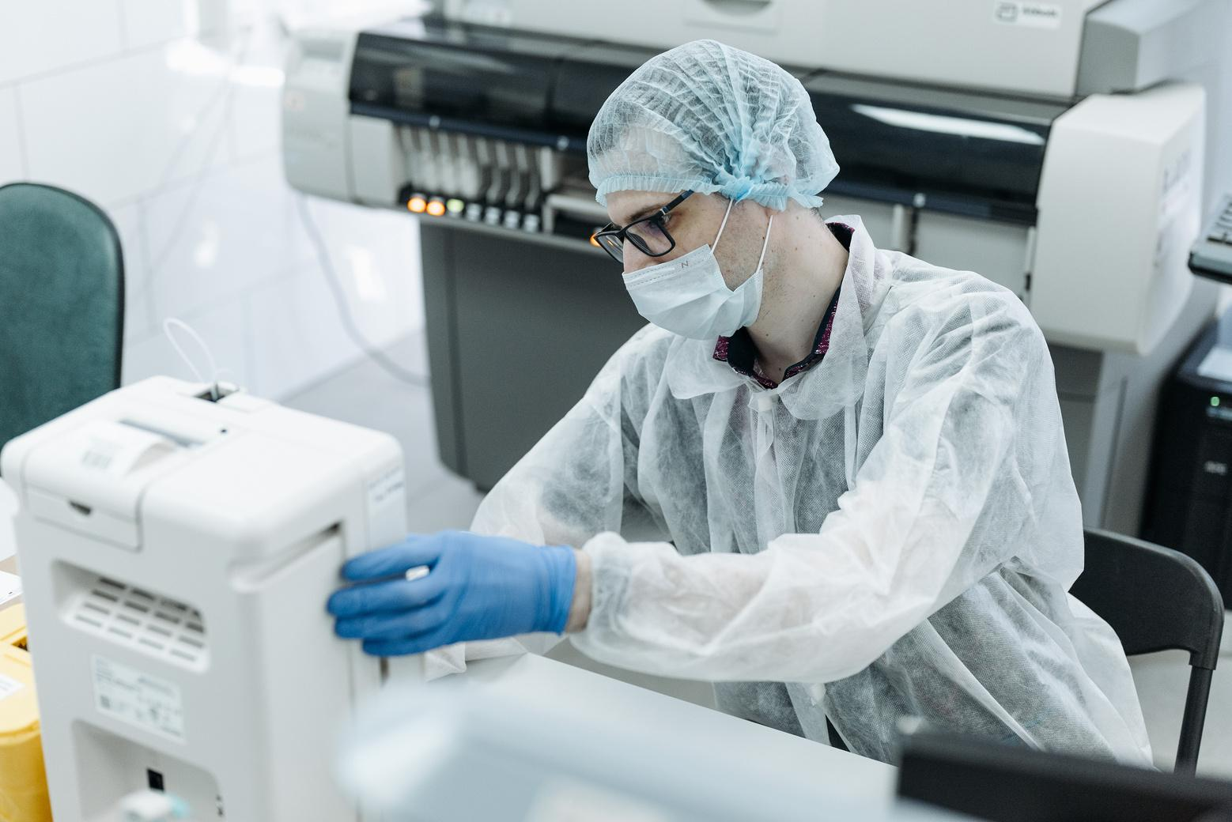
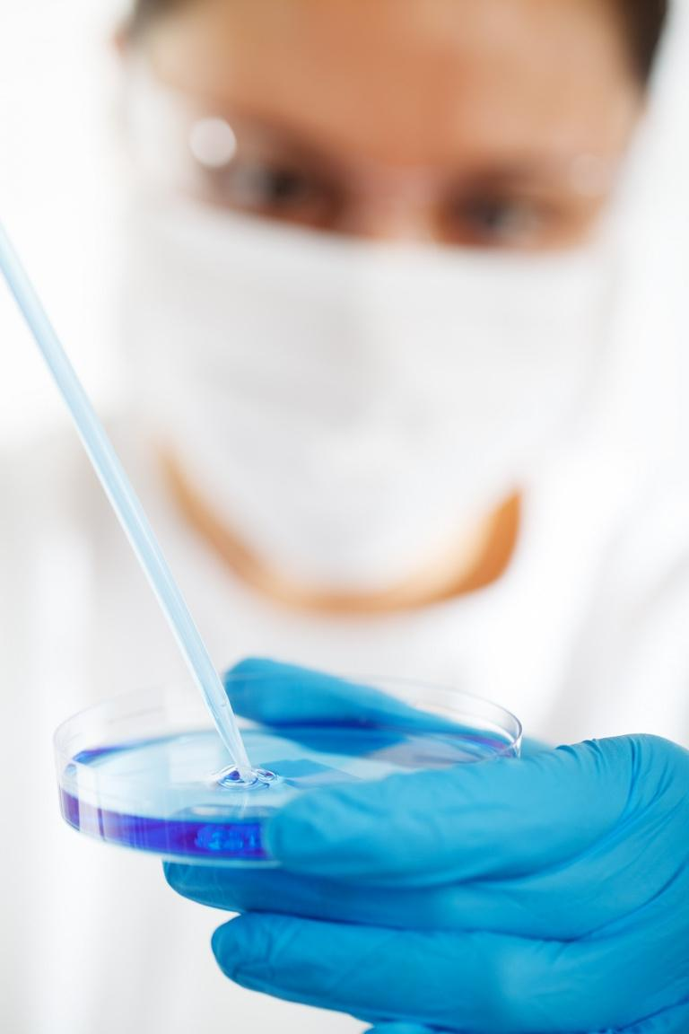
Bacterial
They are Single-celled microorganisms. They are characterized by their prokaryotic cellular structure.
Bacterial are among the first creatures to appear on Earth
Notes:
Read from the presentation

Slide 10
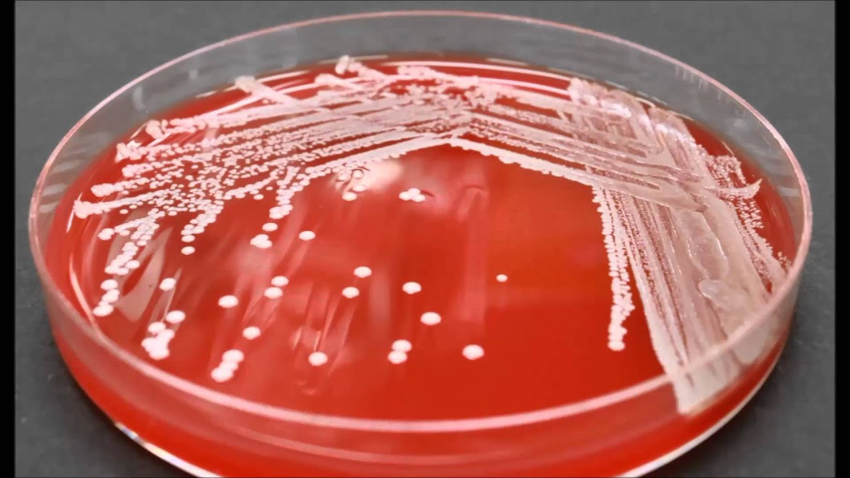
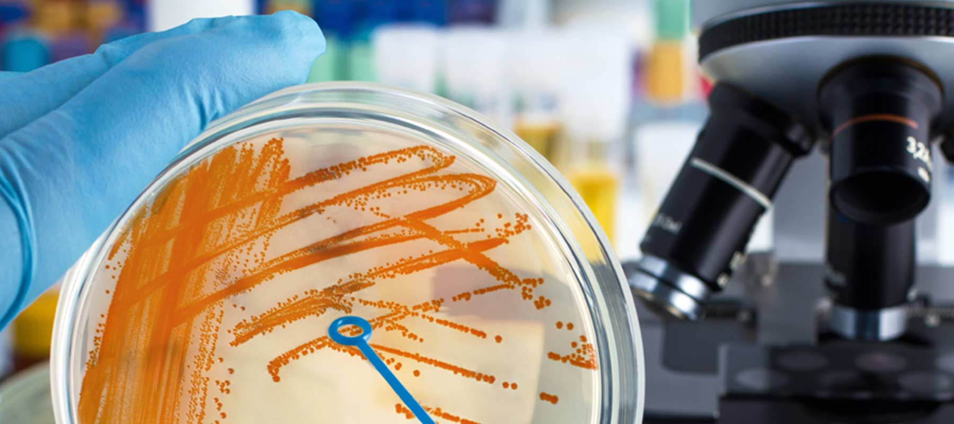
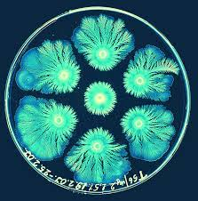
Colony Of Bacterial
Allows researchers to study their growth characteristics, such as colony size,
shape, and color.
provides a macroscopic view of bacterial growth patterns.
By counting the density of the colony, it is possible to estimate the size of the sample we will have to select to optimize the accuracy percentages.
Notes:
Now we talk about the Advantages of colony of bacterial in identification Read from the presentation

Slide 11
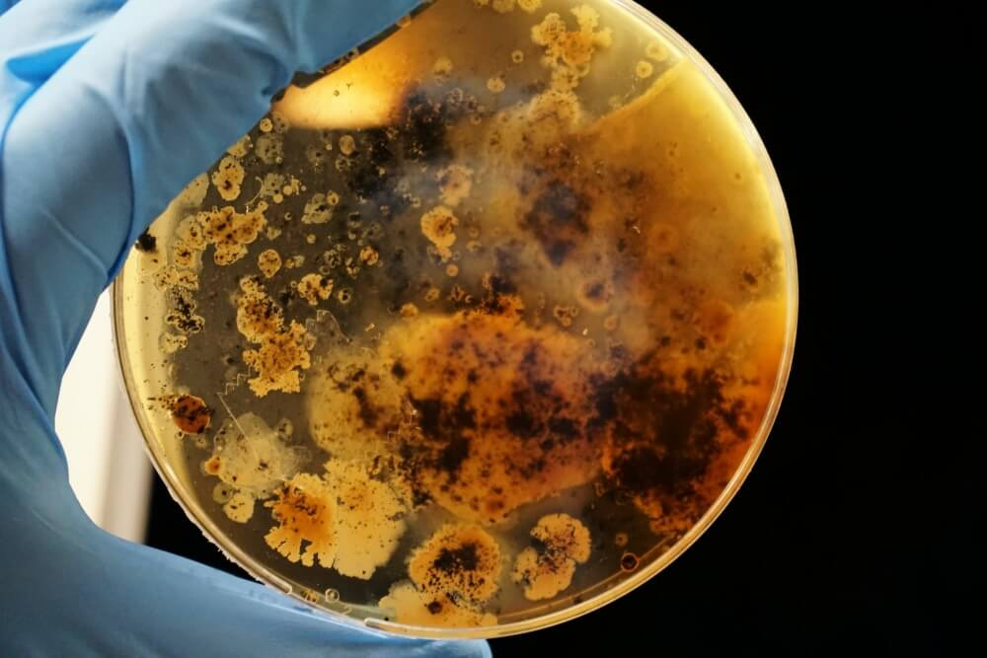
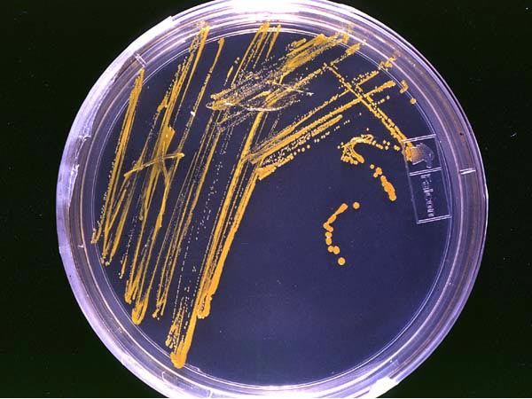
a colony of bacteria
a picture is worth a thousand words

Slide 12
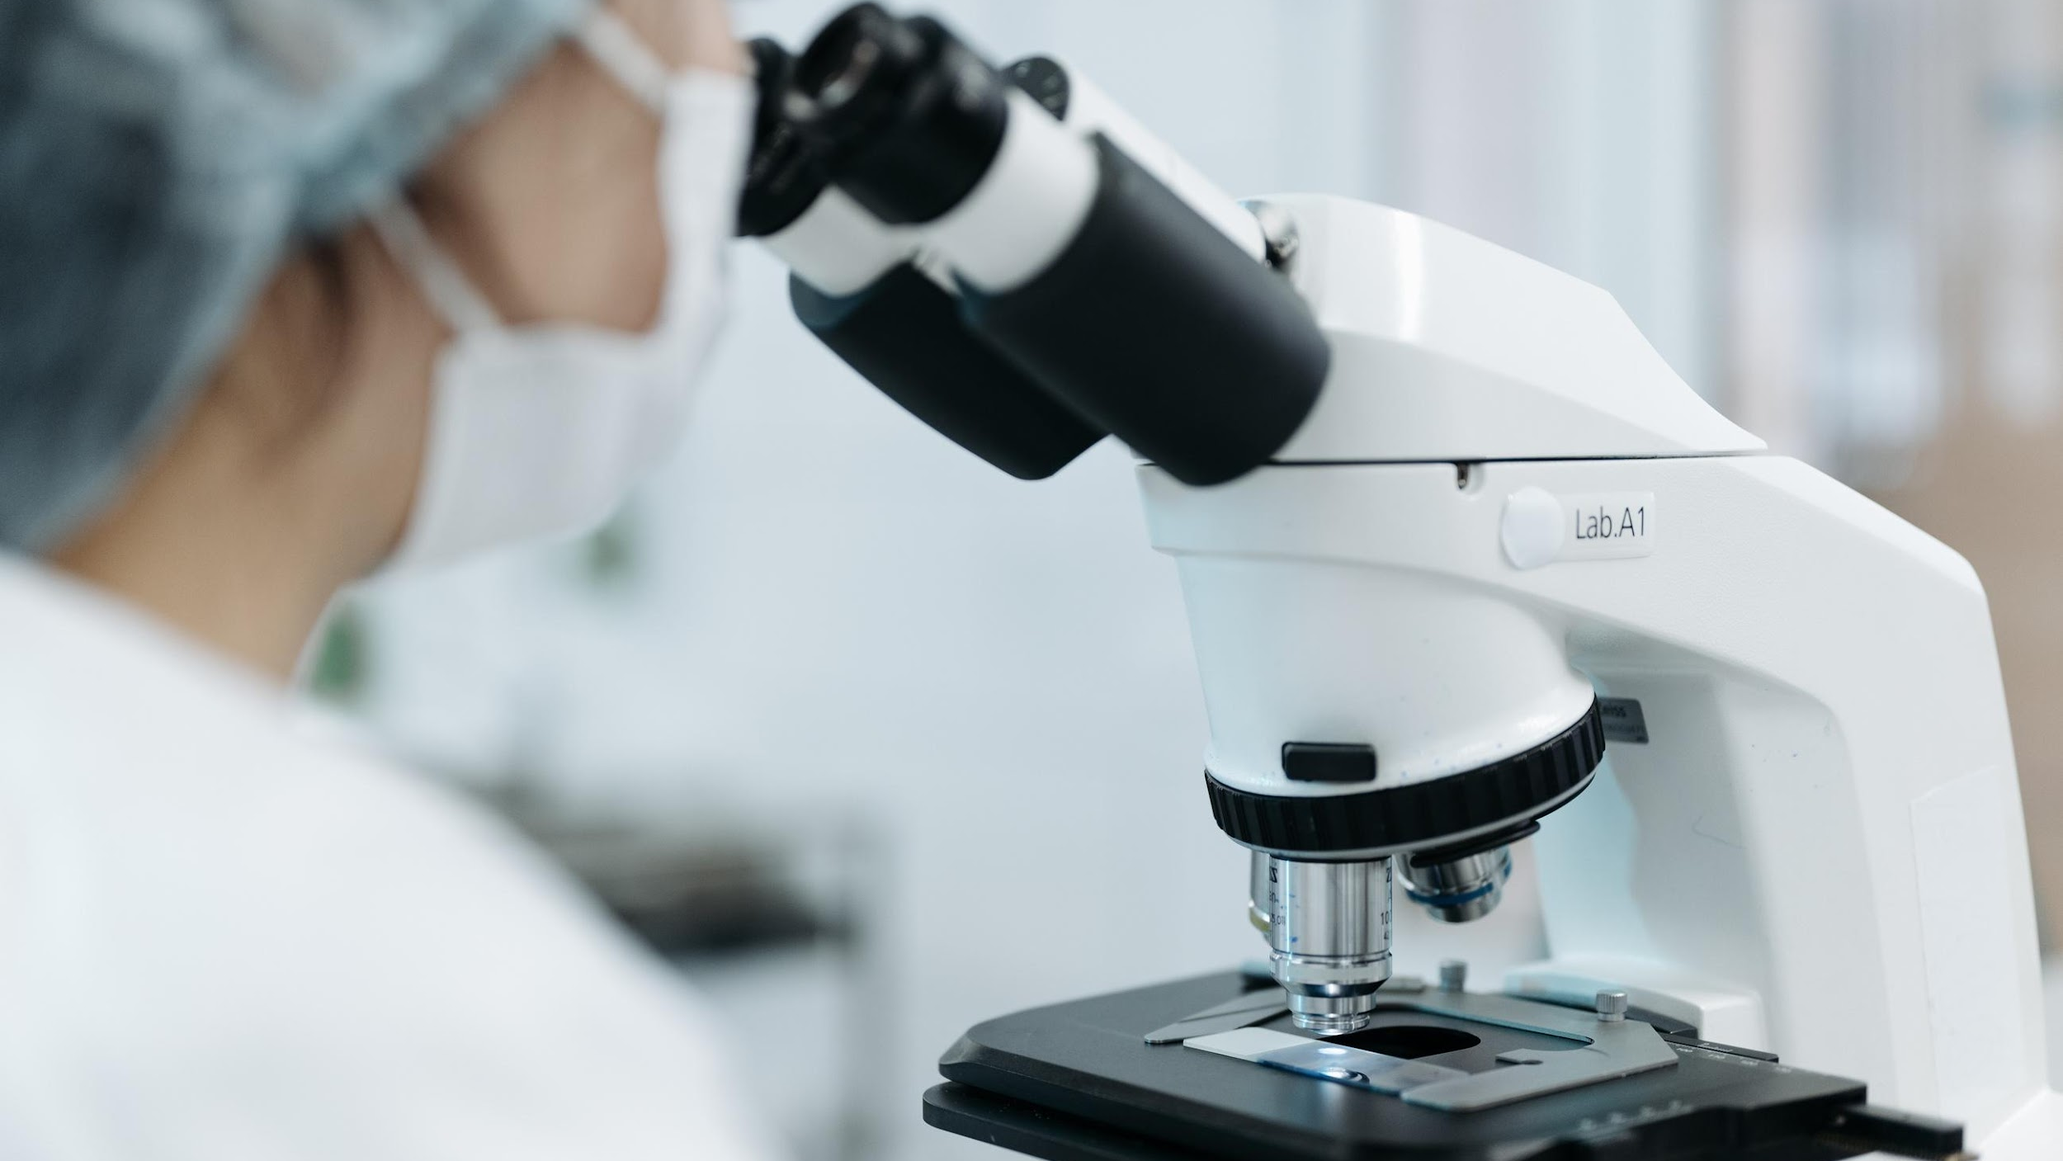
Identify Methods
Observing the physical and biochemical characteristics of bacterial cells.
Phenotypic Method
Use antibodies to identify specific bacterial antigens.
Immunological Method
use DNA or RNA Sequencing to identify bacteria at the genetic level.
Molecular methods
Notes:
The phenotypic method is used in biological research to observe and measure the physical and biochemical characteristics of organisms. This method helps in understanding inheritance of traits, identifying genes linked to traits or diseases, and exploring how genes interact with the environment. The immunological method is a scientific approach used to study and analyze the immune system and its response to foreign substances. It involves techniques and assays that detect and measure immune responses, such as the production of antibodies or activation of immune cells. Molecular methods refer to a collection of techniques used in biological and medical research to study and manipulate molecules, such as DNA, RNA, proteins, and other cellular components. These methods involve the analysis, manipulation, and detection of molecules at the molecular level

Slide 13
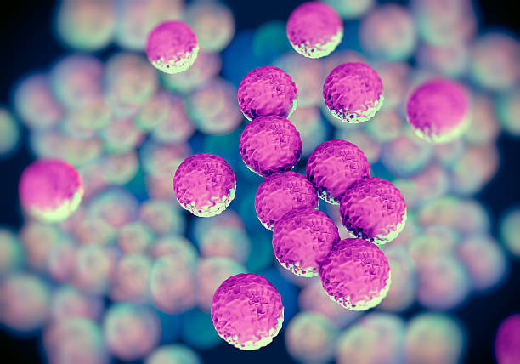
Differences between the methods
Predict | Cost | Time
70%-90% | 5$-50$ | Several days to weeks | Phenotypic Methods
80%-96% | 50$-150$ | Few hours to Day | Immunological Methods
95%-99.9% | 50$-250$ | Few hours to Day | Molecular methods
Notes:
Our software will only accept the image after gram staining, the cheap and simple part of this method,
and then it will go through our software, in order to save time and money

Slide 14
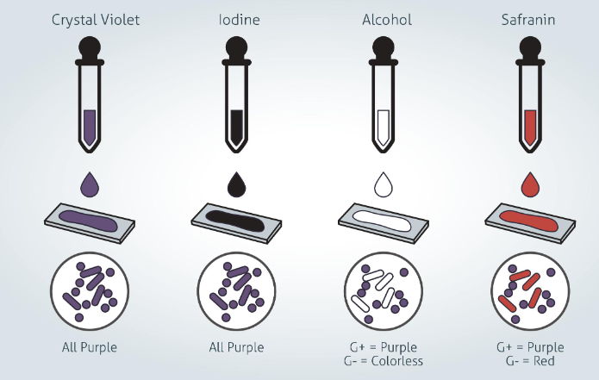
Gram Stain
Staining bacterial cells with crystal violet and iodine
Gram Staining
-Thick peptidoglycan in cell wall
-Crystal Violate color after staining
Gram Positive
-Thinner peptidoglycan in cell wall
-Pink or Red Color After staining
Gram Negative
Notes:
Gram staining is a phenotypic method that involves staining bacterial cells with crystal violet and iodine,
followed by decolorization with alcohol and counterstaining with safranin.
This method is used to distinguish between Gram-positive and Gram-negative bacteria based on differences in the composition of their cell walls.
Gram-positive bacteria retain the crystal violet stain, appearing purple, while Gram-negative bacteria lose the stain and appear pink/red with the counterstain.
It can be concluded from this that if the color of the bacteria after staining is purple then it is positive and is more resistant to drug treatment. And if after coloring the color is red or pink, it will be possible to treat it with milder medication.

Slide 15
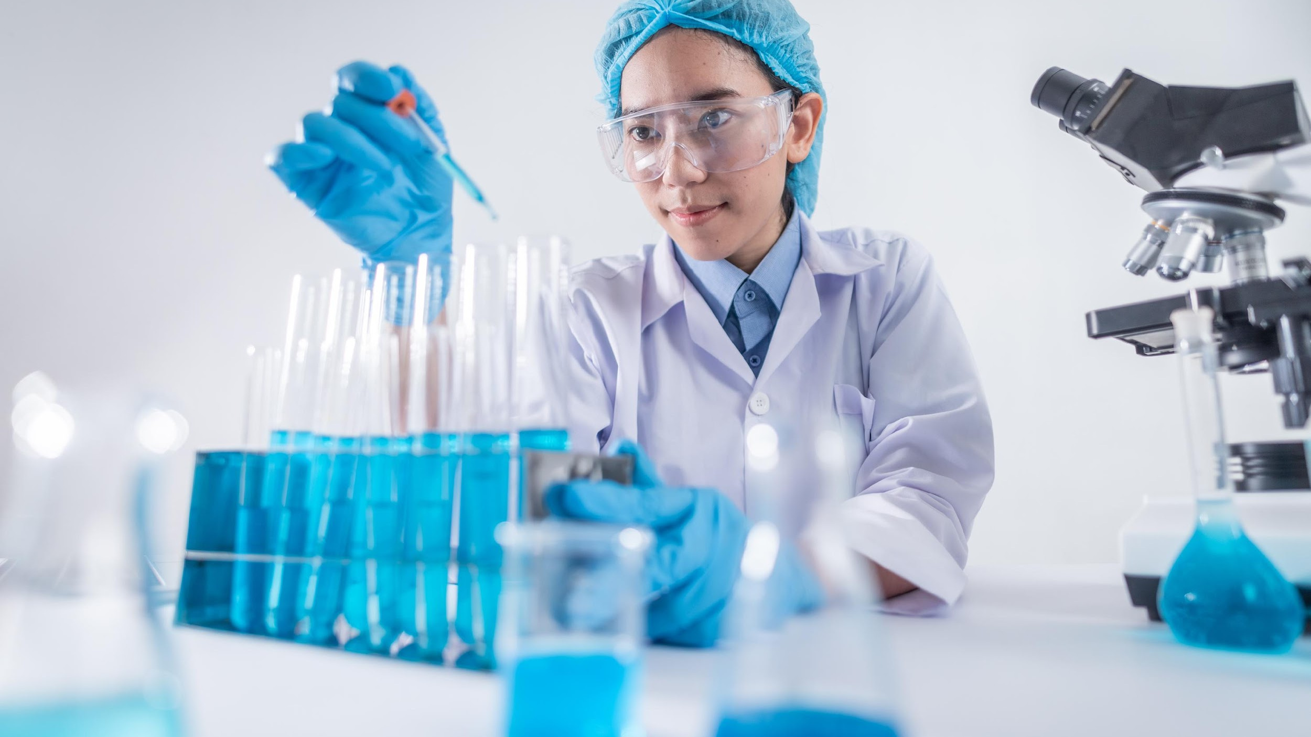
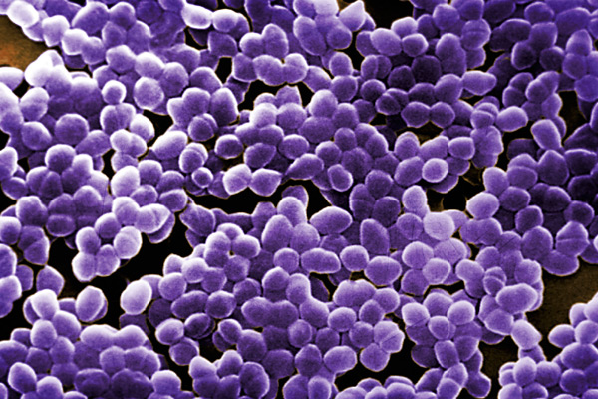
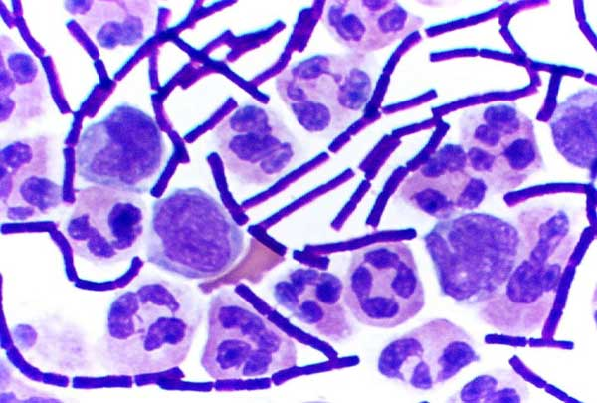
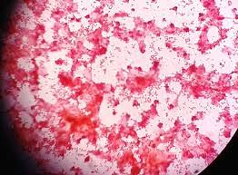
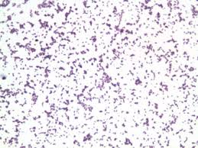
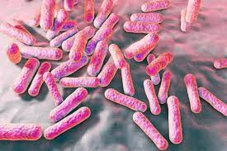
Gram Positive Vs
Gram Negative

Slide 16
5 Main Shapes
Cocci-
These are spherical bacteria that can exist singly or in clusters.
Bacilli-
These are rod-shaped bacteria that can be found singly or in chains.
These are spiral-shaped bacteria that can be found singly or in chains.
Spirilla-
Vibrio’s-
These are comma-shaped bacteria that are typically found singly.
Spirochetes-
These are corkscrew-shaped bacteria that can be found singly
Notes:
Read from the here

Slide 17
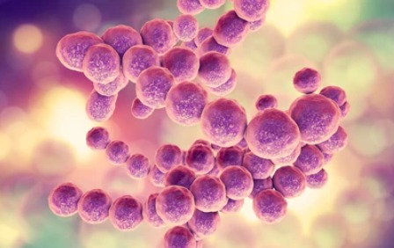
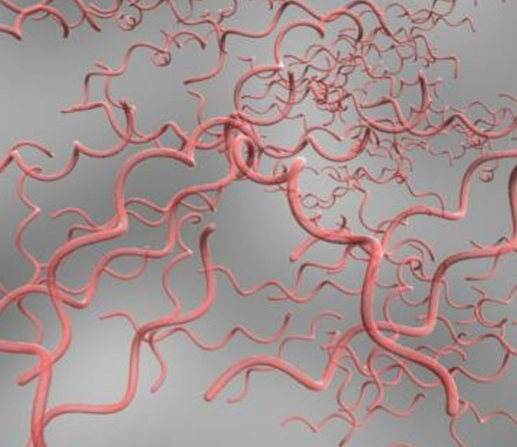
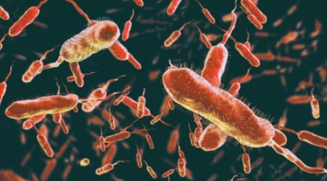
Bacteria Shapes

Slide 18

03.
Software Architecture
Background && U-Net Architecture

Slide 19
Artificial Intelligence
Artificial Intelligence
Is a popular branch of computer science that concerns with building “intelligent” machine capable of performing a human task
Main subjects: machine learning , deep learning NLP, computer vision etc..
Notes:
Read from the present

Slide 20
Convolutional Neural Networks (CNNs)
Model commonly used for image and visual data analysis. It is designed to automatically extract and learn relevant features from input images or text through a series of convolutional layers

Slide 21
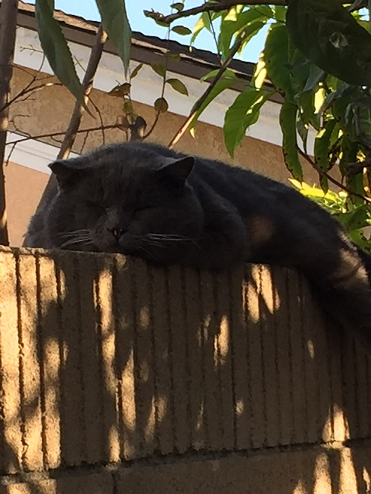
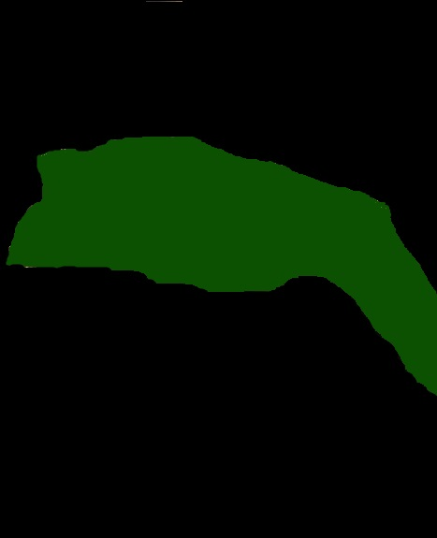
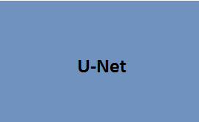
U-Net Input & Output
Learning Segmentation
Input
Output Segmentation map
Notes:
U-Net is a deep learning architecture that is commonly used for image segmentation tasks, particularly in the field of medical image analysis.
It was introduced by Olaf Ronneberger, Philipp Fischer, and Thomas Brox in 2015.
It wo
The U-Net architecture is made up of two main parts: the encoder and the decoder.
The encoder is responsible for capturing the important features and patterns in the image,
while the decoder takes the encoded information and generates the segmented output.

Slide 22
4 Stages Of U-Net
Encoder | Bottleneck | Decoder | Output
1 | 2 | 3 | 4
This stage is responsible for capturing context and extracting features from the input image. It consists of several convolutional layers with progressively decreasing spatial dimensions | The bottleneck serves as a bridge between the contracting path and the expanding path. | The expanding path gradually upsamples the learned features to the original input image resolution. | The final stage of the U-Net algorithm is the output layer, which produces the segmentation map or mask.

Slide 23
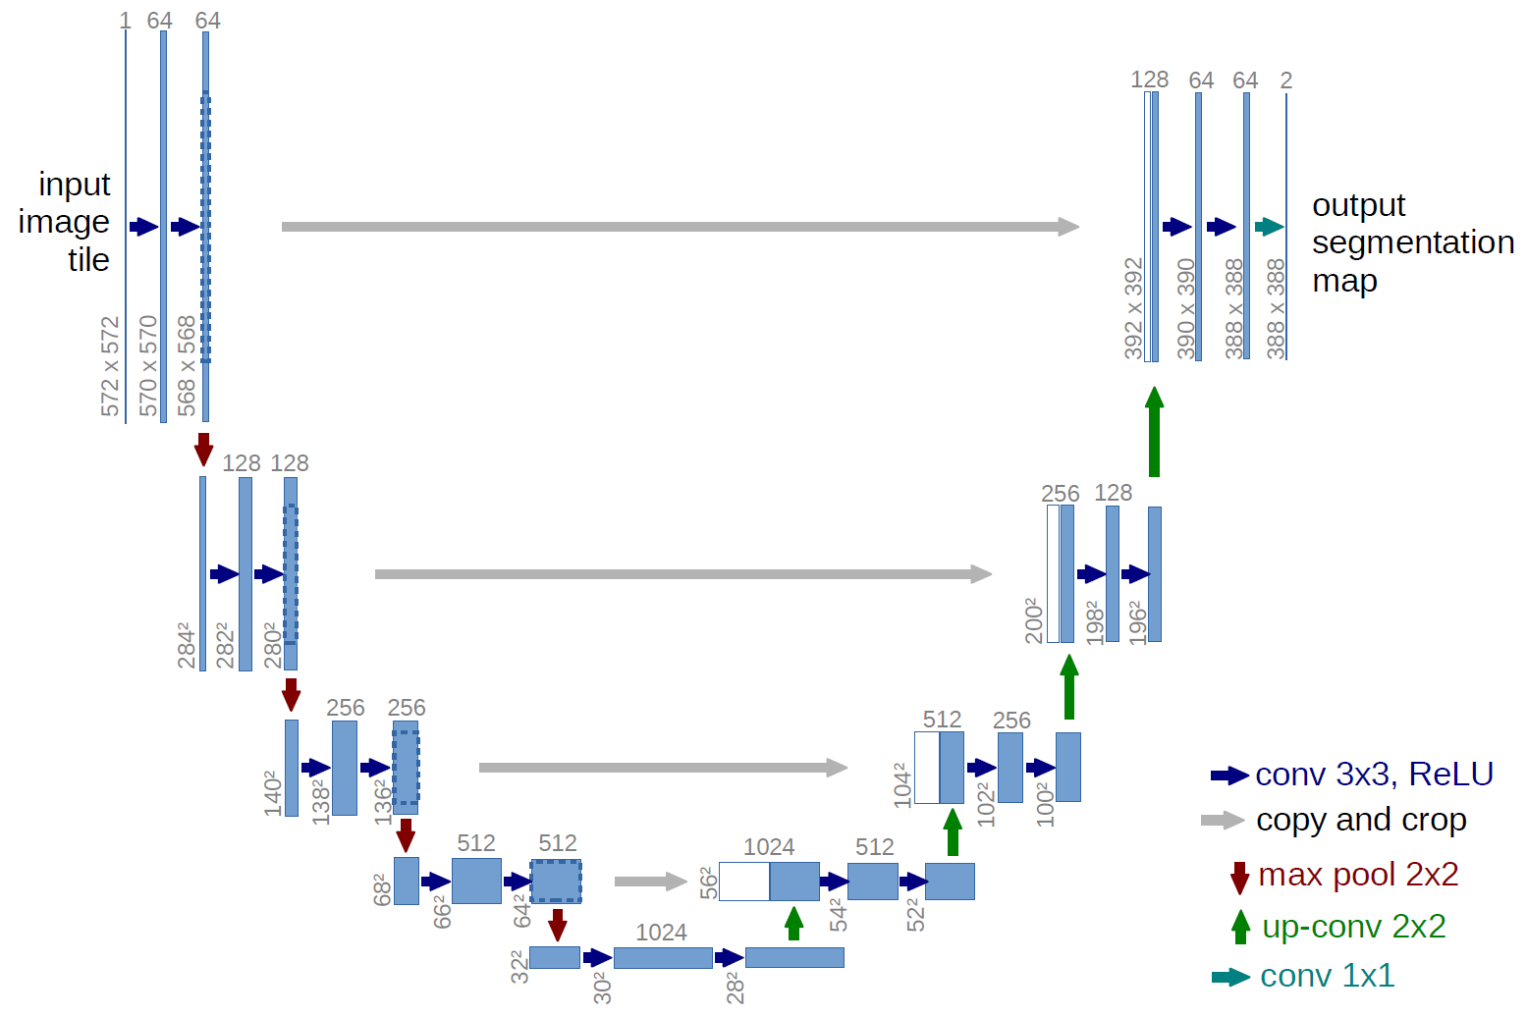
U-Net Architecture Input & Output
Notes:
In unet architecture we can see that have 4 blocs of encoder stage and 4 block of decoder stage and 4 skip connections from encoder block to decoder block , skip connection help the decoder to create better segmentation map of result The basic input of U-NET IS 572*572
(in our project we change it to 224*224 because we using VGG16 pre–Trained Model to improve the accuracy ) then the blue arrow show us conv layer, red arrow show us max pool,
the numbers in the top show us the number of filters and the grey arrow show us the connection skip

Slide 24
U-Net Architecture Input & Output
Encoder Section
- Increases field of view
Notes:
When the input image is passed through the first convolutional layer in U-Net with 64 filters, it means that the layer will compute 64 different feature maps. Each feature map represents a different set of learned features, capturing different aspects of the input image. the first 64 filters in the U-Net architecture typically aim to capture low-level features, These features may include edges, corners, textures, or gradients.
in the second blocks we have input of 284*284 and we use 128 filters the 128 filter typically aim to capture high level features like Local textures: The filters might detect and represent local textures in the input,
such as roughness, smoothness or specific shapes and contours.
The number of times of block varies from implementation to implementation

Slide 25
U-Net Architecture Input & Output
Decoder Section
Create High Resolution
Mapping
Notes:
The decoder stage uses the outputs of each and every block from the same stage in the encoder in order to recover critical information
that can be lost along the way, as a result of combining the output of the decoder stage and the combination of the part that came from
the encoder we have a higher quality and more accurate output As you can see at the end of the last step,
2 segmentation map results are obtained where each pixel is assigned to one of two classes for example the
back part of the image and the front part of the image.

Slide 26
U-Net Architecture Input & Output
Concatenate with high-resolution feature maps from the Contraction Phase
Notes:
These connections involve concatenating the feature maps from the encoder, which capture both low-level and high-level information. By merging these feature maps through concatenation, the U-Net model retains and propagates valuable spatial and
semantic details from earlier stages of the network.

Slide 27
Result
&& Conclusion

Slide 28
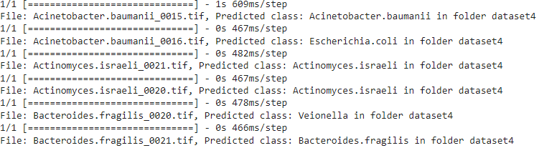
Results
#1 – Prediction Predict Based VGG16 only - 30% Correct Prediction. Predict Based VGG16 && AlexNet – 50% Correct Prediction. Predict Based VGG16 && AlexNet With 80% of our Dataset trained – 70-80% Correct Prediction.
Notes:
In the prediction process, it can be seen that the initial point was during the first phase of our code, where we managed to predict only 30% accurate forecasts for an input size of 100 images and 40% for an input size of 150 images. For the second point, we achieved 50% accuracy in our predictions due to the addition of layers from the AlexNet algorithm, which works well combined with the pre-trained VGG16 system. The latest version, which is our project's current version, combines VGG16 and AlexNet with training on 80% of our dataset. This significantly improved the system's prediction capabilities, achieving a success rate of 70-80%, depending on the input size.

Slide 29
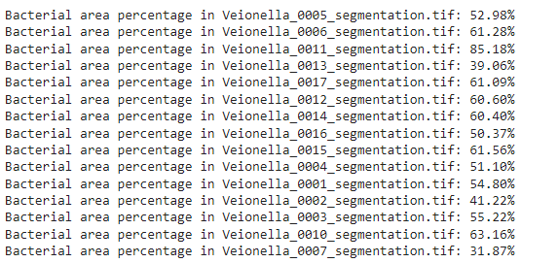
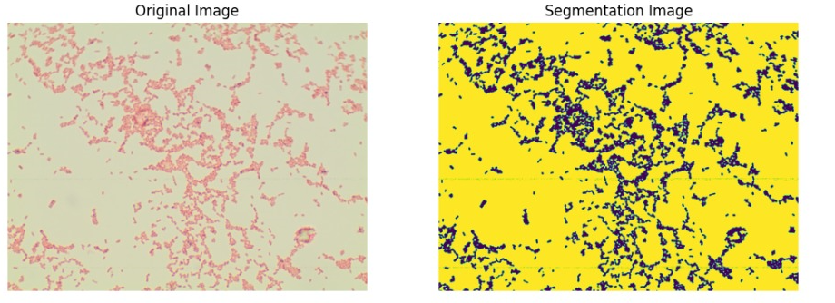
Results
#2- Segmentation- Image Input U-net With VGG16 – was Fail
Otsu Algorithm – Was Success
#3-Segmentation – Bacteria Coverage
Notes:
Creating segmentation images is an important input for the Unet architecture to ensure quality statistics for the user's dataset. This is one of the project tasks that allows the user to best evaluate the data concerning the bacteria in their dataset. Using artificial intelligence with the Unet architecture combined with VGG16, the image creation was not so good because complex architectures, intended for more complex tasks, actually led to a decrease in the quality of the input images. The features extracted by the model caused confusion, resulting in poor-quality segmentation images. For a bacterial coverage of 30%, this architecture produced an 11% coverage from the image, and for 60% coverage, it achieved 97%. We decide to continue with image processing layer, specifically the Otsu algorithm, which created nearly perfect quality segmentation images. For an image with 30% coverage, we achieved 29% accuracy, and for an image with 60% coverage, we achieved 58% accuracy.

Slide 30
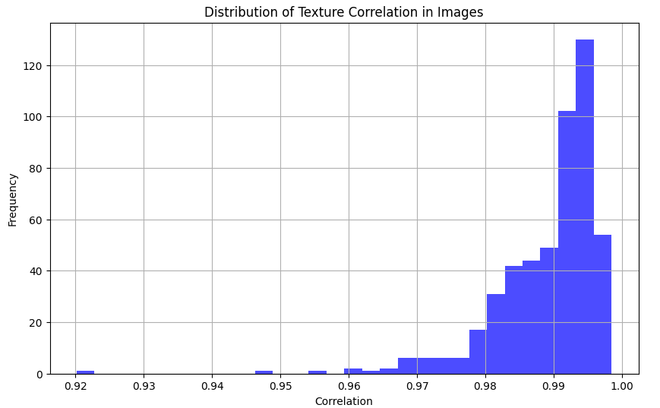
Conclusion
#1
Notes:
Correlation is a statistical measure that describes the relationship and mutual dependence between two variables. The correlation values in the samples range from 0.92 to 1.00. This quality metric is very characteristic of the field of AI. This finding is particularly important in areas where texture uniformity is crucial, such as in the automated analysis of images. According to this graph, it can be inferred that the quality of our dataset indicates a uniform texture, which may reflect the validity of our project's outcomes or a specific medical condition. So the user will be able to receive a quality assessment for their dataset, thereby helping them to quickly and professionally evaluate their results.

Slide 31
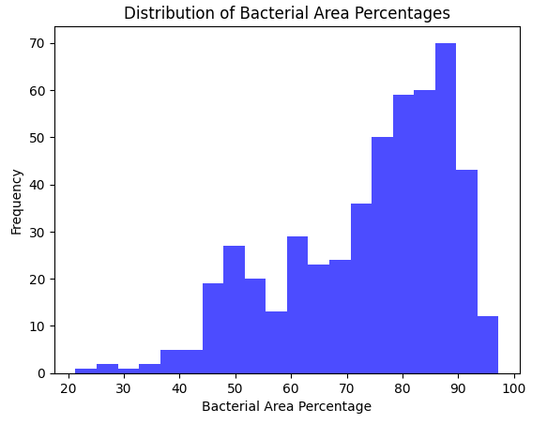
Conclusion
#2
Notes:
We see that there is a relatively low frequency of images with bacterial coverage ranging from 20% to 50%. The frequency begins to increase from about 50% coverage, with clear peaks in the 60%-70% range and another rise to a peak in the 90%-100% range. These results have led us to improve the quality of segmentation operations in the project, and they can be very relevant for a user who wants to evaluate the bacteria present in their samples.

Slide 32
Video
Of The
GUI

Slide 33
Question?? What is the meaning of life? Will AI take over the world?

Slide 34
Thank you!

